Slide 1
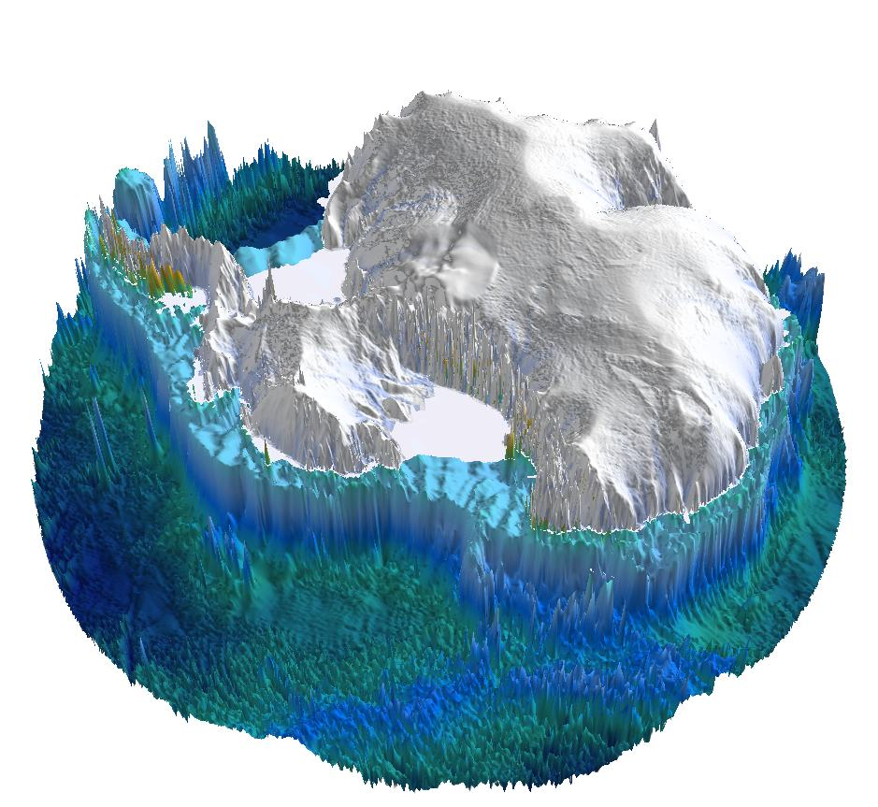
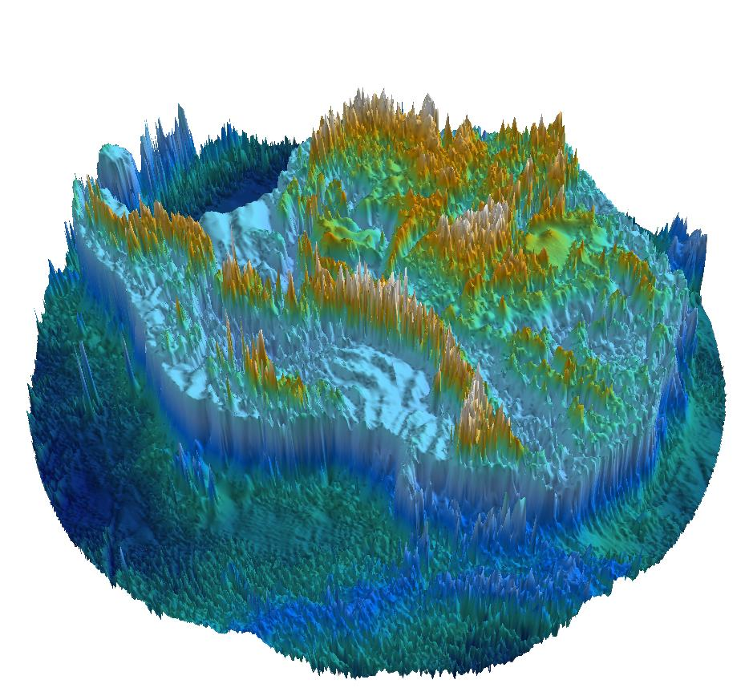
Crustal architecture of the largest pull-apart basin in East Antarctica unveiled
Fausto Ferraccioli (1), Laura Crispini (2), Egidio Armadillo (2), Andreas Läufer (3), and Antonia Ruppel (4)
(1) NERC British Antarctic Survey, Cambridge, United Kingdom
(2) Università di Genova, DISTAV, Genova, Italy
(3) BGR, Federal Institute for Geosciences and Natural Resources, Hannover, Germany
Rennick Graben- the largest subglacial pull-apart basin imaged so far with new aeromagnetic, gravity & radar data
New potential field imaging helps reveal subglacial geology, crustal architecture and tectonics/kinematics
Cenozoic crustal extension/transtension affected this sector of the Transantarctic Mountains
Aeromagnetic data are a key tool to unveil inherited basement features & Jurassic flood basalt magmatism
Rennick Graben

Slide 2
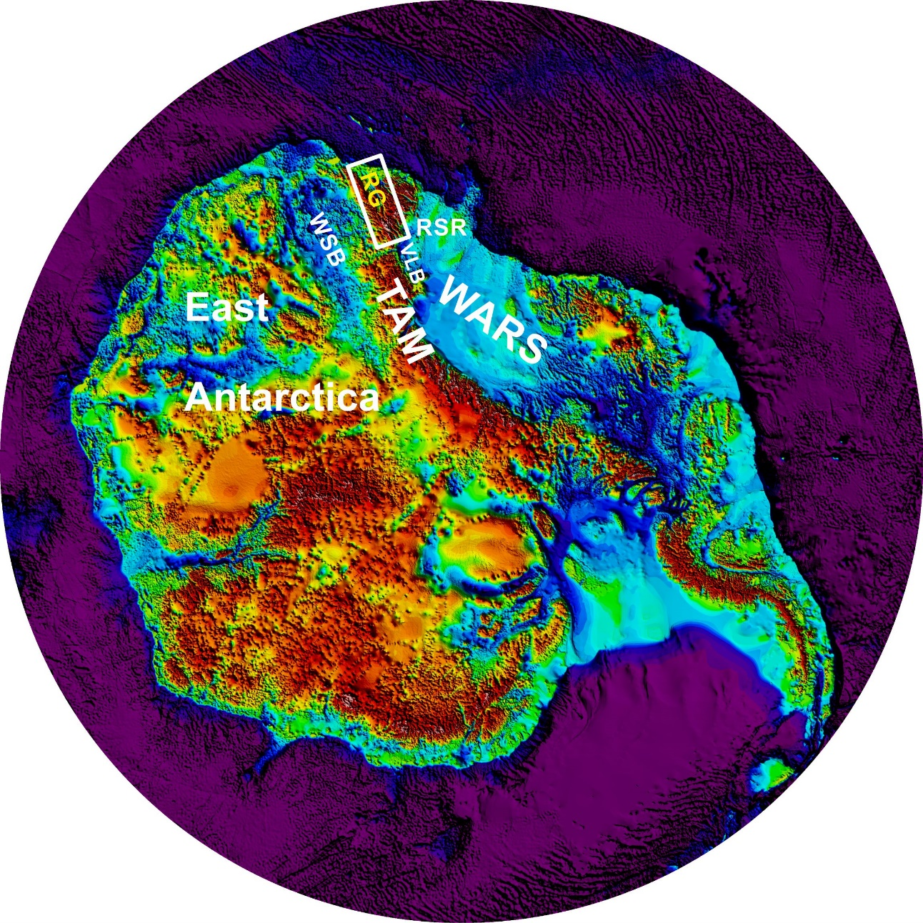
Location & setting of the Rennick Graben in East Antarctica
WARS: West Antarctic Rift System
TAM: Transantarctic Mountains
VLB: Victoria Land Basin
RSR: Ross Sea Rift
WSB: Wilkes Subglacial Basin
The West Antarctic Rift System (WARS) is one of the largest continental rift systems on Earth. It was affected by distributed/wide mode extension in the Cretaceous, followed by narrow mode and variably oblique extension/transtension in the Cenozoic.
However, onshore the extent and impact of Cenozoic extension and transtension within the uplifted Transantarctic Mountains sector of East Antarctica is geophysically much less well-constrained.
Early geological studies indicated that the Rennick Graben (RG) is a left-lateral pull-apart basin of inferred Cretaceous age linked to the early development of Victoria Land Basin in the WARS (Tessensohn, 1994, Terra Antartica). However, more recent studies view the RG as a more localised Cenozoic right-lateral pull-apart basin un-connected to the WARS (Rossetti et al., 2003, Tectonics).
Here we combine new aeromagnetic, aerogravity, land-gravity and bedrock topography imaging to help constrain the extent, architecture and kinematics of the RG, its key basement features & flood basalt magmatism.
Ferraccioli et al., 2020, G-cubed (Special Polar Focus), MS, in prep. Image Author Copyright.

Slide 3
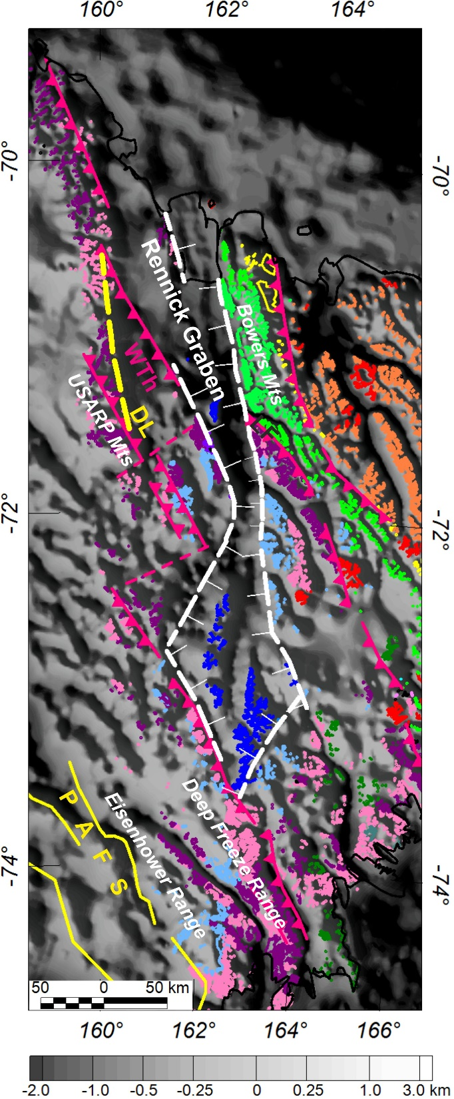
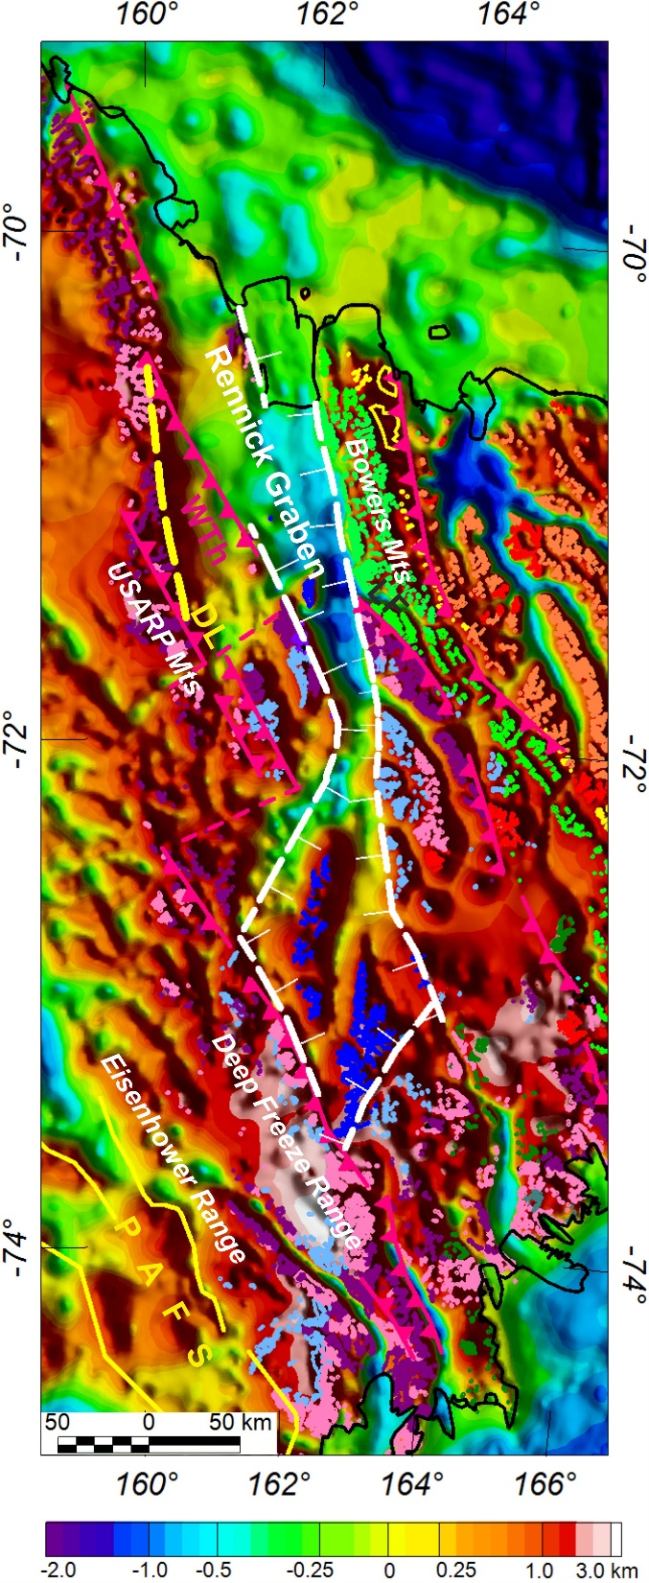
Bedrock topography and geology of the Rennick Graben in East Antarctica
a
b
LF
LF
a) Grey scale and coloured (b) subglacial bedrock topography from radar data superimposed on a tectonic sketch map (GANOVEX & PNRA teams) for Northern Victoria Land.
Note the inferred extent of the Rennick Graben and the location of the major inherited fault systems in the basement- including the terrane bounding Lanterman Fault (LF), the intra-terrane Wilson Thrust (Wth) and Daniels Lineament (DL) (Ferraccioli et al., 2002, GRL) and Prince Albert Fault System along the eastern margin of the Wilkes Subglacial Basin (Ferraccioli & Bozzo, 2003, Geol. Soc. London; Ferraccioli et al., 2009, Tectonophysics).
Ferraccioli et al., 2020, G-cubed (Special Polar Focus), MS, in prep. Image Author Copyright.

Slide 4
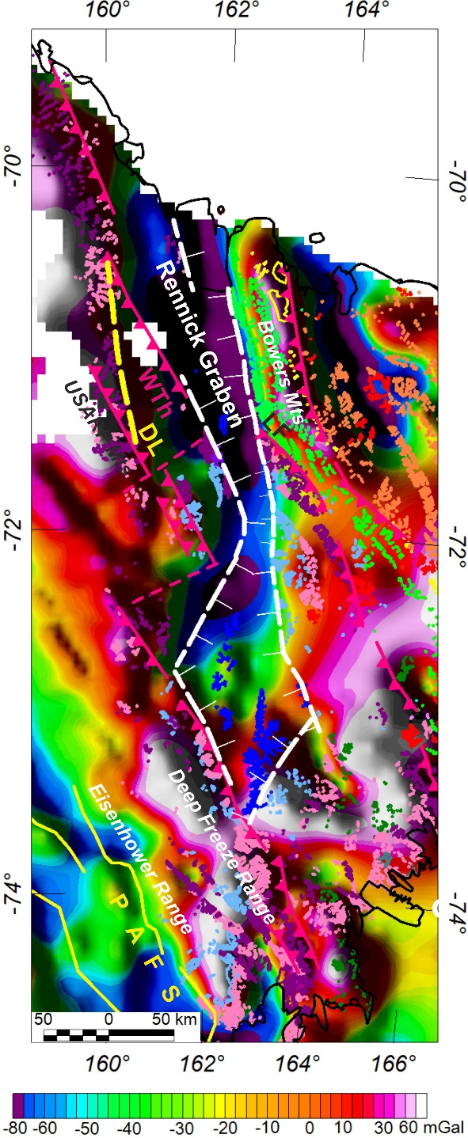
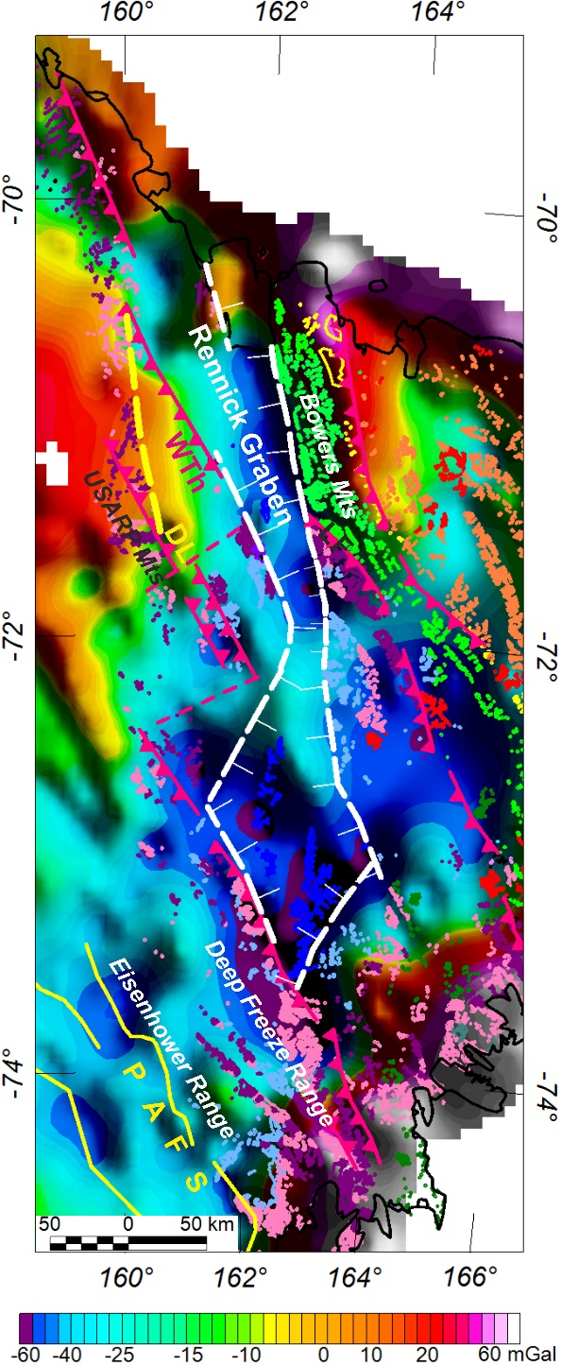
Free-Air and Residual Bouguer gravity anomalies in the Rennick Graben area (East Antarctica)
a
b
a) Free-Air gravity anomalies and (b) Residual Bouguer gravity anomalies (obtained by subtracting a third order trend) superimposed on a tectonic sketch map (GANOVEX & PNRA teams) for Northern Victoria Land.
The Free-air gravity anomaly map helps image the subglacial extent of the Rennick Graben (RG) and its elevated flanks. The map suggests that the RG has a classic lozenge-shape typical of pull-apart basins. It indicates that the RG may be wider both in its northern and central segments than currently apparent from sparse airborne radar data (see previous slide). Also note the linear gravity high stretching from the USARP Mts to the Deep Freeze Range- interpreted as imaging distinct fault-bounded uplifted blocks along the flank of this major pull-apart basin system.
The residual Bouguer gravity anomaly map reveals the contrast between the gravity high over the northern sector of the Wilson Terrane and the linear gravity low over the northern Rennick Graben. A prominent gravity high over the Bowers Mountains reveals dense oceanic basement underlying the Bowers Terrane. Note the sinuous left-stepping geometry of the Rennick pull-apart basin related to inferred Cenozoic right-lateral strike slip faulting.
LF
LF
Ferraccioli et al., 2020, G-cubed (Special Polar Focus), MS, in prep. Image Author Copyright.

Slide 5
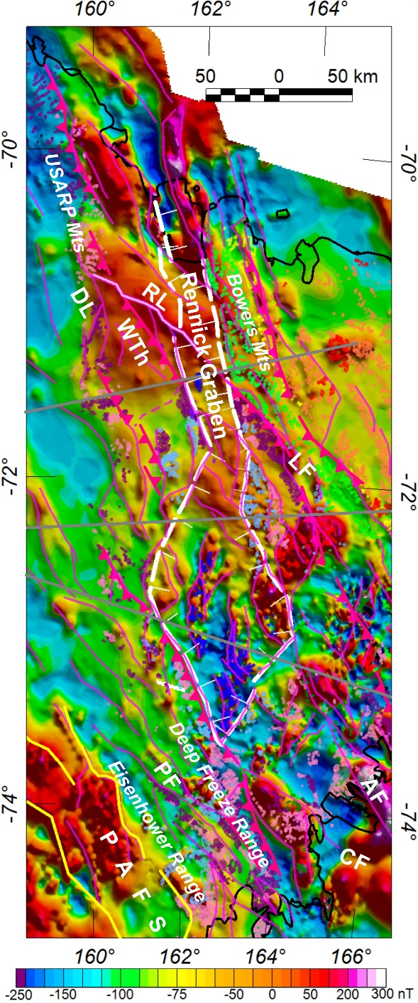
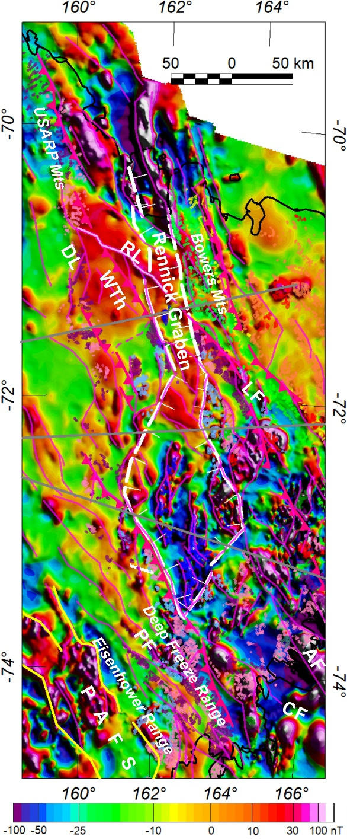
Aeromagnetic anomalies in the Rennick Graben area (East Antarctica)
a
b
a) Aeromagnetic anomalies and (b) Residual Aeromagnetic anomalies (obtained by subtracting the long-wavelength field upward continued to 10 km) superimposed on a tectonic sketch map (GANOVEX & PNRA teams) for Northern Victoria Land.
High frequency magnetic anomalies help delineate the inherited Ross-age thrust faults in the basement and image the subglacial extent of tholeiites of the Ferrar Large Igneous Province- including Kirkpatrick Basalts preserved within the Rennick pull-apart basin.
The broad high over the northern Rennick Graben delineates largely buried Ross-age arc basement, while the regional low over the southern Rennick Graben reflects more weakly magnetic back-arc(?) basement. The different basement may have contributed also to the differing architecture of the two sectors of the pull-apart basin.
Note the prominent Rennick Lineament (RL) beneath the northern Rennick Graben that appears to connect the Lanterman Fault with the Wilson Thrust.
Magnetic lineaments (magenta) are interpreted as revealing subglacial fault systems (see next slide). A much greater complexity in the structural architecture of the RG region is now readily apparent. Grey lines show the location of our new crustal models (not shown here).
LF
LF
Ferraccioli et al., 2020, G-cubed (Special Polar Focus), MS, in prep. Image Author Copyright.

Slide 6
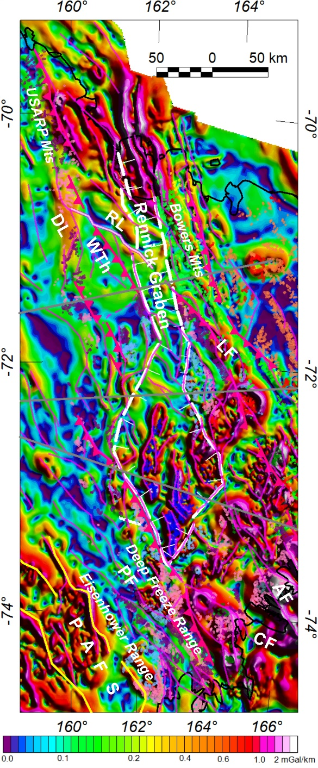
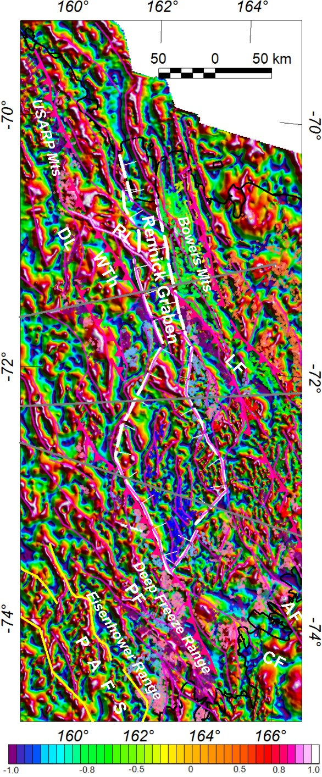
Pseudo-Gravity and Tilt Derivative maps in the Rennick Graben area (East Antarctica)
a
b
a) Maximum Horizontal Gradient of Pseudo-gravity and (b) Tilt derivative aeromagnetic anomalies superimposed on a tectonic sketch map (GANOVEX & PNRA teams) for Northern Victoria Land.
The maximum horizontal gradient of pseudo-gravity map helps image the major fault systems in the region and assists in delineating the extent of the edges of the regions where Kirkpatrick Basalts and Ferrar dolerite rocks are preserved within and along the flanks of Rennick Graben respectively.
The tilt derivative aeromagnetic anomaly map reveals the complex structural architecture of the RG region, revealing faults also within the relatively quieter magnetic regions, such as the central parts of the Wilson Terrane underlying the uplifted flank of the Rennick Graben in the USARP Mountains sector.
Ferraccioli et al., 2020, G-cubed (Special Polar Focus), MS, in prep. Image Author Copyright.

Slide 7
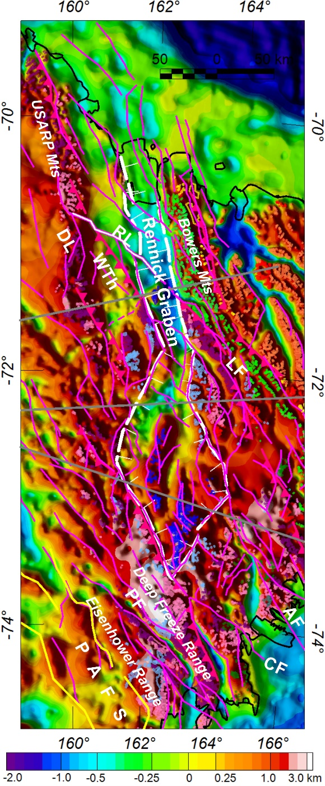
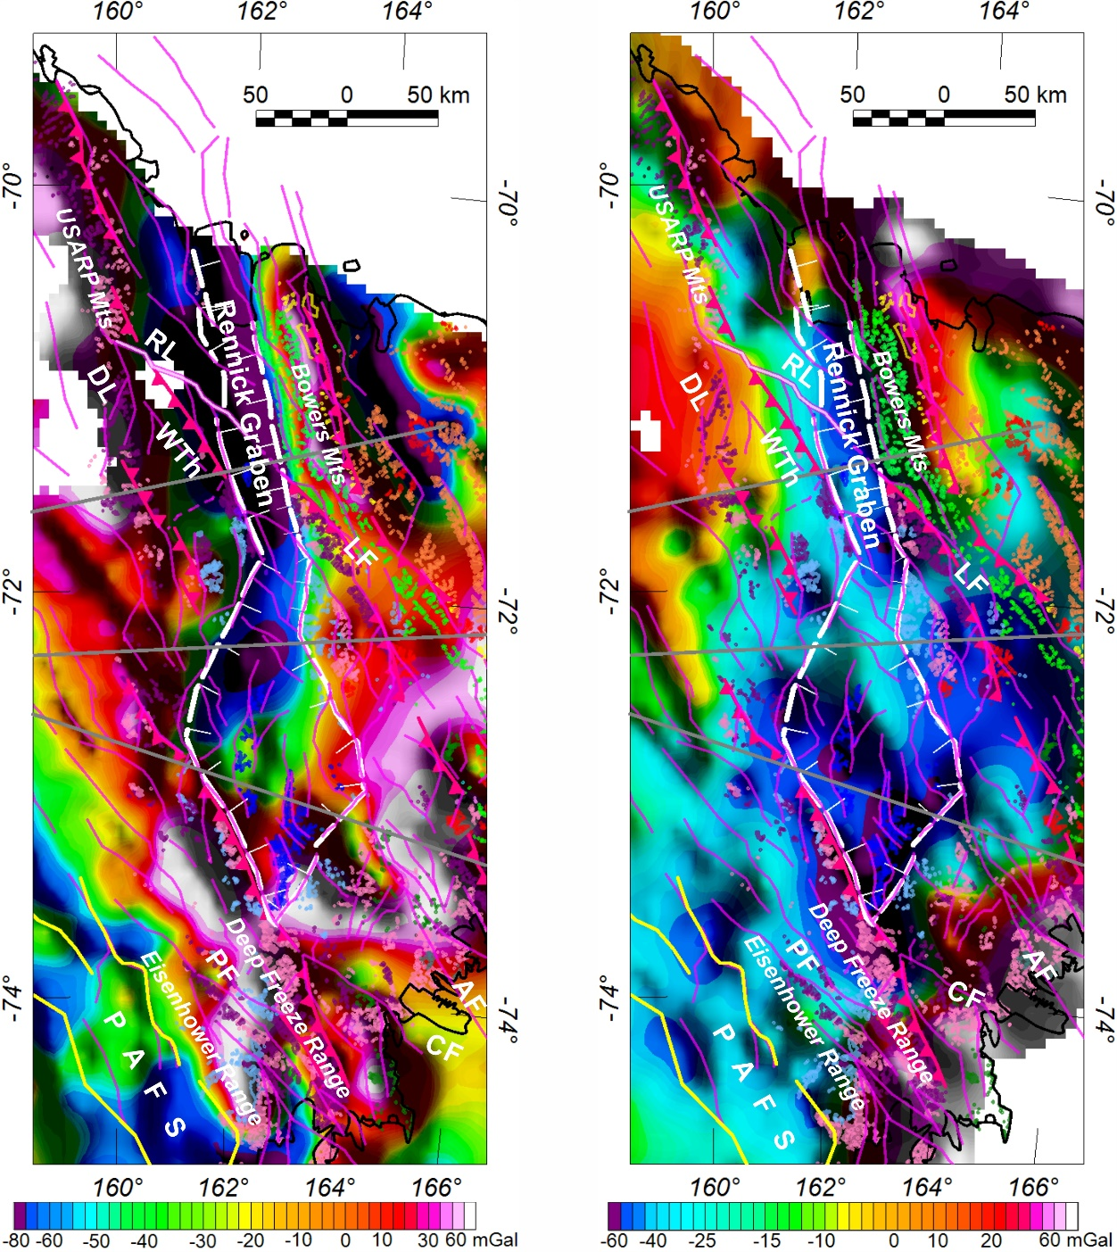
Magnetic lineament interpretation superimposed on bed topography & gravity anomaly imaging
a
b
c
a) Magnetic lineament interpretation superimposed on bedrock topography & tectonic sketch map (GANOVEX & PNRA teams) for Northern Victoria Land.
b) Magnetic lineament interpretation superimposed on Free-Air gravity image & tectonic sketch map.
c) Magnetic lineament interpretation superimposed on Bouguer gravity residual image & tectonic sketch map.
These maps enable new assessments of structural controls on bedrock topography and deeper intra-crustal architecture revealed by the gravity images in the RG region.
Ferraccioli et al., 2020, G-cubed (Special Polar Focus), MS, in prep. Image Author Copyright.

Slide 8
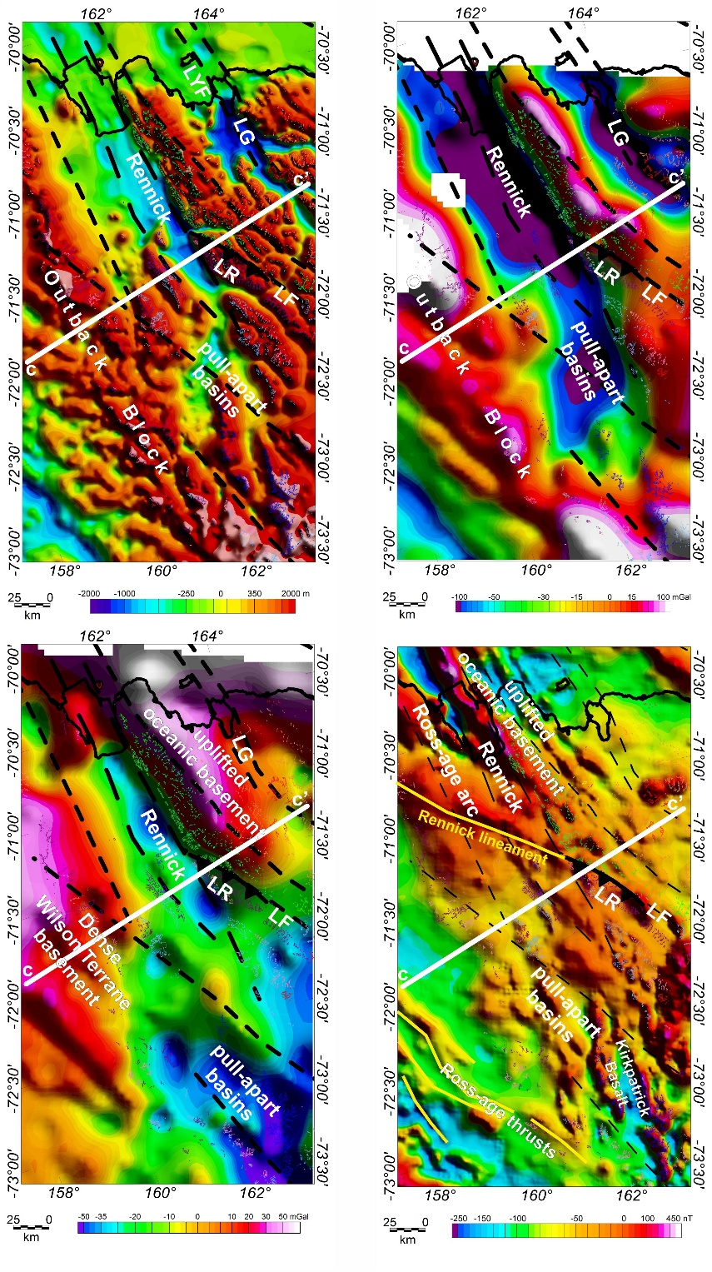
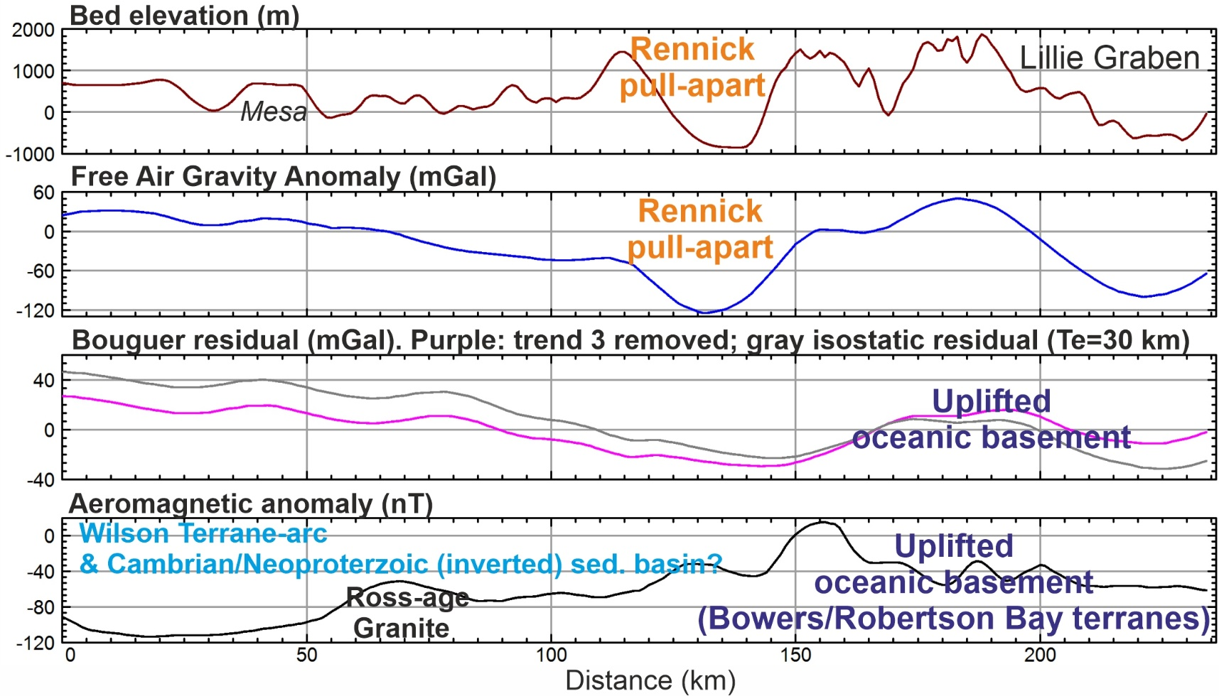
Profile view across the northern segment of the Rennick pull-apart basin
a
b
d
c
d
Location of profile superimposed on bedrock topography, Free Air Gravity, Bouguer Gravity residual (from de-trending) and aeromagnetic anomaly image (a-d).
Profile view and geological interpretation revealing that the northern RG was imposed upon the major inherited tectonic boundary between the Wilson Terrane arc and the oceanic terranes to the east. The prominent low atop of the Outback Block is interpreted as a weakly magnetic but dense back arc basin region in the basement.
Ferraccioli et al., 2020, G-cubed (Special Polar Focus), MS, in prep. Image Author Copyright.

Slide 9
Conclusions
New aeromagnetic anomaly map of the Wilkes Subglacial Basin and adjacent TAM.
The aeromagnetic image helps unveil the cryptic and likely composite Precambrian basement of the Wilkes Subglacial Basin.
Magnetic lows delineate areas where basement is likely buried deeper beneath Beacon sediments and thicker late Neoproterozoic to early Cambrian metasediments.
Such heterogeneity in basement and cover rocks in the WSB is a key finding for future assessments of GHF variability beneath this sector of the EAIS.
Dotted blue line denotes the edge of the thick cratonic lithosphere as modelled from satellite gravity data (see previous slide).
Our magnetic and gravity images reveal the largest pull-apart basin discovered so far in East Antarctica, the Rennick Graben.
The Rennick Graben is interpreted here as a major right-lateral Cenozoic pull-apart basin system.
Enhanced magnetic anomaly images reveal Jurassic Ferrar igneous rocks preserved within the Rennick pull-apart basin.
The complex inherited fault architecture and the contrast between Cambrian arc and back-arc basement is also revealed.
The Rennick Graben is likely part of a wider and diffuse intraplate zone of extension and transtension in East Antarctica.
Ferraccioli et al., 2020, G-cubed (Special Polar Focus), MS, in prep.

