Slide 1


Are economists getting climate dynamics right?
And does it matter?
Frank Venmans^{6,1}
With Simon Dietz^{1,2,3} , Armon Rezai⁴, Rick van der Ploeg^{2,3,5}
1 London School of Economics and Political Science
2 University of Oxford, Oxford
3 CESifo, Munich
4 Vienna University of Economics and Business;
5 Vrije Universiteit Amsterdam, Amsterdam
6 University of Mons, Mons
Notes:
Answer both questions:
No, too much delay between emissions and warming. No saturation of carbon sinks
Yes, carbon price increases by 20 to 30% under corrected

Slide 2
Outline
Motivation
Are economists getting climate dynamics right?
  Too much delay between emissions and warming
  Absence of saturation of carbon sinks
Does it matters?
The solution
Future work

Slide 3
Motivation
Lemoine & Rudik (AER, 2017)

Slide 4
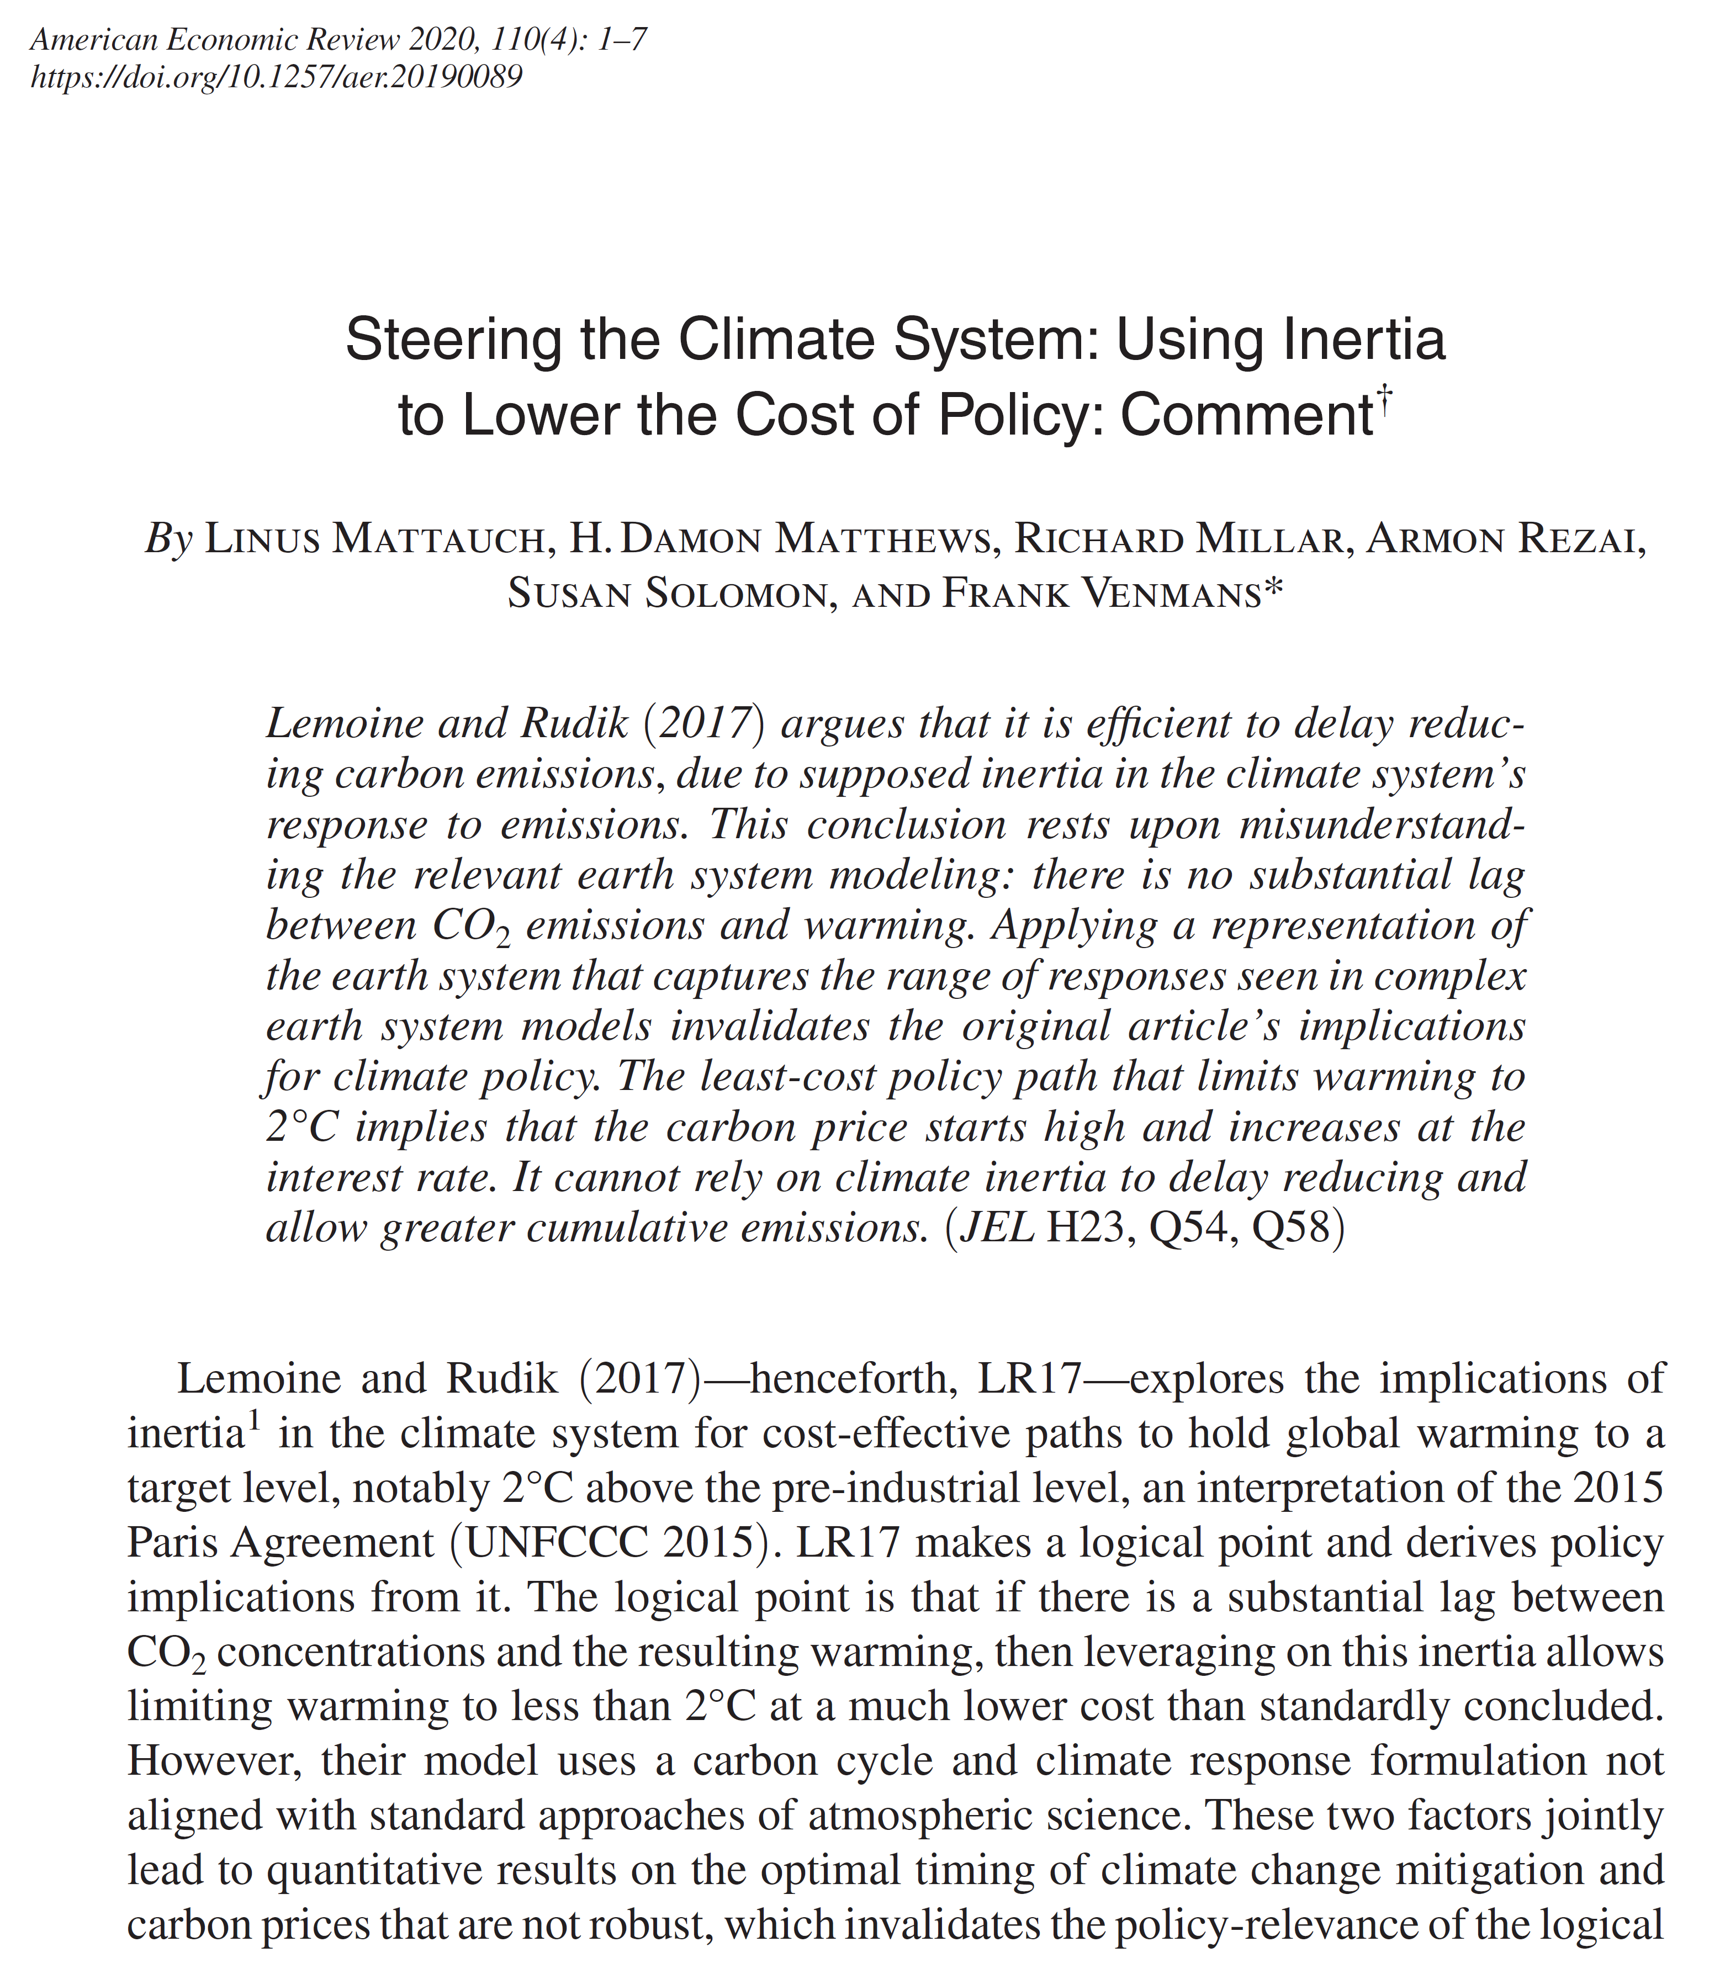
Notes:
In this paper, I was the bridge between the economists and the climate physisists

Slide 5
Integrated Assessment Models
Numerical models
  DICE 2013 (Nordhaus, 2014)
  DICE 2016 (Nordhaus, 2017)
  FUND 3.11 (Waldhoff, Anthoff, Toll 2014)
  PAGE 09 (Hope, 2013)
Analytical models
  Golosov, Hassler, Krusell, Tsyvinski (Econometrica, 2014)
  Lemoine & Rudik (AER, 2017)
  Gerlagh & Liski (JEEA, 2018)
CMIP5 modeling ensemble
  Joos et al. (2013)
  FAIR (Millar, Nicholls, Friedlingstein, Allen 2017)
  Geoffroy et al. (2013)
Notes:
Why do we care? Nordhaus got the nobel price
US interagency work group on the social cost of carbon. SCC required for all federal regulation on CO2.

Slide 6
The Elements of a climate model
Emissions
Concentration
Warming
Joos et al. (2013)
FAIR (2017)
Geoffroy et al. (2013)

Slide 7
Too much delay between emissions and warming

Slide 8
Impact response function for an emission pulse

Slide 9
Carbon absorption models
Notes:
Most models have insufficient decay in the short run.
Very high variation in the long run.

Slide 10
Thermal inertia models
Notes:
All models have a climate sensitivity of 3,1°C (the same steady state).
Too little warming in the short run for all models.
Too much warming after 50 to 100 years.

Slide 11
Saturation of carbon sinks
  Acidification of oceans
  Warmer ocean reduces solubility of CO₂
  Lower photosynthesis feedback both on land and in ocean

Slide 12
Absorption speed under future CO₂ conc.
Notes:
Go back to impact response function to show the effect

Slide 13
Does it matter?
We integrate the other climate dynamics in DICE

Slide 14
Welfare maximising paths: Emissions

Slide 15
Welfare maximising paths: Social Cost of Carbon

Slide 16
Welfare maximising paths: Temperature

Slide 17
2°C cost-minimzing paths: Carbon Price

Slide 18
2°C cost-minimizing paths: Emissions

Slide 20
The isolated effect of delay and carbon feedbacks
Using variants of DICE

Slide 21
Welfare maximising paths

Slide 22
2°C cost-minimising paths

Slide 23
The discount rate matters less
Notes:
Standard discount rate 5,1%
Public discount rate 3,5%

Slide 24
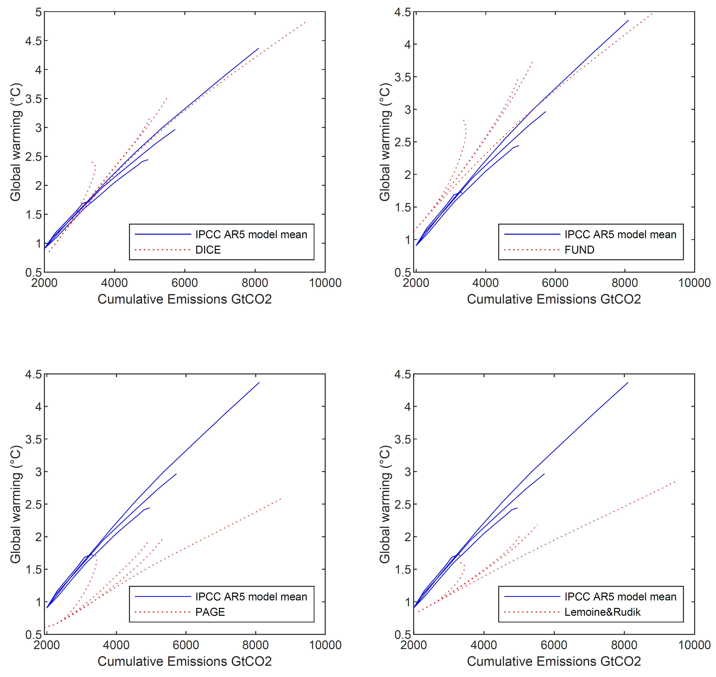
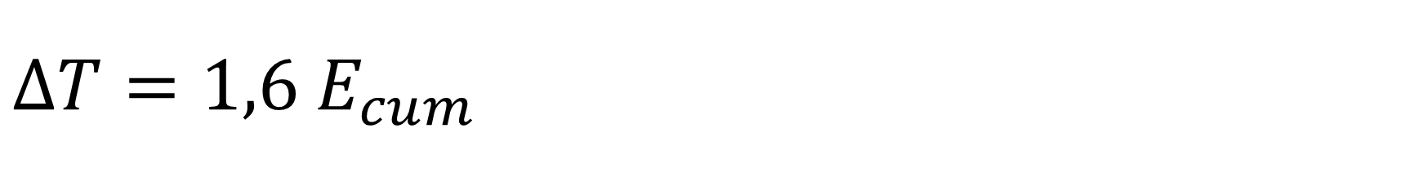
$ΔT=1,6 E_{cum}$
Matthews, Gillett, Stott Zickfeld (Nature, 2009)
Dietz & Venmans (JEEM, 2019)
Notes:
Since I have very talented co-authors on this paper, you may ask yourself what was my contribution. Being an engineer, I focussed on the physics. I went through the science and economic papers and programmed the climate models in matlab to make all the graphs that are related to the climate, not the DICE graphs. This was somehow natural, because I also made the climate graphs in the AER comment.
In number of hours spent I was the most crazy team member for this paper. That mainly signals the efficiency of the other authors 😊

Slide 25
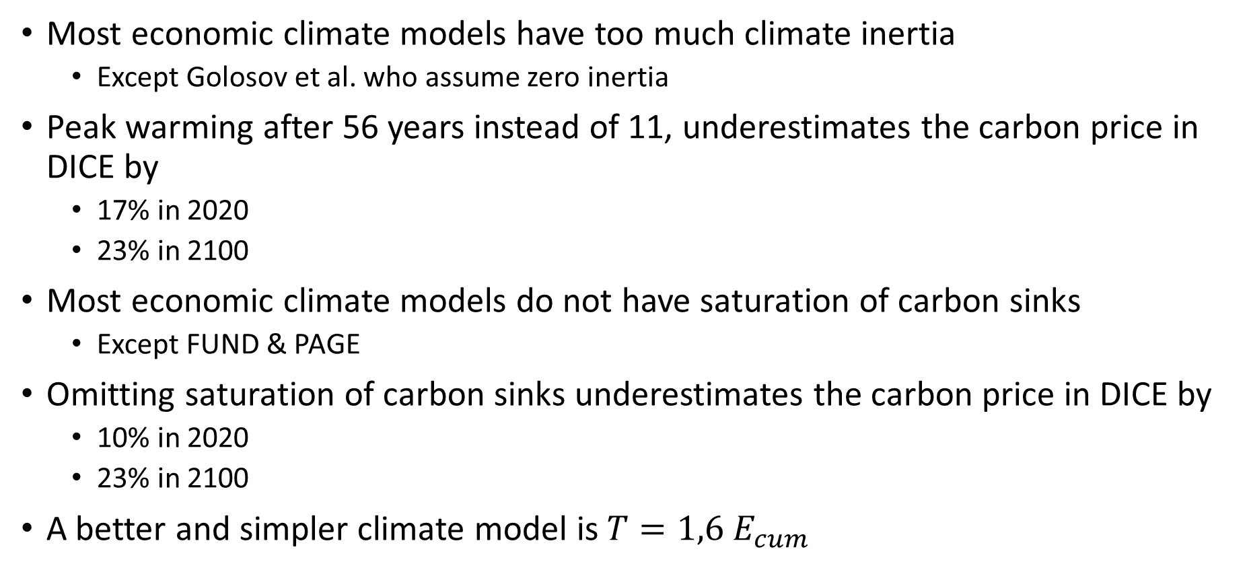
Conclusion
Most economic climate models have too much climate inertia
  Except Golosov et al. who assume zero inertia
Peak warming after 56 years instead of 11, underestimates the carbon price in DICE by
  17% in 2020
  23% in 2100
Most economic climate models do not have saturation of carbon sinks
  Except FUND & PAGE
Omitting saturation of carbon sinks underestimates the carbon price in DICE by
  10% in 2020
  23% in 2100
A better and simpler climate model is $T=1,6 E_{cum}$
Notes:
Would correcting the fast climate response increase the difference between cost-benefit (early action) and cost-effectiveness (postponed action) for a given steady state warming?
Cost-effectivness will have lower carbon prices like in Lemoine and Rudik
Cost-benefit will have also have lower carbon prices like in our results

Slide 26
Future research
Stochastic dynamic optimization
  Optimal emissions under the risk of stranded assets
  The dynamics of innovation
  Climate tipping points
Econometrics / policy evaluation
  Compliance in the EU ETS
  The effect of climate litigation on stock prices

Slide 27
Thank you
I’m happy to answer questions.

Slide 28
Ricke & Caldeira 2014 (ERL)
Similar arguments in Matthews and Caldeira 2008; Eby et al. 2009; Held et al. 2010.
Notes:
Long term effect: driven by never-decaying proportion of the emission pulse, combined with the long delay allowing the deep see to warm up.
Short term effect: driven by zero decay (high forcing), combined with
Fast warming up of upper ocean in the first decade
Much slower warming up of the lower ocean in the following decades

Slide 29
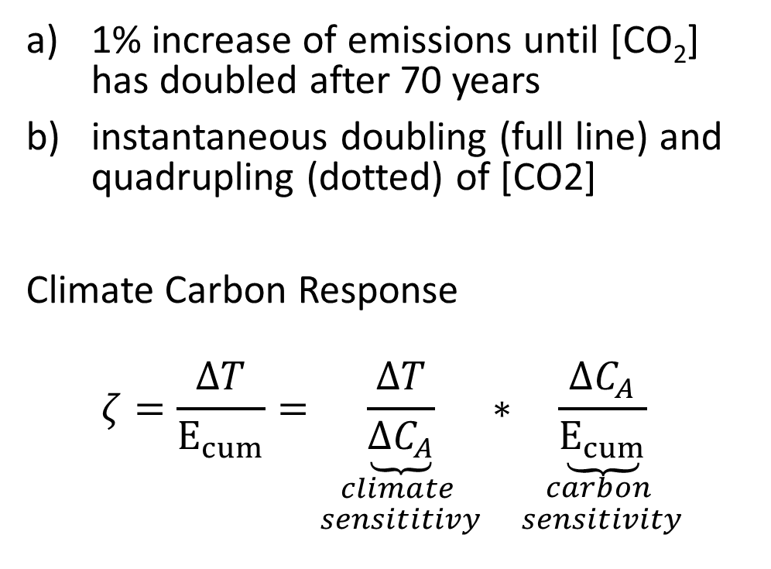
Matthews, Gillett, Stott Zickfeld, 2009 (Nature)
1% increase of emissions until [CO₂] has doubled after 70 years
instantaneous doubling (full line) and quadrupling (dotted) of [CO2]
Climate Carbon Response
$$ζ=\frac{ΔT}{E_{cum}}=\underset{\begin{aligned}climate \\ sensititivy\end{aligned}}{\underbrace{\frac{ΔT}{ΔC_{A}}}}∗\underset{\begin{aligned}carbon \\ sensitivity\end{aligned}}{\underbrace{\frac{ΔC_{A}}{E_{cum}}}}$$

Slide 30

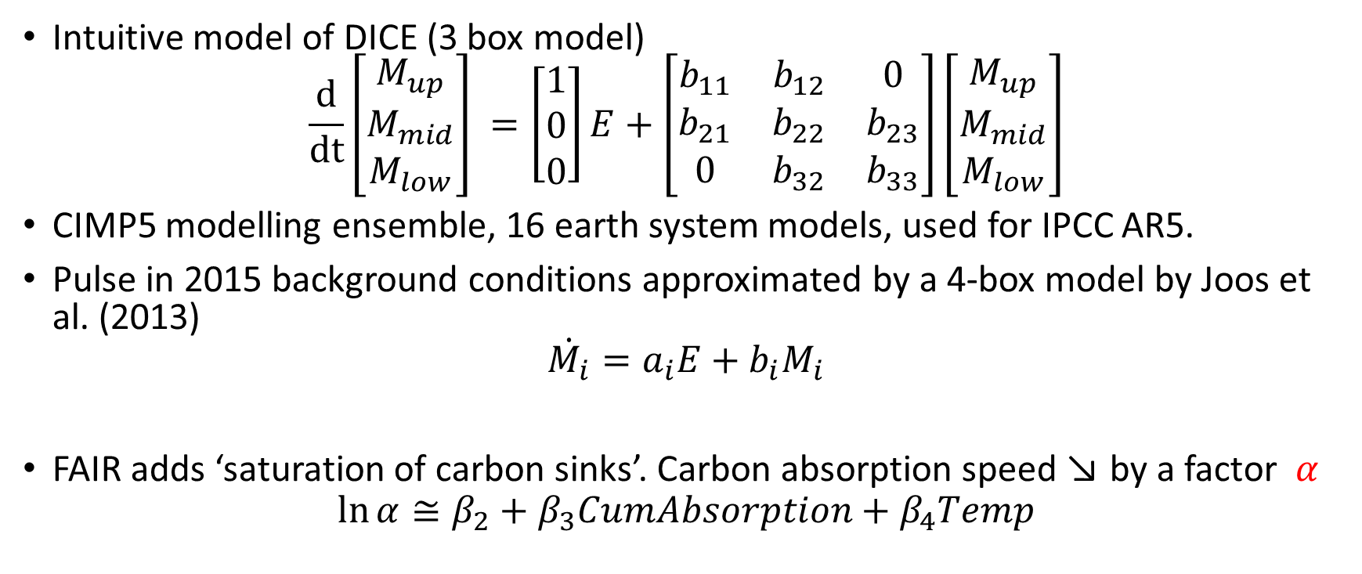
Carbon absorption models
Intuitive model of DICE (3 box model)
$$\frac{d}{dt}\left[\begin{matrix}M_{up} \\ M_{mid} \\ M_{low}\end{matrix}\right] =\left[\begin{matrix}1 \\ 0 \\ 0\end{matrix}\right]E+\left[\begin{matrix}b_{11} & b_{12} & 0 \\ b_{21} & b_{22} & b_{23} \\ 0 & b_{32} & b_{33}\end{matrix}\right]\left[\begin{matrix}M_{up} \\ M_{mid} \\ M_{low}\end{matrix}\right]$$
CIMP5 modelling ensemble, 16 earth system models, used for IPCC AR5.
Pulse in 2015 background conditions approximated by a 4-box model by Joos et al. (2013)
$$\dot{M_{i}}=a_{i}E+b_{i}M_{i}$$
FAIR adds ‘saturation of carbon sinks’. Carbon absorption speed ↘ by a factor $α$
$$\ln{α}≅β_{2}+β_{3}CumAbsorption+β_{4}Temp$$
$$\frac{}{α}$$

Slide 31
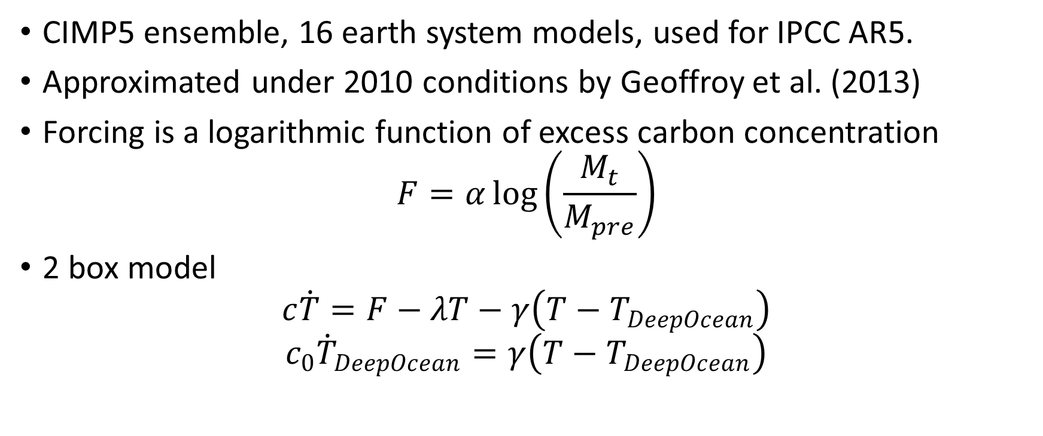
Temperature inertia models
CIMP5 ensemble, 16 earth system models, used for IPCC AR5.
Approximated under 2010 conditions by Geoffroy et al. (2013)
Forcing is a logarithmic function of excess carbon concentration
$$F=α\log\left(\frac{M_{t}}{M_{pre}}\right)$$
2 box model
$$c\dot{T}=F−λT−γ\left(T−T_{DeepOcean}\right)$$
$$c_{0}{\dot{T}}_{DeepOcean}=γ\left(T−T_{DeepOcean}\right)$$

Slide 32



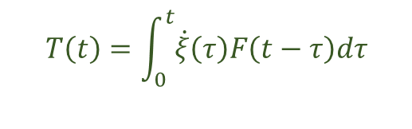
Transient climate response to carbon emissions
Pulse of emissions
Step-function of radiative forcing
Cumulative emissions S
RF
t
t
Atmospheric decay
Temp response to step-function of RF
Dotted under larger background CO₂ concentration
$$ξ=\int_{0}^{t}{\dot{ξ}dτ}$$
$$ξ$$
ΔCO₂ concentration
RF=αln[CO₂]* ΔCO₂
$$\dot{ξ}$$
t
t
Temp response to a pulse of emission
Temp
$$T\left(t\right)=\int_{0}^{t}{\dot{ξ}\left(τ\right)F\left(t−τ\right)dτ}$$
t
Notes:
Average Global Warming Potential for a given Time Horizon is the surface under the RF curve, expressed as energy per m²
Average Global Temperature Potential for a given Time Horizon is the green triangle

