Slide 1
Air-sea fluxes following the unusual summer ice retreats measured by saildrones
Dongxiao Zhang (JISAO/University of Washington and NOAA/PMEL)
Chidong Zhang (NOAA/PMEL)
J. Cross, C. Mordy, E. Cokelet, C. Gentemann, A. Chiodi, P. Stabeno, R. Jenkins, C. Meinig, N. Lawrence-Slavas, H. Tabisola, M. Wang

Slide 2
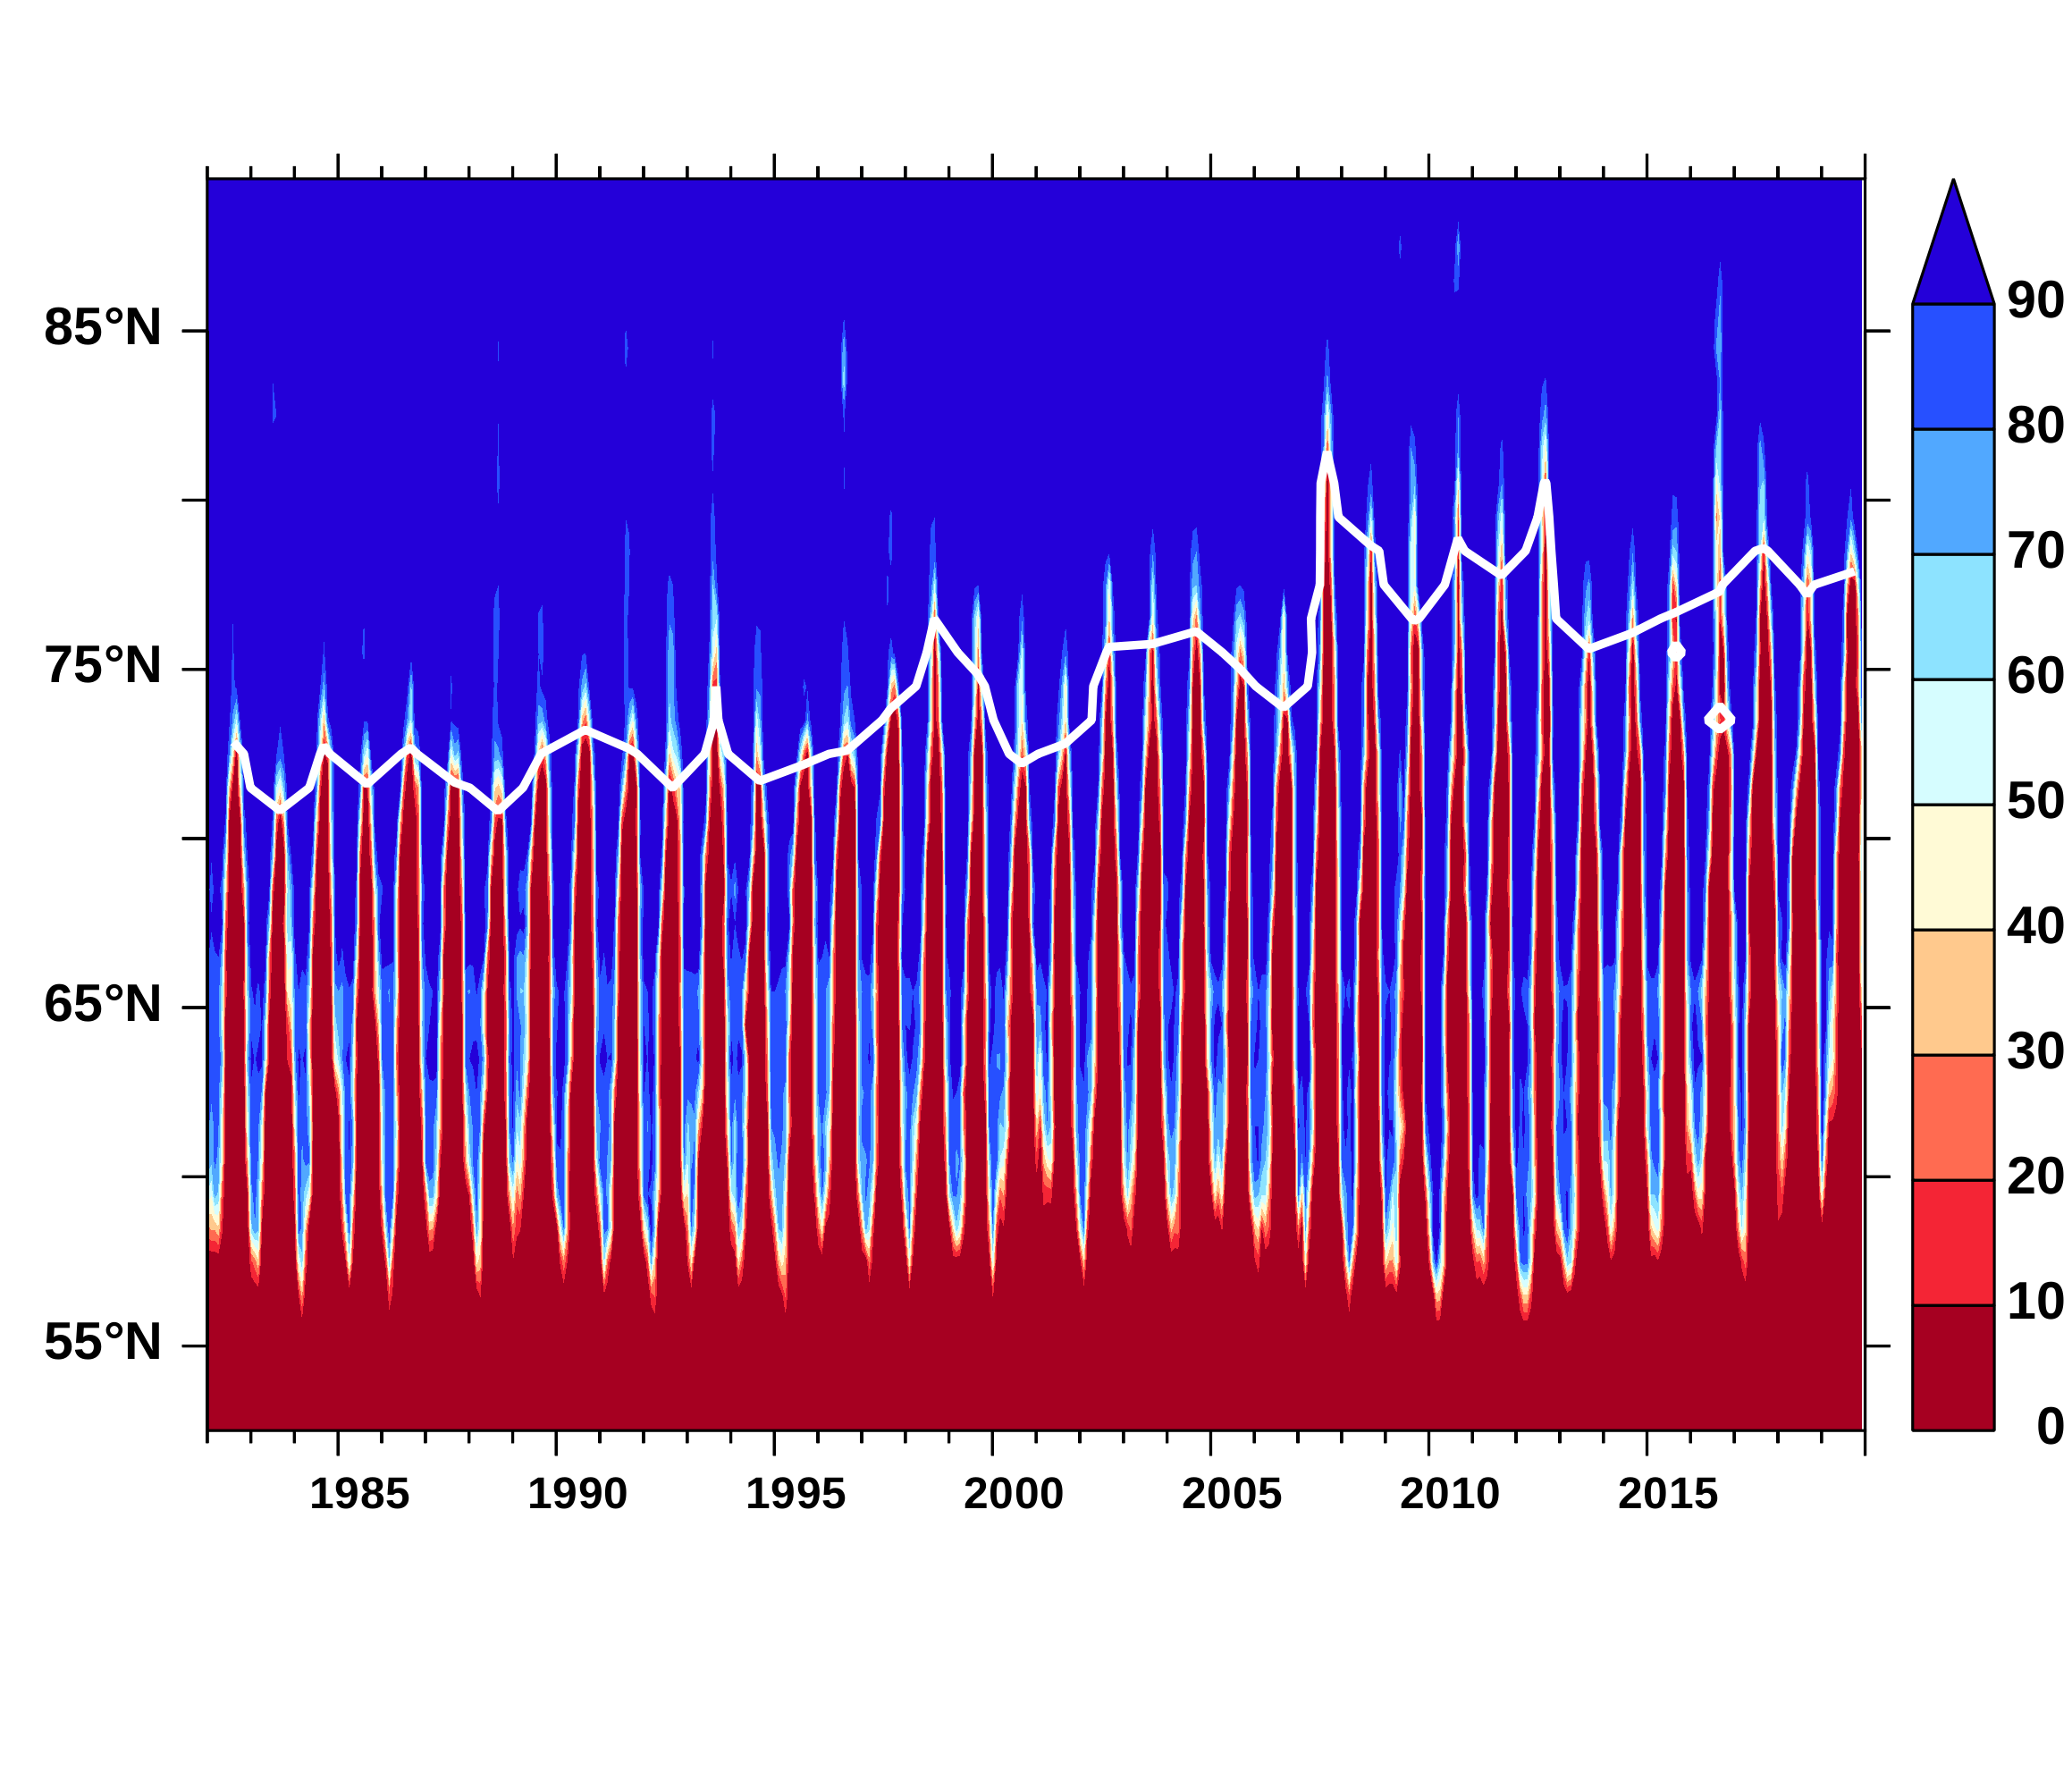
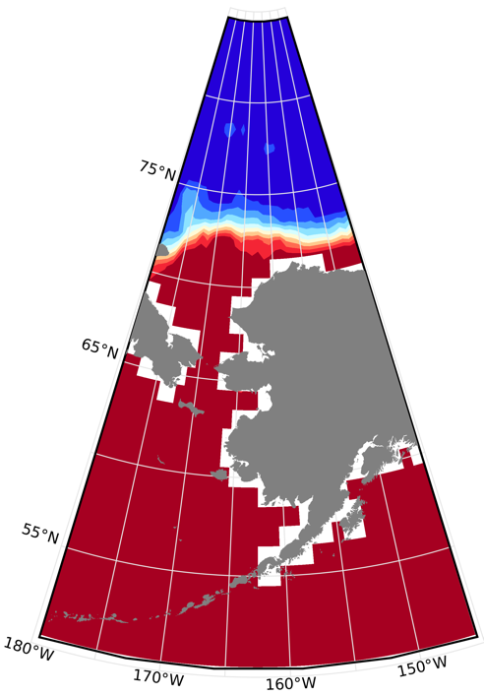
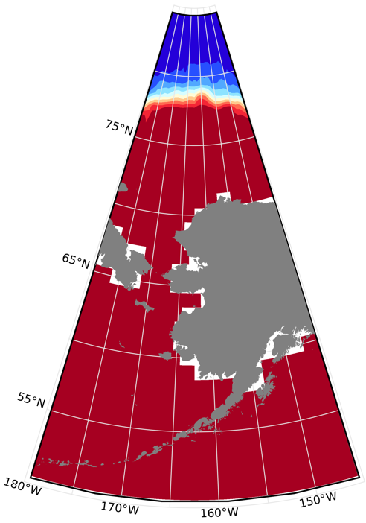
Motivation 1) Vast ocean area normally covered by sea ice opens up for air-sea interaction, which will energize weather system development; 2) Observe air-sea interaction in newly opened Arctic to establish a baseline dataset and to provide real time data for improving forecasts; 3) Demonstrate the feasibility of using autonomous platforms for sustained observation.
Ice edge 15%: Summer ice retreats further North
Sept. 1982
Sept. 2019
Ice concentration (%)
NOAA OI Ice Concentration along 168ºW
Notes:
Add sensors to

Slide 3
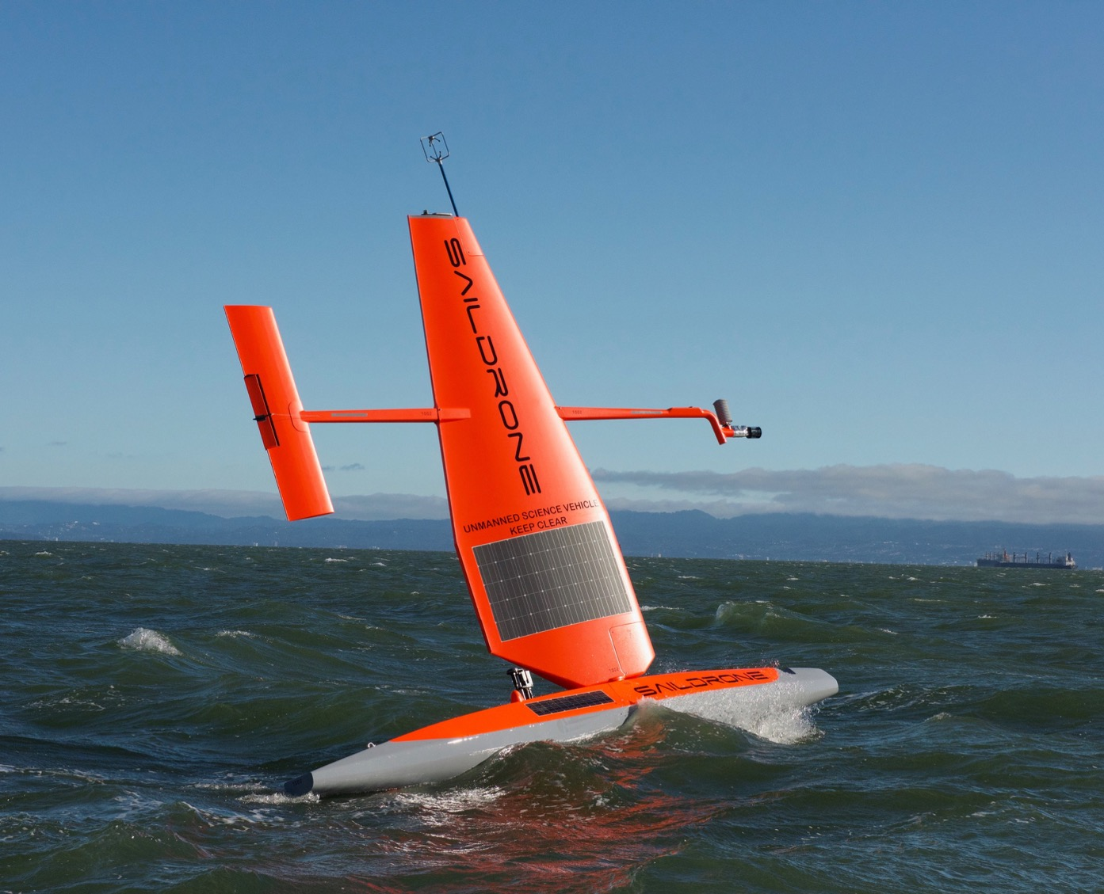
TECHNOLOGY OVERVIEW
SAILDRONE
Unoccupied surface vehicle (USV)
5 m / 15 ft tall
Green Tech.: Wind propulsion; Solar power electronics.
Long Endurance: 12-month; 16,100 km.
Large Payload: >100 kg; Large number of sensor packages.
wind power for
propulsion
solar power
for electronics
satellite link
for live data
7.5 m / 23 ft long
human scale

Slide 4
Saildrones: Global Class Autonomous Surface Vehicles for Air-Sea Interaction Observation
CRADA PMEL-Saildrone Inc 2014
Bering Sea summer 2015 2016 (surface MetOcean, acoustic fish biomass)
Tropical Pacific Observing System (TPOS) and NOAA Tech. Development 2016-2019 (Air-sea heat, momentum and CO₂ fluxes, ADCP upper ocean currents)
Fast development, production and application cycle, Public-Private Partnership.
Meinig et al. 2019 OceanObs’19

Slide 5
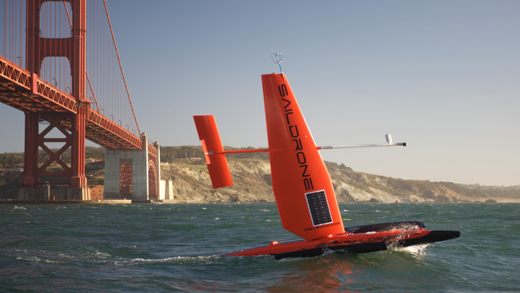
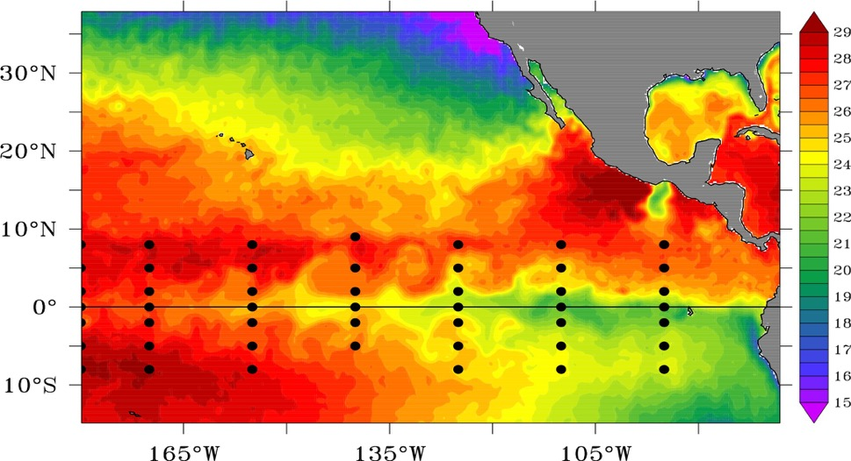
Autonomous Surface Vessels as Low-Cost TPOS Platforms for Observing the Planetary Boundary Layer and Surface Biogeochemistry Co-PIs: M. Cronin, D. Zhang, A. Sutton, C. Meinig Postdoc: Samantha Wills
Testing the ability of Saildrone to make
climate-quality measurements in the Tropics
Three 6-month missions:
1) NASA salinity study (SPURS II) and 125°W section (Sept.2017)
2) Equatorial sections 140°W, with and against currents (Oct. 2018)
3) Cluster of 4 drones, adaptive sampling around 140°W (June 2019)
Legend:
•
TAO buoys
TAO buoy with CO₂ flux sensors
NASA SPURS II Study Site
Saildrone Mission #1
Saildrone Mission #2
Saildrone Mission #3
Notes:
Add sensors to

Slide 6
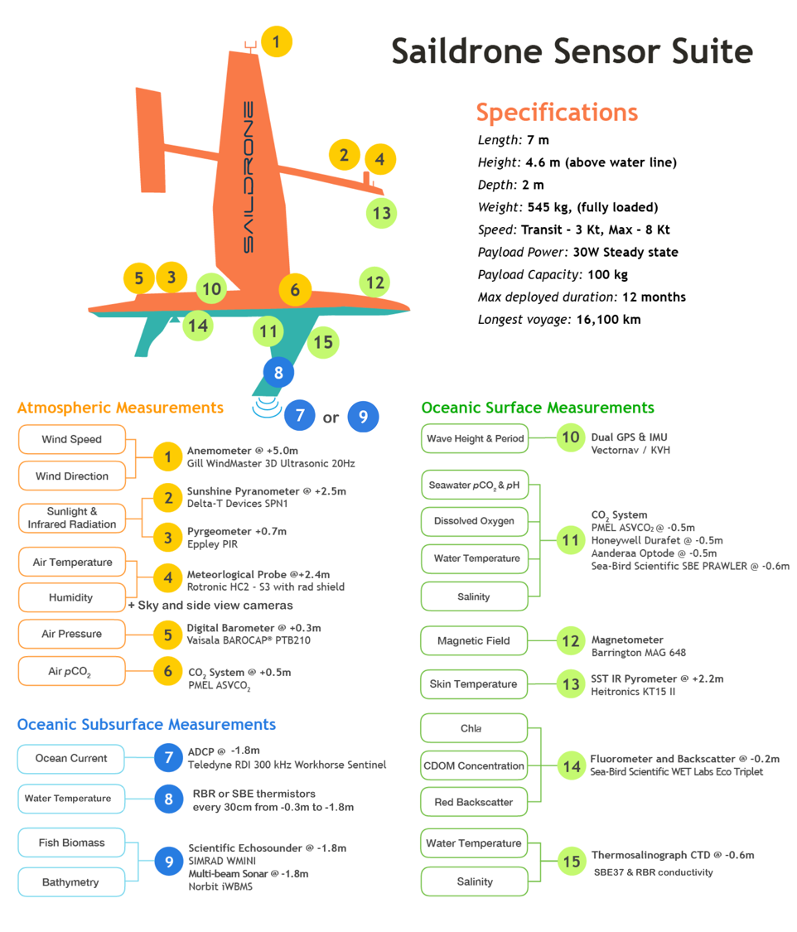
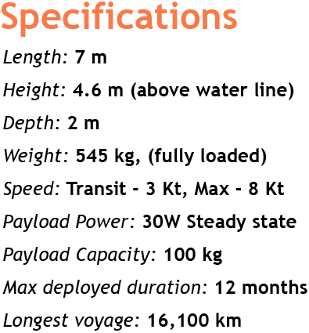
15 Sensor Packages 22 Essential Variables
Off-the-shelf Sensors (data put on GTS):
Air Temperature and Relative Humidity
Air Pressure
SST (@0.6m)
Wind and Wind Stress (Bulk and covariance)
ADCP currents (upper 100m) or Echosounder fish biomass
Air-sea heat fluxes (LW and SW radiation, bulk latent heat and sensible heat)
Waves (significant wave height and period)
Cameras (ice and cloud images)
BGC Suite
Air pCO2, Sea surface pCO2 and pH
Dissolved Oxygen
Chla, CDOM, Red Backscatter
_{Sunlight & IR}

Slide 7
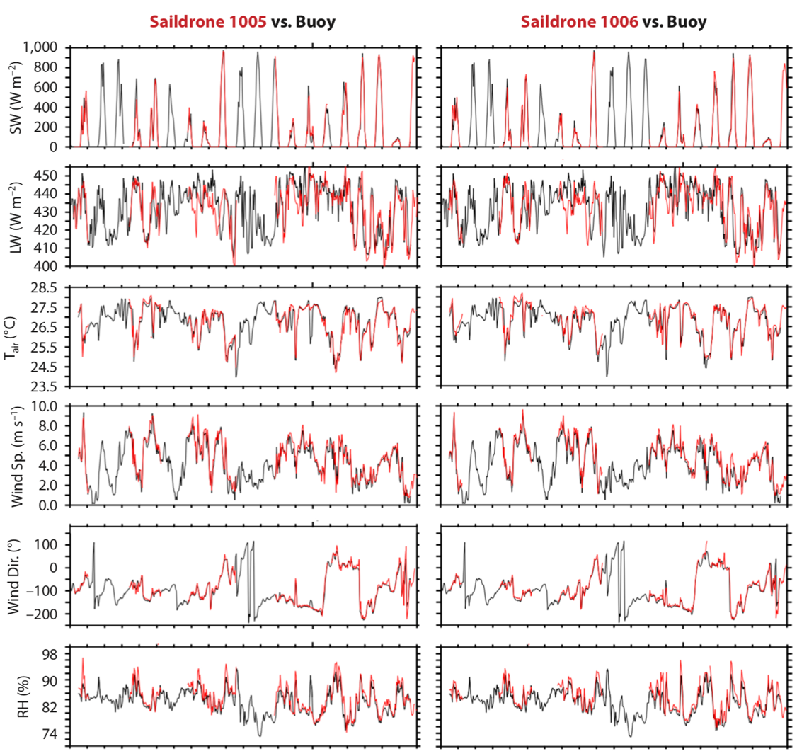
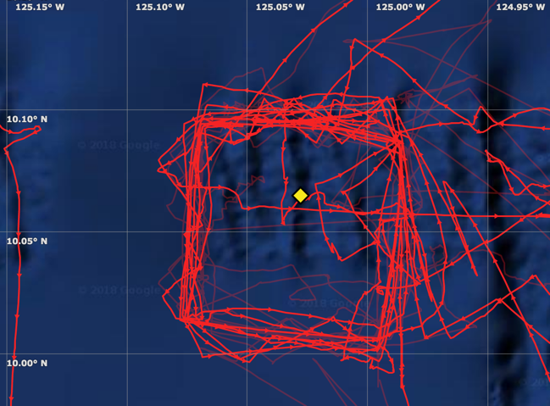
within 12-km
Zhang et al. 2019
Saildrone tracks around SPURS2 WHOI buoy

Slide 8
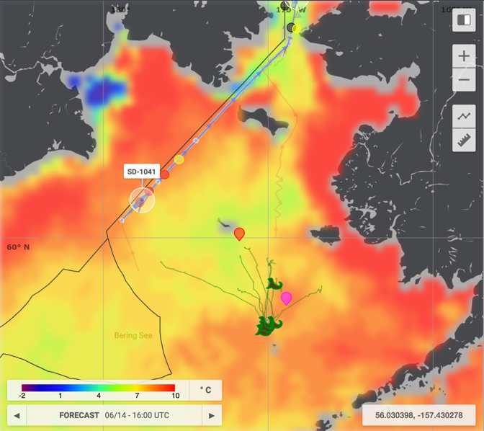
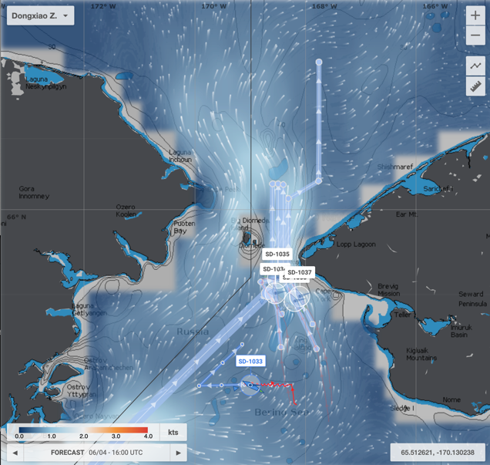
2019 Joint Mission for Observing Arctic Sea Ice Environment
PMEL, UW/JISAO, Farallon Inst., UW/APL, and Saildrone, Inc.
Chidong Zhang et al.
6 Saildrones launched from Dutch Harbor
1 Stayed in Bering Sea to follow tagged seals and have fish biomass survey
5 Sailed through narrow Bering Strait Reaching the Melting Ice Edge
Unescorted, Remotely Controlled 1000s km Away
HYCOM SST forecast HYCOM ocean current forecast

Slide 9
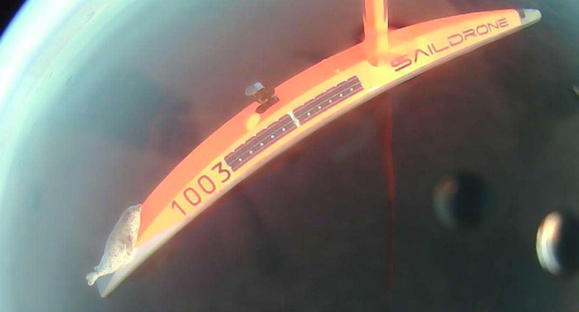
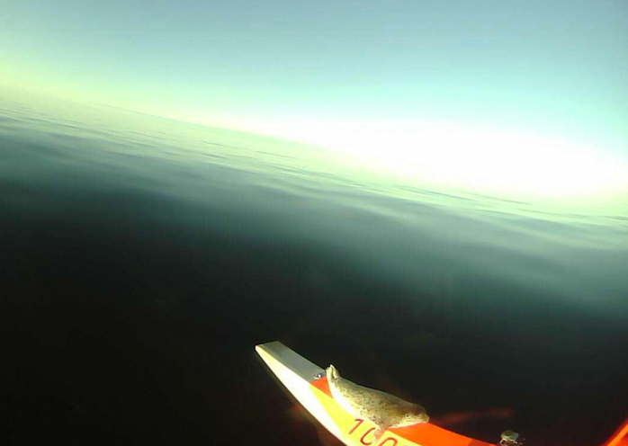
2019 Joint Mission for Observing Arctic Sea Ice Environment
PMEL, UW/JISAO, Farallon Inst., UW/APL, and Saildrone, Inc.
Chidong Zhang et al.
6 Saildrones launched from Dutch Harbor
1 Stayed in Bering Sea to follow tagged seals and fish biomass survey
5 Sailed through narrow Bering Strait Reaching the Melting Ice Edge
Unescorted, Remotely Controlled 1000s km Away
Baby seal takes a ride HYCOM ocean current forecast

Slide 10
7-day Saildrone Tracks over GHRSST and Ice Edge
observation vs. ECMWF reanalysis
Fast melting opened Bering Strait quickly
5 Saildrones through BS by June 4
1st ice encounter June 14
Sampled in and near bands of floating ice and followed a profiling float June 16-26
Really rapid retreat of sea ice in July
Saildrone spent much of August north of 75ºN close to and in Marginal Ice Zone

Slide 11
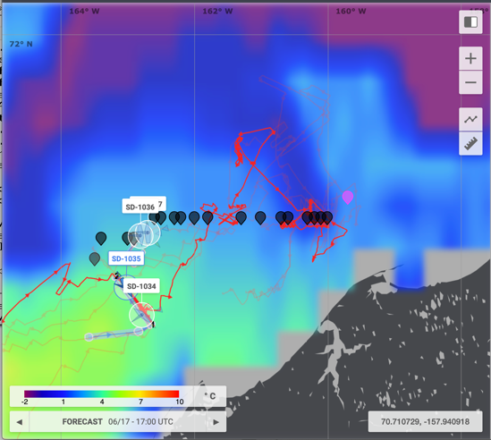
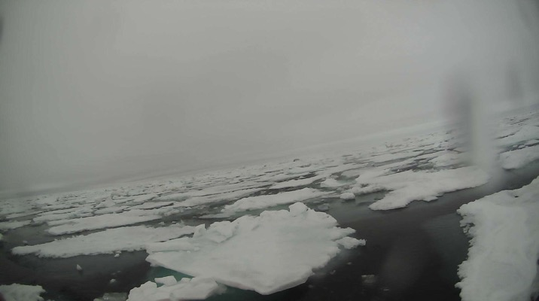
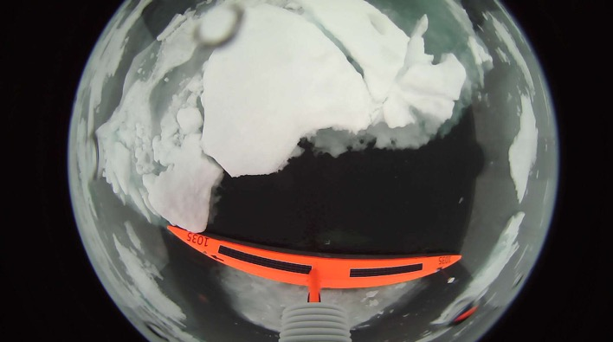
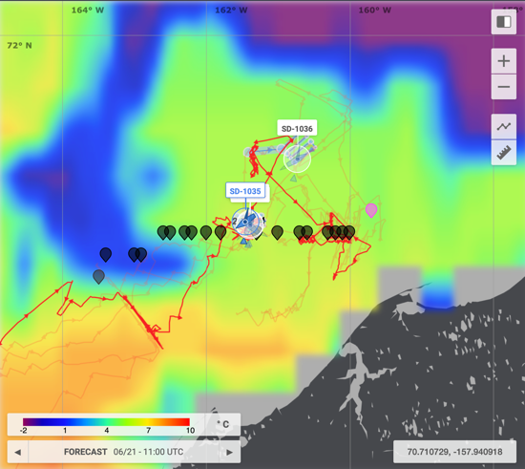
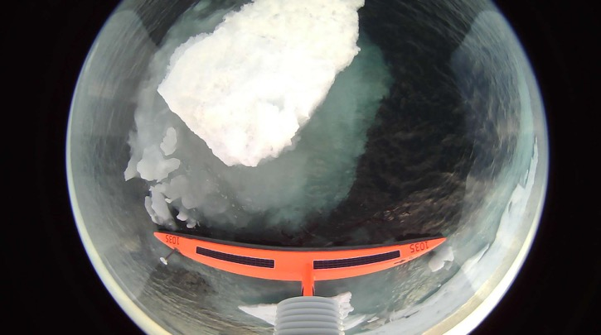
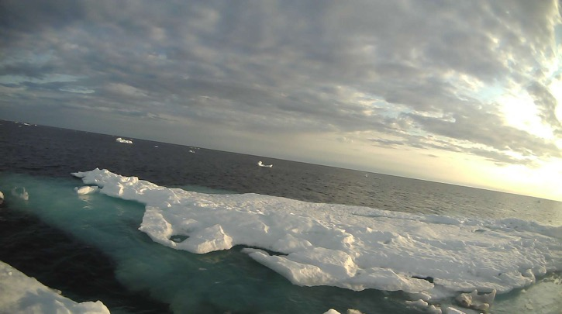
Saildrone tracks on HYCOM SST prediction
Ice pictures by Saildrone 1035, June 14, 2019
Ice pictures by Saildrone 1035, June 21, 2019

Slide 12
Cor.=0.86, RMSE=1.1m/s, Bias=-0.31m/s
Cor.=-0.03, RMSE=2.3ºC, Bias=-0.95ºC
Cor.=0.78, RMSE=0.5 0g/kg, Bias=-0.28 g/kg
Cor.=0.9, RMSE=76W/m², Bias=2.4W/m²
Cor.=0.67, RMSE=1.7ºC, Bias=-0.63ºC
Cor.=0.49, RMSE=25.1W/m², Bias=-3.7W/m²
Observation SD 1035 vs. ERA5 reanalysis (June 2019)
Bias=ERA5-Observation

Slide 13
Cor.=0.93, RMSE=1.06m/s, Bias=-0.27m/s
Cor.=0.8, RMSE=1.51ºC, Bias=-0.61ºC
Cor.=0.91, RMSE=0.44 0g/kg, Bias=-0.26 g/kg
Cor.=0.9, RMSE=74.8W/m², Bias=6.5W/m²
Cor.=0.88, RMSE=1.24ºC, Bias=-0.25ºC
Cor.=0.73, RMSE=20.1W/m², Bias=-2.3W/m²
Observation SD 1035 - ERA5 reanalysis (May – Sept. 2019)
Bias=ERA5-Observation

Slide 14
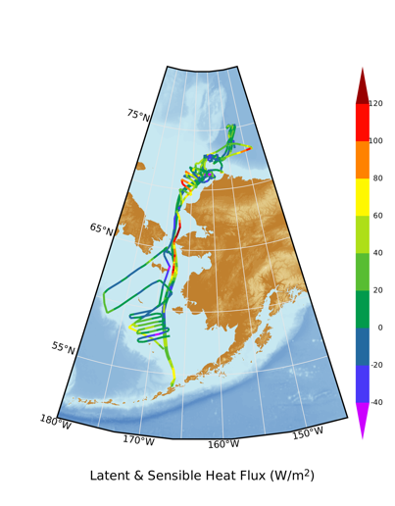
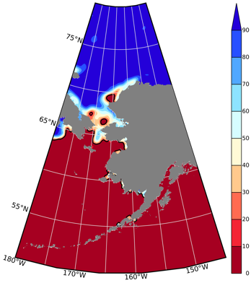
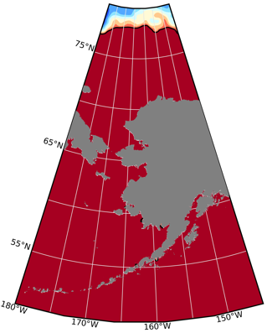
Conclusion
Saildrones have proven to be
Reliable, long-range, long-endurance, GREEN autonomous ocean observing platforms, adaptive to rapidly changing environment, ice retreating/advancing, fronts, eddies, HABs ...
Capable of making measurements of 22 Essential Ocean and Atmospheric Variables, including air-sea heat, momentum, CO2 fluxes, and upper ocean currents, critical for understanding air-sea interaction processes.
Ice Fraction
May 1. 2019
Sept 1. 2019
Latent and Sensible
Heat Flux (W/m²)
3. Valuable for evaluating and feeding real-time data to operational numerical forecasting models.
Future Work (transition to operation)
Test and Improve strategies in navigating and target-sampling complex ocean and atmospheric environments and processes.
Evaluate the benefits of saildrone data (high frequency simultaneous ocean and atmospheric measurements, crossing fronts, adaptive) to Numerical Weather Prediction (NWP) and ocean prediction models.

Slide 15
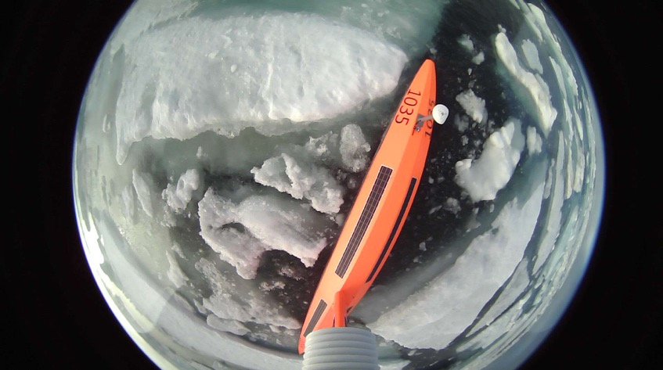
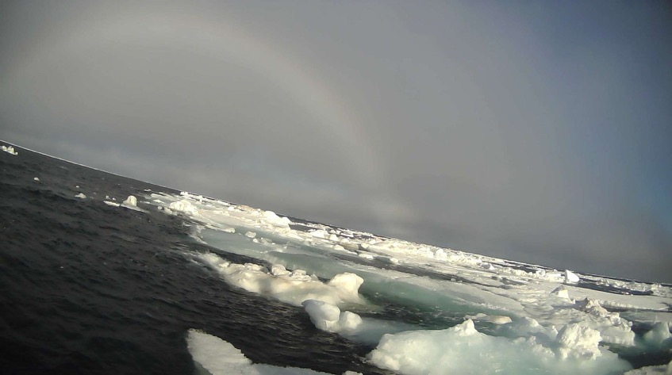
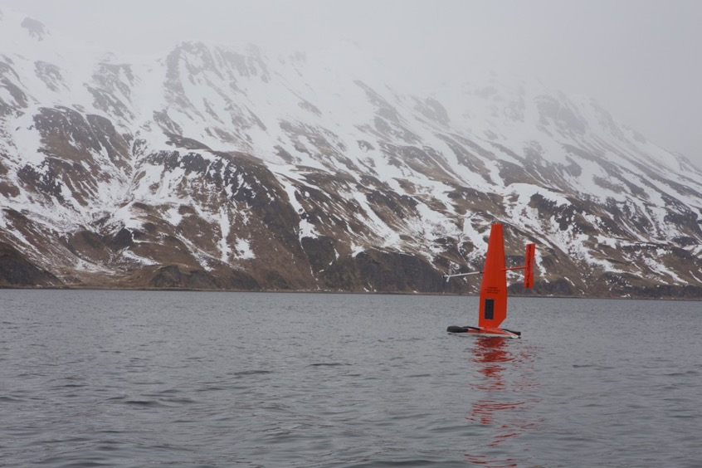
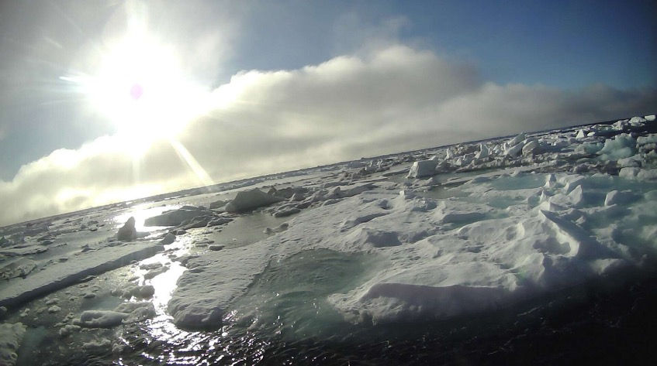
Thanks!

