Slide 1
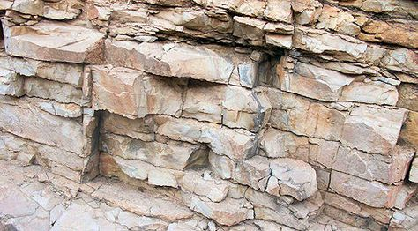
Amplitude signatures in fractured media
Alexey Stovas and Song Jin,
NTNU, Trondheim, Norway
EGU General Assembly 2020, GD8.2, 07.05.2020

Slide 2
OUTLINE
Fractured model. Linear slip.
Effective anisotropy
PP wave reflection coefficient
Conclusions

Slide 3
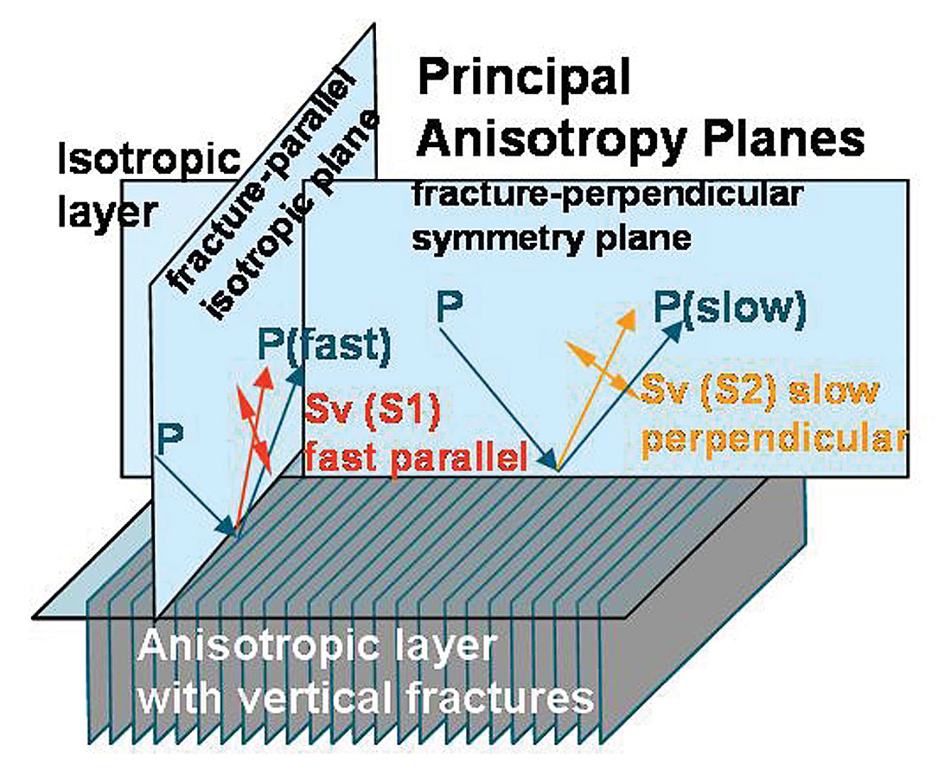
Model. Effective anisotropy
Linear slip theory (Schoenberg and Helbig (1997)
No fractures: Isotropic model
Horizontal fractures: Transversely isotropic model with a horizontal symmetry axis
Horizontal&Vertical fractures: Orthorhombic model
Horizontal&2 sets of Vertical non-orthogonal fractures: Monoclinic model
Horizontal&2 sets of Vertical&Oblique fractures: Triclinic model

Slide 4
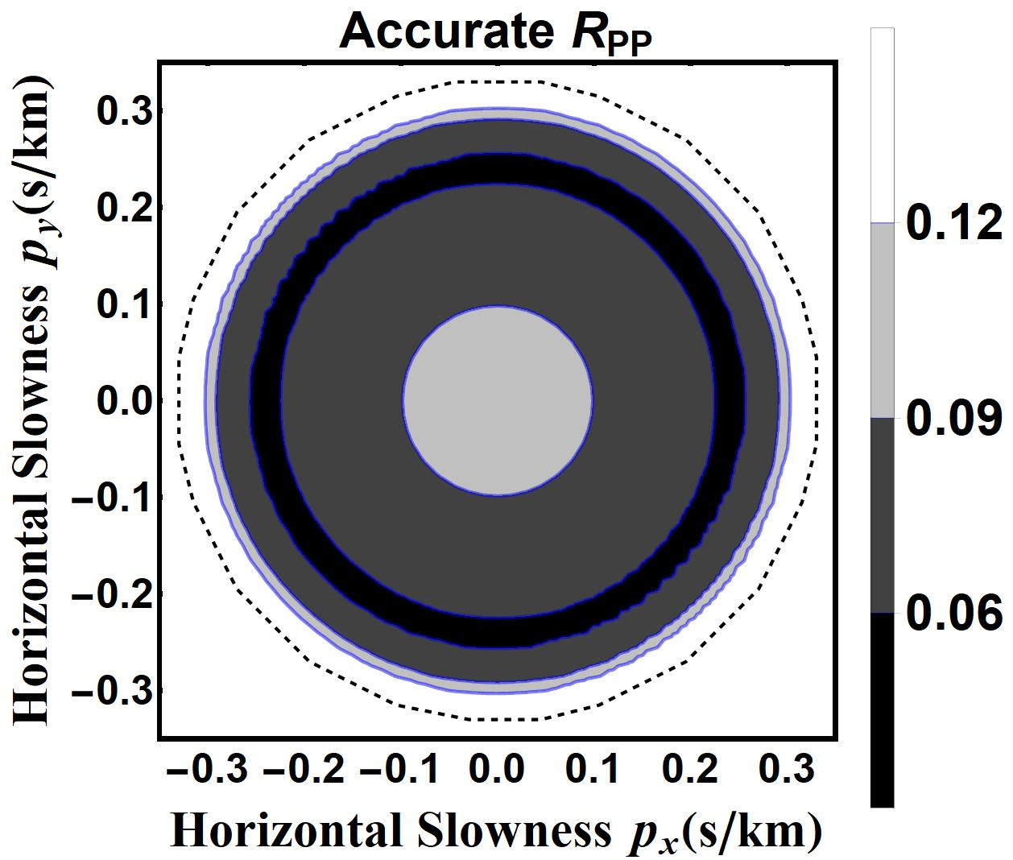
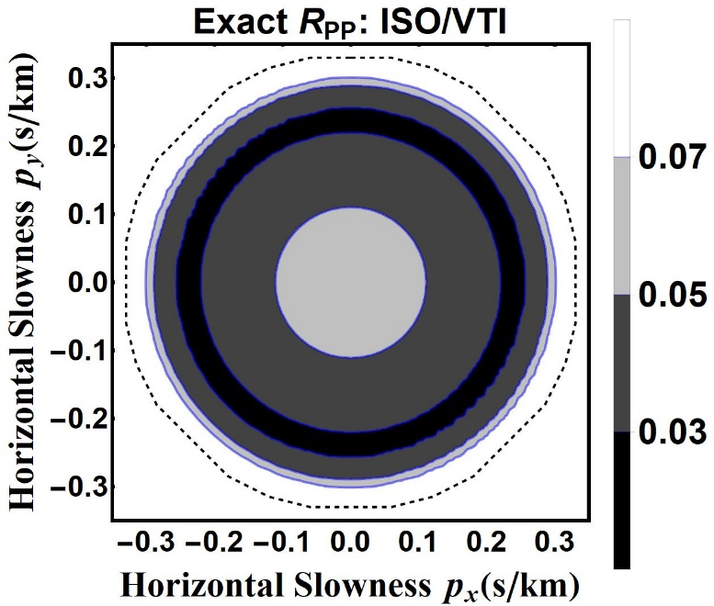
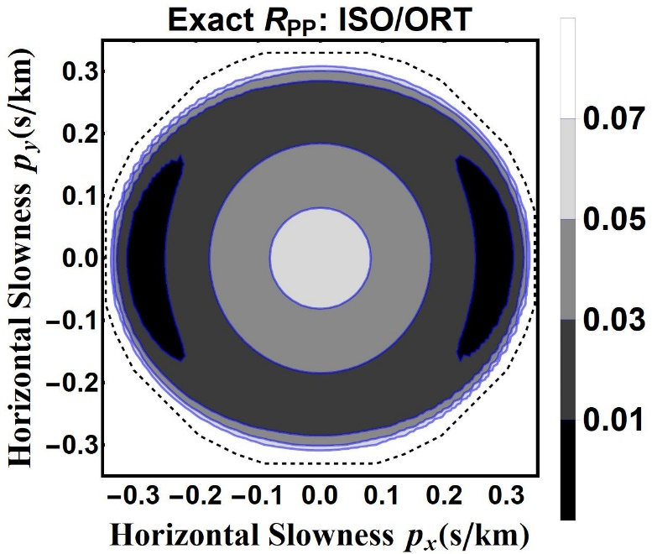
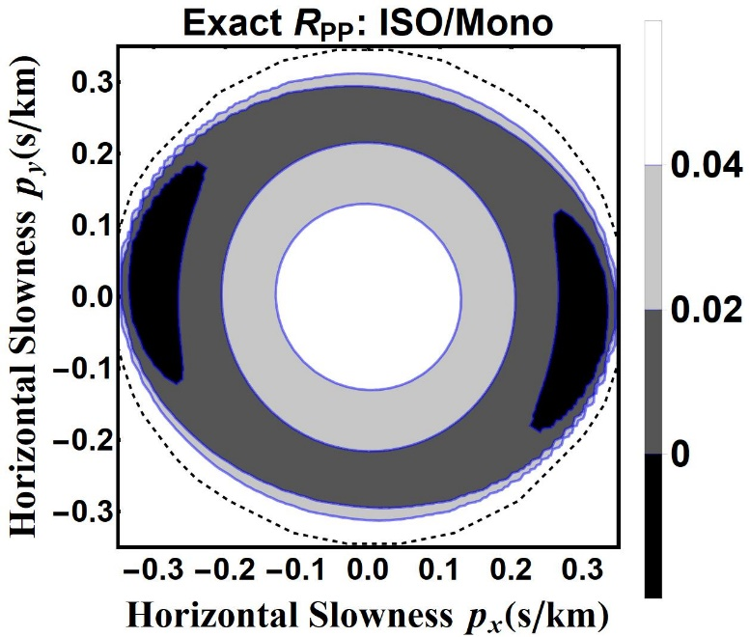
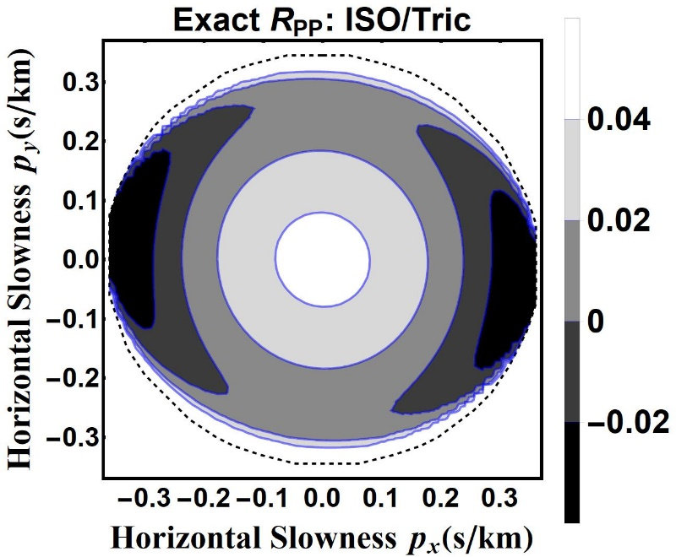
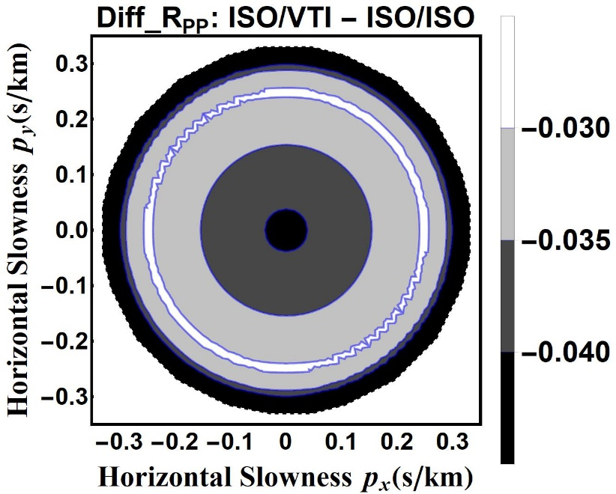
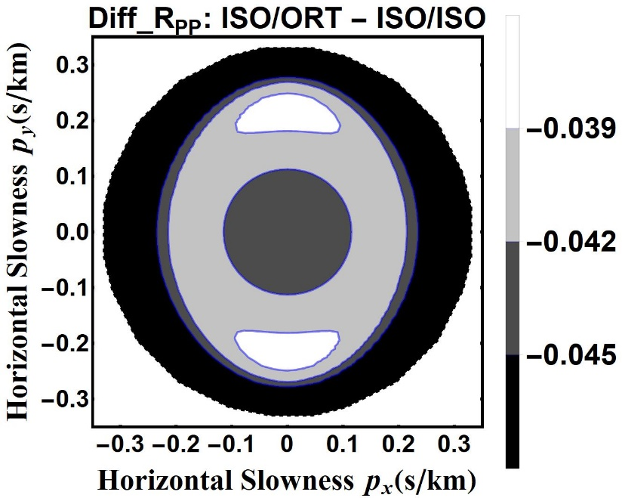
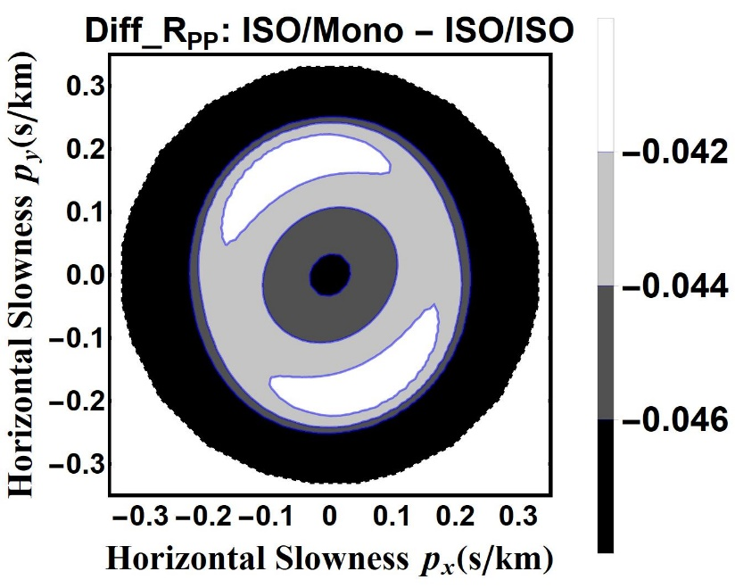
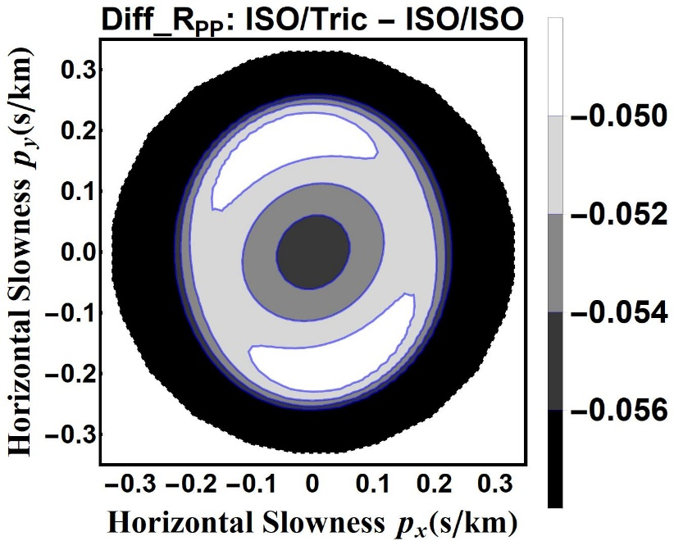
PP wave reflection coefficient
Jin&Stovas 2019a,b; 2020a,b,c

Slide 5
Conclusions
Azimuthal distribution of reflection amplitudes can be used as indicator of fracture orientation.
Amplitudes Versus Angles provide sufficient information for seismic inversion.
Next step is utilization of converted waves.

