Slide 1
The HT diffusion of hydrogen in riebeckite
Federico Galdenzi^{1,2}, Giancarlo Della Ventura^{1,2}, Umberto Susta¹, Francesco Radica¹, Augusto Marcelli^{2,3}
1 Dip. Scienze, Università di Roma Tre, L. S. Leonardo Murialdo 1, 00146, Rome
2 INFN-LNF, Via E. Fermi 40, Frascati 00044 (Rome)
3 Rome International Centre for Material Science Superstripes - RICMASS, Via dei Sabelli 119A, 00185 Rome, Italy

Slide 2
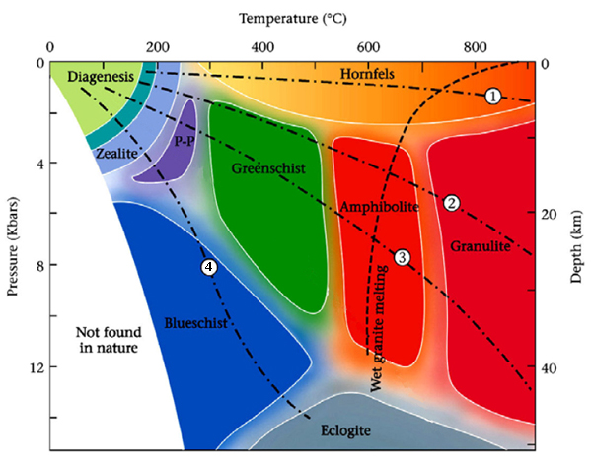
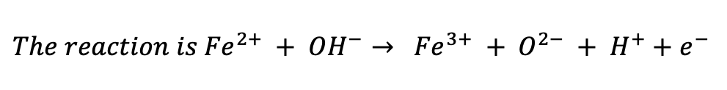
Amphiboles are the main carrier of water at depth, and their dehydrogenation processes are the main cause of enhanced electrical conductivity observed in descending slabs at convergent plate margins
We studied here the dehydration process in riebeckite Na₂Fe⁺²₃Fe³⁺₂Si₈O₂₂(OH)₂
$${The reaction is Fe}^{2+} + {OH}^{−}→ {Fe}^{3+} + O^{2−} + H^{+}+e^{−}$$
Temperature and pressure cause both chemical and structural adjustements
It results in diffusing water into the deep crust/mantle toghether with changes in electrical and physical properties of the rock

Slide 3
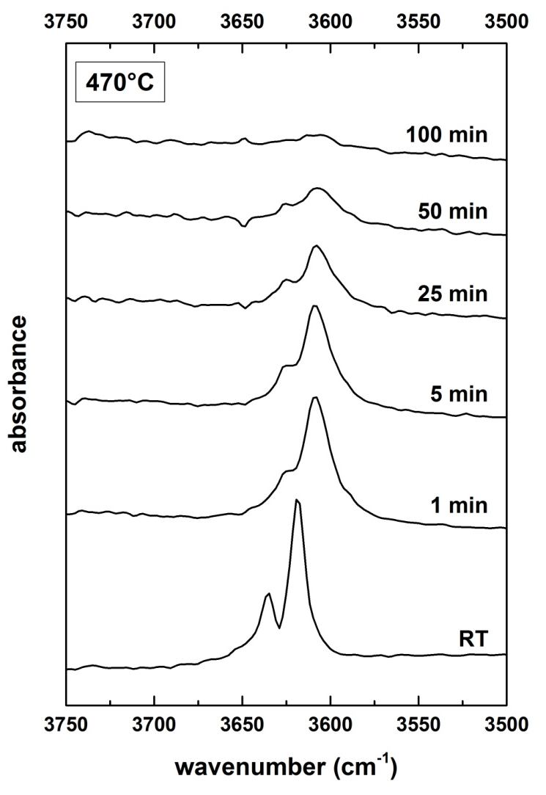
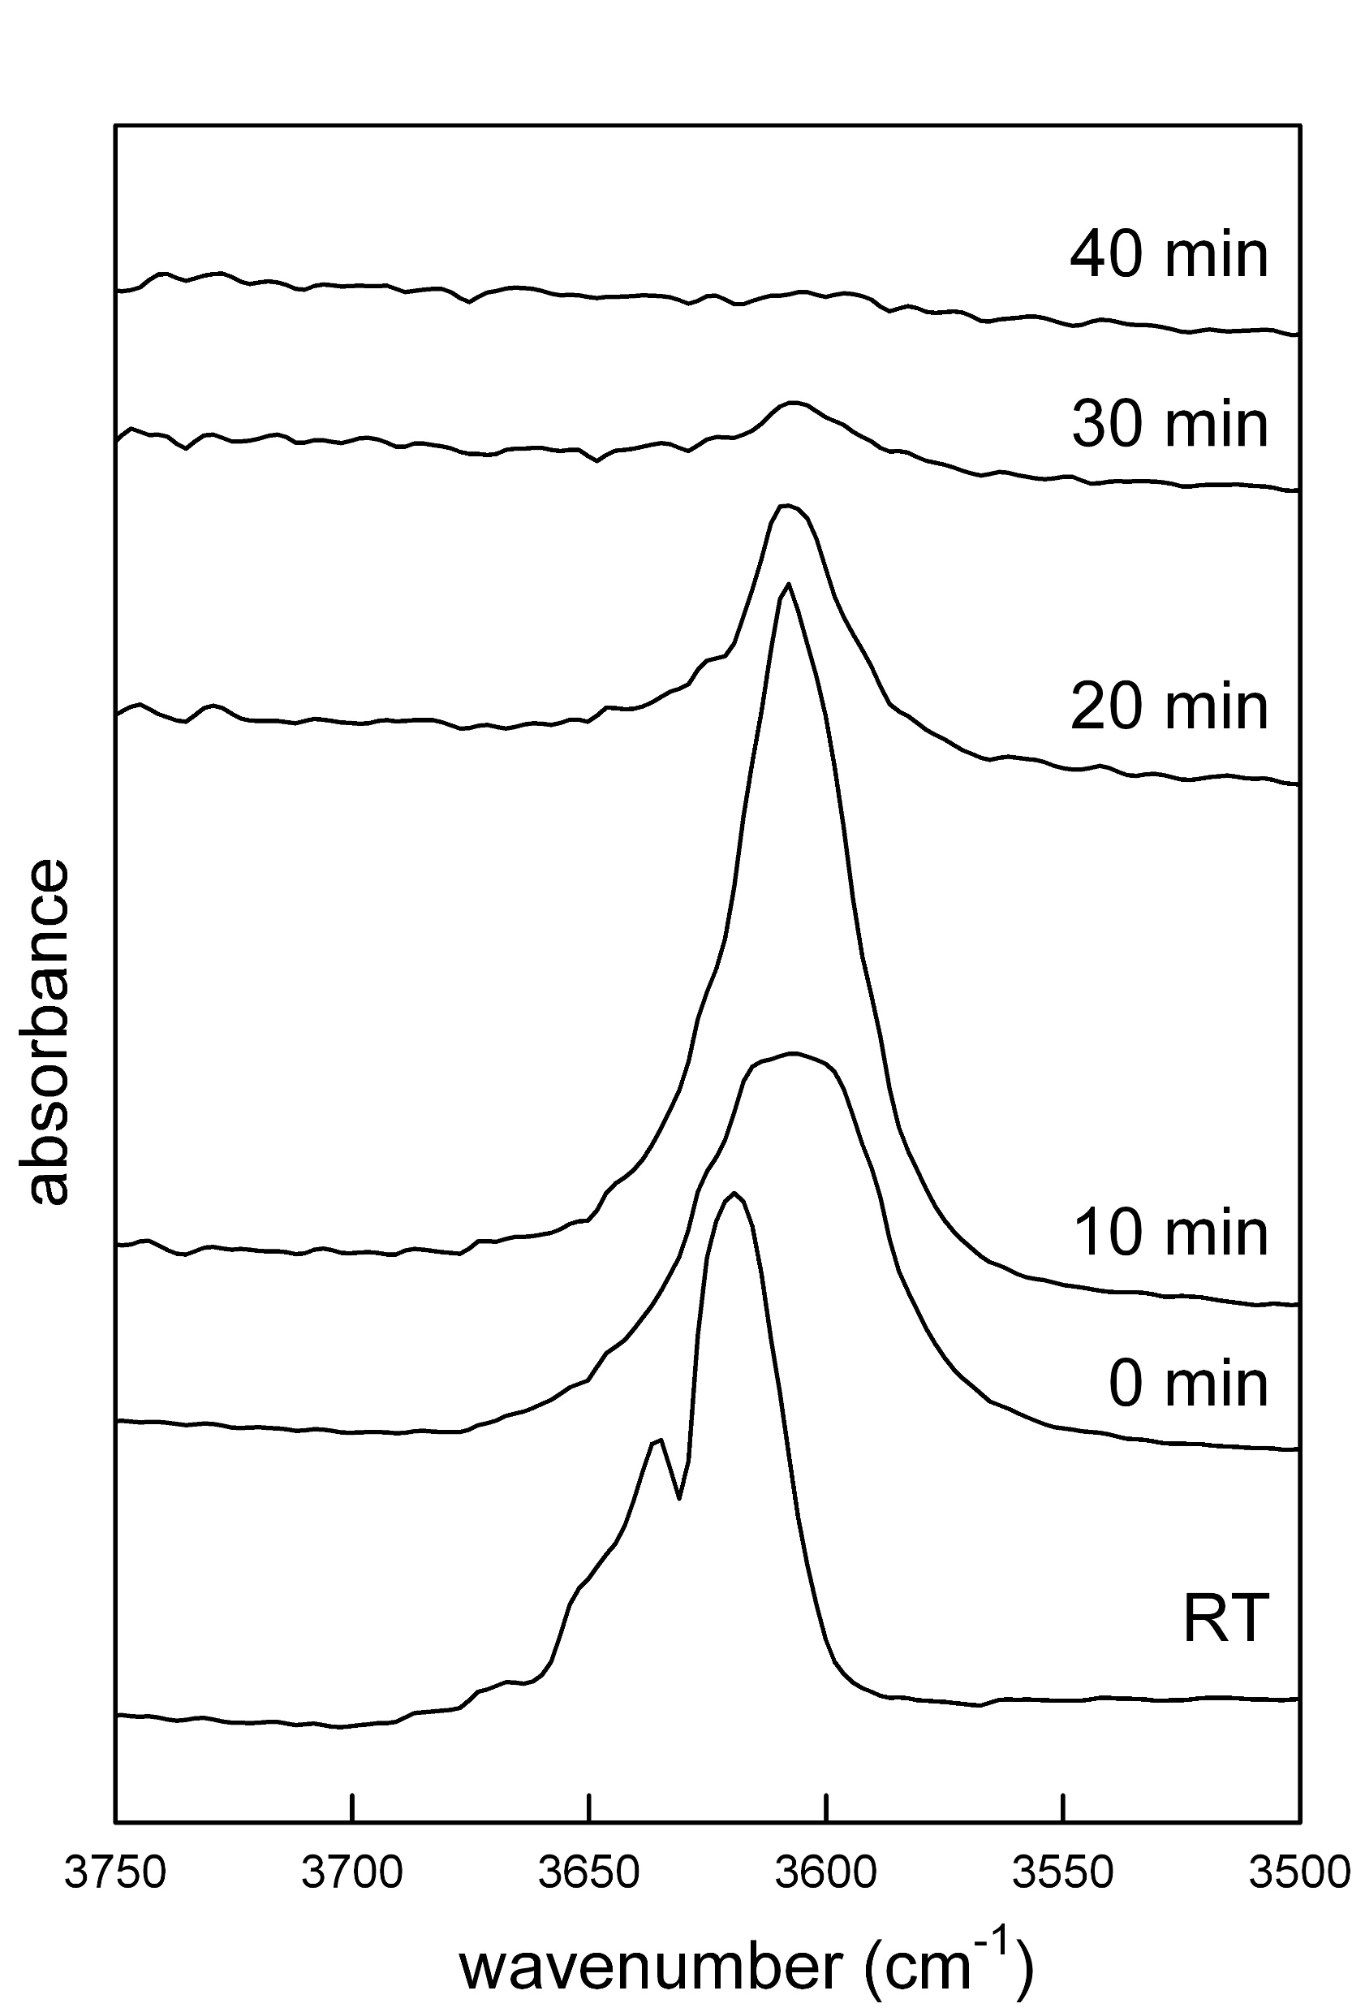
Single-crystals
Pure powders
A combination of techniques (Della Ventura et al. 2018) showed that for 25 < T < 450°C the Fe-oxidation is reversible; for T > 550°C oxy-riebeckite is definitively produced; it is stable up to 900°C
540 °C
470 °C
Here we monitored the IR OH stretching signal during isothermal annealing for both crystals and powders. For crystals we performed two sets of experiments at constant T and different thickness, and at constant thickness, several temperatures
Example of evolution of the OH absorption with time

Slide 4
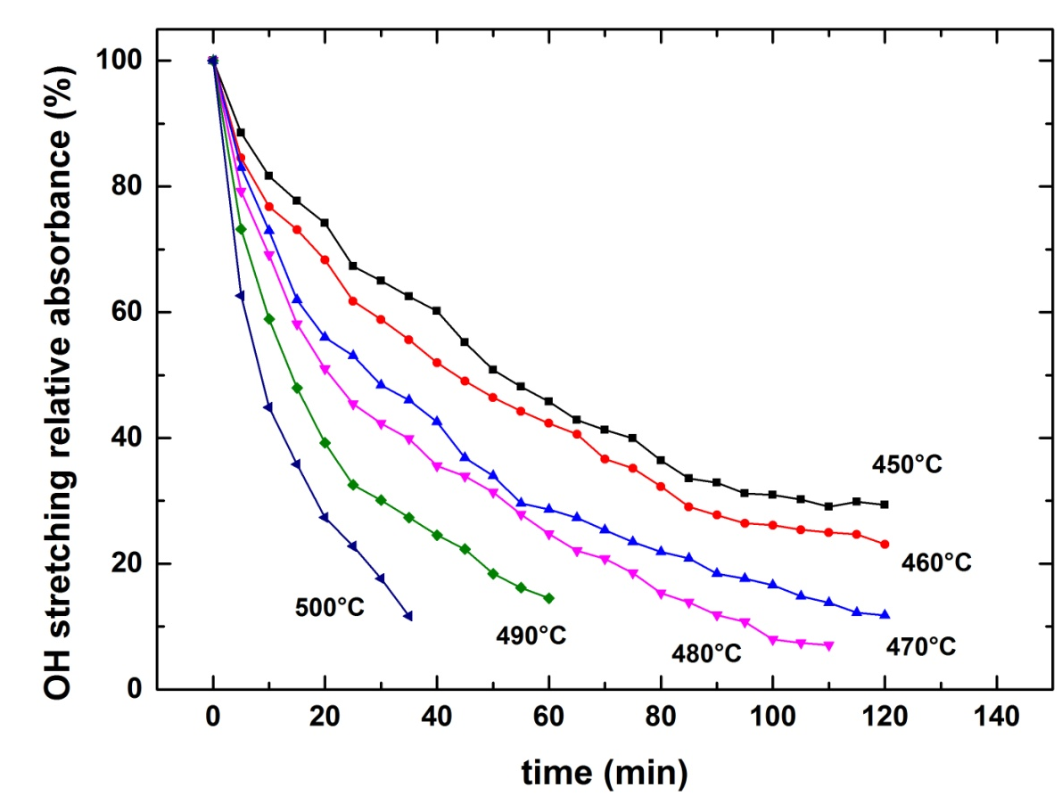
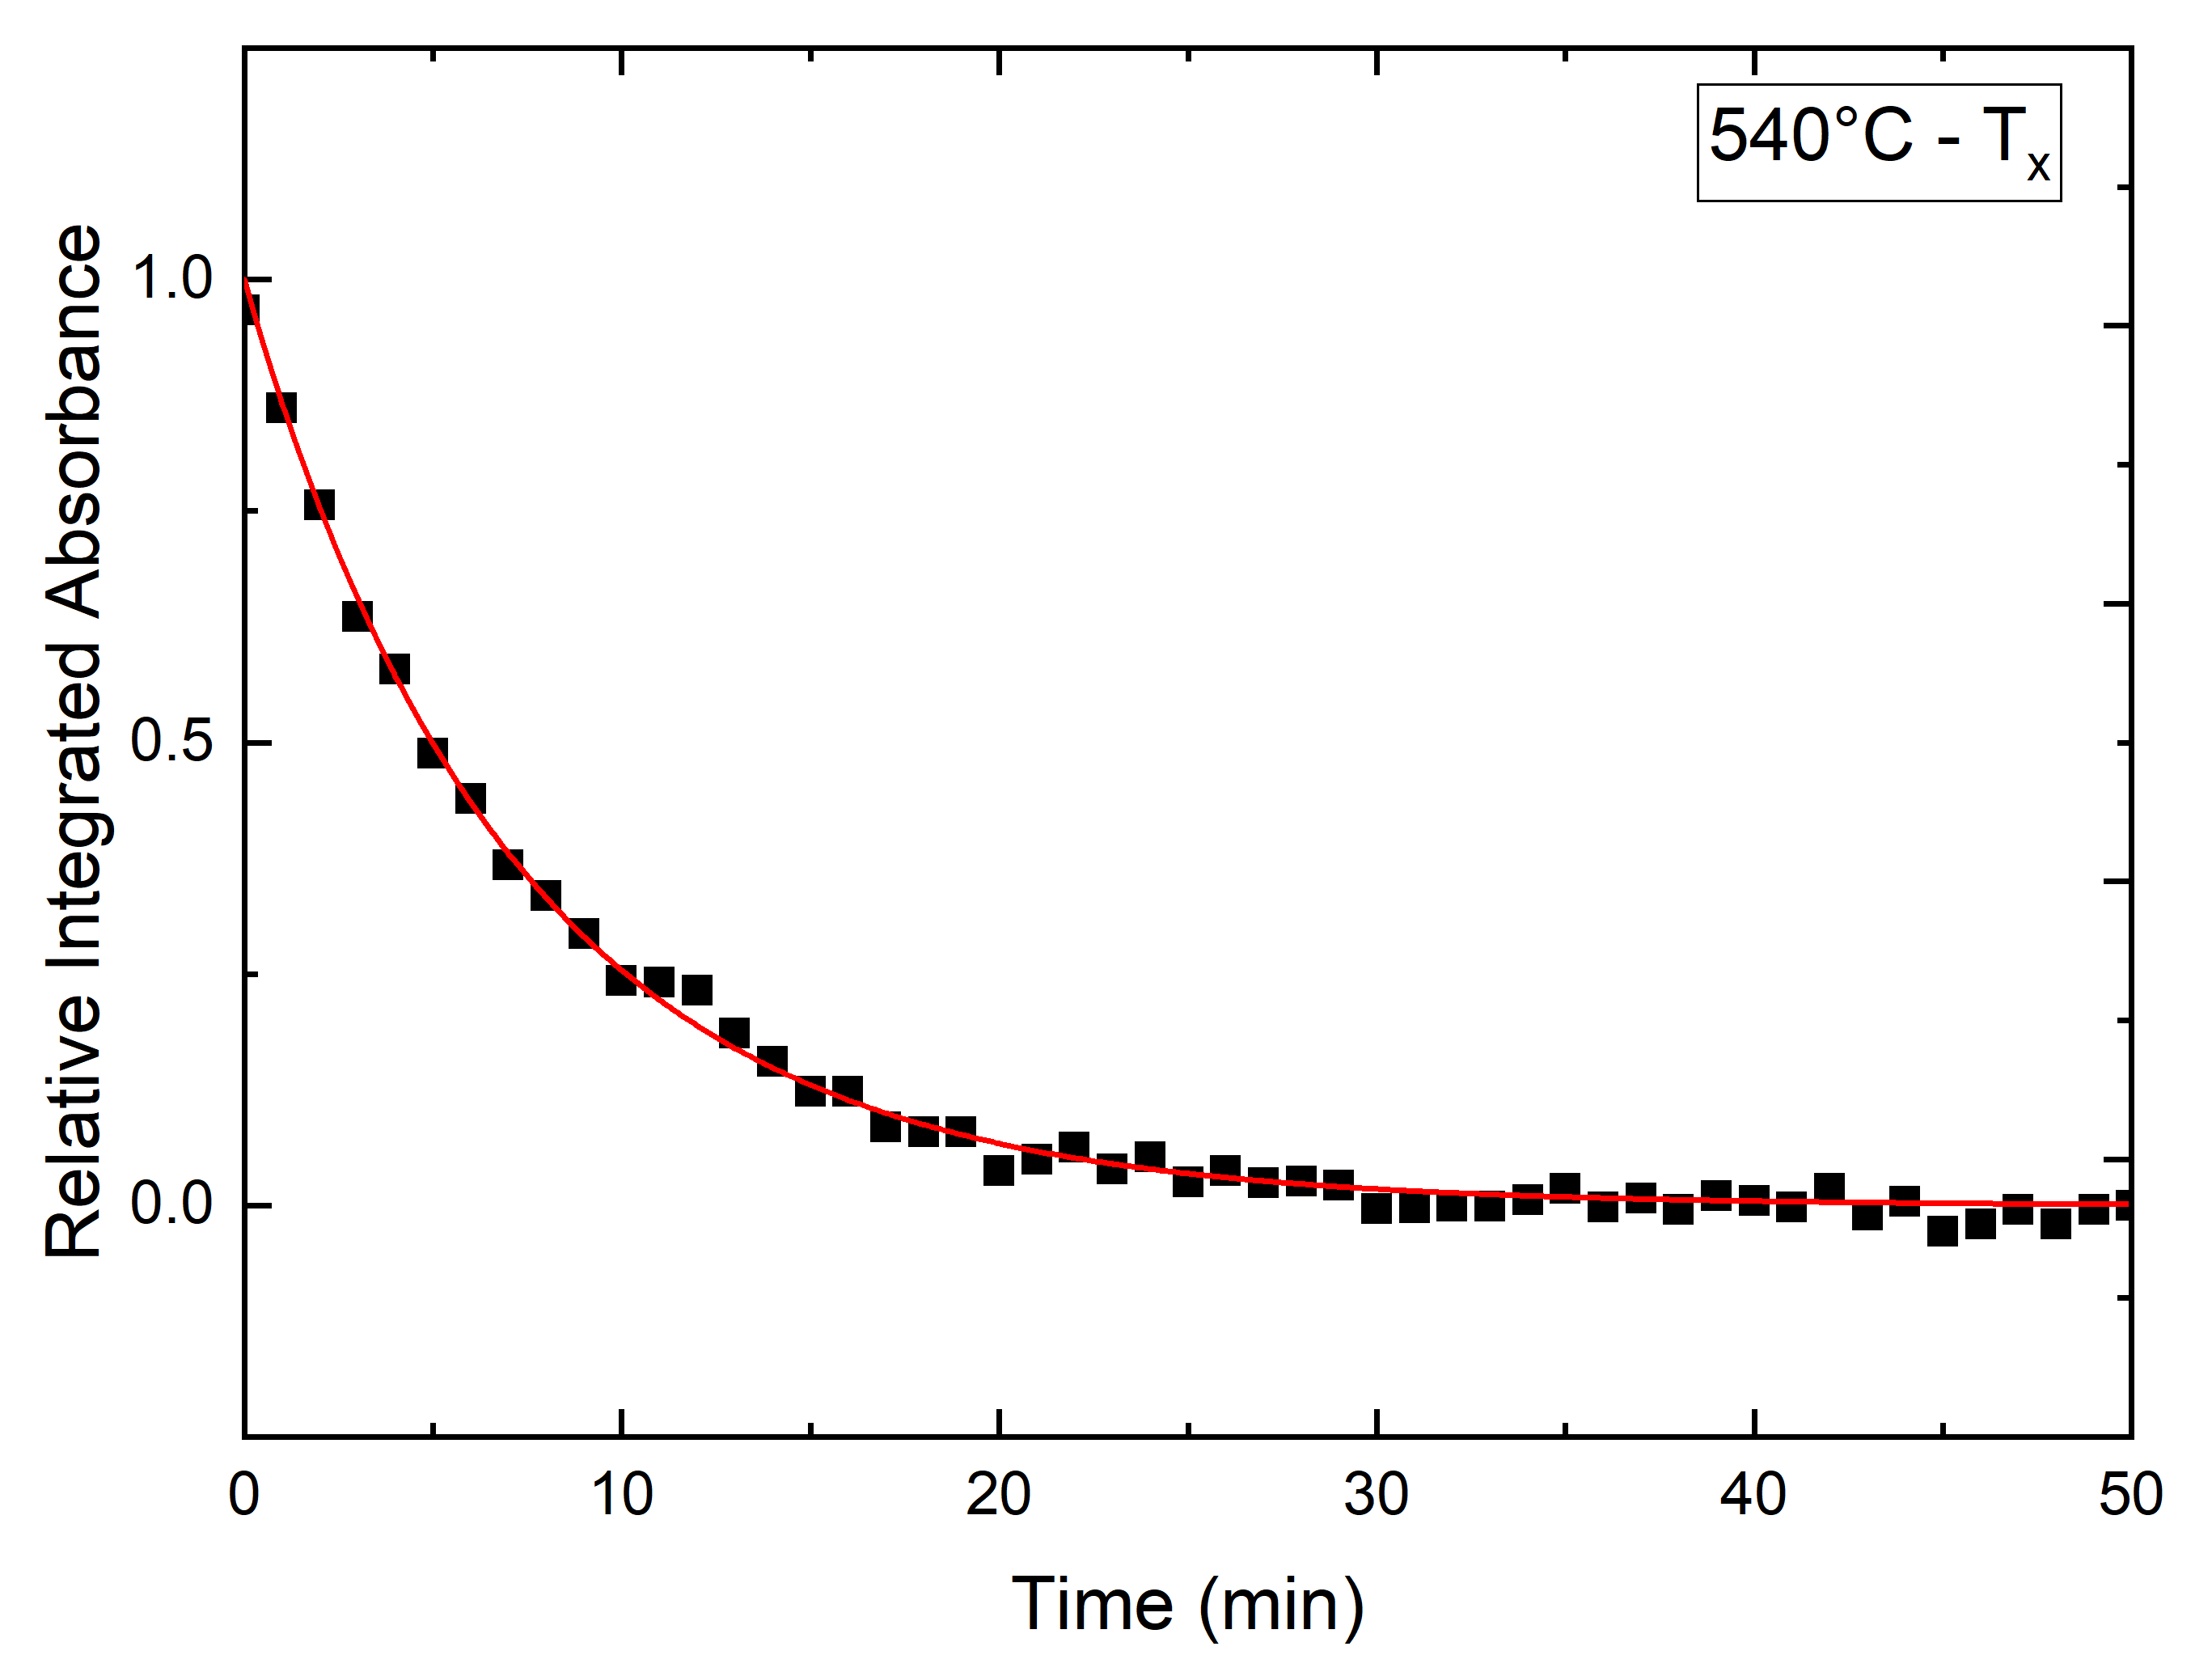

Normalized OH intensity (area) as a function of time at different temperatures
Pure powders
The data were fitted using the Avrami
First order equation
Single-crystals 85 µm thickness
$$A_{t}=A_{0}∗exp⁡(−{\left(Kt\right)}^{m})$$
Activation energies
Sample | State | Pressure (Mpa) | Temp range (°C) | Ea (KJ/mol) | Ref
Riebeckite | Powder | Atm | 450- 500 | 159 | na
Riebeckite | Crystal | Atm | 500-560 | 216 | na
Riebeckite | Crystal | Atm | 500-560 | 276 | na
Horneblende | Powder | 200-800 | 350-550 | 79-84 | Graham et al 1984(Isotope Exchange)
Tremolite | Powder | 200-400 | 350-800 | 71,5 | Graham et al 1984 (Isotope Exchange)
Actinolite | Powder | 200 | 400-670 | 99 | Graham et al 1984 (Isotope Exchange)
Kaersutite | Powder | 0,1 | 600-900 | 104 | Ingrind and Blanchard 2000 (Isotope Exchange)
And then Plotted into Arrhenius Space to evaluate Activation Energy

Slide 5
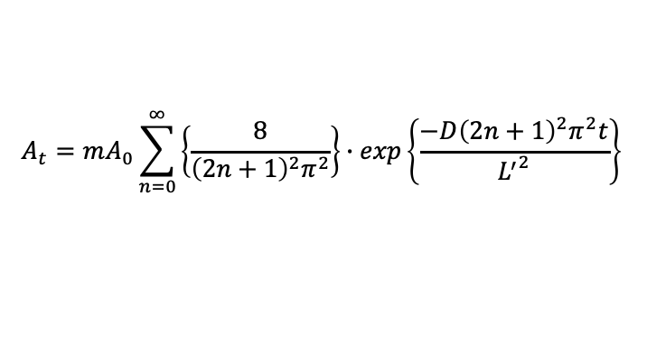
The diffusion of hydrogen in riebeckite was addressed by a second set of experiments: same T different crystal thickess
The data were treated by using the mono-dimensional diffusion model from a plane sheet with a finite thickness (Tokiwai and Nakashima 2010)
$$A_{t}=mA_{0}\sum_{n=0}^{∞}{\left\{\frac{8}{{\left(2n+1\right)}^{2}π^{2}}\right\}}∙exp\left\{\frac{−D{\left(2n+1\right)}^{2}π^{2}t}{{L^{′}}^{2}}\right\}$$
Diffusion coeff
Sample | State | Pressure (Mpa) | Temp range (°C) | -logD (D=[m²/s]) | Ref
Riebeckite | Crystal | Atm | 500-560 | 22,05/25 | na
Horneblende | Powder | 200-800 | 350-550 | 10,82/26,81 | Graham et al 1984
Tremolite | Powder | 200-400 | 350-800 | 24,64/27,85 | Graham et al 1984
Actinolite | Powder | 200 | 400-670 | 21,19 | Graham et al 1984
Kaersutite | Powder | 0,1 | 600-900 | 20,03 | Ingrind and Blanchard 2000
The D coefficients were found to be related to crystal thickness

