Slide 1
Mullard Space Science Laboratory
Department of Space and Climate Physics
How Coherent are Flux Variations in the Outer Radiation Belt?
S. D. Walton¹, C. Forsyth¹, I. J. Rae¹, C. E. J. Watt², R. L. Thompson², M. T. Walach³, R. B. Horne⁴, C. J. Rodger⁵, M. A. Clilverd⁴
¹Mullard Space Science Laboratory, University College London, Dorking, UK
²Department of Meteorology, University of Reading, Reading, UK
³Physics Department, Lancaster University, Bailrigg, UK
⁴British Antarctic Survey, Cambridge, UK
⁵Department of Physics, University of Otago, Dunedin, New Zealand
samuel.walton.18@ucl.ac.uk

Slide 2
SAMPEX PET
[Baker et al, 1993]
We use 1.5 – 6.0 MeV flux data from SAMPEX PET instrument from 1992 – 2004
~600km, 82º incl., 58º FOV
Varying orientation of FOV relative to B, resulting in differing PAD coverage. We identify times when trapped flux is most likely being observed

Slide 3
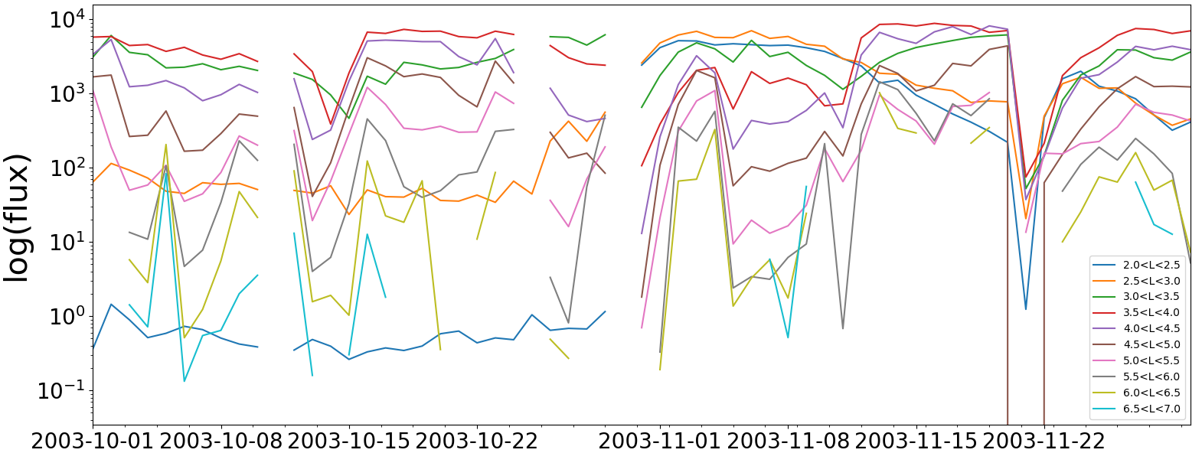
Correlation Matrix Analysis
(b)
(a)
(c)
Time series of trapped flux (12h resolution) binned by L*.
Each bin correlated with every other bin to produce L* vs L* correlation matrix.
Shifted relative to L_{x}=L_{y} line resulting in L* on x-axis vs ΔL outwards on y-axis.

Slide 4
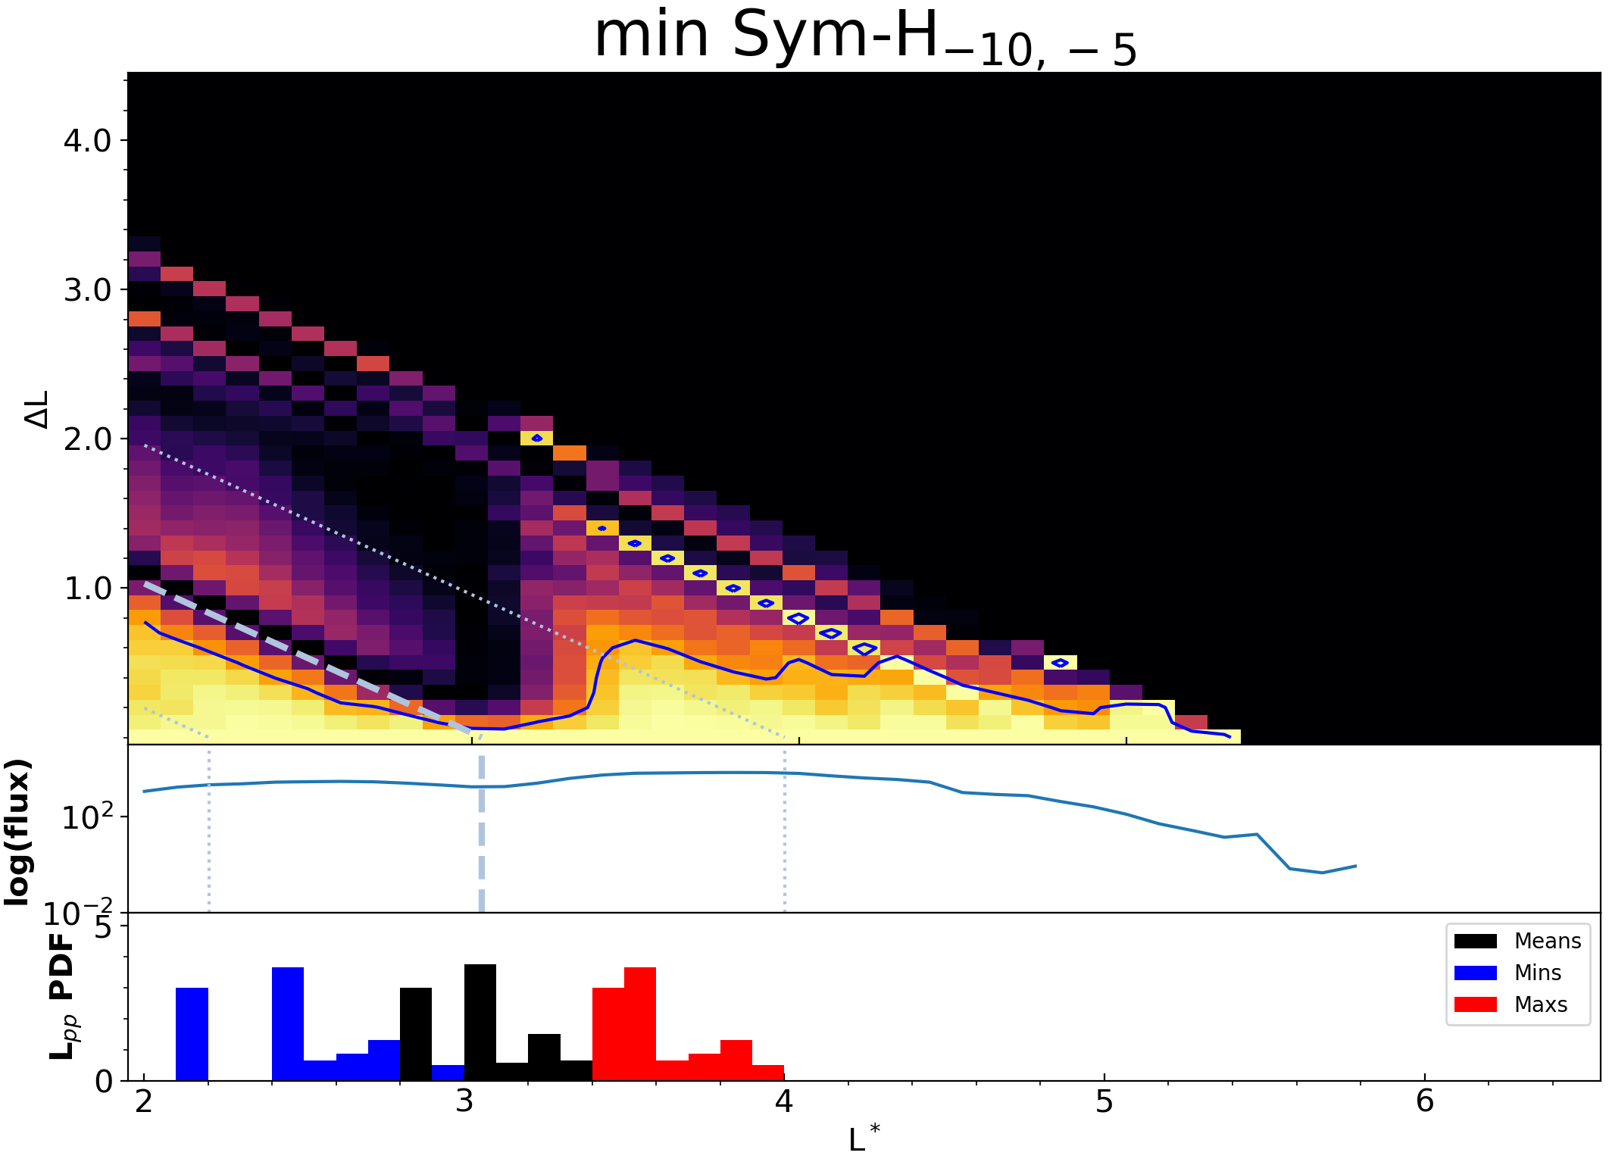
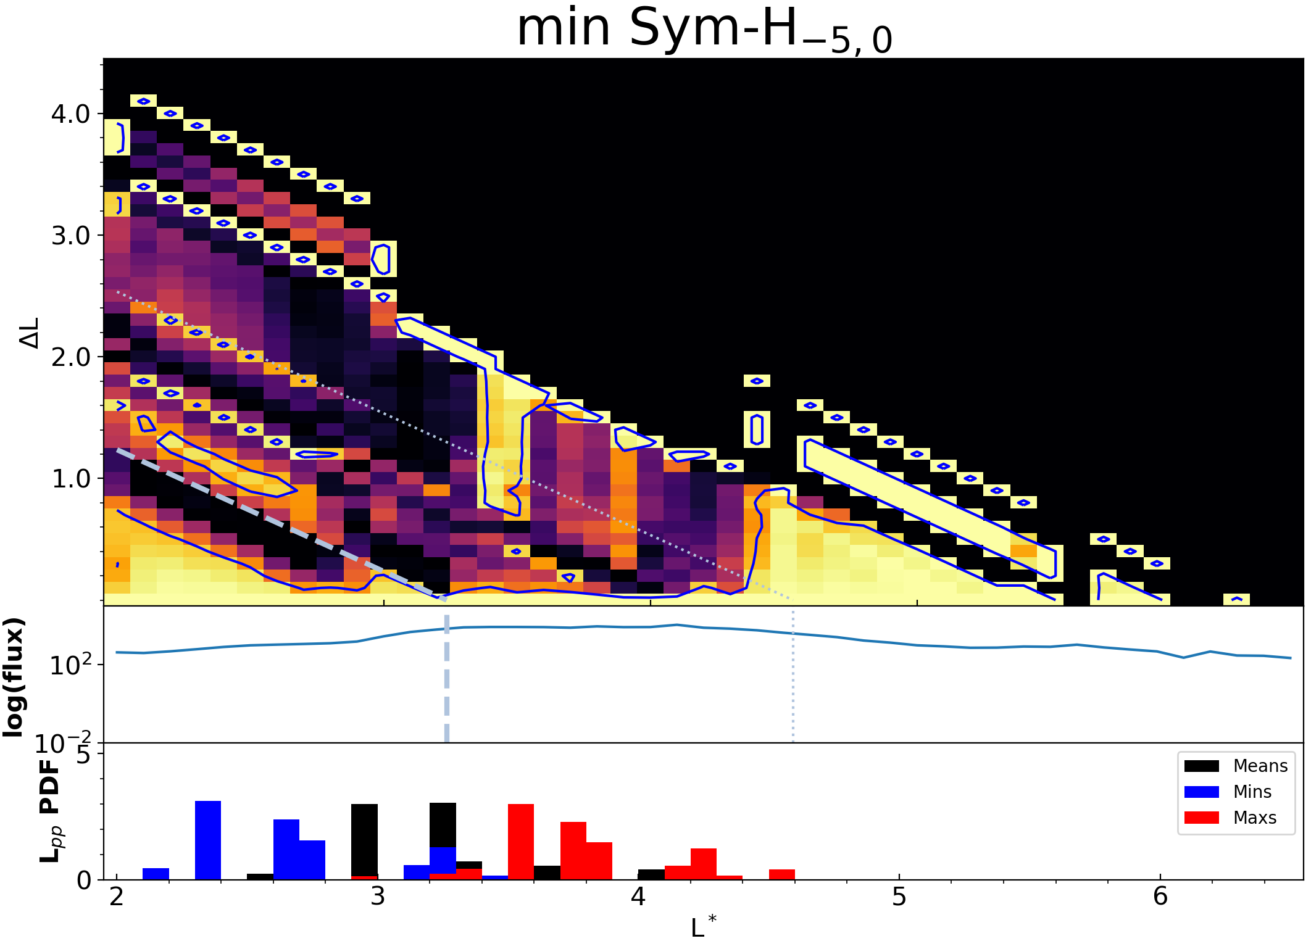
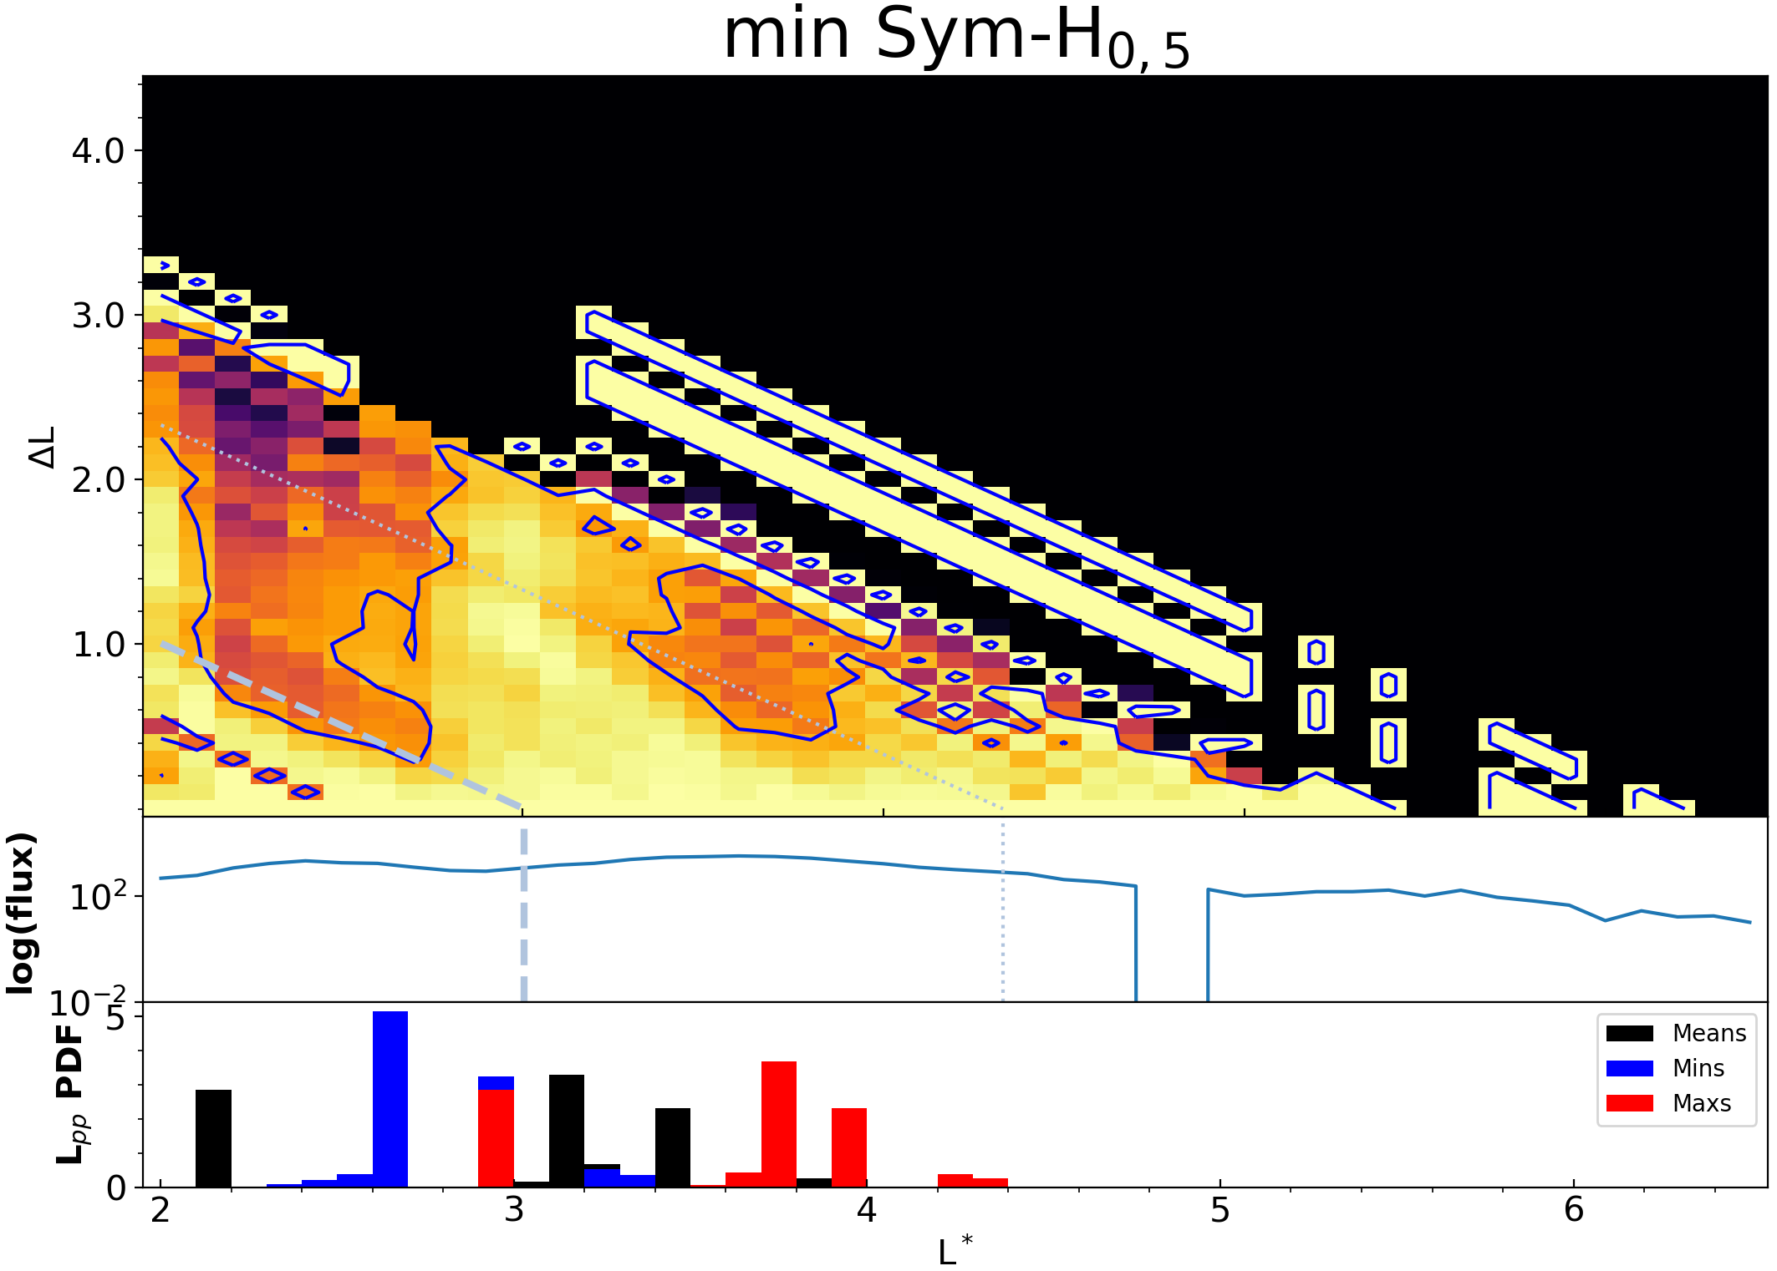
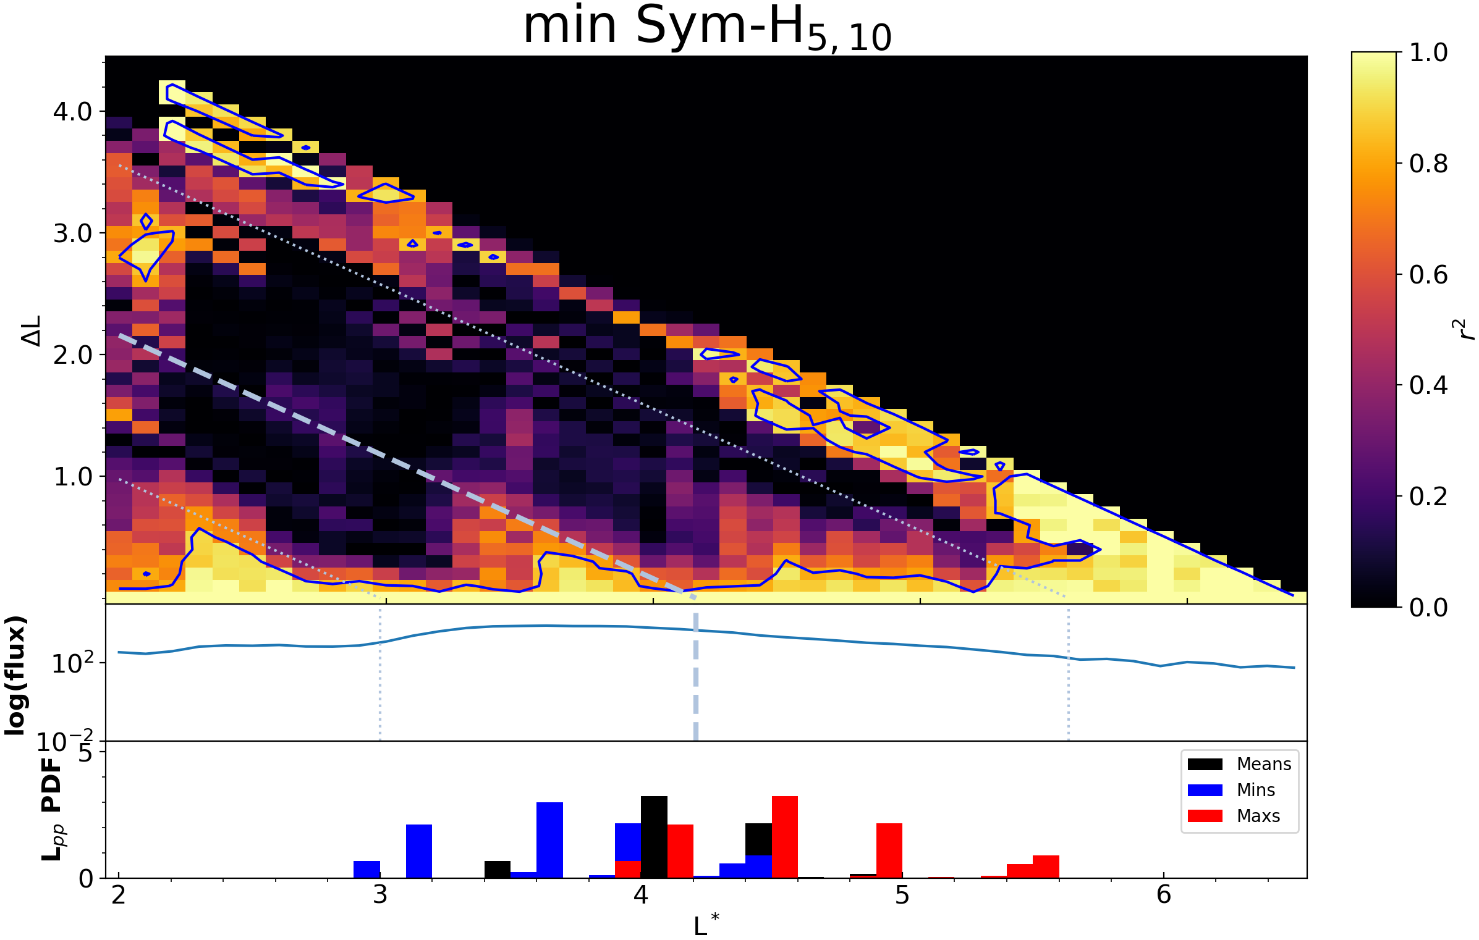
November 2003 Storm
(Pre-Storm Phase) (Initial and Main Phase) (Recovery Phase) (Post-Storm Phase)
(a)
(b)
(c)
(d)
(Pre-storm phase) 10 to 5 days prior to min Sym-H. Strongly, but independently coherent either side of the mean plasmapause location (OBM2003 model). Regions weakly correlating with each other.
(Initial and main phase) Strong correlation inside mean plasmapause and outside maximum plasmapause. Weakly correlated across the spread of the plasmapause locations for that period.
(Recovery phase) Moderately coherent behaviour across all L*’s. Strong coherence inside and outside mean plasmapause.
(Post-Storm phase) Strong correlation just inside minimum and mean plasmapause. Strong correlation outside maximum plasmapause.

Slide 5
Statistical Analysis Method
(a)
(b)
(c)
(d)
ΔL from mean plasmapause location
Correlation matrices produced for 4 phases of 10 ‘large’ storms in the SAMPEX period identified by Walach and Grocott (2019)
Pre-storm, Initial and main, recovery, post-storm phases are grouped together and aligned by their respective mean plasmapause location.
Mean correlation matrix calculated for each phase.

Slide 6
Statistical Analysis Results
(a)
(b)
(c)
(d)
(a)
(b)
(c)
(d)
ΔL from mean plasmapause location
Strongly correlating region inside and outside the plasmapause. Individual regions weakly correlating with other regions.
Moderate-strongly correlating throughout, with no obvious link to mean plasmapause.
Large, strongly correlating region across all L*’s outside mean plasmapause. Relatively weak correlation inside.
Less widespread, but strongly correlating region outside plasmapause.

Slide 7
Discussion
Plasmapause appears to separate regions where fluxes vary in a similar manner.
Fluxes inside the plasmapause are often very strongly coherent (when there is flux present), yet weakly coherent with flux outside.
Flux outside of the plasmapause is often very strongly coherent with nearby flux.
During the recovery phase, fluxes across all L*’s are more highly correlated due to an underlying increase in flux t all L*’s.

