Slide 1
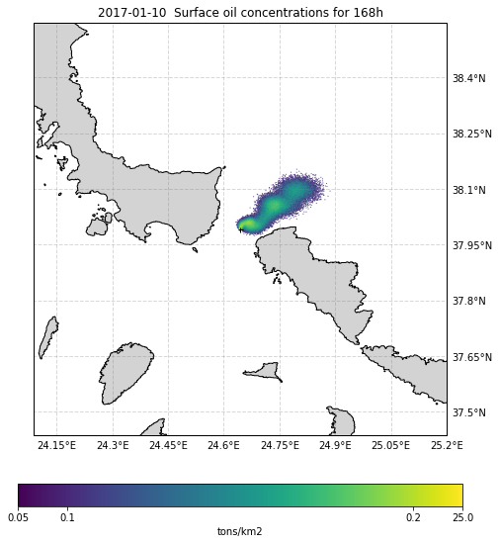
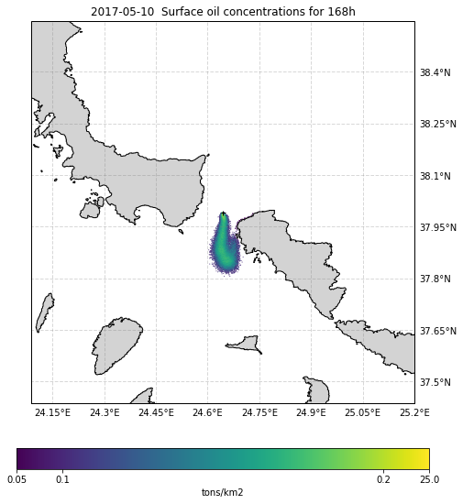
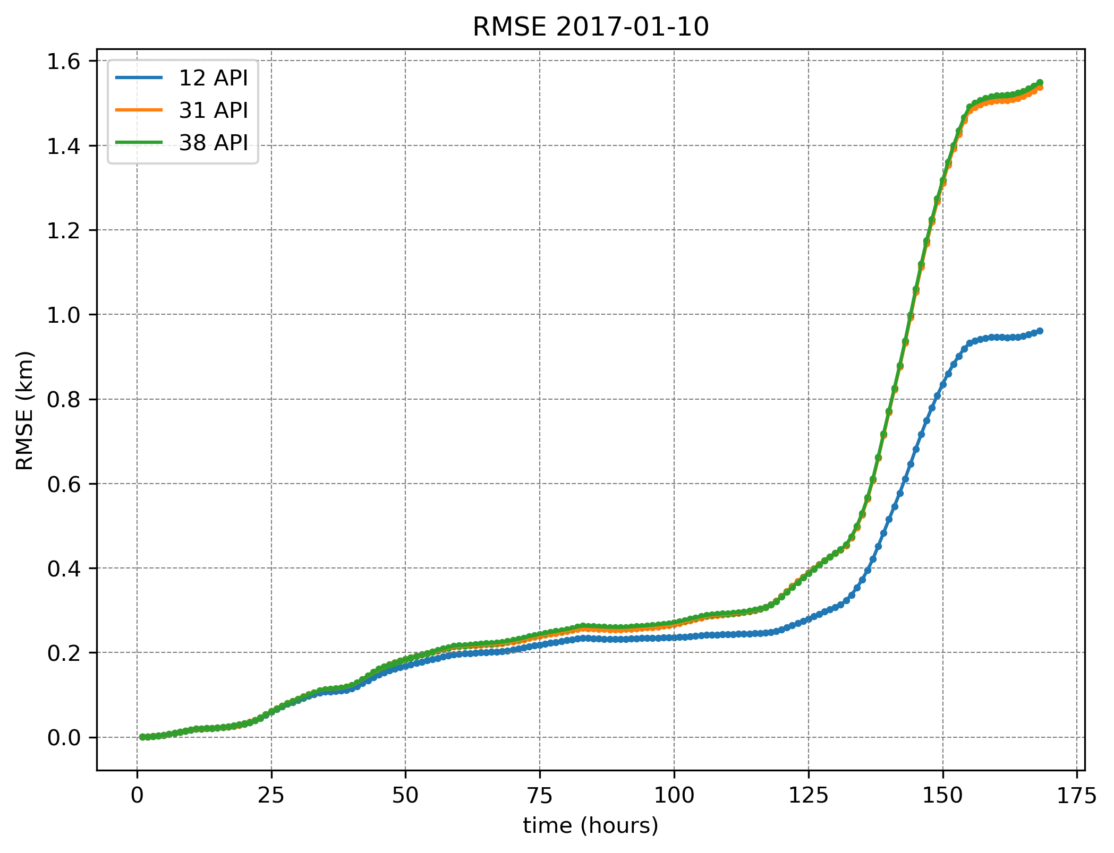
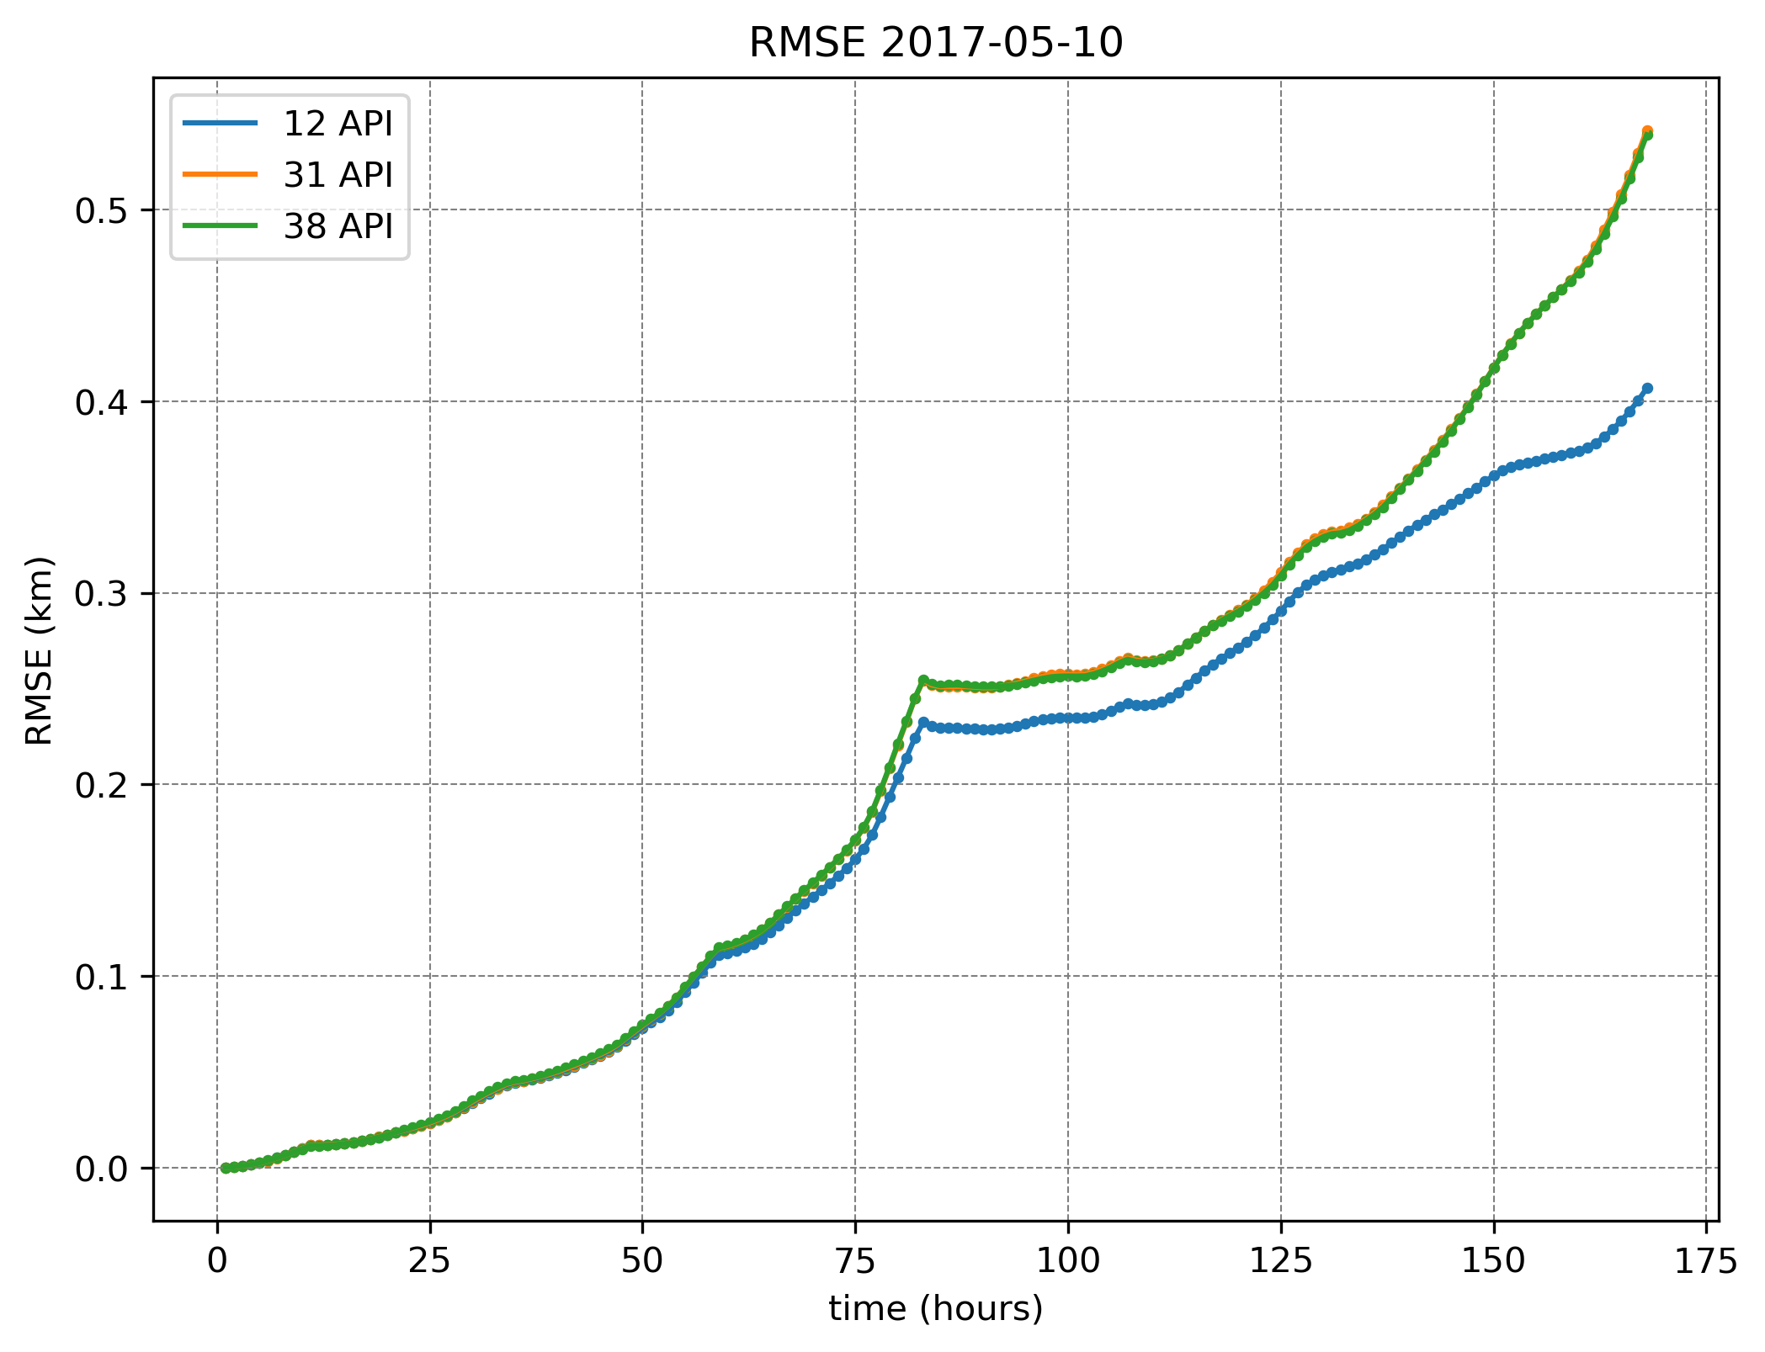
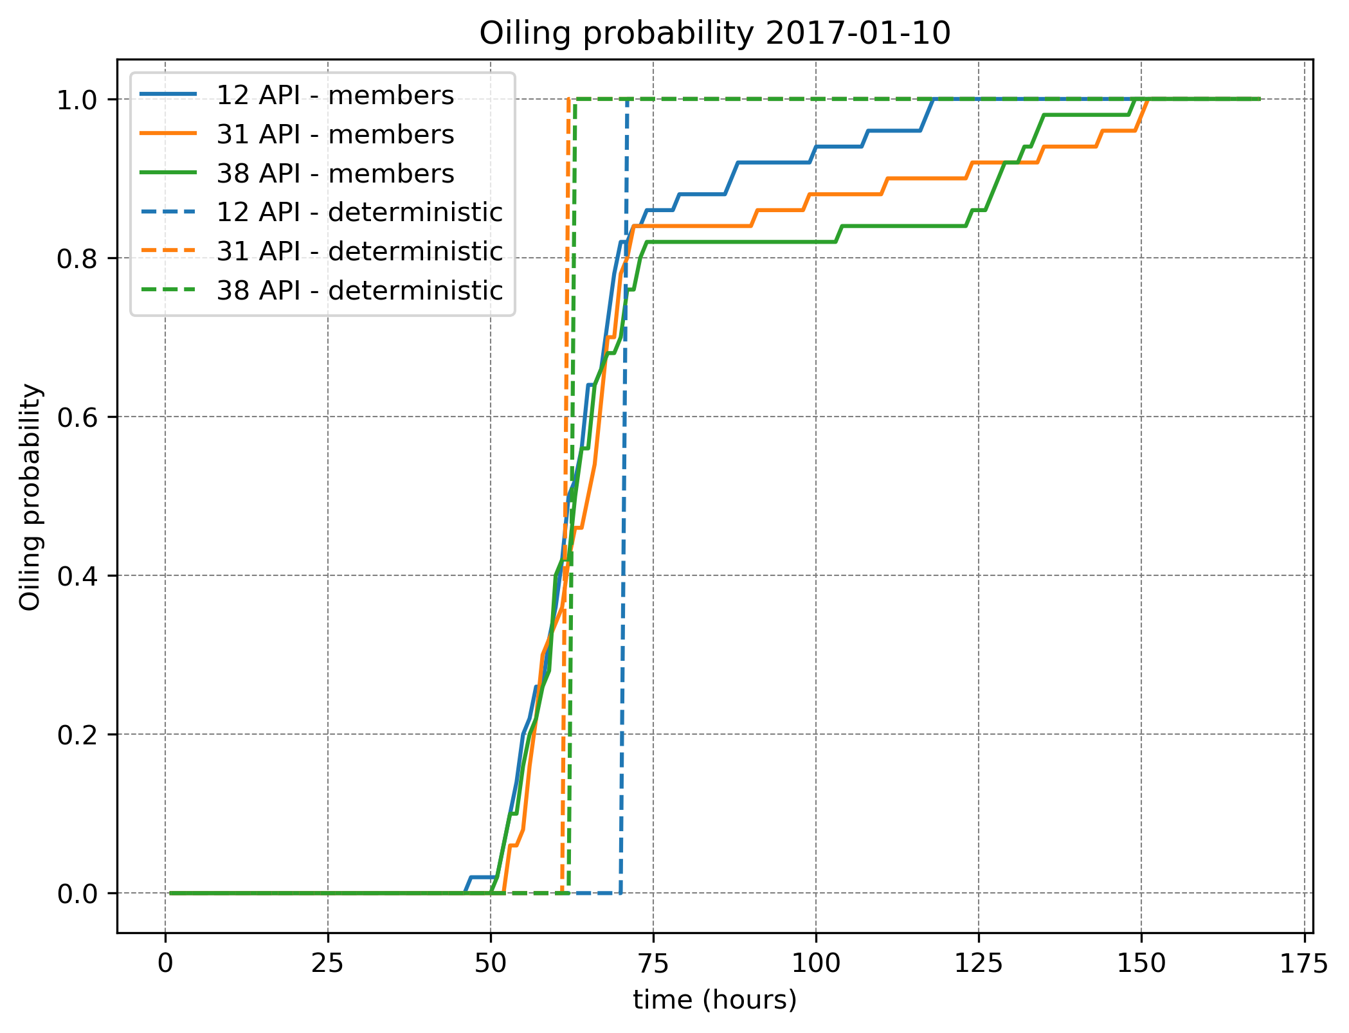
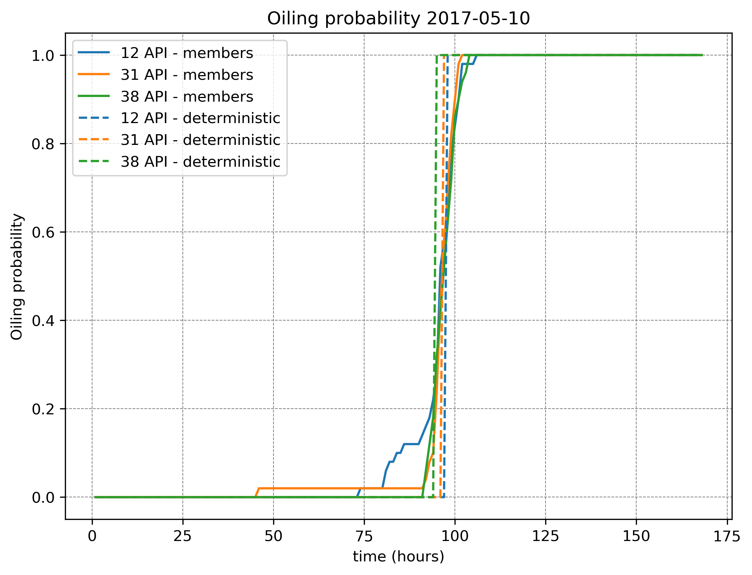
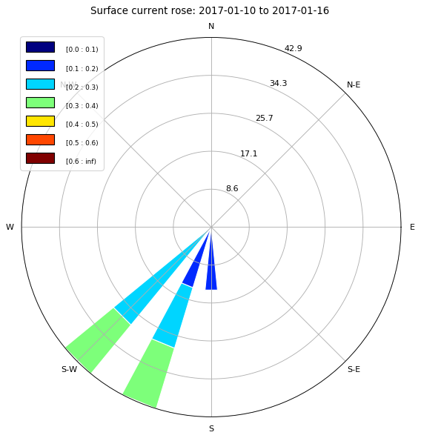
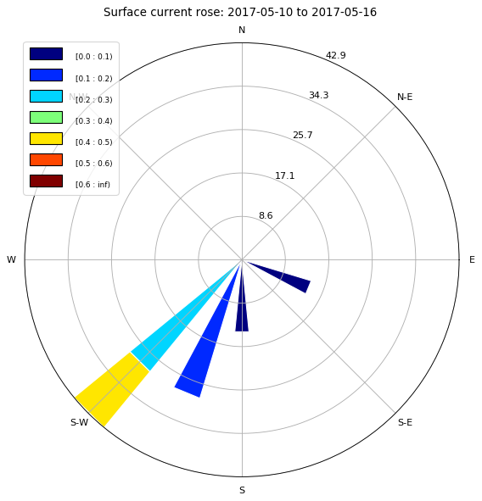
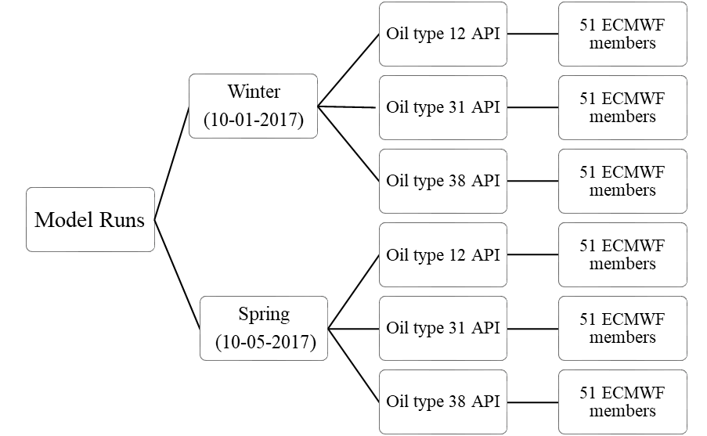
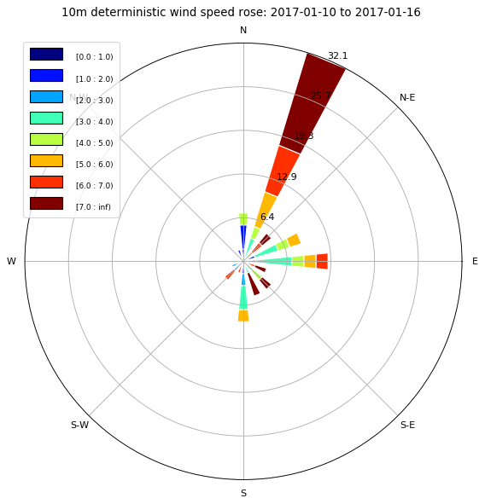
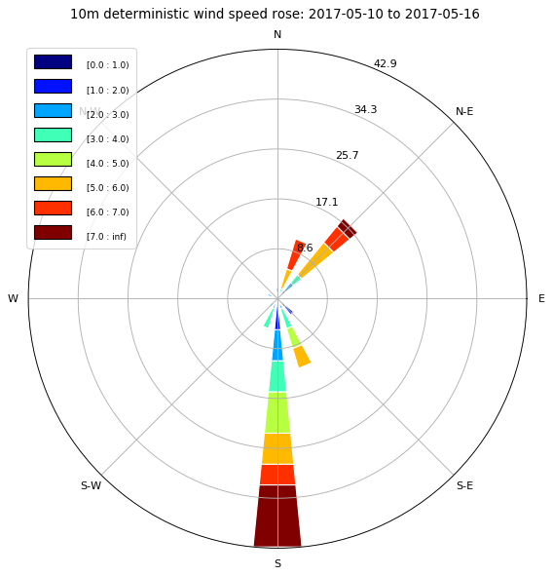
Oil spill forecasting systems uncertainty assessment in the Aegean Sea
Konstantinos Kampouris¹ , Vassilios Vervatis¹, John Karagiorgos¹, Sarantis Sofianos¹
¹University of Athens, Ocean Physics and Modelling Group, Athens, Greece
EGU2020-20228
Introduction
Analysis of the forecast ensembles was performed using metrics like:
RMSE (root mean square error) (M. De Dominicis et al., 2013)
$$RMSE\left(t_{i}\right)=\sqrt{\frac{\sum_{s=1}^{S}{{d_{i}\left(x_{s}\left(t_{i}\right),x_{0}\left(t_{i}\right)\right)}^{2}}}{S}}$$
where di is the distance at the selected time ti, between the simulated stochastic member position, xs, and the deterministic member position, xo, and S is the total number of ensemble simulations.
Oiling probability (P. Amir-Heidari, et al., 2019), (Goldman et al., 2015)
$$P=\frac{\sum_{i=1}^{N}{B_{i}}}{N}$$
where Bi equals 1 if the simulation i leads to a maximum concentration of greater than zero, or 0 if the simulation i leads to a maximum concentration of zero, and N is the total number of simulations.
Although unintentional oil pollution caused by ships is declining over the years, increased oil shipments may pose an increased risk. In the event of an oil spill, modeling predictions serve as the initial/forefront tools to assist regional and national contingency plans (G. Zodiatis et al., 2017).
The Aegean in particular, as one of the busiest waterways in the world, has a relatively high probability of developing significant oil spills. Combined with complex and intense weather and sea current patterns with strong seasonality, complicated coastline and bathymetry, the uncertainty assessment of the oil spill forecasting systems in this region is of great interest.
Fig. 3. MEDSLIK II deterministic oil trajectory for oil API 31.
Objective
The purpose of this study is to evaluate the impact of the uncertainty of the atmospheric forcing on the performance of the oil spill modelling and the dispersion of the pollutants in the marine environment
Methods and Model Set-up
Ensemble simulations were carried out using the ECMWF Ensemble Prediction System and the oil spill model MEDSLIK II.
50 member ensembles were performed with seven days forecast lead time, during different seasons. The oil spill duration and the spill rate were chosen taking into account significant accidents of the past like for instance the Prestige case. The number of parcels used in the simulations was 100.000 . Stokes drift was taken into account in the calculation of oil transport and the depth of the mixing layer was set according to the oceanographic data used.
Experiments performed included:
Fig. 4. RMSE between the deterministic and stochastic member trajectories as a function of the prediction time.
Results
50 ensembles of hourly (1h) wind speed values at 10 m as well as the deterministic values for the time period of January 2017 and May 2017.
The corresponding oceanographic data for the above two periods and for depths of 0 m, 10 m, 30 m, 120 m.
3 types of oil: API 12, API 31 and API 38 representing heavier, medium and lighter oil spills, covering also a wide range of oil densities (Sepp Neves, Pinardi, & Martins, 2016).
Fig. 1. Surface current speed and direction for the two time periods
Fig. 5. Oil spill beaching probability
Conclusions
Oil spill transportation in the study area is primarily influenced by the wind forcing. The sensitivity analysis performed indicates the importance of the wind on the performance of the oil spill modelling especially in nearshore areas.
RMSE increases over time and displays different behavior for different oil types. This increase is especially apparent in the winter.
Oil spill beaching probability shows an uncertainty in the hit time for beached oil, in contrast to the binary event for the deterministic run. Oil spill response plans should take into account this uncertainty.
Schematic. 1. Model set-up
Fig. 2. 10m deterministic wind speed and direction for the two time periods
Contact
References
Konstantinos Kampouris
University of Athens, Ocean Physics and Modelling Group, Athens, Greece
Email: kkampour@geol.uoa.gr
Phone: 6938809276
Zodiatis G. et al. (2017) Numerical Modeling of Oil Pollution in the Eastern Mediterranean Sea. In: Carpenter A., Kostianoy A. (eds) Oil Pollution in the Mediterranean Sea: Part I. The Handbook of Environmental Chemistry, vol 83. Springer, Cham
Sepp Neves, A.A., Pinardi, N. & Martins, F. IT-OSRA: applying ensemble simulations to estimate the oil spill risk associated to operational and accidental oil spills. Ocean Dynamics 66, 939–954 (2016). https://doi.org/10.1007/s10236-016-0960-0
De Dominicis, M., Pinardi, N., Zodiatis, G., and Archetti, R.: MEDSLIK-II, a Lagrangian marine surface oil spill model for short-term forecasting – Part 2: Numerical simulations and validations, Geosci. Model Dev., 6, 1871–1888, https://doi.org/10.5194/gmd-6-1871-2013, 2013.
Amir-Heidari, P., Arneborg, L., Lindgren, J. F., Lindhe, A., Rosén, L., Raie, M., … Hassellöv, I. M. (2019). A state-of-the-art model for spatial and stochastic oil spill risk assessment: A case study of oil spill from a shipwreck. Environment International, 126(February), 309–320, https://doi.org/10.1016/j.envint.2019.02.037
Goldman, R., Biton, E., Brokovich, E., Kark, S., & Levin, N. (2015). Oil spill contamination probability in the southeastern Levantine basin. Marine Pollution Bulletin, 91(1), 347–356. https://doi.org/10.1016/j.marpolbul.2014.10.050

