Slide 1
Large VOC enhancements in recent massive wildfires observed from space
Bruno Franco¹, L. Clarisse¹, J. Hadji-Lazaro², D. Hurtmans¹,
G. Lecomte¹, S. Turquety³, C. Clerbaux^{2,1}, and P.-F. Coheur¹
¹Université Libre de Bruxelles (ULB), Spectroscopy, Quantum Chemistry and Atmospheric Remote Sensing (SQUARES), Brussels, Belgium (bfranco@ulb.ac.be)
²LATMOS/IPSL, Sorbonne Université, UVSQ, CNRS, Paris, France
³Laboratoire de Météorologie Dynamique (LMD)-IPSL, Sorbonne Université, CNRS UMR 8539 Ecole Polytechnique, Paris, France
EGU General Assembly, 8th May 2020, Vienna, Austria
EGU2020-20243
https://doi.org/10.5194/egusphere-egu2020-20243
© Authors. All rights reserved

Slide 2
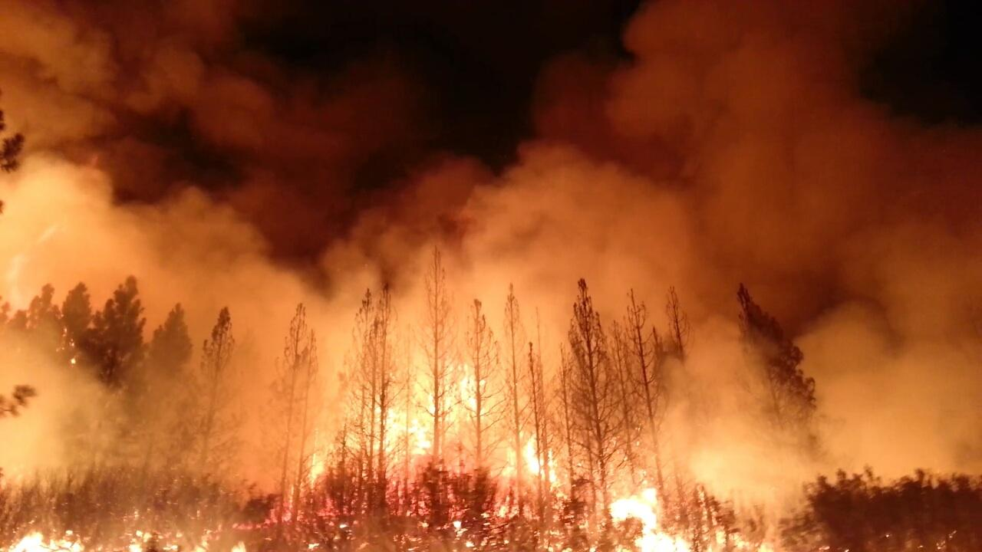
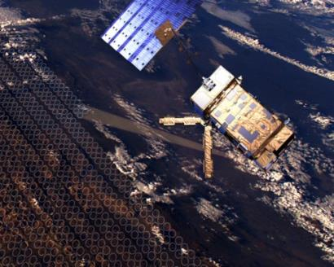
Overview Massive wildfires erupted in Amazonia and through the subarctic region in summer 2019, and in Australia in winter 2019-2020. During such biomass burning events, sizeable amounts of volatile organic compounds (VOCs) were emitted directly by the fires as well as rapidly produced in plumes via the degradation of short-lived gas precursors. Nadir-viewing infrared sensors onboard meteorological satellites, such as IASI (Infrared Atmospheric Sounding Interferometer) embarked on the Metop platforms, provide global and spatially dense observations that are very useful to track biomass burning events throughout the globe and to provide trace gas quantification in fire plumes. We apply a general retrieval framework, based on an artificial neural network, to derive the integrated abundance (total column) of several major VOCs from the infrared radiance spectra recorded by IASI. Here, we present daily regional snapshots of VOC enhancements in the plumes from the recent Amazonian, Australian and subarctic wildfires.
Metop: Polar orbiting satellite
U.S. Department of Agriculture
Picture: eumetsat.int
Picture: esa.int
IASI: Thermal IR nadir sounder
© Authors. All rights reserved

Slide 3
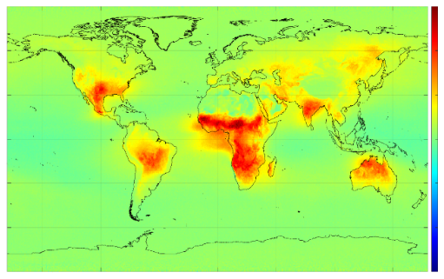
1.
The ANNI (Artifical Neural Network for IASI) retrieval framework consists, for each individual spectrum, in the calculation of a Hyperspectral Range Index (HRI) to quantify the target gas absorption in the spectrum, and in its subsequent conversion into gas integrated abundance (total column) using an artificial feedforward neural network accounting for the state of the atmosphere and surface.
HRI setup
HRI calculation, data assembly
IASI/Metop
This retrieval method reveals particularly sensitive to the detection of weak, sometimes broadband, infrared absorbers, while its computing efficiency permits the processing of the entire IASI observational time series (2007 – …).
Quasi-global distributions of single-pixel total columns and associated uncertainties are produced twice-daily (a.m. and p.m. satellite overpasses).
EUMETSAT level 1c
EUMETSAT level 2
Ancillary data
Spectra subset
Latitude
Longitude
Time
Z angle
Temp°
Pressure
H₂O
Emissivity
O₃
HRI
Hyperspectral Range Index
IASI/Metop
Building training sets
Neural Network setup, gas retrieval
EUMETSAT Level 2
Training set
Final product
Temp°
Pressure
H₂O
HRI
Column
Eumetsat L2
Gas
profiles
Forward simulations
Neural network training
Output layer
Single-pixel total column and uncertainty
Input layer
Computational layers
Franco et al (2018) J. Geophys. Res.: Atmos., 123 (24), 13,963-13,984. https://doi:10.1029/2018jd029633
Clarisse et al (2019) J. Geophys. Res.: Atmos., 124 (3), 1618-1647. https://doi:10.1029/2018jd029701
© Authors. All rights reserved

Slide 4
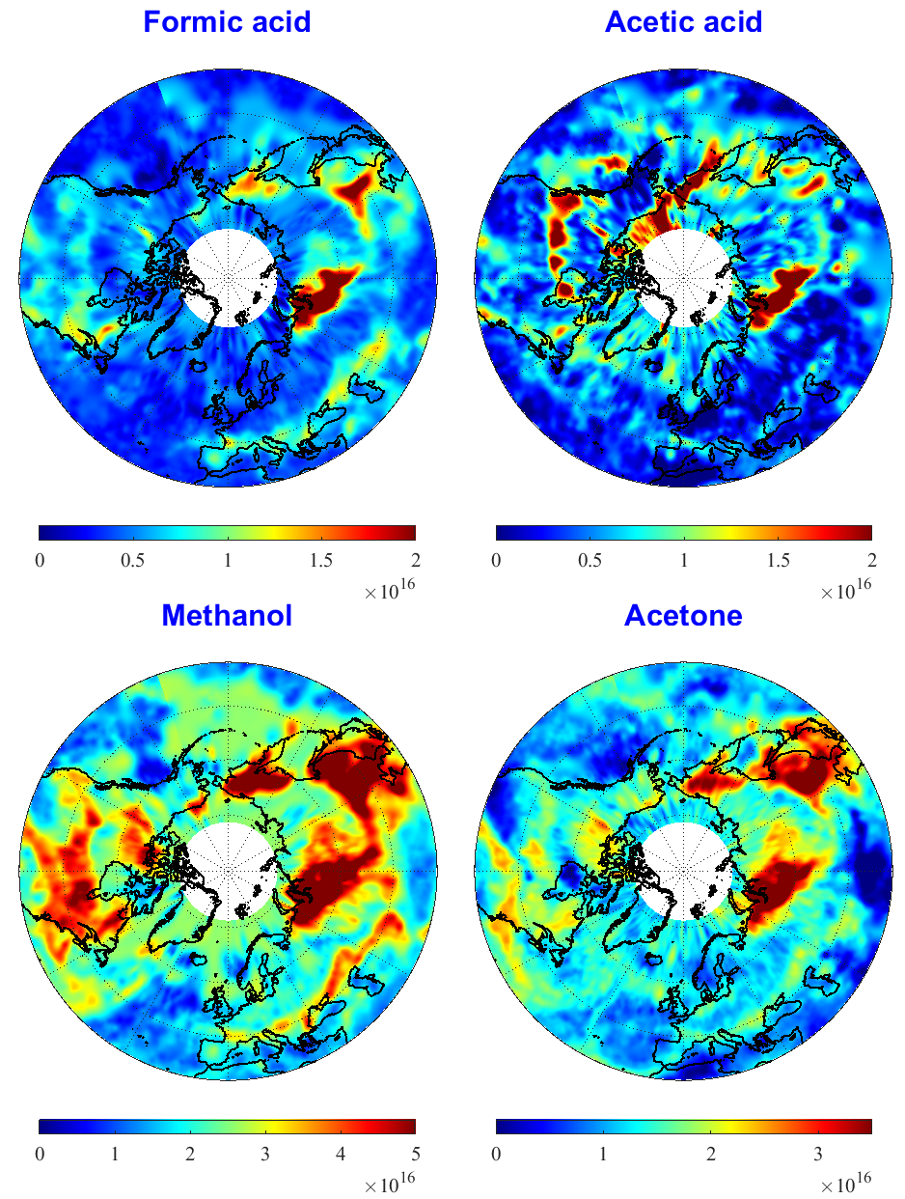
2.
Originally developed for the retrieval of ammonia (NH₃) and dust,
the ANNI framework now permits also the retrieval of a suite of VOCs:
Methanol (CH₃OH), formic acid (HCOOH) and PAN (CH₃C(O)O₂NO₂)
Franco et al (2018), JGR, 123 (24), 13,963-13,984. https://doi:10.1029/2018jd029633
Acetone (CH₃C(O)CH₃)
Franco et al (2019), GRL, 46, 2884-2893. https://doi.org/10.1029/2019GL082052
Acetic acid (CH₃COOH)
Franco et al (2020), GRL, 47, e2019GL086239. https://doi.org/10.1029/2019GL086239
Acetylene (C₂H₂) and hydrogen cyanide (HCN)
➔ under development
Ammonia (NH₃)
Van Damme et al (2017), AMT, 10(12), 4905-4914. https://doi.org/10.5194/amt-10-4905-2017
Whitburn et al (2016), JGR, 121, 6581-6599. https://doi.org/10.1002/2016jd024828
Dust
Clarisse et al (2019), JGR, 124 (3), 1618-1647. https://doi:10.1029/2018jd029701
© Authors. All rights reserved

Slide 5
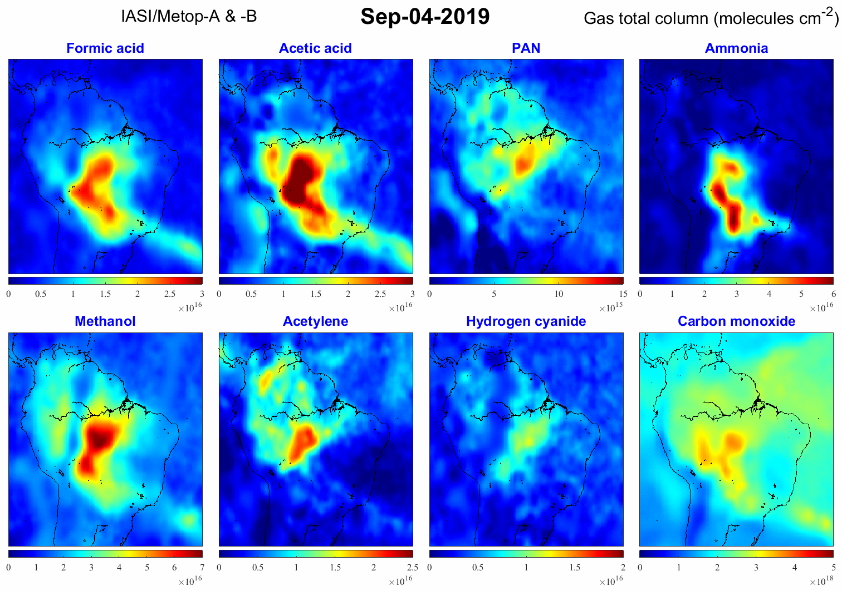
© Authors. All rights reserved
3.
2019 Amazonian wildfires

Slide 6
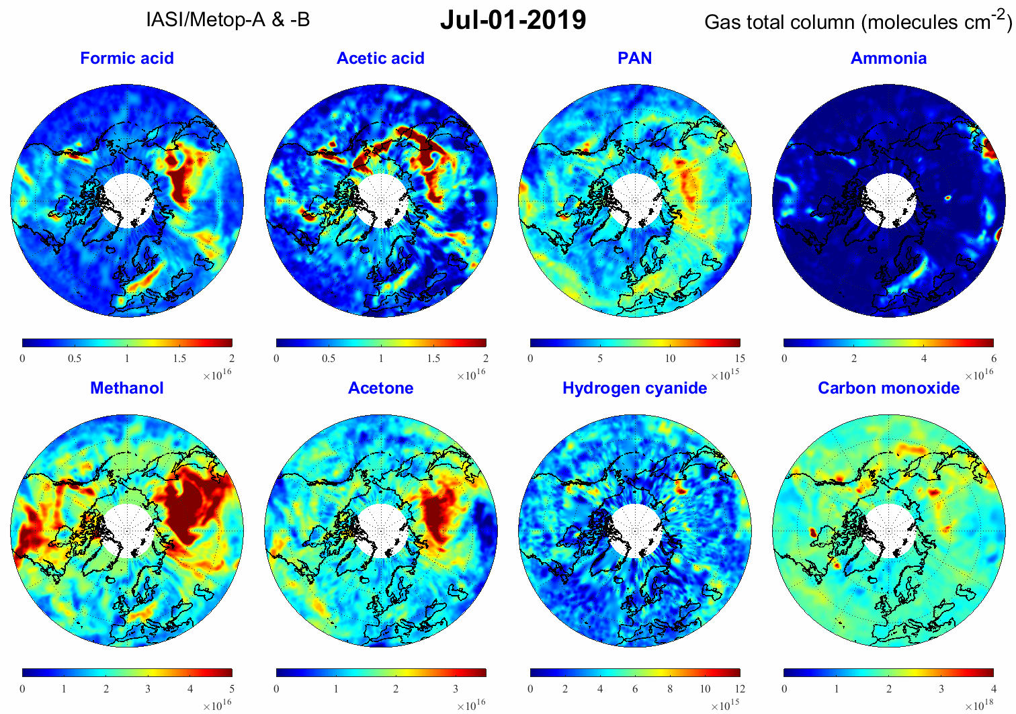
© Authors. All rights reserved
4.
2019 subarctic fires

Slide 7
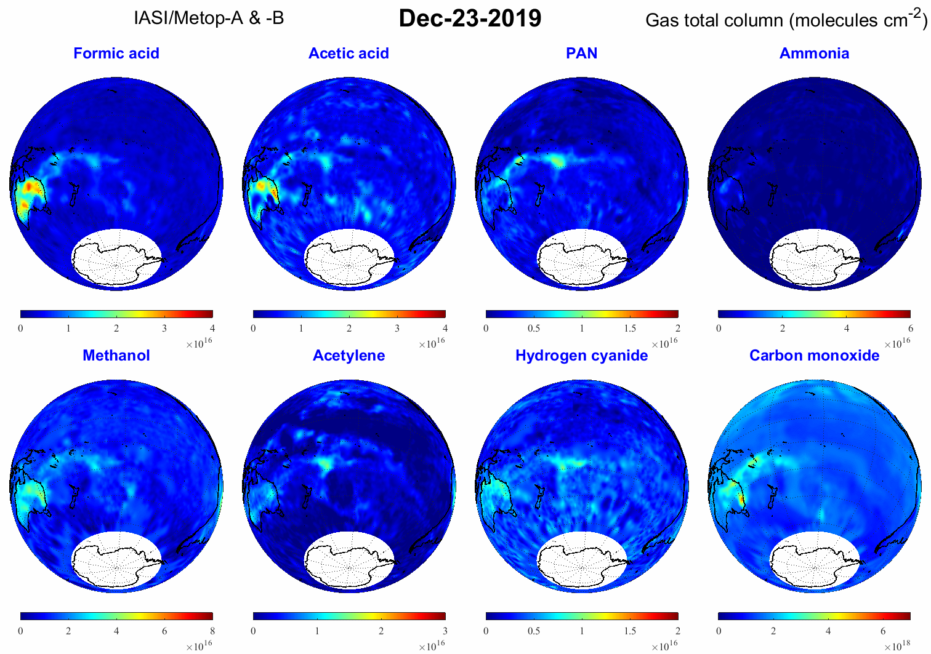
© Authors. All rights reserved
5.
2019-2020 Australian
bushfires

Slide 8
Acknowledgements The research has been supported by the project OCTAVE (Oxygenated Compounds in the Tropical Atmosphere: Variability and Exchanges (http://octave.aeronomie.be/) of the Belgian Research Action through Interdisciplinary Networks (BRAIN-be; 2017-2021; Research project BR/175/A2/OCTAVE) and by the IASI.Flow Prodex arrangement (ESA-BELSPO). L. Clarisse is a research associate supported by the F.R.S.-FNRS. The French scientists are grateful to CNES and Centre National de la Recherche Scientifique (CNRS) for financial support. IASI is a joint mission of Eumetsat and the Centre National d’Etudes Spatiales (CNES, France). The IASI Level-1C data are distributed in near real-time by Eumetsat through the EumetCast distribution system. The authors acknowledge the AERIS data infrastructure (https://www.aeris-data.fr/) for providing access to the IASI Level-1C data and Level-2 temperature data.
© Authors. All rights reserved
EGU General Assembly, 8th May 2020, Vienna, Austria
EGU2020-20243
https://doi.org/10.5194/egusphere-egu2020-20243

