Slide 1
Effects of prescribed burning on soil fertility and carbon dynamics in pre-littoral Mediterranean mountain pastures
José Manjón-Cabeza¹, Mercedes Ibáñez¹, Antonio Rodríguez¹, Maria Josep Broncano², Josepa Plaixats³, and Maria Teresa Sebastià¹
¹ GAMES group, Department of Fruit Growing Botany and Gardening,School of Agrifood and Forestry Science and Engineering, University of Lleida, Spain (jose.manjon-cabeza@hbj.udl.cat)
² ECOFUN Lab, Prog. Landscape Dynamics and Biodiversity, Ecological and Forestry Applications Research Centre (CTFC)
³Department of Animal and Food Science, Autonomous University of Barcelona.

Slide 2
Introduction
Pastures are a key factor in the global landscape
Pastures occupy between 26% of the terrestrial surface
Pasture surface is decreasing in the Iberian Peninsula due to abandonment and climate change, being substituted by shrublands
One way to recover these pastures is prescribed burning
Although prescribed burning is a strategy to recover grasslands, we know very little about how the soil is affected by those low intensity fires
More research is needed about the role of local pre-burning conditions on soil responses

Slide 3
Questions
1. How does the soil respond to disturbance by prescribed burning?
2. Are there legacy effects -dependent on pre-burning conditions- involving soil responses?
3. Is this response modulated by the local microtopography of the pasture?

Slide 4
Materials and methods
The study was carried out in Pla de la Llacuna, at Pla de la Calma, an elevated plateau (1250-1350 m asl) in Montseny Natural Park
Bedrock is siliceous, and soils have low pH and a significant content in organic C and N
Stratified sampling by slope (3: flat, gentle, moderate), pre-burning vegetation patch (6: Calluna, Cladonia, Cytisus, Erica and Pteridium dominated patches)
We sampled before the prescribed low-intensity burning and After the first samples were taken a fire was made and 3 months after prescribed burning
Twelve soil variables were analyzed: SWC, Bulk density and pH at 0-5 cm depth; Total N, Total C, P Olsen, P₂O₅, NO₃⁻ + NO₂⁻, NH₄⁺ at 0-5 cm depth
Data analyzed through: a) multivariate analysis by CANOCO 5.1; and b) linear mixed models by R ver. 3.6.3, models selected by AIC

Slide 5
Effect of prescribed burning
Soil variables decreasing after burning: SWC 0-5 cm, Bulk density, pH, N, C, P Olsen, P₂O₅
Soil variables increasing after burning: NO₃⁻ + NO₂⁻, NH₄⁺
Soil variables unchanged after burning: SWC 5-10 cm

Slide 6
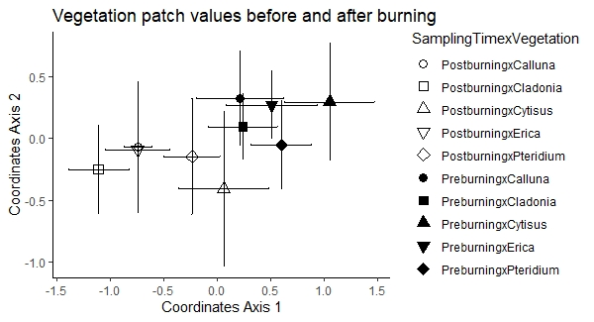
Legacy effects of the previous vegetation
Soil variables affected by previous vegetation after burning: SWC 0-5 cm, SWC 5-10 cm, C, P Olsen, P₂O₅ , NH₄⁺
Soil variables unaffected by previous vegetation after burning : Bulk density, pH, N, NO₃⁻ + NO₂⁻

Slide 7
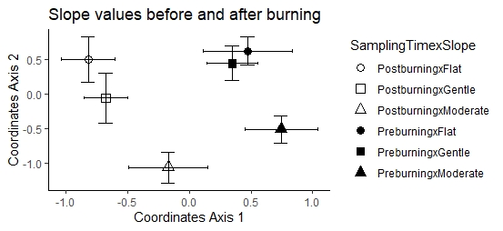
Results. Effect of the topography

Slide 8
Conclusions
The use of prescribed burning negatively affects the soil fertility after a short period of time
The topography plays an important role in the changes of fertility
The use of prescribed burning interacts with the topography and the previous vegetation patches determining the fertility of the soil

