Slide 1

Syntheses of rare K-titanates (yimengite, mathiasite and priderite) at high TP conditions: application to modal metasomatism
Sofia S. Vorobey ¹ , Valentina G. Butvina ² , Oleg G. Safonov ^{1, 2}
1 Department of Petrology, Geological Faculty, Lomonosov Moscow State University, Moscow, Russia
² Korzhinskii Institute of Experimental Mineralogy RAS, Chernogolovka, Russia

Slide 2
MANTLE METASOMATISM
compositional changes in the mantle wall-rock due to interaction with mantle fluids (Lloyd & Bailey, 1973)
Cryptic metasomatism
Stealth metasomatism
(Dawson, 1984): changes in composition (especially, trace elements) without addition of new phases
(O’Reilly & Griffin, 2013): addition of new phases, which are indistinguishable mineralogically from the common peridotite phases
Modal (patent) metasomatism
Various agents: alkaline silicate melts, carbonatitic melts, aqueous-(carbonic-salt) fluids
Leading role of potassium (high K/Na ratio)
Usually multi-stage with increasing effect
(Harte, 1983): “the presence of minerals additional to those seen commonly in peridotites”

Slide 3
Alkaline fluids in the mantle
Si+Al+Ti+Cr+P
up to 1.5 wt. % Cl,
10-18 wt. % K₂O
silicate
up to 5 wt. % Cl,
12-20 wt. % K₂O
carbonate-silicate
up to 12 wt. % Cl,
25-28 wt. % K₂O
carbonate
Cl
chloride-carbonate
Ca+Mg+Fe+Ba+Sr
up to 40 wt. % Cl
26-36 wt. % K₂O

Slide 4
Mineral indicators of the modal potassic metasomatism
Harlow & Davis (2004)

Slide 5
Reactions of modal mantle metasomatism
5En + Grt + [K₂O + 2H₂O] = Phl + Di (Kushiro, Aoki, 1968)
8En + Di [1/2 K₂O + 1/2 Na₂O + H₂O] = KRich + 2 Fo
Schematic reaction:
Chr 1+ Ru1/Ilm1 + [K₂O + 2H₂O] = Pri/Yim/Ma + Chr2 ± Ru2/Ilm2±Phl/Kfs

Slide 6
The purpose of the study is an experimental reproduction of reactions controlled by the K activity in fluids, i.e. study of the interaction of mineral associations of peridotite of the upper mantle with H₂O-salt and H₂O-CO₂-salt fluids
The system of CHROMITE + ILMENITE/RUTILE + H₂O-CO₂-K₂CO₃ at 3.5 and 5 GPa and 1200°C
Research problem:
Experimental reproduction of the reaction of mantle metasomatism with the participation of fluids H₂O-(CO₂)-KCl and H₂O-(CO₂)-K₂CO₃ , revealing their dependence on the concentration of alkaline (salt) components in the fluids.
The formation of Cr-bearing potassium titanates of the mathiasite-lindsleyite and yimengite-hawthorneite groups and priderite in reactions of H₂O-(CO₂)-K₂CO₃ fluids with assemblages chromite+rutile and chromite+ilmenite at 3.5 and 5 GPa.

Slide 7
Yimengite
Assosiated with: olivine, chromian pyrope, chromite, phlogopite, ilmenite, chromian diopside, enstatite, apatite, zircon, moissanite, phlogopite, K-richterite, the LIMA phases, armalcolite, rutile, ilmenite
_{Described:} the kimberlite dykes of the Shandong province, China (Dong et al., 1983); the kimberlites of the Guaniamo area, Venezuela (Nixon, Condliffe, 1989), and Float-Ouellet, Australia (Kiviets et al., 1998); the inclusions in diamonds (Sobolev et al., 1988, 1998; Bulanova et al., 2004); kimberlite pipe Bultfontein (South Africa); etc.
Mathiasite
Assosiated with:
phlogopite, diopside, K-richterite, Nb-Cr-rutile, Mg-Cr-Nb-ilmenite and Mg-Cr spinel (Haggerty et al., 1983)
_{Described:}
in the metasomatized peridotite xenoliths from De Beers and other kimberlite pipes of South Africa (Erlank and Rickard, 1977; Smyth et al., 1978; Jones et al. 1982; Konzett et al., 2000, 2013);
in xenocrysts of chromian pyrope (Rezvukhin et al., 2018) and in diamonds (Sobolev, Efimova, 2000) from kimberlites;
etc.
Priderite
Assosiated with:
_{The same minerals}
_{Described:}
Prider (1939) and Norrish (1951) in the Kimberly lamproites, Western Australia, and was subsequently found as a typomorphic mineral of leucite lamproites (Jaques et al., 1989);
in metasomatized peridotite xenoliths from kimberlites (Konzett et al., 2013; Giuliani et al., 2012; Naemura et al., 2015; Haggerty, 1987);
diamond inclusions (Jaques et al., 1989);
Chrome-dominant variety of priderite is found in the metasomatized peridotites only (Haggerty, 1987, 1991; Konzett et al., 2013; Giuliani et al., 2012; Naemura et al., 2015);
etc.

Slide 8
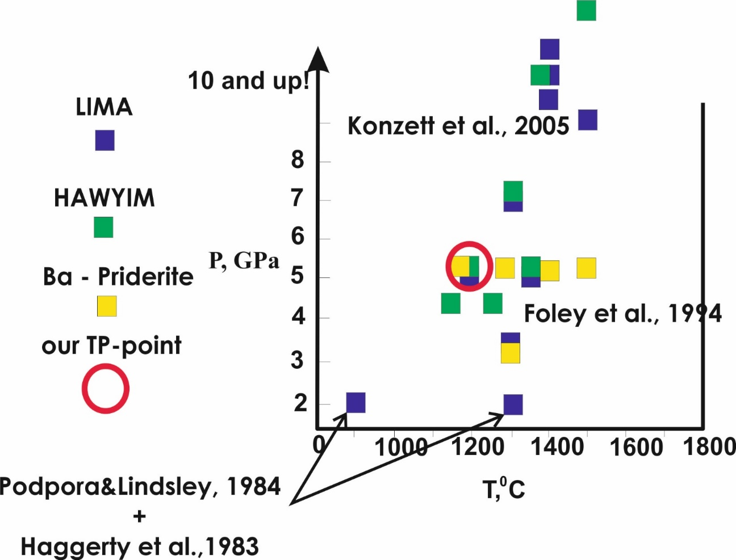
Yimengite
АМ₁₂О₁₉
K(Cr, Ti, Mg, Fe, Al)₁₂O₁₉ magnetoplumbite group hawthorneite-yimengite (Ba↔ K)
(HAWYIM)
K-(Ba) titanates (K → Ti, Cr, Fe³⁺)
Mathiasite
АМ₂₁О₃₈
K(Cr, Ti, Mg, Fe, Al)₂₁O₃₈
crichtonite group
lindsleyite-mathiasite (Ba↔ K)
(LIMA)
Priderite
A²⁺B²⁺Ti₇O₁₆ – A⁺₂B²⁺Ti₇O₁₆ – A²⁺B³⁺₂Ti₆O₁₆ – A⁺₂B³⁺₂Ti₆O₁₆
_{A-K, Ba, B-Cr, Ti, Mg, Fe, Al}
hollandite group
Ba↔ K

Slide 9
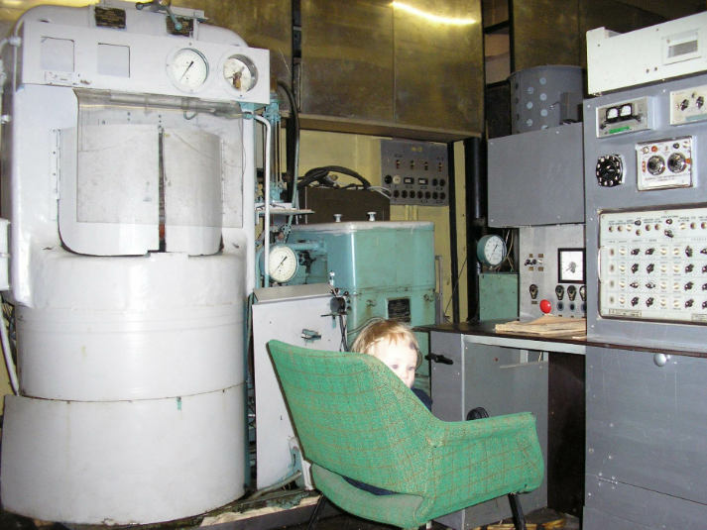
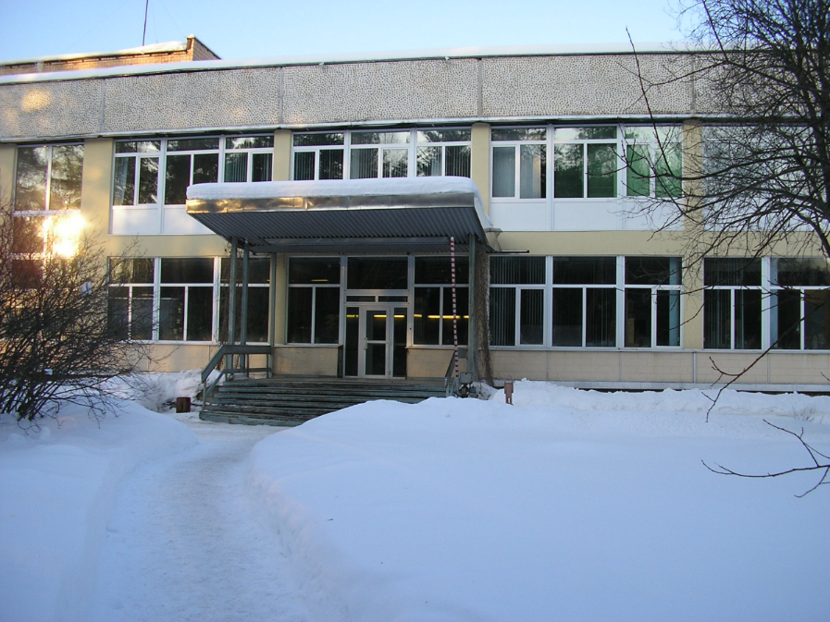
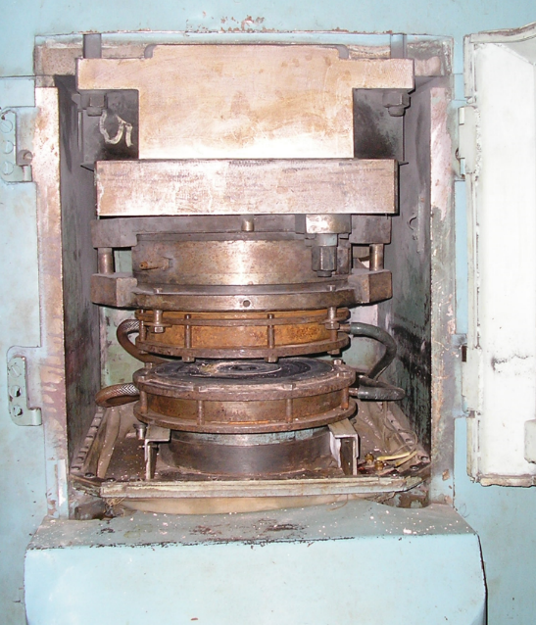
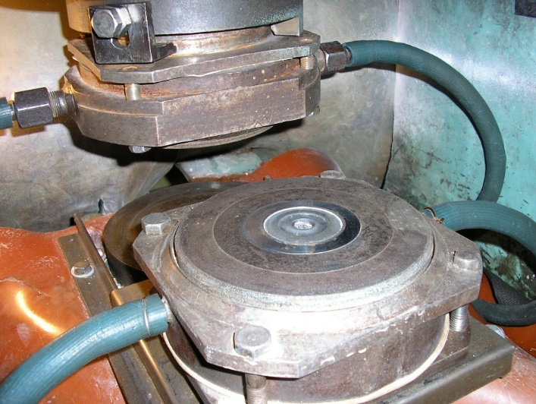
Experimental procedure
The experiments were performed at 3.5 ; 5 GPa and 1200°C using a toroidal high-pressure anvil-with-hole type apparatus (NL-40 and NL-13T) at the Korzhinskii Institute of Experimental Mineralogy of Russian Academy of Sciences (IEM RAS), Chernogolovka
5 GPa, NL-13T
3-3.5 GPa, NL-40

Slide 10
The system of CHROMITE + ILMENITE/RUTILE + H₂O-CO₂-K₂CO₃ fluids at 3.5 and 5 GPa and 1200°C
Starting materials
Table 1. Chemical compositions (wt. %) of the initial minerals used in experiments on the synthesis of K-Cr titanates.
*FeO=FeO+Fe₂O₃
Oxides | Chromite |  |  | Ilmenite
TiO₂ | 1,96 | 1,23 | 2,8 | 46,81 | 45,10
Cr₂O₃ | 57,2 | 58,7 | 56,6 | - | -
FeO* | 25,7 | 26,4 | 22,9 | 44,25 | 43,39
Al₂O₃ | 4,10 | 4,24 | 4,80 | 0,78 | 0,25
MnO | 0.75 | 0,18 | 0,58 | 2,99 | 2.65
MgO | 10.10 | 9,49 | 10,50 | 0,58 | 0,49
Nb₂O₅ | - | - | - | 1,00 | 1,66
Sum | 99,72 | 100,16 | 98,19 | 93,54 | 96,41
 | per 4 O |  |  | per 3 O
Ti | 0,05 | 0,03 | 0,07 | 0,93 | 0,93
Cr | 1,57 | 1,61 | 1,55 | - | -
Fe³⁺ | 0,15 | 0,15 | 0,10 | 0,09 | 0,07
Fe²⁺ | 0,52 | 0,61 | 0,56 | 0,92 | 0,91
Al | 0,18 | 0,17 | 0,20 | 0,03 | 0,05
Mn | 0,02 | 0,01 | 0,02 | 0,06 | 0,06
Mg | 0,53 | 0,49 | 0,54 | 0,03 | 0,02
Nb⁵⁺ | - | - | - | 0,01 | 0,01

Slide 11
Table 2. Conditions and results of experiments on the synthesis of K-Cr titanates at 3.5 and 5 GPa and 1200⁰C.
№№ | Mineral composition, (mas.%) | Fluid, (mas.%) | Contains of fluid in the system, % | Time, h. | P, GPa | Synthesis of priderite, yimengite, mathiasite
Sp1 | Spinel | K₂CO₃ | 30 | 21 | 5 | -,-,-
Sp2 | Spinel: rutile (1:1) | K₂CO₃:ox.ac. (9:1) | 20 | 23 | 5 | +,-,-
A1 | Spinel: rutile (1:1) | K₂CO₃:ox.ac. (9:1) | 10 | 20 | 5 | +,-,-
A2 | Spinel: rutile (2:1) | K₂CO₃:ox.ac. (9:1) | 10 | 24 | 5 | +,-,-
B1 | Spinel: ilmenite (1:1) | K₂CO₃:ox.ac. (9:1) | 10 | 22 | 5 | +,+,-
B1-1 | Spinel: ilmenite (1:1) | K₂CO₃:ox.ac. (7:3) | 10 | 22 | 5 | -,+,+
B1-2 | Spinel: ilmenite (1:1) | K₂CO₃:ox.ac. (5:5) | 10 | 22 | 5 | -,+,-
B1-3 | Spinel: ilmenite (1:1) | K₂CO₃:ox.ac. (3:7) | 10 | 22 | 5 | -,-,-
B1-4 | Spinel: ilmenite (1:1) | K₂CO₃:ox.ac. (1:9) | 10 | 22 | 5 | -,-,-
B2 | Spinel: ilmenite (2:1) | K₂CO₃:ox.ac. (9:1) | 10 | 20 | 5 | +,+,-
M-0 | Spinel: ilmenite (1:1) | K₂CO₃:ox.ac. (9:1) | 10 | 8 | 3,5 | -,+,+
M-1 | Spinel: ilmenite (1:1) | K₂CO₃:ox.ac. (7:3) | 10 | 8 | 3,5 | -,+,+
M-2 | Spinel: ilmenite (1:1) | K₂CO₃:ox.ac. (5:5) | 10 | 8 | 3,5 | -,+,+
M-3 | Spinel: ilmenite (1:1) | K₂CO₃:ox.ac. (3:7) | 10 | 8 | 3,5 | -,-,-
M-4 | Spinel: ilmenite (1:1) | K₂CO₃:ox.ac. (1:9) | 10 | 8 | 3,5 | -,-,-
System spinel-K₂CO₃, spinel-rutile-K₂CO₃-oxalic acid (hereinafter ox.ac.), spinel-ilmenite-K₂CO₃-ox.ac. As the starting substances for the experiments we used natural chromite and synthetic TiO₂ powder or natural ilmenite, which were mixed in ratios of 1:1 or 2:1 by weight. Composition chromite (Mg_{0.49-0.54}Fe_{0.50-0.54}Mn_{0.01-0.02}Zn_{0.01-0.02})(Al_{0.17-0.20}Cr_{1.55-1.61}Fe_{0.10-0.22}Ti_{0.03-0.07})O₄ (see table.1) was selected from the xenolith of the garnet lherzolite of the kimberlite pipe Pionerskaya, Yakutia. Ilmenite of the composition Fe_{0.98}Mg_{0.01}Mn_{0.06}Ti_{0.93}Al_{0.01}Nb_{0.01}O₃, is xenocrysts from kimberlite pipe Udachnaya, Yakutia. As a fluid component, a mixture of K₂CO₃ and oxalic acid in different ratios was used (9:1; 7:3; 5:5; 3:7; 1:9) by weight. The mixture of chromite + TiO₂ was mixed with a "fluid" mixture in the ratios 4:1 and 9:1, and chromite + ilmenite – in the ratio 9:1 by weight. The experimental conditions are presented in table. 2.

Slide 12
Table 3. Representative analyses of chromite in the run products.
*Fe³⁺/(Fe³⁺+Fe²⁺) ratio in chromite
** Δlogf_{O2} =(logf_{O2}-logf_{O2}^{QFM}) (Nikitina et al., 2010)
Oxygen fugacity was not specially controlled in the experiments being suggested that it was controlled by starting mineral phases, first of all, by chromite. The chromite composition allows estimation of logf_{O2} on the basis of the Fe³⁺/Fe²⁺ ratio in this mineral. We used the dependence of the deviation of the oxygen fugacity of the system from the QFM buffer (Δlogf_{O2}) on the ratio Fe³⁺/Fe²⁺ in chromite given by Nikitina et al. (2010). The Fe³⁺ / Fe²⁺ ratios in chromite were estimated from the crystal chemical formulas. The obtained values Δlogf_{O2} (Table 3) indicate the oxygen fugacity in the experiments at 1.1-1.6 logarithmic unit below the QFM buffer.
№ | Sp2-1 | A1-1 | A2-6 | B1-11 | B2-4
Ox/Mineral | Chr | Chr | Chr | Chr | Chr
TiO₂ | 2,67 | 3,64 | 3,61 | 4,62 | 4,16
Cr₂O₃ | 58,12 | 57,76 | 56,01 | 53,43 | 58,25
FeO | 18,60 | 17,99 | 20,23 | 24,67 | 21,22
Al₂O₃ | 5,14 | 4,55 | 5,73 | 5,10 | 5,61
K₂O | 0,24 | 0,20 | 0,10 | 0,38 | 0,20
MnO | 0,60 | 0,29 | 0,81 | 0,39 | 0,61
MgO | 11,51 | 12,42 | 11,92 | 9,61 | 11,48
ZnO | 0,15 | 0,12 | 0,10 | 0,12 | 0,10
Sum | 97,03 | 96,97 | 98,51 | 98,30 | 101,63
 | Formula quantities per 3 cations
Ti | 0,07 | 0,09 | 0,09 | 0,12 | 0,10
Cr | 1,57 | 1,56 | 1,49 | 1,45 | 1,51
Fe³⁺ | 0,09 | 0,08 | 0,11 | 0,13 | 0,08
Fe²⁺ | 0,44 | 0,43 | 0,46 | 0,58 | 0,51
Al | 0,21 | 0,18 | 0,23 | 0,21 | 0,22
K | 0,01 | 0,01 | 0,00 | 0,02 | 0,01
Mn | 0,02 | 0,01 | 0,02 | 0,01 | 0,02
Mg | 0,59 | 0,63 | 0,60 | 0,49 | 0,56
Zn | 0,00 | 0,00 | 0,00 | 0,00 | 0,00
φ_{Sp}* | 0,170 | 0,157 | 0,193 | 0,183 | 0,136
Δlogf_{O2}** | -1,3 | -1,4 | -1,1 | -1,2 | -1,6

Slide 13
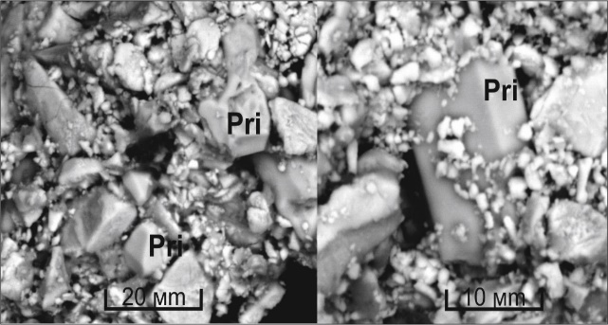
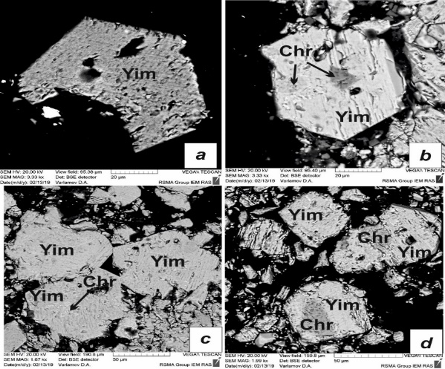
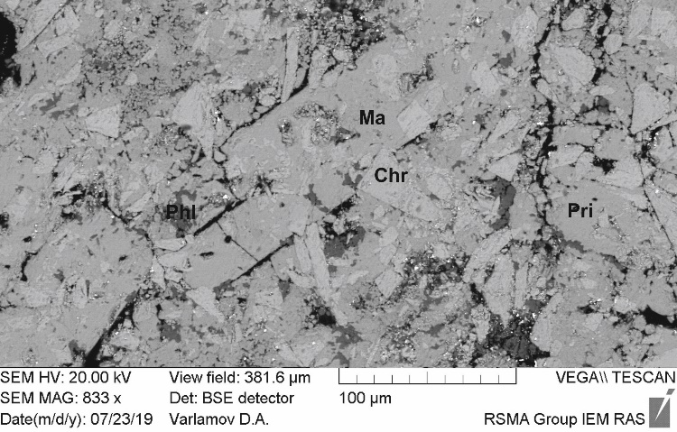
Table 4. Representative analyses of priderite, yimengite and mathiasite.
*FeO=FeO+Fe₂O₃
№№ | Sp-4 | Sp-5 | A1-5 | A2-7 | B1-12 | В1-3 | B1-1-2 | B1-1-12
Минерал | Pri | Pri | Pri | Pri | Yim | Yim | Yim | Ma
TiO₂ | 69,45 | 69,03 | 69,83 | 69,21 | 34,29 | 38,34 | 36,11 | 51,16
Cr₂O₃ | 15,62 | 16,45 | 19,00 | 17,03 | 25,31 | 21,9 | 23,14 | 2,29
FeO* | 0,83 | 0,5 | 0,52 | 0,42 | 23,09 | 26,3 | 24,4 | 32,42
Al₂O₃ | 0,91 | 0,89 | 0,79 | 0,70 | 1,97 | 1,68 | 1,56 | 0,39
K₂O | 11,26 | 11,39 | 10,95 | 11,26 | 4,78 | 4,88 | 5,15 | 1,89
MnO | 0,37 | 0,03 | 0,15 | 0,06 | 1,79 | 1,80 | 1,68 | 2,82
MgO | 0,68 | 0,51 | 0,30 | 0,40 | 2,20 | 1,82 | 2,27 | 5,36
Nb₂O₅ | 0,00 | 0,00 | 0,00 | 0,12 | 2,94 | 3,44 | 2,35 | 2,00
Сумма | 99,12 | 98,80 | 101,54 | 99,20 | 96,37 | 100,16 | 96,66 | 98,33
 | Per 16 О |  |  |  | Per 19 О |  |  | Per 38 O
Ti | 6,23 | 6,22 | 6,13 | 6,22 | 4,04 | 4,34 | 4,23 | 12,05
Cr | 1,47 | 1,56 | 1,75 | 1,61 | 3,14 | 2,60 | 2,85 | 0,57
Fe³⁺ | 0,07 | 0,05 | 0,05 | 0,04 | 2,24 | 2,41 | 2,47 | 8,48
Fe²⁺ | - | - | - | - | 0,48 | 0,57 | 0,39 | -
Al | 0,13 | 0,13 | 0,11 | 0,10 | 0,36 | 0,30 | 0,29 | 0,14
K | 1,71 | 1,74 | 1,63 | 1,72 | 0,96 | 0,94 | 1,02 | 0,75
Mn | 0,04 | 0,00 | 0,01 | 0,01 | 0,24 | 0,23 | 0,22 | 0,75
Mg | 0,12 | 0,09 | 0,05 | 0,07 | 0,51 | 0,41 | 0,53 | 2,50
Nb⁵⁺ | 0,00 | 0,00 | 0,00 | 0,01 | 0,24 | 0,27 | 0,19 | 0,28

Slide 14
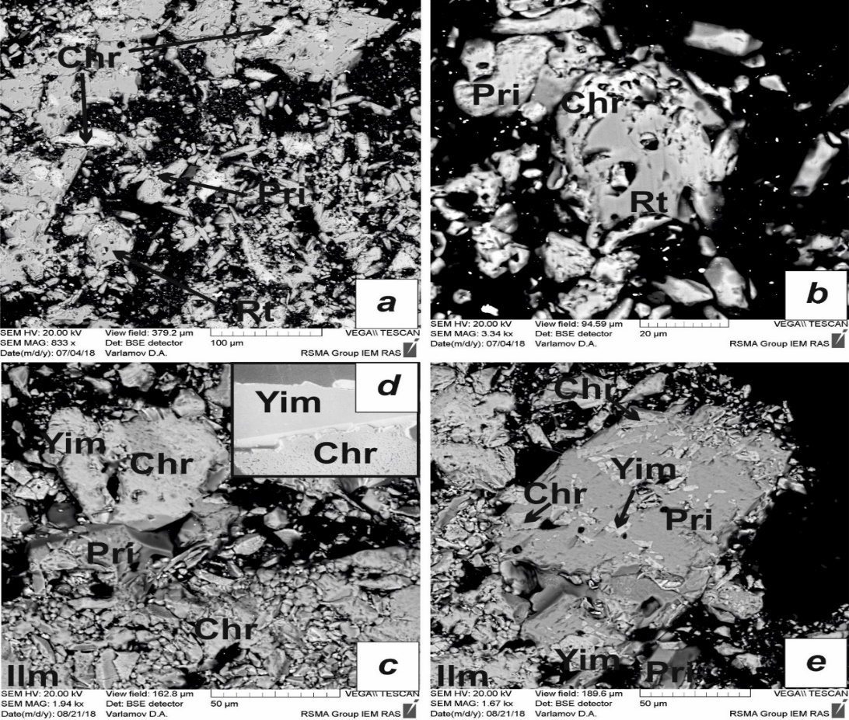
Table 5. Representative analyses ( f. e.) of compositions of paragenetic minerals (products) in experiments on the synthesis of K-Cr titanates.
№опыта | B1
Comp-t/Mineral | Yim |  | Pri1 |  | Ilm1 |  | Ilm2 |  | Rt1
Ti | 4,76 |  | 6,15 |  | 0,93 |  | 0,98 |  | 0,85
Cr | 2,87 |  | 1,56 |  | - |  | 0,01 |  | 0,20
Fe³⁺ | 0,25 |  | 0,15 |  | 0,08 |  | 0,03 |  | -
Fe²⁺ | 3,30 |  | 0,10 |  | 0,95 |  | 0,70 |  | -
Al | 0,35 |  | 0,06 |  | 0,02 |  | - |  | -
K | 1,01 |  | 1,77 |  | - |  | - |  | -
Mg | 0,47 |  | 0,06 |  | 0,04 |  | 0,28 |  | -
№Exp. | Sp2 |  |  |  |  | B1-1
Comp-t/Mineral | Chr1 | Chr2 |  | Pri2 |  | Yim1 |  | Yim2 |  | Ilm3
Ti | 0,10 | 0,14 |  | 6,23 |  | 4,34 |  | 4,25 |  | 0,97
Cr | 1,47 | 1,46 |  | 1,47 |  | 2,99 |  | 3,31 |  | 0,02
Fe³⁺ | 0,02 | - |  | 0,11 |  | 0,68 |  | 0,42 |  | 0,04
Fe²⁺ | 0,31 | 0,46 |  | - |  | 2,61 |  | 2,74 |  | 0,74
Al | 0,31 | 0,26 |  | 0,13 |  | 0,69 |  | 0,66 |  | -
K | - | - |  | 1,71 |  | 1,00 |  | 1,01 |  | -
Mg | 0,79 | 0,68 |  | 0,12 |  | 0,67 |  | 0,67 |  | 0,23
Run products of the experiment B1 (Table 2) in the system chromite-rutile/ilmenite-K₂CO₃-H₂O-CO₂ at 5 GPa and 1200ºC. (a, b) experiments A1 and A2 (Table 2): priderite, chromite, rutile; (c, e) experiment B1 (Tables 2 and 5): chromite, ilmenite, priderite, yimengite; (d) intergrowth of yimengite and chromite from the kimberlite sill Prospect 039, Guaniamo province, Venezuela (Nixon, Condliffe, 1989).

Slide 15
Reactions:
Using composition of phases in the run Sp2 products (Table 5), the following equilibrium represents the formation of priderite:
24.50Chr₂ + 5.79TiO₂ + K₂CO₃ + 0.46O₂ + 1.10Cr₂O₃ = 1.17Pri + 9.45Chr + 14.57Chr₁ + CO₂ (1)
Using composition of phases in the run B1 products (Table 5), a number of equilibria could be written to illustrate the formation of this titanate assemblage, for example:
Rt + 0.11Chr + 0.12K₂CO₃ + 0.21Ilm₁ = 0.11Pri + 0.05Yim + 0.03Cr₂O₃ + 0.13Ilm₂ + CO₂ (2)
Using representative composition of phases in the run B1-1 products (Table 5), a number of equilibria could be written to illustrate the formation of this titanate assemblage, for example:
5.29Chr + 9.87Ilm + 1.08K₂CO₃ + 7.61TiO₂ = Yim₁ + 1.14Yim₂ + 0.68Cr₂O₃ + 8.09Ilm₃ (3)

Slide 16
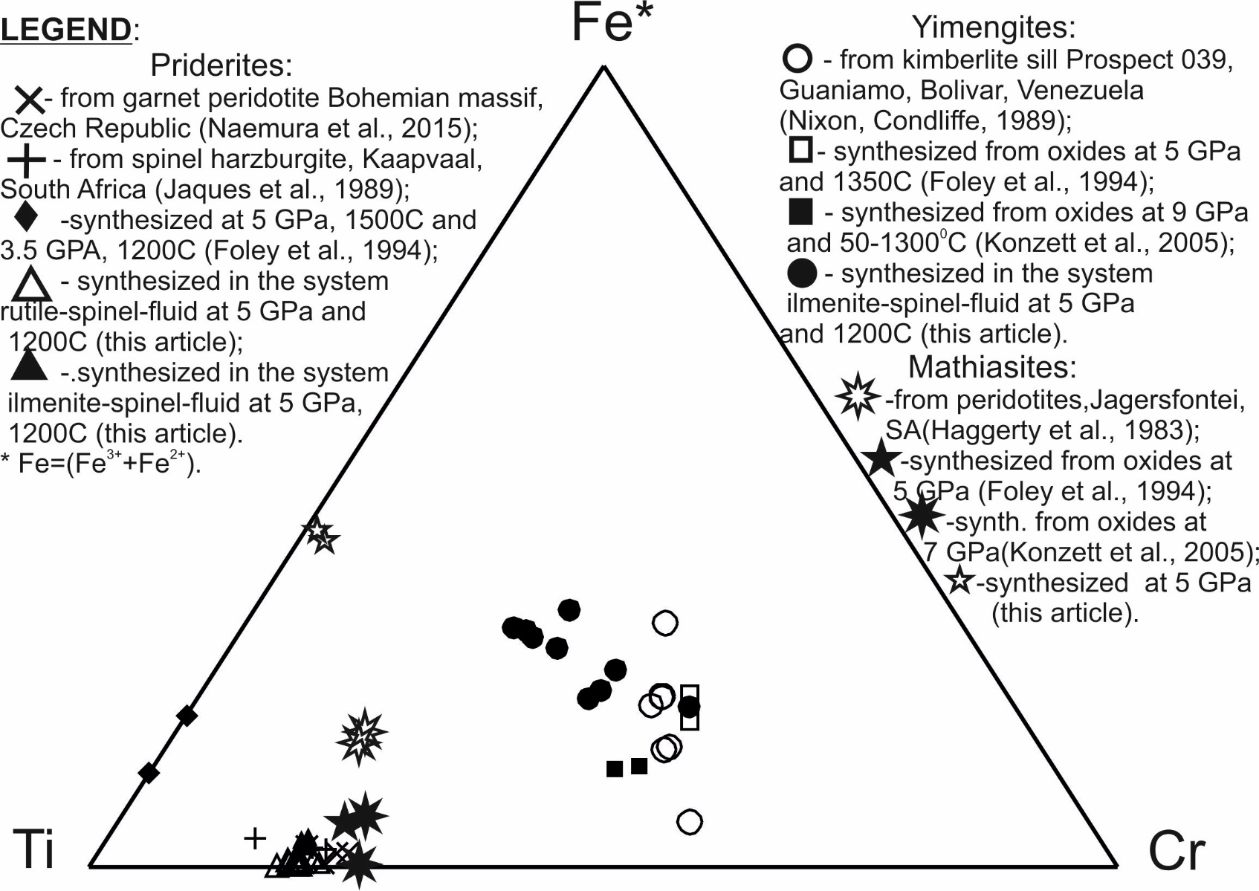
Diagram of Ti – Fe – Cr illustrating the variation of the composition of synthesized yimengite, mathiasite and priderite in comparison with the compositions of natural minerals.

Slide 17
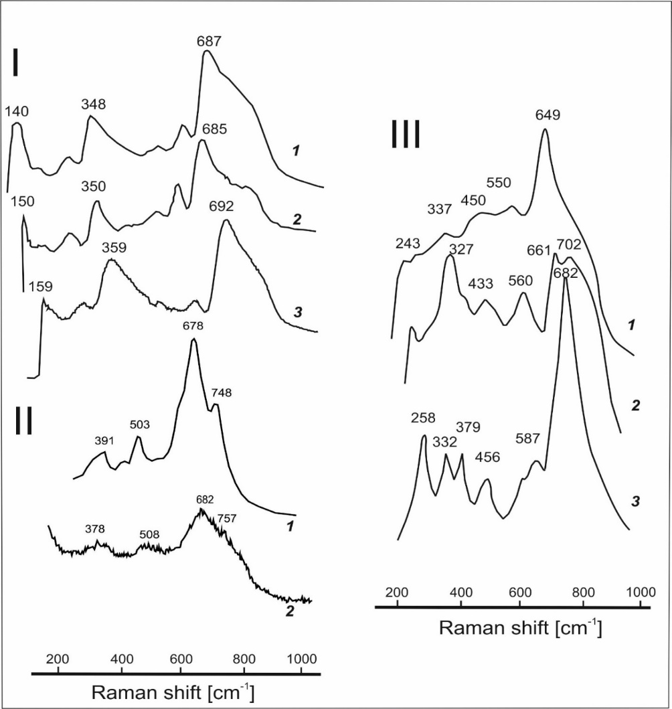
The system of CHROMITE + ILMENITE/RUTILE + H₂O-CO₂-K₂CO₃ fluids
Raman spectra of the synthesized phases: I-1) K-Cr priderite from metasomatized peridotites from kimberlites of South Africa (Konzett et al., 2013); I-2) K-Ba-Cr priderite from inclusions in chromites of Bohemian Massif garnet peridotites (Naemura et al., 2015); I-3) synthesized K-Cr priderite (analysis Sp-4, Table 4); II-1) solid solution yimengite-hawthorneite synthesized from the oxides at 12 GPa and 1400ºС (ex. JKW88, see Konzett et al., 2005); II-2) the synthesized yimengite (analysis B1-12, Table 4); III-1) mathiasite synthesized from the oxides at 7 GPa and 1300ºС (ex. JKW43, see Konzett et al., 2005); III-2) lindsleyite synthesized from the oxides at 7 GPa and 1300ºС (ex. JKW43, see Konzett et al., 2005); III-3) synthesized mathiasite (analysis B1-1-12, Table 4).

Slide 18
The system of CHROMITE + ILMENITE/RUTILE + H₂O-CO₂-K₂CO₃ fluids
CONCLUSIONS
The principal possibility of the formation of minerals of crichtonite and magnetoplumbite groups and priderite in the reactions of chromite with alkaline aqueous-carbonic fluids and melts is confirmed. Such substances are considered as main agents of potassium metasomatism, leading to the formation of titanates in the upper mantle (Konzett et al, 2013; Rezvukhin et al. 2018).
The formation of these phases does not proceed directly on chromite (e.g. Haggerty et al. 1983; Haggerty, 1983; Nixon, Condliffe, 1989), and requires additional titanium source. They are rutile and ilmenite, which are themselves usually are products of modal metasomatism of peridotites. This experimental fact demonstrates that the formation of titanates marks probably the most advanced or repeated stages of metasomatism in mantle peridotites.
This is also proved by the relationships of titanates with phlogopite. Association of titanates with phlogopite characterized by a higher activity of the potassium component in the fluid/melt than the formation of phlogopite alone. Such conditions can again be created at the most advanced or repeated stages of mantle metasomatism.
The relationship between titanates is also a function of the activity of the potassium component in the fluid/melt. Priderite is an indicator of the highest potassium activity in the mineral-forming medium. The above examples from natural associations (Zhou, 1986; Konzett et al., 2013; Almeida et al., 2014) well illustrate this conclusion.
Supports: NIR АААА-А18-118020590148-3

Slide 19

Thank you for your attention

