Slide 1
Chlorinated Very Short-Lived Substances: development + evaluation of gridded emissions for global models and on recent emission trends
Tom Claxton, Ryan Hossaini and
Ewa Bednarz et al.
Lancaster University, Lancaster, UK
EGU 2020 (online) Tuesday 5th May 2020

Slide 2
Presentation Material
The content of these slides is from our new paper, currently in press at JGR:

Slide 3
Background
Important source of reactive chlorine to the troposphere and stratosphere
Chlorinated Very Short-Lived Substances (Cl-VSLS) are compounds with tropospheric lifetimes less than ~6 months.
Major Cl-VSLS include dichloromethane (CH₂Cl₂), chloroform (CHCl₃) and perchloroethylene (C₂Cl₄).
CH₂Cl₂ and C₂Cl₄ (the focus of this study) are chiefly anthropogenically sourced, from use as (e.g.) industrial solvents.
Global CH₂Cl₂ concentrations observed to have increased rapidly since the earlys 2000s, while C₂Cl₄ has declined.
For both compounds, the global emission magnitude, distribution and regional trends are uncertain.

Slide 4
Objectives of this work
The most recent set of gridded Cl-VSLS emissions are from the Reactive Chlorine Emissions Inventory (RCEI), produced in 1999 (i.e. are now very outdated).
Our core objectives are:
to perform a synthesis inversion in order to optimise a set of prior global CH₂Cl₂ and C₂Cl₄ emissions
To quantify regional and global emission totals and trends for both compounds
To produce and evaluate a set of time-varying (2006-2017) gridded CH₂Cl₂ and C₂Cl₄ emissions for use in models

Slide 5
Method: synthesis inversion 1
The synthesis inversion procedure requires:
A regional prior emission estimate for each Cl-VSLS (e.g. from the RCEI)
Global Cl-VSLS observations (NOAA + AGAGE)
Concentrations of Cl-VSLS from a chemical transport model (to constrain regional sources)
Also important to have an estimate of the uncertainty on the a) prior emissions, b) observations, and c) model responses (see Appendix 1 for detail on Methods)

Slide 6
Method: synthesis inversion 2
We have used the TOMCAT offline CTM which included a simple description of Cl-VSLS chemical loss via OH (offline field) and photolysis.
The model was run at a horizonal resolution of 2.8×2.8°and with 60 levels (surface to ~60 km).
The CTM provides a description of the response at each observation location to a unit emission flux of Cl-VSLS from each region under consideration (see Appendix 1).
We considered emissions from 10 land and 4 ocean regions. Note, ocean CH₂Cl₂ emissions only included in a sensitivity run (Appendix 2).

Slide 7
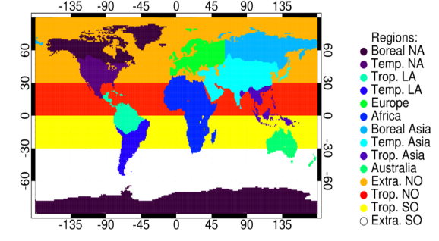
Method: regions considered
Our inversion considers 10 land and 4 ocean regions (see below). The region mask is adapted from previous TRANSCOM studies.

Slide 8
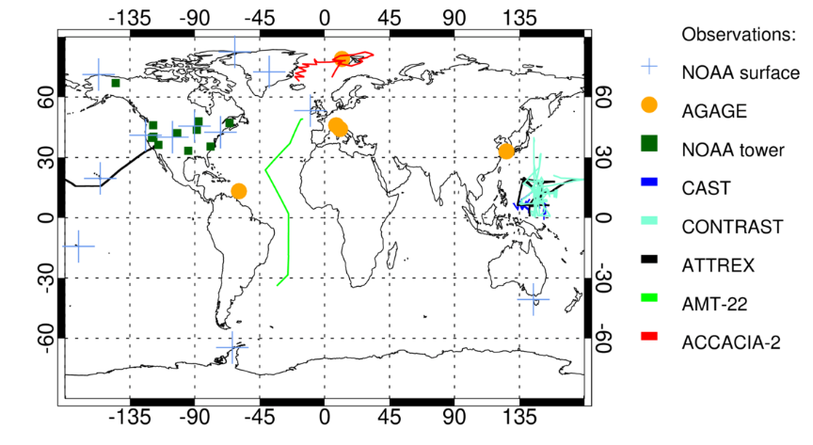
Method: surface observations
Aircraft campaigns
Note: only surface NOAA and AGAGE observations were assimilated in the inversion. NOAA tall tower and aircraft measurements were ‘held back’ for independent verification of the posterior emissions

Slide 9
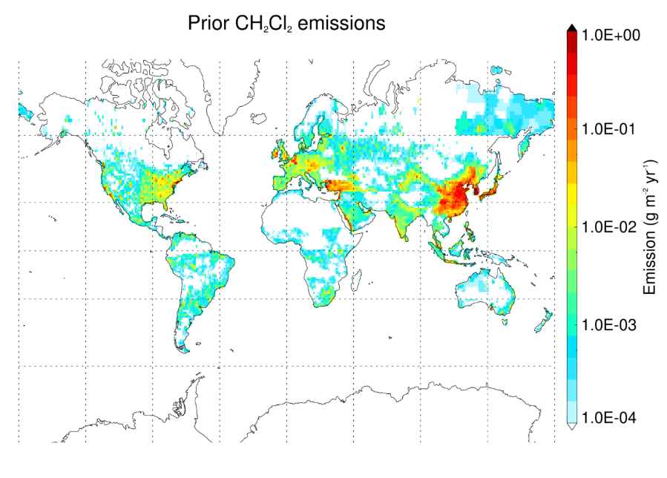
Method: prior emissions
For each region considered, a prior industrial emission estimate was taken based on RCEI data (Keene et al., 1999) or industry data.
Figure shows the prior CH₂Cl₂ emission input.
Within regions, we assume a CH₂Cl₂ & C₂Cl₄ emission distribution similar to that of HCFC-22 (Xiang et al., 2014).

Slide 10
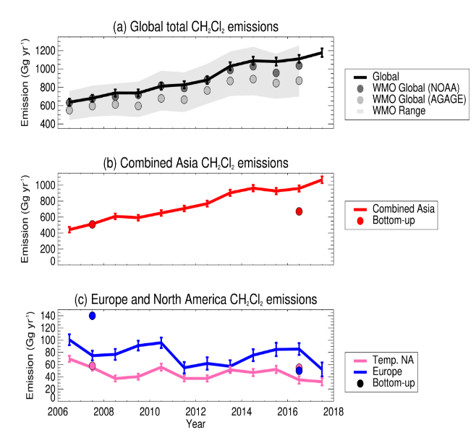
Results: CH₂Cl₂ emission trends
1177 Gg yr⁻¹ in 2017 (this work)
(a) Global total CH₂Cl₂ emissions increase by 85% (2006 to 2017). Total matches within WMO 12-box model estimates.
(b) Increasing Asian (red) emissions can explain most of global increase. Comprise 89% of 2017 global total emission.
(c) In contrast, emissions from Europe and N. America decreased. May reflect concern over carcinogenity.

Slide 11
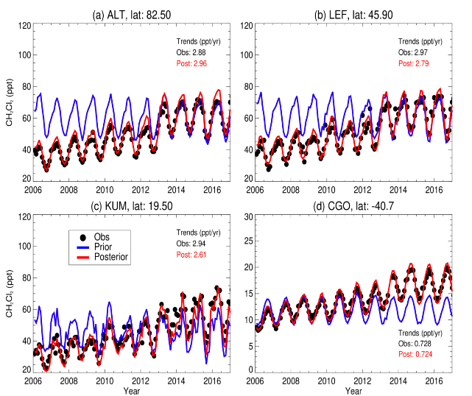
Results: CH₂Cl₂ VMR trends
Our posterior CH₂Cl₂ emissions were included in a forward run of the TOMCAT CTM.
Figure compares modelled CH₂Cl₂ using prior and posterior emissions with surface observations from the NOAA network (4 sites).
Note, these observations were assimilated by the inversion procedure.
Posterior emissions provide good representation of surface CH₂Cl₂ abundance and trends over time.

Slide 12
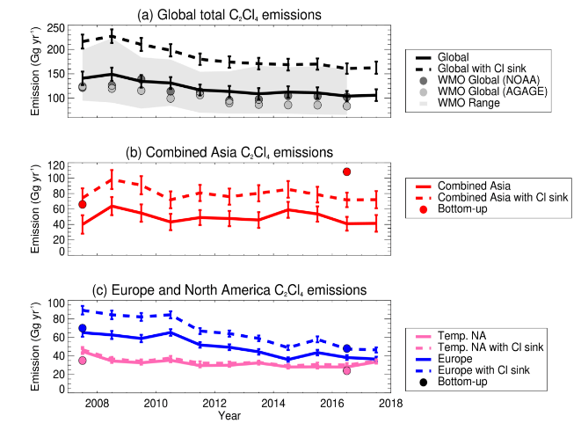
Results: C₂Cl₄ emission trends
Inclusion of the C₂Cl₄ + Cl sink (dashed line) increases global emissions by ~50%.
(a) Global total C₂Cl₄ emissions decrease over 11-year study period (2007-2017) by 24%, to 106 Gg yr⁻¹ in 2017.
(b) Emissions from Asia account for 39% of the 2017 global total emission.
(c) Emissions from Europe and N America decrease over the study period.
Note, WMO estimates (12-box model) in panel (a) do not account for influence of C₂Cl₄ + Cl reaction on the C₂Cl₄ lifetime

Slide 13
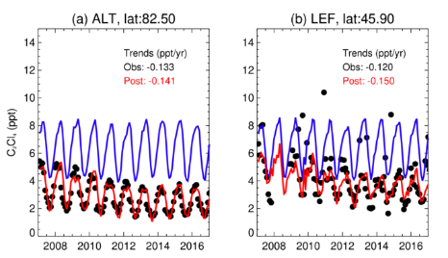
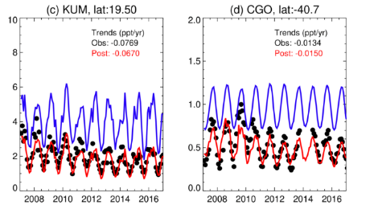
Results: C₂Cl₄ VMR trends
Our posterior C₂Cl₄ emissions were included in a forward run of the TOMCAT CTM.
Figure compares modelled C₂Cl₄ using prior and posterior emissions with surface observations from the NOAA network (4 sites).
Note, these observations were assimilated by the inversion procedure.
Posterior emissions provide good representation of surface C₂Cl₄ abundance and trends over time.

Slide 14
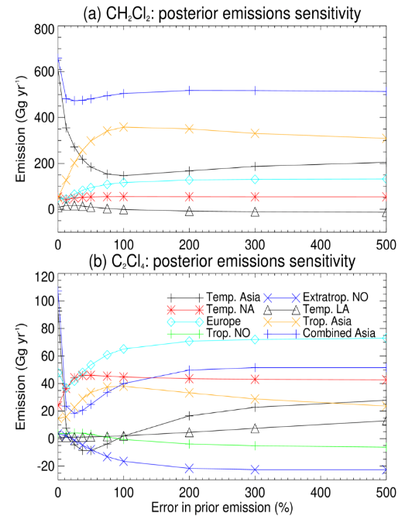
Results: sensitivity to prior emission error
To provide constraint, the inversion requires an estimate of the error on each prior emission. We assumed ±100%.
We also tested the sensitivity of our posterior emissions to values from 0-500% (see figures).
Beyond 100% error, our regional posterior emissions generally became insensitive, suggesting that 100% was a fair choice for the error value.
Note, our two Asian regions (Temperate and Tropical) ‘drift’ towards each other, and variance analysis showed that they were correlated. Thus, these two regions are combined in presenting results.

Slide 15
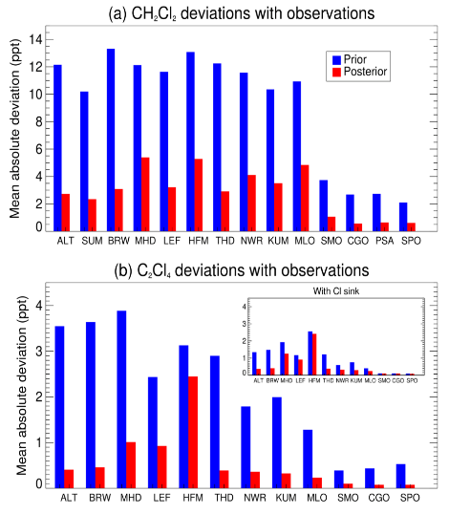
Results: do the posterior emissions perform better?
Over all NOAA network sites, for each month the bias between observations and CTM outputs (i.e. run with prior vs. run with posterior emissions) can be calculated.
Figure (panel a) shows the deviations in CH₂Cl₂ concentration have decreased at every site by at least 60%.
Deviations in C₂Cl₄ also decreased at every site, with an average reduction of 80% (panel b).
site code

Slide 16
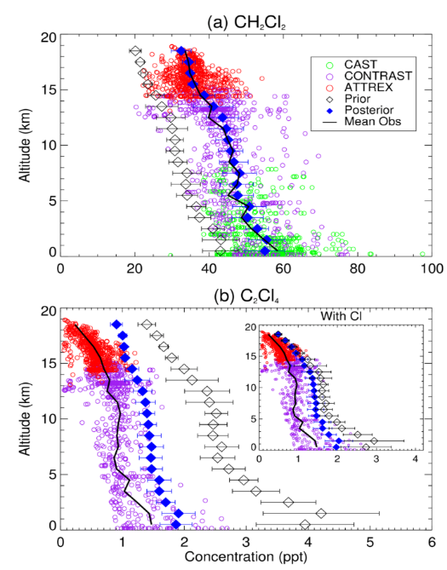
Independent verification: aircraft observations
Independent data is useful in testing the veracity of the inversion outputs (i.e. observations that were not assimilated).
We compared a CTM run with the posterior emissions with observations from 3 aircraft missions (CAST, CONTRAST, ATTREX), performed over the West Pacific in 2014, near key Asian source regions.
CH₂Cl₂ posterior output matches very well to the observational mean, across the entire vertical profile (top panel).
C₂Cl₄ posterior output (bottom panel) offers significant improvement compared to the prior, but on average overestimates C₂Cl₄ by ~0.53 ppt. Including the C₂Cl₄ + Cl sink reaction slightly reduces this bias.

Slide 17
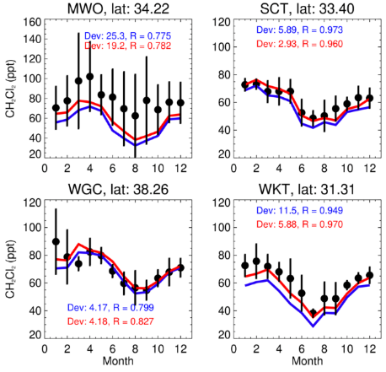
Independent verification: tall tower sites
The NOAA tall tower network provides a cluster of ‘independent’ (to the inversion) observations based in the USA. Figure compares performance of prior and posterior model outputs with these observations, in 2015 (monthly means).
CH₂Cl₂
Mean CH₂Cl₂ deviations between the observations and model outputs are generally reduced due to the inversion, but this improvement is smaller where the prior model output performed well to begin with.

Slide 18
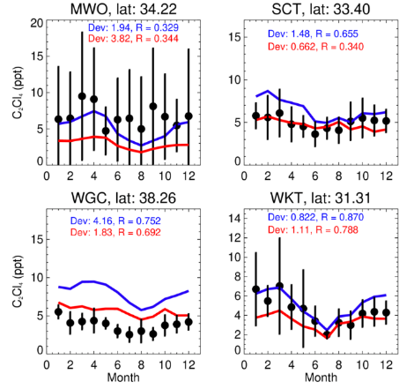
Independent verification: tall tower sites
The NOAA tall tower network provides a cluster of ‘independent’ (to the inversion) observations based in the USA. Figure compares performance of prior and posterior model outputs with these observations, in 2015 (monthly means).
C₂Cl₄
Large decreases in North American C₂Cl₄ emissions leads to similar decreases in the posterior model output – this leads to good improvement at background sites (e.g. WGC), but less representative at more locally polluted sites (e.g. MWO).

Slide 19
Summary
We have quantified regional and global emissions of CH₂Cl₂ and C₂Cl₄ over a 12-year study period, 2006-2017.
Our approach optimised a set of prior global emissions using a synthesis inverison procedure.
We estimate global total CH₂Cl₂ emissions increased by 85% over the study period, mainly reflecting increases in Asian emissions. Over the same period, European and N American emissions decline, indicating a continental-shift in the emisison distribution.
In contrast, global C₂Cl₄ emissions steadily decrease, by 24%, over the 11-year study period.
Our resulting gridded set of global Cl-VSLS emissions have been evaluated and shown to perform well. They can be used in future model studies to look at impacts of Cl-VSLS in the troposphere and stratosphere.

Slide 20
Appendix 1: synthesis inversion
The equation to solve for optimised posterior emissions in the synthesis inversion process is as follows:
$x_{a}=x_{b}+{\left[G^{T}.R^{−1}.G+ B^{−1}\right]}^{−1}.G^{T}.R^{−1}.(y−G.x_{b})$
where $x_{a}$ are posterior emissions, $x_{b}$ are prior emissions, $G$ is the concentration model output, $y$ is the observations, $R$ is the covariance matrix for the observational errors and $B$ is the covariance matrix for the emissions errors.
The equation to determine $R$ for a given observation is provided by the total observational error, $σ_{total}$:
$σ_{total}= \sqrt{{σ_{sf}}^{2}+ {σ_{meas}}^{2}+ {σ_{mismatch}}^{2}}$
where the three terms under the square root represent error contributions due to sampling frequency error, measurement error, and model misrepresentation, respectively.

Slide 21
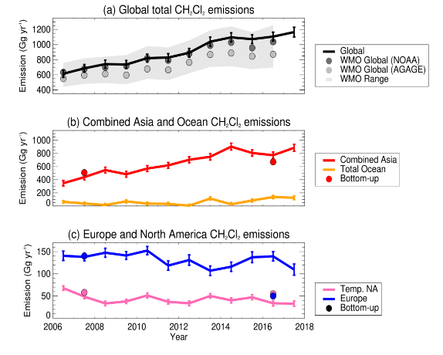
Appendix 2: ocean emissions
CH₂Cl₂ emissions experiment – the 4 ocean regions were added to a separate inversion.
Follows same trend as main scenario, but with smaller Asian contribution (75% in 2017), and ocean contribution of 11% in 2017. Global total 1166 Gg yr⁻¹ (c.f. 1177 in main scenario).
The close similarities lead to no changes in observational comaprisons between the two cases.
Inconclusive whether ocean emissions are significant.

