Slide 1
Nonlinear drift resonance between charged particles and ULF waves
Xu-Zhi Zhou¹, Li Li^{1,2}, Yoshiharu Omura²
Peking University, Beijing, China
Kyoto University, Kyoto, Japan
In colaboration with:
Qiu-Gang Zong, Suiyan Fu, & Robert Rankin

Slide 2
ULF waves in the magnetosphere
Hydromagnetic waves standing on closed geomagnetic field lines
Ionosphere
Ionosphere
Fixed
B₀
B₀
Second Harmonic
Fundamental Mode
Fixed
Ionosphere
Ionosphere
Standing
Shear Alfven waves

Slide 3
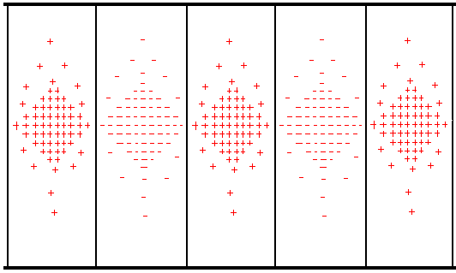

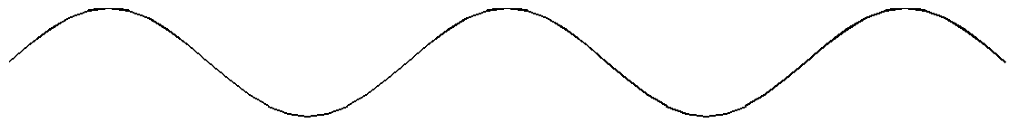

ULF wave-particle resonances
ULF waves can accelerate and transport magnetospheric particles via a process named drift resonance [Southwood & Kivelson, 1981].
Particle motion in ULF wave field:
Observational signatures?
High-energy particle fluxes lead low-energy fluxes by 180º across the resonant energy
wave rest frame
Virtual Spacecraft observations:
Low-energy particles
Resonant particles
High-energy particles

Slide 4
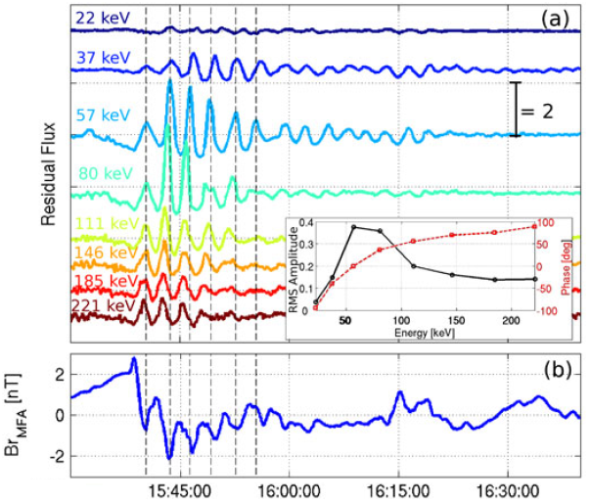
Observations of drift resonance
Observations from Van Allen Probes (resonance at 60-80 keV):
Signatures:
High-energy particle fluxes lead low-energy particle fluxes, by 180º across resonant energy
[Claudepierre et al., 2013]

Slide 5
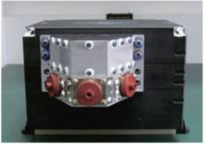
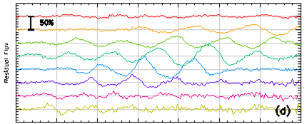
Observations of drift resonance
Observations from BD-IES
Phase shift in electron
fluxes greater than 180º
across energies?
Caused by spatial & temporal variations of ULF wave amplitude.
[Li, Zhou et al., 2017]

Slide 6
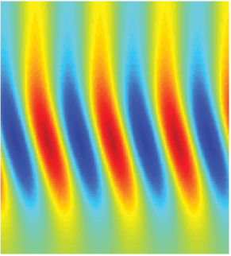
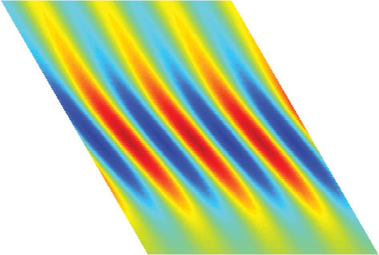
Resonance in waves with a finite lifespan
Consider the spatial distribution of particle fluxes after interacting with quasi-steady ULF waves
Particle motion in ULF wave field:
W
wave rest frame
Spatial distribution
LT
If we turn off the waves at this moment, particles would drift at an energy-dependent velocity with their energies unchanged

Slide 7
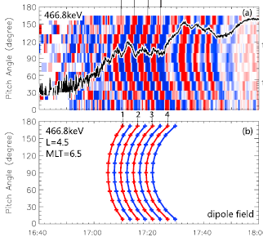
Observations of drift resonance
Observations from BD-IES
Remote signatures for
spatially & temporally
localized ULF waves
Similar effects in pitch
angle spectrum
[Hao et al., 2017; Kamiya et al., 2018]
[Li, Zhou et al., 2017]

Slide 8
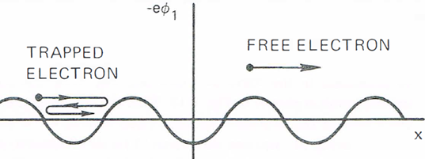
Nonlinear interactions
In the framework above, unperturbed particle drift orbits are assumed despite their energy gain/loss from the ULF waves
Not realistic for strong waves -- nonlinear response expected!
Nature of the nonlinear behavior
E
In analogy to the Landau
damping of Langmuir waves
High-energy particles
Low-energy particles

Slide 9
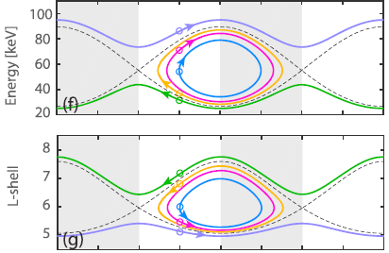


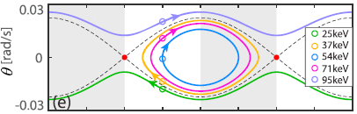
Nonlinear interactions
Complications: charged particles move inward/outward when they gain/lose energy from the ULF waves.
The time variations of energy and
L can be reorganized, into particle
location and drift velocity in the
wave rest frame.
Pendulum equation of motion

Slide 10
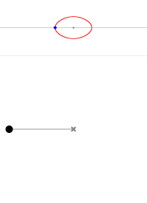
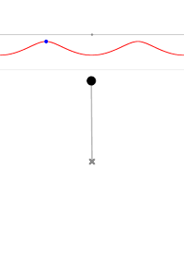

Nonlinear interactions
Complications: charged particles move inward/outward when they gain/lose energy from the ULF waves.
The time variations of energy and
L can be reorganized, into particle
location and drift velocity in the
wave rest frame.
Pendulum equation of motion
with characteristic frequency:
based on small-angle approximation

Slide 11
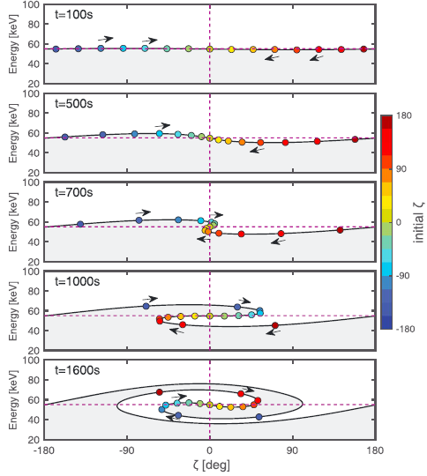
Nonlinear interactions
Evolution of particle
phase-space locations
within ULF waves
Formation of rolled-up
structures as nonlinear
effects dominate

Slide 12
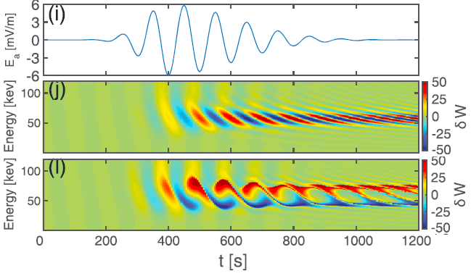
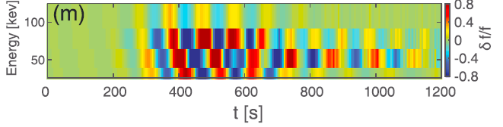
Observations of nonlinear drift resonance
Expected signatures of nonlinear drift resonance
Expectations from linear theory
Rolled-up structures from nonlinear theory
However, rolled-up structures are hardly visible in realistic data with lower resolution (due to phase mixing)
[Li, Zhou et al., 2018]

Slide 13
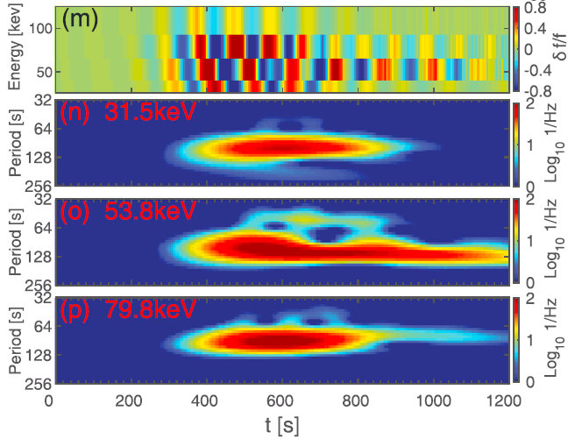
Observations of nonlinear drift resonance
Indications from wavelet spectrum (at each energy channel)
Higher harmonic of particle flux oscillations only appear near the resonant energy
[Li, Zhou et al., 2018]

Slide 14
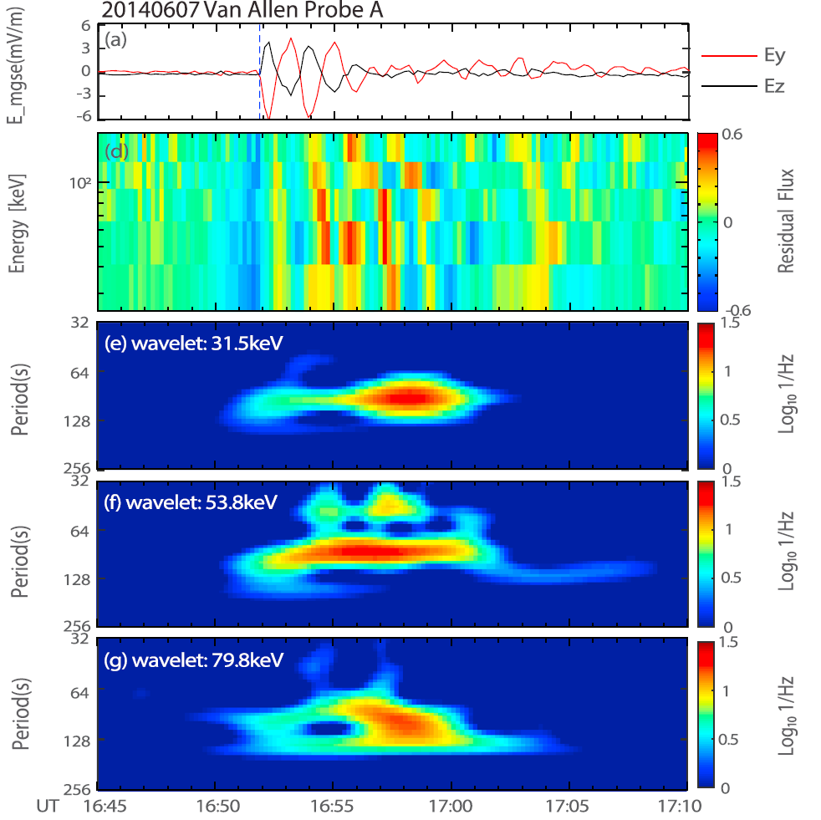
Observations of nonlinear drift resonance
Observations from Van
Allen Probes
Higher harmonic of
particle flux oscillations
only appear at 53 keV,
indicating occurrence of
nonlinear drift resonance
More direct evidence of
nonlinear drift resonance
requires high resolution
data
[Li, Zhou et al., 2018]

Slide 15
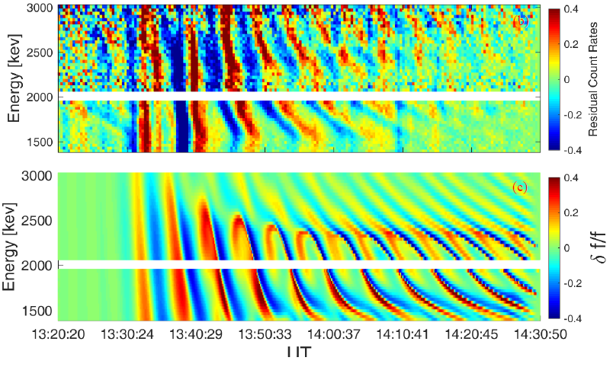
Observations of nonlinear drift resonance
High-resolution, ‘histogram’ data from MegEIS/Van Allen Probes are recently available (see Hartinger et al., 2018)
An example:
High-resolution
‘histogram’ data
Preliminary
simulation result

Slide 16
Consequence of nonlinear resonance
How can resonant particles achieve stronger acceleration than the trapping width?
Roles of dawn-dusk electric field?
Additional acceleration @ night
& deceleration @ dayside

Slide 17

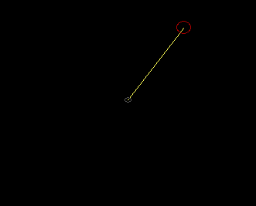
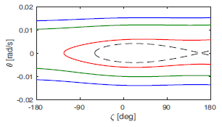
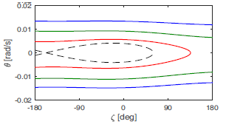
Consequence of nonlinear resonance
How can resonant particles achieve stronger acceleration than the trapping width?
Roles of dawn-dusk electric field?
Additional acceleration @ night
& deceleration @ dayside
Driven pendulum equation
with MLT-dependent torque applied
nightside
dayside
Quasi-periodically force pendulum

Slide 18
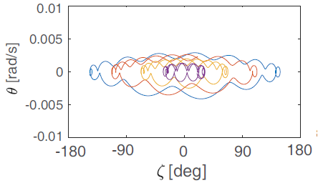
Consequence of nonlinear resonance
Whether chaotic orbits appear or not depends on the ratio between the particle trapping frequency and drift (driving) frequency
Small m: drift freq >> trapping freq
Large m: drift freq << trapping freq
Intermediate m: drift freq ~ trapping freq
Particles are trapped in the potential
well despite very large perturbations
Some remain trapped. Untrapped particles are accelerated & transported inward at nightside and decelerated & transported outward at dayside
Chaotic motion, diffusion

Slide 19
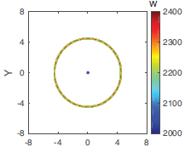
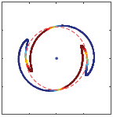
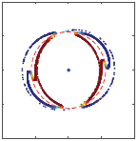
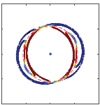
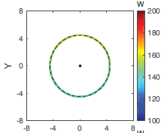
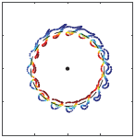
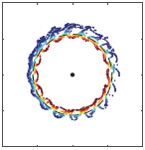
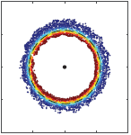
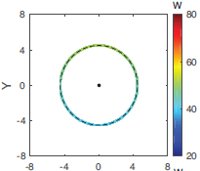
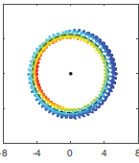
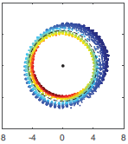
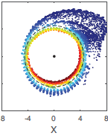
Simulation
Particles are launched at resonant energies
m=2
m=16
m=60

Slide 20
Summary
ULF waves play an important role in the particle dynamics within the inner magnetosphere
Extension of conventional drift resonance theory towards the nonlinear regime, to formulate the nonlinear particle trapping with a pendulum equation
First observational identification of nonlinear drift resonance
Dawn-dusk electric field serves as an inhomogeneity factor in the pendulum equation, which causes particle scattering especially when the particle trapping frequency is close to the drift frequency

