Slide 1
ULF wave modulation of the ionosphere as observed by SuperDARN radars and GPS/TEC technique
O.V. Kozyreva, V.A. Pilipenko, E.C. Bland, L.J. Baddeley, and V.I. Zakharov
Institute of Physics of the Earth, Moscow;
University Centre in Svalbard, Norway Moscow State University

Slide 2
Early Observations
Pc5 waves (T~3-10 min) are the most powerful wave process in the terrestrial environment and they can significantly modulate the ionosphere. An examination of the impact on the ionosphere by disturbances of different physical nature with data from magnetometers and ionosphere sounding techniques: radars, riometers, and GPS receivers, may provide an insight into the mechanisms of the magnetosphere-ionosphere coupling.
Capabilities of magnetometers are limited because they cannot measure in-situ long-period ULF waves in the region where the energy transfer from the magnetosphere into the upper atmosphere-ionosphere.
Ionospheric radars (e.g., SuperDARN) have become a valuable tool, providing information about ULF wave interaction with the ionosphere. ULF wave activity observed by a radar is not just a replica of geomagnetic waves observed on the ground.
Information on total electron content (TEC) of the ionosphere from the global navigational satellite systems (GPS, GLONASS, etc.) can provide a new clue on the modulation of the ionospheric plasma by ULF disturbances.

Slide 3
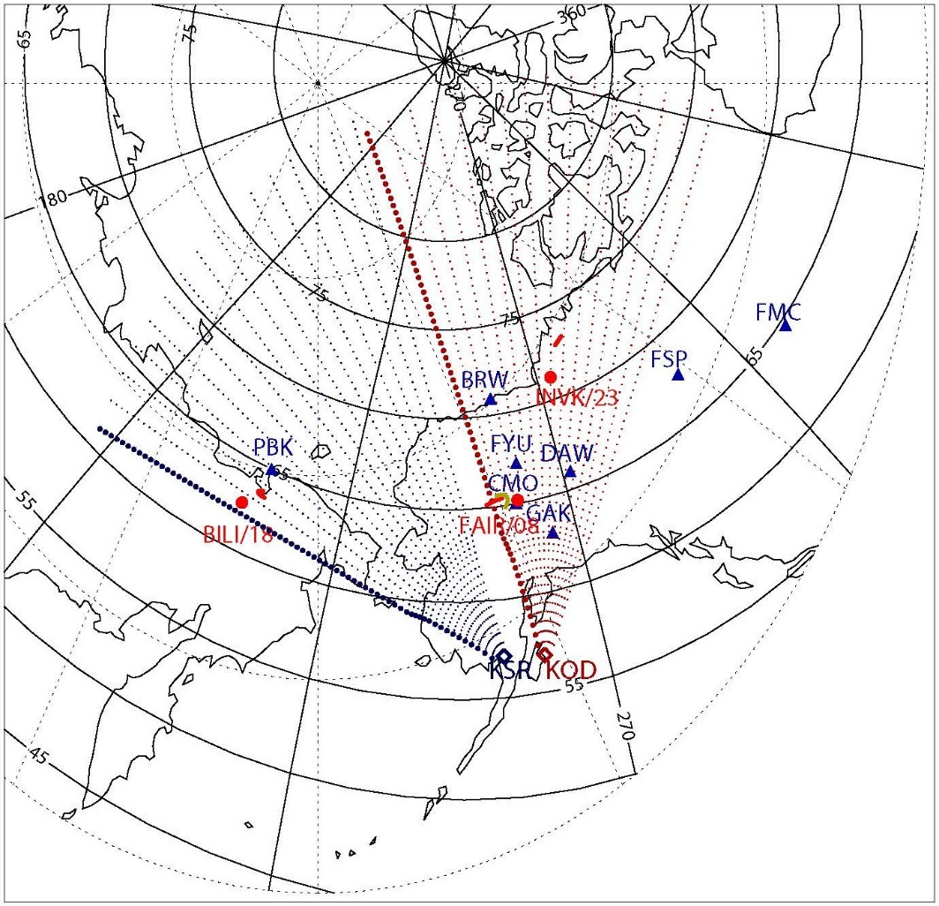
Magnetometer network 1-min data allows a construction of the latitudinal and longitudinal profiles of the ULF wave activity.
SuperDARN HF radars The Kodiak (KOD, 2-min) and King Salmon (KSR, 1-min) SuperDARN radars with 16 beams and 75 range gates (45 km resolution) enable one to measure with high temporal and spatial resolution (~50 km) the ionospheric velocity V along a beam in the F-region ionosphere
GPS/TEC receivers Array of GPS receivers provide 30-sec data on slant TEC, which has been recalculated into the vertical TEC N_{T}. To avoid uncertainties of the absolute value N_{T} determination we derived from GPS data the rate of TEC changes (ROT) dN_{T}/dt using the phase measurements only. A radio path between a ground receiver STN and GPS satellite with the PRN N is denoted as STN/N.

Slide 4
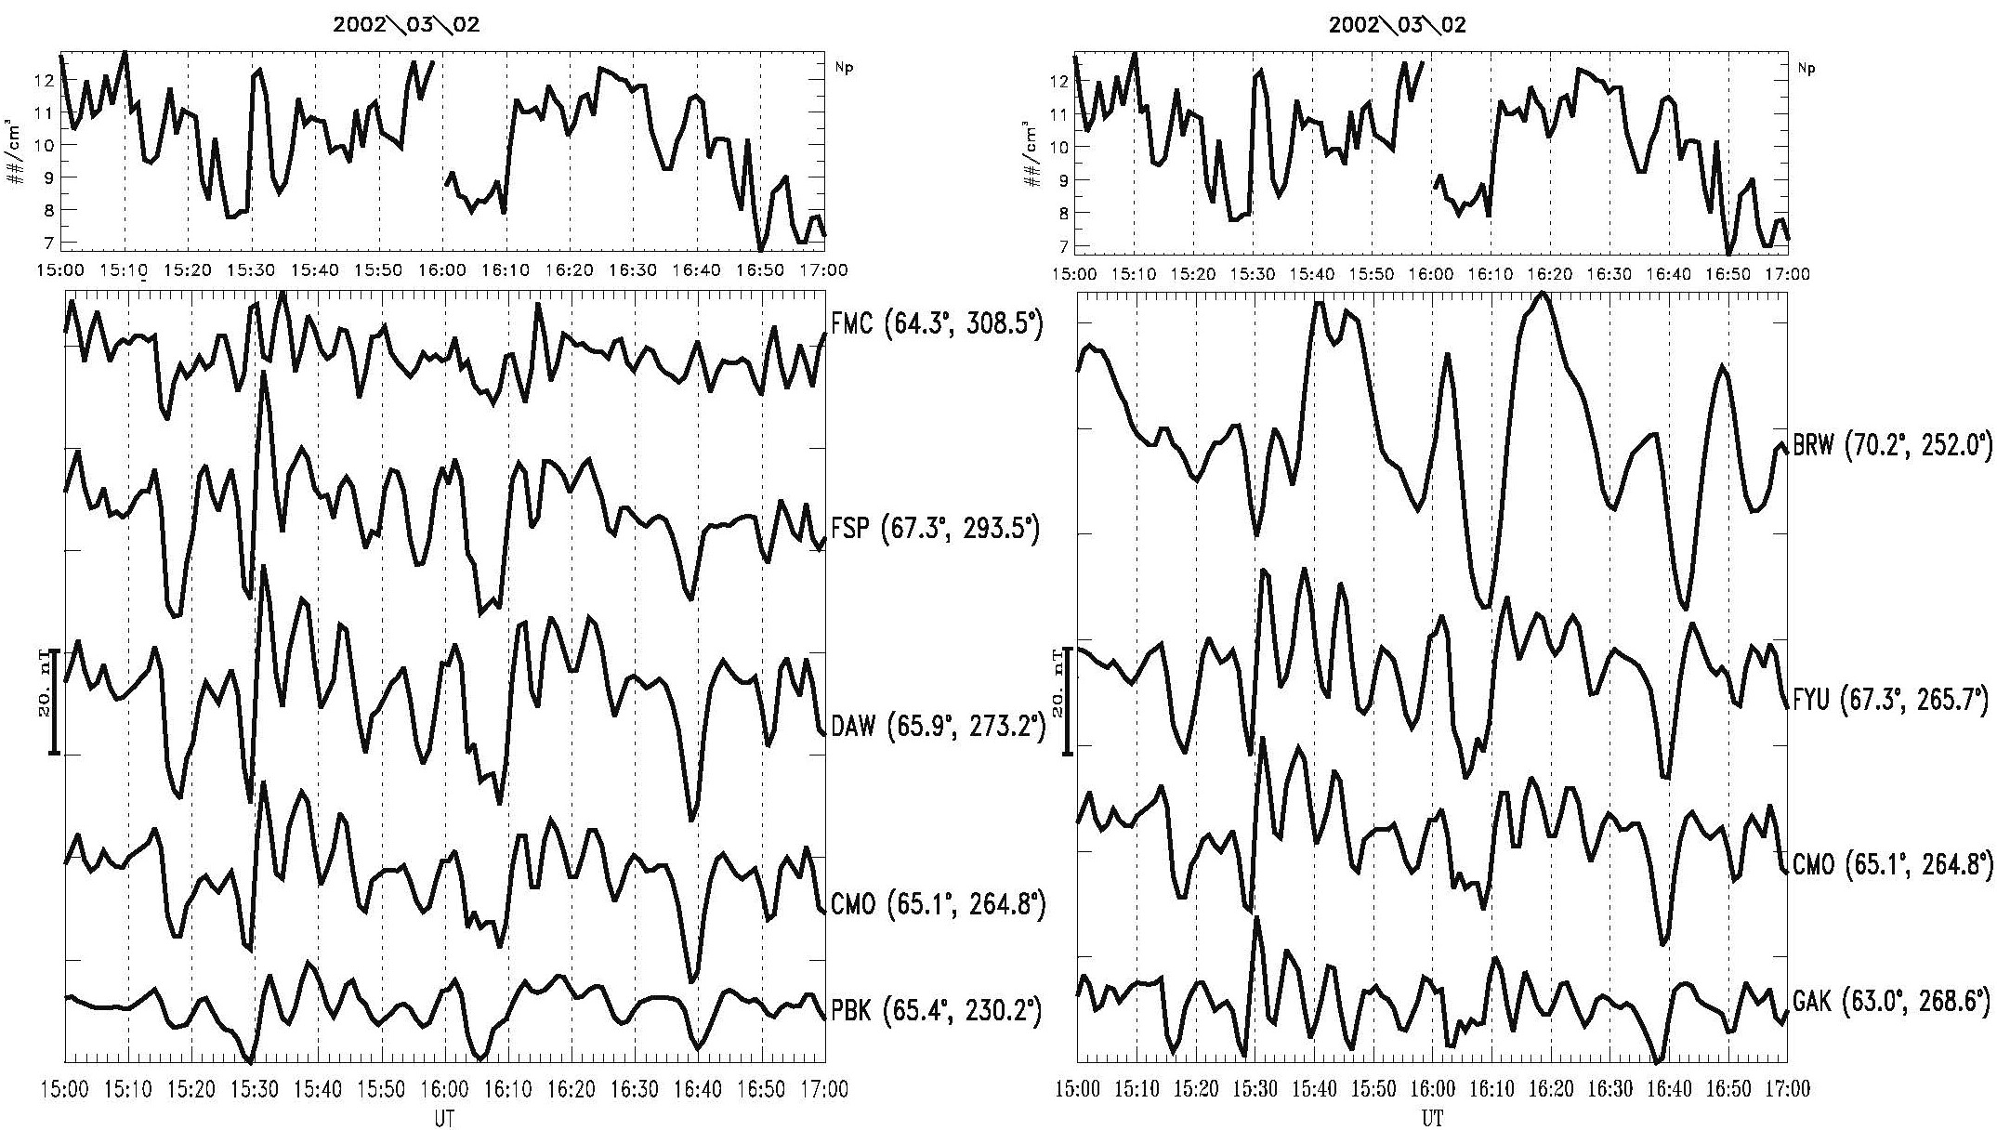
On March 02, 2002 bursts of transient geomagnetic Pc5 pulsations are stimulated by jumps of the solar wind Np from ~2 cm⁻³ to ~8 cm⁻³ on the background of steady solar wind V~380 km/s.
Longitudinal magnetometer array shows westward (anti-sunward) wave propagation
Latitudinal profile shows that Pc5 waves are concentrated at Φ~63º-67º. At Φ≥70º, daytime high-latitude irregular pulsations (IPCL) can be seen at cusp latitudes.

Slide 5
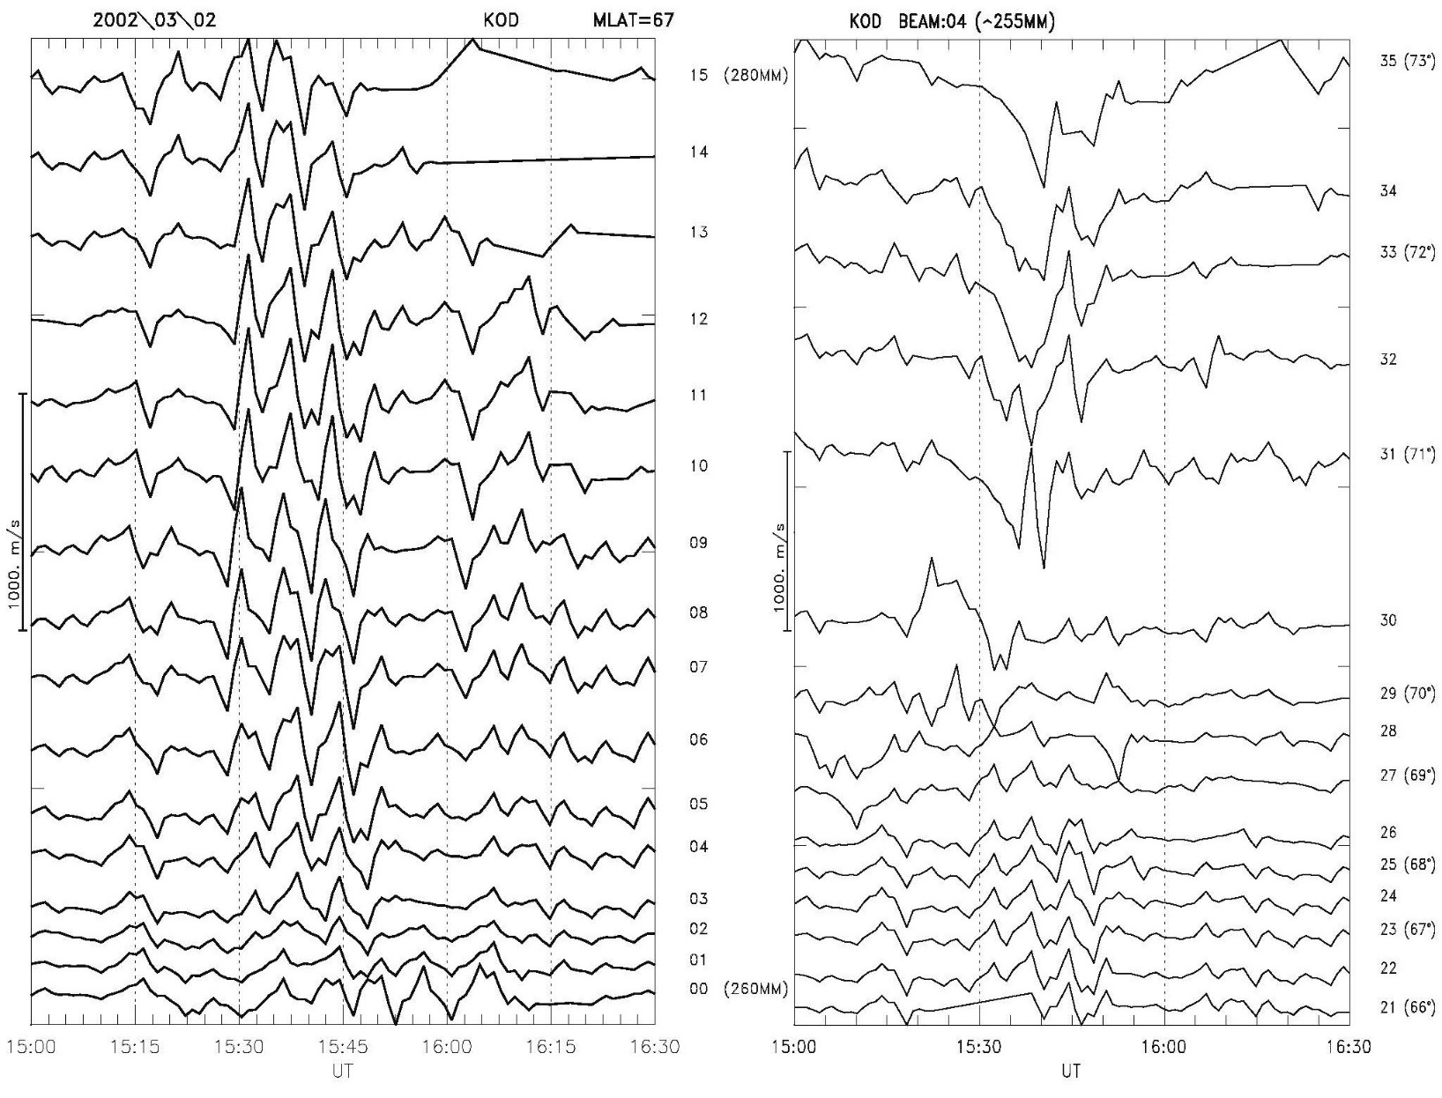
Spatial structure of ionospheric ULF wave signatures
~71º-73º IPCL
<70º Pc5 waves
From analysis of longitudinally spaced KOD range gates at Φ~67°: wave azimuthal number m=8±3; azimuthal scale λy~1500 km.
Latitudinal profile of Doppler velocity oscillations (meridional component V~Vx) constructed from KOD data

Slide 6
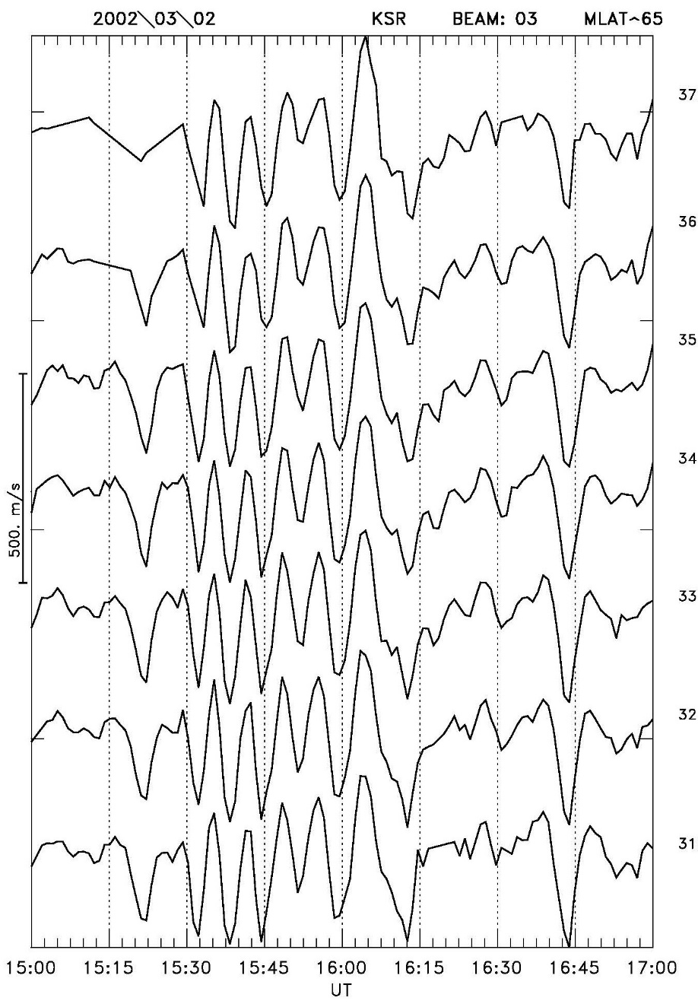
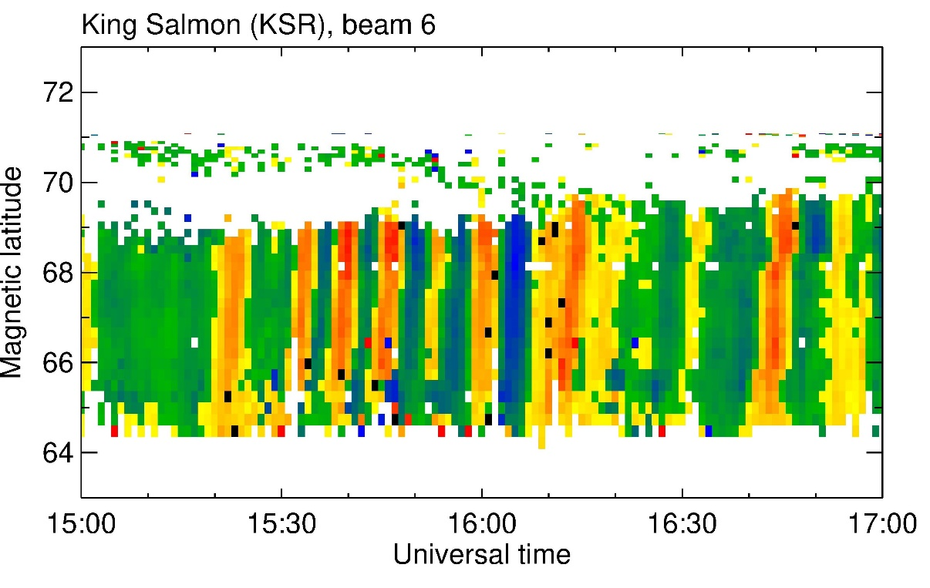
From KSR multi-beam radar data the longitudinal profile has been constructed along Φ~65º of Doppler velocity (azimuthal component V~V_{y} ) with peak-to-peak amplitudes V_{y}~300 m/s.
Spatial phase structure of ionospheric Pc5 oscillations
An inclined pattern of Doppler velocity at RTI plot indicates an apparent poleward propagation of the ionospheric Pc5 pulsations

Slide 7
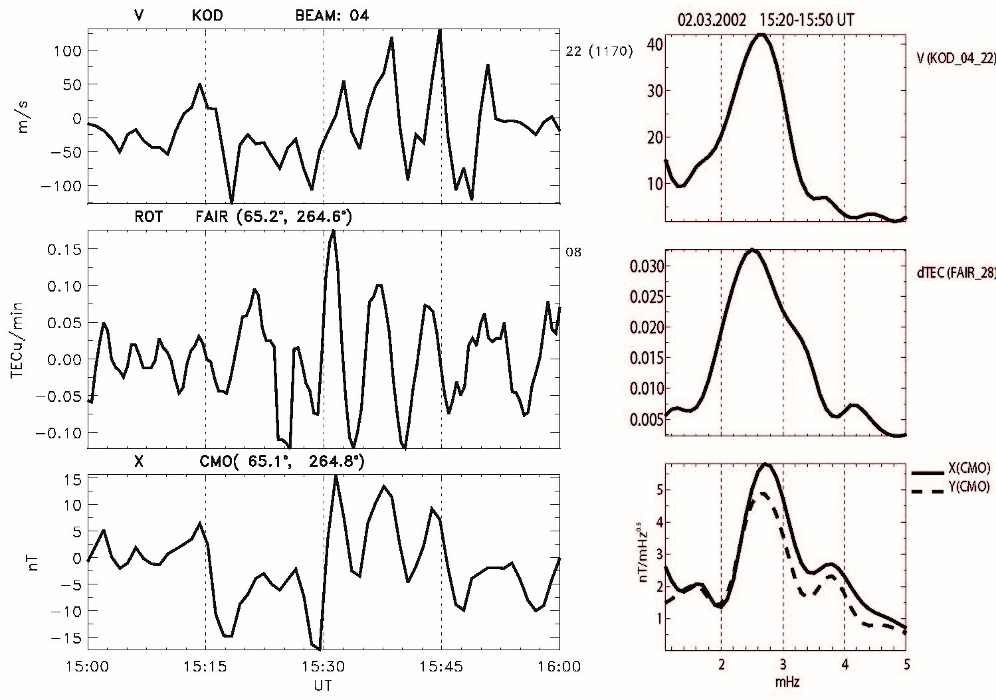
Comparison of radar beam KOD/04 (Vx component), TEC (ROT from FAIR/08 track), and magnetometer (X component) at CMO
Transient Pc5 pulsations are observed by all instruments with p-t-p amplitudes Vx~200 m/s, ROT~0.2 TECu/min, and Bx~15 nT.
Spectra of variations of the magnetic field, ionospheric Doppler meridional velocity, and ROT reveals dominant f~2.6 mHz (T~6.4 min) in all instruments.

Slide 8
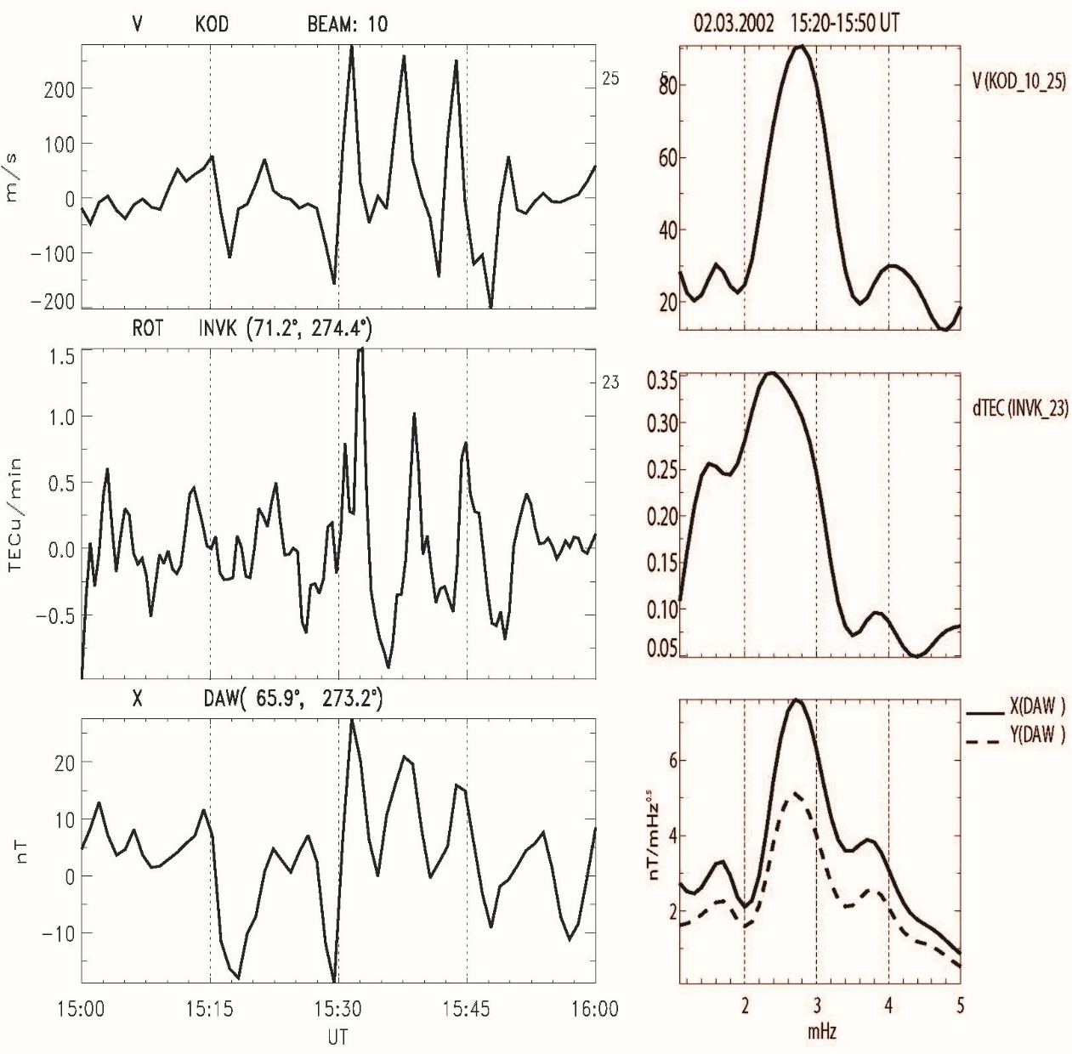
Comparison of KOD/10 radar Doppler velocity (V~Vx) , ROT from INVK/23 track, and magnetic field (X component) at BRW (at the same Φ as the pierce point)
Doppler
Sounder
A good correspondence between Pc5 signatures in all instruments! The p-t-p amplitudes of variations are Vx~300 m/s, ROT~1.0 TECu/min, and X~20 nT. Spectra of both ionospheric and magnetic field variations confirms the occurrence of coherent pulsations with f~2.6 mHz.

Slide 9
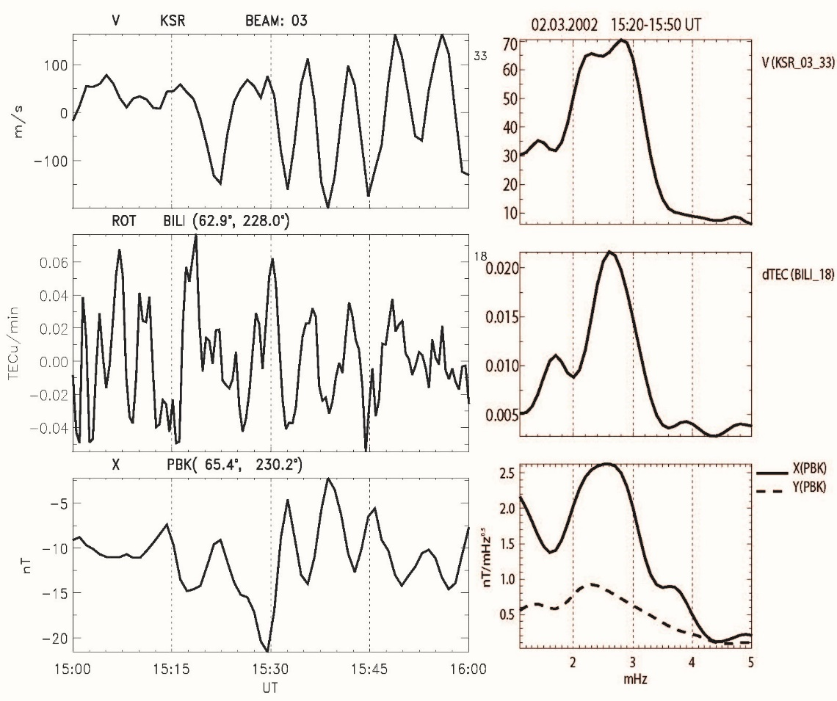
Not observed on the ground, only by Doppler sounding
Comparison of KSR/03 Doppler velocity (azimuthal component Vy), ROT from BILI/18 track, and magnetic field (X component) at PBK station
Transient Pc5 pulsations are observed by all instruments with peak-to-peak amplitudes Vy~300 m/s, ROT~0.06 TECu/min, and X~15 nT.
Spectra show pulsations with f~2.6 mHz both in the geomagnetic field and ionosphere.
Are they observable with GPS?
Waters et al., 2007

Slide 10
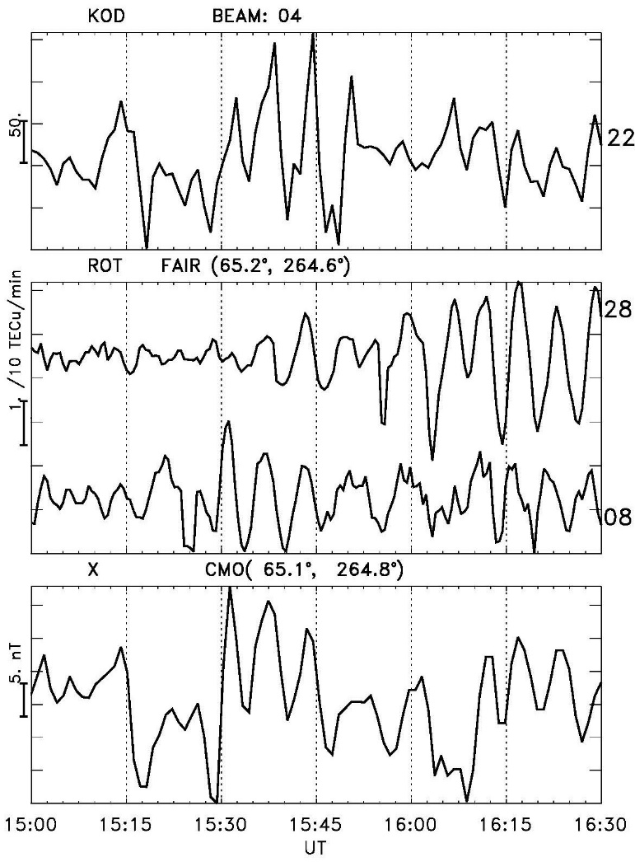
Comparison of Doppler radar velocity KOD/04 (Vx component), ROT from two nearby radio paths, and magnetic field (X component).
Although radio paths FAIR/28 and FAIR/08 are close to each other, their ROT waveforms are not identical.
Ratio between the spectral amplitudes at f=2.6 mHz :
KOD: Vx/X(CMO)~7 (m/s)/nT; Vx/X(DAW)~12 (m/s)/nT
KSR: Vy/X(PBK)~25 (m/s)/nT
Ratio of spectral amplitudes between ROT and V:
ROT(FAIR/08)/Vx(KOD/04)~7.6⋅10⁻⁴ (TECu/min)/(m/s)
ROT(INVK/23)/Vx(KOD/10)~34⋅10⁻⁴ (TECu/min)/(m/s)
ROT(BILI/18)/Vy(KSR/03) ~3.4⋅10⁻⁴ (TECu/min)/(m/s)
These results provide a valuable information for modelers trying to interpret the effects of the ULF wave modulation of the ionosphere.

Slide 11
Plausible mechanisms of the ionosphere modulation by ULF waves
Theory of Alfven wave interaction with the thin ionosphere: ratio of the ionospheric plasma toroidal component V_{y} to the ground magnetic disturbance Bx
The ionospheric conductances predicted by the IRI-2016 model are rather low: at CMO Σ_{P}=0.8 S, and Σ_{H}=0.6 S, whereas at PBK Σ_{P} = 0.3 S, and Σ_{H}=0.3 S. Magnetic field inclination is I~80º.
According to this estimate the ratio between drift velocity in the ionosphere and ground magnetic response must be ~23 (m/s)/nT. The observed ratio between KOD/10 and CMO (X component) is ~7 (m/s)/nT and for KOD/04 and DAW (X component) is ~12 (m/s)/nT.
For the KSR/PBK pair the ratio must be ~47 (m/s)/nT. The observed ratio between the amplitude of the ionospheric velocity at KSR/03 beam and ground magnetic response is ~25 (m/s)/nT.
Observed ratios agree with the theoretical estimate with an accuracy ~50%. Keeping in mind the model simplicity, uncertainty of the ionospheric background parameters, and mismatch between the radar backscatter location and position of a ground magnetometer the correspondence is qualitatively good.

Slide 12
TEC and Doppler velocity pulsations
A plausible mechanism of TEC modulation may be related to field-aligned plasma transport: FAC and thermal electron flux transported by an Alfven wave cause a depletion/accumulation of plasma in the ionosphere. As a result, the plasma density in a region with strong vertical gradient of N_{e}(z) may increase/decrease.
An upper estimate of variation of plasma density integrated along a flux tube, N_{T}, can be obtained from the height-integrated balance equation
The current j_{z} entering the upper ionosphere by an Alfven wave is related to the transverse electric field E⊥ in the ionosphere
Combination of balance equation with this estimate yields
For the realistic parameters of wave and ionosphere the above estimate provides
The predicted value is about order of magnitude less than observed relationship ROT/Vy~3⋅10⁻⁴ (TECu/min)/(m/s) for the BILI/18-KSR/03 pair. Thus, other mechanisms should be considered.

Slide 13
Puzzling results
The ionosphere modulation may be associated with the heating of the ionospheric ions
Assuming that |V|=300 m/s, the Joule heating can cause the Ti enhancement up to ΔT_{i}~70º K.
The plasma heating may shift the ionization-recombination balance due to the temperature-dependent recombination coefficient β(T)∝T, and cause plasma density variations, owing to periodic ion heating of F-layer plasma and subsequent increase/decrease of β and N
According to this estimate, for T~10³ K, and ΔT~70 K, the expected plasma modulation depth is to be ΔN_{T}/N_{T}~7%. Therefore, for ΔN_{T}~0.3 TECu, the estimated amplitude of the ROT variations with period T~6.4 min is ROT~ 2πΔN_{T}/T~0.3 TECu/min.
This estimate is within the range of observed magnitude of TEC modulation, ROT~0.2-1.0 TECu/min.

Slide 14
TEC modulation due to a periodic drift across a lateral gradient of the ionospheric plasma with velocity V induced by an Alfven wave
Assuming that in the N-S direction at latitude distance ΔΦ[deg] the TEC value varies by ΔN_{T}, the possible variations of TEC can be estimated as
A latitudinal gradient of TEC in the region of Alaska from global TEC maps (http://vt.superdarn.org) is ΔN_{T}/ΔΦ~4 TECu/deg. Thus, the expected normalized effect may be ROT/Vx~2⋅10⁻³ (TECu/min)/(m/s).
Therefore, a steep latitudinal gradient of TEC may be sufficient to produce observed TEC modulation by ~(0.8-3.0)⋅10⁻³ (TECu/min)/(m/s). The occurrence of a wide range of plasma inhomogeneities in the auroral ionosphere may explain a large variety of the observed TEC responses to Pc5 waves.
Modulated precipitation of soft electrons
Periodic oscillations of field-aligned flux of soft electrons driven by Alfven wave cannot be detected by riometers, but it can cause additional ionization in the F-layer. However, this assumption cannot be validated because of lack of relevant data from any ground instrument (e.g., imagers) or LEO satellites.

Slide 15
So what?
Impulses of the solar wind density triggered transient Pc5 pulsations on the morning flank both in geomagnetic field and ionospheric plasma. GPS/TEC technique has turned out to be sensitive enough to detect Pc5 waves even with a moderate amplitude on the ground, ~20 nT. These results are the first simultaneous observations of Pc5 waves by radar, GPS, and magnetometer. The measured ratios between spectral amplitudes of Doppler velocity, TEC, and magnetic field oscillations can be a basis for future theories of ULF wave modulation of the ionosphere.
The relationships between amplitudes of variations of the ionospheric velocity and geomagnetic field have been reasonably well interpreted with the theory of Alfven wave interaction with the thin ionosphere.
Although the presented results have provided additional observational evidence of the TEC modulation by ULF waves, a responsible modulation mechanism is not comprehended yet. Such mechanisms, as the ion heating and field-aligned plasma transport, seemingly cannot alone interpret the observed effects. Occurrence of local steep gradients at auroral latitudes, >1 TECu/deg, may be sufficient to produce the observed TEC modulation by Alfven waves.
The effect of TEC modulation by Pc5 waves is a challenge for the MHD wave theory, because the responsible mechanism has not been established yet. Combined usage of magnetometers, radars, and GPS/TEC receivers is a perspective way to reveal the physics of the ionosphere modulation. It may open a possibility to monitor a modulated precipitation of soft electrons, which cannot be detected by riometers.
This study is supported by the grant ES647692 from the program INTPART of Research Council of Norway

