Slide 1
Methods in studying the effects of soil amendments on greenhouse gas emissions from cultivated peatland, and the effects on associated soil microbe communities
Jussi Ronkainen¹, Maarit Liimatainen ², Henri Siljanen¹, Marja Maljanen ¹
¹ University of Eastern Finland, Department of Environmental and Biological Sciences, P.O. Box 1627, 70211 Kuopio
² Natural Resources Institute Finland, Product Systems, Meat and non-food animal production, Oulu, Finland, Paavo Havaksen tie 3, 90570 Oulu
Agricultural organic soils such as peatfields are a major source of large quantities of greenhouse gases (GHG) such as carbon dioxide (CO₂) and nitrous oxide (N₂O)
Soil amendments are widely used to improve yield of crops by improving soil quality
Can soil amendments such as calcium carbonate, gypsum or biochar be used to inhibit GHG emissions from agricultural peat soils?
Does soil amendment addition affect the population structure or group activity of soil microbial communities?

Slide 2
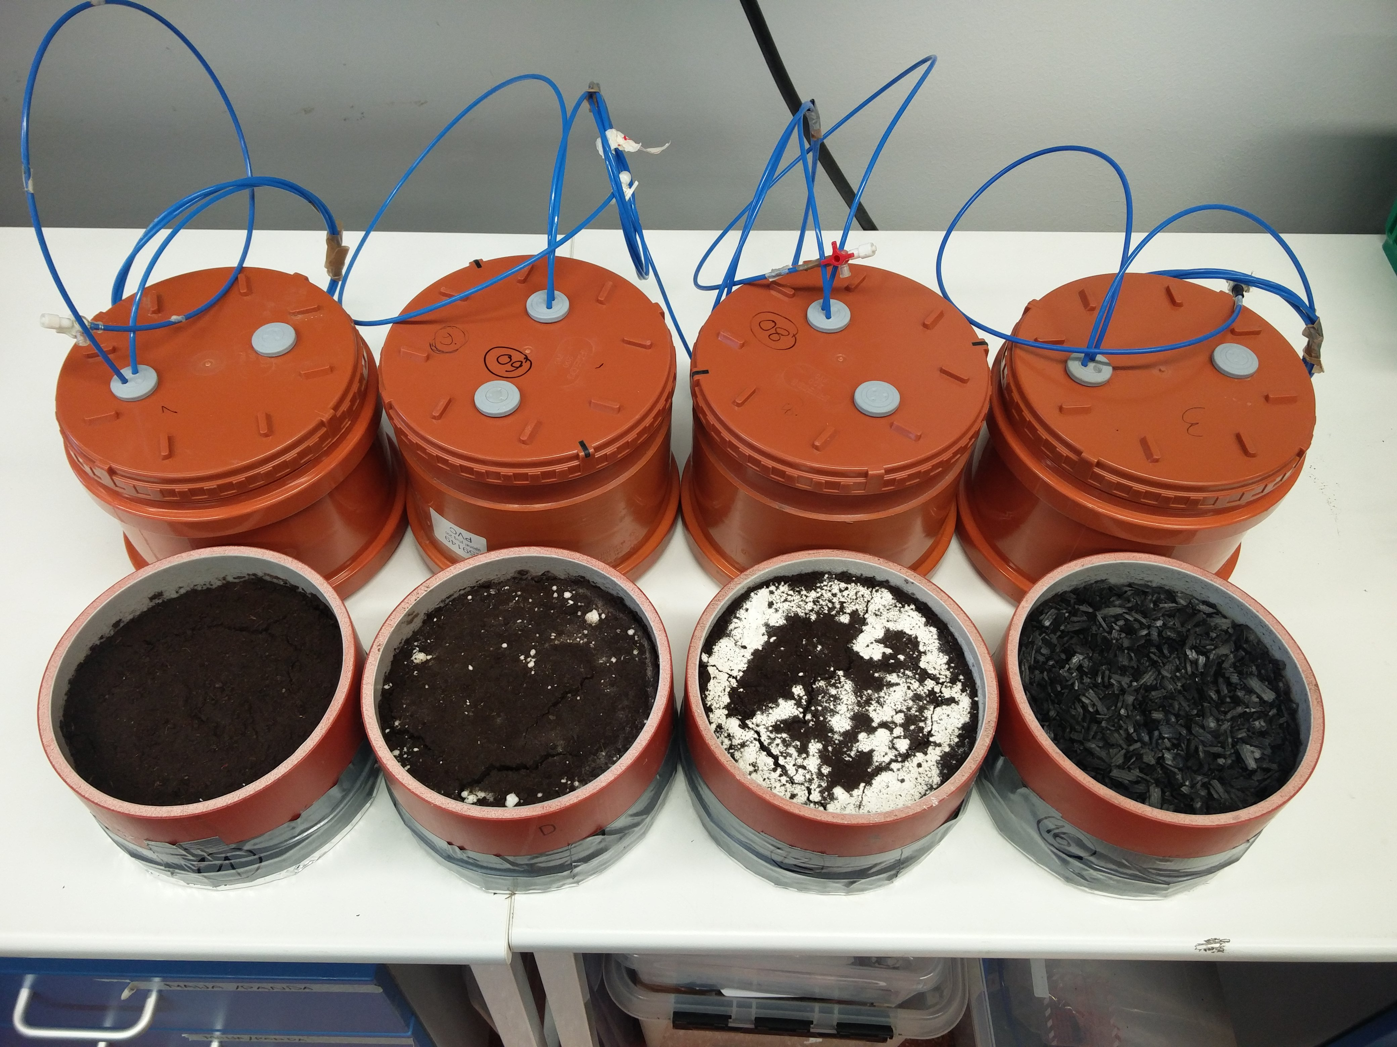
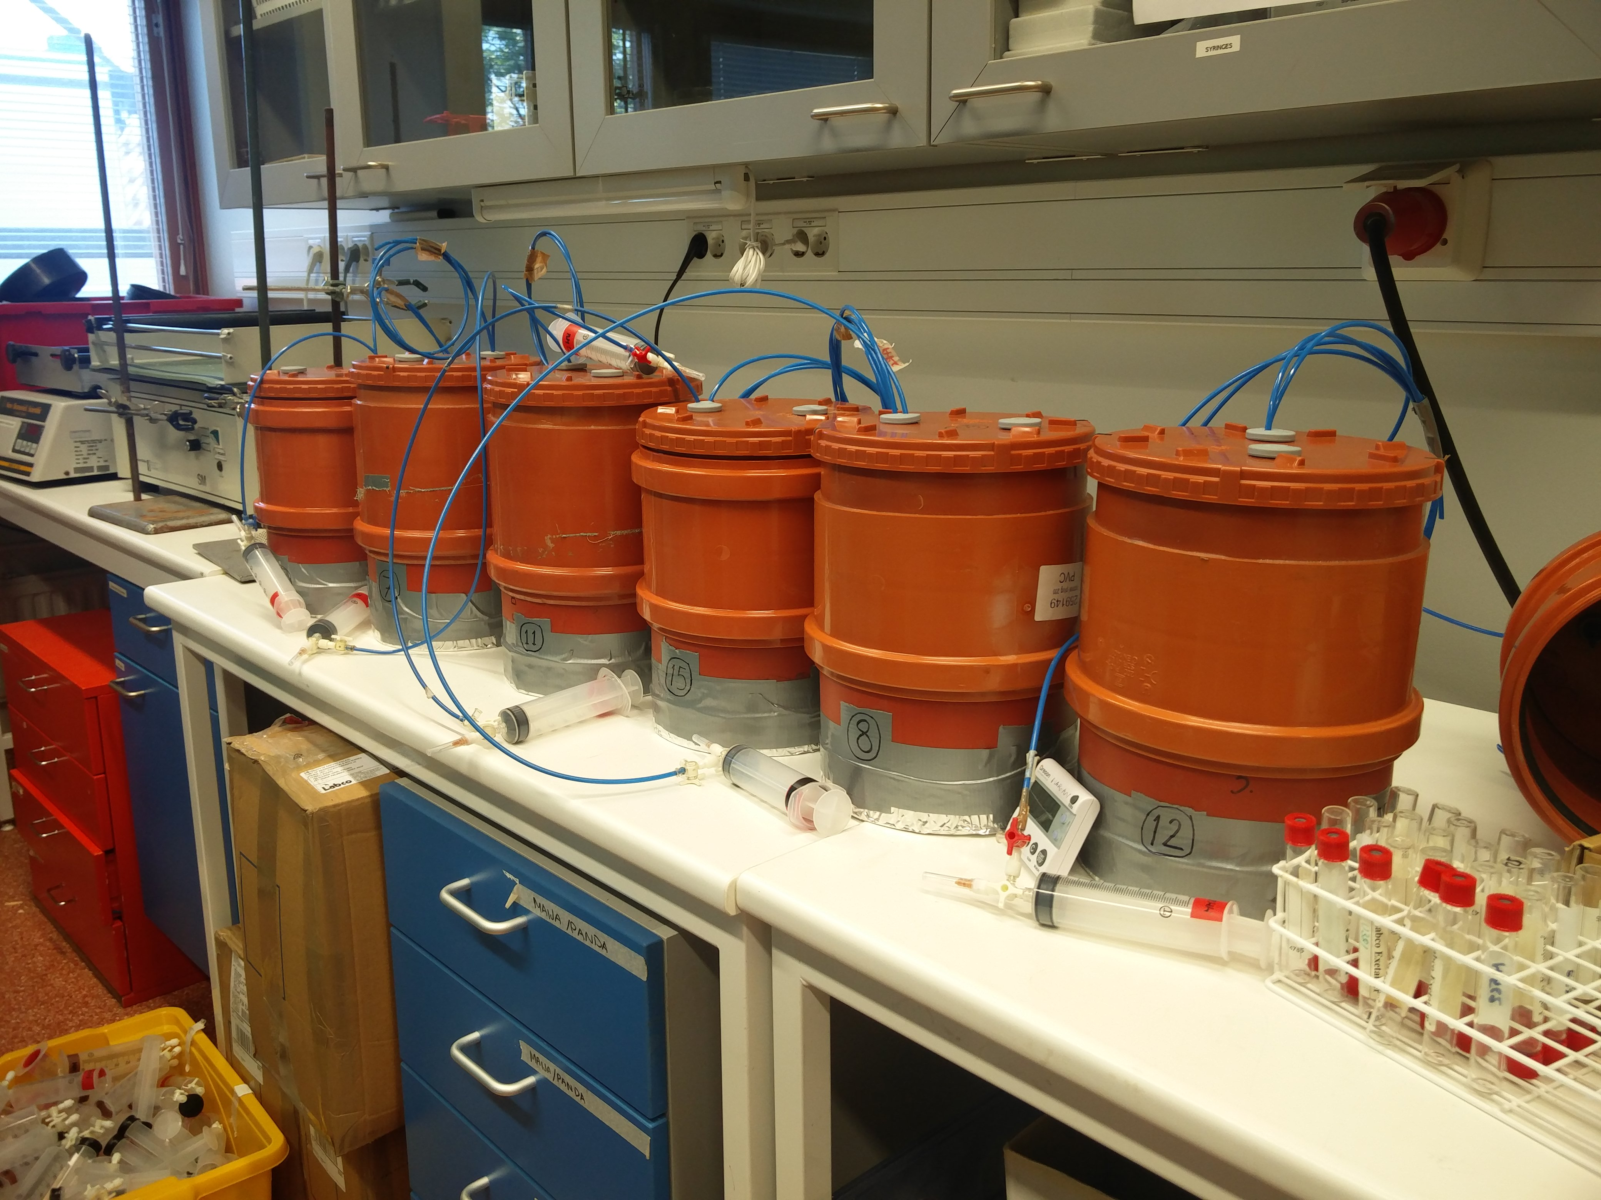
Latest experiment
Packed core incubation for 71 days
Gas sampling with chambers and analysis with Gas Chromatography Mass Spectrometer for CO₂ and N₂O at multiple time points
Single point measurements for nitrous acid (HONO) and nitrogen oxides (NO_{x})
Measurements for soil anion and ammonium concentrations, pH and electrical conductivity before and after the incubation
Extracting DNA and RNA from soils before and after the incubation for community structure sequencing based on16S rRNA-gene, and community activity study based on gene copy numbers of key nitrogen cycle enzyme-coding genes (amoA, nirK, nirS, narG, nrfA)
Treatments, left to right: Control, Gypsum, Calcium Carbonate, Biochar
Gas sampling in progress

Slide 3
I’d be interested in discussing with anyone doing experiments on the effects of soil amendments on greenhouse gas emissions, especially biochar
I’m also interested in discussing about the challenges involved in extracting and amplifying DNA and RNA from soil samples.
During laboratory work we incorporated a method for determining DNA/RNA extraction efficiency via the use of DNA/RNA standard during extraction and purification of sample nucleic acids, and I’d be more than happy to share experiences in such methods!
Acknowledgement
This research is done as a part of the FACCE ERA-GAS funded PEATWISE project
This PhD work done by Jussi Ronkainen is funded by a personal grant from Kone Foundation

