Slide 1
Hydrologic-hydraulic coupling for flash flood real-time simulation: Application to the October 2015 French Riviera floods
Charpentier--Noyer, M.¹, Bourgin, F.^{1,2},
Kirstetter, G.³,
Delestre, O.³,
Brigode, P.⁴
¹ GERS-LEE, Univ Gustave Eiffel, IFSTTAR, F-44344 Bouguenais, France
² Université Paris-Saclay, INRAE, UR HYCAR, Antony, France
³ Université Côte d’Azur, Laboratoire de Mathématiques J.A. Dieudonné, France
⁴ Université Côte d’Azur, Observatoire de la Côte d'Azur, CNRS, IRD, Géoazur, France

Slide 2
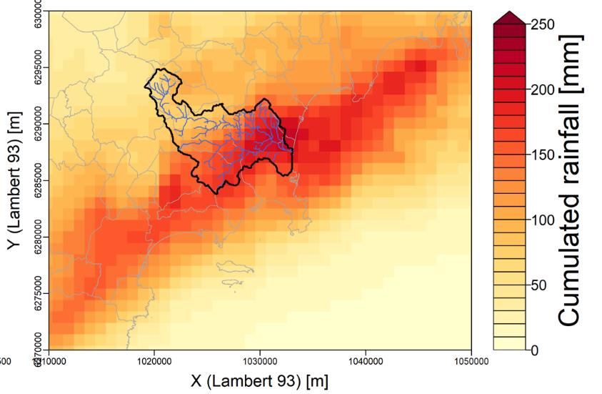
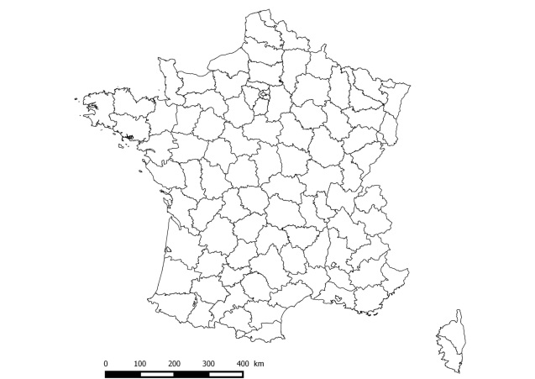
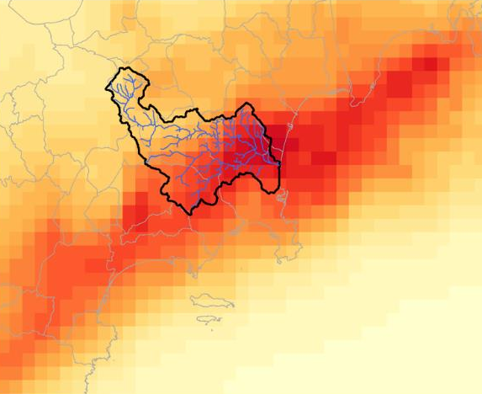
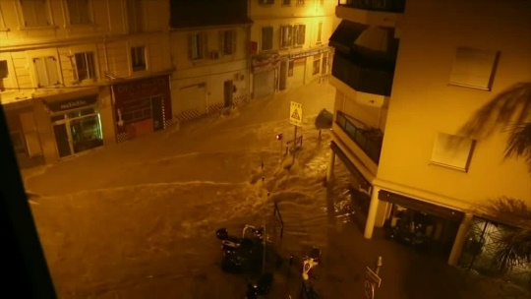
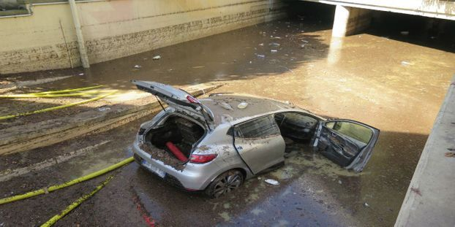
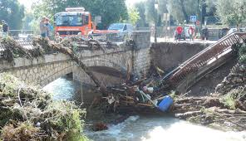
The flash floods of October 3, 2015
1
Located in the south of France on the French Riviera
Exceptional rainfall between 18h and 23h, a heavy rain occurred on the region (fig.1)
200 mm of precipitation accumulation recorded in 3 hours
Large floods on the Brague, Frayère and Riou de l’Argentière rivers
Casualties and economic losses (fig.2):
20 deaths
600 millions euros of damages
20000 damaged cars
400 persons rescued
1200 persons temporary re-located
Figure 1: Cumul rainfall of the October 3, 2015
Source: Kirstetter et al., (2019)
Among the 5 most expensive floods in France (CCR 2016)
Under what conditions can real-time 2D flood modelling be a tool for flash flood forecasting? What are the benefits of hydrological/hydraulic coupling for flash flood forecasting?
Figure 2: Observed damages
Source: Nice Matin

Slide 3
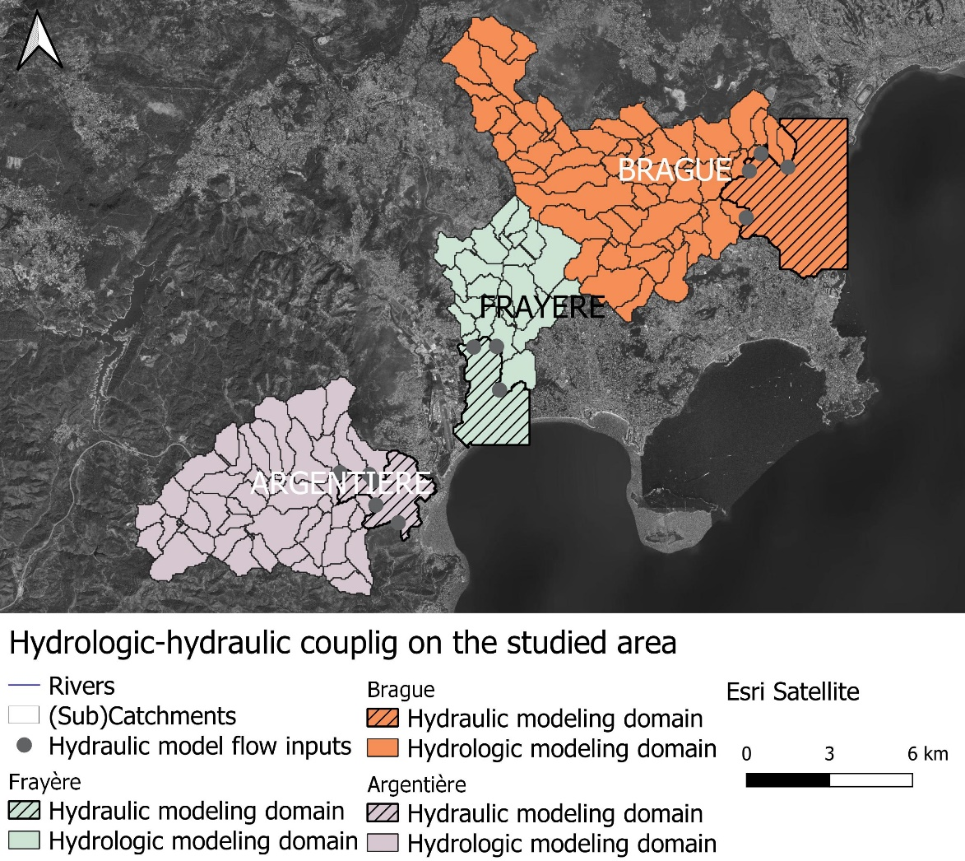
Hydrologic-hydraulic coupling : compromise between calculation time and precision
2
Work on the three main flooded areas : Brague, Frayère and Riou de l’Argentière basins.
Rainfall-runoff model, CINECAR (Gaume et al., 2004), on the upstream part of the domain (hydrologic modeling domain in fig.3): quick estimation of the streamflow temporal evolution
Estimation of net rainfall (SCS-CN model) : SCS Production function with a uniform value of CN = 70 (post-event surveys - Lebouc and Payrastre, 2017 & Kirstetter et al., - 2019)
Propagation on each reach
Transport by solving the kinematic wave equation (Le Bihan, 2016)
Hydraulic model, Basilisk (http://basilisk.fr – 2D hydraulic modelling:
Water level and velocity at any point of the downstream plain (hatched in fig.3)
Shallow-Water finite volume numerical scheme
Order 2 in space and time
Quadtree-adaptive grid refinement:
Cohabitation of several mesh sizes at the same time
A refinement criterion is defined for moving from one mesh size to another, finer or coarser, depending on the estimate of the discretization error (Van Hooft et al., 2018)
Figure 3: Hydrologic-hydraulic coupling

Slide 4
Dataset (1/2)
3
Figure 4: Example of a DEM (aggregated to 4m) – Brague
Source : Kirstetter et al., (2019)
Figure 5: Rainfall cumul
Source : Kirstetter et al., (2019)
DEM: RGE ALTI (large-scale topographic component) of the IGN obtained by LiDAR surveys or analysis of aerial photos (fig.4)
Manning coefficients: uniform value of 0,066
Rainfall dataset: PANTHERE radar from Météo France (fig.5)
Spatial resolution: 1km
Acquisition time step: 5min
Used for the hydrologic and hydraulic models (rainfall mask for the area with no hydrologic simulation)

Slide 5
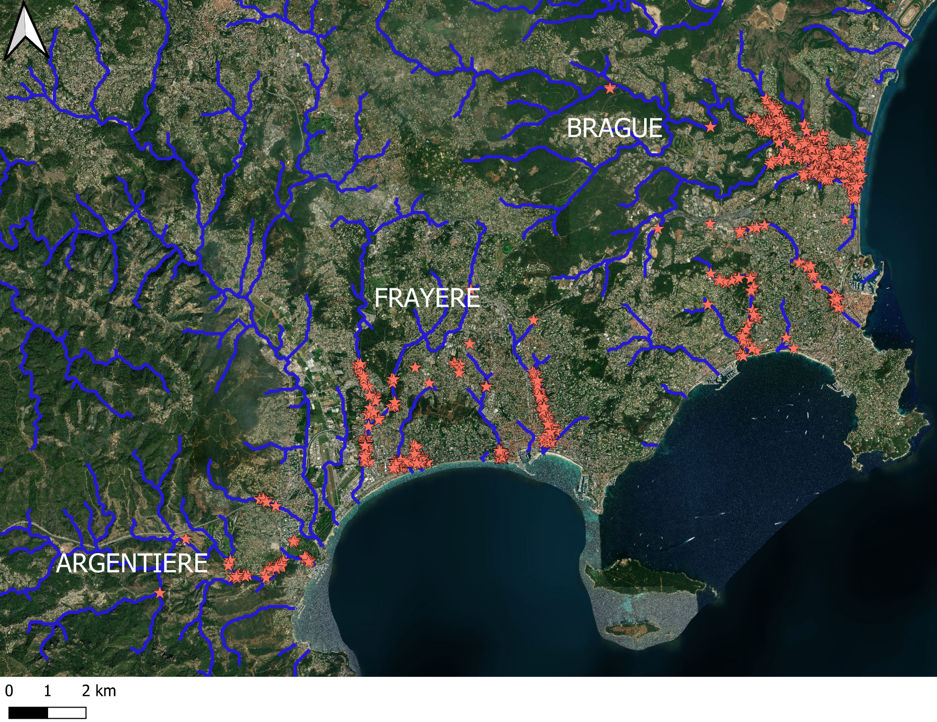
Dataset (2/2)
4
Post-event investigations: Lebouc and Payrastre (2017)
High water marks (more than 500 in the area)
Peak flow estimations
Figure 6: High water marks for the October 2019, 15 flood

Slide 6
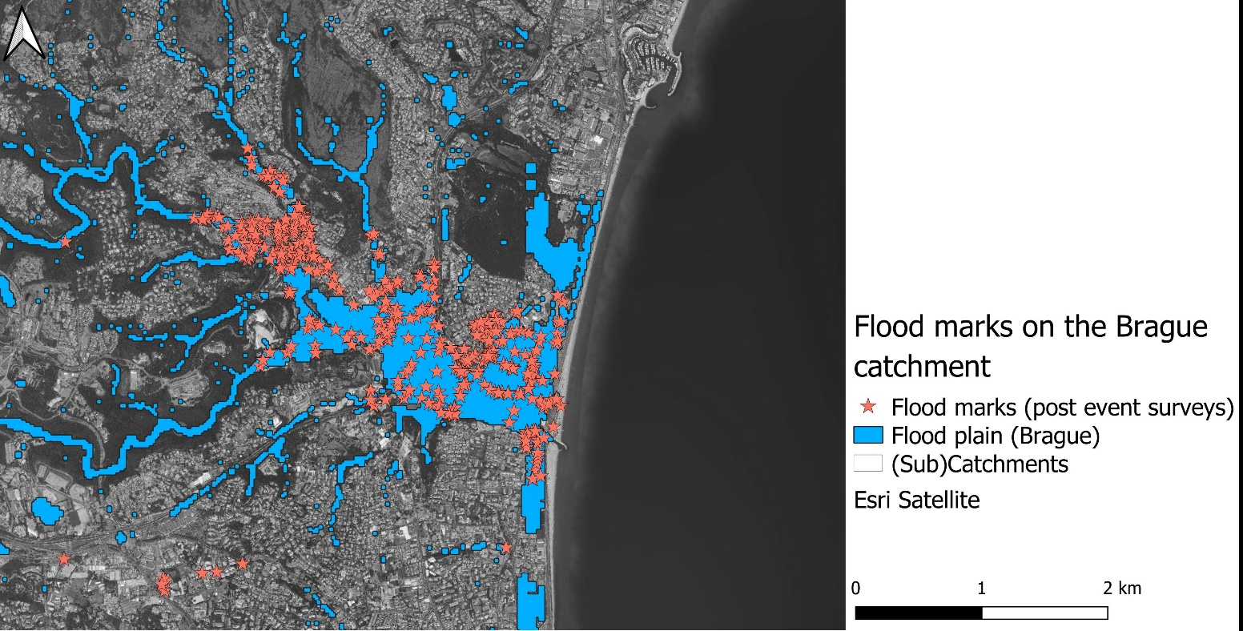
List of the simulations made and performance criteria
5
List of the simulations: combination of the different values for grid refinement and refinement criteria
Grid refinement | Refinement criteria | Manning coefficients | Boundaries conditions
8m - 64m 8m - 32m 4m - 32m | 0.05m 0.1m 0.15m 0.2m | 0.066 | Closed – cannot go beyond the simulation area (for the sea) Water velocity = 0 m/s No problem for the other boundaries (rain masks)
Criteria used to qualify the simulations (performance) :
Comparison of peak flows (simulated and estimated during the post-event surveys)
Number of flood marks located in the flood plain compared to the total flood marks in the simulated area (fig.6)
Differences between the simulated and the observed free surfaces
Root Mean Square Error (RMSE)
$$RMSE= \sqrt{\frac{\sum{\left(η_{simulated}−η_{observed})²\right.}}{flood marks number}}$$
Figure 7: Flood marks in the studied area – post-event surveys

Slide 7
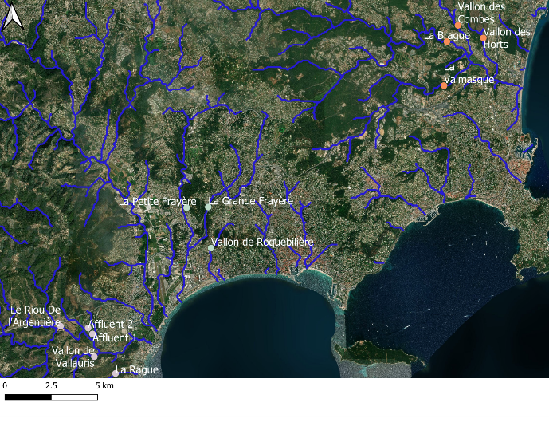
Modelling of the flood (1/7)
6
Criterion A: Verification before the hydraulic simulation: consistency of the flows produced by the hydrological model at the input of the hydraulic model with the flows from the post-event surveys:
No post-event flow values for some rivers
Figure 8: Peak flows from CINECAR and those evaluated after the event (the square brackets represent the estimated peak flow interval, the point the maximum flow reached during the hydrological simulation) and location of these points
Criterion B: Comparison between the results and information gathered from post-event surveys: flood plain (more than 5cm for the simulated water level) and free surface
 | Total number of flood marks in the modeling area | Flood marks number outside the simulated flood plain | Flood marks percentage in the simulated flood plain
Brague | 317 | 27 | 91%
Frayère | 123 | 15 | 88%
Argentière | 42 | 2 | 95%

Slide 8
Modelling of the flood (2/7)
7
Videos : Evolution of the water level (left) and mesh size (right) during the hydraulic simulation for the Brague catchment
Threshold value: 0,05m
Mesh size: 4-32m

Slide 9
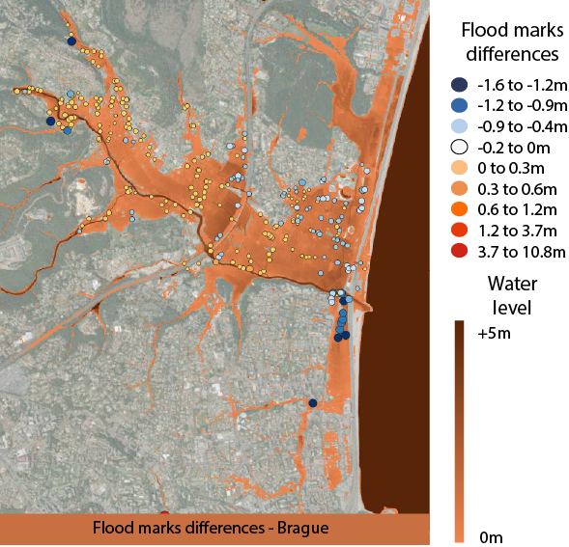
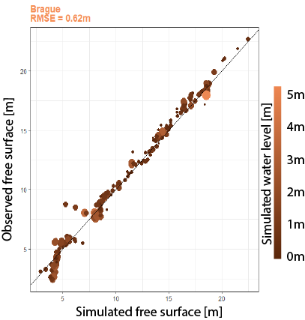
Modelling of the flood (3/7)
8
For the Brague catchment
Negative difference = free surface estimated by BASILISK is higher than the one given by the post-event data
Many more positive (185) than negative (95) differences (fig.9)
Criterion C
Tendency to higher free surfaces simulated by BASILISK for free surfaces between 0 and 3.5m (fig.10)
Criterion C
RMSE on the free area difference is 0.62m
Criterion D
Figure 9: Differences between flood marks (post-event surveys) and simulated water level for Brague catchment
Threshold value: 0,05m
Mesh size: 4-32m
Figure 10: Comparison between observed and simulated free surface for Brague catchment
Threshold value: 0,05m
Mesh size: 4-32m

Slide 10
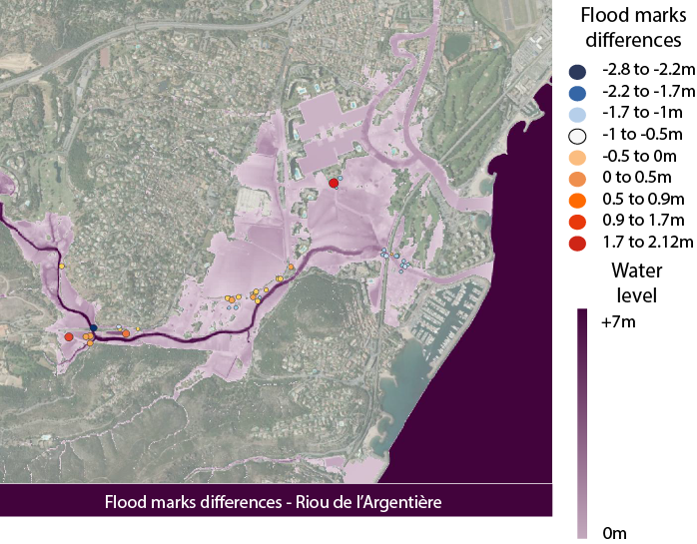
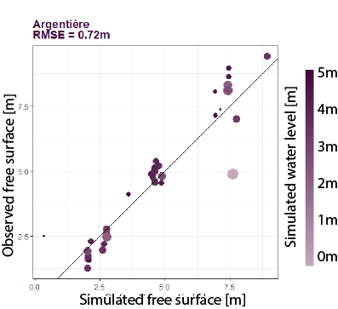
Modelling of the flood (4/7)
9
For the Argentière catchment
Almost as many positive (23) as negative (17) flood marks differences (fig.11)
Criterion C
RMSE = 0,72m (fig.12) but strong dispersion: some points are strongly underestimated while others are largely overestimated
Criterion D
Figure 11: Differences between flood marks (post-event surveys) and simulated water level for Argentière catchment
Threshold value: 0,05m
Mesh size: 4-32m
Figure 12: Comparison between observed and simulated free surface for Argentière catchment
Threshold value: 0,05m
Mesh size: 4-32m

Slide 11
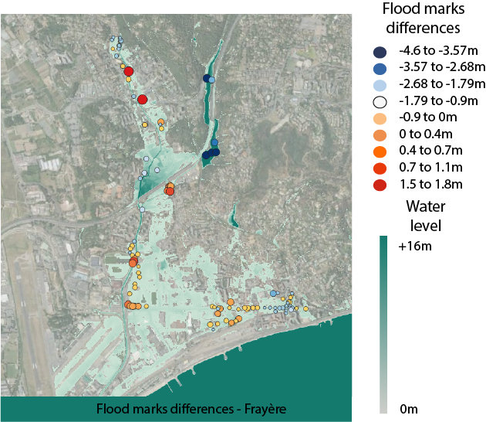
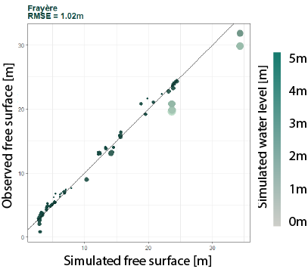
Modelling of the flood (5/7)
10
For the Frayère catchment
Overestimation of the flood marks upstream (fig.13)
Action of the railway line – DEM treatment
Conversely, underestimation downstream of the railway (fig.13)
Criterion C
Quite good in the plain
Criterion C
important approximation on free surfaces (fig.14) – RMSE = 1,02m
Criterion D
Figure 14: Comparison between observed and simulated free surface for Frayère catchment
Threshold value: 0,05m
Mesh size: 4-32m
Figure 13: Differences between flood marks (post-event surveys) and simulated water level for Frayère catchment
Threshold value: 0,05m Mesh size: 4-32m
Flood mark comparisons (general conclusion for the 3 basins):
Influence of DEM post-treatment (cutting off roads to allow full passage of the river): local modification of topography and flow dynamics (due to obstacle removal)
The use of adaptive meshing in areas with large variations in topography can significantly change the altitude and consequently the free surface
For small free surface heights, the simulation overestimates the free surface height

Slide 12
Modelling of the flood (6/7)
11
Figure 15: Evolution of RMSE depending on mesh size and refinement criteria
Study of the sensitivity to the adaptive mesh parameters : refinement criteria & size mesh
Very small errors due to refinement and little impact on the RMSE value.
Very close results for a threshold value of 0.1m or 0.05m regardless of mesh size
For a threshold value of 0.2m, reduced impact for mesh sizes from 4 to 32m (gains in terms of computing time to look at)
The main errors for the Frayère come from the MNT treatment
The smaller the minimum size grid is (here at least, the minimum size is 4m) and the smaller the RMSE is.
Gain in precision on the calculated free surfaces
Experimental validation of the hydraulic simulations

Slide 13
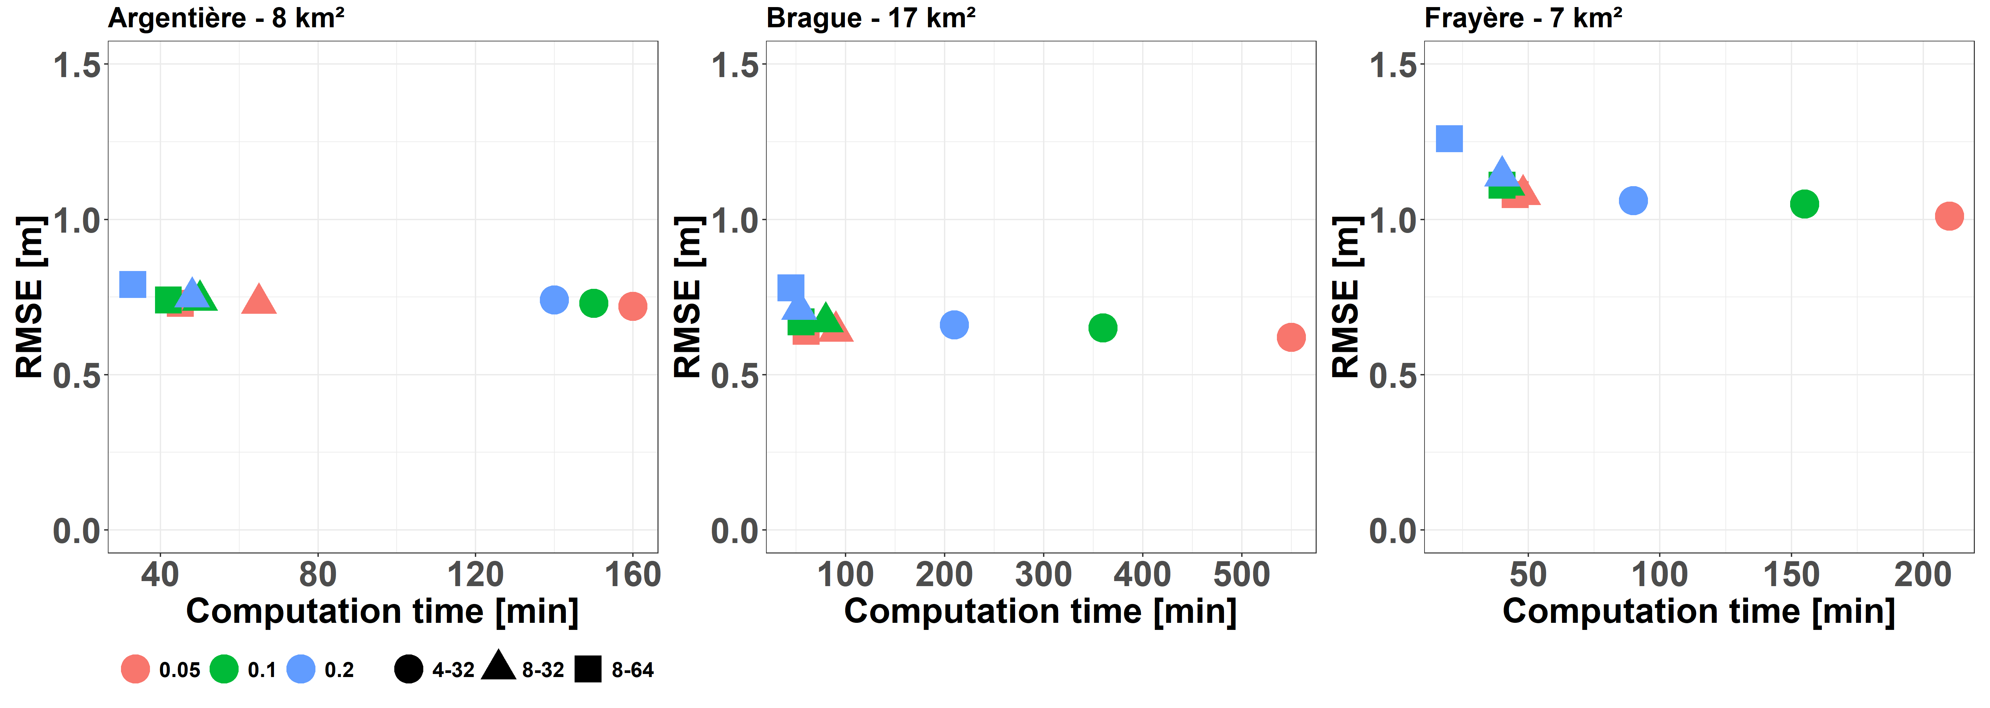
Modelling of the flood (7/7)
12
Computation time : Linux virtual machine with 32 Intel(R) Xeon(R) CPU E5-2650-v4 2.20GHz CPUs
In the context of flood forecasting, a simulation can be considered in real time if its calculation time is much faster than the duration of the event.
Figure 16: Evolution of RMSE with the computation time depending on mesh size and refinement criteria
Both in terms of calculation but also in terms of precision, it is more interesting to keep a simulation with larger maximal size meshes and a smaller refinement criterion rather than the opposite

Slide 14
Conclusion & Perspectives
13
About flood marks using:
Good way to evaluate simulation results
Highlighting the influence of DEM post-treatment: local modification of topography and flow dynamics (due to obstacle removal)
Good correspondence between simulated and surveyed flood marks:
90% of the flood marks from the post-event surveys are in the simulated flood plain
Analysis of the influence of the refinement criterion and mesh levels for adaptive meshing
Above a value for the refinement criterion, no more influence of the maximal size mesh on the RMSE
Good accuracy and calculation time up to 40 minutes
Size from 8 to 64 m with a threshold value of 0.1m seems to be the better compromise between accuracy and computation time
Promising performances both in terms of calculation time but also in terms of accuracy of the simulated flood areas and water levels
Perspectives:
Works on flood marks comparison mode
Adaptive mesh based on topography rather than water height
Consideration of the rainwater network

Slide 15
References
14
CCR. (2016). Les Catastrophes Naturelles en France : Bilan 1982-2016. Retrieved from https://erisk.ccr.fr/publications/BilanCatNat2017_en_ligne.pdf
Gaume, E., Livet, M., Desbordes, M., and Villeneuve, J.P. (2004): Hydrologic analysis of the Aude, France, flash flood 12 and 13 november 1999, J. Hydrol., 286, 135–154, https://doi.org/10.1016/j.jhydrol.2003.09.015G.
Kirstetter , F. Bourgin, P. Brigode, O. Delestre (2019) : Real-time inundation mapping with a 2D hydraulic modelling tool based on adaptive grid refinement: the case of the October 2015 French Riviera flood
Lebouc, L., & Payrastre, O. (2017). Reconstitution et analyse des débits de pointe des crues du 3 octobre 2015 dans les Alpes Maritimes . Convention Action 14 HAL Id : hal-01589775 Convention DGPR-Ifsttar 2016 des crues du 3 octobre 2015 dans les Alpes Maritimes.
Van Hooft, J. A., Popinet, S., van Heerwaarden, C. C., van der Linden, S. J. A., de Roode, S. R., & van de Wiel, B. J. H. (2018). Towards Adaptive Grids for Atmospheric Boundary-Layer Simulations. Boundary-Layer Meteorology, 167(3), 421–443. https://doi.org/10.1007/s10546-018-0335-9

