Slide 1



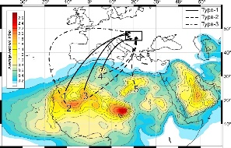
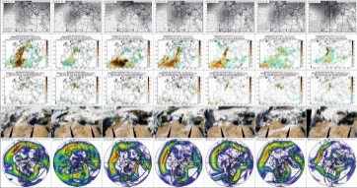
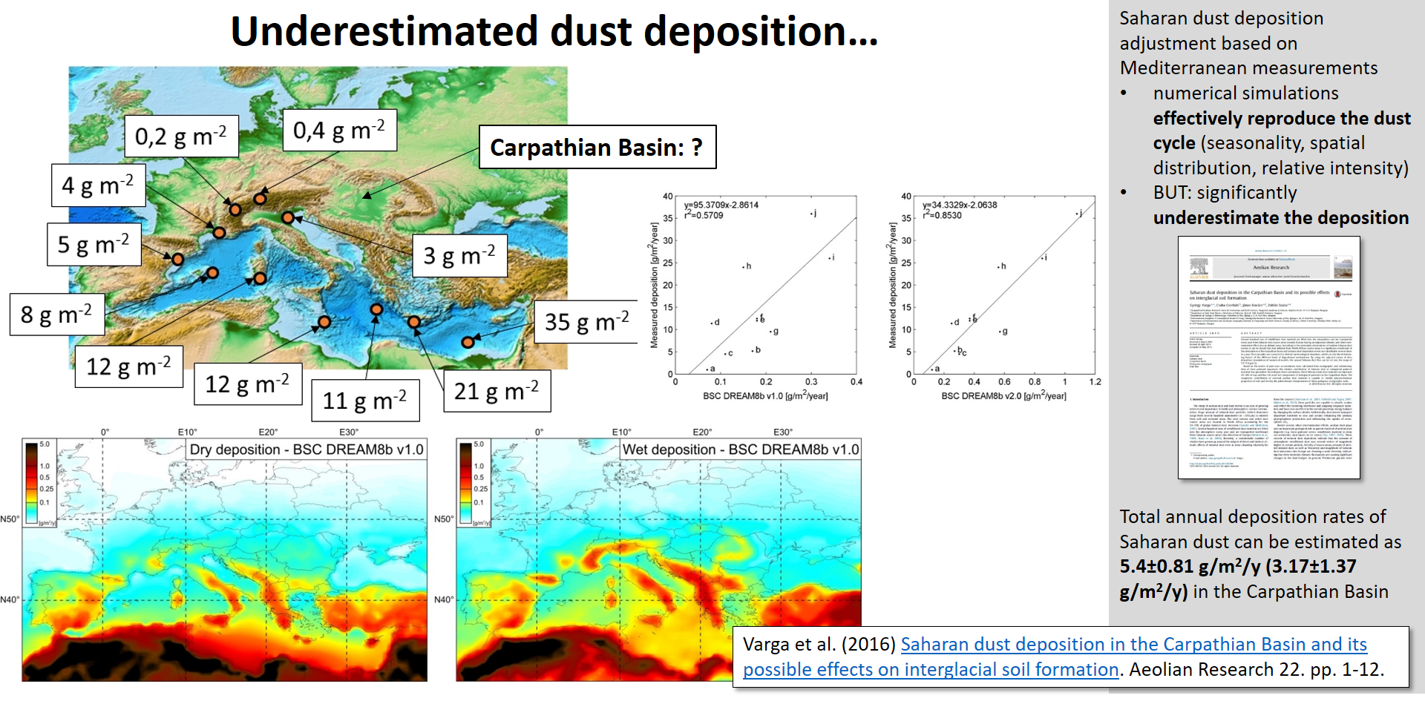
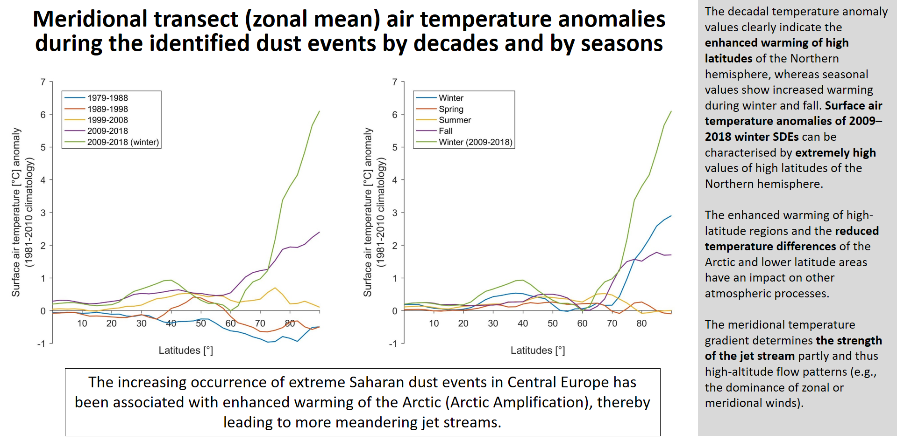
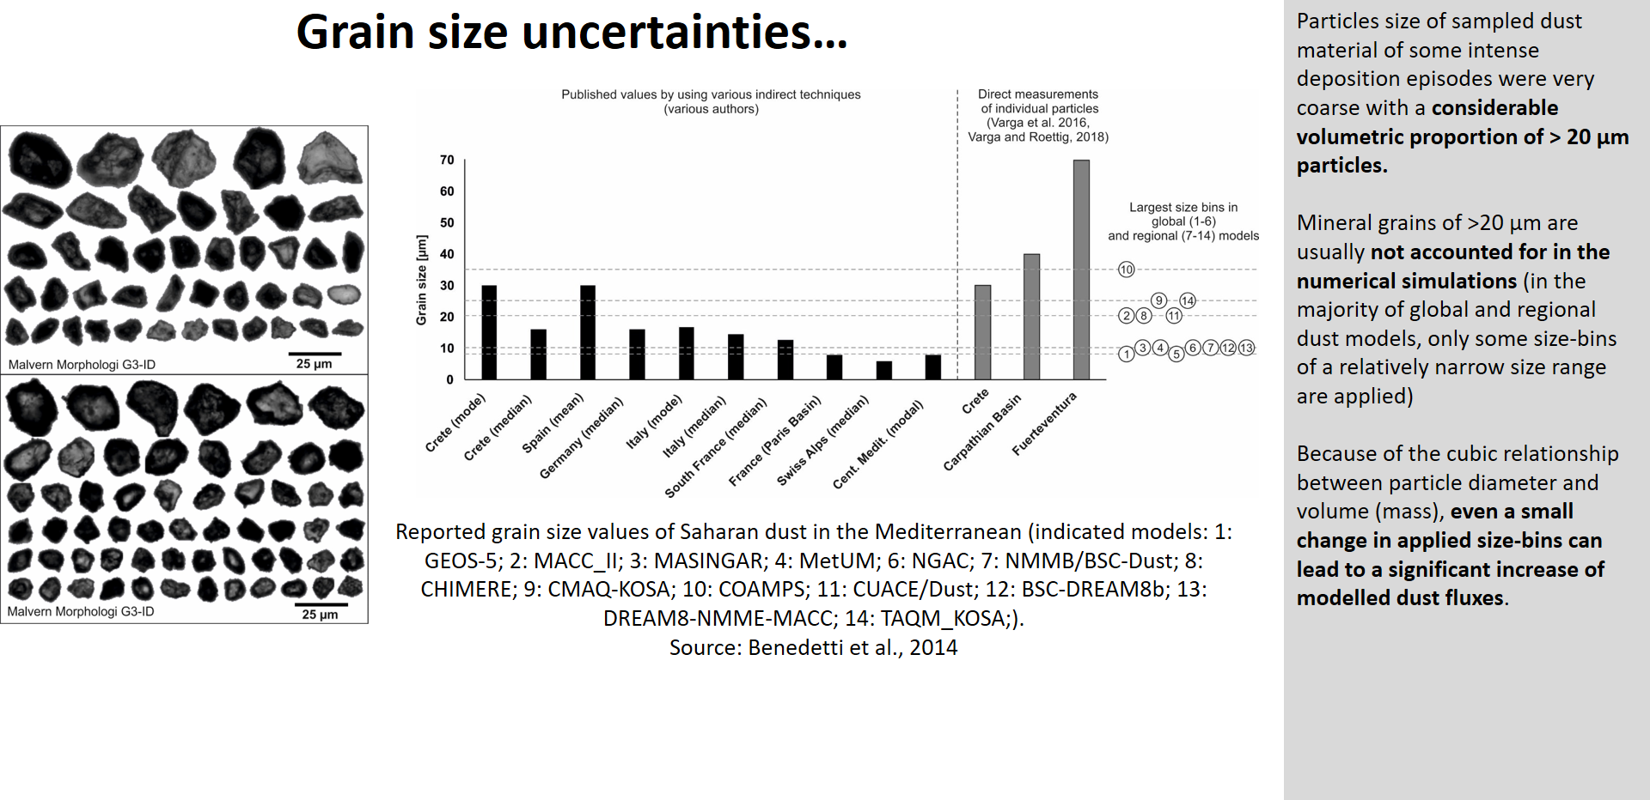
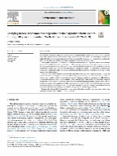
40-years of Saharan dust events in the Carpathian Basin: background, frequency, intensity, changing patterns
György Varga ⁽¹⁾ – Nadia Gammoudi⁽²⁾ – János Kovács ^{(2,3)}
⁽¹⁾ Research Centre for Astronomy and Earth Sciences, Budapest, Hungary (varga.gyorgy@csfk.mta.hu),
⁽²⁾ Department of Geology & Meteorology, University of Pécs, Ifjúság u. 6, H-7624 Pécs, Hungary
⁽³⁾ Environmental Analytical & Geoanalytical Research Group, Szentágothai Research Centre, University of Pécs, Ifjúság u. 20, Pécs, H-7624, Hungary

Slide 2
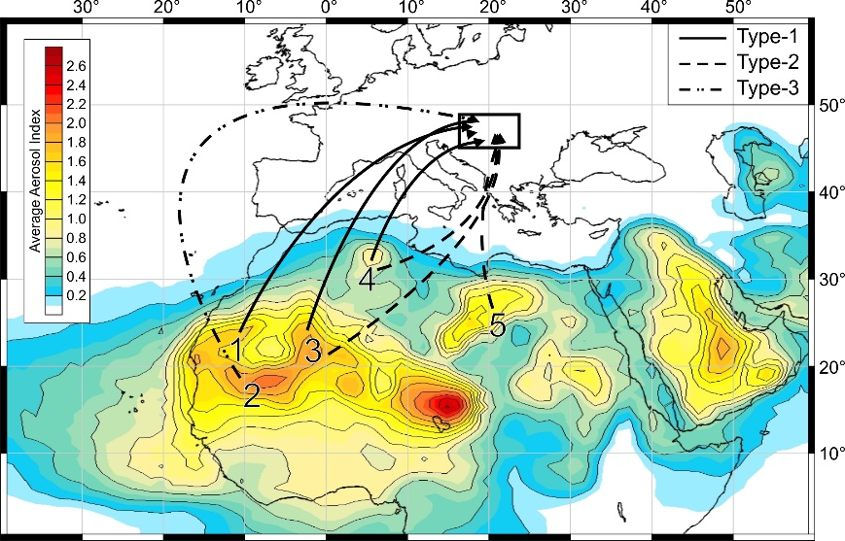
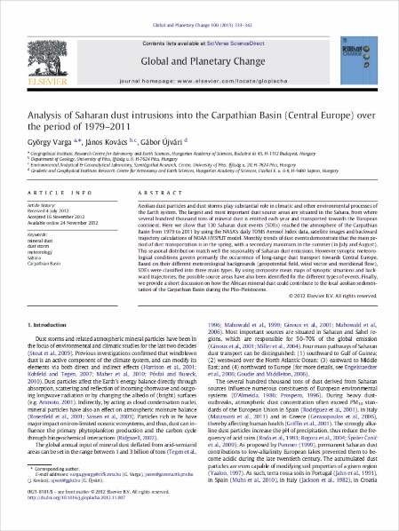
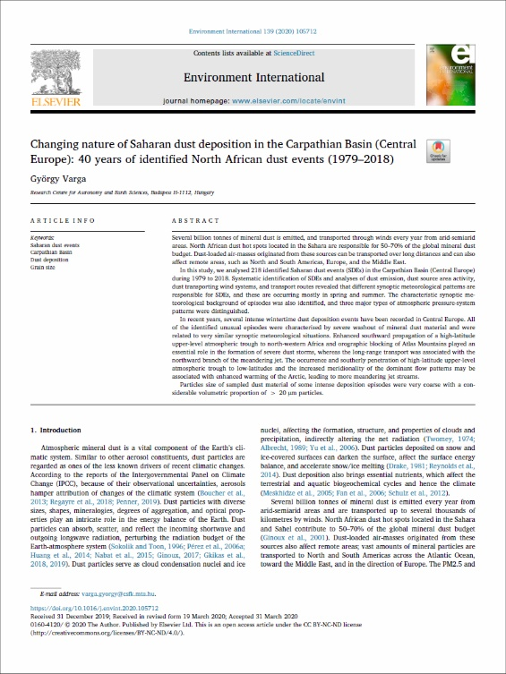
Saharan dust in the Carpathian Basin
Previous long-term investigations revealed a clear seasonal pattern of SDEs affecting Central Europe based on 130 identified episodes. This analysis of daily aerosol index data from 1979 to 2011 indicated the spring- and summertime maxima of mineral dust episodes
Varga, Gy., Kovács, J., Újvári, G. (2013) Analysis of Saharan dust intrusions into the Carpathian Basin (Central Europe) over the period of 1979-2011. Global and Planetary Change 100. pp. 333–342.
218 Saharan dust events were identified between 1979 and 2018 (NASA TOMS and OMI Aerosol Index) by satellite observations
BSC DREAM8b v1.0 and v2.0 numerical dust simulations show similar frequency of dust events
HYSPLIT backwards-trajectories were applied to confirm the Saharan origin
700 hPa geopotential height, zonal and meridional wind vectors were used to determine different types of synoptic meteorological patterns of Saharan dust events (SDEs)
summarized dry and wet deposition data of the five available dust size-bins of the NASA’s Modern-Era Retrospective analysis for Research and Applications, Version 2 (MERRA-2) were applied to estimate dust deposition
Varga, Gy. (2020). Changing nature of Saharan dust deposition in the Carpathian Basin (Central Europe): 40 years of identified North African dust events (1979–2018). Environmental International 139. 105712

Slide 3
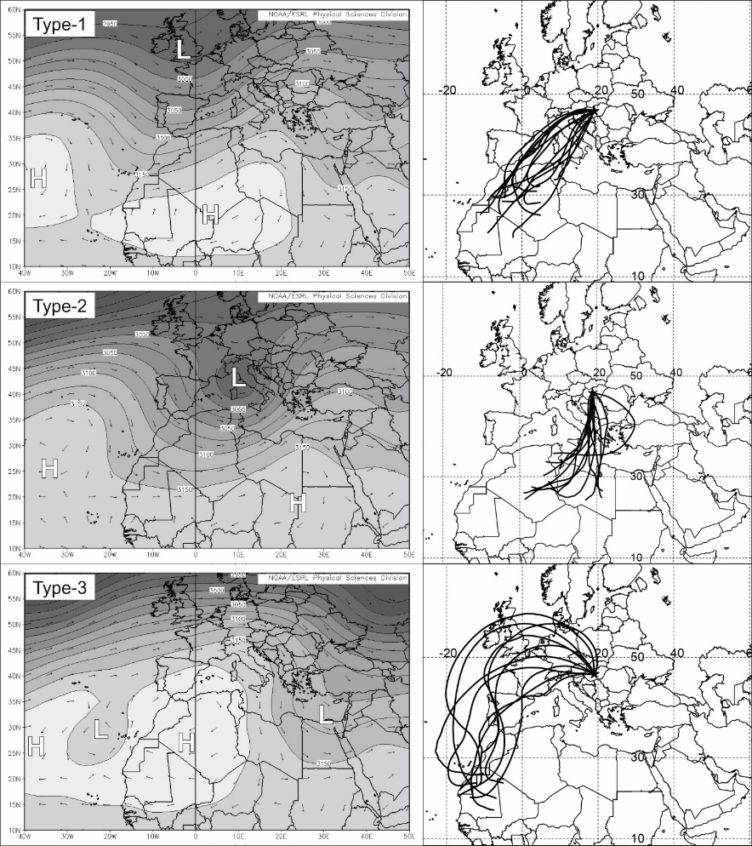
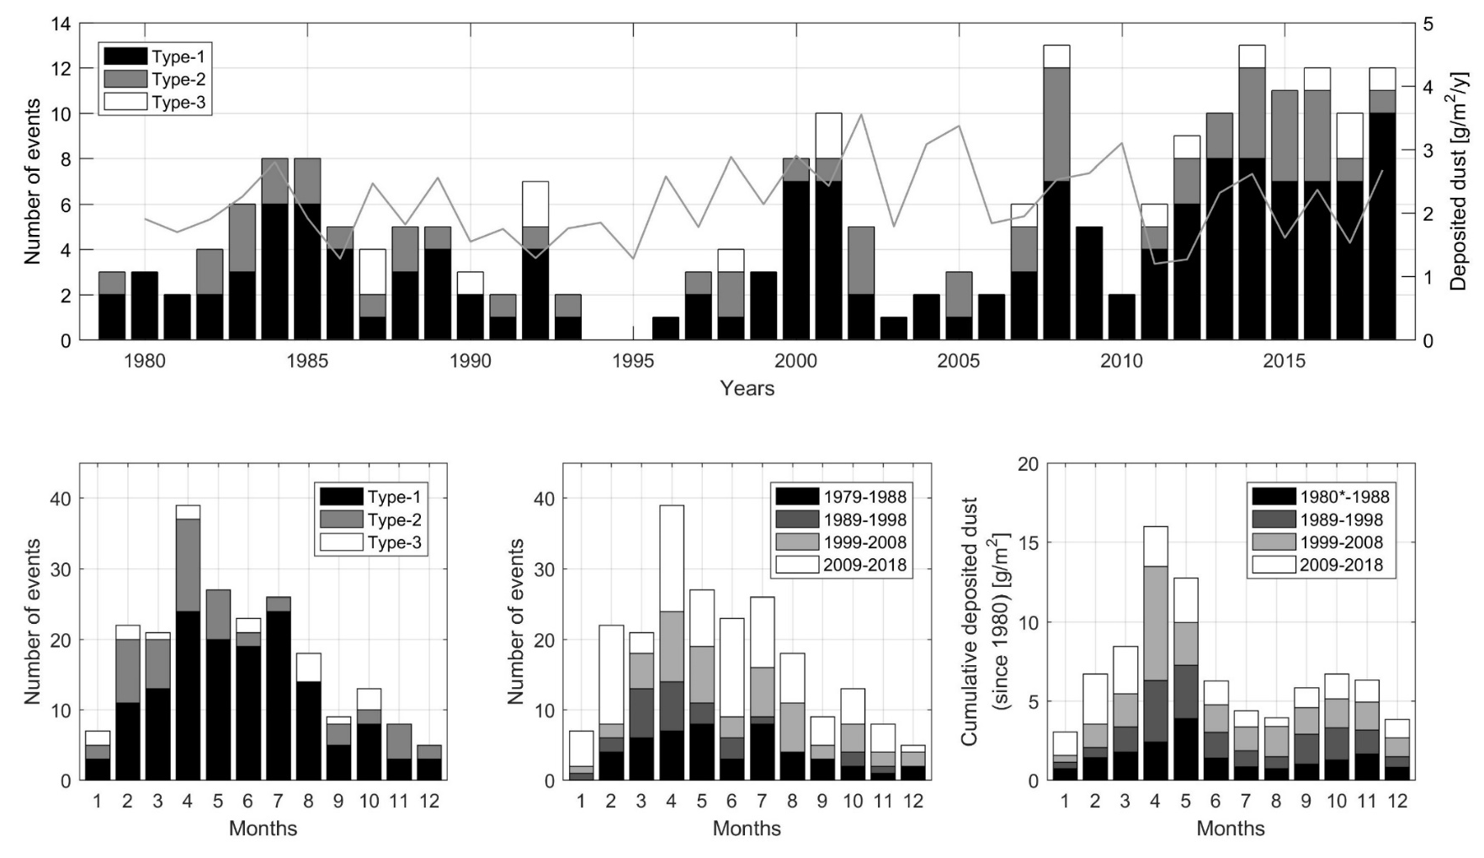
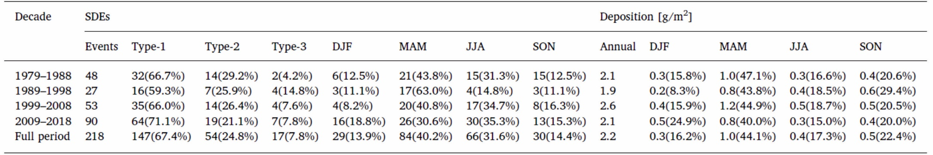

Slide 4
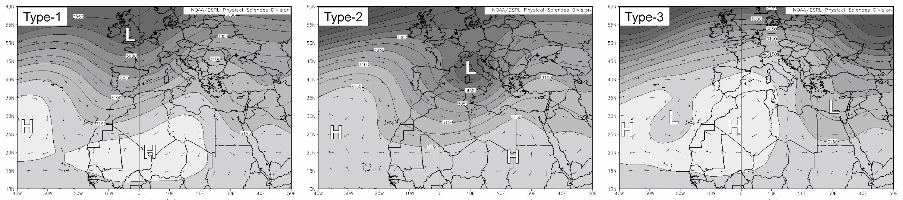
67.4% (n=147)
strong SW flow between the southwards moving well-developed trough and eastern cell of the divided subtropical high
24.8% (n=54)
southerly winds associated with depressions centred in the Central Mediterranean
warm sector winds on the foreside of the cyclones
7.8% (n=17)
high pressure centre is established over NW Africa and SW Europe
anticyclonal flows carry dust over the eastern Atlantic
at the mid-latitudes westerlies

Slide 5
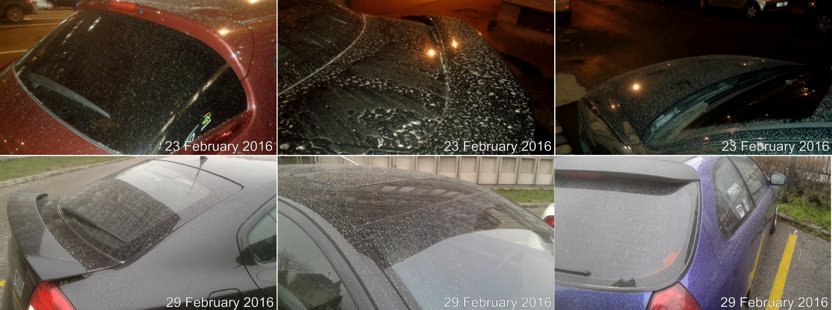
Intense dust depositional event – unusual (?) episodes
SDE #1-7

Slide 6
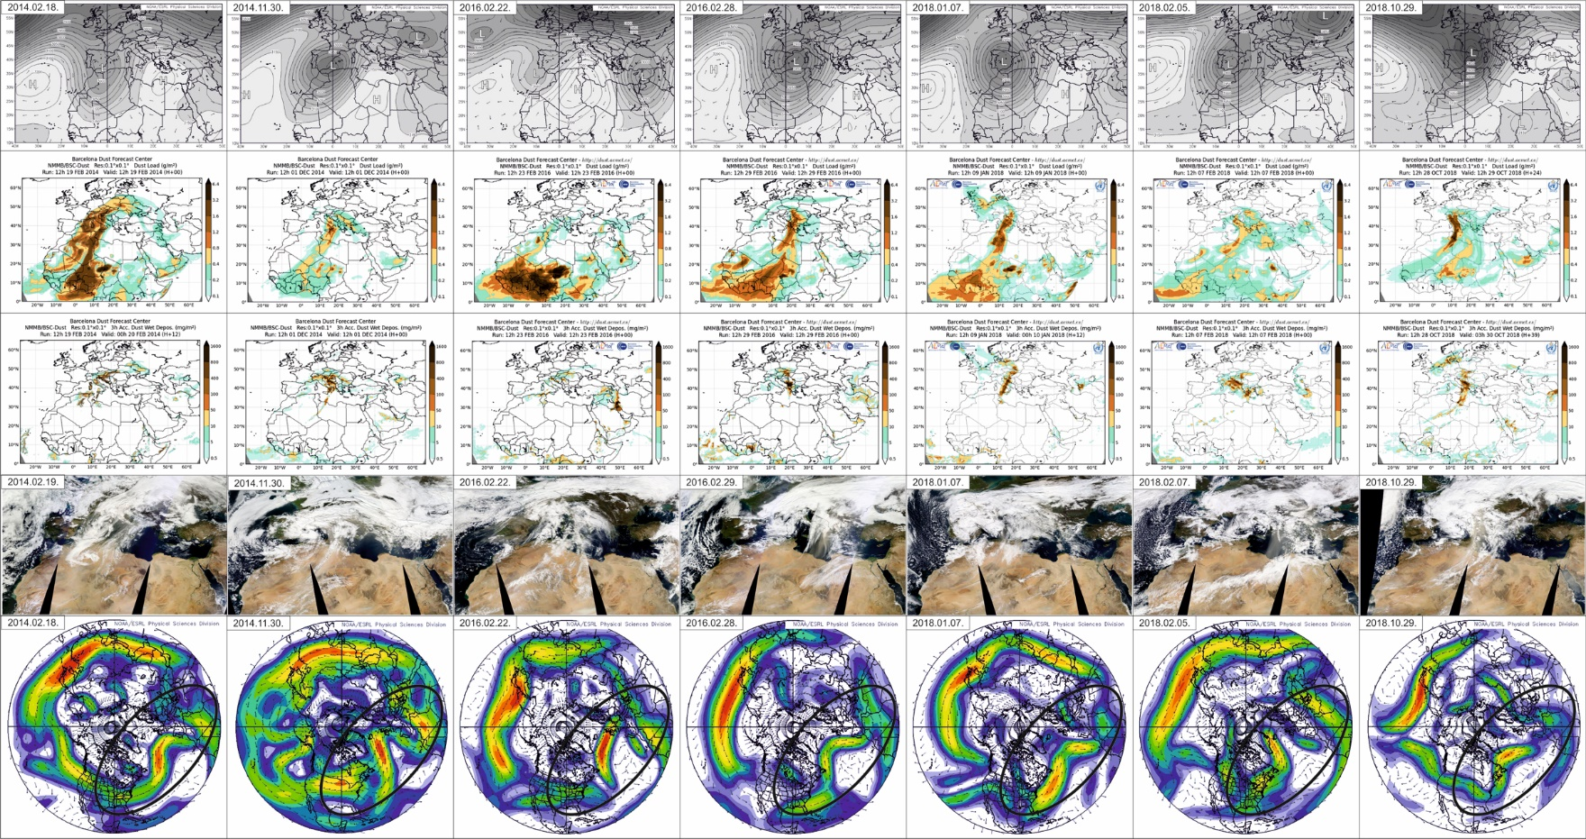
SDE#1
SDE#2
SDE#3
SDE#4
SDE#5
SDE#6
SDE#7

Slide 7
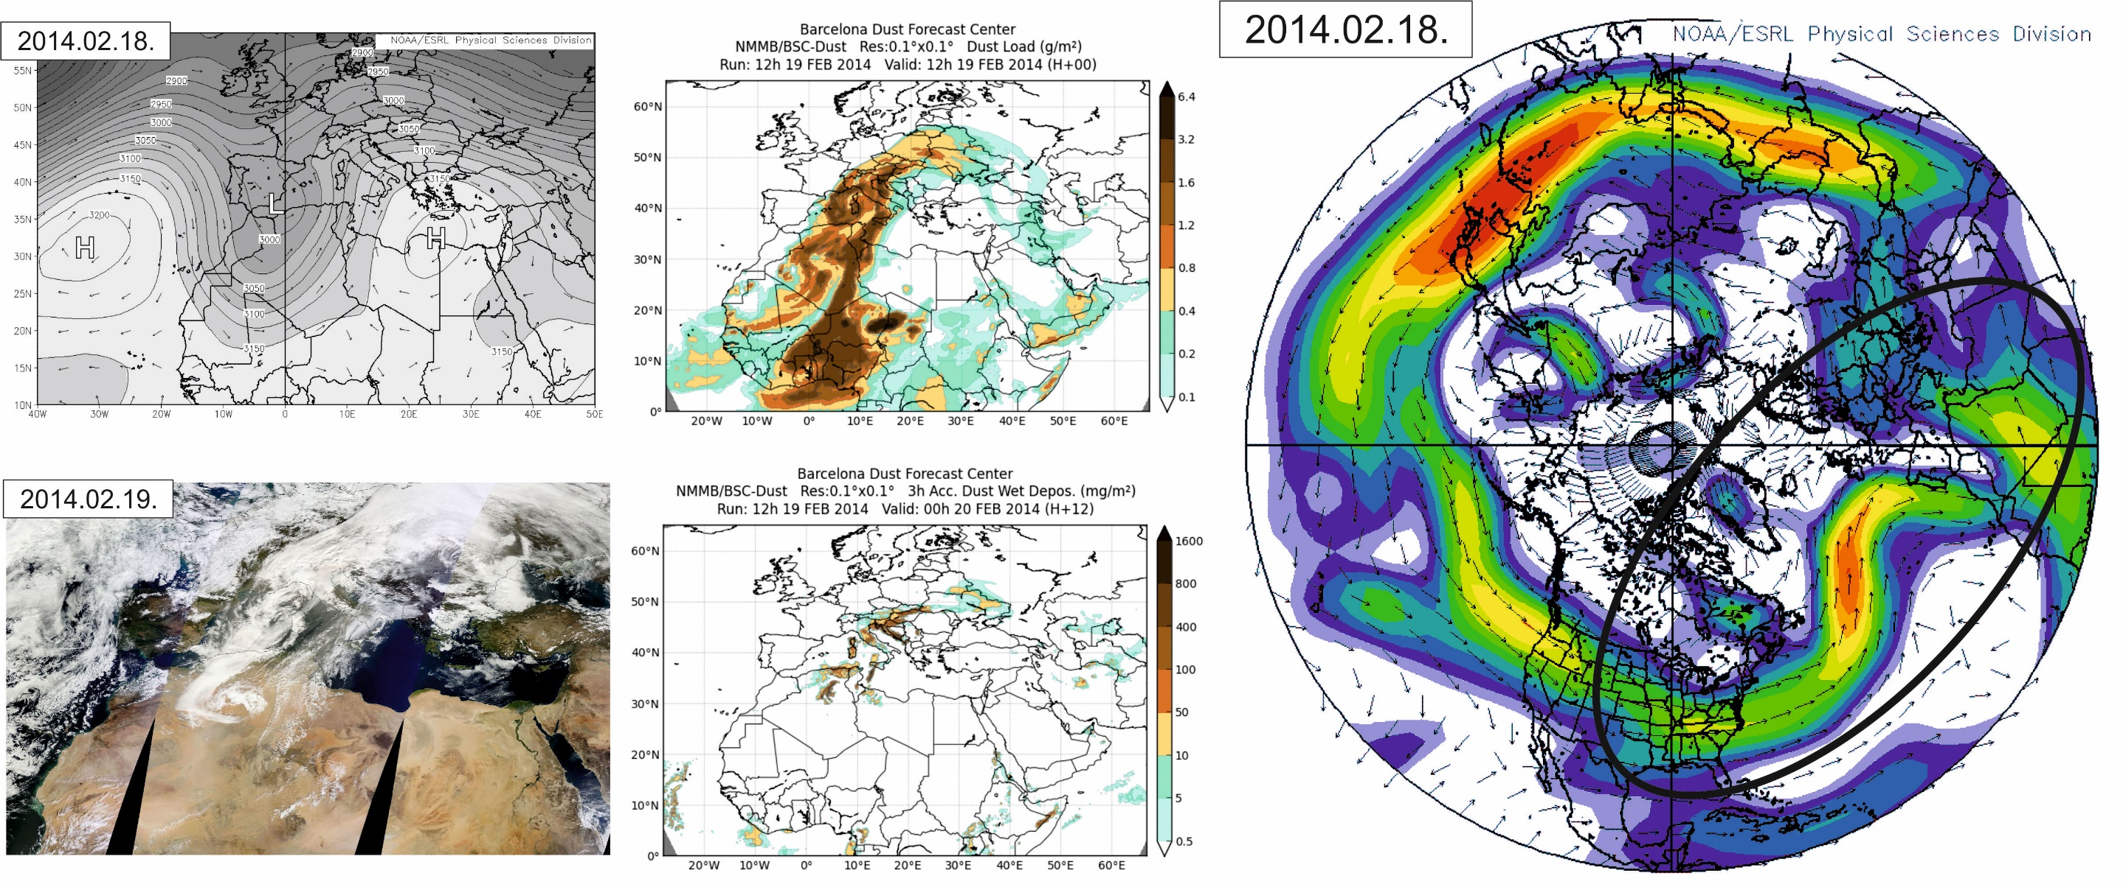
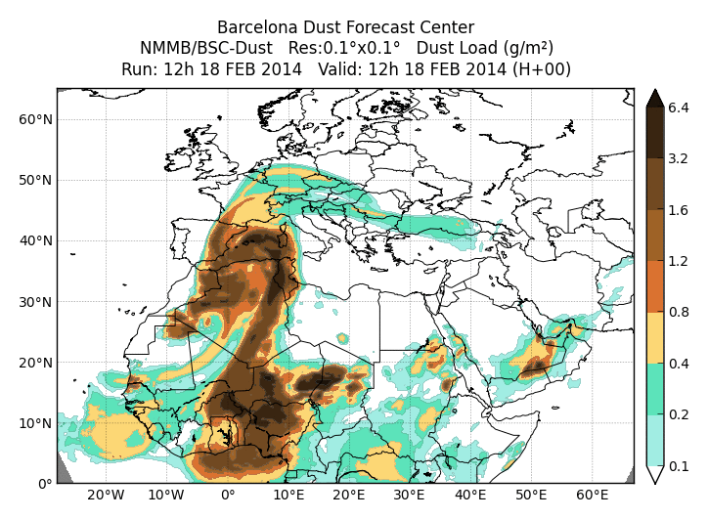
SDE#1
SDE#2
SDE#3
SDE#4
SDE#5
SDE#6
SDE#7

Slide 8
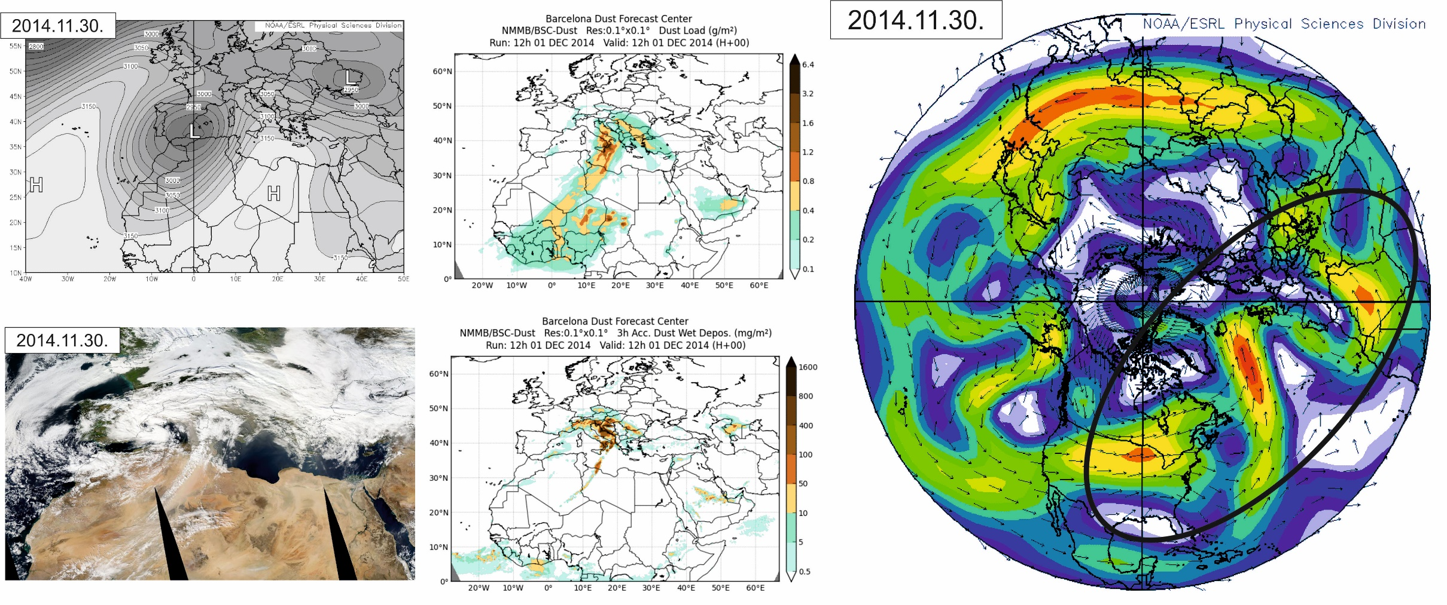
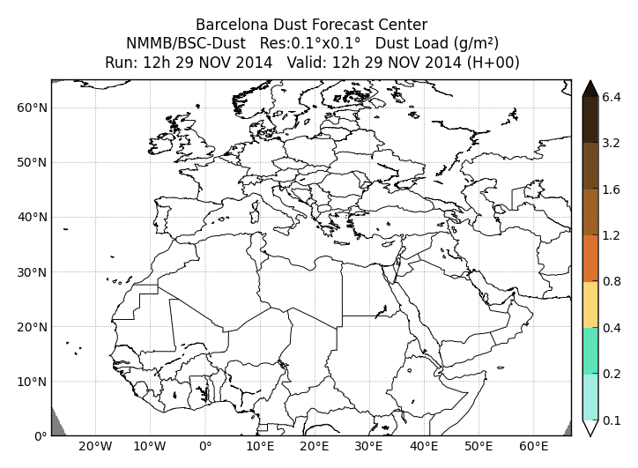
SDE#1
SDE#2
SDE#3
SDE#4
SDE#5
SDE#6
SDE#7

Slide 9
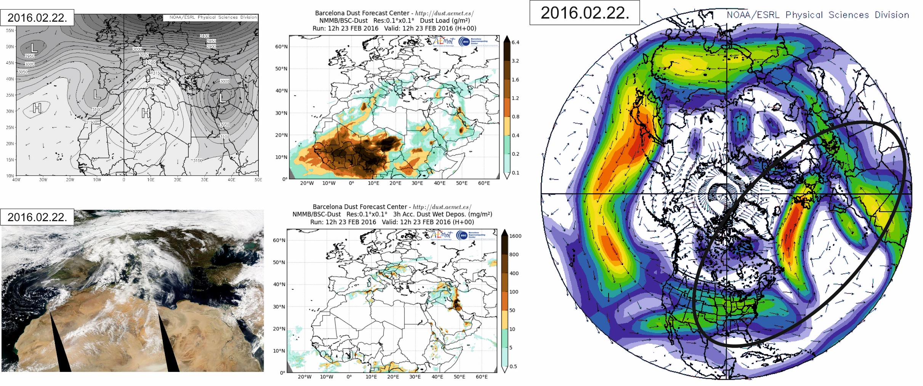
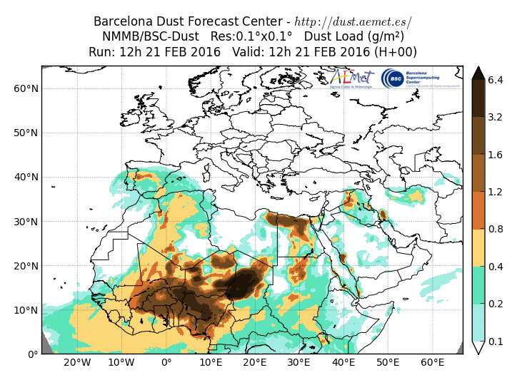
SDE#1
SDE#2
SDE#3
SDE#4
SDE#5
SDE#6
SDE#7

Slide 10
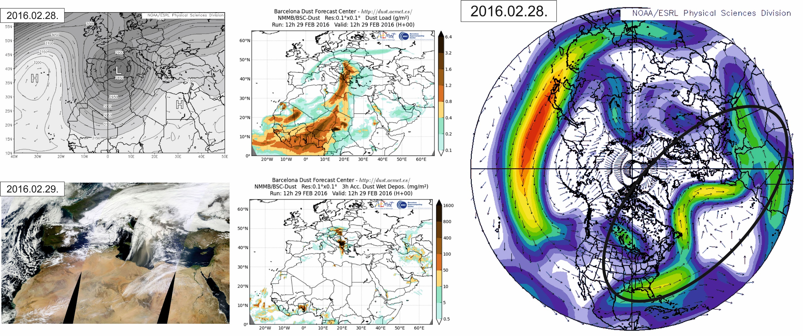
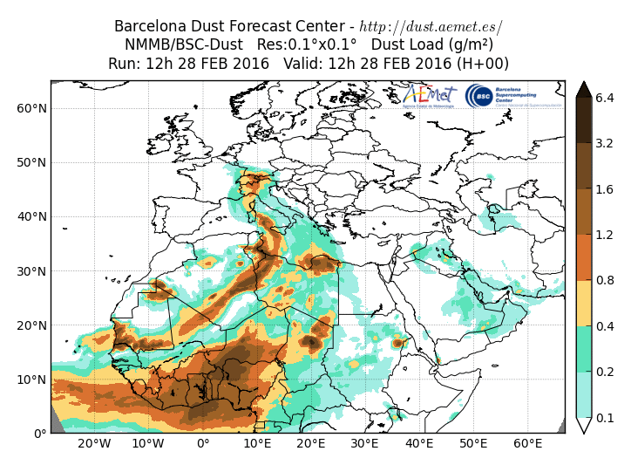
SDE#1
SDE#2
SDE#3
SDE#4
SDE#5
SDE#6
SDE#7

Slide 11
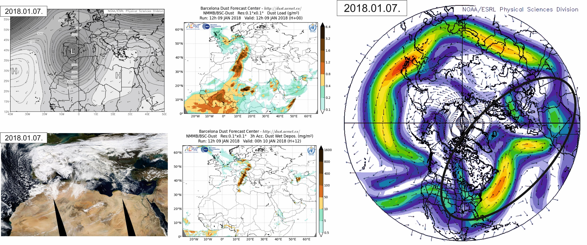
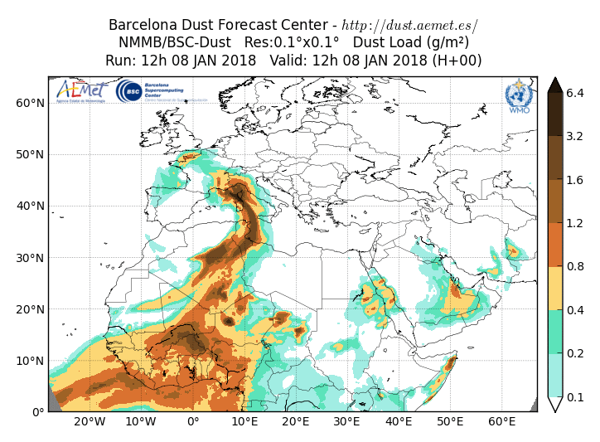
SDE#1
SDE#2
SDE#3
SDE#4
SDE#5
SDE#6
SDE#7

Slide 12
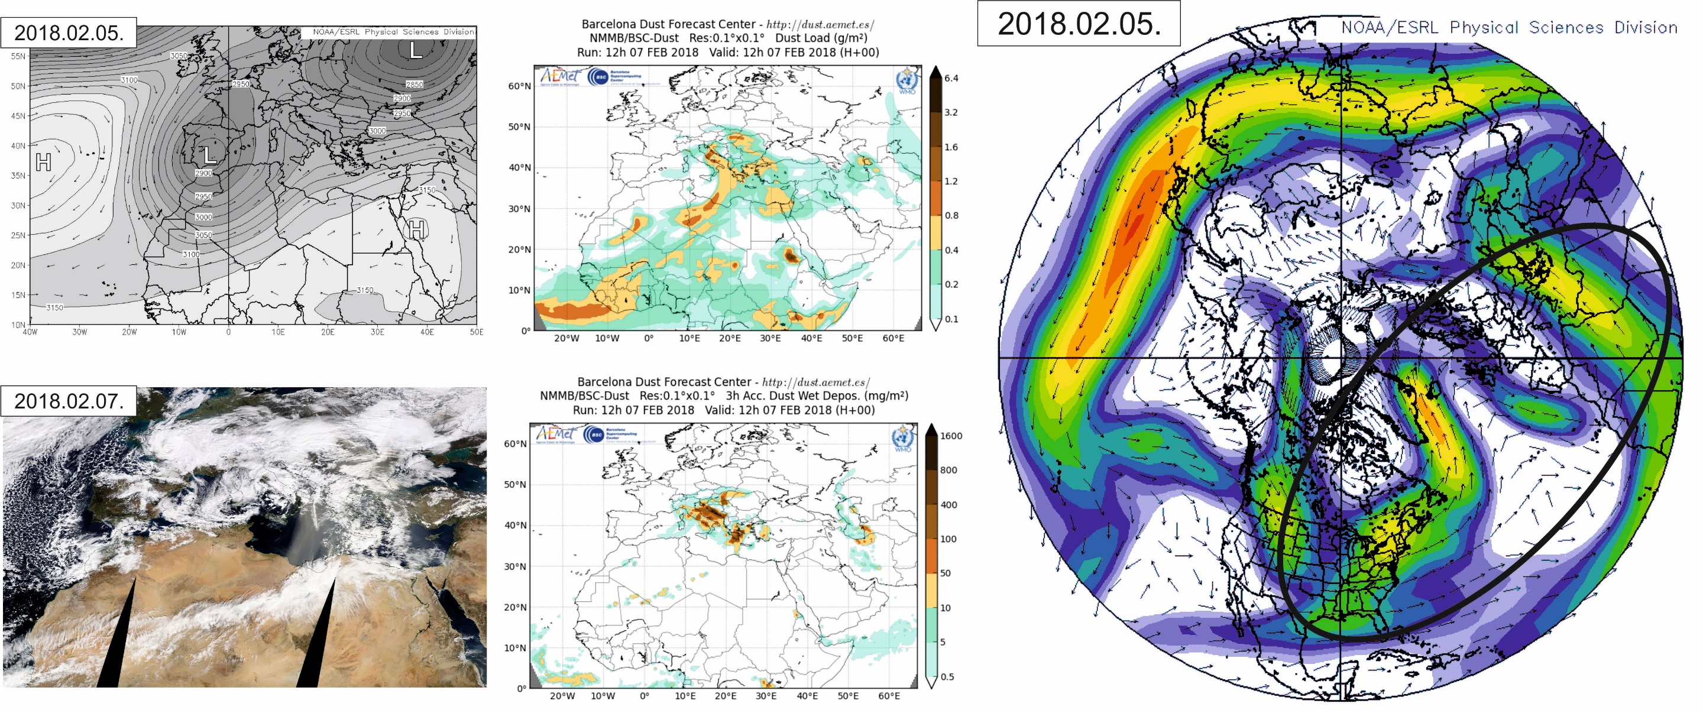
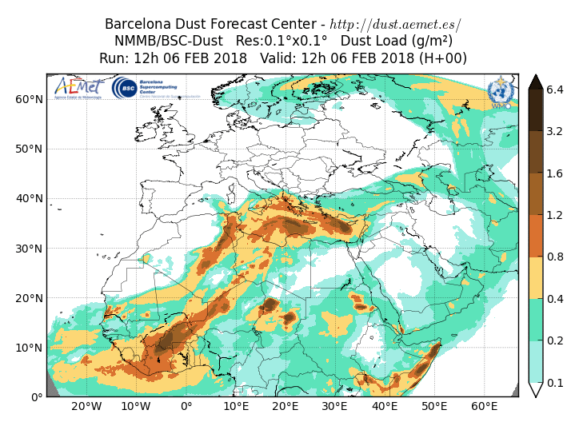
SDE#1
SDE#2
SDE#3
SDE#4
SDE#5
SDE#6
SDE#7

Slide 13
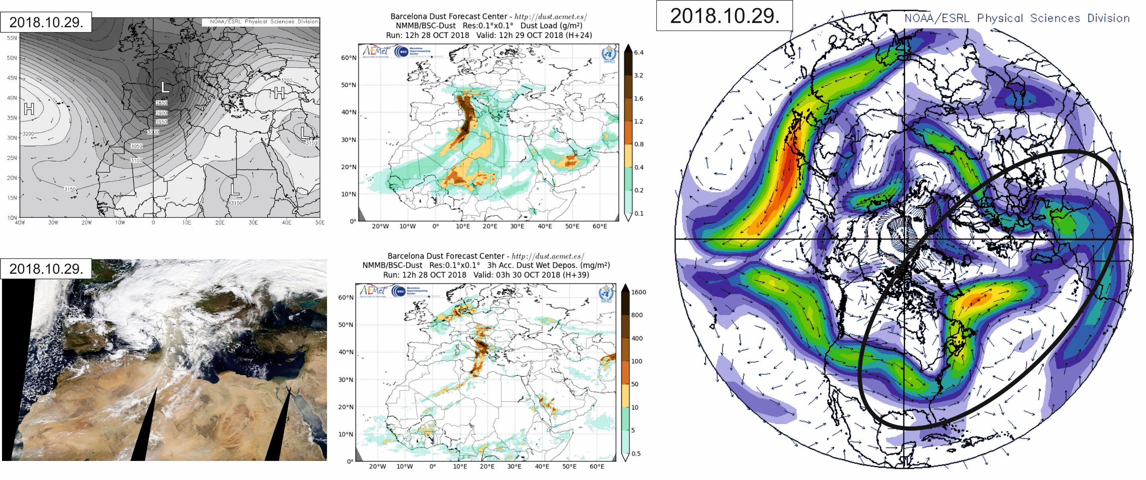
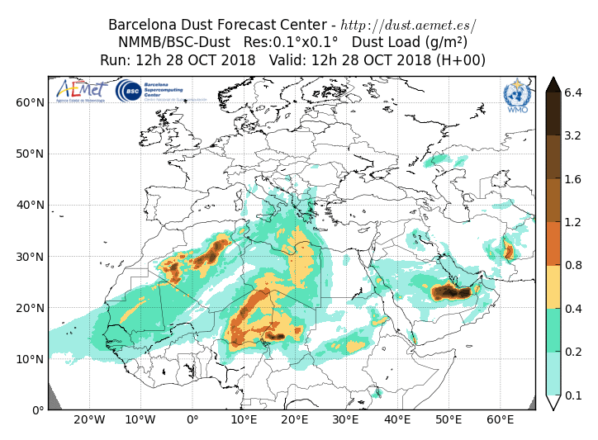
SDE#1
SDE#2
SDE#3
SDE#4
SDE#5
SDE#6
SDE#7

Slide 14
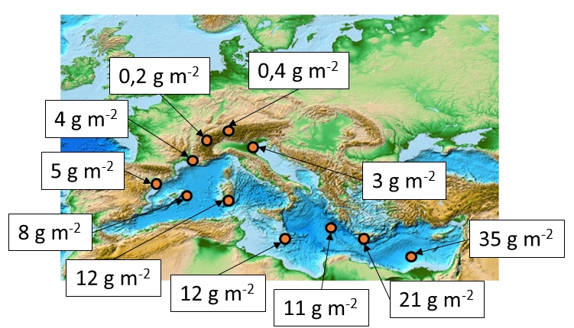
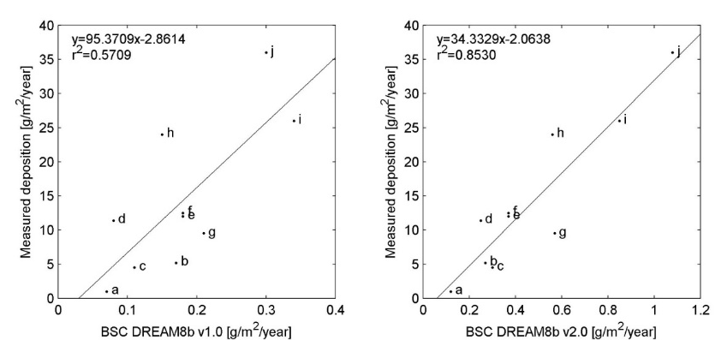
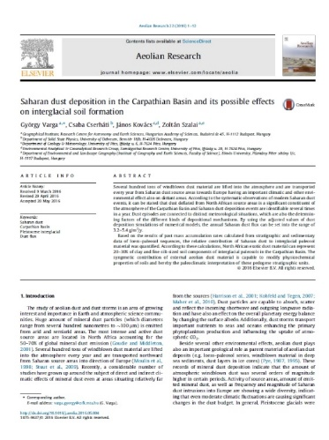
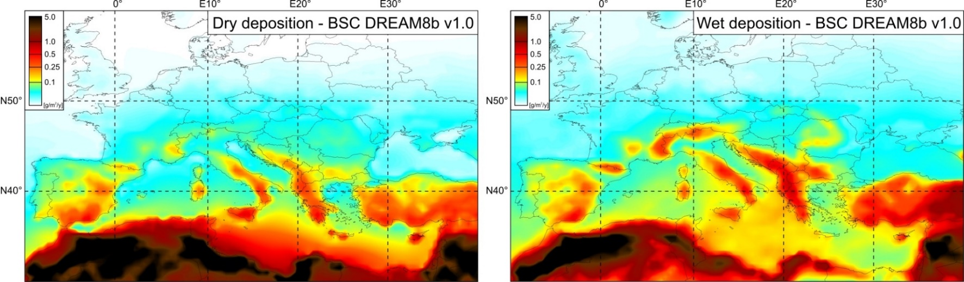
Underestimated dust deposition…
Saharan dust deposition adjustment based on Mediterranean measurements
numerical simulations effectively reproduce the dust cycle (seasonality, spatial distribution, relative intensity)
BUT: significantly underestimate the deposition
Total annual deposition rates of Saharan dust can be estimated as 5.4±0.81 g/m²/y (3.17±1.37 g/m²/y) in the Carpathian Basin
Carpathian Basin: ?
Varga et al. (2016) Saharan dust deposition in the Carpathian Basin and its possible effects on interglacial soil formation. Aeolian Research 22. pp. 1-12.

Slide 15
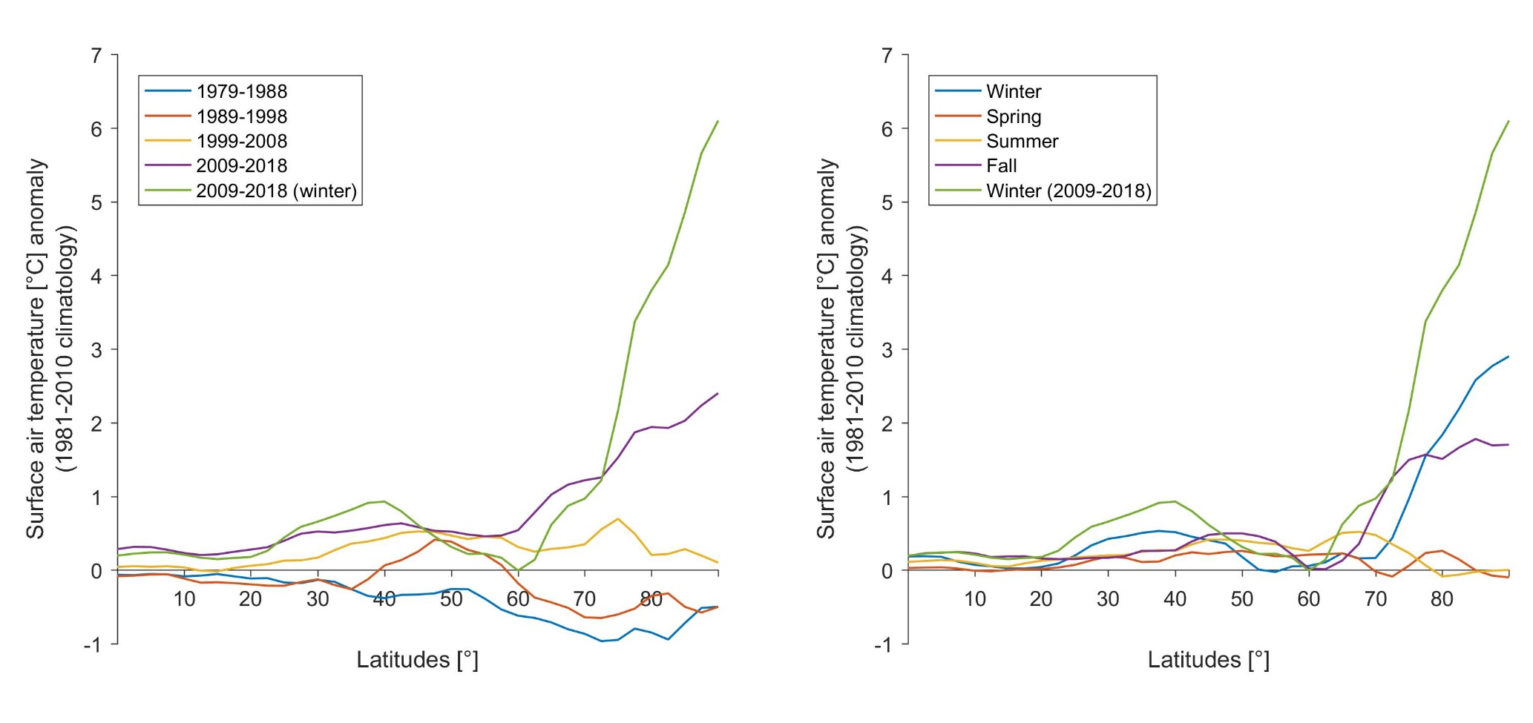
Meridional transect (zonal mean) air temperature anomalies during the identified dust events by decades and by seasons
The decadal temperature anomaly values clearly indicate the enhanced warming of high latitudes of the Northern hemisphere, whereas seasonal values show increased warming during winter and fall. Surface air temperature anomalies of 2009–2018 winter SDEs can be characterised by extremely high values of high latitudes of the Northern hemisphere.
The enhanced warming of high-latitude regions and the reduced temperature differences of the Arctic and lower latitude areas have an impact on other atmospheric processes.
The meridional temperature gradient determines the strength of the jet stream partly and thus high-altitude flow patterns (e.g., the dominance of zonal or meridional winds).
The increasing occurrence of extreme Saharan dust events in Central Europe has been associated with enhanced warming of the Arctic (Arctic Amplification), thereby leading to more meandering jet streams.

Slide 16
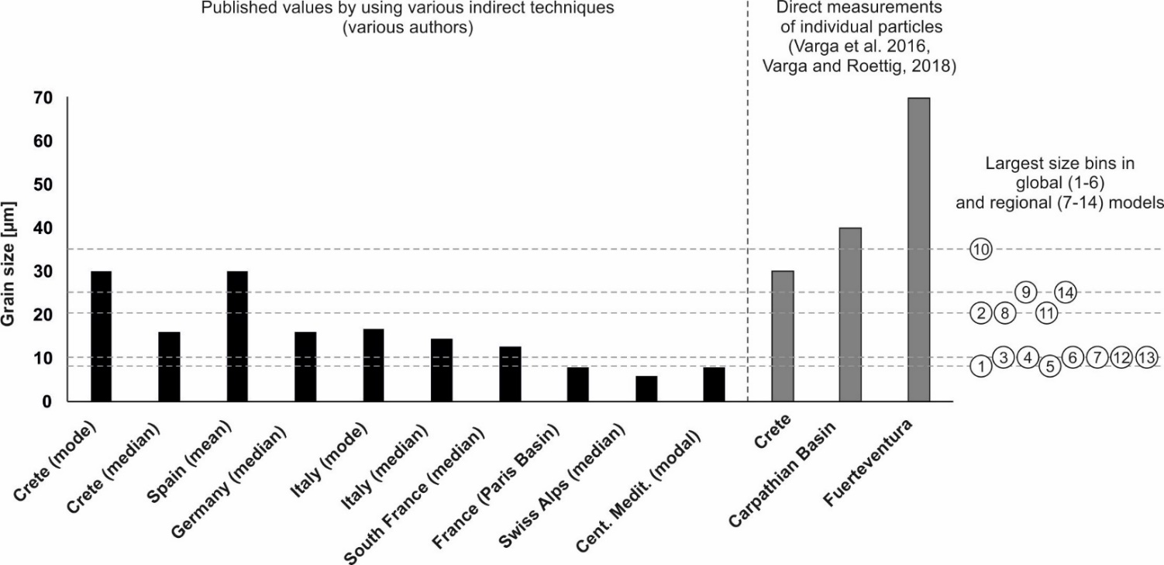
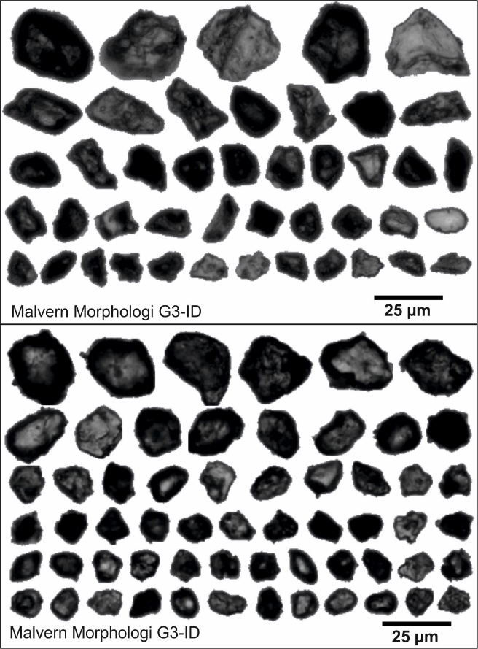
Grain size uncertainties…
Particles size of sampled dust material of some intense deposition episodes were very coarse with a considerable volumetric proportion of > 20 μm particles.
Mineral grains of >20 μm are usually not accounted for in the numerical simulations (in the majority of global and regional dust models, only some size-bins of a relatively narrow size range are applied)
Because of the cubic relationship between particle diameter and volume (mass), even a small change in applied size-bins can lead to a significant increase of modelled dust fluxes.
Reported grain size values of Saharan dust in the Mediterranean (indicated models: 1: GEOS-5; 2: MACC_II; 3: MASINGAR; 4: MetUM; 6: NGAC; 7: NMMB/BSC-Dust; 8: CHIMERE; 9: CMAQ-KOSA; 10: COAMPS; 11: CUACE/Dust; 12: BSC-DREAM8b; 13: DREAM8-NMME-MACC; 14: TAQM_KOSA;).
Source: Benedetti et al., 2014

Slide 17
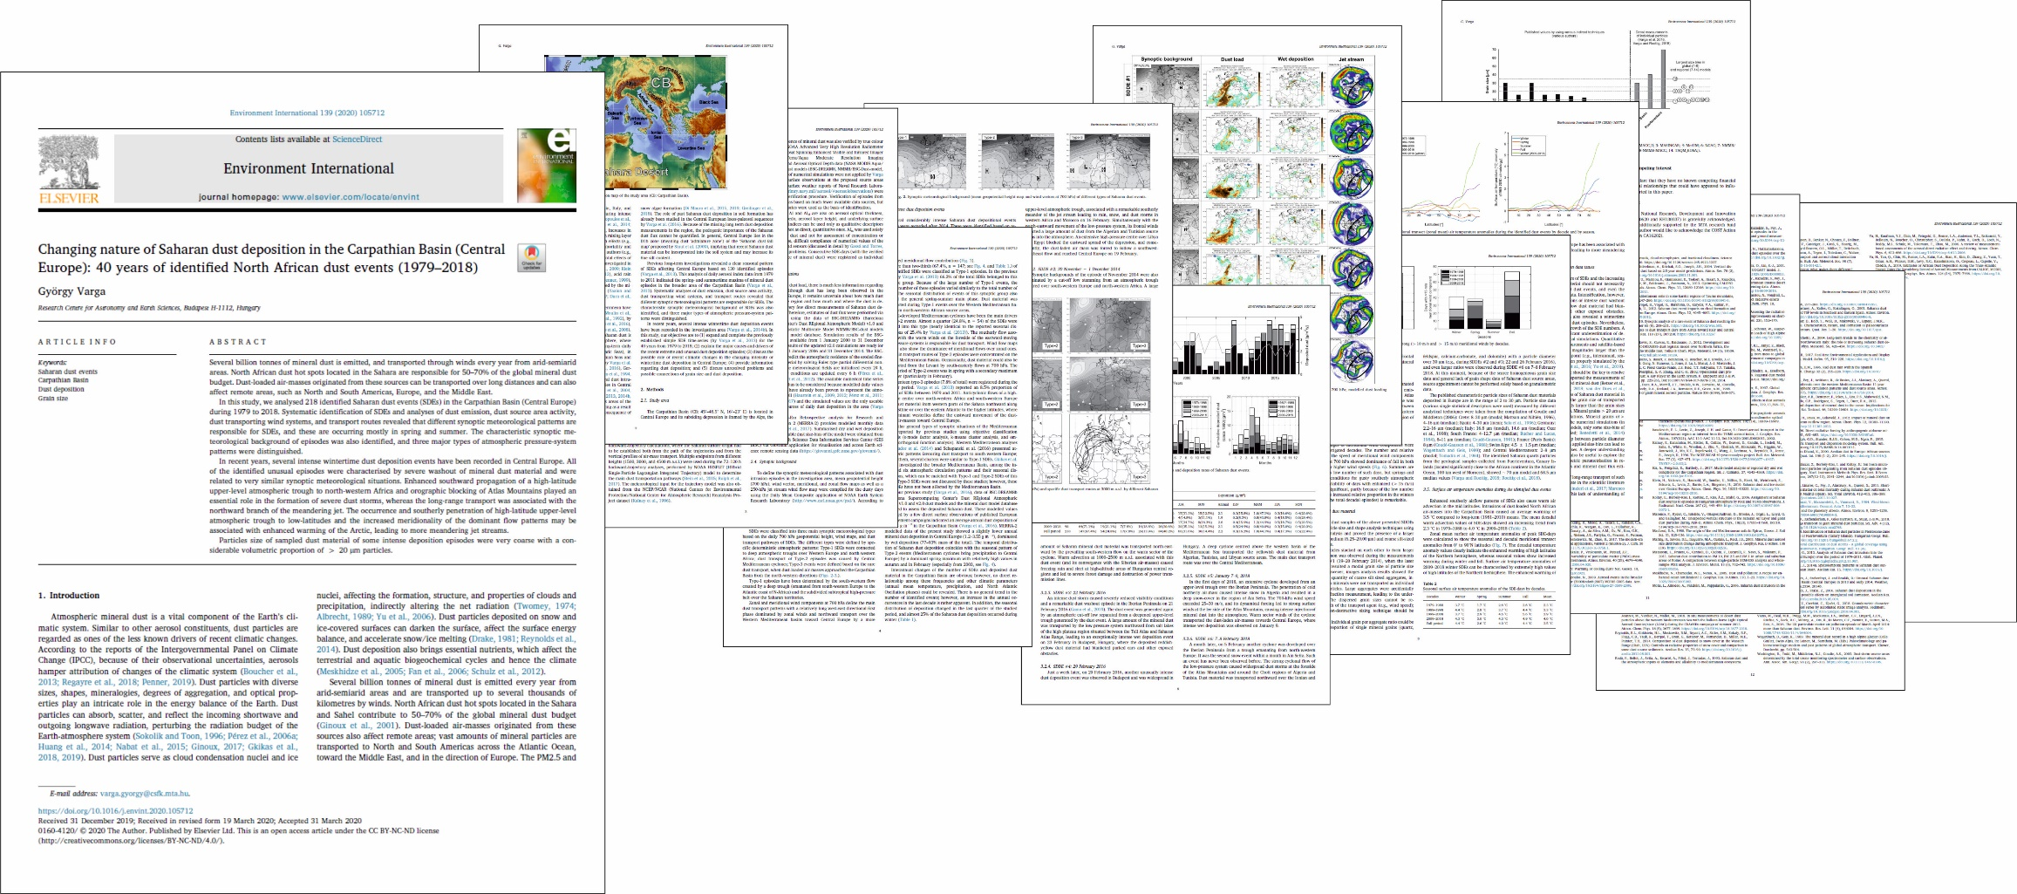
Thank you for your kind attention!
For more details:
Varga, Gy. (2020). Changing nature of Saharan dust deposition in the Carpathian Basin (Central Europe): 40 years of identified North African dust events (1979–2018). Environmental International 139. 105712
https://doi.org/10.1016/j.envint.2020.105712
Support by the National Research, Development and Innovation Office (NKFIH K120620 and KH130337) is gratefully acknowledged. The research was additionally supported by the MTA research fund KEP-08/2018. The author would like to acknowledge the COST Action inDust (COST Action CA16202).

