Slide 1
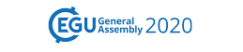
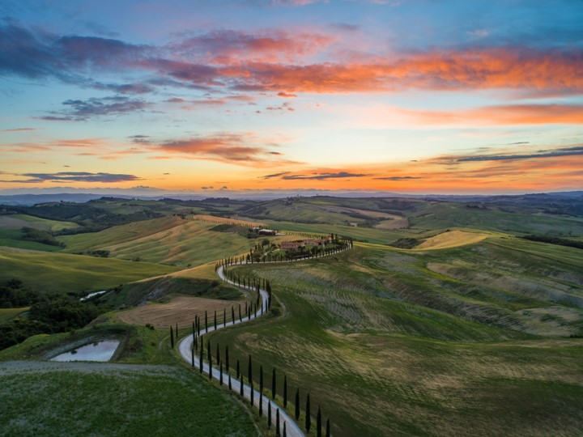
Session ERE2.6 “Exploration, utilization and monitoring of
conventional and unconventional geothermal resources”
Feasibility, Design and Authorization of a Zero Emission
Geothermal Power Plant in Italy
Case Study: “Montenero” Project
Basile P., Brogi R., Favaro L., Mazzoni T.

Slide 2
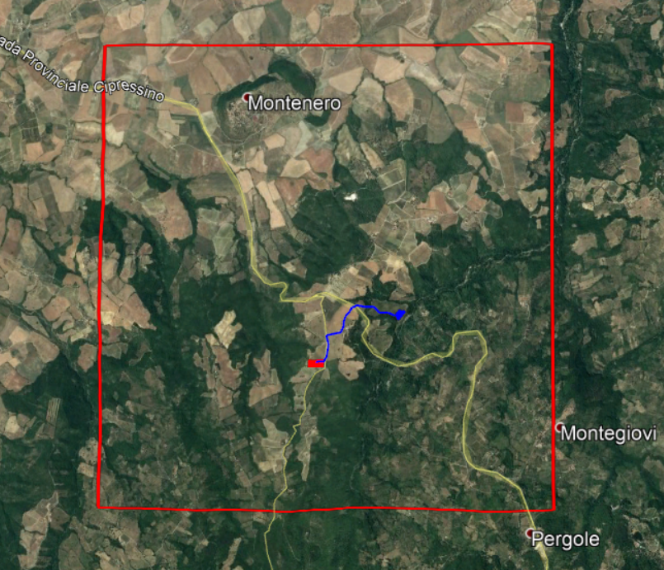
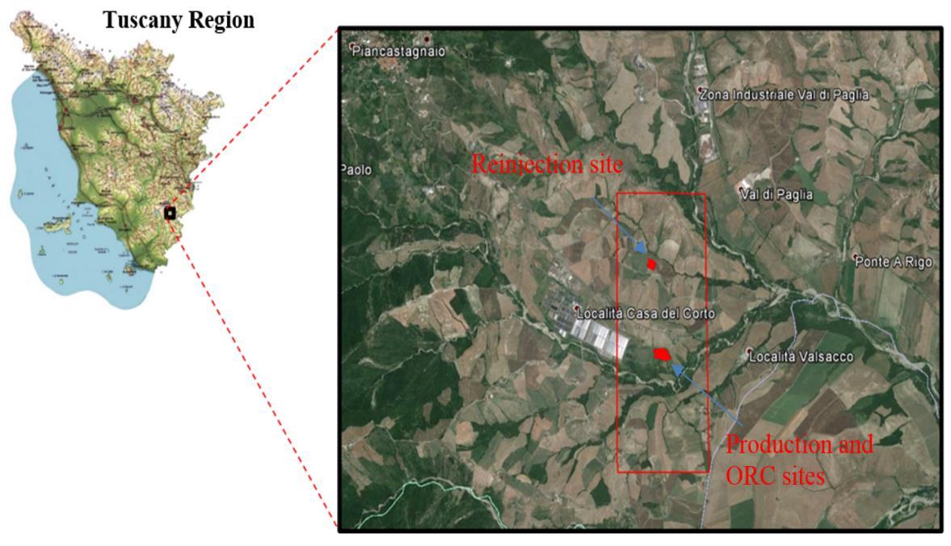
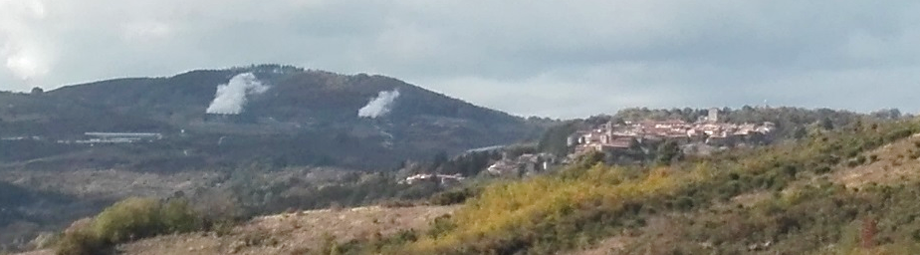
Project Area
The “Montenero” Research Permit (RP) is located in Tuscany (Italy), on the west edge of the great geothermal anomaly of Mt. Amiata.
Italy's nickname is “The Bel Paese" meaning
“ the beautiful country"
Historical heritage
Architecture
Landscape
Excellent agriculture, food and wine
The community and local authorities, living around the project site, are very sensitive to any possible transformation of the present economic and social activities, dominated by rural tourism and production and sale of excellent food products and famous wine.
Population and local authorities are worried about the possible emission of Carbon Dioxide (CO₂) and, pollutants in the atmosphere such as Hydrogen Sulphide and Mercury (H₂S and Hg), land occupation and visual impact.

Slide 3
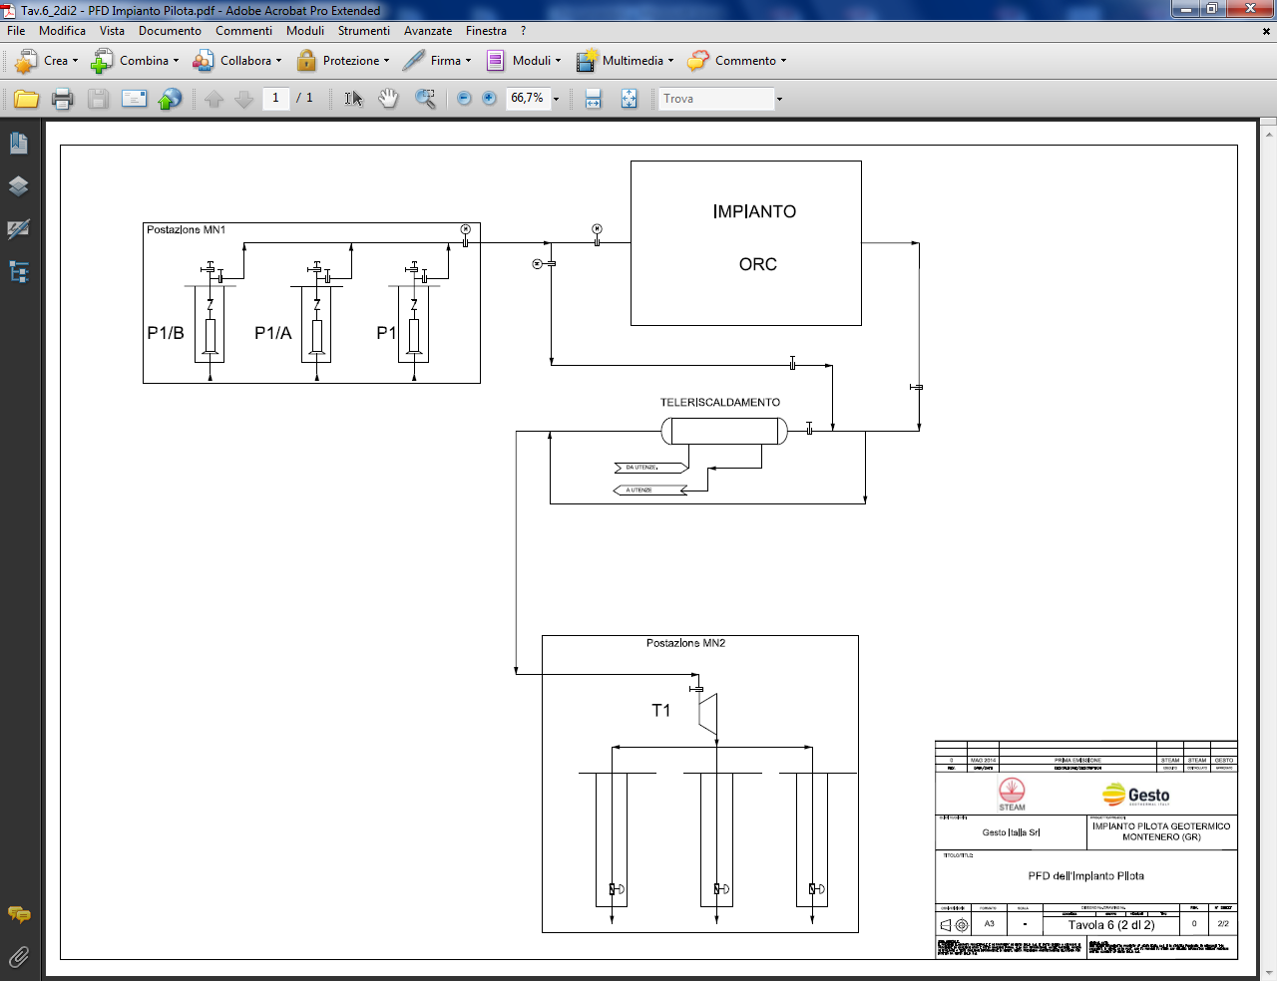
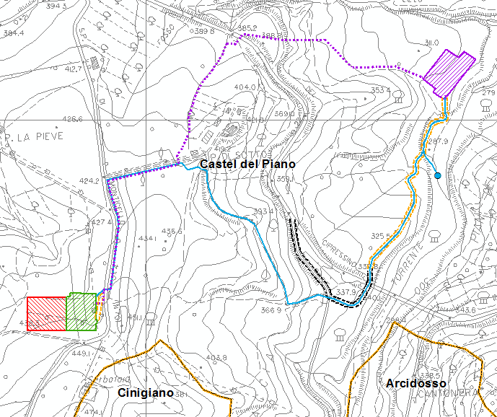
Proposed Technological Solution
Therefore, the project is designed to promote social acceptability by the population and by the Authorities, adopting several innovative technological solutions such as:
total reinjection of geothermal fluid (No GHG Emissions);
visual impact mitigation, using appropriate technological solutions;
geothermal fluid production settling in well electrical submersible pumps (ESP);
buried pipelines at high pressure and spill detection.
ORC
Production Wells
Reinjection Wells
The ‘‘Montenero’’ project is designed to produce a net power of 5 MWe.
One production well pad (MN1) with 3 wells (1 Vertical and 2 Deviated);
The ORC power plant;
One reinjection well pad (MN2) with 3 wells (1 Vertical and 2 Deviated).
MN2
The ORC plant will be installed next to the production well pad. The reinjection well pad will be located approximately 1.5 km away from the production area.
MN 1 - ORC

Slide 4
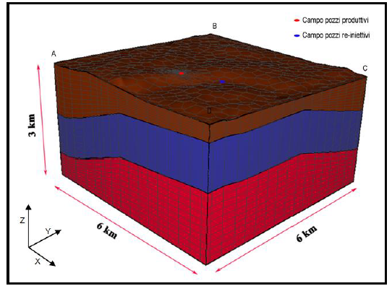
Environmental Impact
Environmental aspects connected to geothermal project developments are receiving increasing attention in Europe and in particular in Italy (“Guidelines for the usage of medium and high enthalpy geothermal resources” Ministry of Economic Development and the Ministry of the Environment July 2016)
Air Emission
The Geothermal Power Plant is a total reinjection power plant. Therefore, during normal operations, no gaseous pollutants are emitted in to the atmosphere.
Underground Impacts
A 3D numerical model has been developed using the software Tough2^{(R)} to evaluate pressure and temperature variations in the reservoir due to the production of 450 t/h at 180 °C and reinjection of 450 t/h at 100 °C.
The simulation results predict a variation of +/- 4.5 bar near reinjection and production wells respectively after 30 years of production/reinjection.
The model estimated a temperature decrease at the production wells of less than 0.5 °C, after both 30 and 50 years of fluid reinjection at 100 °C.
As a result, the thermal effects due to re-injection can be neglected.

Slide 5
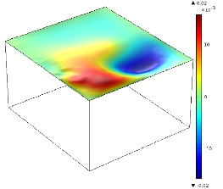
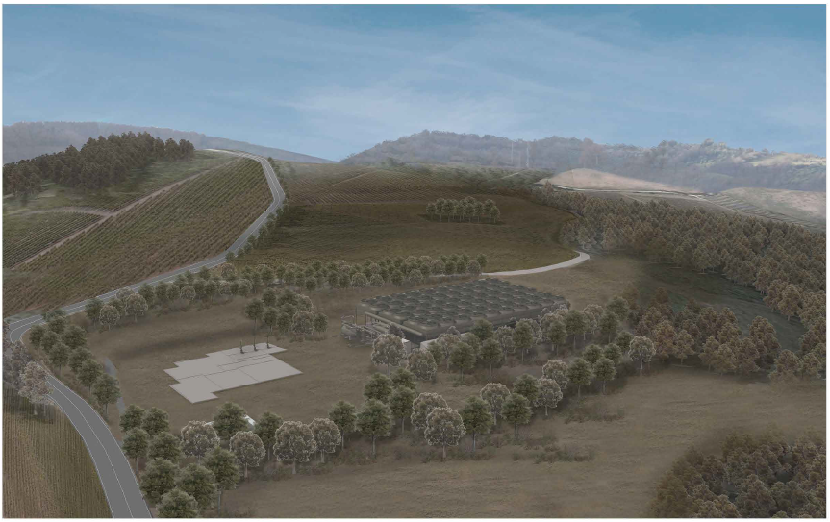
Environmental Impact
Underground Impacts
Induced Seismicity
The simulation results (ΔP) were used to evaluate the potential seismic magnitude (M_{w}) effect according to the following Lay and Wallace equation (1995)
The solution of equation produces a value of M_{w} of – 4.7 (negative).
Subsidence
Subsidence was also evaluated as 2 cm of soil elevation
variation after 30 years of production nearby the production wells.
Land take and Landscape
The plant layout has been designed to limit its land footprint.
The 6 wells (3 productive and 3 re-injective) will be drilled over two drilling pads for a total of 16.000 m² of land utilizing one vertical and two deviated wells in each pad.
As mentioned, the reinjection pipeline will be underground to reduce visual impact.

Slide 6
Conclusion
Due to these innovative solutions, the “Montenero" project obtained:
the acknowledgment of National Interest of the geothermal exploitation;
the environmental authorization by a national procedure;
the direct access to Feed In Tariff (FIT) system.
Innovative solutions present in the Montenero project could be verified and improved with the implementation of the operation.
We expect the Power plant to be commissioned by the end of 2020.

Slide 7


Session ERE2.6 “Exploration, utilization and monitoring of
conventional and unconventional geothermal resources”
Thanks for your attention
Via Ponte a Piglieri, 8
56122 Pisa, Italy
Tel.: +39 050 9711664
Fax: +39 050 3136505
info@steam-group.net
www.steam-group.net

