Slide 1
Systematic scenario process to support analysis of long‐term emissions scenarios and transformation pathways for the IPCC WG3 6th Assessment Report
Edward A. Byers¹, Keywan Riahi¹, Elmar Kriegler², Volker Krey¹, Roberto Schaeffer³, Detlef van Vuuren⁴, Matthew Gidden⁵, Daniel Huppmann¹, Jarmo Kikstra¹, Robin Lamboll⁶, Malte Meinshausen⁷, Zebedee Nicholls⁷, and Joeri Rogelj⁶
IIASA, IIASA, Laxenburg, Austria (byers@iiasa.ac.at)
Potsdam Institute for Climate Impacts Research, Potsdam, Germany
COPPE, Federal University of Rio de Janeiro, Brazil
Netherlands Environmental Assessment Agency, The Hague, Netherlands
Climate Analytics, Berlin, Germany
Imperial College London, London, UK
Climate Energy College, University of Melbourne, Australia
EGU General Assembly 2020 ITS3.4/CL3.4
07/05/2020
https://doi.org/10.5194/egusphere-egu2020-20564

Slide 2
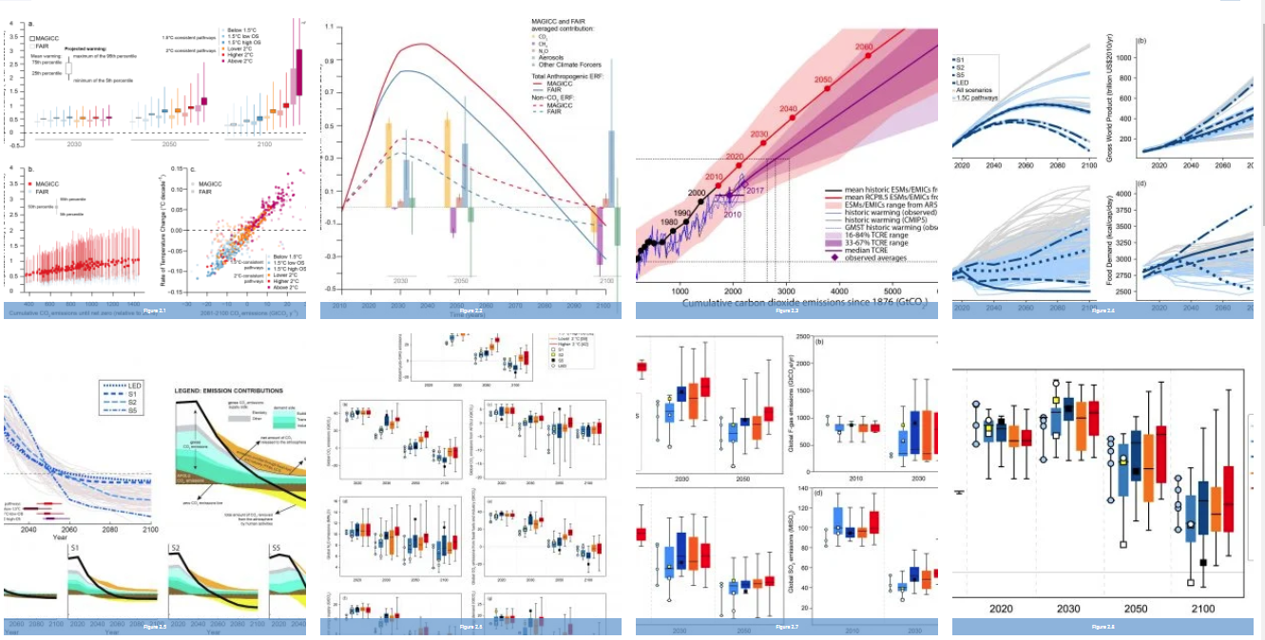
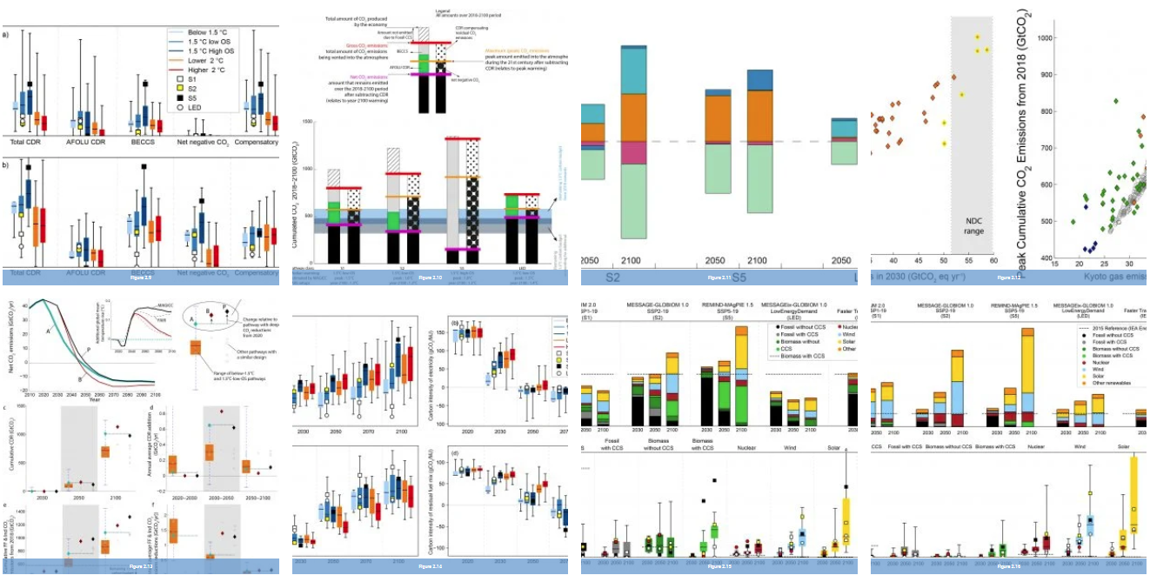
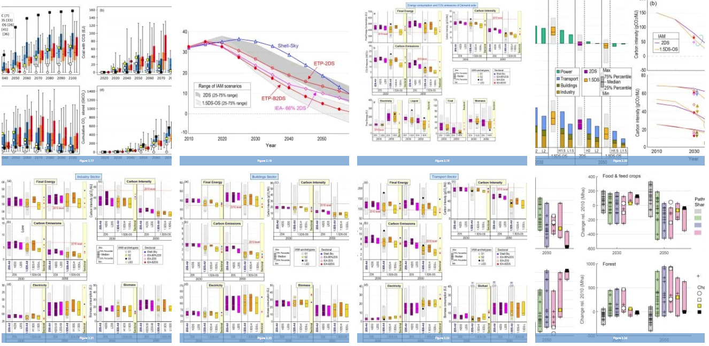
IPCC Special Report 1.5°C (Ch2)
400+ Global Scenarios to 2100 with:
Emissions
Primary & Final energy
Population & GDP
Land-use, agriculture and environment
+ more…
Management challenges
Collection
Storage
Data consistency
Quality control & vetting
Version control and updates
Security
Scientific challenges
Quality control & vetting
Sample biases
Emissions-Temp. response
Analysis
Transparency

Slide 3
The scenarios process for AR6
Figure 1 from D. Huppmann et al. (2018). doi: 10.1038/s41558-018-0317-4
Defining the scope of scenarios collection
Calls for scenarios (open)
AR6 scenario submission portal
Quality control and vetting
Climate assessment and categorization
Debiasing and identifying Illustrative Pathways
Meta-data processing and Model report cards
Report, workflows and database publication

Slide 4
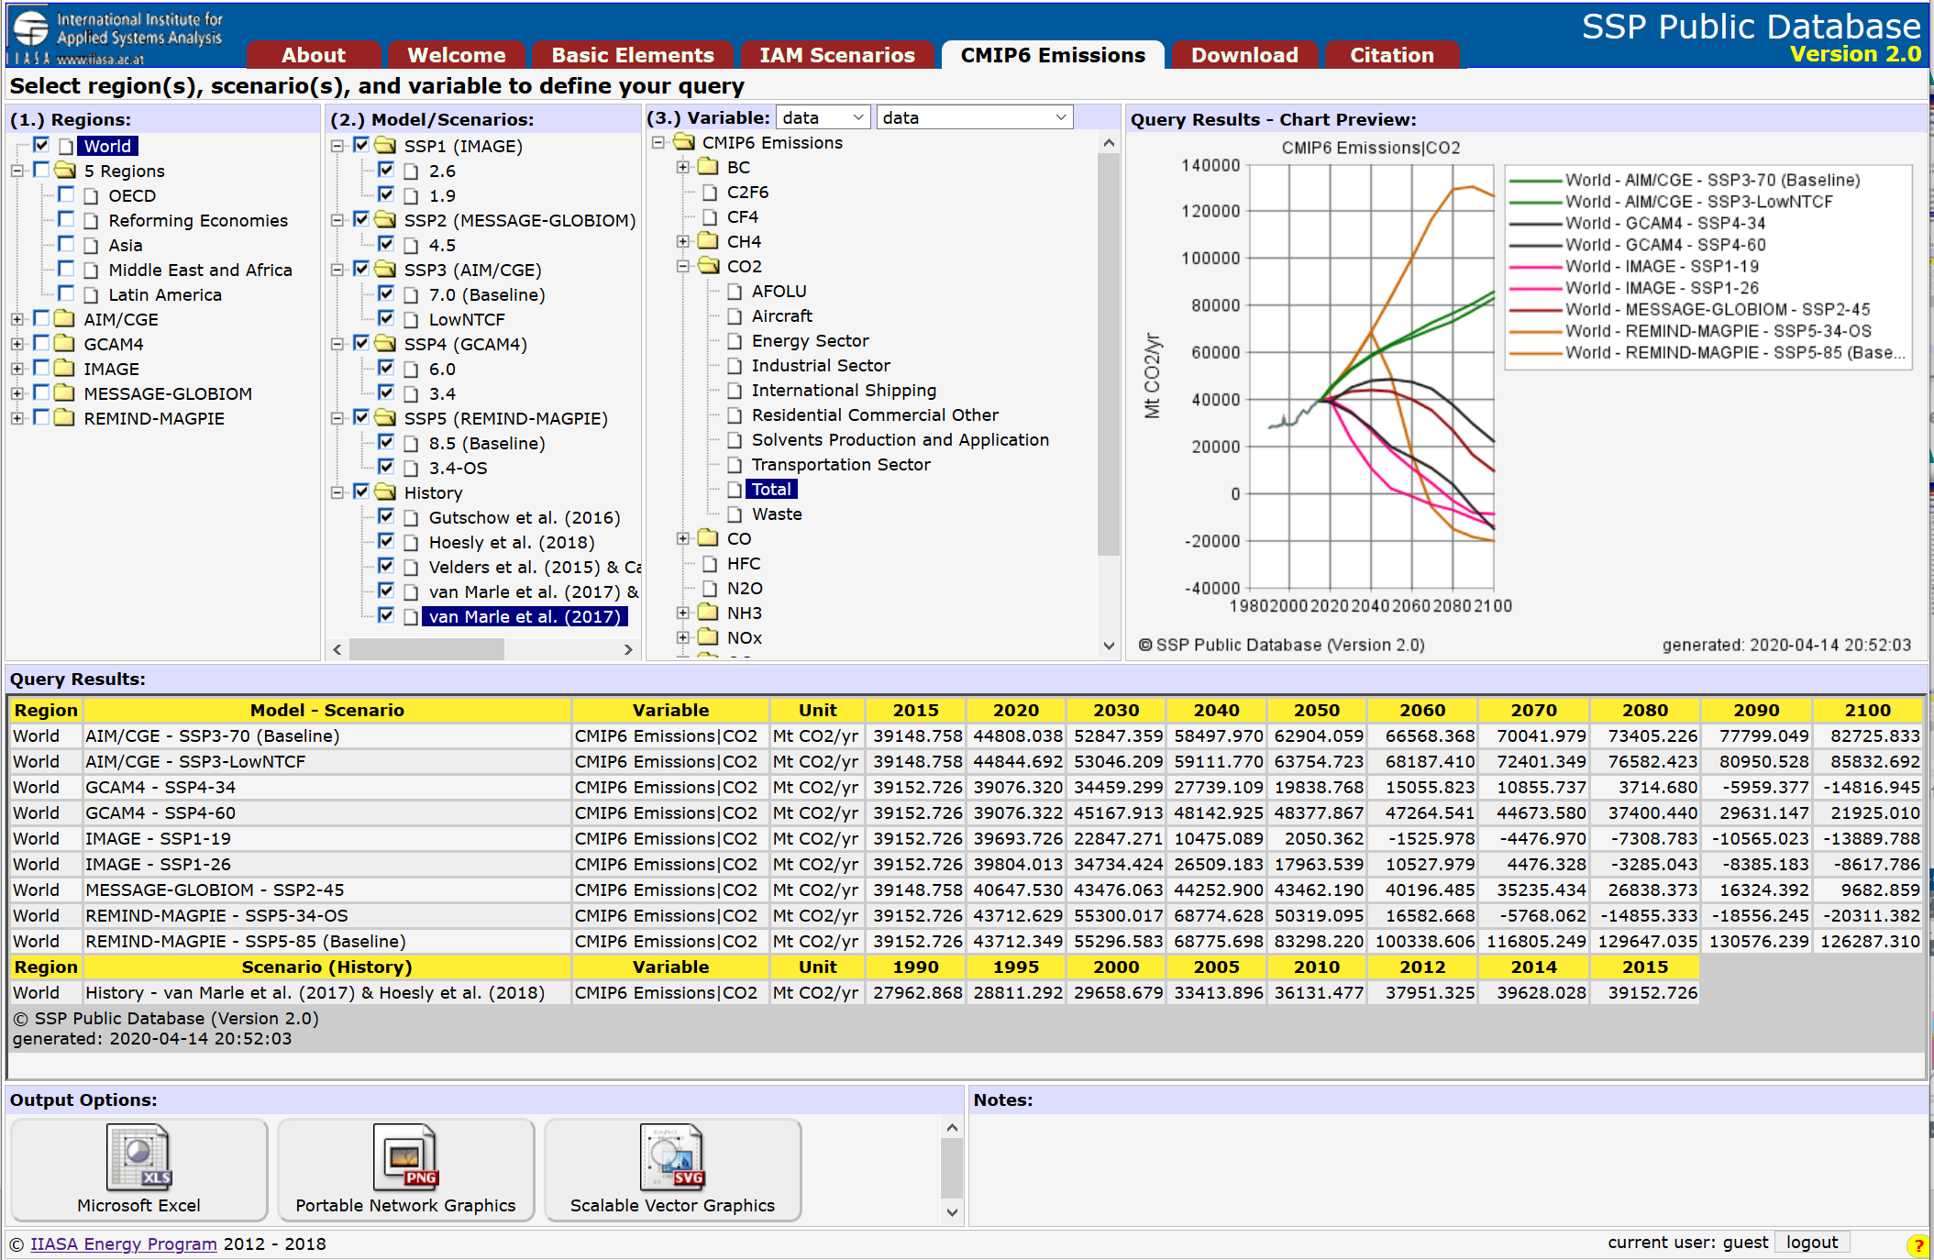
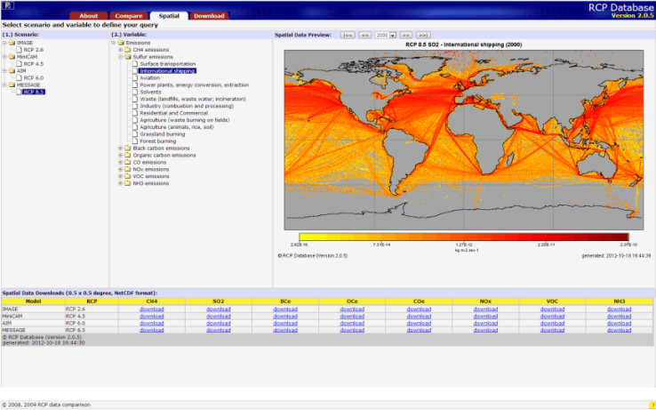
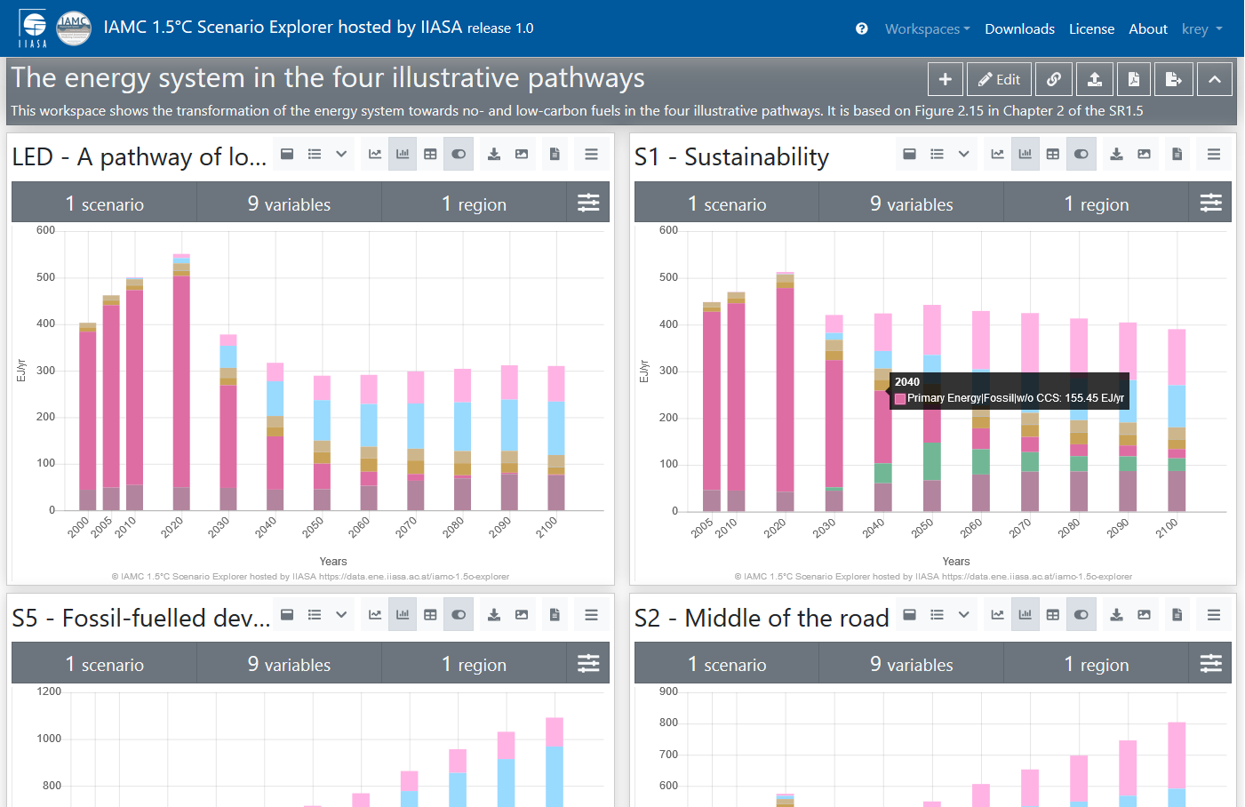
Services for IPCC and Scientific Community
IPCC AR5 database
SSP database
https://secure.iiasa.ac.at/web-apps/ene/AR5DB
https://tntcat.iiasa.ac.at/SspDb/
RCP database
SR1.5 scenario explorer
http://tntcat.iiasa.ac.at/RcpDb/
https://data.ene.iiasa.ac.at/iamc-1.5c-explorer/
and many more …
Notes:
Over the past years, the ENE program has developed a number of data dissemination tools. On the one hand, we host a number of web-databases which are mostly addressing the scientific community; examples include:
Representative Concentration Pathway (RCP) database which hosts emissions, land use data, both as regional and gridded data, for the IPCC AR5 process
Global Energy Assessment (GEA) scenario database
Several databases for modeling comparison projects of the integrated assessment modeling community

Slide 5
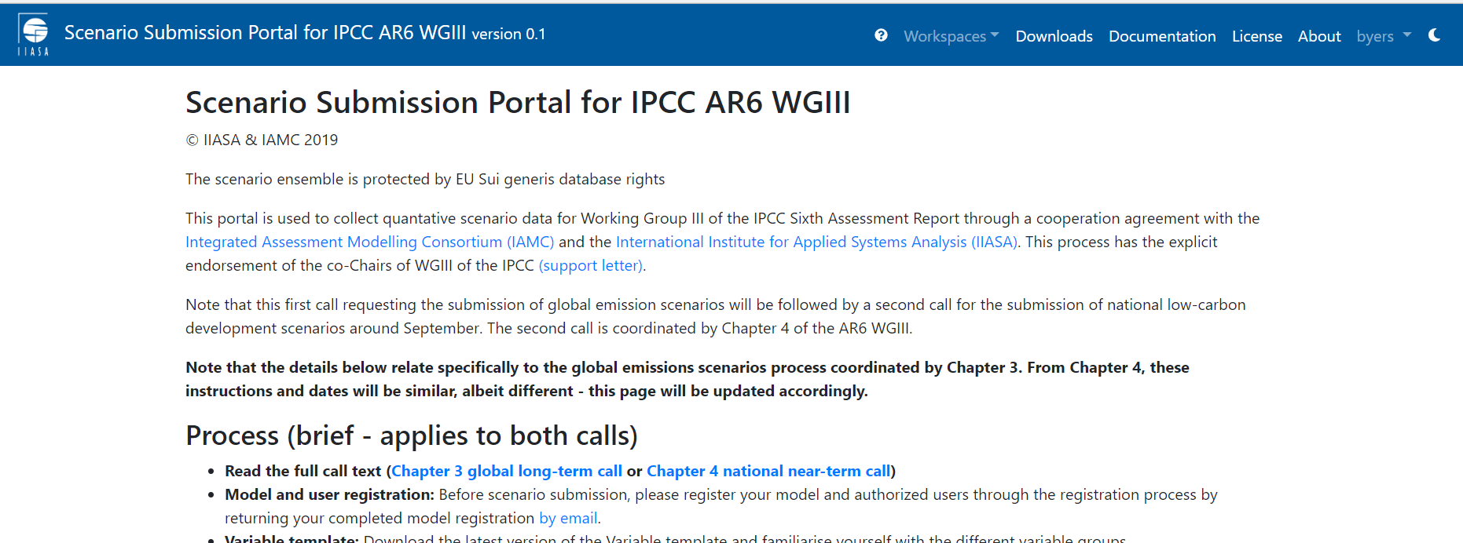
Calling out to the community
https://data.ene.iiasa.ac.at/ar6-scenario-submission/#/about

Slide 6
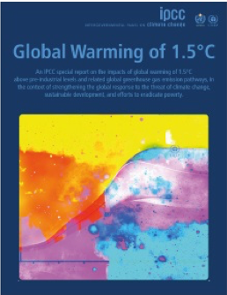
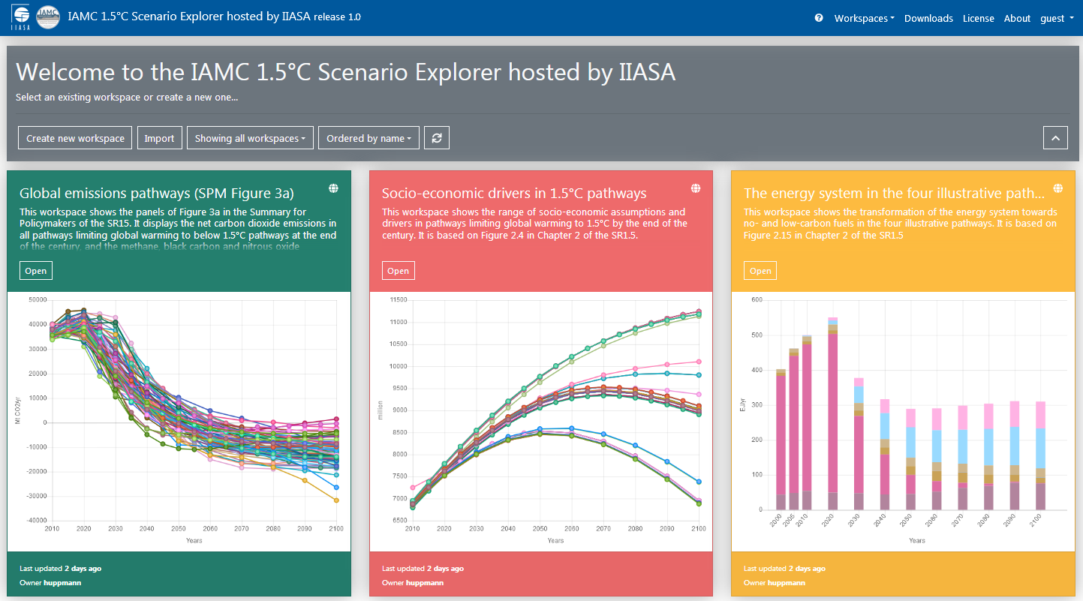
Building upon the Scenario Explorer for SR1.5 and the AR5 databases
Special Report on Global Warming of 1.5°C (IPCC SR15, http://www.ipcc.ch/report/sr15/)
Facilitate collection of scenarios from the community
Facilitates data sharing and analysis during report writing
Establish internally consistent, quality-controlled and comparable data sets
Data-security during report writing
Data transparency on publication
Visit the Scenario Explorer at https://data.ene.iiasa.ac.at/iamc-1.5c-explorer

Slide 7
Curating more scenarios from the community
Targeted calls to get more sectoral models –:
Global / long term emissions(Ch 3)
National / short-term emissions (Ch 4)
Demand & service levels (Ch 5)
Energy systems (Ch 6)
Buildings (Ch 9)
Transport (Ch 10)
EDGAR historical emissions (Ch2)
Approximately 2000 variables to accommodate high resolution information across many sectors
An IPCC scenario database beyond global integrated assessment scenarios

Slide 8
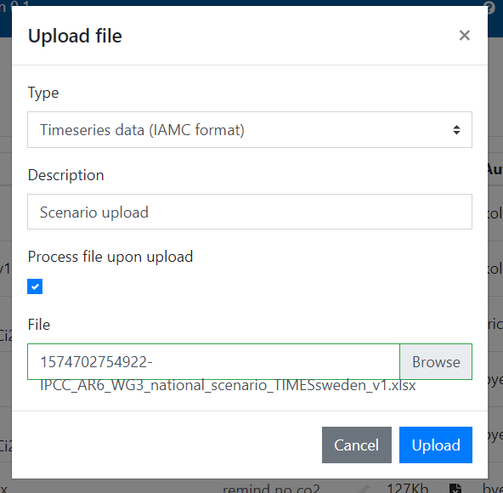
Scenario upload couldn’t be simpler
Data must be in the correct format
- it is a database
- important for quality control (names, regions, units)

Slide 10
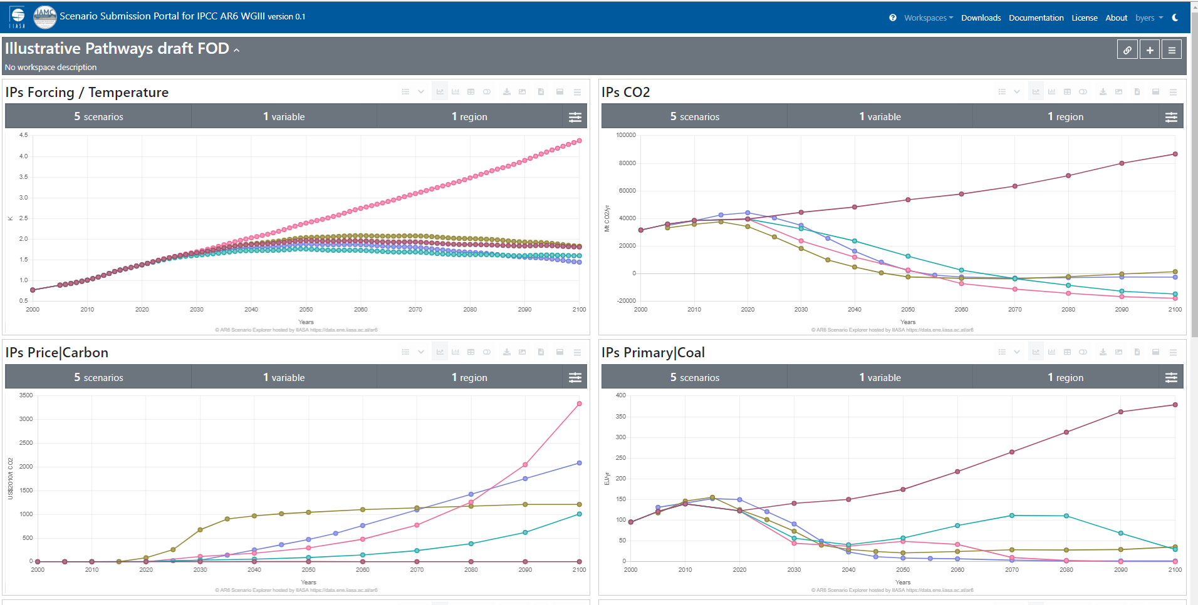
Snapshot download
Analysis your way
Different snapshots depending on your focus:
- World
R5/R10 regions
National
ISO countries
Native regions
Buildings
… more
See an example at: https://data.ene.iiasa.ac.at/iamc-1.5c-explorer/#/workspaces/2

Slide 11
Post-processing assessment pipeline
Data QC (names, units, regions, region aggregation, data type)
Climate assessment – from emissions to surface temperature
Harmonization (CEDS CMIP6) + infilling,
Simple climate models (OpenSCM – MAGICC7, FAIR,…)
Probabilistic assessment updated to WGI distributions
Feasibility assessment categorization
SDG indicators and climate impacts
Avoided macroeconomic impacts and social cost of carbon
Edward Byers, Jarmo Kikstra, Zeb Nicholls, Robin Lamboll, Matt Gidden, Chris Smith, Daniel Huppmann, Jared Lewis, Malte Meinhshausen, Joeri Rogelj, Keywan Riahi,.. + more
Max Tavoni, Elina Brutschin, Giacomo Marangoni ,…
Volker Krey, Bas van Ruijven, Ed Byers, Shinichiro Fujimori,…
Laurent Drouet, Max Tavoni ,…
Multidimensional feasibility prototype: Marangoni et al.

Slide 12
Get in touch if there are scenarios that should be part of the AR6
https://data.ene.iiasa.ac.at/ar6-scenario-submission
Dr Edward Byers International Institute for Applied Systems Analysis byers@iiasa.ac.at @edwardbyers

