Slide 1
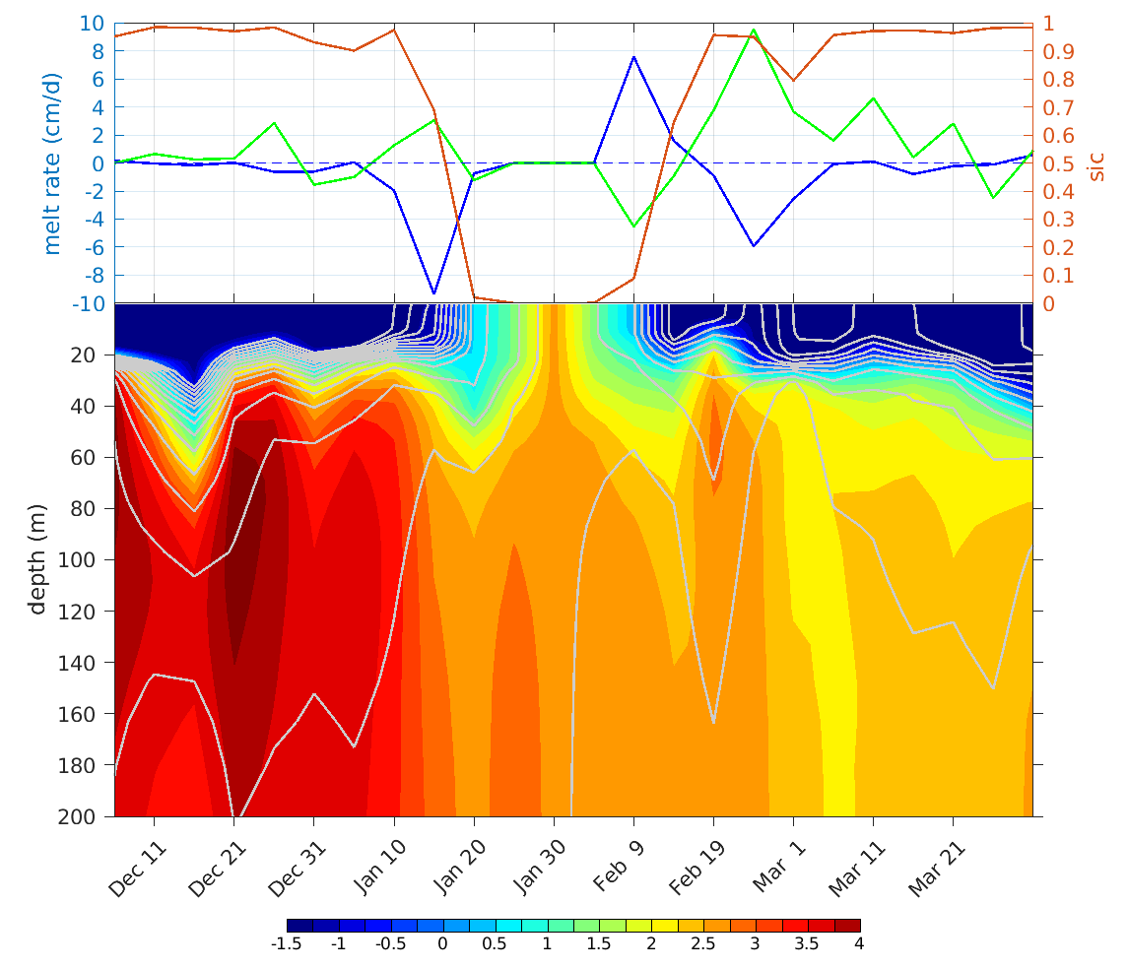
Ocean role in the winter sea ice openings north of Svalbard
EGU2020-20578
Christophe Herbaut, Marie-Noëlle Houssais and Anne-Cécile Blaizot.
LOCEAN, Sorbonne Université/CNRS/MNHN, Paris, France
Large winter sea ice melt rates are found along the pathway of the Atlantic Water boundary current
An example of eastward expansion of winter sea ice opening in 2006
Melt rate (cm/d) and 50% ice concentration (black line) composites for large (> 1 std) melt events and climatology of temperature at 50 m (c.i. 1°C) (1998-2017)
Time evolution at 30°E, 81.5°N in winter 2006 of:
Upper panel: sea ice concentration (red), net sea ice growth rate (blue) and net sea ice convergence
Lower panel: ocean temperature (colour) and potential density (grey isolines, c.i 0.05).
EGU2020 OS1.11: Changes in the Arctic Ocean, sea ice and subarctic seas systems: Observations, Models and Perspectives

Slide 2
Motivation
EGU2020-20578
Significant changes in the winter sea ice cover North of Svalbard:
Reduced winter sea ice coverage in the Western Eurasian Basin in the recent years (Close et al, 2015; Ivanov et al. 2016 ; Onarheim et al, 2018)
Some links with the Atlantic water heat transport (Årthun et al., 2019, Yeager et al., 2015).
Concommitant changes in the upper Arctic Ocean structure
Atlantification of the Eurasian Basin: North Svalbard oceanic conditions tend to expand eastward in recent years (Polyakov et al., 2017).
Ocean vertical mixing can lead to large (> 100 W/m²) ocean heat flux to the sea ice during storm events (Meyer et al., 2018)
Objectives of the study
What are the areas of preferred winter sea ice melt ?
How does the ocean impact sea ice melt and to which extent does melt contribute to sea ice openings North of Svalbard?

Slide 3
Method
EGU2020-20578
Model:
1/24° ocean-sea ice model (NEMO)
Arctic-North Atlantic, 75 levels
Simulation: 1995-2017
6h forcing fields: modified ERA-I
Composite analysis based on:
Winter (DJFM) sea ice melt and sea ice convergence indices (indices are defined over the North Svalbard domain, white line)
Analysis of possible forcing terms : surface wind stress, ocean temperature, vertical mixing, over the region of large (> 2cm/day) melt rates.
Sea ice divergence and associated wind stress patterns
Model domain
EGU20 -OS1.11 – C. Herbaut, Ocean role in the winter sea ice openings north of Svalbard

Slide 4
EGU2020-20578
(Left) Temperature and (right) ocean velocity shear composites for large melt events at the time of (red), 5 days before (green) and 10 days before (blue) the maximum melt. Indices are averaged over the area of large (>2cm/day) sea ice melt
45 % of large melt events are concomitant to strong winds, with no specific wind direction
Evidence of enhanced entrainment of subsurface warm water into the mixed layer
(blue) Sea ice melt; (red) surface stress (indices averaged over the domain of large ice melt)
Sea ice convergence composites for large sea ice divergence events
10 m wind composites for large ice divergence events
Larger ice divergence rates are found in the southwestern part of the domain in response to southeasterly winds
Sea ice divergence dominates the ice volume variations in this region (not shown)
EGU20 -OS1.11 – C. Herbaut, Ocean role in the winter sea ice openings north of Svalbard

Slide 5
Conclusions
EGU2020-20578
Large winter sea ice melt events, though short time events, can contribute to 40% of the total winter ice melt in the area north of Svalbard.
Large melt events show enhanced signature along the AW pathway which extends into the interior of the ice pack as far as 40°E
Strong southeasterly winds, which can sustain altogether northward ice edge retreat and efficient ice melt through entrainment, create optimal conditions for major ice openings such as those observed north of Svalbard in e.g. 2006
This work was supported by the Blue-Action project which has received funding from the European Union's Horizon 2020 research and innovation programme under grant agreement no. 727852.
EGU20 -OS1.11 – C. Herbaut, Ocean role in the winter sea ice openings north of Svalbard

