Slide 1
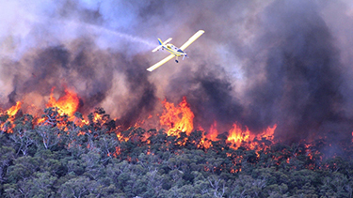
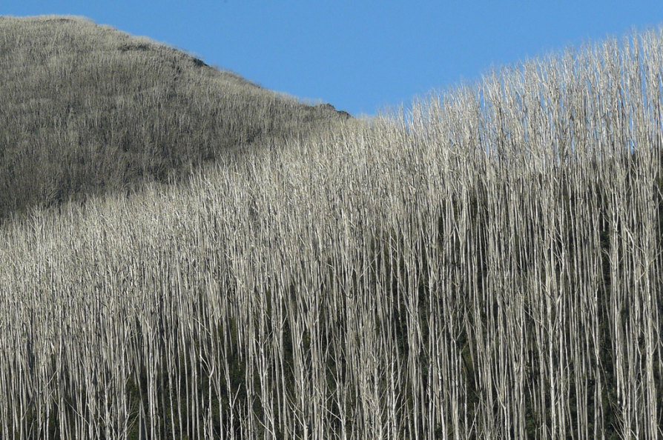
High Frequency Fire Drives Forest Species Change: Impacts on Ecohydrology and Ecosystem Functioning
Patrick Lane, Shyanika Lakmali, Richard Benyon, Assaf Inbar, Gary Sheridan
School of Ecosystem and Forest Sciences, Faculty of Science

Slide 2
Background
Some eucalypt species (E.regans, E. delegatensis mainly), known as the “ash” have a distinct ecology. They are obligate seeders – killed by medium-hot fire, followed by dense fast growing high water using single aged stands
These are wet eucalypt forests, and are iconic species (E.regnans is the tallest flowering plant on earth), and, crucially, vegetate crucial water supply catchments (ie. Melbourne, a city of > 4 mill.)
These forests cover around 3 million ha. of SE Australia (mainly Victoria)
Disturbance of these forests have significant implications for water supply and ecosystem functioning
Notes:
Victoria is an example of an extreme risk – others might be California coast, however it is possible unburned WQ is low, so treatment capacity is better?
Risk levels differ in different parts of SE Aust (Sydney, Adelaide), and even between areas in close proximitiy

Slide 3
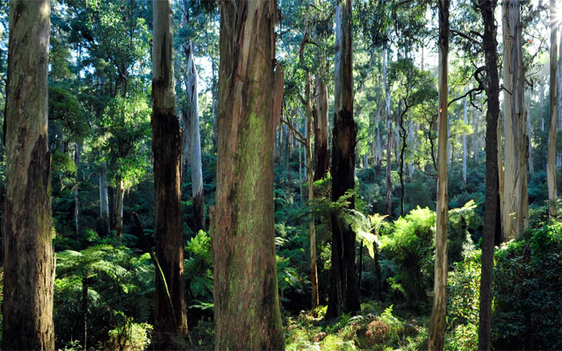
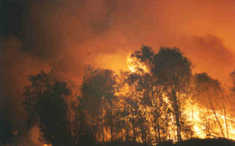
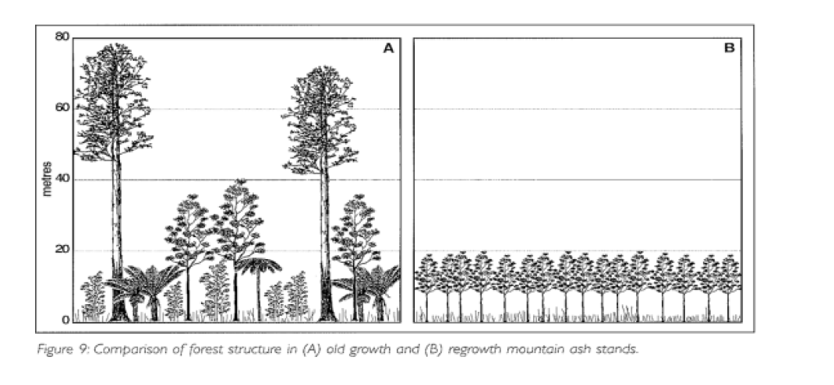
Mountain Ash Fire Ecology
E.regnans are the tallest flowering plant on earth..!
http://www.pbs.org
http://www.aqob.com.au

Slide 4
Decisions…what should we/could we/might we make to preserve water resources?
These species require 15-20 years to develop seed, meaning that fires of < 15-20 years recurrence result in understorey species (frequently acacia species) colinising the site. Eventually (~80 years) acacias die and are replaced by “scrub”
This signifies a radical shift from tall, wet forests to an understorey species to a scrub landscape
The eco-hydrologic implications of this are potentially highly significant, and have not been explored until recent
Notes:
Victoria is an example of an extreme risk – others might be California coast, however it is possible unburned WQ is low, so treatment capacity is better?
Risk levels differ in different parts of SE Aust (Sydney, Adelaide), and even between areas in close proximitiy

Slide 5
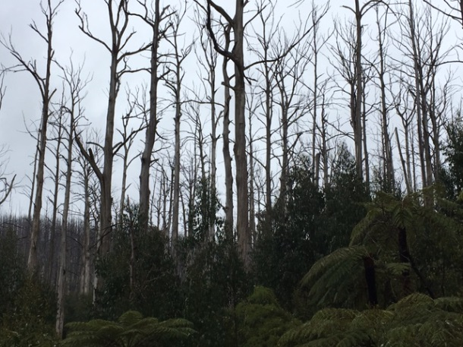
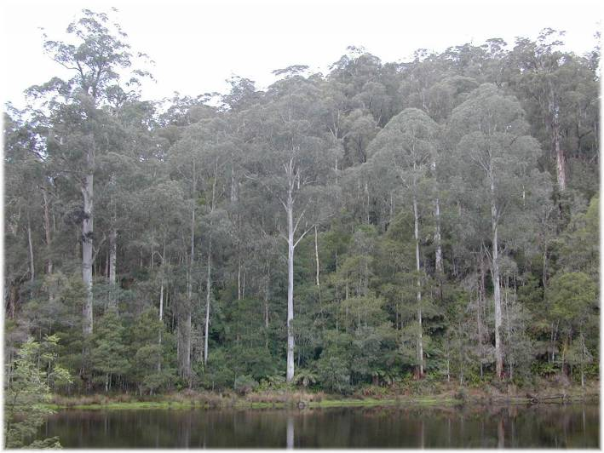
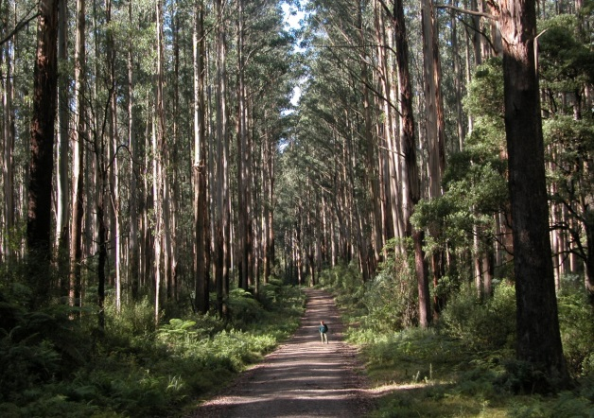
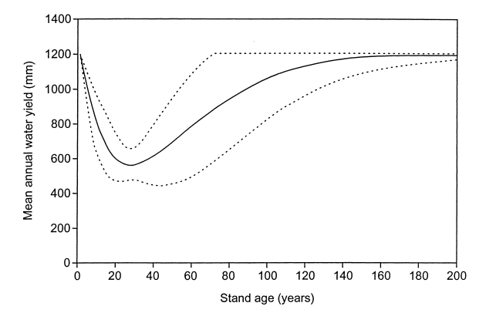
Ash species eco-hydrologic response
Kuczera curve – long term streamflow response to 100% mortality, relative to old growth condition
Kuczera, JH, 1987

Slide 6
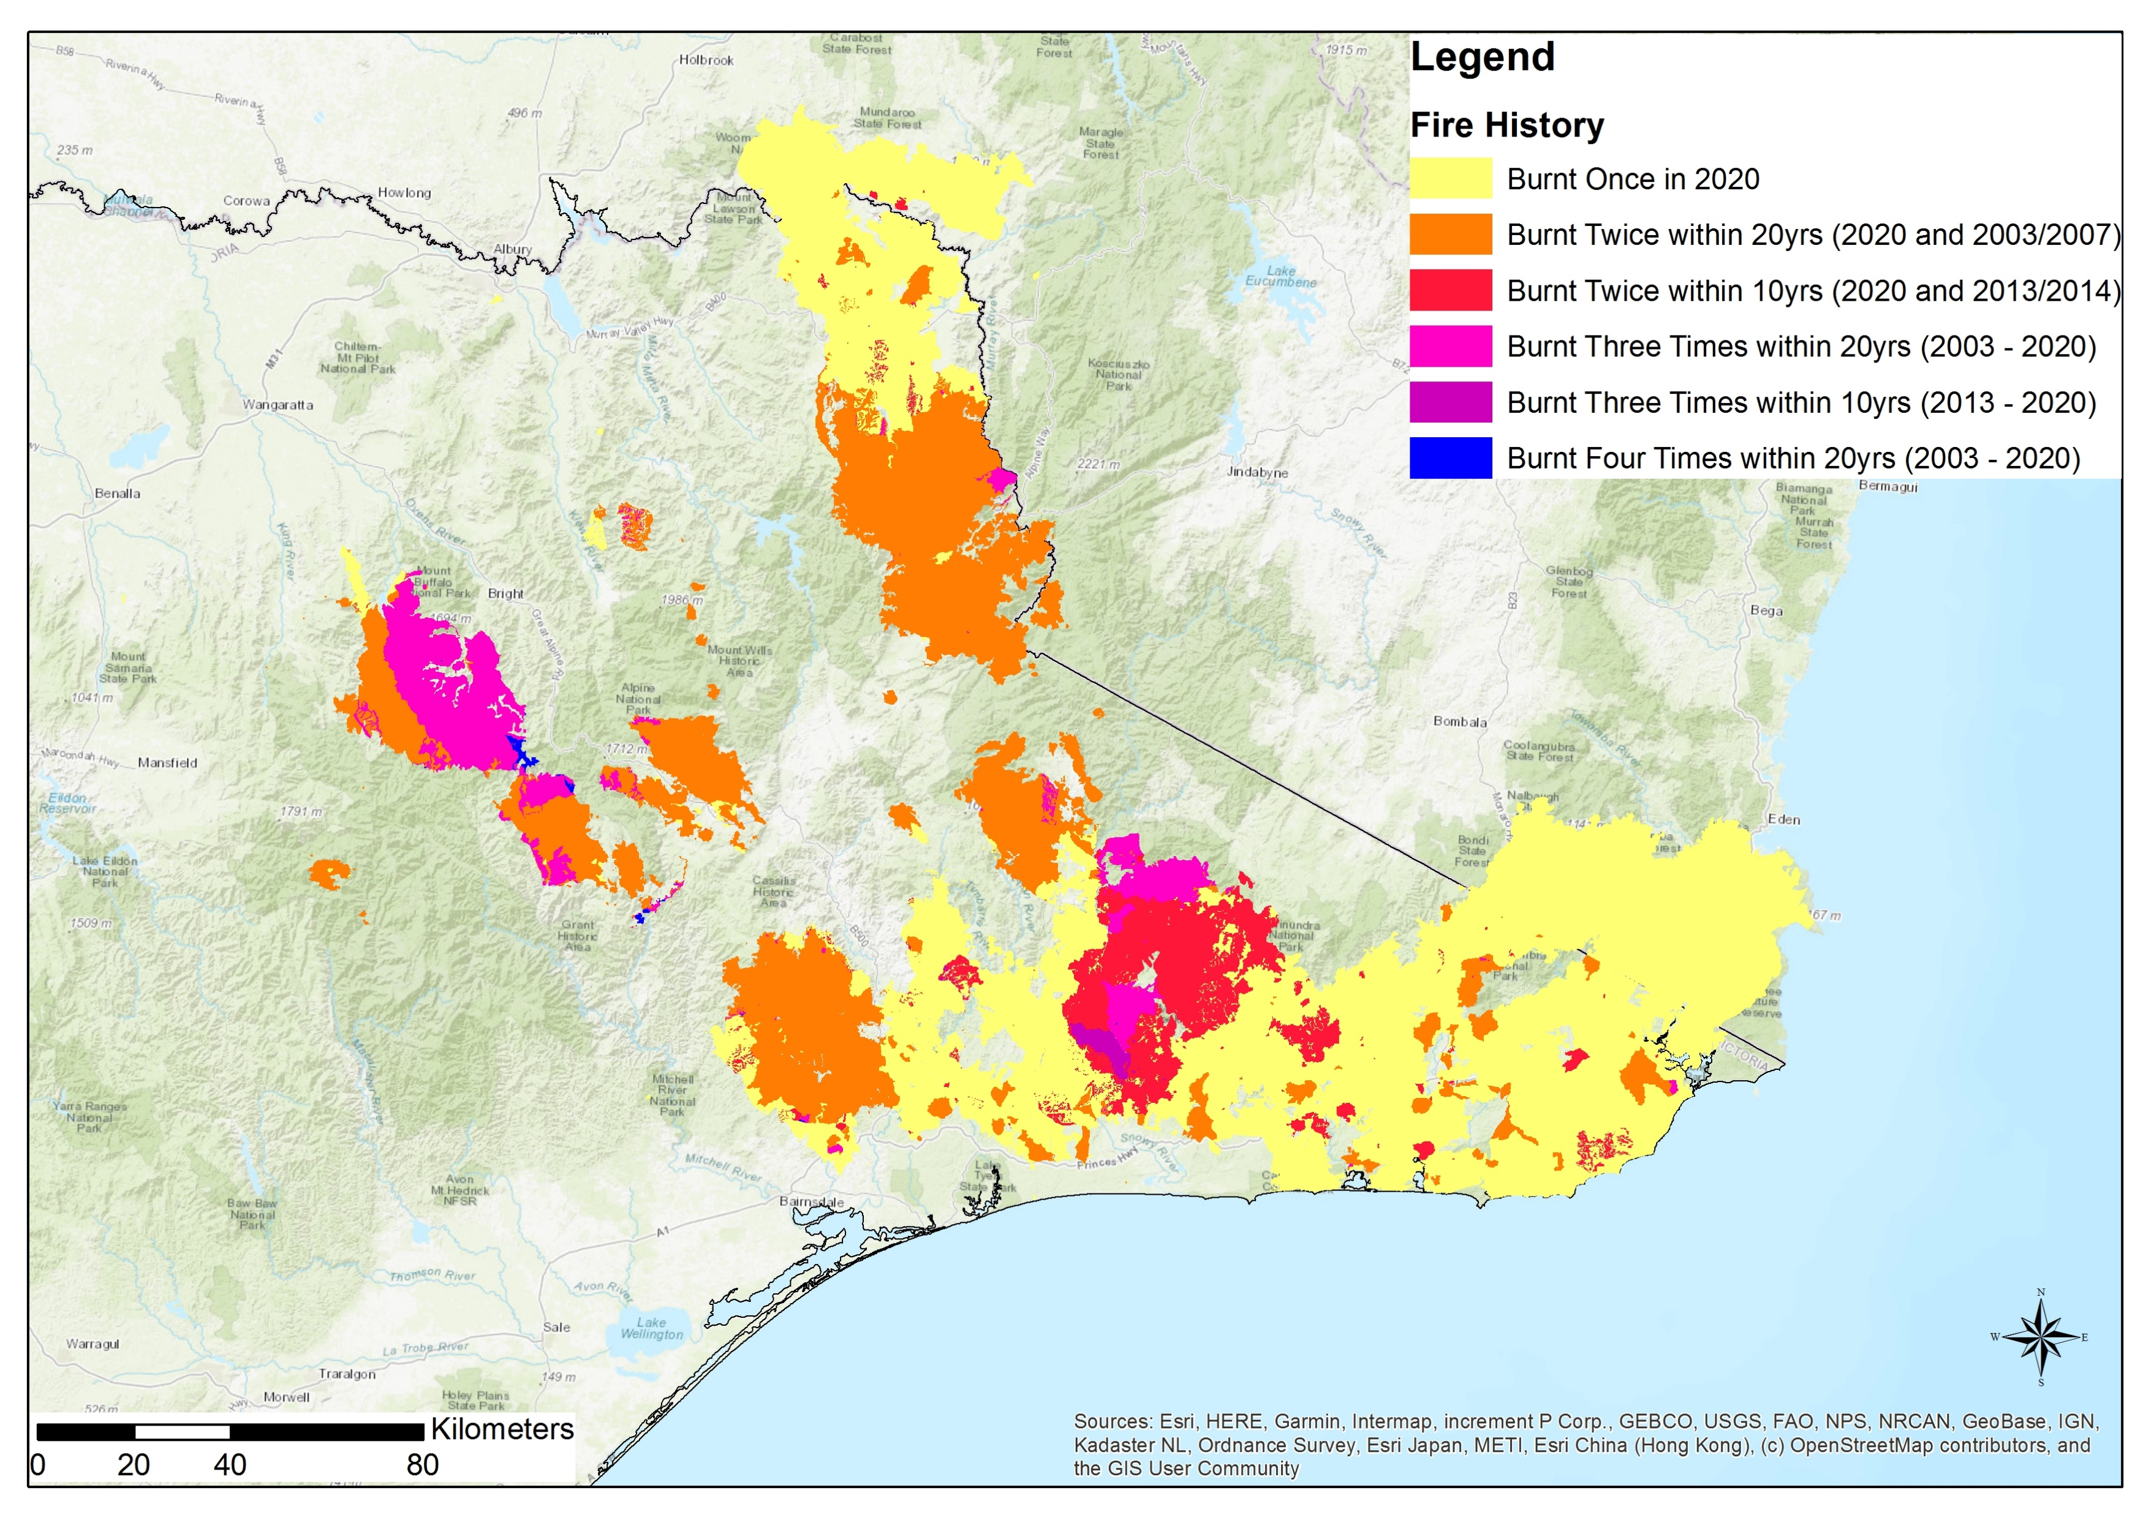
Victorian fires….there’s a lot of it about, and often!
High frequency fire events in Victoria since 2003 (excludes the 2009 catastrophic Black Saturday fire)
Fire frequency has increased markedly in the past 17 years in SE Australia, with significant areas experiencing multiple burns
Notes:
Victoria is an example of an extreme risk – others might be California coast, however it is possible unburned WQ is low, so treatment capacity is better?
Risk levels differ in different parts of SE Aust (Sydney, Adelaide), and even between areas in close proximitiy

Slide 7
Victorian fires….there’s a lot of it about, and often!
Incidence of large stand replacing fires in wet forests in central Victoria
Red dots depict fires, size of dot represents area burnt. Stand replacing fires occur when conditions in the top RH corner of the graph are satisfied – extreme VPD and high soil moisture deficit. Climate predictions suggest greater frequency of these conditions
Notes:
Victoria is an example of an extreme risk – others might be California coast, however it is possible unburned WQ is low, so treatment capacity is better?
Risk levels differ in different parts of SE Aust (Sydney, Adelaide), and even between areas in close proximitiy

Slide 8
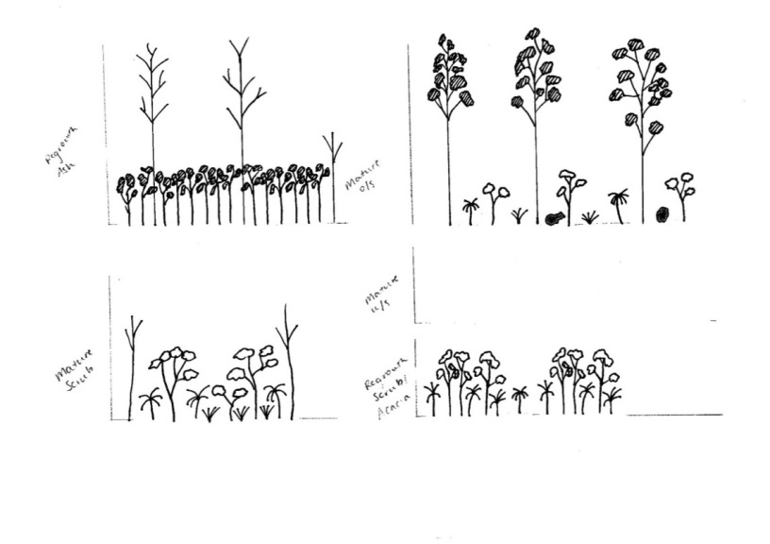




Double burn = alternate states – alternative Et and flammability?
Ash Forest Mature - Regrowth
Acacia
dominated - Scrub
70m
35m
0m
All of these states exist in the same ecotone – the Mountain Ash “habitat”. Their presence/absence is controlled by fire

Slide 9
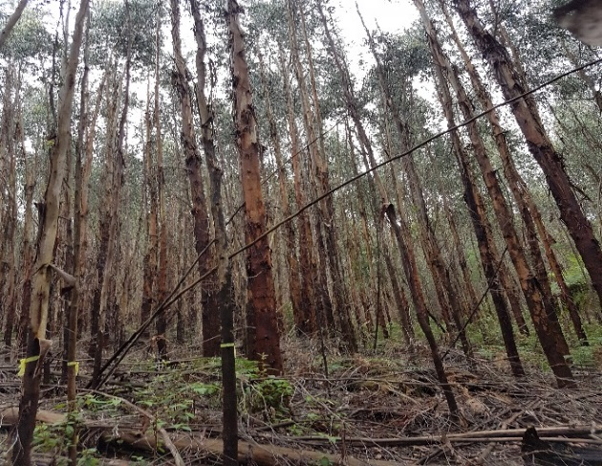
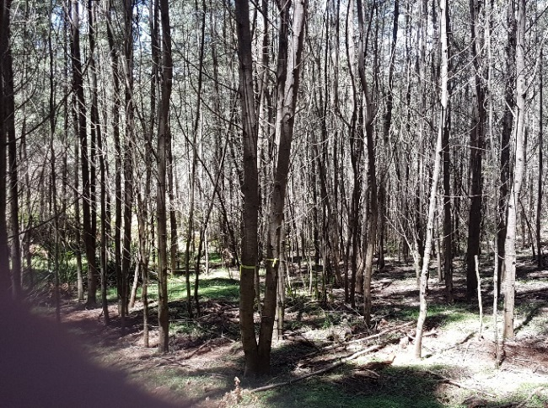

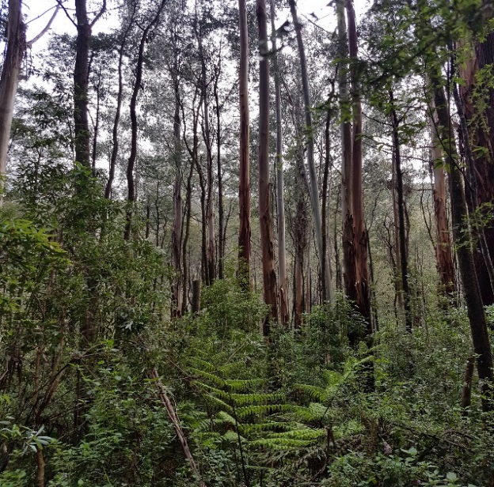
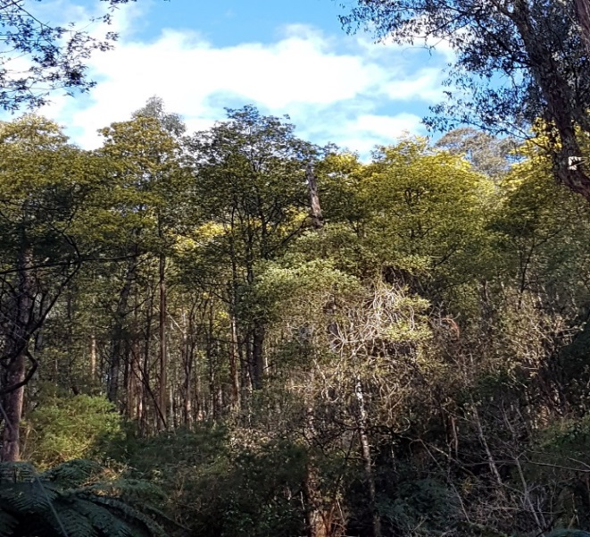
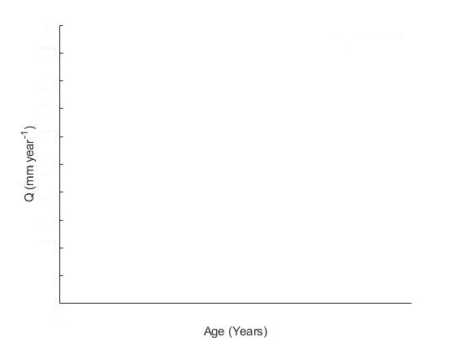
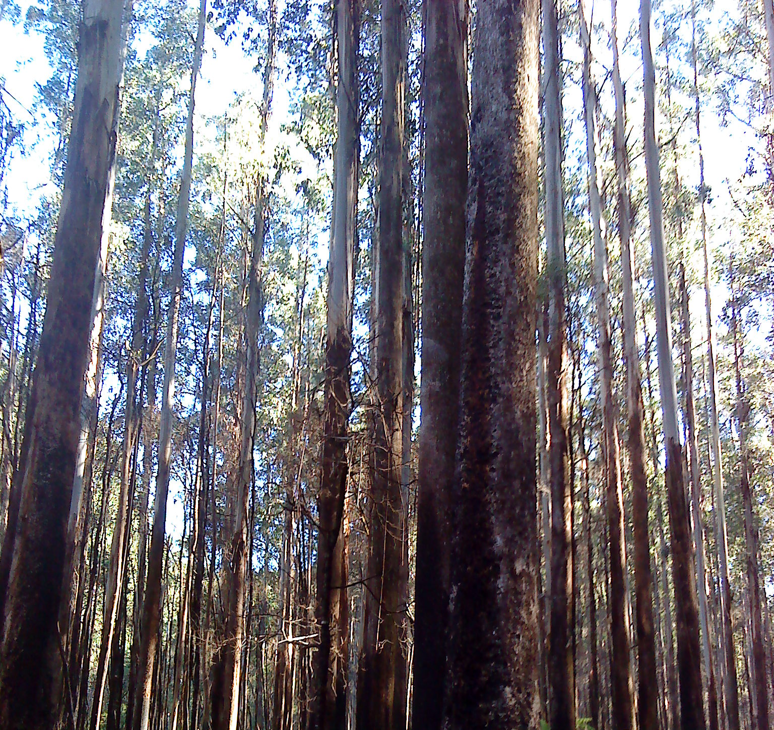
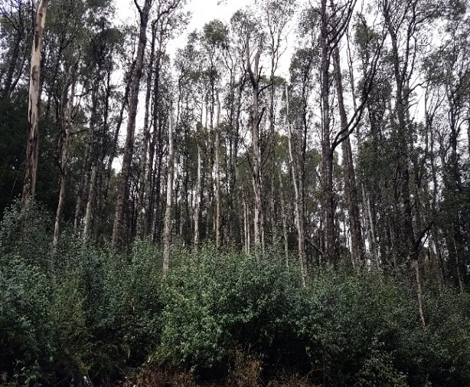
Experimental design – water balance plots were established in these stands (sapflow, throughfall, soil evaporation, micrometeorology, stand inventory)
E.reganas forests
Hydrological response of E.reganas forests
A.dealbata forests
10-Year old Forests
10-Year old Forests
Hydrological response of A.dealbata forests
35-Year old Forests
35-Year old Forests
?
80-Year old Forests
80-Year old Forests
Notes:
Hydrological response of E.regnanas forests well studied in the published hydrological literature over the last few decades. This response of E.regnans forests explain the water yield from E.regnans forests after single fire event. But now the emerging issue of this vegetation replacement with A.dealbata forests create a big question mark in the phase of this hydrological studies. After this replacement of vegetation, A.dealbata forests will continue their life cycle in the forests. So what will happen to the water yield from the forest water catchments is largely unknown. Therefore, from this research I try to answer those questions. To answer these research questions, I compared evapotranspiration between typical E.regnans and A.dealbata forests to understand possible eco-hydrological implications of this vegetation change to water yield from the forest water catchments.

Slide 10
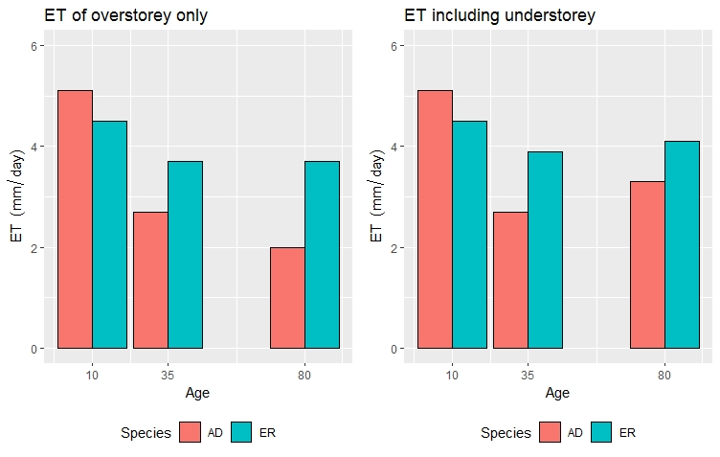
Results – plot level ET
AD = Acacia dealbata
ER = Eucalyptus regnans
Shyanika Lakmali, (unpublished PhD data)

Slide 11
Decisions…what should we/could we/might we make to preserve water resources?
The plot scale results demonstrated a clear reduction of ET with age in both species, but with a greater relative reduction in Acacia dealbata ET
This was driven largely by changes in structural attributes – stem density and basal area, which results in a large reduction in sapwood area
Sapwood area proved to be the strongest predictor of Et
A model with sapwood area and sap velocity as a function of vapour pressure deficit was used to develop ET and then streamflow curves over time for both species
The results show a clear reduction in ET, and increase in streamflow with age
Notes:
Victoria is an example of an extreme risk – others might be California coast, however it is possible unburned WQ is low, so treatment capacity is better?
Risk levels differ in different parts of SE Aust (Sydney, Adelaide), and even between areas in close proximitiy

Slide 12
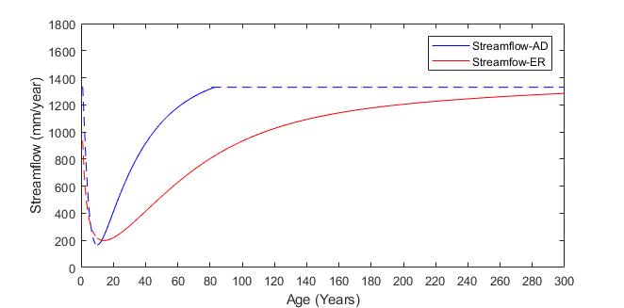
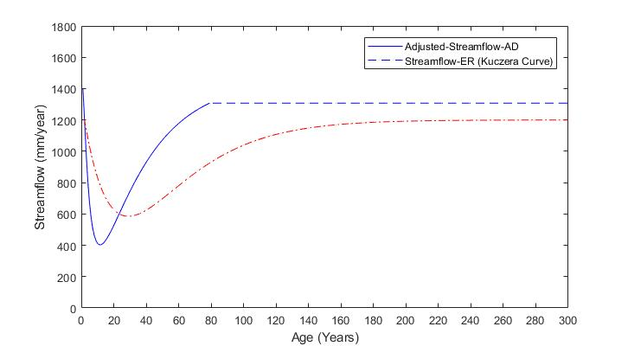
Long-term implications for streamflow of species replacement
Both AD and ER curves extrapolated from plot data in Lakmali PhD study
ER curves are the “Kuczera curve” (Kuczera, 1987)

Slide 13
Conclusions
Increased fire frequency is predicted for SE Australia due to warming and drying climate – we are seeing the conditions under which wet forests will burn increasing
Multiple short interval fires in obligate seeder forests have been shown to lead to species replacement, with eco-hydrologic equilibrium disrupted
When E.regans is replaced by Acacia species we have observed a distinct change over time of stand structure, biomass and evapotranspiriation
This leads to a predicted increase in streamflow over the 80 year life of the acacia species relative to the E. regnans stands they have replaced
While this can be seen as a “good” outcome for water supplies, it represents a profound ecological shift – loss of iconic tall wet forests
Such a shift may be emblematic of future ecohydrologic responses to climate
Notes:
Victoria is an example of an extreme risk – others might be California coast, however it is possible unburned WQ is low, so treatment capacity is better?
Risk levels differ in different parts of SE Aust (Sydney, Adelaide), and even between areas in close proximitiy

