Slide 1
An approach to organize loss data related to geo-hydrological hazards
Paola Salvati, Ivan Marchesini, M. Elena Martinotti, Carmela Vennari, Marco Donnini,
Cinzia Bianchi, Alessandro Sarretta, And Domenico Casarano
Geo-hydrological processes - i.e., landslides, floods, sinkholes - can occur as a consequence of a single trigger e.g., a single intense or prolonged rainfall. Multiple phenomena occurring as a result of a given trigger can cause a cumulated socio-economic impact which is often difficult to separate and to attribute to each single damaging phenomenon e.g., a single landslide, a group of nearby landslides, a single inundation.

Slide 2
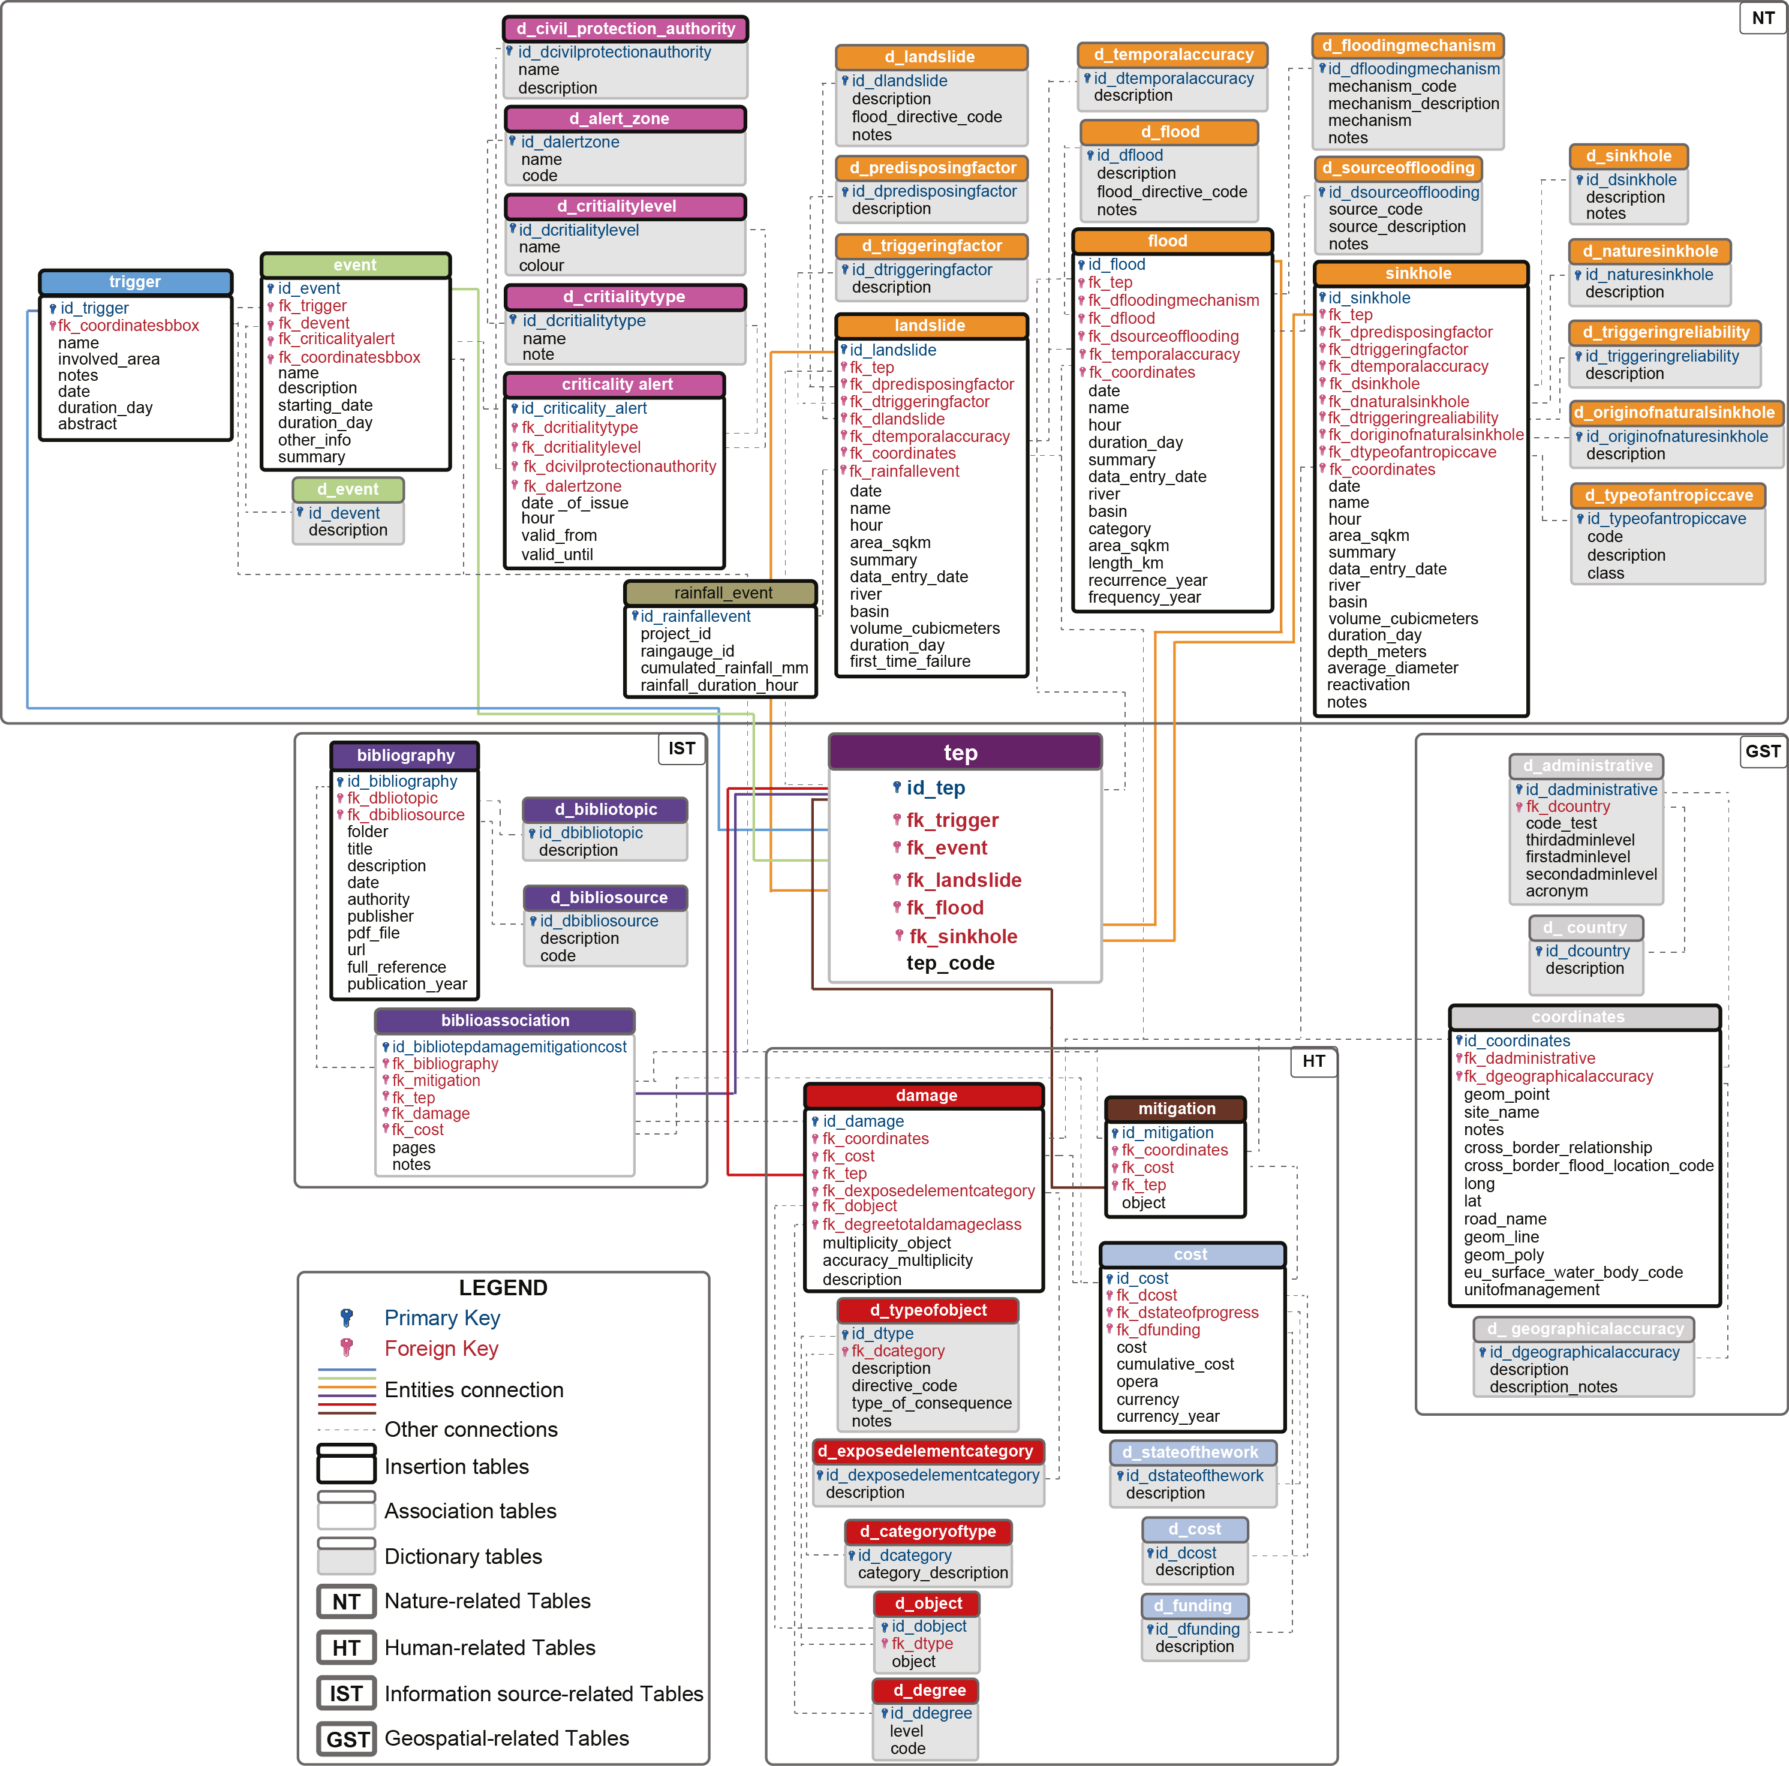
LAND-deFeND
LAND-deFeND - LANDslide and Floods National Database, is a freely available database structure designed to register information about past geo-hydrological hazards: landslides and/or floods and/or sinkholes.
The structure is hierarchical and is based on the definition of four groups of tables that collectively describe the relevant characteristics of the geo-hydrological events and their socio-economic consequences and environmental impacts: Nature-related Tables, Human-related Tables, GeoSpatial-related Tables, and Information Source-related Tables.
Modify by Napolitano et al., 2018 https://doi.org/10.1016/j.jenvman.2017.11.022
Notes:
LAND-deFeND - LANDslide and Floods National Database, is a freely available database structure designed to register information about past geo-hydrological hazards: landslides and/or floods and/or sinkholes. The structure was first published by Napolitano et al in 2018 (https://doi.org/10.1016/j.jenvman.2017.11.022). The structure was then modified and updated to allow: (i) collect and store information on sinkholes, (ii) collect and store information on the rainfall event responsible for landslide occurrence, (iii) store the bounding box of individual meteorological triggers, (iv) manage information about the warning level issued by civil protection authorities before and during an emergency, and (v) produce reports and output / exchange data in formats compliant to the EC Flood Directive, and to the Italian Department for Civil Protection (DPC).

Slide 3
LAND-deFeND database structure
Nature-related tables
LANDSLIDES
GEO-HYDROLOGICAL HAZARDS
NATURAL ENTITIES
FLOODS
SINKHOLES
In the Nature-related Tables it is possible collect data on the single geo-hydrological processes associated to a unique major trigger - which is the meteo-climatic or seismic cause – TRIGGER - of the geo-hydrological hazards
Human-related tables
HUMAN-RELATED
ENTITIES
DAMAGE
CONSEQUENCES
COST
In the Human-related Tables it is possible collect data on the costs associated to damage and necessary for mitigation. The tables include fields describing the damaged public or private properties, goods and services, the related economic costs, the human impact - deaths, missing persons, injured people - and when present the mitigation actions.
MITIGATION
Notes:
The Human-related Tables (HT) include fields describing the damaged public or private properties, goods and services, the related economic costs, the human impact (deaths, missing persons, injured people) and the mitigation actions designed to protect a given area, building, structure or infrastructure. In this context, the Damage table stores information on the effects of a specific geo-hydrological hazard on buildings, structures and infrastructures, and on the population
Human-related Tables it is possible collect data about the costs of the works necessary for restoring the damage and for mitigation of the risk. The tables include fields describing the damaged public or private properties, goods and services, the related economic costs, the human impact - deaths, missing persons, injured people - and when present the mitigation actions.

Slide 4
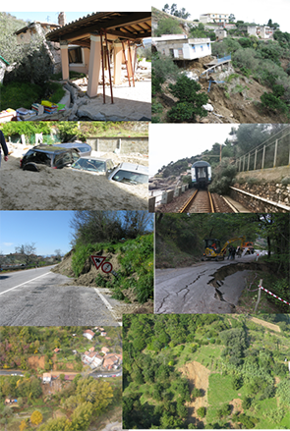
Damage and cost relation
KIND OF DATA
WHO PAY FOR
BUILDINGS
TOURISTIC FACILITIES
CULTURALHERITAGE
…….
CARS
COST
COST
INDUSTRIAL SITES
EQUIPMENTS
…….
ESTIMATED
PUBLIC
ROADS
ALLOCATED
PRIVATE
RAILWAYS
SPENT
INSURANCE
HIGHWAY
…….
RIVER BANKS
PARTIAL COST
DRAINAGE SYSTEM
FOR A SINGLE DAMAGE OR GROUP OF DAMAGE
…….
CHANNEL
TOTAL COST
PIPELINE
ENCOMPASSE ALL THE COSTS – TOTAL GOVERNAMENT FOUND
WATER MAIN
…….
Notes:
The Damage table stores information on the effects of a specific geo-hydrological hazard on buildings, structures and infrastructures, and on the population.
The Cost table stores information on the economic value of the damage, of the construction works, and of the remediation and the mitigation measures. In addition to the monetary value, fields on the Cost table allow separating economic costs that are (i) estimated (ii) officially allocated but not yet spent, or (iii) spent. The distinction is important when attempting to determine the actual cost of a damaging event or trigger. In real cases, the information on the cost caused by a trigger, event or phenomenon is often generic e.g., it encompasses costs for damage remediation and for risk mitigation. To consider this possibility, the Damage and Mitigation tables include a foreign key to link them to the Cost table, so that information on multiple damage and mitigation works can be related to a single, cumulated monetary values in the Cost table.

Slide 5
DATA SOURCES
COST ESTIMATES MAY VARY A LOT
NEWSPAPERS
- LOCAL
- NATIONAL
COST DATA
TOTAL COST ESTIMATES OR PARTIAL COST ESTIMATES - REFERRED TO EACH DAMAGE - MAY BE COMPILE IMMEDIATELY AFTER THE EVENT
MORE DETAILED ESTIMATES MAY BE ELABORATED AFTER THE EMERGENCY PHASE ON THE BASIS OF FIELD SURVEYS AND DATA COLLECTION
REPORTS AND ADMINISTRATIVE DOCUMENST CAN PROVIDE CUMULATIVE MONETARY ESTIMATES
ACTS AND LAW DECREES MADE AVAILABLE INFORMATION ABOUT GOVERNMENTAL FOUNDS
- NEWS ON LINE
FIELD SURVEY
- CIVIL PROTECTION TECHNICIANS
- MUNICIPAL TECHNICIANS
- RESEARCHERS
COST DATA
TECHNICAL
REPORTS
- CIVIL PROTECTION AGENCIES
- REGIONAL OR OTHER GOVERMENT OFFICES
- RESEARCH CENTERS
COST DATA
ADMINISTRATIVE
DOCUMENTS
- CIVIL PROTECTION REGIONAL AGENCIES OR NATIONAL DEPARTMENT
- REGIONAL OR NATIONAL OFFICES
ACTS AND
LAW DECREES
- MUNICIPAL OFFICES
COST DATA
- CIVIL PROTECTION NATIONAL DEPARTMENT
- REGIONAL OR NATIONAL OFFICES
Notes:
The damage caused by geo-hydrological and other natural hazards in Italy has been, and is currently being fixed primarely using public resources, often following specific legislation. As a result, the few available cost estimates are given in reports and documents produced by local, regional, and national government administrations and authorities. Lack of a rigorous strategy, and of a single and accurate method to collect damage and cost information, combined with a complex network of agencies involved in reconstruction activities and cost reimbursement, make the collection of reliable costs data challenging. In addition, the long periods required to complete restoration activities following a geo-hydrological event result in supplementary costs that are seldom accounted, making it even more difficult to obtain comprehensive cost estimates.

Slide 6
COST ESTIMATES MAY VARY DEPENDING ON THE TIME SPENT BY THE EMERGENCY
NEWSPAPERS
EMERGENCY
DAMAGE FIELD SURVEY
TECHNICAL
REPORTS
TOTAL COST ESTIMATES FOR STATE OF EMERGENCY DECLARETION
REQUESTS AND EVALUATION INSURANCE CLAIMS
INSURANCE REIMBORSEMENTS
GOVERNAMENT COMPENSATIONS
HOW DATA CAN BE RECORDED TO BE HELPFUL FOR EX POST OR EX ANTE ANALYSIS??
In LAND-deFeND DATABASE STRUCTURE:
COST DATA CAN BE RECORDED FROM MANY SOURCES OF INFORMATION IN DIFFERENT TIME
COSTS CAN BE GROUPED BY TYPE, BY TYPE OF DAMAGE, BY PROCESSES, BY YEAR, ……
COSTS CAN BE ADDED UP SEPARATELY DEPENDING THEY ARE ESTIMATED OR THEY ARE SPENT
COSTS CAN BE ADDED UP SEPARATELY DEPENDING THEY REGARD PRIVATE PROPERTIES OR PUBLIC SECTOR
ECONOMIC EVALUATIONS AT DIFFERENT GEOGRAPHICAL - NATIONAL, REGIONAL, MUNICIPAL - SCALE
Notes:
The LAND-deFeND database structure allowing for economic evaluations at different geographical (national, regional, municipal) and temporal (from days to decades) scales. This proves useful for the estimation of the total cost determined by a single entity i.e., a single “phenomenon”, “event” or “trigger”.

Slide 7
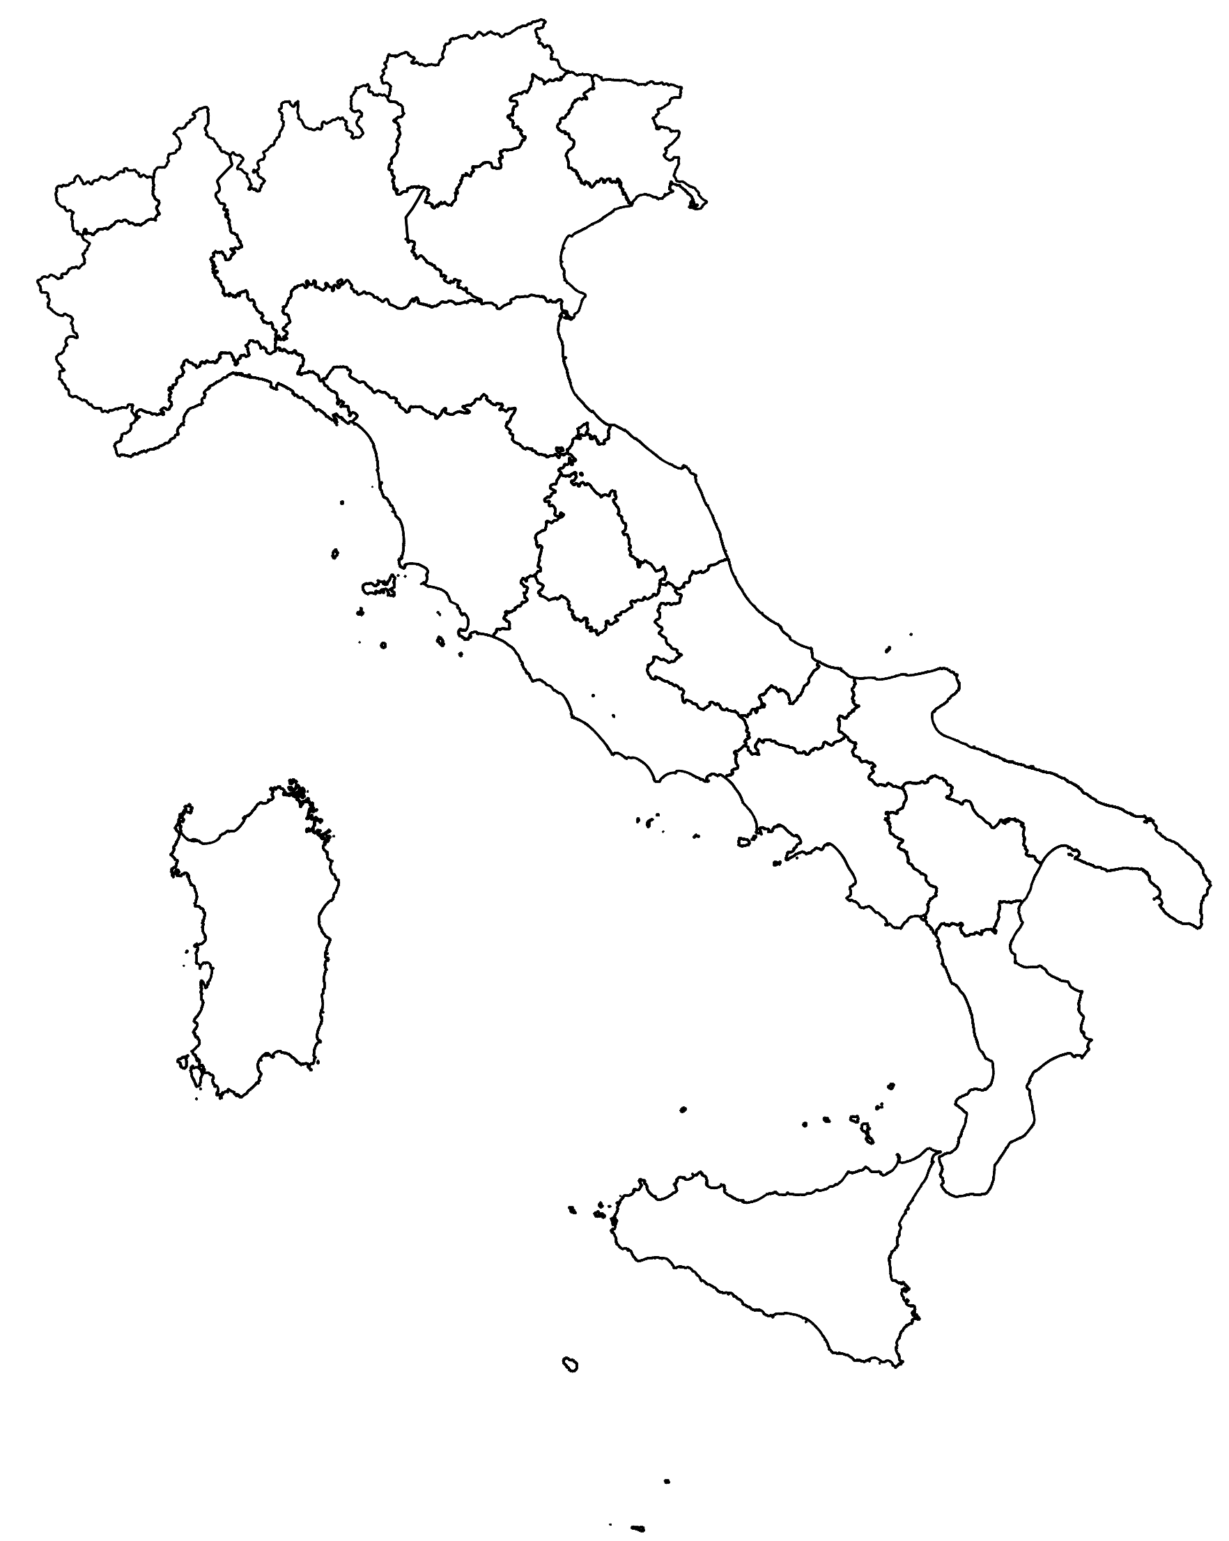
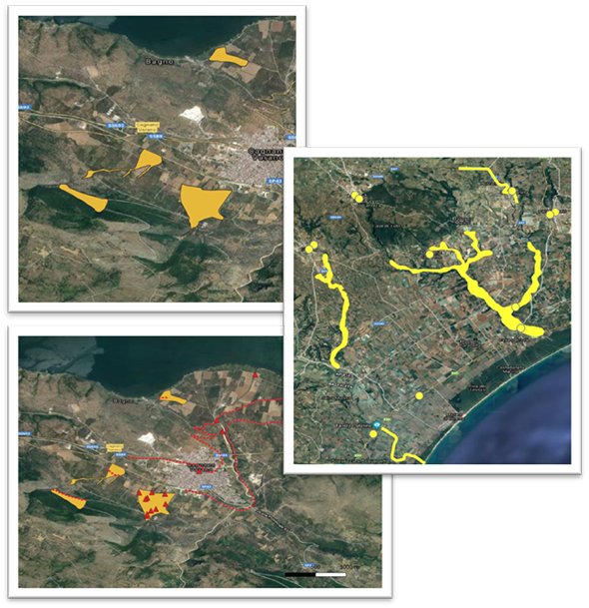
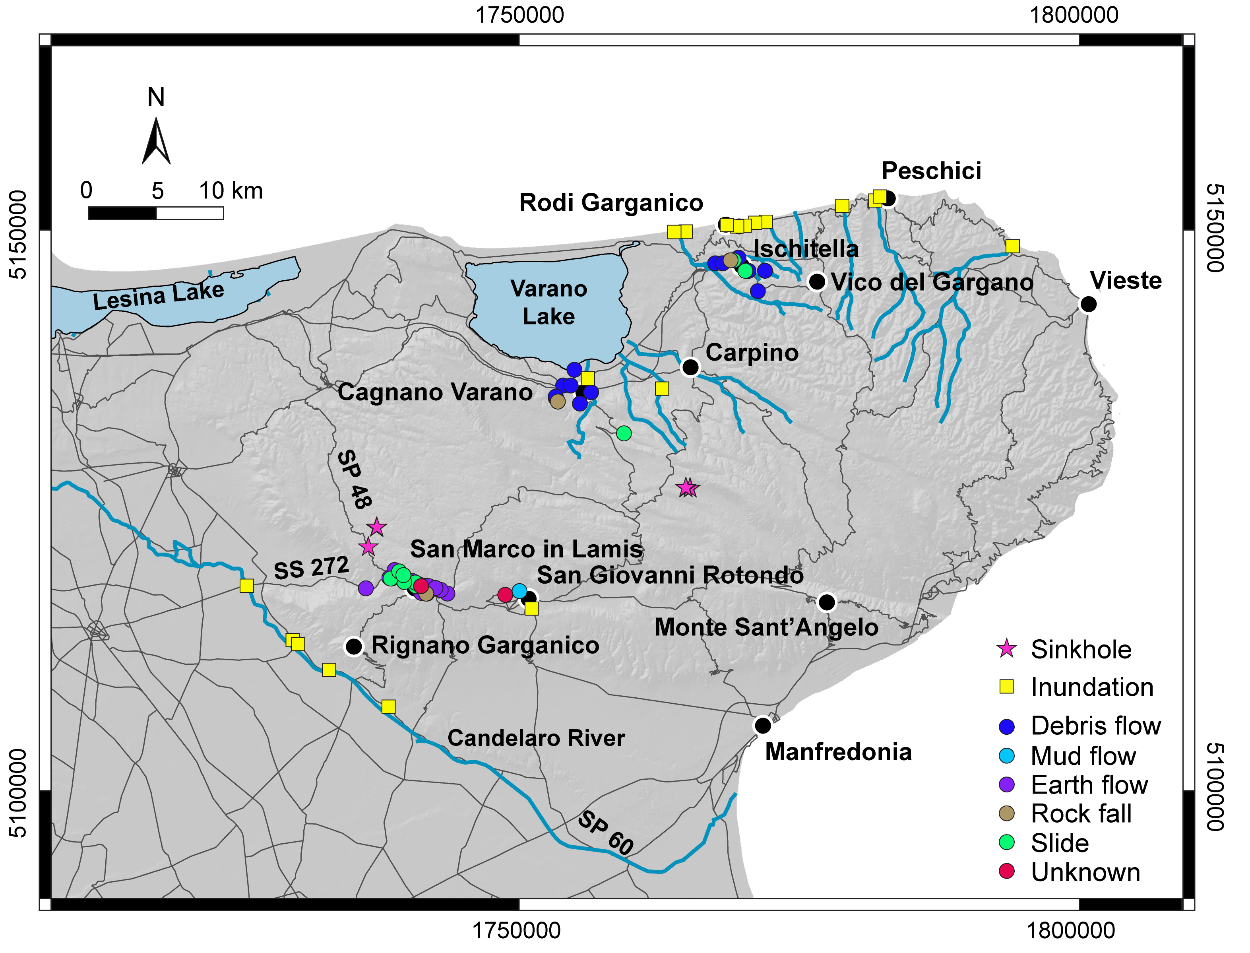
Example for Gargano Trigger 1-6 September 2014
GEO-HYDROLOGICAL HAZARDS
LANDSLIDES
FLOODS
Modify by Martinotti et al., 2018 doi:10.5194/nhess-17-467-2017
Notes:
The perturbed meteorological conditions over Italy in the 6-day period 1–6 September 2014 resulted in torrential precipitation in the Gargano Promontory (Puglia region in southern Italy) , with cumulated rainfall exceeding 500 mm. The sequence of intense rainfall events resulted in a number of floods, flash floods, landslides and sinkholes, and caused two flood fatalities at Peschici and at Carpino (http://polaris.irpi.cnr.it/), and severe socio-economic damage. Throughout the Promontory, the road and railway networks were interrupted at several sites by inundations and landslides, and many road underpasses were clogged by debris and sediments. In several towns and dwellings the inhabitants were evacuated from their homes, and a number of touristic resorts were inundated by water, mud, and debris.

Slide 8
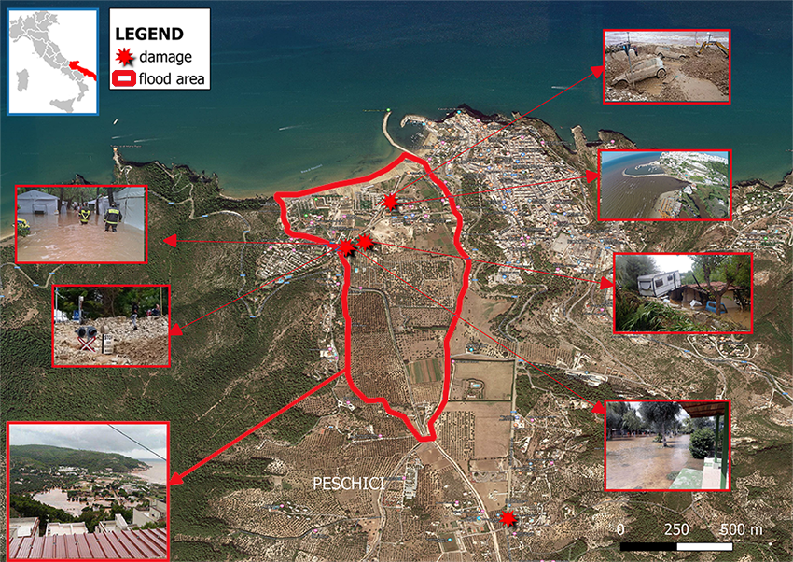
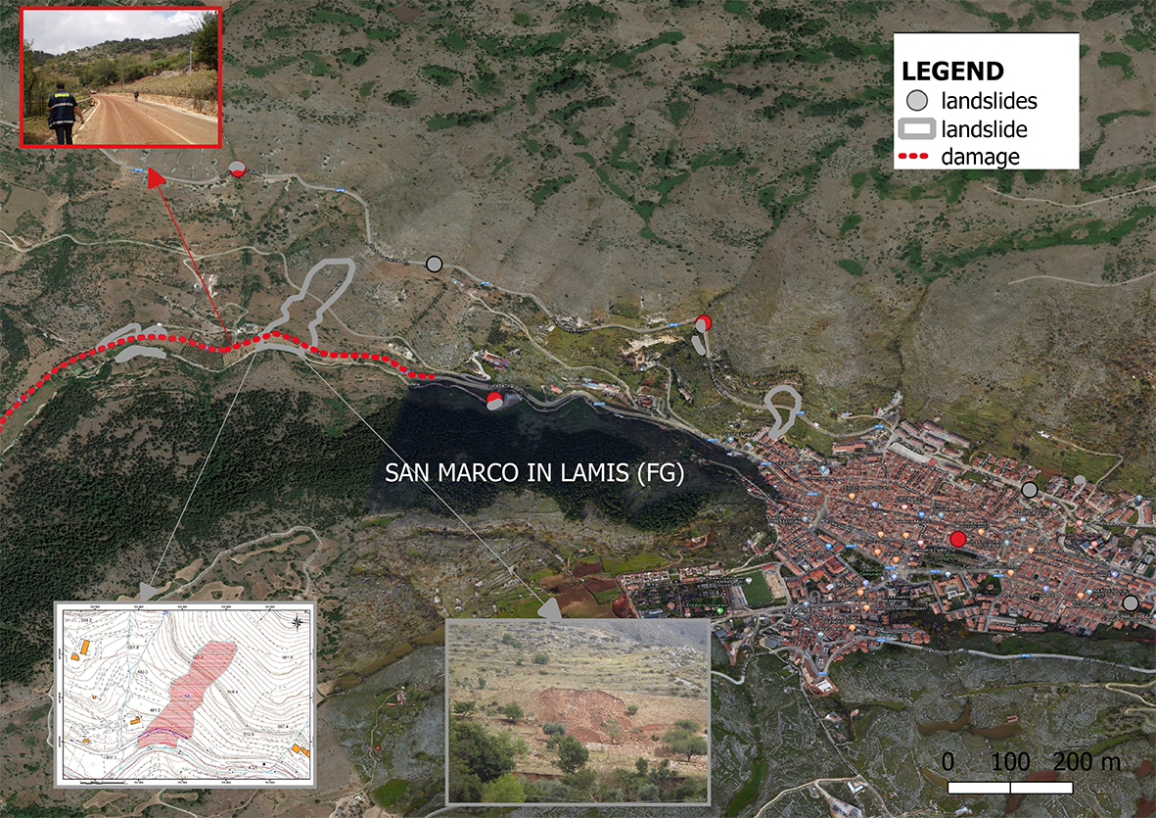
Example for Gargano Trigger 1-6 September 2014
FLOODS
LANDSLIDES
MUNICIPAL ROAD
PROVINCIAL ROAD
STORMWATER DRAINAGE SYSTEM
MUNICIPAL ROAD
RAILWAY
ARTIFICIAL CHANNELS
BUILDINGS
DAMAGE
CAMPSITE
TOURISTIC FACILITIES
DAMAGE
AGRICULTURAL LAND LOSS
AGRICULTURAL LAND LOSS
Notes:
The figures shows the sites where flood and landslide damage were recorded in two different municipalities: Peschici in the left and San Marco in Lamis in the right. he types of damage recorded are listed in the red boxes.

Slide 9
Example for Gargano Trigger 1-6 September 2014
FLOODS
LANDSLIDES
AT SITE LEVEL
AT MUNICIPAL LEVEL
COST DATA ENCOMPASSES 5 DAMAGED SITES
COST DATA ENCOMPASSES ALL THE DAMAGED SITES IN THE MUNICIPAL TERRITORY
TOTAL COST 2.5 M€
TOTAL COST € 180K€
COST
DAMAGE AND SITES ARE KNOWN
COST
DAMAGE AND SITES ARE KNOWN
AT EACH ELEMENT THE COMULATIVE COST DATA WAS ASSOCIATED
AT EACH ELEMENT THE COMULATIVE COST DATA WAS ASSOCIATED
Notes:
The figures shows the sites where flood and landslide damage were recorded in two different municipalities: Peschici in the left and San Marco in Lamis in the right. The cost data available corresponding to the damage are listed in the light blue boxes. Only cumulative cost are available encompass the works necessary for the restoration of the 5 sites.
Cost data can be recorded separately if they concern a cumulative amount of money spent for many damage restorations or for many reimbursements or if they are a specific cost related to a unique damage.

Slide 10
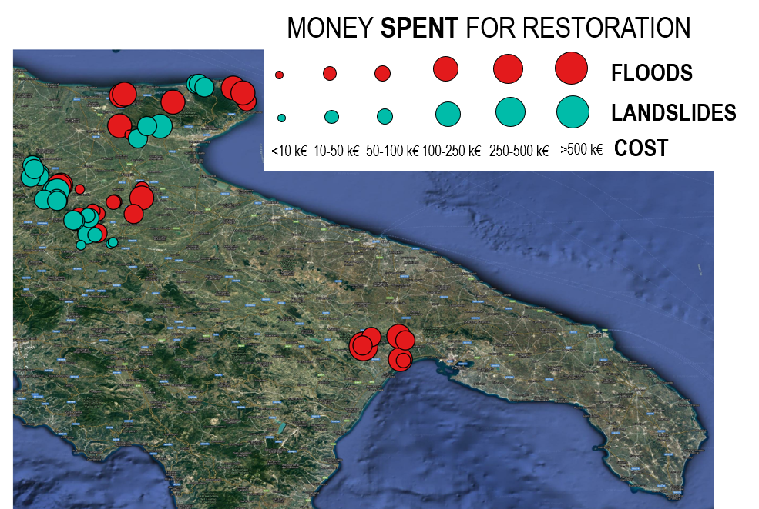
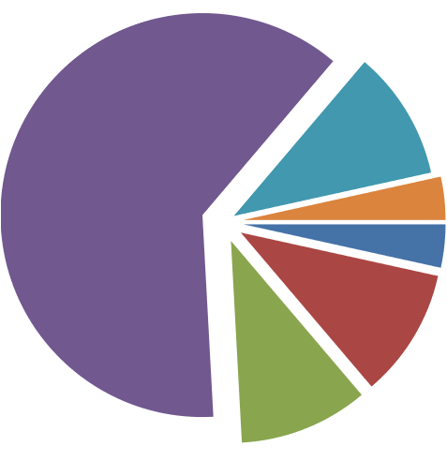
Example for 4 different triggers
TRIGGERS
07 - 08 October 2013
30 November - 3 December 2013
March – April 2016
01 - 06 September 2014
COST DATA FOR LANDSLIDES
TYPE OF LANDSLIDE | # COST DATA
ROCKFALL | 1
MUDFLOW | 4
EARTHFLOW | 1
FLOW SLIDE | 1
LANDSLIDE | 21
COST INFORMATION PER
TYPE OF LANDSLIDE
COST INFORMATION PER TYPE OF FLOOD
TYPE OF FLOOD | # COST DATA
PLUVIAL | 4
FLUVIAL | 4
<10 k€
10-50 k€
10-50 k€
10-50 k€
250-500 k€
>500 k€
Notes:
For the same region data on 4 major triggers are available and of the geo-hydrological processes occurred. The slide shows some possible elaboration of the data.
The pie chart represents the amounts of money spent for landslides divided in 6 classes of cost. Most od the restoration costs consist in about 10-50 K€. The two tables list the cost data information by type of processes.

