Slide 1
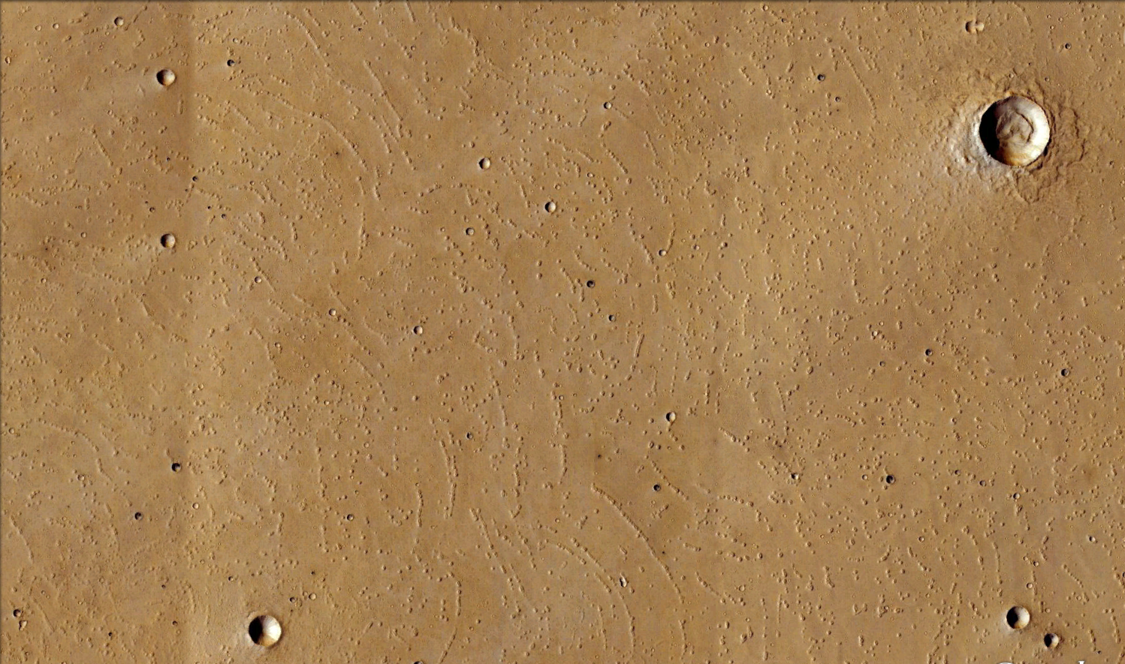
Geology of Isidis Planitia based on study of mascon and chains of cones
Leszek Czechowski¹, Natalia Zalewska², Jakub Ciążela², Mateusz Kuzaj³
1.University of Warsaw, Faculty of Physics, Institute of Geophysics, ul. Pasteura 5, 02-093 Warszawa, Poland, lczech@op.pl.
2. Space Research Centre, Polish Academy of Sciences, ul. Bartycka 18A, 00-716 Warszawa, Poland
3.Wroclaw University of Science and Technology, Wybrzeże Stanisława Wyspiańskiego 27, 50-370 Wrocław, Poland
30 km

Slide 2
Introduction:
We consider the surface structures and geological history of Isidis planitia on Mars. It is a plain located inside a large impact basin, of ~1500 km in diameter. Geologic history of Isidis Planitia is quite complicated and many details remain unclear.
Our direct scope is determination of origin of cones and chains of cones. We believe that better analysis of surface structures and large deep structures (e.g. mascon) will allow a better understanding of the origin of Isidis and similar regions on Mars.
30 km

Slide 3
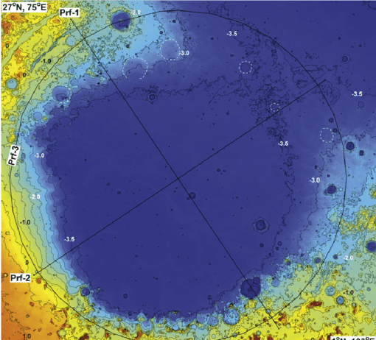
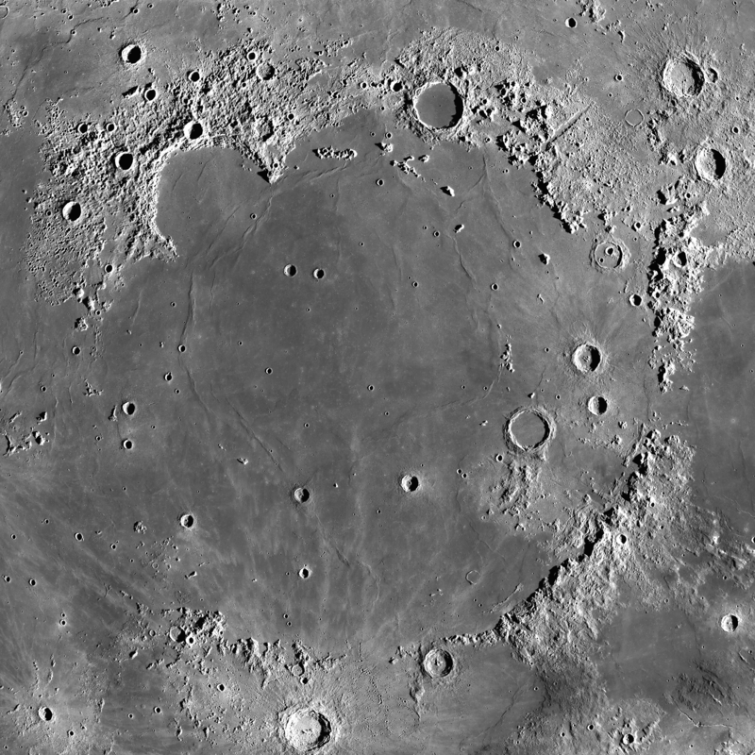
Mare Imbrium, an analog of Isidis Planitia: a large impact basin with a mascon (NASA).
Isidis Planitia, a region of our study.It is a large impact basin with a mascon, covered by marine/glacial deposits. Topography based on MOLA, resolution is 128 pxs/deg. Contour lines are at 0.5 km interval. After Ivanov et al. 2012 Icarus org/10.1016/j.icarus.2011.11.029

Slide 4
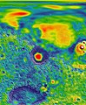
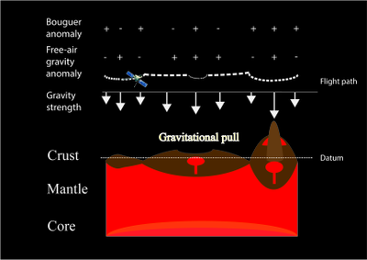
Mascon and magmatic/volcanic/tectonic activities
Mars free-air gravity map produced along with the GMM-3 gravity solution (Red: gravity high; Blue: gravity low) (Credit: NASA's Scientific Visualization Studio)
The process of mascon’s formation are not fully understand. Anyway, it requires plume of dense plume from mantle (see model). It leads to magmatic/volcanic/tectonic activities. Below a scheme of gravity and density after Xaviertang, wikipedia)

Slide 5
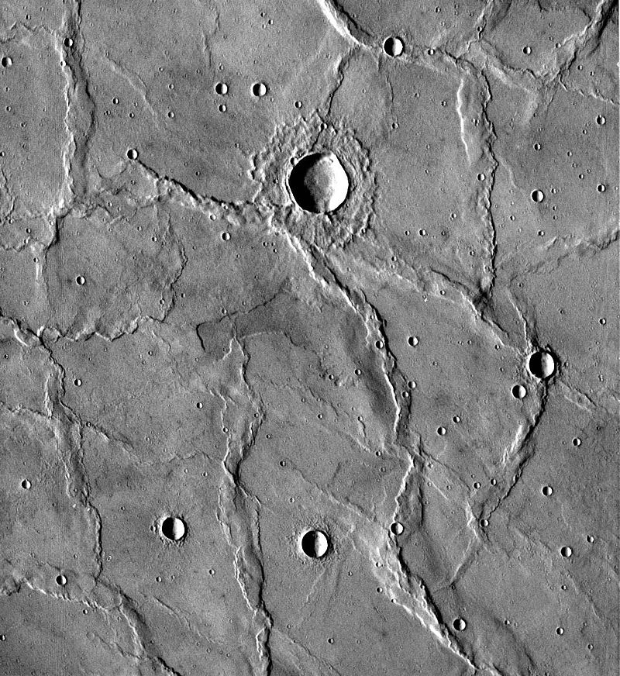
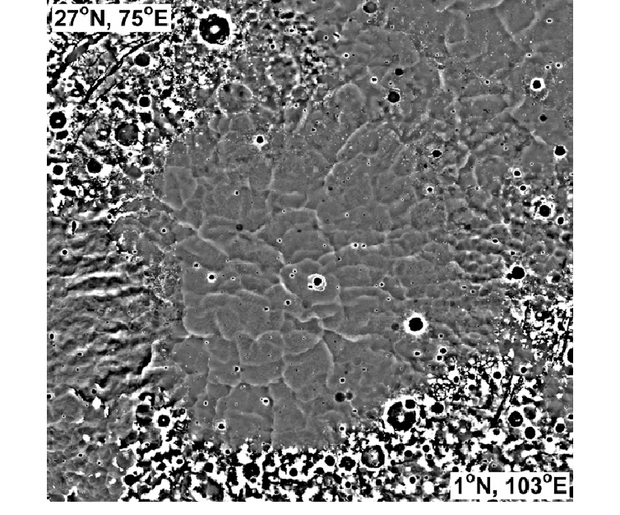
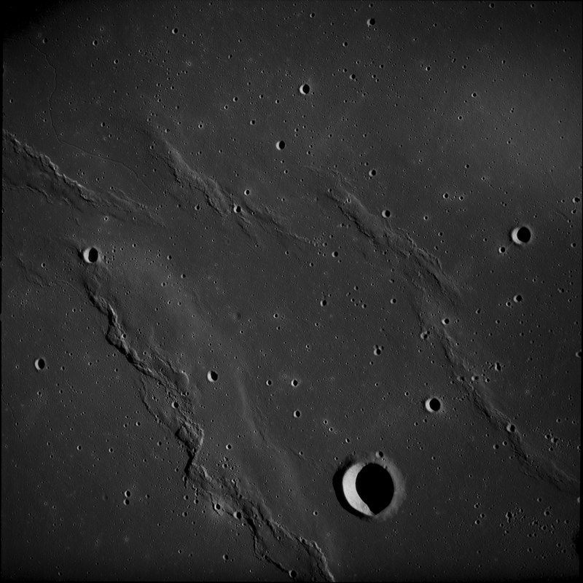
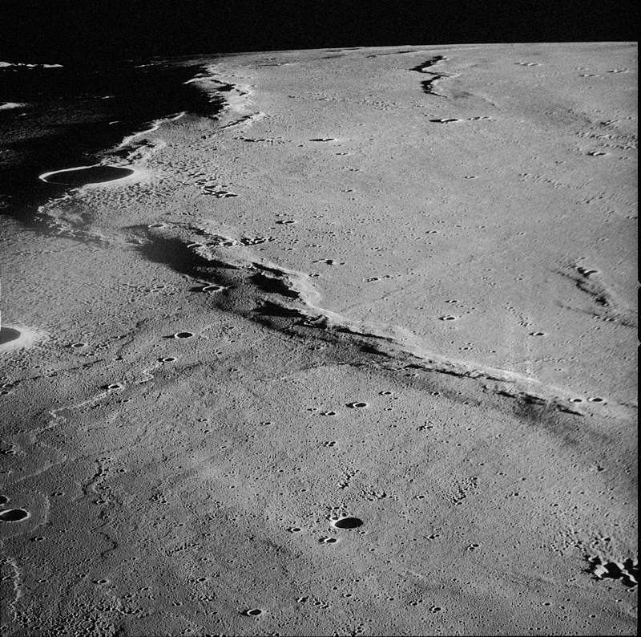
Possible topography below deposits on Isidis. High-pass filtered topography, i.e. only wavelength <100 km are shown. One can see curvilinear ridges which are not seen in the normal map (compare with the previous slide). The ridges separate the floor into basins (their size: tens of kilometers across and tens of meters deep). After Ivanov et al. 2012 Icarus https://doi.org/10.1016/j.icarus.2011.11.029
Similar curvilinear ridges found on Moon and Mars (NASA)
50 km
100 km
50 km

Slide 6
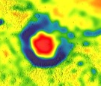
Problems and methods:
Considereing thermal conditions after formation of basin and mascon:
Mascon is an anomalously high mass concentration below the surface. its existence is an important source of information about past thermal conditions.
Numerical models: we used two kinds of models.
Large scale model of thermal processes. The model allows to determine thermal conditions and in the period when the mascon was formed.
Small scale model of cone’s formation (compare Czechowski, L., et al. 2020. LPSC 2020 in The Woodlands, Tx).
Comparison of processes on different celestial bodies: Mars, Moon, Earth. Mars is a body of intermediate mass and size between Earth and the Moon. Cones ofdifferent origin are found on all these bodies.
Differences and similarities are important! We take into account differences between physical conditions on Moon, Earth and Mars.
30 km
Isidis mascon- Free -Air Gravity

Slide 7
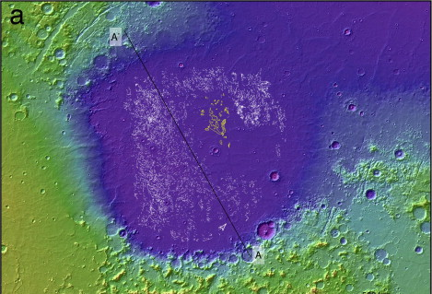
Topography of Isidis basin with cone chains (white lines) and cone fields (yellow spots). After: R.Ghenta et al. (2012) https://doi.org/10.1016/j.icarus.2011.10.018

Slide 8
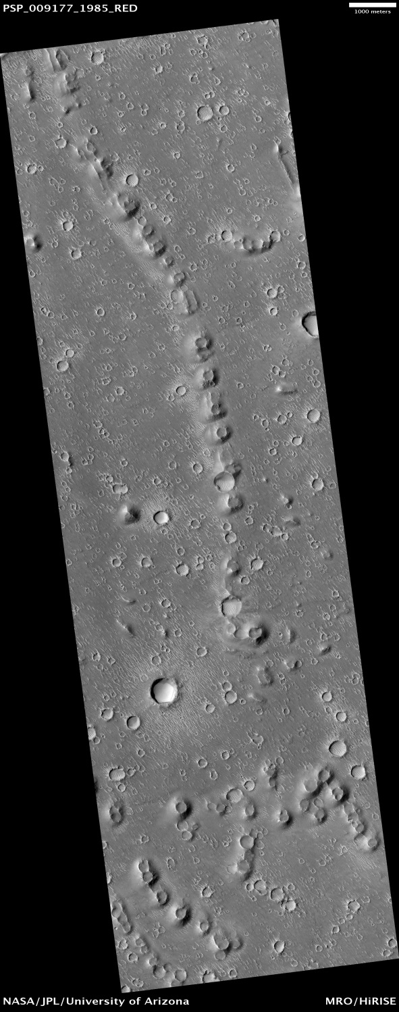
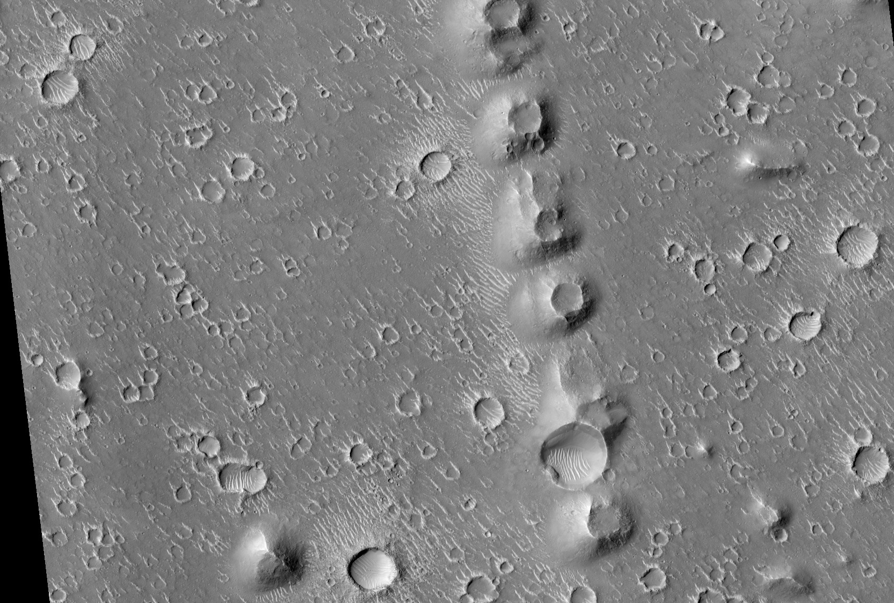
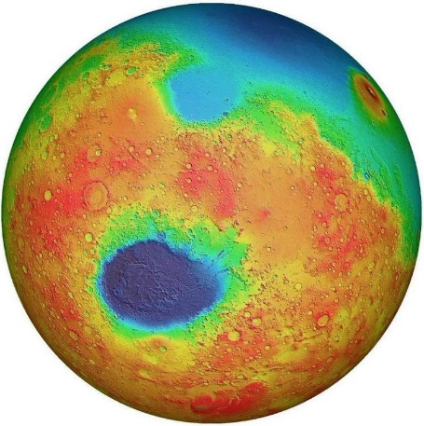
Chains of cones on Isidis Planitia
A plain located inside a large impact basin of ~1500 km in diameter. Its age is ~3.8 Ga
2 km
1 km

Slide 9
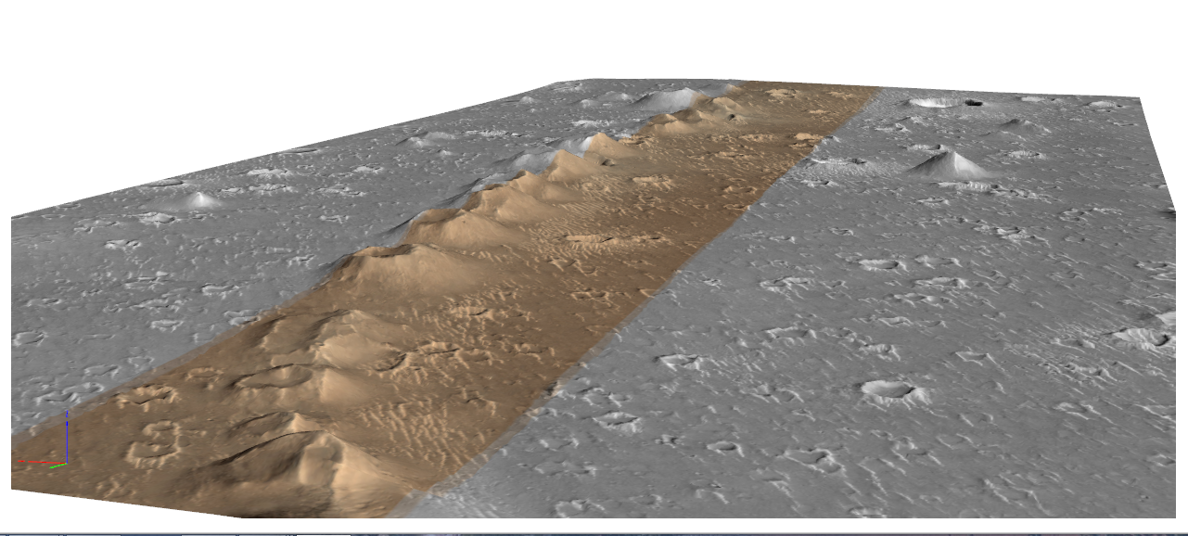
HiRISE-based digital terrain model of a typical chain of cones in Isidis Planitia
PSP_008887_1985, PSP_009177_1985
1 km
K. Rotchimmel –Institute of Aviation, Warsaw, Poland

Slide 10
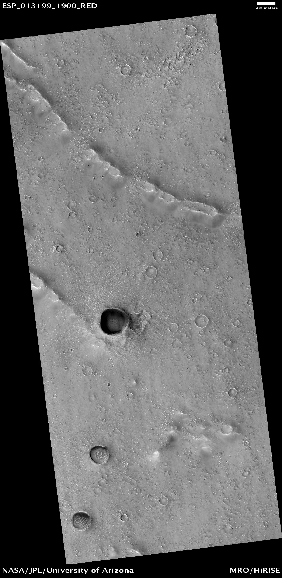
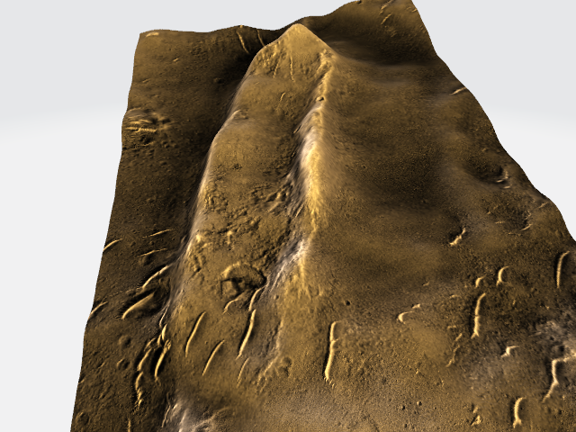
500 m
Generated 3D model of longitudinal cone with furrow
Many of these chain have a characteristic furrow through the center, suggesting that fissure volcanism along circumferential dikes was common in the Isidis area. The cones are arranged in arcuated parallel chains in many places.

Slide 11
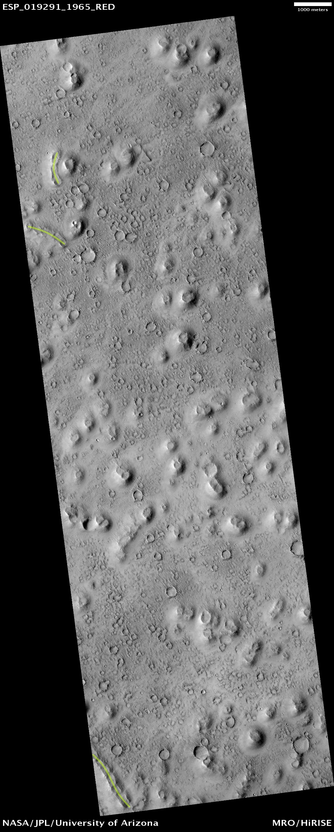
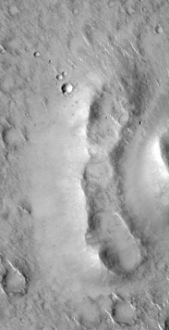
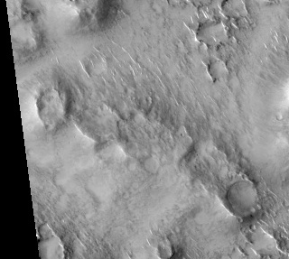
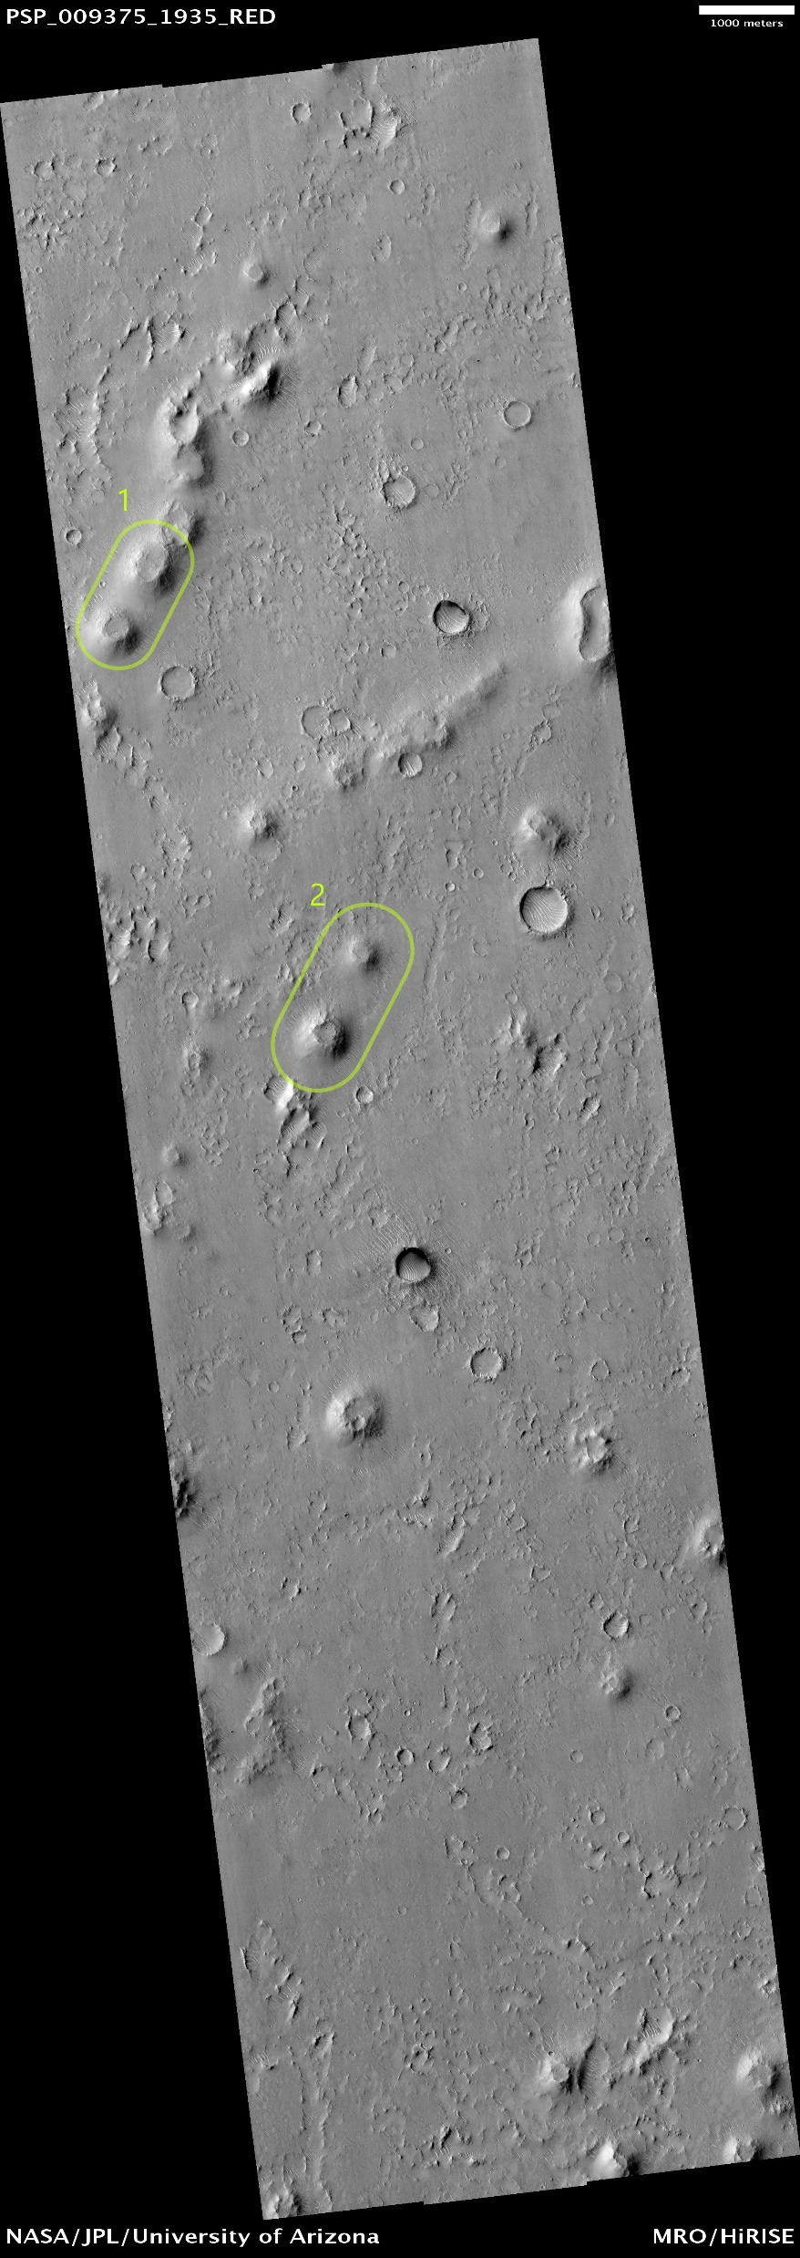
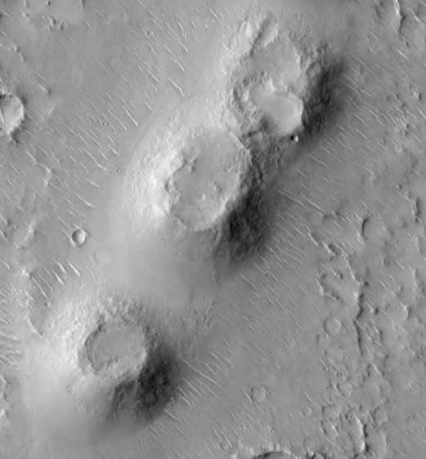
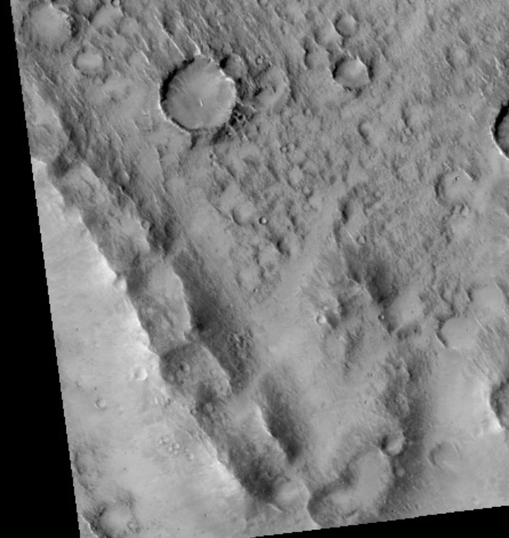
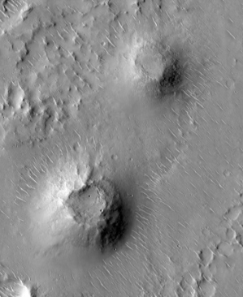
Connected cones with the characteristic furrow
Separated cones with central calderas
The separated cones have diameters of 300–500 m and heights of ~30 m. These imply slopes of 7–11° consistent with explosive type of volcanism. As a part of the Isidis area we study separated polygons with a characteristic pattern of cone chains. Each of the separated polygons has its own representative type of cone.

Slide 12
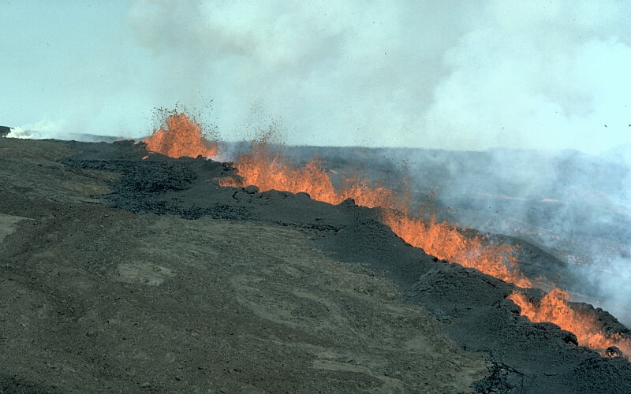
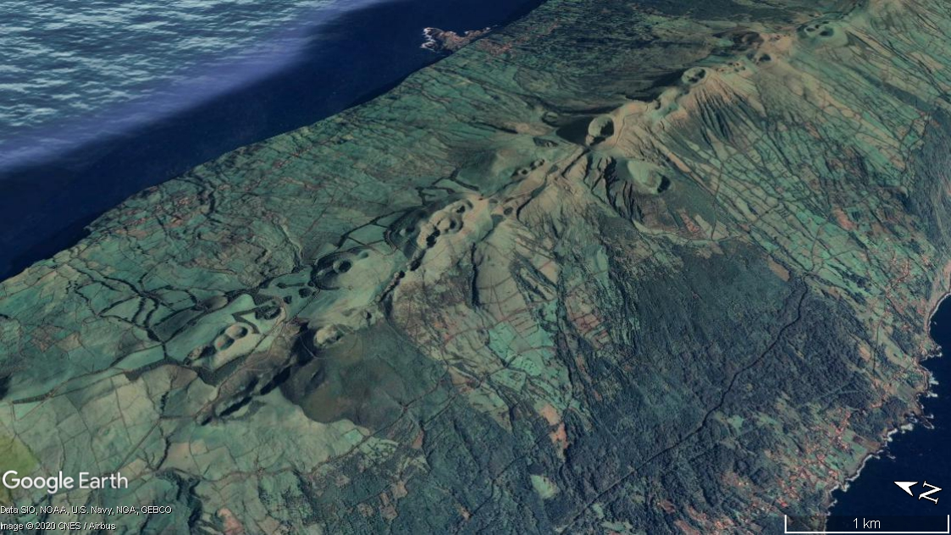
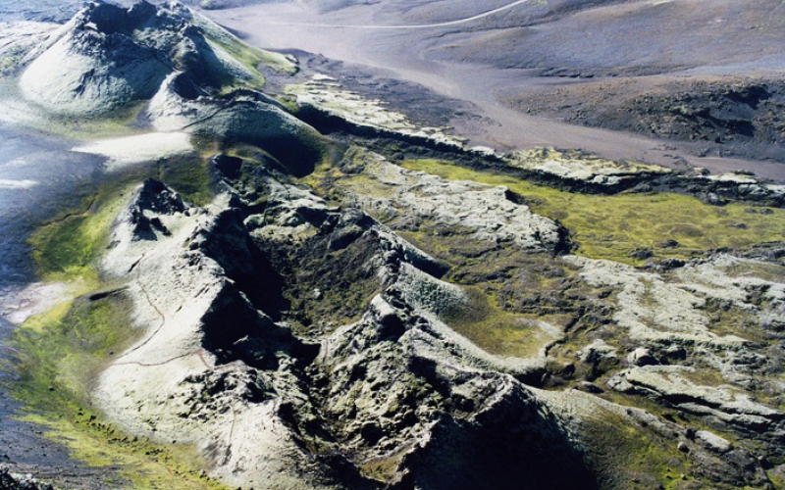
Holuhraun Iceland
29 Aug. 2014-27 Feb. 2015
São Jorge- Azores
Similar cones are known from Iceland (64°03′53″N 18°13′34″). We recognize this type of volcanism on Lanzarote on Lanzarote (Canary Islands) and Sao Jorge (Azores). Whereas many dikes controlling the cones are situated in the rift zones, some are controlled by stress field of central volcanoes and these could be the best analogues for the Martian dikes and related volcanic cones. Prime examples of such dikes on Iceland are documented by Gudmundson et al. (2009).
Laki – Iceland 1783-1784

Slide 13
Possible interpretation of the stress distribution forming dikes under the Isidis crust
Possible geometries of centrally-inclined sheet swarms resulting from internal excess magma pressure: A. radial planar sheets from a spherical magma chamber; B. concave-upward (bowl-shaped) sheets from a spherical magma chamber; C. concave-downward (trumpet-shaped) sheets from a sill-shaped magma chamber; and D. planar parallel sheets from a laccolith-like chamber.
(Tibaldi 2015)

Slide 14
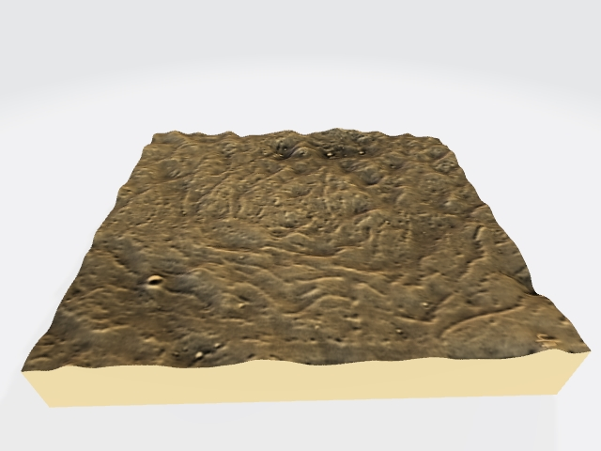
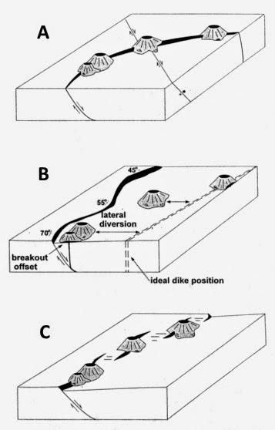
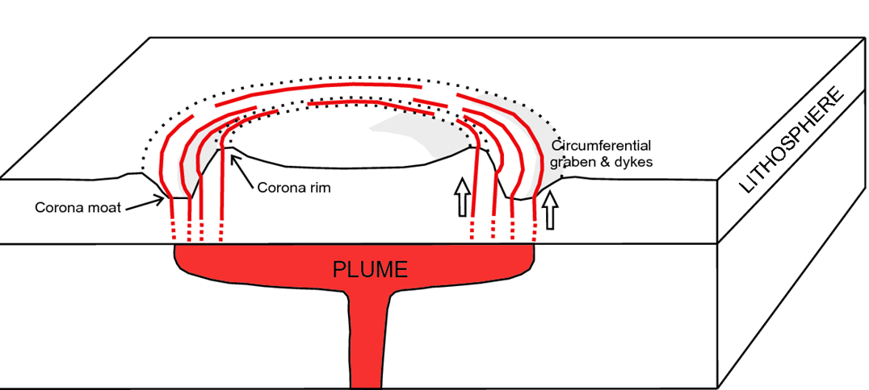
Possible cone formation proces on Isidis
10 km
View of the western part of Isidis. The cone chains form a circular structure
Model of a Venusian corona generated above the edge of a plume that has flattened at the base of the lithosphere showing a raised rim, a moat and an annulus of graben underlain by dykes (not to scale). Modified after Ernst and Buchan (1998). The dashed lower portion of circumferential dykes indicates the uncertainty in how magma propagates from the edge of the plume or magmatic underplate to reach the upper crust (Srivastava et al. 2019) This model can explain the formation of circular swarms of cones responsible for forming cones. Fig. ABC

Slide 15
Thank you for your attention
References
[1] Ivanov, M.A., et al. 2012, Icarus. https://doi.org/10.1016/j.icarus.2011.11.029
[2] Rickman, H., et al. Planetary and Space Science, 166, 70–89, 2019.
[3] Czechowski, L., et al. 2020. Submitted for LPSC 2020 in The Woodlands, Tx.
[4] Ghent R., Anderson S., Pithawala T.: The formation of small cones in Isidis Planitia, Mars through mobilization of pyroclastic surge deposits, Icarus, Vol. 217, pp. 169-183, 2012
[5] Guidat T. et al. Landform assemblage in Isidis Planitia, Mars: Evidence for a 3 Ga old polythermal ice sheet. Earth and Planetary Science Letters Vol. 411, 1 February 2015, Pages 253-267. 2015
[6] Gudmundsson A., Ruth A.: Mechanical interaction between active volcanoes in Iceland.: Geophysical Research Letters, Vol. 34 pp. L10310, 1-5, 2007
[7] Gudmundsson A. et.al, Effects of dyke emplacement and plate pull on mechanical interaction between volcanic systems and central volcanoes in Iceland. Special Publications of IAVCEI 2009
[8] Zalewska N.: Global Martian volcanism as a new interpretation of geological past of terrestrial bodies and moons in the Solar System, EPSC Abstracts, Vol. 11, EPSC2017-372, 2017
[9] Tibaldi A., Structure of volcano plumbing systems: A review of nmulti-parametric effects. Journal of Volcanology and Geothermal Research 298, 85–135, 2015

