Slide 1
Video of the presentation: https://cloudstor.aarnet.edu.au/plus/s/ElVVPSx6EhS320F

Slide 3
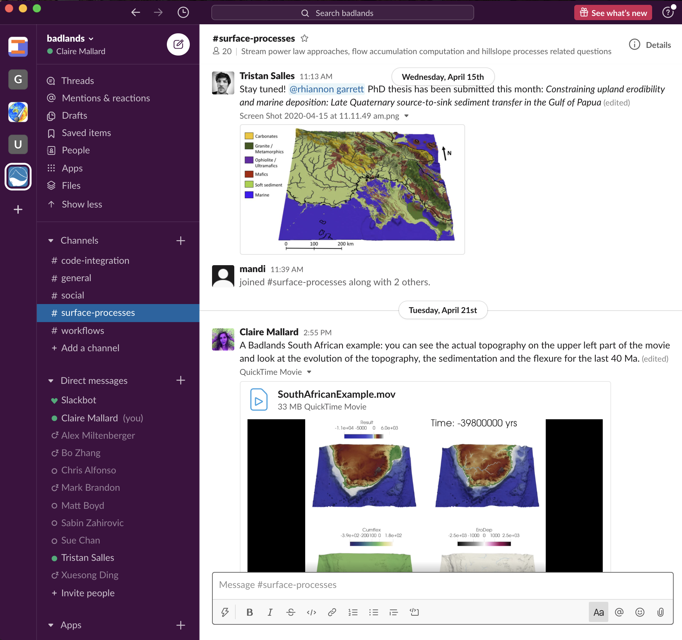
Calculate the x and y components of the velocity vectors
Salles et al. (2018)
https://badlands.readthedocs.io/en/latest/
Moore et al. (2015)

Slide 4
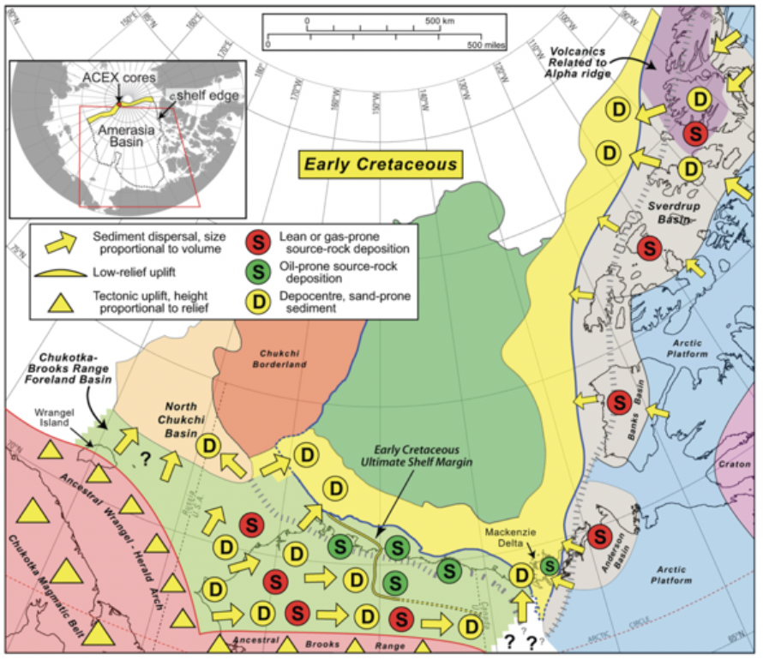
Comparison with predicted dispersal patterns – Early Cretaceous
Modelling
Early Cretaceous
Houseknecht and Bird (2011)

Slide 5
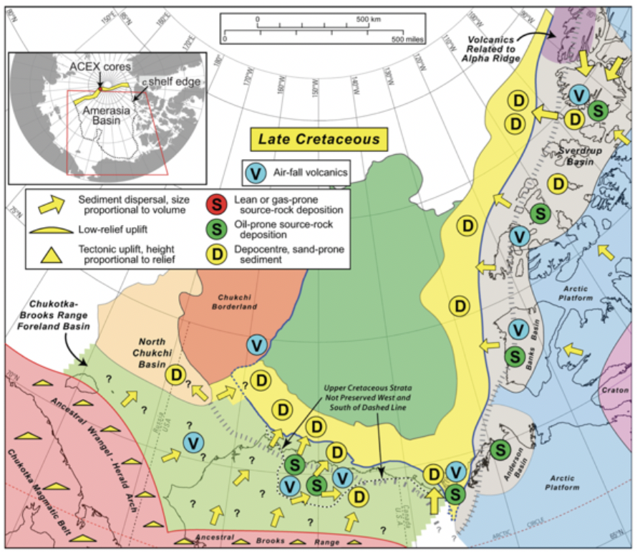
Modelling
Late Cretaceous
Houseknecht and Bird (2011)

Slide 6
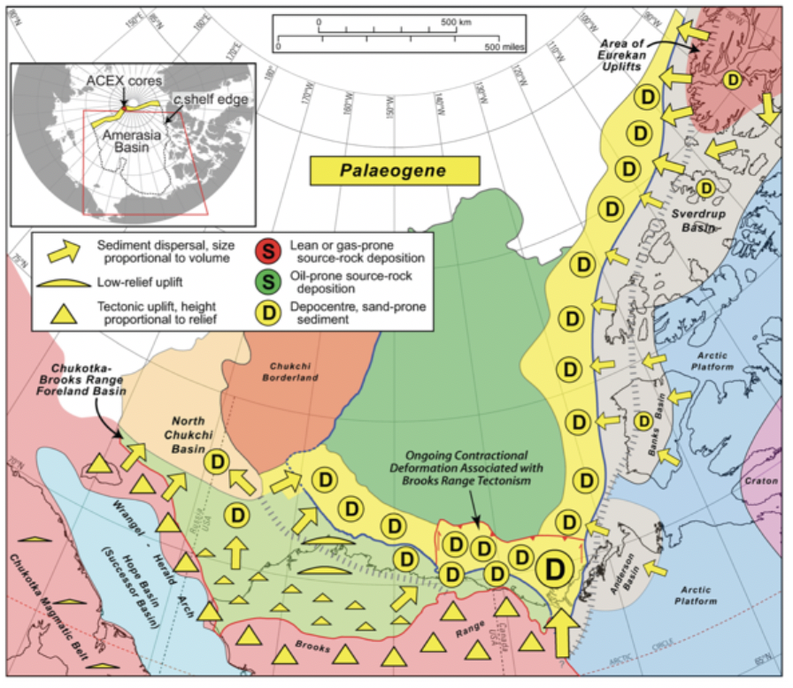
Modelling
Paleogene
Houseknecht and Bird (2011)

Slide 7
If you have questions or comments:
claire.mallard@sydney.edu.au

