Slide 1
European Catalogue of Volcanoes and volcanic areas: a EUROVOLC contribution to strengthen the volcanological community Di Vito Mauro A. (1), Óladóttir Bergrun A. (2, 3), Barsotti Sara (2), WP11 collaborators (4) 1 Istituto Nazionale di Geofisica e Vulcanologia Osservatorio Vesuviano, Naples, IT 2 Icelandic Meteorological Office, Reykjavík, Iceland 3 Institute of Earth Sciences, Reykjavík, Iceland 4 CIVISA, IGM , CSIC, IPGP, OPGC, LMU , UCABGS, HSGME
Notes:
Sharing data, sharing information, sharing results is becoming a priority within open scientific communities. The European volcanological community has been fostering the integration of information on active volcanoes through the EUROVOLC project.
Institutions currently responsible for monitoring active volcanoes in Europe and over-seas territories, participate in WP 11 aiming to make the information consistently available to the general public and stakeholders through a friendly and interactive web-site.

Slide 2
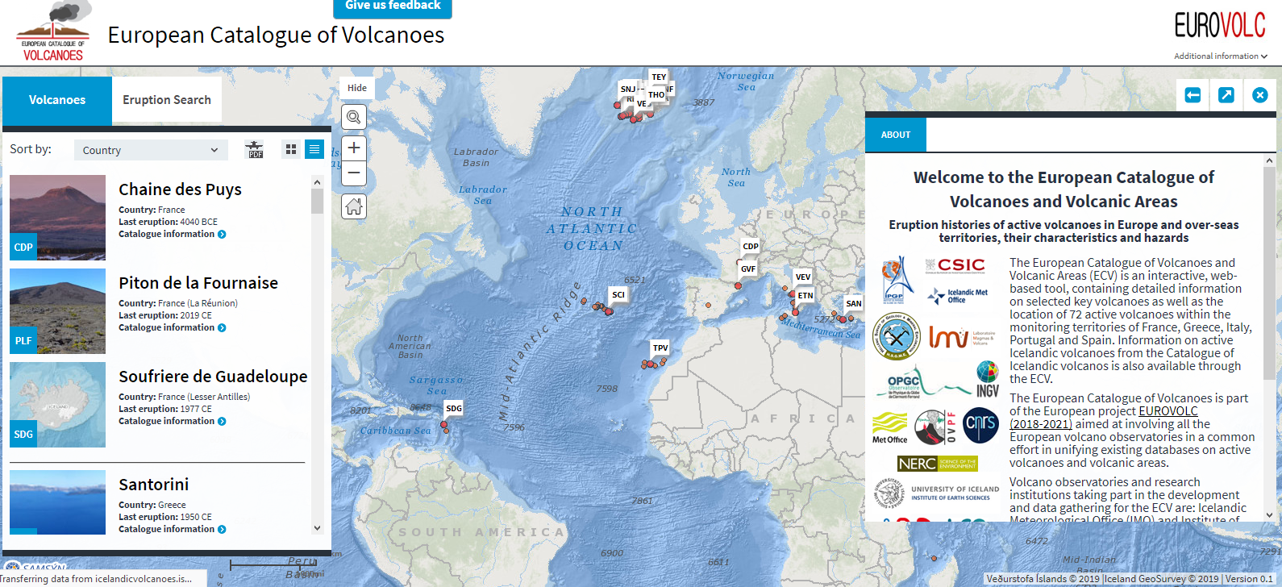
The European Catalogue of volcanoes: The main interface
The European Catalogue of Volcanoes and volcanic areas now exists including a total of 42 volcanoes!
Notes:
A European Catalogue of Volcanoes (ECV) has been created containing information on geological background, historical eruptive activity, eruptive scenarios and potential hazards for the following volcanoes:
Etna and Vesuvio in Italy;
Santorini in Greece;
Chain de Puys, La Piton de la Fournaise and La Soufriere de la Guadaloupe in France and French territories;
Teide and La Garrtoxa Fields in Spain and Canary Islands;
Fogo and Sete Cidades in Azores Islands).
All 32 active Icelandic volcanoes are accessible through the same interface (by sharing the backend with the Catalogue of Icelandic Volcanoes), enlarging the number of volcanoes accessible through ECV to 42.

Slide 3
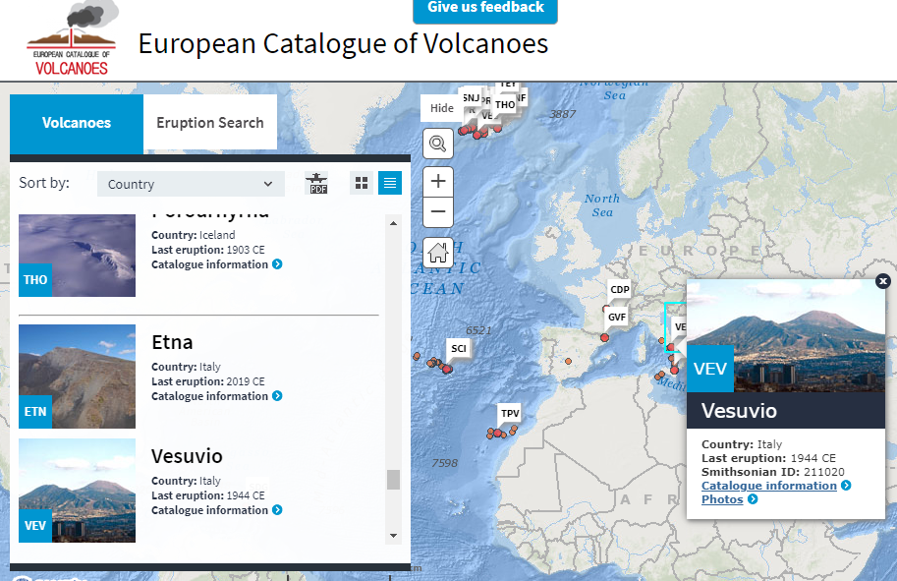
The European Catalogue of volcanoes: How to select a volcano

Slide 4
The European Catalogue of volcanoes: The structure
Functionalities and features currently implemented in the ECV
Short description

Slide 5
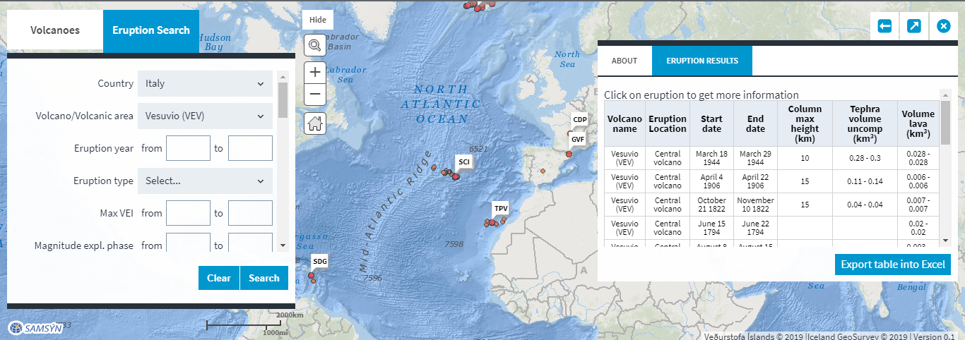
The European Catalogue of volcanoes: The content
Additionally, the ECV includes a database of quantitative parameters characterizing selected eruptions, facilitating the adoption of such eruptive source parameters for numerical modelling validation, comparison and volcanic hazard assessment.

Slide 6
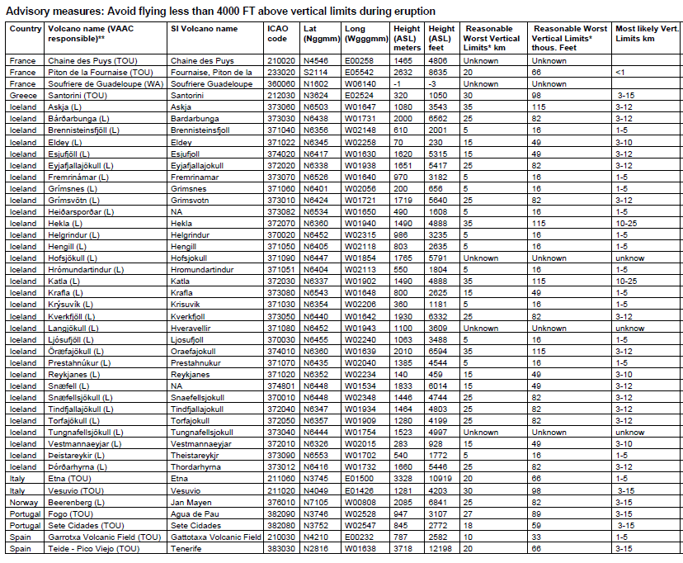
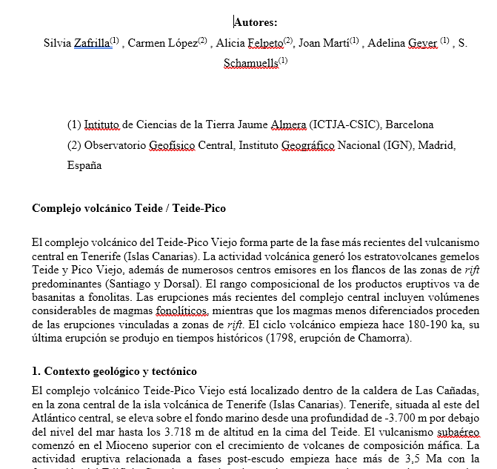
The European Catalogue of volcanoes: IMPORTANT ADDITIONS
WP11 decided to provide the information about volcanoes in both English and local language (CSIC, INGV, HSGME, CIVISA and IMO have already completed the task)
The aviation table

Slide 7
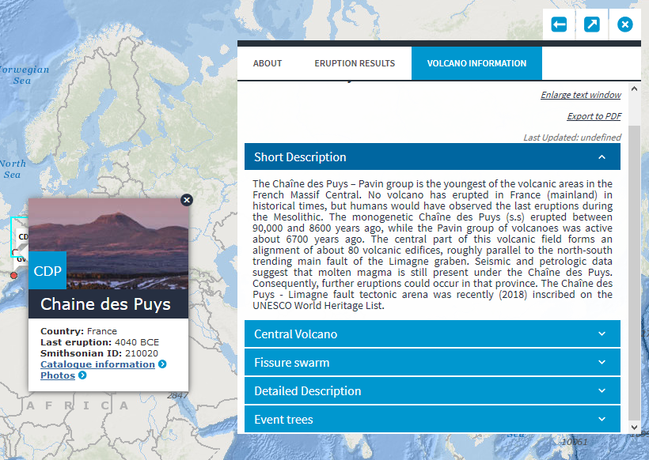
The European Catalogue of volcanoes: The Event Tree
An important milestone regards the addition of Event Tree to the catalogue
ECV is already designed to include them
They will be static image added with explanatory text
Already existing for: Vesuvius, La Soufriere de la Guadaloupe, Teide, almost for Santorini
In progress for: Grímsvötn, Etna

Slide 8
The final message:
The European Catalogue of Volcanoes and Volcanic areas will be eventually open to the general public by the end of the project
Expected date: January 2021
volcanoes.eurovolc.eu
volcanos.eurovolc.eu

