Slide 1
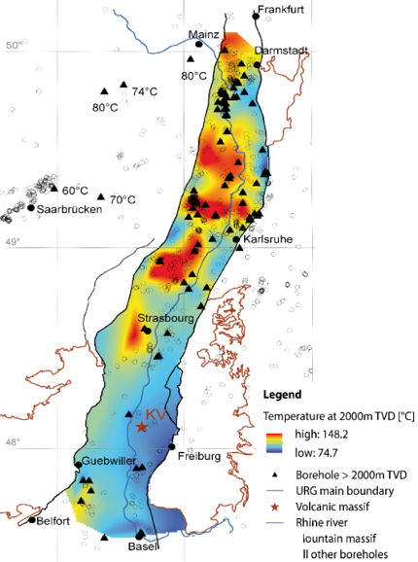
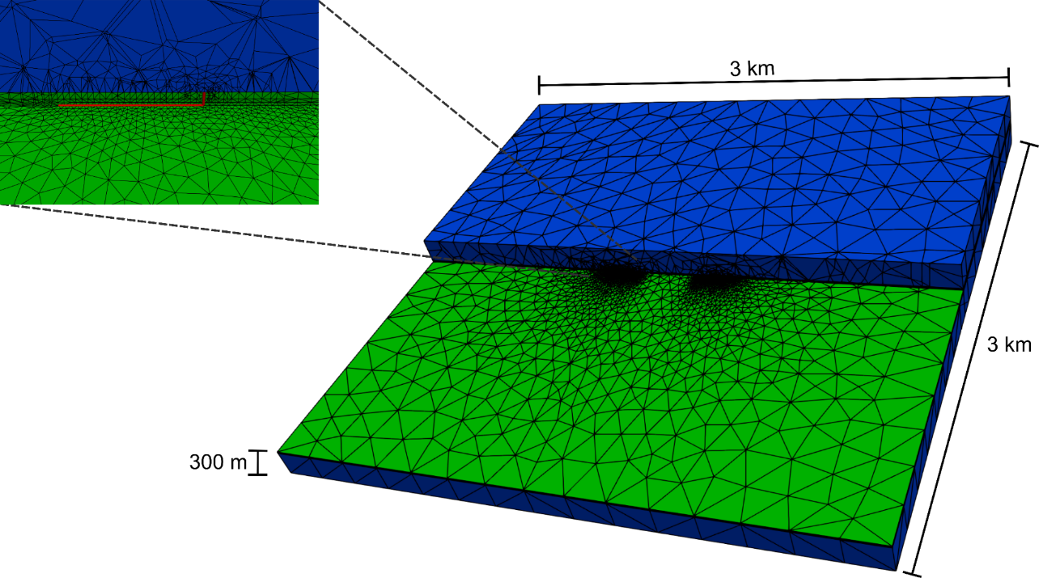
Utilization of abandoned hydrocarbon reservoirs for deep geothermal heat storage
K. Stricker, J. Grimmer, R. Egert, J. Bremer, A. Dashti, M. Gholamikorzani, J. Meixner, K. Schaetzler, E. Schill und T. Kohl
© Authors. All rights reserved.

Slide 2
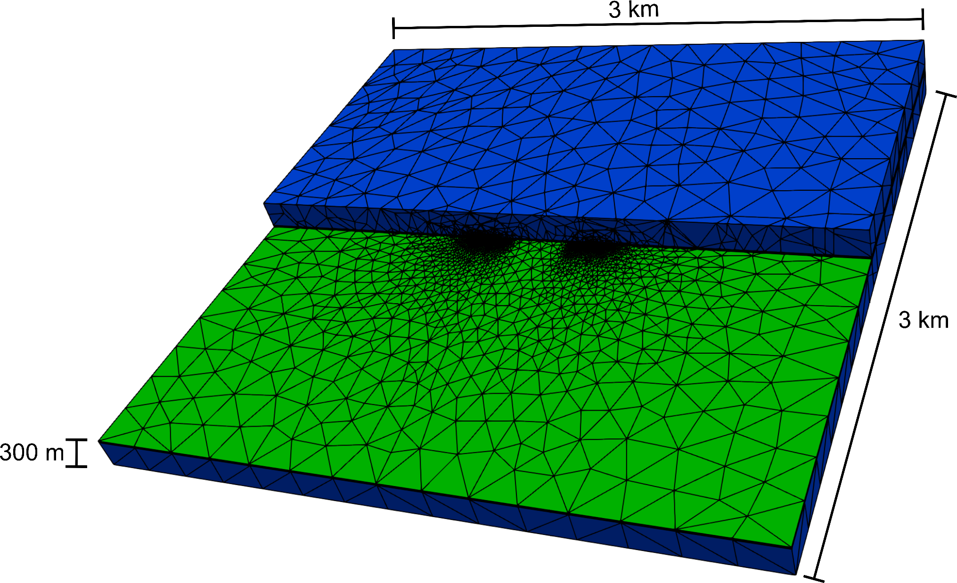
Executive summary: Background
Executive summary
Motivation
Data compilation
Numerical modeling
Results & Discussion
Conclusion
Well characterized reservoirs
Positive temperature anomalies in the URG
Former oil fields as potential storage sites
Generic thermo-hydraulic model

Slide 3
Executive summary: Results
Executive summary
Motivation
Data compilation
Numerical modeling
Results & Discussion
Conclusion
Increasing storage efficiency over time
Increasing storage efficiency for horizontal wells
Increasing storage efficiency for higher thicknesses
Modeling shows general suitability of abandoned oil fields in the URG for heat storage

Slide 4
URG: High potential for heat storage?
Executive summary
Motivation
Data compilation
Numerical modeling
Results & Discussion
Conclusion
High temperatures in the subsurface of the Upper Rhine Graben (URG)
Well characterized storage formations
Baillieux et al., 2013
Notes:
New technology for the energy transition
Worldwide potential
High storage volumes, known reservoir geometries
Well known petrophysical reservoir properties
→ Interesting for high-temperature heat storage

Slide 5
Potential storage sites
Executive summary
Motivation
Data compilation
Numerical modeling
Results & Discussion
Conclusion
Böcker (2015)
Notes:
- Green patches: abandoned oil fields in the URG

Slide 6
Estimation of storage volumes
Executive summary
Motivation
Data compilation
Numerical modeling
Results & Discussion
Conclusion
Obtained from e.g. LBEG (2018)
Notes:
Produced oil volumes represent minimum estimation of the storage volume of potential heat storage sites
Dark grey: Oil fields with production from Tertiary only
Medium grey: Oil fields with production from both Tertiary and Mesozoic
Light grey: Oil fields with production from Mesozoic only

Slide 7
Petrophysical properties of potential storage sites
Executive summary
Motivation
Data compilation
Numerical modeling
Results & Discussion
Conclusion
Various sources, e.g. Bruss (2000), Böcker (2015)
Notes:
Figure shows data obtained from cores of oil wells in the URG
Detailed references: BRGM (1971), Sauer et al. (1981), Bruss (2000), Caron (2012), GeORG-Projektteam (2013), Böcker (2015)

Slide 8
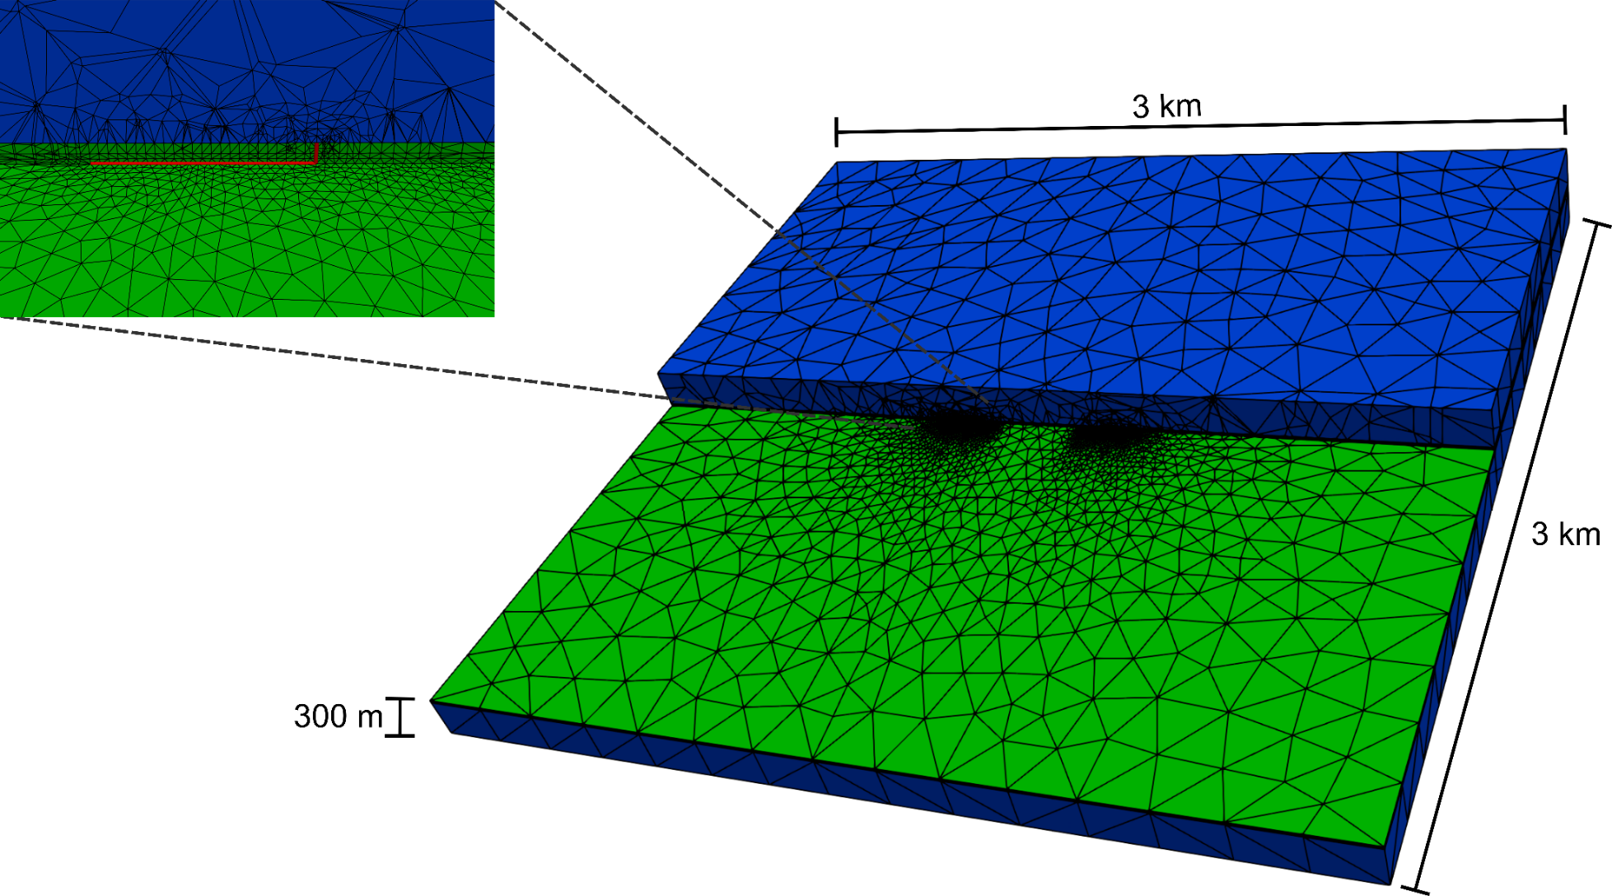
Numerical model
Executive summary
Motivation
Data compilation
Numerical modeling
Results & Discussion
Conclusion
Generic model
Cyclic storage operation
Notes:
FE Solver: MOOSE/TIGER (Mesh: Gmsh)
Thermo-hydraulic modeling
Parametrization based on data of abandoned oil fields in the URG
2 wells (cold and warm)
Cyclic storage operation with two semi-annual cycles
1st half of each year (summer phase): Injection into warm well (140 °C) + production from cold well
2nd half of each year (winter phase): Production from warm well + injection into cold well (70 °C ⬄ ambient reservoir temperature)
2 borehole geometries:
Purely vertical well
Additionally added 100 m horizontal well section

Slide 9
Parametrization
Executive summary
Motivation
Data compilation
Numerical modeling
Results & Discussion
Conclusion
Parameter |  | Ranges
 |  | Min | Max
Permeability [m²] | Vertical well | 6.6x10⁻¹⁵ | 3.3x10⁻¹³
 | Horizontal well | 1x10⁻¹⁵ | 3.3x10⁻¹³
Reservoir thickness [m] |  | 5 | 20
Thermal conductivity [Wm⁻¹K⁻¹] | Reservoir | 2 | 3
 | Cap rock | 1 | 2
Flowrate (injection/production) [Ls⁻¹] |  | 1 | 10
Injection temperature of the hot well |  | 120 | 160
Notes:
Parametrization based on data of abandoned oil fields in the URG
Ranges used for parametric study

Slide 10
Increasing efficiency of recovery over time
Executive summary
Motivation
Data compilation
Numerical modeling
Results & Discussion
Conclusion
Notes:
Parametrization of the shown “base case” (average reservoir properties):
Reservoir permeability: 6.6x10⁻¹⁴ m²
Reservoir thickness: 10 m
Thermal conductivities: Reservoir (2 Wm⁻¹K⁻¹), Cap rock (1.4 Wm⁻¹K⁻¹)
Injection/production flowrate: 2 L/s
Minimum production temperature increases from 94.5 °C (cycle 1) to 112.7 °C (cycle 10) → heating of the reservoir with increasing time caused by accumulation of thermal energy (i.e. heat losses from previous cycles)
Analogous effect for the efficiency of recovery: Increase from 66 % to 82 % (no maximum reached after 10 years ⬄ efficiency still increasing until steady-state conditions are reached)
Terms of energy:
2.72 GWh are annually stored
Cycle 1: 1.81 GWh can be retrieved, cycle 10: 2.22 GWh can be retrieved

Slide 11
Influence of increasing reservoir thicknesses
Executive summary
Motivation
Data compilation
Numerical modeling
Results & Discussion
Conclusion
Notes:
Asterisks in the left figure (also valid for the other figures on this and the following slide) represent performed simulations:
Red asterisks: „feasible“ parametrization ⬄ pressure changes within the reservoir below defined threshold of 2 MPa (avoidance of e.g. induced seismicity)
Black asterisks: parametrization not feasible
Increasing thicknesses ⬄ higher efficiency of recovery
Increasing thicknesses lead to lower pressure changes within the reservoir → more feasible permeability-flowrate combinations
Increasing flowrates → pronounced increase in the efficiencies
Increasing permeabilities → slightly reducing efficiencies
Different influence of the parameter variation: Reservoir thickness (up to 9 %) > injection/production flowrate (up to 6 %) > reservoir permeability (± 0 %)
Red frame: Parametrization of the previously mentioned base case

Slide 12
Influence of the borehole geometry
Executive summary
Motivation
Data compilation
Numerical modeling
Results & Discussion
Conclusion
Notes:
Lower pressure changes for the horizontal well setup due to a larger contact area between well and reservoir
Implementation of a complementary horizontal well section leads to the following:
Reservoirs with lower permeabilities can be utilized for heat storage (different permeability thresholds)
Equal permeabilities allow heat storage using higher flowrates

Slide 13
Conclusion of hydraulics and geometry
Executive summary
Motivation
Data compilation
Numerical modeling
Results & Discussion
Conclusion
Notes:
Horizontal well setup allows the utilization of higher flowrates (due to lower pressure changes within the reservoir) → maximum annually extractable energy increases compared to the vertical well setup (in spite of lower efficiencies of recovery)
Red frame → Example (κ = 6.6e⁻¹⁴ m², Δz = 10 m):
Vertical well setup: Q_{max} = 2 L/s, ΔE_{max} = 2.22 GWh
Horizontal well setup: Q_{max} = 5 L/s, ΔE_{max} = 5.59 GWh
2.5 times higher storage potential for identical reservoir properties
Drilling of a horizontal section can be used to i) enable the utilization of a reservoir with low permeabilities in the first place, or ii) increase the storage potential of a reservoir (in case the spatial extent of the reservoir allows the drilling of such wellbores)

Slide 14
Selection of the suited borehole geometry
Executive summary
Motivation
Data compilation
Numerical modeling
Results & Discussion
Conclusion
 | Permeability [m²]
Thickness [m] | 10⁻¹⁵ | 3.3x10⁻¹⁵ | 6.6x10⁻¹⁵ | 10⁻¹⁴ | 3.3x10⁻¹⁴ | 6.6x10⁻¹⁴ | 10⁻¹³ | 3.3x10⁻¹³
5 | - | - | - | - | 2.02 | 2.01 | 5.19 | 10.44
10 | - | - | - | 0.98 | 2.13 | 5.59 | 11.33 | 11.34
20 | - | 0.97 | 0.97 | 2.16 | 8.84 | 11.85 | 11.93 | 11.92
Notes:
Values in the cells show the maximum pressure changes occurring within the reservoir
Selection of the suited borehole geometry always depends primarily on the reservoir permeability and thickness:
Red shaded cells: not feasible with either horizontal nor vertical well setup
Blue shaded cells: highest storage potential by utilizing a complementary horizontal well section
Green shaded cells: highest storage potential for a purely vertical well setup

Slide 15
Influence of thermal properties
Executive summary
Motivation
Data compilation
Numerical modeling
Results & Discussion
Conclusion
Notes:
Influence of the heat capacities of both reservoir and cap rock is negligible
Thus, only the influence of thermal conductivities was investigated
Asterisks in the upper left figure represent performed simulations
Increasing thermal conductivities lead to decreasing efficiencies of recovery (⬄ higher heat losses due to higher thermal diffusion)
Low reservoir thickness: Efficiency of recovery solely depends on the thermal conductivity of the cap rock
Increasing influence of the thermal conductivity of the reservoir with increasing thickness AND for the horizontal well setup (⬄ lower influence of the cap rock – acting as thermal insulator – on the propagation of the injected hot water)
Influence of varying thermal conductivities on the efficiency of recovery (up to 6 %) is in the same range as the influence of hydraulic and geometrical parameters (up to 9 %) → thermal conductivities should receive equal attention as the latter in the planning of deep geothermal heat storage sites

Slide 16
URG: High potential for heat storage
Executive summary
Motivation
Data compilation
Numerical modeling
Results & Discussion
Conclusion
Notes:
Contour plot: Potential annual energy extraction for the vertical well setup
Black dashed line: Threshold of feasibility for the horizontal well setup
Grey circles: Core measurements of (abandoned) oil wells in the central URG (average measurements are displayed in case data ranges are available)
Vertical well setup: 24 out of 31 well measurements lie within the contour plot → feasible storage sites
Horizontal well setup: Feasible storage sites increase to 29 out of 31 ⬄ increased amount of potential storage sites AND higher storage potential in general (as shown on slide 13)

Slide 17
Conclusion
Executive summary
Motivation
Data compilation
Numerical modeling
Results & Discussion
Conclusion
Well characterized potential storage sites (abandoned oil fields)
Increasing efficiency of recovery over time
Increasing efficiency of recovery with higher reservoir thicknesses as well as injection/production flowrates
Higher extractable energy for the horizontal well setup
Selection of the suited well geometry based on reservoir properties
Increasing efficiency of recovery with decreasing thermal conductivities
The majority of the investigated abandoned oil fields seem to be utilizable as deep geothermal heat storage sites
Contact: kai.stricker@kit.edu

Slide 18
References
Baillieux, Paul; Schill, Eva; Edel, Jean-Bernard; Mauri, Guillaume (2013): Localization of temperature anomalies in the Upper Rhine Graben: insights from geophysics and neotectonic activity. International Geology Review 55 (14), pp. 1744-1762.
Böcker, Johannes (2015): Petroleum system and thermal history of the Upper Rhine Graben. Implications from organic geochemical analyses, oil-source rock correlations and numerical modelling. Dissertation. RWTH Aachen, Aachen. Fakultät für Georessourcen und Materialtechnik.
BRGM (1971): Possibilités d‘injection en couches profondes d‘effluents industriels. Service géologique d‘Alsace et de Lorraine. Strasbourg.
Bruss, Dietfried (2000): Zur Herkunft der Erdöle im mittleren Oberrheingraben und ihre Bedeutung für die Rekonstruktion der Migrationsgeschichte und der Speichergesteinsdiagenese. Dissertation. Forschungszentrum Jülich / Universität Erlangen-Nürnberg, Jülich. Institut für Chemie und Dynamik der Geosphäre 4: Erdöl und Organische Geochemie.
Caron, E. (2012): Réalisation d‘une base de données porosité-perméabilité dans le fossé rhénan. Bachelorthesis. Université Lille Nord de France, Lille.
GeORG-Projektteam (2013): Geopotenziale des tieferen Untergrundes im Oberrheingraben, Fachlich Technischer Abschlussbericht des Interreg-Projekts GeORG, Teil 3: Daten, Methodik, Darstellungsweise. Edited by Sokol, Günter; Nitsch, Edgar. Freiburg i. Br.
LBEG (2018): Erdöl und Erdgas in der Bundesrepublik Deutschland (2018). Niedersächsisches Landesamt für Bergbau, Energie und Geologie (LBEG). Hannover.
Sauer, K.; Nägele, R.; Tietze, R. (1981): Geothermische Synthese des Oberrheingrabens zwischen Karlsruhe und Mannheim (Anteil Baden-Württemberg). Geologisches Landesamt Baden-Württemberg. Freiburg i. Br.

