Slide 1
Picture @ A. Shynkarenko
D1899 | EGU2020-20733
6th May 2020
Tsunami modelling on lake scales - a sensitivity analysis
Paola Bacigaluppi*, Robert M. Boes, David F. Vetsch
Contact: bacigaluppi@vaw.baug.ethz.ch
Affiliation: ETH Zurich, Laboratory of Hydraulics, Hydrology and Glaciology (VAW)
© Authors. All rights reserved

Slide 2
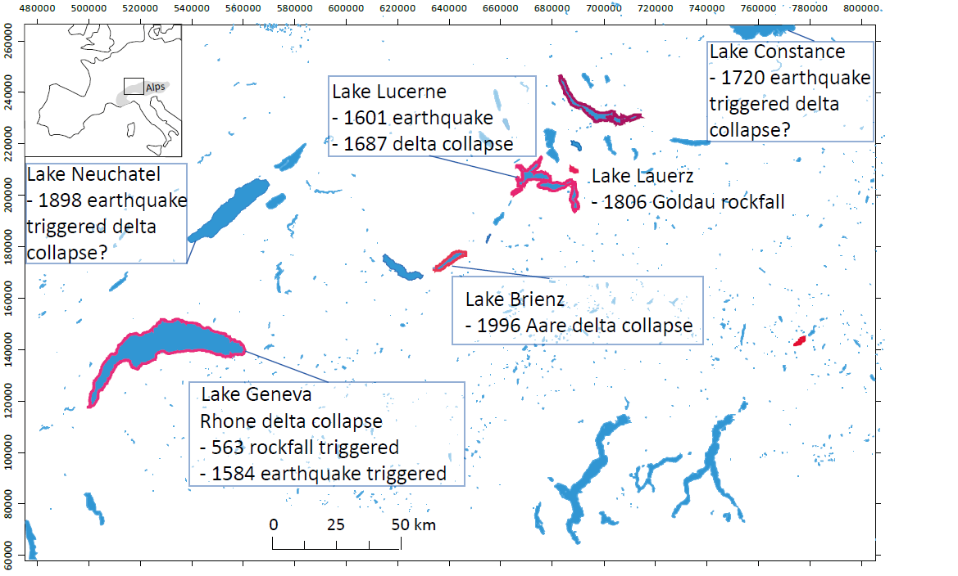
Motivation: Lake Tsunamis
Tsunamis may occur in every acquatic system
Hystorically:
563 AD Lake Geneva: - rockfall-induced delta-collapse
- modelled wave heights up to 8m
1601 AD Lake Lucerne: - earthquake-triggered sublacustrine slope failure
& rockfall in Bürgenstock
- wave heights of 4m in Lucerne
1941 AD Laguna Palcacocha, Peru: - large avalanche
- killing ~ 1,800 to 7,000 inhabitants
climate warming tends to enhance slope instabilities
Urge for prediction of possible hazardous events
To know more check:
D1900 |
EGU2020-4711
Picture @ K. Kremer
Goal: Understand governing mechanisms of genesis, propagation and inundation of tsunamis in lakes.

Slide 3
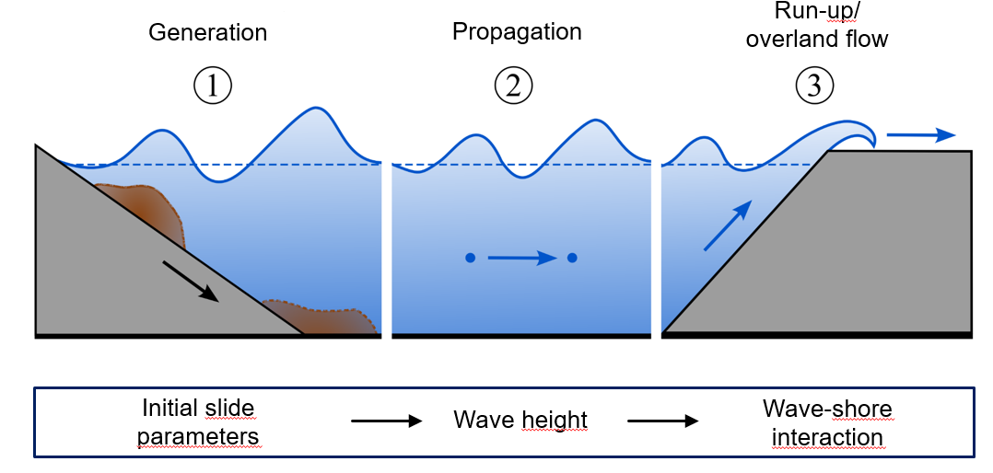
Main key questions: Overview
Wave generation processes
Propagation of waves
Inundation
Proof of concept – Workflow
BASEMENT A freeware simulation tool for hydro- and morphodynamic modelling
Trigger mechanismus
Impact on the shoreline
Key Properties: Lake Tsunami Modeling
Efficient Simulation Workflow
3

Slide 4
Goals of the present contribution
<
Goal:
Understand governing mechanisms of genesis, propagation and inundation of tsunamis in lakes.
Focus on propagation & inundation:
Sensitivity analysis on lake scales for diverse modelling equations & softwares
Tsnamis: long waves compared to water depth for submerged landslides
What mathematical model fits best?
Depends on the scales of the physical problem – e.g. relative wave length $\frac{L_{w}}{href }$
Presence of linear or non-linear waves for lake scales
Shallow Water model: no frequency dispersion ( ~ propagation time & shape of wave)
Frequency dispersion: Boussinesq-type model
h : water depth
q_{x} : discharge, x
g : grav. acceleration
S_{h}: lateral i/o discharge
S_{fx}: friction, x
z_{B} : bottom elevation

Slide 5
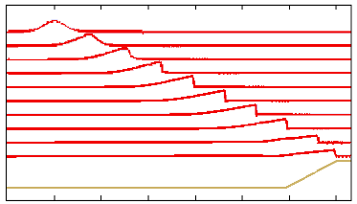
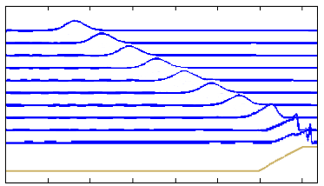
Propagation of waves & mathematical model
Depth-averaged 2D models based on the Shallow Water equations
Boussinesq-type equations derived from Schäffer and Madsen (1995)
$$∂_{t}h+∂_{x}q_{x}+∂_{y}q_{y}=S_{h}$$
$$∂_{t}h+∂_{x}q=0$$
$$∂_{t}q_{x}+∂_{x}\left(\frac{q_{x}^{2}}{h}+0.5gh^{2}\right)+∂_{y}\left(\frac{q_{x}q_{y}}{h}\right)+gh\left(∂_{x}z_{B}+S_{f_{x}}\right)=0$$
$$\left(1−D\right)∂_{t}q+∂_{x} \left(q2+\frac{g}{2}h^{2}\right)−gh∂_{x}href−B{ghref}^{2}{∂_{xx}\left(href{∂_{x}η}_{ }\right)}_{ }=−f_{D}$$
$$∂_{t}q_{y}+∂_{x}\left(\frac{q_{x}q_{y}}{h}\right)+∂_{y}\left(\frac{q_{y}^{2}}{h}+0.5gh^{2}\right)+gh\left(∂_{y}z_{B}+S_{f_{y}}\right)=0$$
$$D\left(ω\right)=\left(B+\frac{1}{2}\right){href}^{2}{∂_{xx}ω}_{ }−\frac{1}{6}{href}^{3}∂_{xx}{\left(\frac{ω}{href}\right)}_{ }$$
and
$$B=\frac{1}{15}$$
Good for broken waves (shocks)
Simple and efficient for run-up
Accurate prediction of shoaling
No intrinsic dissipation mechanism
Legend:
𝜂(x,t) : wave shape
A : wave amplitude
h : water column height
h_{ref} : still water reference height
q_{x} : discharge, x
g : grav. acceleration
S_{h} : lateral i/o discharge
S_{fx} : friction, x
z_{B} : bottom elevation
5

Slide 6
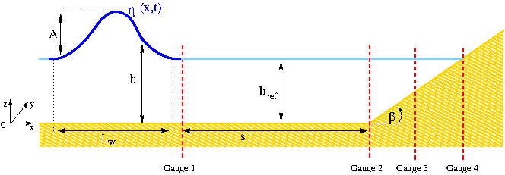
Propagation of waves and what to consider – Insight on lake scales
Depth-averaged 2D models based on the Shallow Water equations
Boussinesq-type equations derived from Schäffer and Madsen (1995)
$$∂_{t}h+∂_{x}q_{x}+∂_{y}q_{y}=S_{h}$$
$$∂_{t}h+∂_{x}q=0$$
$$∂_{t}q_{x}+∂_{x}\left(\frac{q_{x}^{2}}{h}+0.5gh^{2}\right)+∂_{y}\left(\frac{q_{x}q_{y}}{h}\right)+gh\left(∂_{x}z_{B}+S_{f_{x}}\right)=0$$
$$\left(1−D\right)∂_{t}q+∂_{x} \left(q2+\frac{g}{2}h^{2}\right)−gh∂_{x}href−B{ghref}^{2}{∂_{xx}\left(href{∂_{x}η}_{ }\right)}_{ }=−f_{D}$$
$$∂_{t}q_{y}+∂_{x}\left(\frac{q_{x}q_{y}}{h}\right)+∂_{y}\left(\frac{q_{y}^{2}}{h}+0.5gh^{2}\right)+gh\left(∂_{y}z_{B}+S_{f_{y}}\right)=0$$
$$D\left(ω\right)=\left(B+\frac{1}{2}\right){href}^{2}{∂_{xx}ω}_{ }−\frac{1}{6}{href}^{3}∂_{xx}{\left(\frac{ω}{href}\right)}_{ }$$
and
$$B=\frac{1}{15}$$
 | BASEMENT v3 | BoussClaw (GeoClaw 5.6)
Under developement since | 2003 | 1994
Purpose of use | Teaching, research & projects | Teaching, research
Hyperbolic systems of PDE | Shallow Water Eqs. | Boussinesq-type Eqs.
Simulated dimensions | 1- & 2-D | 1- & 2-D
Numerical Approach | Finite Volumes | Finite Volumes
Computational Mesh | Unstructured | Structured
Multi-core CPU simulations
Support of GPGPU accelation
Typical scales of Lakes (cf. Lake Lucerne)
s = [800, 1600, 3200, 6400]m,
h_{ref} = [40, 80, 120, 160, 200]m and,
Generated wave amplitudes A=[0.1,0.2,0.3, 0.4, 1, 2, 4, 6]m.
Difference between Basement and BoussClaw for Gauge 4
< +0.06%
Relative wave height Ɛ=A/h_{ref} between 0.0005 – 0.15
Wave length L_{w} between 749 – 64892 m
Ratio (A+h_{ref})/L_{w} between 0.0031 – 0.061
Outlook
Legend:
𝜂(x,t) : wave shape
A : wave amplitude
h : water column height
h_{ref} : still water reference height
s : propagation distance with constant bathymetry
𝛽 : slope angle for the run-up shoreline
6

Slide 7
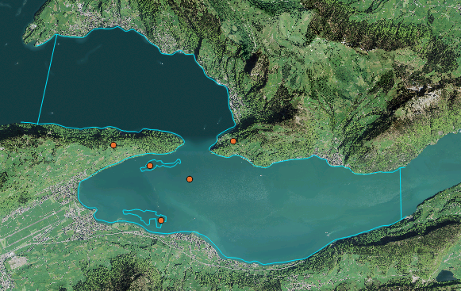
Preview of BASEMENT v3.0 performance abilities – Lake Lucerne
Initial conditions:
Simulation – fine grid (video)
Water surface: 434m a.s.l. [Source: https://www.hydrodaten.admin.ch/de/2207.html]
Two submerged landslides
– Δ= - 5m (c.f. Figure below, area with light blue dot)
– Δ= - 7m (c.f. Figure below, area with yellow dot)
Case Study
Case Study
Area of a single cell: 50m²
Simulated time since landslides: 160s
Time needed for simulation, 2.6million cells
GPU: 103.3s
7

Slide 8
Conclusions and Outlook
Conclusions
BASEMENT 3.0 for tsunami modelling
Non-linear Shallow Water Equations appear suitable for the considered lake scales
Qualitative proof of concept of wave generation, propagation & run-up on selected case study of Lake Lucerne
Outlook
What controls wave propagation in narrow and confined lake basins?
Can the simulations be matched with hydraulic laboratory modeling & historic event description?
Acknowledgments
This project is financed by the Sinergia Project of the Swiss National Science Foundation nr. 171017.
8

