Slide 1
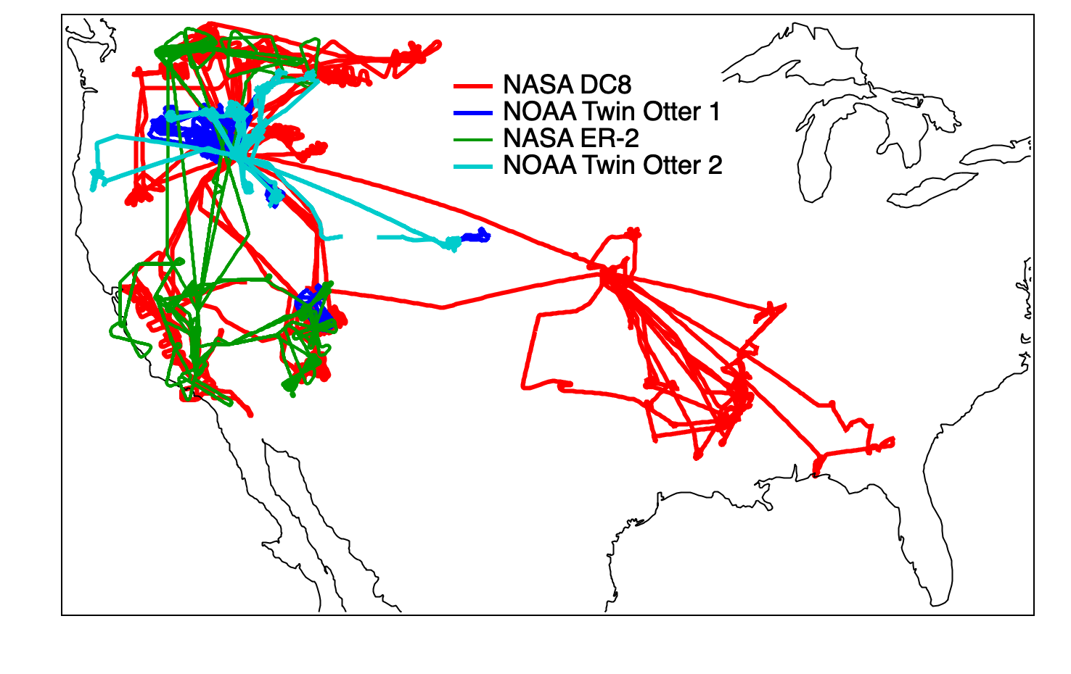
The FIREX-AQ 2019 Dataset is Public
www.esrl.noaa.gov/csd/projects/firex-aq/
https://espo.nasa.gov/firex-aq
Williams Flats
PyroCb, 8/8/19
Agricultural fire
Photo: David Peterson
FIREX-AQ Science team
Notes:
Cover slide 1: FIREX-AQ is the Fire Impacts on Regional to Global Environments and Air Quality Study; an intensive that occurred in 2019 focused on measurements in North America. Full information and data available via the website links.

Slide 2
Notes:
Slide 2: Hello everyone – I’m happy to have the opportunity to increase awareness of the NOAA/NASA FIREX-AQ dataset in Europe. We think that this detailed information will have relevance to the global fire science community. From this opening graphic, you can get the sense that measurements that we carried out last year over the US were focused on improving understanding of a wide range of processes affecting burning emissions into the atmosphere. Here we’ll share just an overview of the activities that took place. The main point of this presentation is to point you towards this outstanding dataset and involved in helping to address analysis questions.

Slide 3
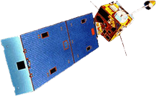
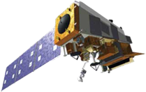
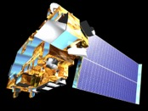
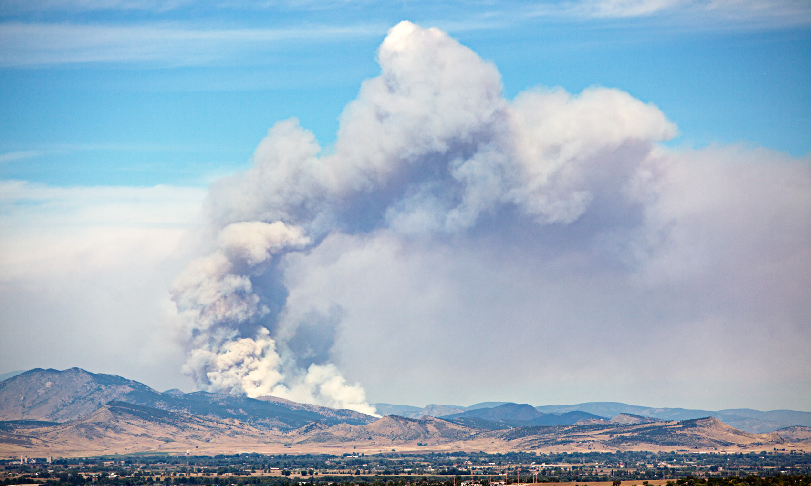
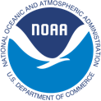
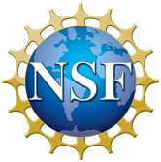
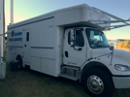
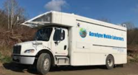
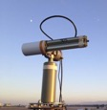
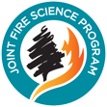
FIREX-AQ Coordinated Research Activities
NOAA GOES-R
NOAA/NASA JPSS
NASA TERRA
Satellites: Remote Sensing
Multi-agency collaborations to study complex fire systems
High-Altitude Remote Sensing
NASA ER-2
NASA DC-8
NOAA/NASA FIREX-AQ
Aircraft: Local to Continental In-situ & Remote Sensing
Laboratory study: 2016
Field intensive: 2019
MET Twin Otter
NOAA/CU NightFOX
Coordinating Projects
CHEM Twin Otter
Mobile/Fixed Sites: Local to Continental
NSF WE-CAN
C130 aircraft study: 2018
LARGE Mobile
Aerodyne Mobile Lab
AERONET DRAGON
JFSP Western Wildfire Campaign (FASMEE): Source fuel fire studies: 2019+
Mt. Bachelor, Missoula, and McCall Observatories
International Biomass Burning Initiative (IGAC):
communicate globally what is learned in U.S.
Notes:
Slide 3: FIREX-AQ brought together many different institutions to generate a very comprehensive measurement campaign, covering global to very local scales. Information about all these activities can be found online; see the URLS repeated at the first and last slides. From high altitude to low, data is available from he NASA ER-2 carrying satellite emulator instruments; the NASA DC8 flying laboratory, with both in situ and remotely-sensed data; two NOAA twin otters examining fire-induced wind fields and in-situ chemistry (day and night); multiple mobile laboratories measuring aerosols, chemistry, and radiation; and ground-based remote-sensing and fuels information. This wide array of effort allows exhaustive characterization of gases and aerosols, optical properties, wind fields, fire radiative power. The ground-based examinations of fuels and burned areas permit clearer connections of atmospheric pollutants to their sources than measurements unassociated with this kind of information. Modeling efforts were used during the campaign to predict transport, and study emissions and transformations.

Slide 4
FIREX-AQ Scope
In situ from air/ground measurements
Remote sensing: optical, dynamic from ground, airborne, and satellite platforms
Fuels/residue evaluations
Modeling:
High resolution
Multiple domains
Notes:
Slide 4: FIREX-AQ was focused on measurements over the US. It had two distinct foci; first, a more extensive study with all of the platforms just described in the US West, looking at wildfires. Then, the DC-8 flying laboratory flew alone to study of smaller agricultural and prescribed fires in the central and south east US.

Slide 5
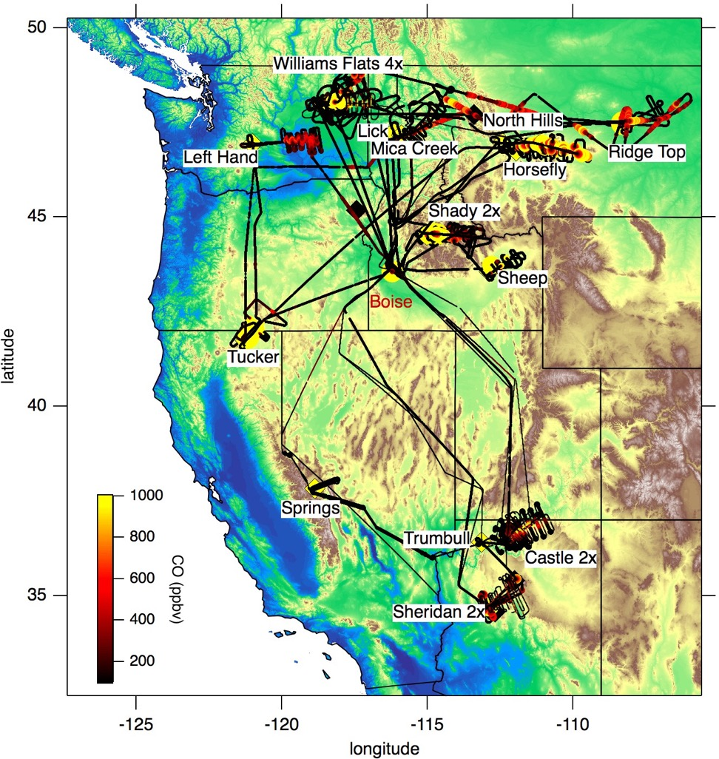
FIREX-AQ Flights for Wildfires in Western US
DC-8 Tracks, only
14 large fires, multiple aircraft
Grass, woodland, scrub
Wind profiling around fires
Daytime/Nighttime measurements
Point-of-emission mobile lab measurements
Atmospheric aging timescales over range of minutes to ~24 hours
Interactions in an urban environment
Repeated (day after day) sampling of some fires
PyroCb
Notes:
Slide 5: A major focus was on wildfires in the western US. You can see from the bulleted list of highlights that the dataset is extensive and valuable. Fuels evaluations are ongoing but should be completed soon. Comparison of satellite FRP retrievals with those from the aircraft are also ongoing.

Slide 6
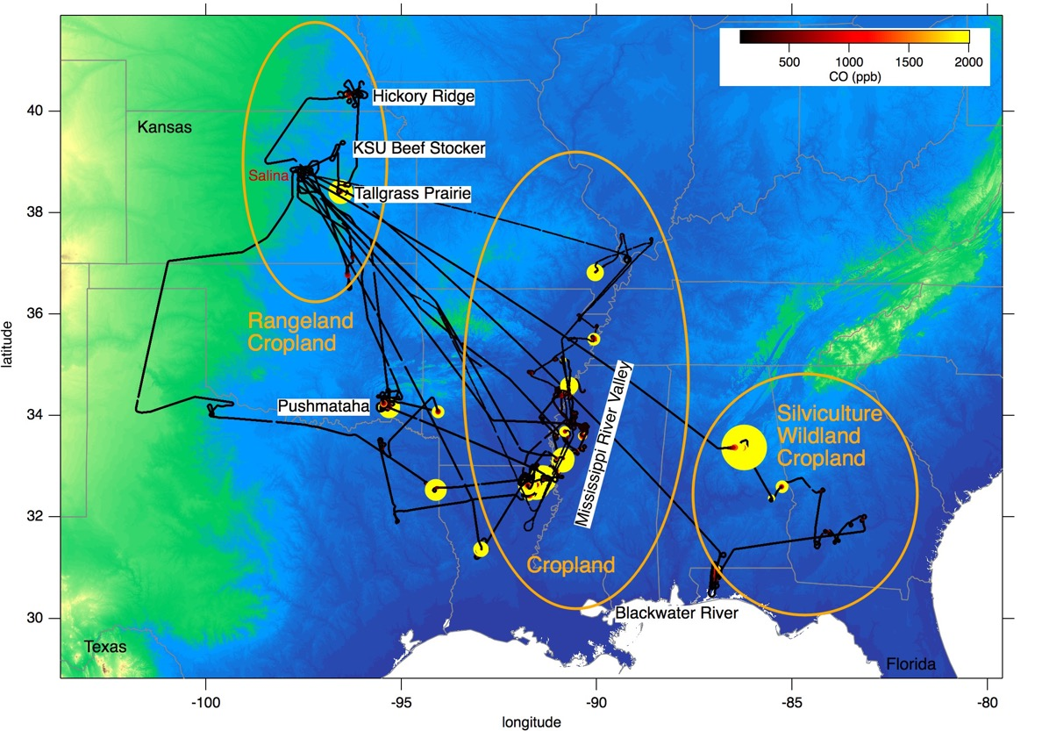
FIREX-AQ DC-8 Flights for Agricultural and Prescribed Burns
~90 different fires
Corn, timber, soy, rice, land clearing,pile/slash; unintentionally, a house fire was also captured.
Multiple samples from most fires
High resolution fire radiative power (FRP) for satellite comparison
PyroCu
Notes:
Slide 6: Another major focus was on smaller agricultural and prescrivbed fires mostly in the southeast US. These are fires that are underrepresented in emissions inventories in part because of satellite overpass timing, and in part because of their small sizes. Fuels evaluations and FRP comparisons are still ongoing but should be done soon. We welcome your input.

Slide 7
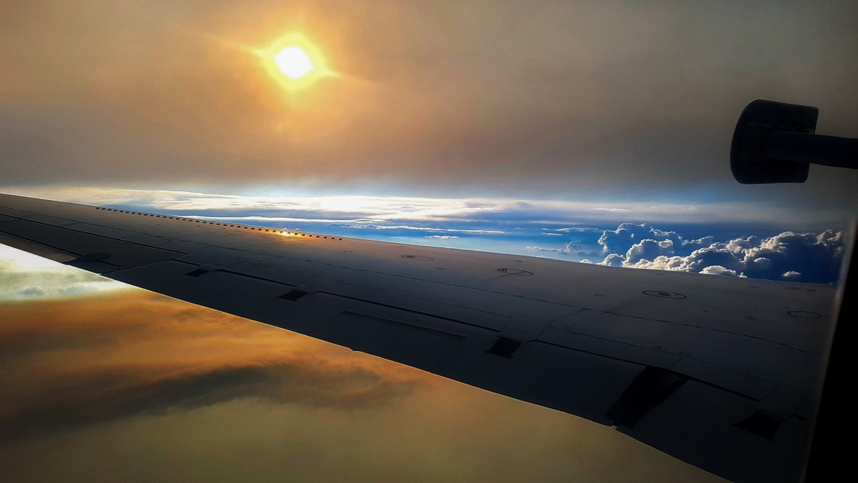
Mission info:
www.esrl.noaa.gov/csd/projects/firex-aq/
and
https://espo.nasa.gov/firex-aq
Public Data Archive:
https://www-air.larc.nasa.gov/cgi-bin/ArcView/firexaq
Photo: G. Gkatzelis
Notes:
Final slide; To sum up – these two websites provide a great entry for you to connect with the groups that collected the data, and the data that is now public from the aircraft and mobile labs. Please feel free to explore and get in touch with question or ideas.

