Slide 1
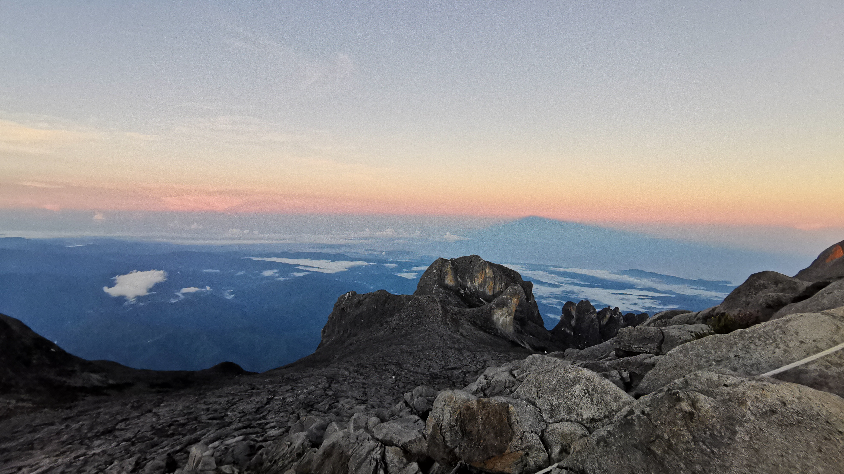

Seismicity of the Mt. Kinabalu fault system in Sabah, Borneo, revealed using QuakeMigrate
Conor Bacon¹, Sam Bedell¹, Tom Winder¹, Amy Gilligan², Nick Rawlinson¹, Felix Tongkul³, Simone Pilia¹, Dave Cornwell², Omry Volk¹, Tim Greenfield¹
1 Dept. of Earth Sciences, University of Cambridge, UK
2 School of Geosciences, University of Aberdeen, UK
3 Universiti Malaysia Sabah, Malaysia
Photo: Conor Bacon
Notes:
What are the big lessons we can learn from this work?
dv/v
Modelling crucial
Sensitivity kernels crucial
Loading vs. PFP effect on the crust
Dv/v
Earthquakes

Slide 2
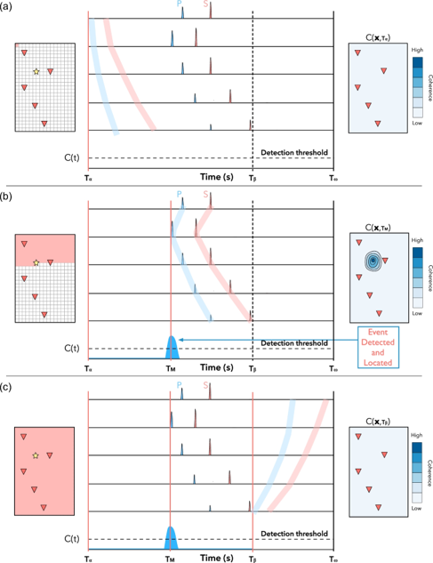

Earthquake detection
Migration techniques*
Many different techniques, same core principle
Waveform information time-lagged and stacked to detect and locate events
Implicit phase association
High potential for automation
*a.k.a. back-projection, coalescence, reverse-time imaging, waveform-stacking, among others…
Grigoli et al. 2018
Seismicity of the Mt. Kinabalu fault system in Sabah, Borneo, revealed using QuakeMigrate
Find us on
Notes:
Background: detecting earthquakes from continuous data
‘Traditional’ = pick-based techniques
What they are
Migration
Quickly repeating events, implicit phase association, robustness against noise, remove mis-association
Why this is important
Statistics, relative relocation

Slide 3
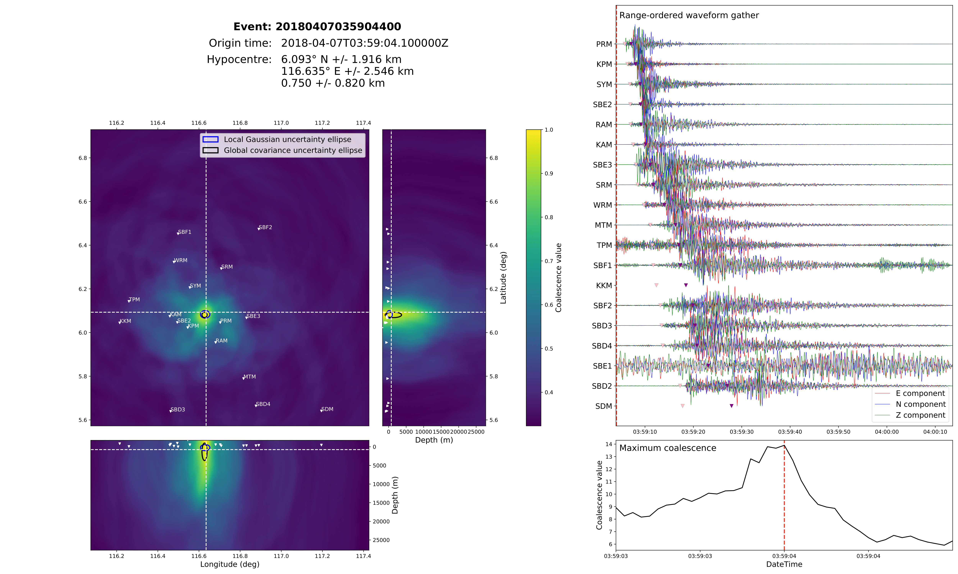
QuakeMigrate
Produce a robust catalogue with locations, phase picks & magnitudes from continuous seismic data
Modular: adaptable and extensible
Python: widely supported; utilises existing packages (e.g. ObsPy) for easy incorporation into a streamlined workflow
Open-source: ready to benefit from improvements driven by the QMigrate community!
Magnitude: 3.1 +/- 0.5 ML
https://github.com/QuakeMigrate
Smith et al. (in prep) – QuakeMigrate: a modular, open-source Python package for earthquake detection and location
Seismicity of the Mt. Kinabalu fault system in Sabah, Borneo, revealed using QuakeMigrate
Find us on
Notes:
Background: detecting earthquakes from continuous data
‘Traditional’ = pick-based techniques
What they are
Migration
Quickly repeating events, implicit phase association, robustness against noise, remove mis-association
Why this is important
Statistics, relative relocation

Slide 4
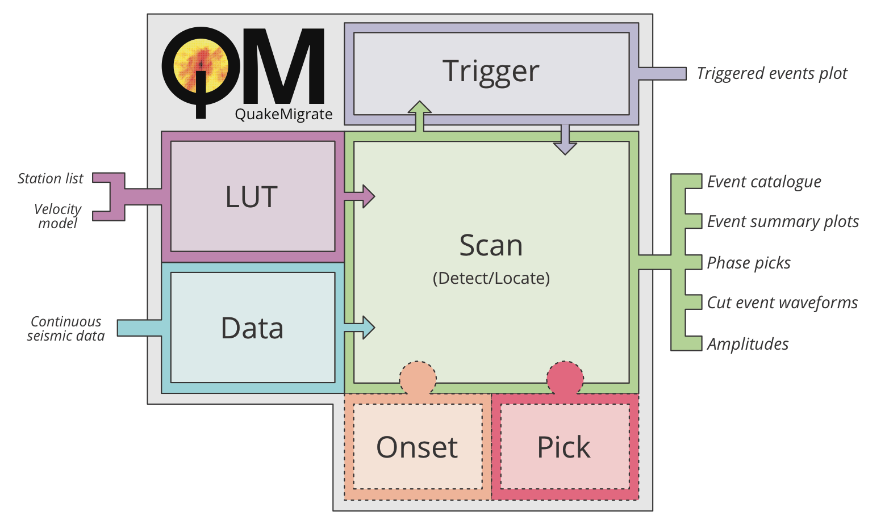
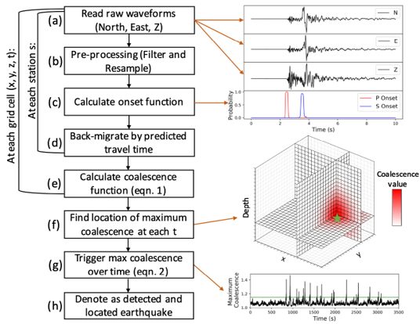
QuakeMigrate
Produce a robust catalogue with locations, phase picks & magnitudes from continuous seismic data
Modular: adaptable and extensible
Python: widely supported; utilises existing packages (e.g. ObsPy) for easy incorporation into a streamlined workflow
Open-source: ready to benefit from improvements driven by the QMigrate community!
Courtesy of Bing Li
Seismicity of the Mt. Kinabalu fault system in Sabah, Borneo, revealed using QuakeMigrate
Find us on
Notes:
Background: detecting earthquakes from continuous data
‘Traditional’ = pick-based techniques
What they are
Migration
Quickly repeating events, implicit phase association, robustness against noise, remove mis-association
Why this is important
Statistics, relative relocation

Slide 5
Velocity
QuakeMigrate
Traveltime lookup table
  Station coordinates
  Velocity model
  Grid
Detect: scan through continuous data archive
  Lookup table
  Waveform data (any ObsPy-compatible format)
Trigger: identify candidate earthquakes
Locate: re-scan on high-resolution grid
y
x
+
Depth
z
S
P
=
Drew et al. 2013
Seismicity of the Mt. Kinabalu fault system in Sabah, Borneo, revealed using QuakeMigrate
Find us on
Notes:
Background: detecting earthquakes from continuous data
‘Traditional’ = pick-based techniques
What they are
Migration
Quickly repeating events, implicit phase association, robustness against noise, remove mis-association
Why this is important
Statistics, relative relocation

Slide 6
QuakeMigrate
Traveltime lookup table
  Station coordinates
  Velocity model
  Grid
Detect: scan through continuous data archive
  Lookup table
  Waveform data (any ObsPy-compatible format)
Trigger: identify candidate earthquakes
Locate: re-scan on high-resolution grid
Pre-processing
  Re-sampling (optional)
  Data availability checks
  Bandpass filter (2-16 Hz)
ObsPy: e.g. Beyreuther et al. 2011
Drew et al. 2013
Seismicity of the Mt. Kinabalu fault system in Sabah, Borneo, revealed using QuakeMigrate
Find us on
Notes:
Background: detecting earthquakes from continuous data
‘Traditional’ = pick-based techniques
What they are
Migration
Quickly repeating events, implicit phase association, robustness against noise, remove mis-association
Why this is important
Statistics, relative relocation

Slide 7
QuakeMigrate
Traveltime lookup table
  Station coordinates
  Velocity model
  Grid
Detect: scan through continuous data archive
  Lookup table
  Waveform data (any ObsPy-compatible format)
Trigger: identify candidate earthquakes
Locate: re-scan on high-resolution grid
STA/LTA
0.2s / 1.0s
STA/LTA
0.2s / 1.0s
Drew et al. 2013
Seismicity of the Mt. Kinabalu fault system in Sabah, Borneo, revealed using QuakeMigrate
Find us on
Notes:
Background: detecting earthquakes from continuous data
‘Traditional’ = pick-based techniques
What they are
Migration
Quickly repeating events, implicit phase association, robustness against noise, remove mis-association
Why this is important
Statistics, relative relocation

Slide 8




QuakeMigrate
Traveltime lookup table
  Station coordinates
  Velocity model
  Grid
Detect: scan through continuous data archive
  Lookup table
  Waveform data (any ObsPy-compatible format)
Trigger: identify candidate earthquakes
Locate: re-scan on high-resolution grid
Waveforms stacked using the geometric mean
Efficient implementation in C
Drew et al. 2013
Seismicity of the Mt. Kinabalu fault system in Sabah, Borneo, revealed using QuakeMigrate
Find us on
Notes:
Background: detecting earthquakes from continuous data
‘Traditional’ = pick-based techniques
What they are
Migration
Quickly repeating events, implicit phase association, robustness against noise, remove mis-association
Why this is important
Statistics, relative relocation

Slide 9




QuakeMigrate
Traveltime lookup table
  Station coordinates
  Velocity model
  Grid
Detect: scan through continuous data archive
  Lookup table
  Waveform data (any ObsPy-compatible format)
Trigger: identify candidate earthquakes
Locate: re-scan on high-resolution grid
Waveforms stacked using the geometric mean
Efficient implementation in C
Drew et al. 2013
Seismicity of the Mt. Kinabalu fault system in Sabah, Borneo, revealed using QuakeMigrate
Find us on
Notes:
Background: detecting earthquakes from continuous data
‘Traditional’ = pick-based techniques
What they are
Migration
Quickly repeating events, implicit phase association, robustness against noise, remove mis-association
Why this is important
Statistics, relative relocation

Slide 10
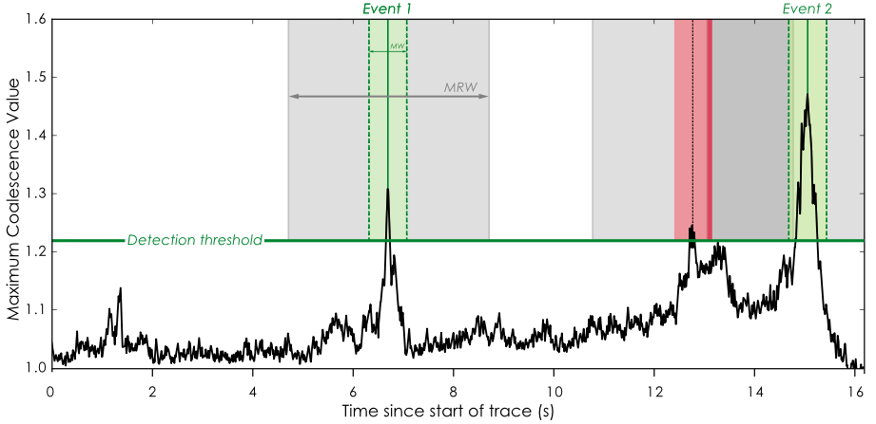
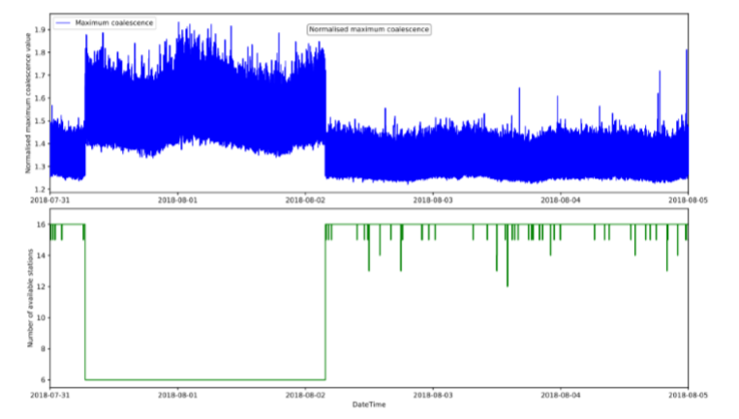
  Marginalisation window
QuakeMigrate
Traveltime lookup table
  Station coordinates
  Velocity model
  Grid
Detect: scan through continuous data archive
  Lookup table
  Waveform data (any ObsPy-compatible format)
Trigger: identify candidate earthquakes
Locate: re-scan on high-resolution grid
  Minimum repeat window
Static threshold
Simple, but performs poorly with changing background noise/station availability – often cannot use a static threshold without introducing lots of noise
Can we do better?
Need case scenario…
Stations go offline
Smith et al. (in prep)
Seismicity of the Mt. Kinabalu fault system in Sabah, Borneo, revealed using QuakeMigrate
Find us on
Notes:
Background: detecting earthquakes from continuous data
‘Traditional’ = pick-based techniques
What they are
Migration
Quickly repeating events, implicit phase association, robustness against noise, remove mis-association
Why this is important
Statistics, relative relocation

Slide 11
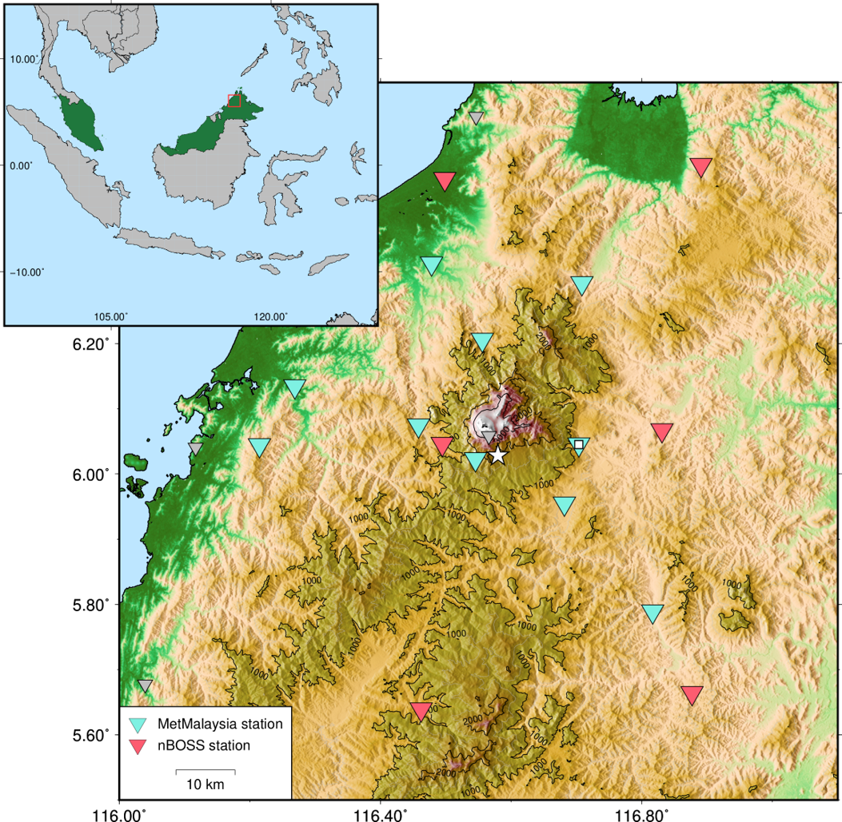
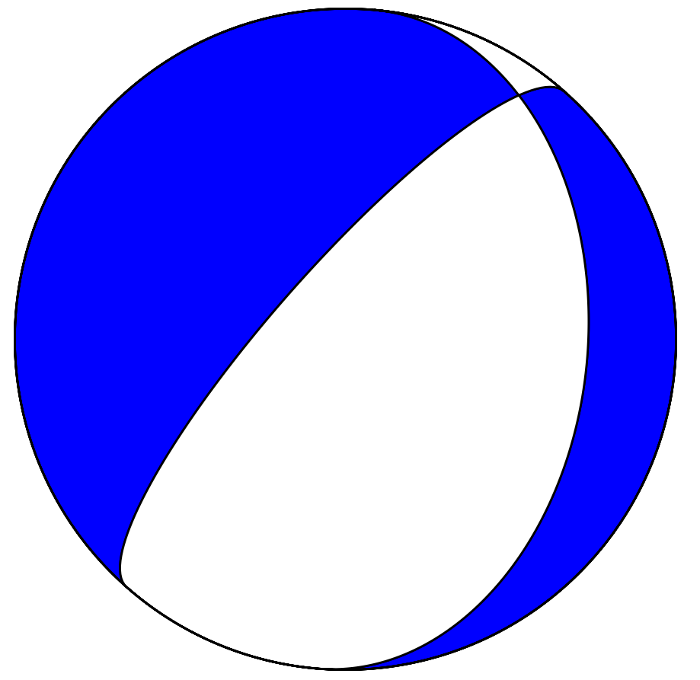
Mt Kinabalu
M_{W} 5.2 earthquake on 08/03/2018
3 aftershocks recorded by MetMalaysia
< 200 events catalogued in region since 1990
Malaysia
Mt Kinabalu
M_{W} 5.2
Normal fault
Seismicity of the Mt. Kinabalu fault system in Sabah, Borneo, revealed using QuakeMigrate
© Conor Bacon
Find us on
Notes:
Background: detecting earthquakes from continuous data
‘Traditional’ = pick-based techniques
What they are
Migration
Quickly repeating events, implicit phase association, robustness against noise, remove mis-association
Why this is important
Statistics, relative relocation

Slide 12
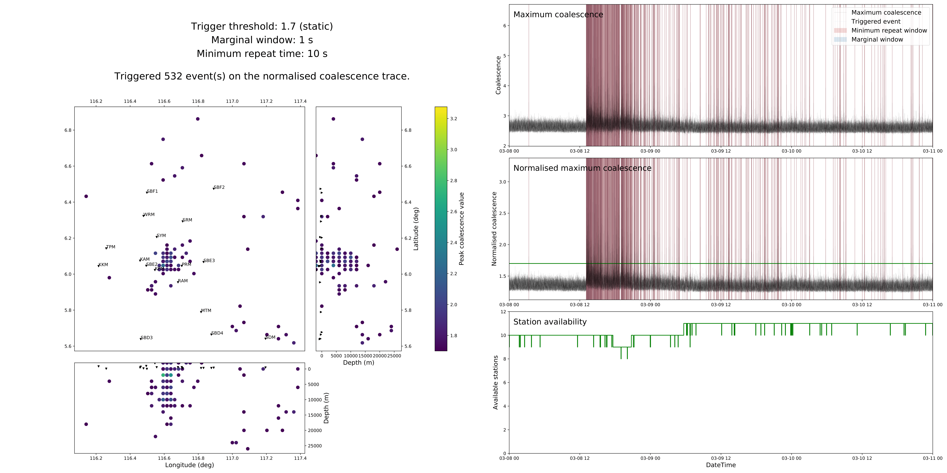
Mt Kinabalu
M_{W} 5.2 earthquake on 08/03/2018
3 aftershocks recorded by MetMalaysia
< 200 events catalogued in region since 1990
Aftershock sequence of >500 earthquakes captured by QuakeMigrate within 72 hours of mainshock
Static threshold: normalised coalescence > 1.7 -> 532 events
Main shock
Mt Kinabalu
Seismicity of the Mt. Kinabalu fault system in Sabah, Borneo, revealed using QuakeMigrate
© Conor Bacon
Find us on
Notes:
Background: detecting earthquakes from continuous data
‘Traditional’ = pick-based techniques
What they are
Migration
Quickly repeating events, implicit phase association, robustness against noise, remove mis-association
Why this is important
Statistics, relative relocation

Slide 13
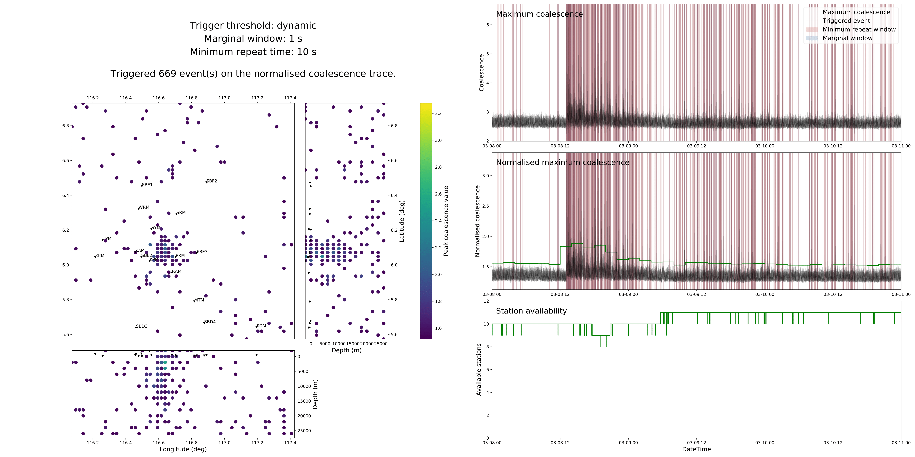
Mt Kinabalu
M_{W} 5.2 earthquake on 08/03/2018
3 aftershocks recorded by MetMalaysia
< 200 events catalogued in region since 1990
Aftershock sequence of >500 earthquakes captured by QuakeMigrate within 72 hours of mainshock
Dynamic threshold: Median Absolute Deviation – MAD factor of 10 -> 669 events
Main shock
Mt Kinabalu
More triggers, but is it actually better?
Seismicity of the Mt. Kinabalu fault system in Sabah, Borneo, revealed using QuakeMigrate
© Conor Bacon
Find us on
Notes:
Background: detecting earthquakes from continuous data
‘Traditional’ = pick-based techniques
What they are
Migration
Quickly repeating events, implicit phase association, robustness against noise, remove mis-association
Why this is important
Statistics, relative relocation

Slide 14
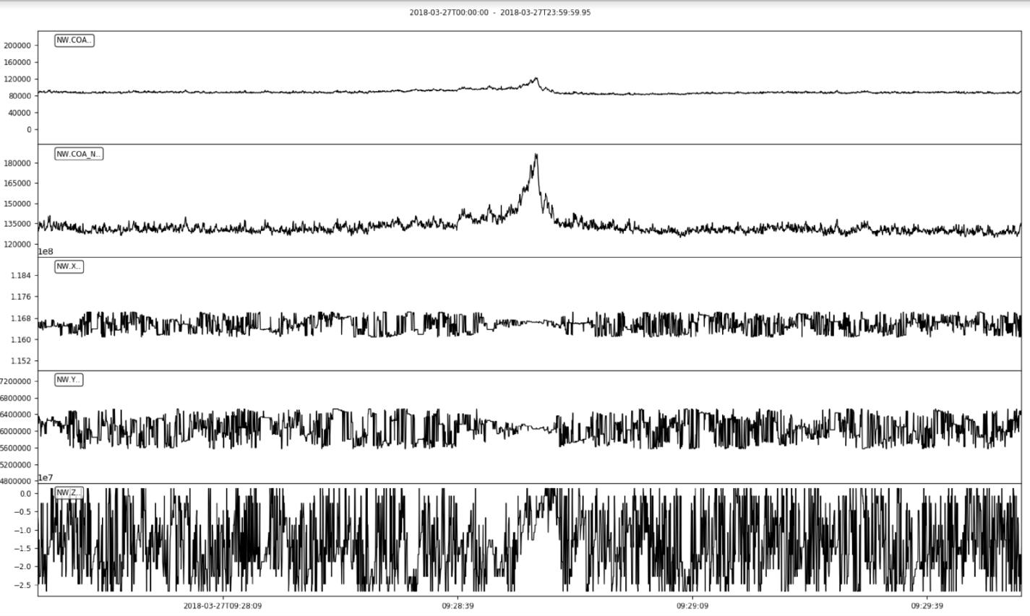
Machine learning for
triggering
Uses more of the available information
Location stabilises around peak coalescence
(Mostly) unsupervised
  K-means
  XGBoost
Max coalescence
Max normalised coalescence
X coord of peak
Y coord of peak
Z coord of peak
Stability = information?
Work by Sam Bedell (MSci student)
Seismicity of the Mt. Kinabalu fault system in Sabah, Borneo, revealed using QuakeMigrate
© Conor Bacon
Find us on
Notes:
Background: detecting earthquakes from continuous data
‘Traditional’ = pick-based techniques
What they are
Migration
Quickly repeating events, implicit phase association, robustness against noise, remove mis-association
Why this is important
Statistics, relative relocation

Slide 15
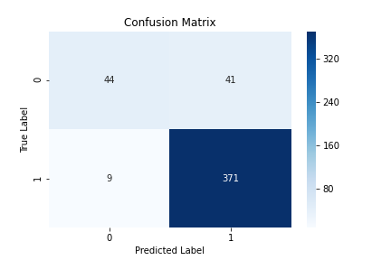
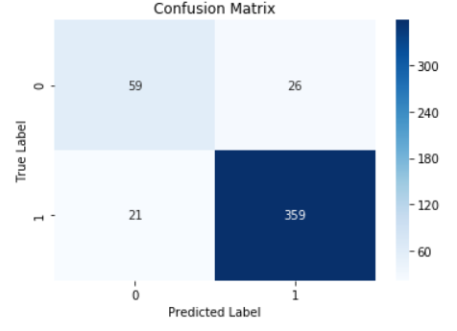
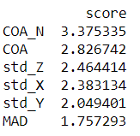
Machine learning for
triggering
Uses more of the available information
Location stabilises around peak coalescence
(Mostly) unsupervised
  K-means
  XGBoost
K-means clustering
XGBoost
{
Relative importance
Note: 1 = event, 0 = not event
Work by Sam Bedell (MSci student)
Seismicity of the Mt. Kinabalu fault system in Sabah, Borneo, revealed using QuakeMigrate
© Conor Bacon
Find us on
Notes:
Background: detecting earthquakes from continuous data
‘Traditional’ = pick-based techniques
What they are
Migration
Quickly repeating events, implicit phase association, robustness against noise, remove mis-association
Why this is important
Statistics, relative relocation

Slide 16
Machine learning for
triggering
Uses more of the available information
Location stabilises around peak coalescence
(Mostly) unsupervised
  K-means
  XGBoost
Using 24 hours of data after mainshock
 | Before | With ML and a lower threshold
Number of real events | < 294, not fully labelled | 371
Number of False events | ~ 30-40 | 41
Time to run | Negligible | Models themselves are of the order of ms - s to run, generating stats takes longer, several s depending on size of dataset.
Work by Sam Bedell (MSci student)
Seismicity of the Mt. Kinabalu fault system in Sabah, Borneo, revealed using QuakeMigrate
© Conor Bacon
Find us on
Notes:
Background: detecting earthquakes from continuous data
‘Traditional’ = pick-based techniques
What they are
Migration
Quickly repeating events, implicit phase association, robustness against noise, remove mis-association
Why this is important
Statistics, relative relocation

Slide 17
QuakeMigrate
Traveltime lookup table
  Station coordinates
  Velocity model
  Grid
Detect: scan through continuous data archive
  Lookup table
  Waveform data (any ObsPy-compatible format)
Trigger: identify candidate earthquakes
  Detection threshold
  Minimum repeat interval
Locate: re-scan on high-resolution grid
Magnitude: 3.1 +/- 0.5 ML
Coalescence volume, waveform gather, and event metadata
Manual review = tedious
-> image recognition
Seismicity of the Mt. Kinabalu fault system in Sabah, Borneo, revealed using QuakeMigrate
Find us on
Notes:
Background: detecting earthquakes from continuous data
‘Traditional’ = pick-based techniques
What they are
Migration
Quickly repeating events, implicit phase association, robustness against noise, remove mis-association
Why this is important
Statistics, relative relocation

Slide 18
Machine learning for
Quality Control
Simple patterns
Classify and give each event a score -> optimise time spent doing QC
Convolutional Neural Network – simple architecture
 | Before without ML | With ML
Accuracy | Somewhat subjective, 2 independent observers agreed approx. 94% of the time. | 96.5%
Time | A few seconds per event | Of the order of seconds/minutes/hours to train, near instant to predict once trained.
Work by Sam Bedell (MSci student)
Seismicity of the Mt. Kinabalu fault system in Sabah, Borneo, revealed using QuakeMigrate
© Conor Bacon
Find us on
Notes:
Background: detecting earthquakes from continuous data
‘Traditional’ = pick-based techniques
What they are
Migration
Quickly repeating events, implicit phase association, robustness against noise, remove mis-association
Why this is important
Statistics, relative relocation

Slide 19
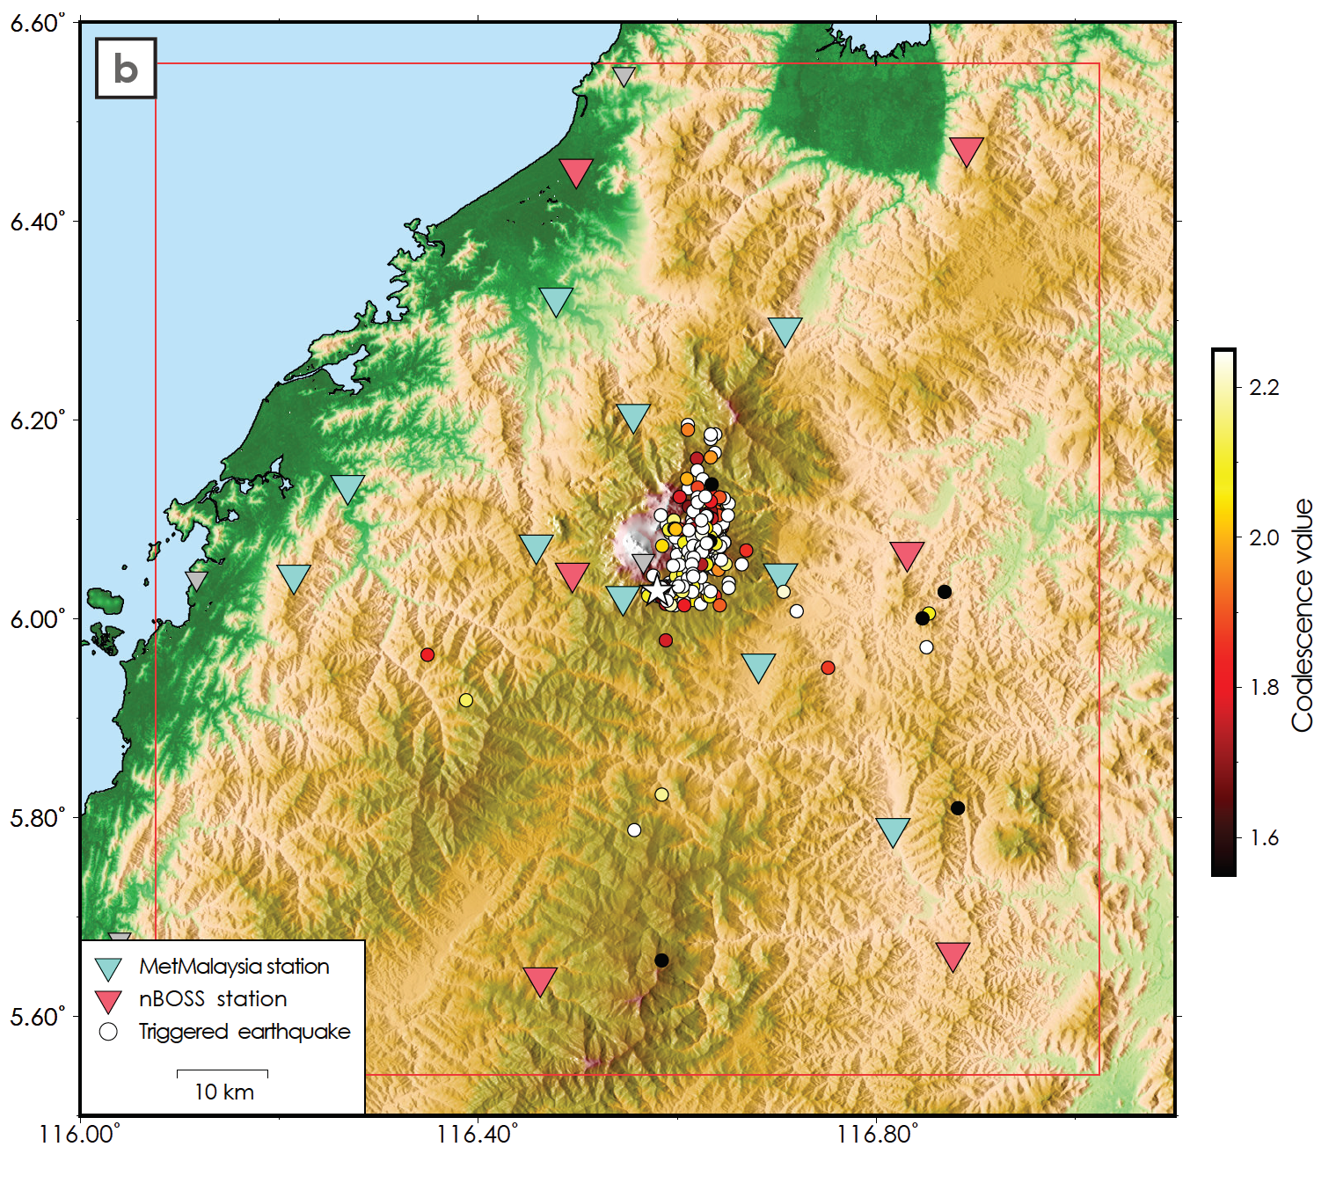
Synthesising results
Improved catalogue with fewer events to QC
Working on streamlining this automation
 | Before ML | After ML
Number of real events | Up to 294 | 360+, not including test set
Number of false events | Unknown, likely 10-30. | 10+
Promising results that could lead to further automation.
Seismicity of the Mt. Kinabalu fault system in Sabah, Borneo, revealed using QuakeMigrate
© Conor Bacon
Find us on
Notes:
Background: detecting earthquakes from continuous data
‘Traditional’ = pick-based techniques
What they are
Migration
Quickly repeating events, implicit phase association, robustness against noise, remove mis-association
Why this is important
Statistics, relative relocation

Slide 20
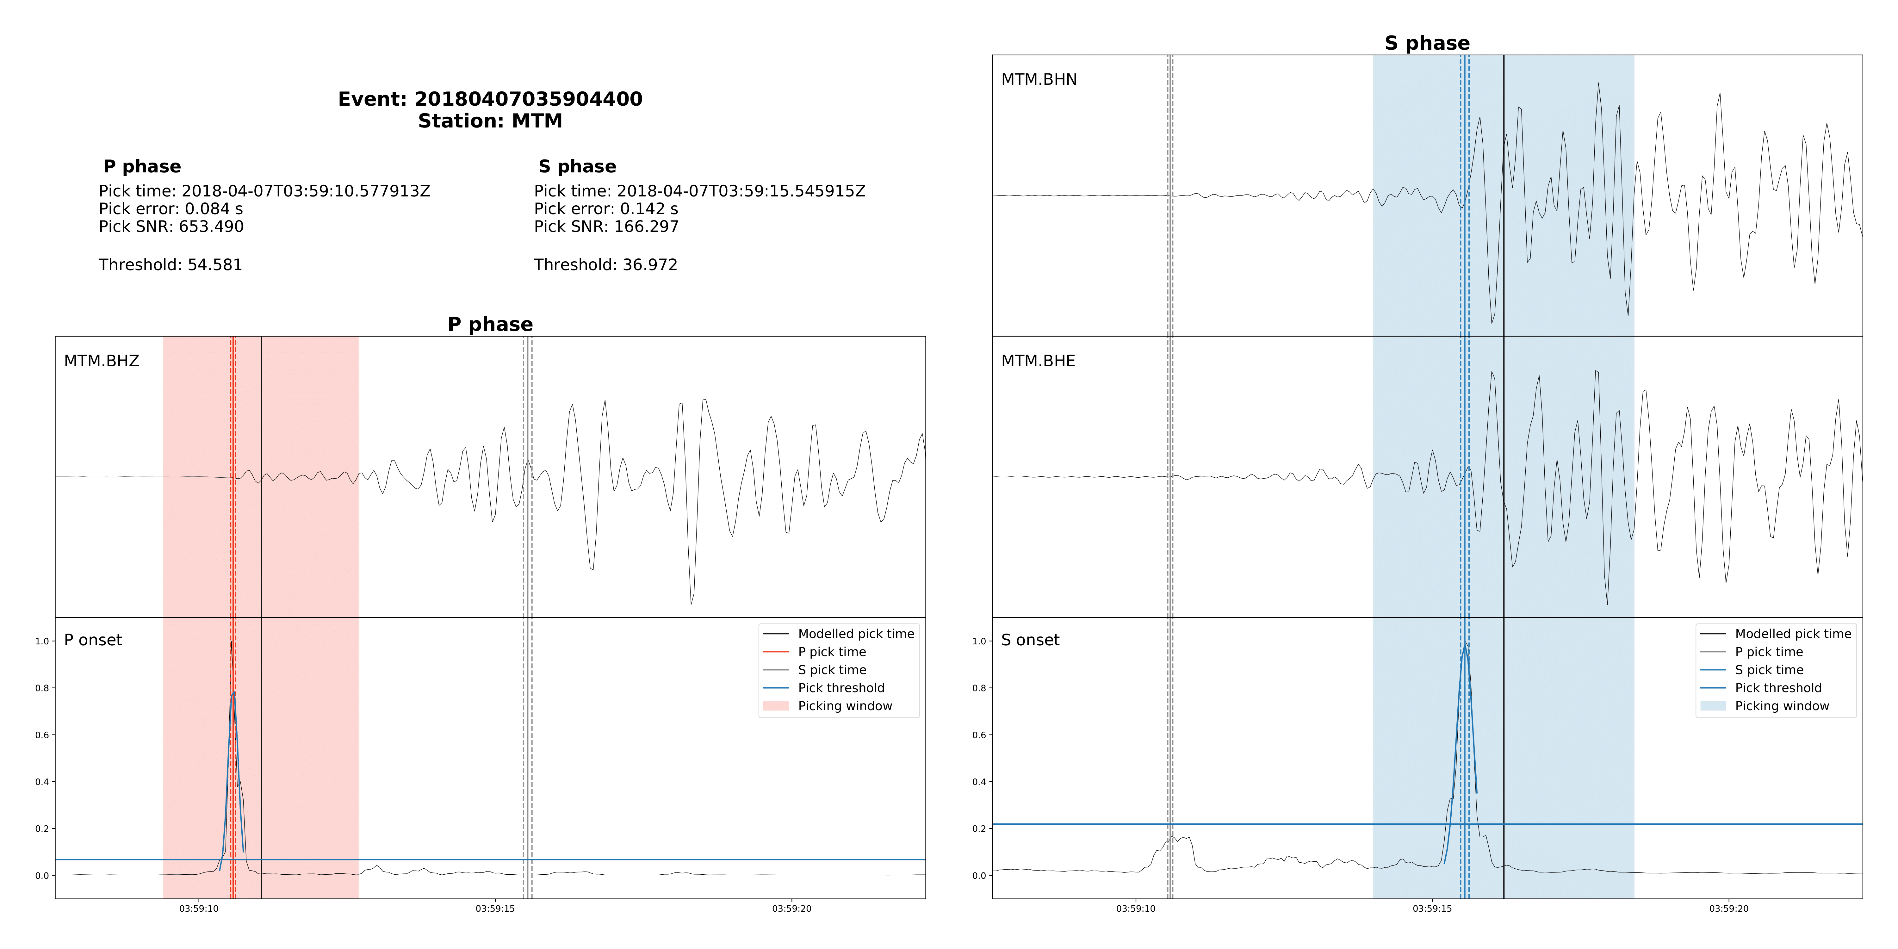
Additional features
Modular phase picking
Magnitude estimation
Modular onset functions
Direct export to input files for other software, including:
  ObsPy (Beyreuther et al., 2013)
  NonLinLoc (Lomax, 2001)
  HypoDD (Waldhauser, 2001)
  MFAST (Savage et al., 2010)
Automatic phase picking
Easy to include alternative picking algorithms – contributions welcome!
Seismicity of the Mt. Kinabalu fault system in Sabah, Borneo, revealed using QuakeMigrate
Find us on
Notes:
Background: detecting earthquakes from continuous data
‘Traditional’ = pick-based techniques
What they are
Migration
Quickly repeating events, implicit phase association, robustness against noise, remove mis-association
Why this is important
Statistics, relative relocation

Slide 21
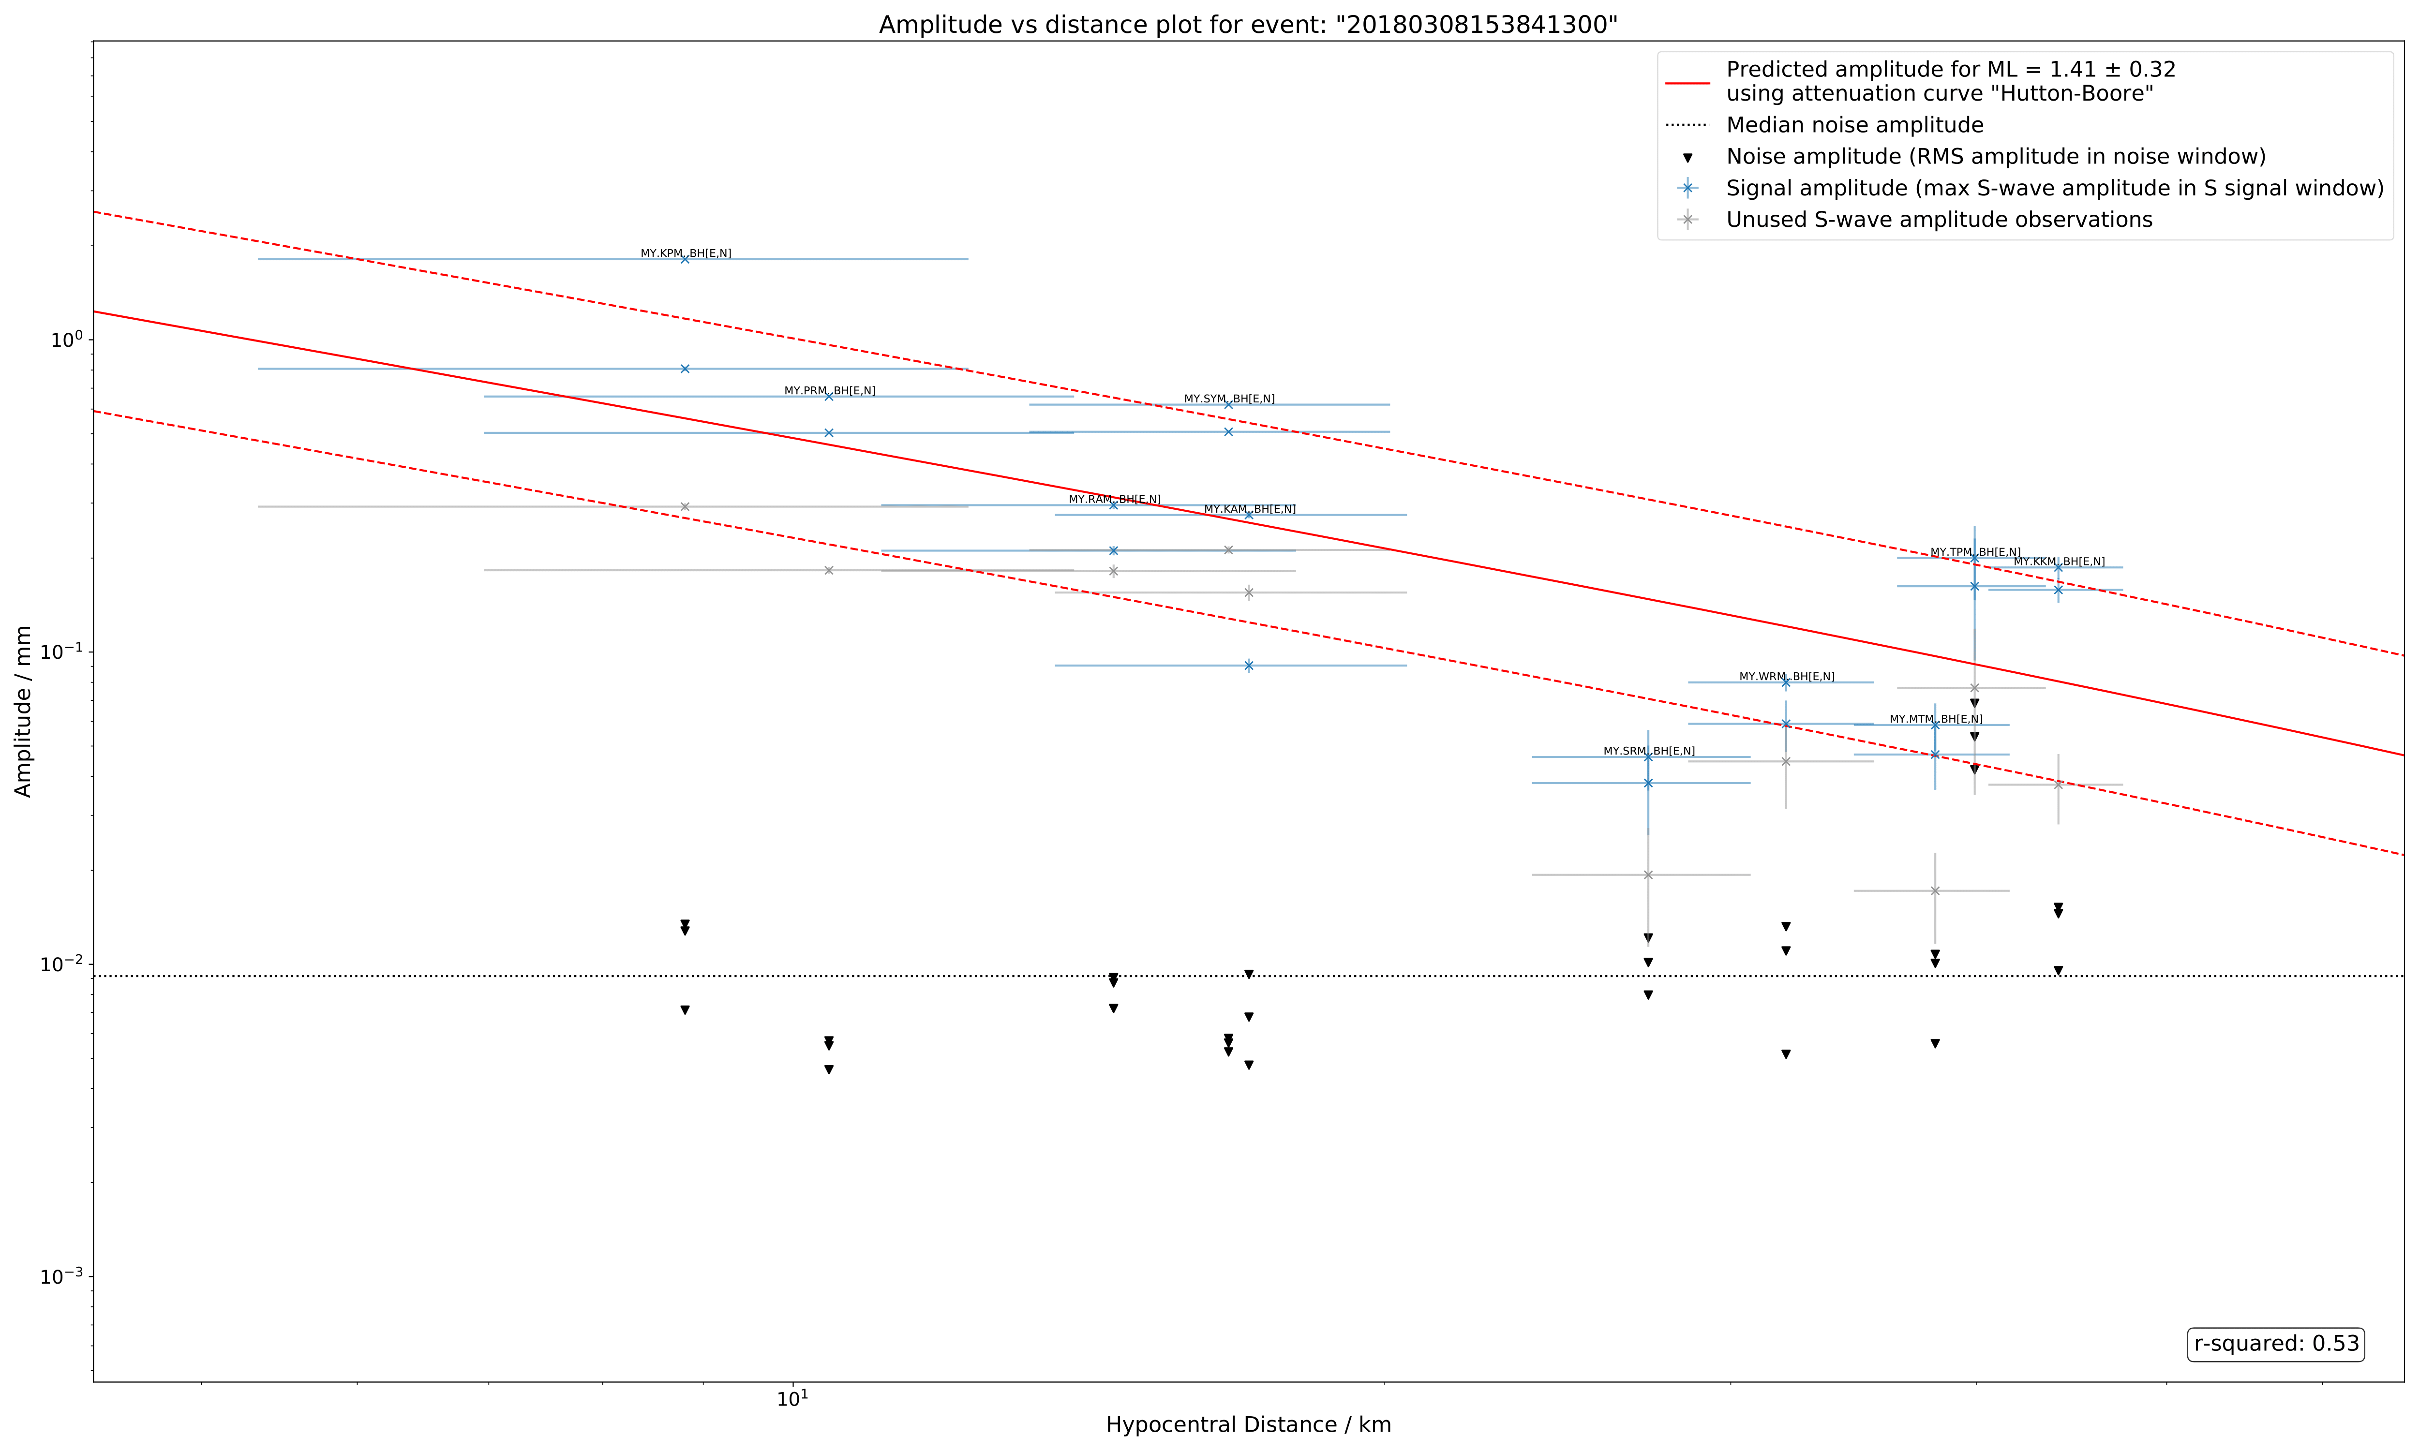
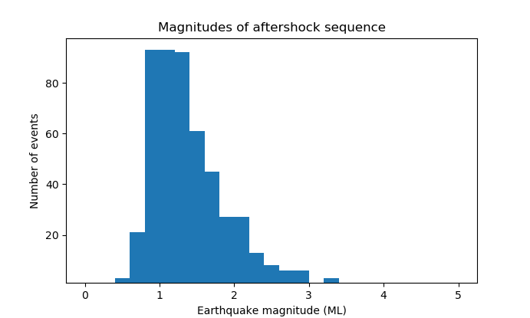
Additional features
Modular phase picking
Magnitude estimation
Modular onset functions
Direct export to input files for other software, including:
  ObsPy (Beyreuther et al., 2013)
  NonLinLoc (Lomax, 2001)
  HypoDD (Waldhauser, 2001)
  MFAST (Savage et al., 2010)
Local magnitude estimation
Seismicity of the Mt. Kinabalu fault system in Sabah, Borneo, revealed using QuakeMigrate
© Conor Bacon
Find us on
Notes:
Background: detecting earthquakes from continuous data
‘Traditional’ = pick-based techniques
What they are
Migration
Quickly repeating events, implicit phase association, robustness against noise, remove mis-association
Why this is important
Statistics, relative relocation

Slide 22

QuakeMigrate
Produce a robust catalogue with locations, phase picks & magnitudes from continuous seismic data
Modular: adaptable and extensible
Python: widely supported; utilises existing packages (e.g. ObsPy) for easy incorporation into a streamlined workflow
Open-source: ready to benefit from improvements driven by the QMigrate community!
- S41D-0559
- S23D-0676
- S21B-07
- T21A-03
- T53B-05
- C13C-1315
Results presented at EGU 2020:
- SM6.1/GMPV9/TS5.7 - D1479
- GMPV9.7/NH2.6/SM6.6 - D1585
Results presented at AGU 2019:
- V43C-0199
- V51A-01
- V43B-01
- V13D-0189
- V11B-04
Volcano seismology
Tectonic seismicity
Induced seismicity
Icequakes
Seismicity of the Mt. Kinabalu fault system in Sabah, Borneo, revealed using QuakeMigrate
Find us on
Notes:
Background: detecting earthquakes from continuous data
‘Traditional’ = pick-based techniques
What they are
Migration
Quickly repeating events, implicit phase association, robustness against noise, remove mis-association
Why this is important
Statistics, relative relocation

Slide 23
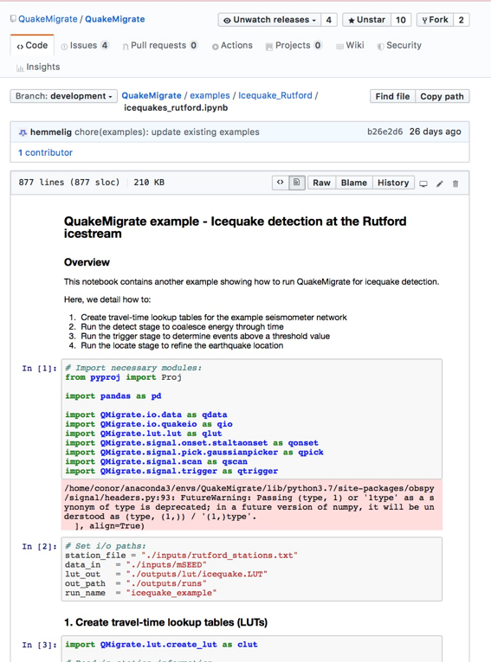
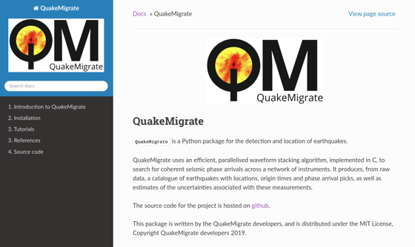
QuakeMigrate
Produce a robust catalogue with locations, phase picks & magnitudes from continuous seismic data
Modular: adaptable and extensible
Python: widely supported; utilises existing packages (e.g. ObsPy) for easy incorporation into a streamlined workflow
Open-source: ready to benefit from improvements driven by the QMigrate community!
Building towards a framework for waveform migration techniques
Contact us!
Conor Bacon – conor.bacon@esc.cam.ac.uk
Tom Winder – tom.winder@esc.cam.ac.uk
Jonny Smith – jdsmith@caltech.edu
https://github.com/QuakeMigrate
Smith et al. (in prep) – QuakeMigrate: a modular, open-source Python package for earthquake detection and location
Seismicity of the Mt. Kinabalu fault system in Sabah, Borneo, revealed using QuakeMigrate
Find us on
Notes:
Background: detecting earthquakes from continuous data
‘Traditional’ = pick-based techniques
What they are
Migration
Quickly repeating events, implicit phase association, robustness against noise, remove mis-association
Why this is important
Statistics, relative relocation

Slide 24
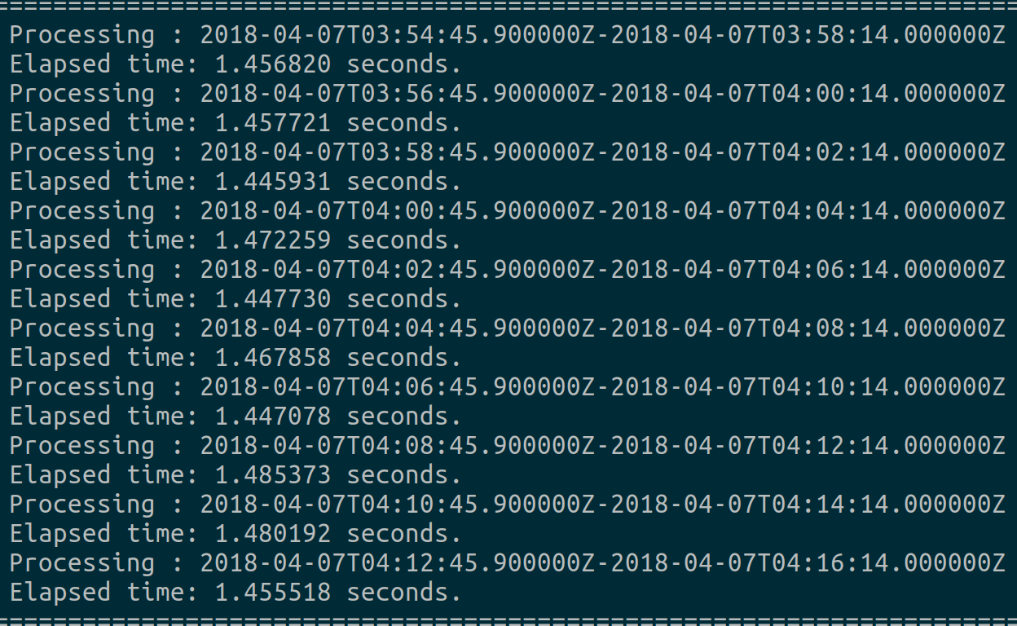
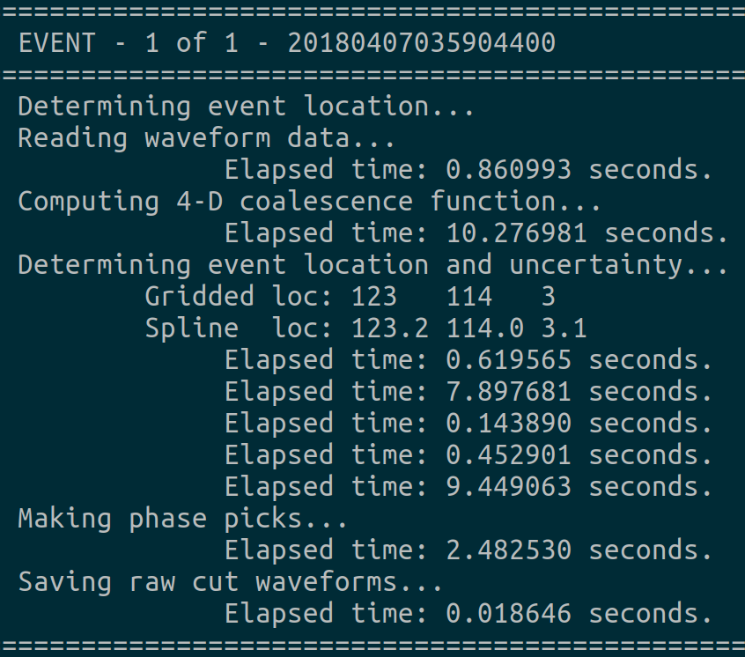
Computational costs
Heavy lifting performed using optimised C code
Multithreaded
Tunable to memory limitations
Detect
20 stations
Grid shape - [40, 40, 15] (decimated)
Sampling rate = 20 Hz
-> 1 day of data processed in 20 mins
Locate
20 stations
Grid shape - [200, 200, 60]
Sampling rate = 20 Hz
-> 1 event processed in < 25s
(no plotting)
Run on a Dell XPS 15 with Intel® Core™ i7-7700HQ CPU @ 2.80GHz and 16.0 GB RAM
Seismicity of the Mt. Kinabalu fault system in Sabah, Borneo, revealed using QuakeMigrate
Find us on
Notes:
Background: detecting earthquakes from continuous data
‘Traditional’ = pick-based techniques
What they are
Migration
Quickly repeating events, implicit phase association, robustness against noise, remove mis-association
Why this is important
Statistics, relative relocation

