Slide 1


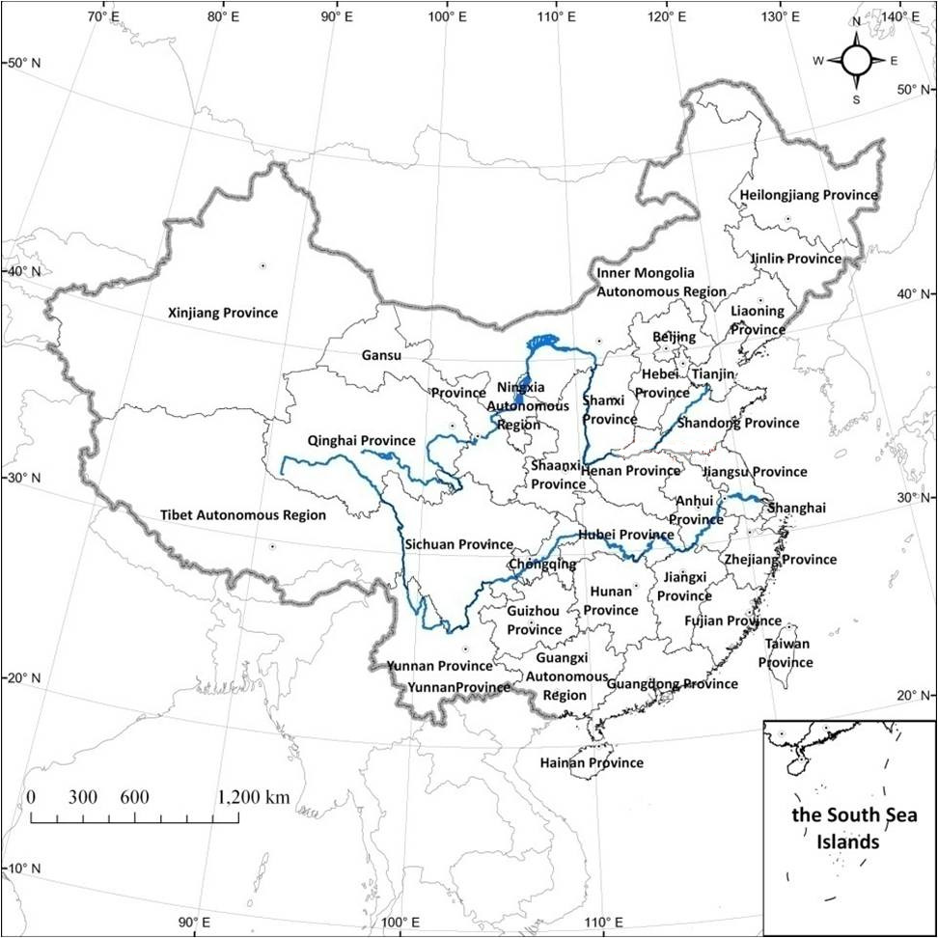
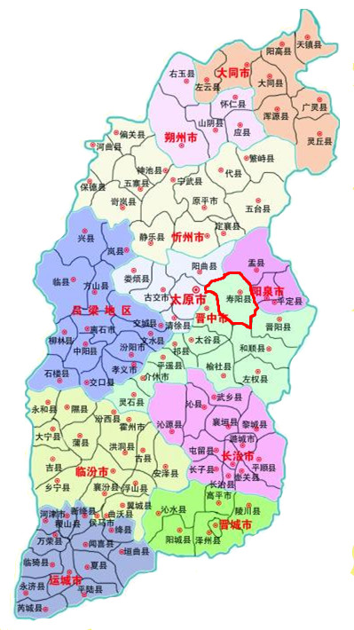
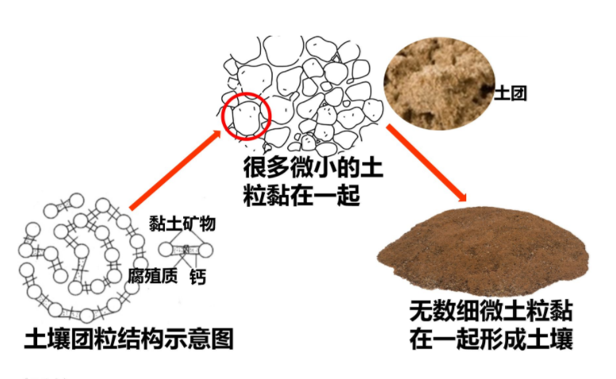
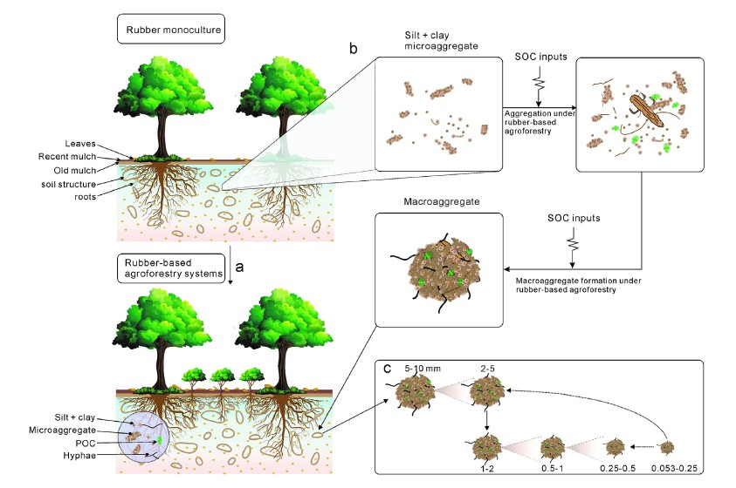
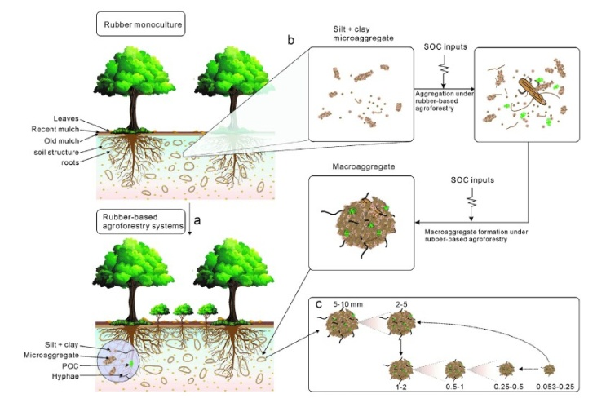

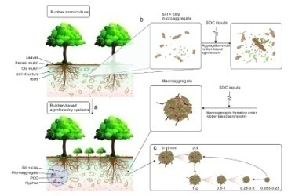
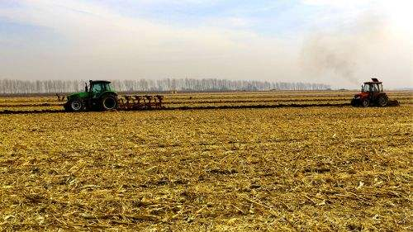
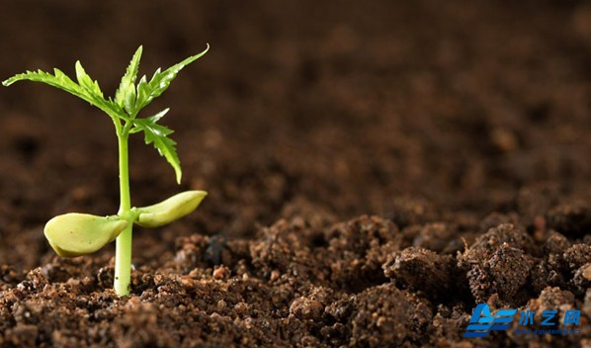
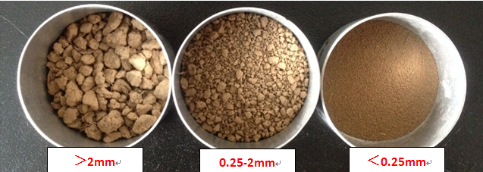
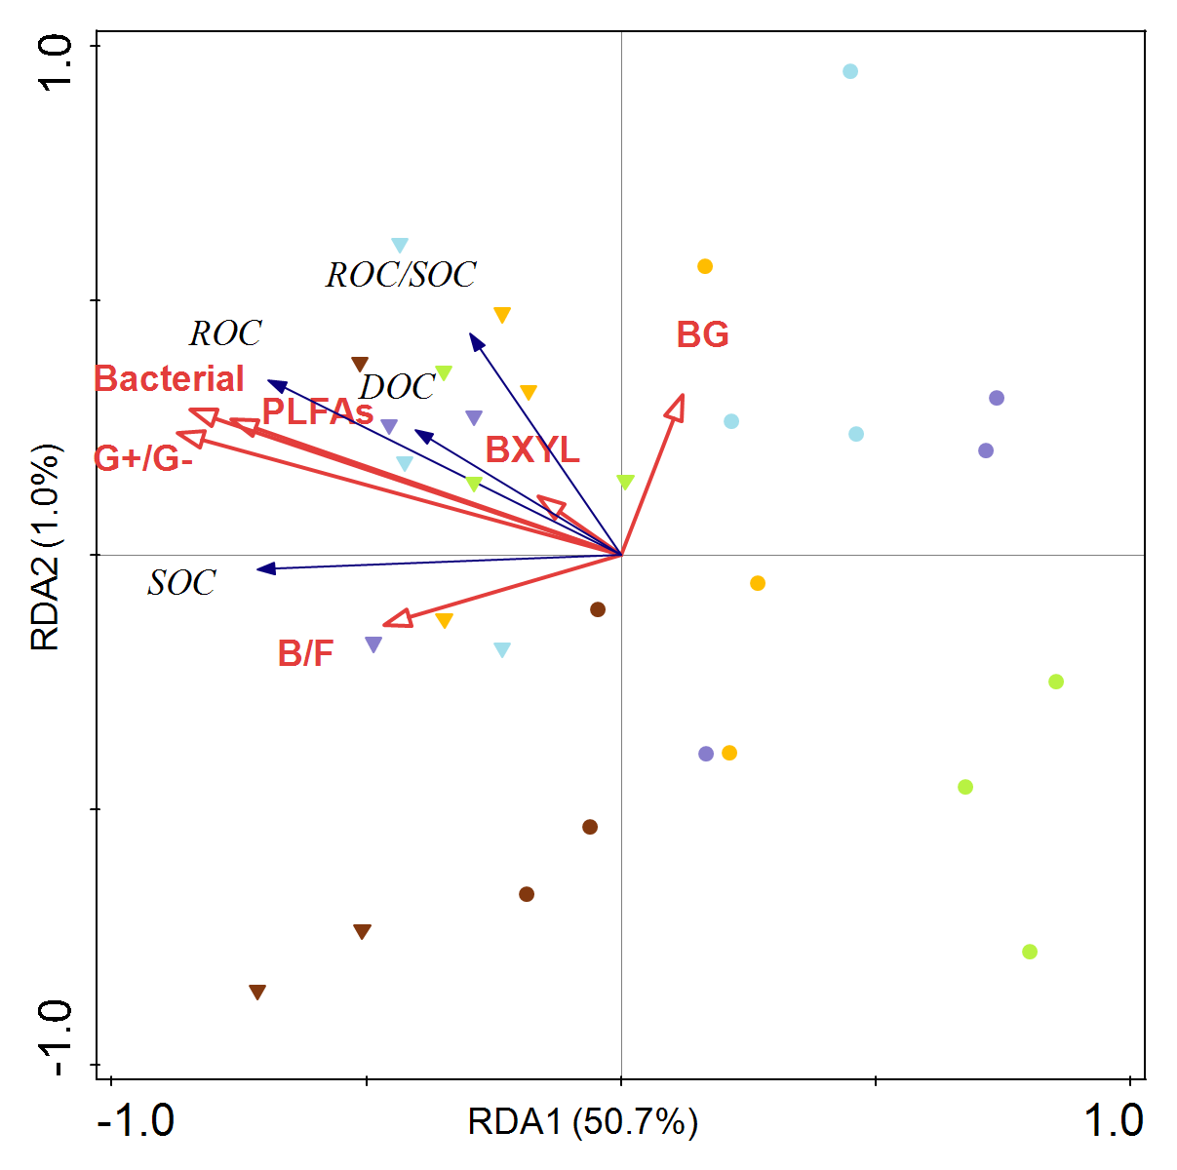
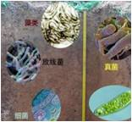
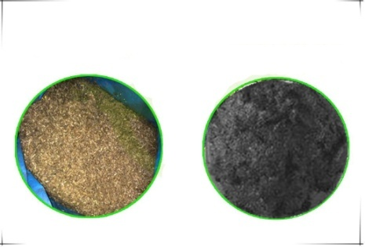
Soil aggregate size affects C sequestration and microorganisms inside aggregate under straw addition
J. Lu^{1,2}, S. Li ^{1,2} , A. Degré¹ and X. Wu²
¹ ULiège - Gembloux Agro-Bio Tech, Water-Soil-Plant Exchanges, Passage des Déportés, 2, 5030 Gembloux, Belgium
² Chinese Academy of Agricultural Sciences, Institute of Agricultural Resources and Regional Planning, Beijing, China
Context
Most of the previous studies on soil microorganisms and C sequestration were done at a large scale i.e. larger quantities of soil; few studies are known in aggregate size fractions. Therefore, the objective of this research is to analyze the variation of microbial community and C accumulation, including C derived from straw, in different sizes aggregates under straw addition.
Results
1.
Soil fraction | SOC (g kg⁻¹) |  | Increase rate of SOC (%)
 | 1 | 2
Bulk soil | 15.69±0.10eB | 17.57±0.07bA | 12.02±0.43b
＞5mm | 15.21±0.30fB | 17.59±0.06bA | 15.69±0.30a
2-5mm | 16.12±0.10dB | 16.50±0.13dA | 2.35±0.80c
1-2mm | 16.87±0.05cB | 17.37±0.15cA | 2.67±0.87c
0.25-1mm | 17.58±0.27bA | 17.23±0.02cA | -1.99±0.12e
＜0.25mm | 18.40±0.10aA | 18.577±0.19aA | 0.96±0.64d
Two-way ANOVA showed that aggregate size classes, straw amendment, and their interactions strongly inﬂuenced SOC content (p＜0.001).
Dryland Agriculture Demonstration Zone in Zongai Village,
112°–113 ° E, 37 °–38 ° N
2.
Inner C sequestration increase
¹³C Straw inputs
Microorganism in aggregates
Methodology
Methodology
＞5 mm
2-5 mm
1-2 mm
0.25-1 mm
＜0.25 mm
Long-term straw application: 27 years
Dominant microbe : Fungi and negative bacteria
(1) fertilized with crop residue removed after harvesting;
(2) fertilized with maize straw (3,000 kg ha⁻¹.) application after harvesting.
Dominant microbe : Positive bacteria
Incubation with ¹³C straw: 300 days
＞5 mm, 2-5 mm, 1-2 mm, 0.25-1 mm, ＜0.25 mm
The PLFA biomass significantly (p＜0.001) increased greatly in ＞2 mm aggregates than in ＜2 mm aggregates, and fungi and G- bacteria were more important to increasing C sequestration in ＞2 mm aggregates and G+ bacteria dominated in ＜2 mm aggregates.
The content of C_{straw} increased gradually as the aggregate size increased under straw addition.
The difference in the rate of C mineralization resulted in greater C accumulation in＜0.25 mm aggregates than in ＞2 mm aggregates.
¹³C Straw addition
S ＞5mm
S 2-5mm
S 1-2mm
Phospholipid fatty acid analysis
S 0.25-1mm
S ＜0.25mm
Microbial community composition
OC in aggregates
NS ＞5mm
NS 2-5mm
NS 1-2mm
NS 0.25-1mm
NS ＜0.25mm
OC contents were positively associated with microorganism indicators among aggregates under straw addition. Compared to other indicators, B/F and G+/G- bacteria had a stronger correlation with SOC.
Conclusion and further works
SOC content in aggregates has significantly increased under the application of straw.
Lower C_{straw} but higher C accumulation was occured in ＜0.25 mm aggregates than in other ones.
The dominant microbe varies with the aggregate size, which plays an important role in C accumulation.
Next : Quantify the maximum amount of C sequestration in aggregates and determine the major species in different sizes of aggregates.

