Slide 1
Using Swarm to study ionosphere-thermosphere coupling
© Johnathan K. Burchill 2020. All rights reserved
Properties and dynamics of ionosphere-thermosphere coupling may be investigated using observations from the Swarm electric field instruments (EFI). We illustrate this claim using measurements of vertical ion drift and electron temperature made by the EFIs, within the context of ambipolar diffusion parallel to the geomagnetic field. The associated ambipolar electric field is difficult to measure directly. Rather, under conditions where the ambipolar electric field is assumed to be specified, the ion-neutral momentum transfer collision frequency may be derived from the EFI measurements. In this talk, the theory, measurements and methodology of this approach are presented. Statistical analysis reveals highly-correlated ion upflow and electron temperature. Derived collision frequencies are found to be within an order of magnitude of empirical estimates at Swarm altitudes. We speculate on the feasibility of using this technique to examine the dynamics of ionosphere-thermosphere coupling using Swarm.
Acknowledgments:
Data: European Space Agency.
Analysis: supported by Canadian Space Agency Discussions: D. Knudsen, S. Buchert, J. van Irsel, Y. Chen

Slide 2
Inspired to explain the physical basis for the high correlation of averaged ion upflow and electron temperature enhancements associated with cusp thermospheric density anomaly (see Kervalishvili and Lühr, 2013).
That paper speculates that ambipolar electric field is key to the process
We assume the ambipolar electric field is present, and it sets up a steady-state ion drift parallel to the geomagnetic field vector according to the subsonic, gradient-free stress fluid approximation for an electron, single-ion, neutral model (see Schunk and Nagy, 2009 textbook, equation 5.54 and definitions and assumptions therein).
Neglecting the gradient in the stress tensor $τ_{i}$, this equation can be expressed as a linear relation between the ion upflow $v_{i∥}$ and electron temperature $T_{e}$ as
$v_{i∥}=aT_{e}+b$, with slope $a=\frac{k}{m_{i}ν_{in}H_{i}}$, and intercept $b=\left[v_{n}−\frac{G_{∥}}{ν_{in}}+\frac{2k}{m_{i}ν_{in}}\frac{∂T_{p}}{∂s}+\frac{kT_{i}}{m_{i}ν_{in}H_{i}}\right]$.
Given reasonable estimates for the ion composition and ion density scale height $H_{i}$, we estimate the ion-neutral momentum-transfer collision frequency $ν_{in}$ from the EFI ion velocity and electron temperature
We will ignore the tilt of the magnetic field and use only the vertical ion drift measurements.

Slide 3
Statistics of upflow perturbations vs electron temperature perturbations (from van Irsel et al., in preparation for submission to JGR)
Swarm A
~460 km alt.
High-pass filtered upflows and temperatures are median-binned to reveal the linearity for the northern hemisphere polar region.
Large scatter and possible bias associated with non-zero intercept terms, and varying ion composition. A line is fit only to the linear portion (red triangles).
Swarm B
~510 km alt.
Swarm measurements for the year 2016 from the version 0101 experimental cross-track flow and extended Langmuir probe datasets from https://swarm-diss.eo.esa.int/#swarm%2FAdvanced%2FPlasma_Data.

Slide 4
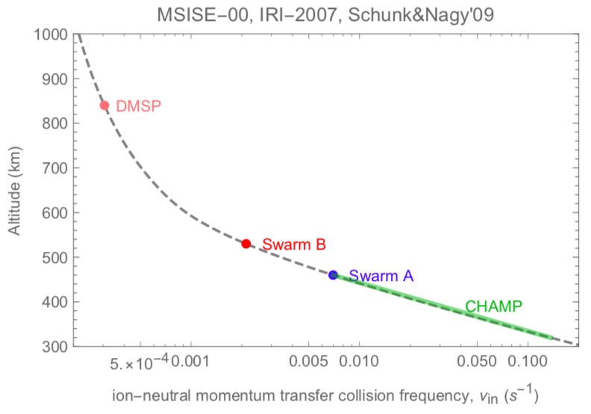
Ion-neutral collision frequencies in the topside F region (from van Irsel et al., in preparation for submission to JGR)
$$a=\frac{k}{m_{i}ν_{in}H_{i}}$$
The collision frequency is estimated from the slope, assuming the ion mass is 16 a.m.u. and the ion density scale height is derived from the IRI as ~130 km at the satellites.
Satellite | $$ν_{in}$$
Swarm A | 0.025 s⁻¹
Swarm B | 0.017 s⁻¹
Estimated collision frequencies are within an order of magnitude of calculations (Schunk and Nagy, 2009) based on empirical models MSISE-00 and IRI-2007.

Slide 5
Using Swarm to study ionosphere-thermosphere coupling
The results show promise for using Swarm to probe a fundamental parameter of ionosphere-thermosphere coupling in the topside-ionosphere: the ion-neutral momentum transfer collision frequency.
Further investigation is needed to assess the uncertainties and the regions and times of applicability of the technique. The feasibility of estimating the collision frequency on an orbit-by-orbit or daily basis should be investigated.

