Slide 4
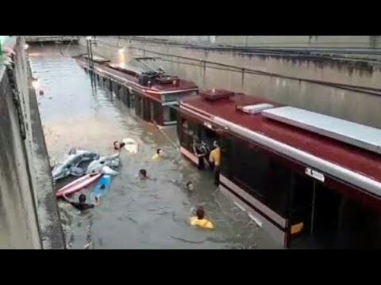
1- Contemporary society has more to do with weather that what we like to accept.
Click on the image

