Slide 1
Southern University of Science and Technology
Mirror Instability Driven by Pickup Ions in the Outer Heliosheath
Ameneh Mousavi ⁽¹⁾, Kaijun Liu ⁽¹⁾, Kyungguk Min ⁽²⁾ (1) Department of Earth and Space Sciences, Southern University of Science and Technology, Shenzhen, China (2) Department of Astronomy and Space Science, Chungnam National University, Daejeon, South Korea
May 06, 2020

Slide 2
About the IBEX Ribbon
Southern University of Science and Technology
The Interstellar Boundary Explorer images the boundary of the heliosphere.
The ribbon of Energetic Neutral Atoms (ENAs) is discovered at the edge of the solar system.
One of the most prosperous scenarios to explain the source of the ribbon is the secondary ENA mechanism.

Slide 3
The secondary ENA mechanism¹
Southern University of Science and Technology
TS
HP
Neutrals in LISM drift into the heliosphere.
LISM: Local Interstellar Medium
ISMF: Interstellar Magnetic Field
SW: Solar Wind
IHS: Inner Heliosheath
OHS: Outer Heliosheath
PUI: Pickup Ion
TS: Termination Shock
HP: Heliopause
The neutrals charge-exchange with the SW or IHS ions and create primary ENAs.
The primary ENAs fly into the outer heliosheath, charge-exchange with interstellar plasma ions and create energetic ions.
The PUIs charge-exchange with interstellar neutrals to generate secondary ENAs that are directed toward the Earth and detected by the IBEX detectors.
The energetic ions are picked up by the Interstellar magnetic field and form a ring-beam velocity distribution.
IHS
OHS-LISM
The plausibility of the secondary ENA scenario depends on the stability of the pickup ion velocity distribution

Slide 4
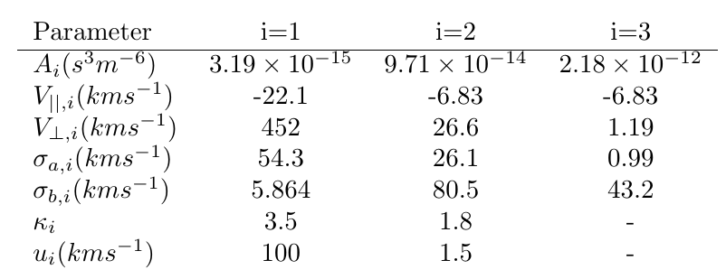
Initial velocity distribution of plasma particles
Southern University of Science and Technology
A “realistic” PUI velocity distribution function can be obtained based on the global model of neutral atoms in the heliosphere, namely the Multi-Scale FLUid-Kinetic Simulation Suite (MS-FLUKSS)^{1,2}.
PUIs from the SW neutrals
PUIs from the IHS neutrals
$$α={2.84}^{°}$$
$ion thermal velociy:v_{th}=$ 0.7$V_{A}$
Alfven speed: $V_{A}$ = 34.5km/s
The background proton particles are isotropic and Maxwellian.

Slide 5
Dispersion relation for the electromagnetic mirror mode¹:
The growth rate of mirror instability
Southern University of Science and Technology
Figure1: The growth rate of mirror instability normalized by the ion cyclotron frequency
Density of Ions
PUIs from the SW neutrals | $n_{1}$(${cm}^{−3}$) | 3.6$×{10}^{−5}$
PUIs from the IHS neutrals | $n_{2}$(${cm}^{−3}$) | 8.6$×{10}^{−5}$
 | $n_{3}$(${cm}^{−3}$) | 1.0$×{10}^{−4}$
Background ions | $n_{p}$(${cm}^{−3}$) | 0.1

Slide 6
Hybrid Simulation: Mirror mode fluctuations
$$\hat{y}$$
Southern University of Science and Technology
Here, we investigate the development of the mirror modes and the scattering of the outer heliosheath PUIs in phase space.
The background magnetic field makes angle $θ$ with the direction of wave propagation.
$$\vec{B0}$$
$$θ$$
$$\hat{x},\vec{k}$$
$$\hat{z}$$
$$1^{st}$$
$$2^{nd}$$
$${(N−1)}^{th}$$
$$N^{th}$$
$$L_{x}$$
one-dimensional simulation box
Simulation parameters
Domain size ($L_{x}$) | $$800c/ω_{pp}$$
Time step | $$0.02Ω_{p}^{−1}$$
Number of cells (N) | $$960$$
Number of particles per cell for each species | $$50000$$
Number of time steps | $$50000$$

Slide 7
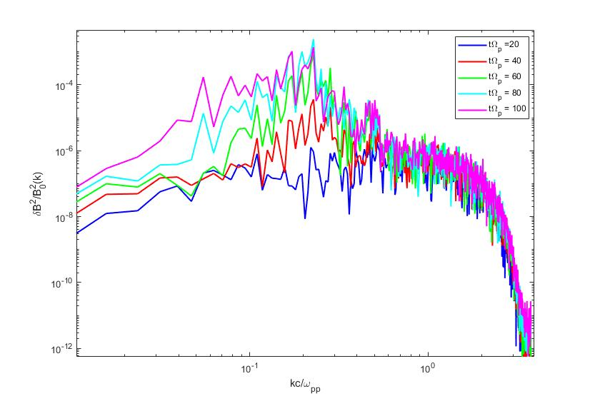
Hybrid simulation results
Southern University of Science and Technology
Figure 2: Spectra of the fluctuating magnetic field for $θ=30°$
The region of the most unstable modes suggested by linear instability analysis
This figure proves that at the early stages of the simulation, the oblique modes with $θ=30°$ are unstable.
The wavenumbers in the range of $kc/ω_{pp}$<0.5 are the growing mirror modes.
The fastest growing modes have the normalized wavenumbers between 0.1 and 0.4 that is in agreement with the results obtained by the linear analysis ) Figure 1).

Slide 8
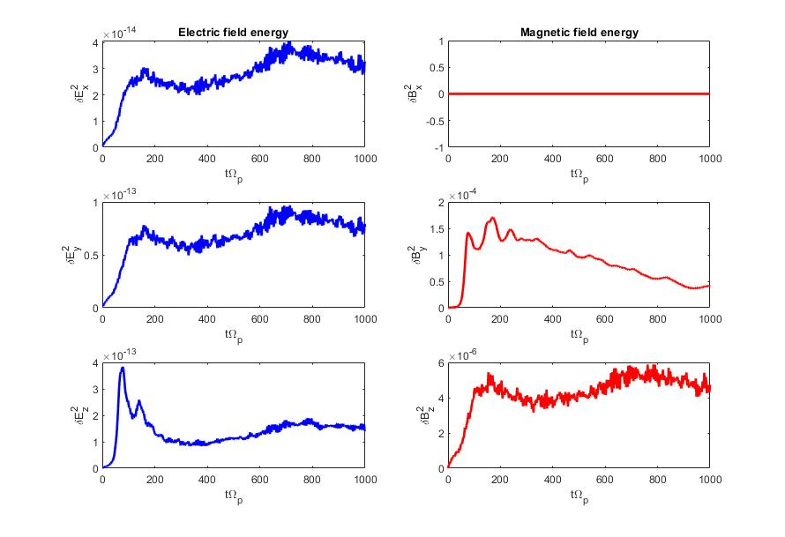
Figure 3: Time evolution of the magnetic and electric field energies for $θ=30°$
Hybrid simulation results
These figures confirm the excitation of the oblique modes .
Exponential wave growth happens before $tΩ_{p}=100$.

Slide 9
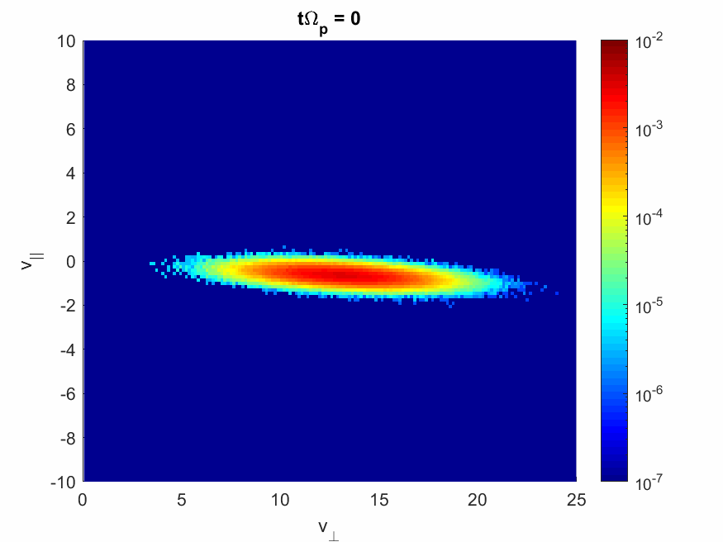
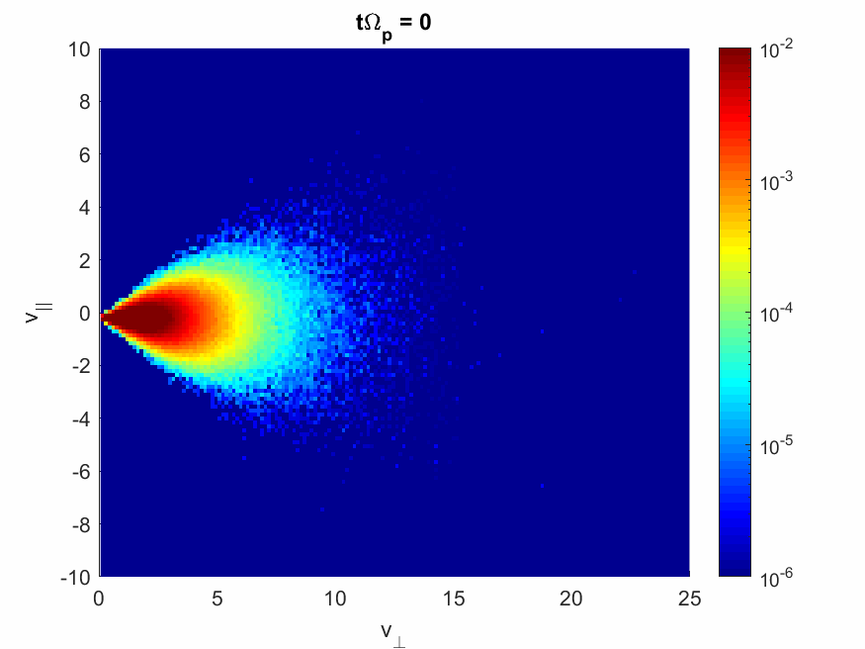
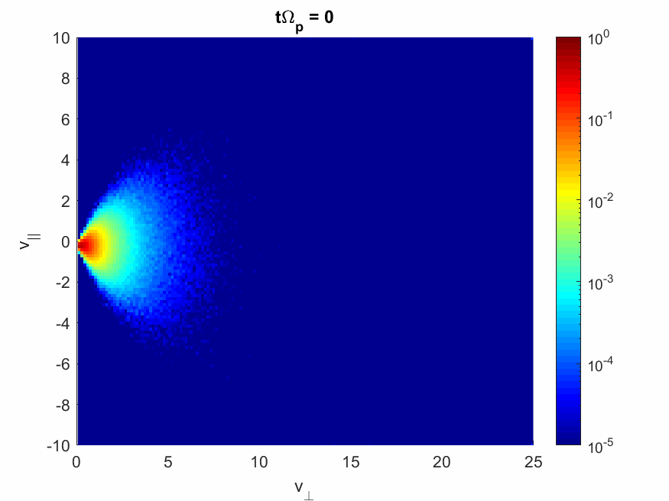
Time evolution of the pickup ion distributions for $θ=30°$
Hybrid simulation results
Southern University of Science and Technology
Based on the one-dimensional simulation results in the range of $0≤tΩ_{p}≤1000$ , the most significant scattering of the PUIs occur in the parallel velocities for those produced by the SW neutrals, which are described by a ring-type distribution function.
PUIs from the SW neutrals ($f_{1}$)
Mirror instability scatters the distribution $f_{1}$ in parallel velocities. But, $f_{2}$ and $f_{3}$ are not modified significantly by the wave-particle interactions.
PUIs from the IHS neutrals ($f_{2}$)
PUIs from the IHS neutrals ($f_{3}$)

Slide 10
Summery and Conclusion
Southern University of Science and Technology
The PUIs in the outer heliosheath can be described by a more realistic three-component velocity distribution function obtained by MS-FLUKSS model.
The “realistic” PUI distributions are unstable to oblique mirror instability.
Growth rate for the mirror instability is calculated employing both linear kinetic analysis and hybrid simulations.
The mirror instability causes the parallel heating of the outer heliosheath PUIs .
For the PUIs with neutral SW origin, the initial velocity distribution is substantially modified.
The initial ring-type distribution of the PUIs changes to a multimodal distribution.

