Slide 1
Ground-based measurements of turbulence in electrified clouds
E.A.Mareev, V.V.Klimenko, L.V.Lubyako, M.V.Shatalina, S.O.Dementyeva, N.V. Ilin
Institute of Applied Physics, Russian Academy of Sciences, Nizhny Novgorod, RF
evgeny.mareev@gmail.com

Slide 2
Motivation
A problem of the electric field dynamics in turbulent electro-active clouds (Cumulus, Stratus, Cumulonimbus) is one of the most relevant and complex problems of dynamical meteorology and atmospheric electricity. This problem is important for the study of intense large-scale electric field and its fluctuations that may lead to high-energy particle flows and lightning discharges, for electric current parameterization. Direct field measurements in convective clouds with a developed electrical structure are very difficult; so one of urgent tasks is the development of remote sensing methods for turbulence characteristics in electro-active clouds.

Slide 3
Motivation (continued)
The growth of a large-scale electric field in a turbulent atmosphere is caused by the generation of an electric charge on colliding particles (hydrometeors and dust). Meanwhile, observations (including preliminary observations of the authors) and theoretical studies (Mareev and Dementyeva, JGR, 2017) show that intensification of thunderstorm activity can be associated with increased turbulence in the cloud. This paper presents some new ideas and results of experimental and theoretical studies of the role of turbulence in electro-active clouds.

Slide 4
Content of experimental work
The main attention is paid to complex remote observations of different types of clouds with an experimental set-up including the microwave radiometers of 3 cm and 8 mm wavelengths (time resolution of order of one second), the network of electrostatic fluxmeters spaced by several kilometers each from another, and the meteorological radar. The data of recent several years were used for analysis. A principal idea of our approach is to use the wave-length channels allowing us to reveal both optically thick and optically transparent cloud events A special attention was paid to comparative analysis of the turbulence characteristics in thunderclouds and in clouds that do not have a developed electrical structure.

Slide 5
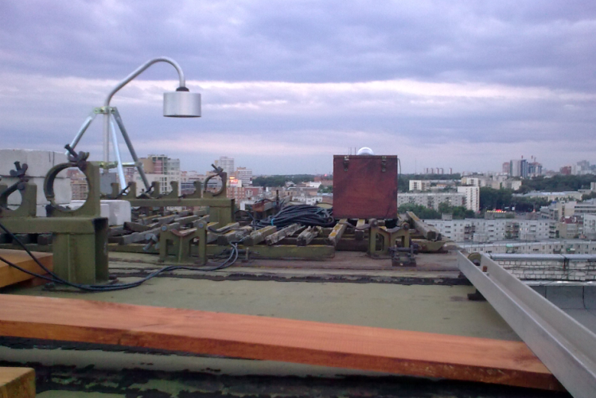
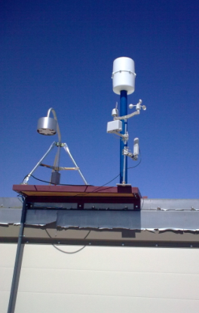
Experimental setup
Institute of
Applied
Physics
Nizhny Novgorod city
Volga river
IPM
Oka river

Slide 6
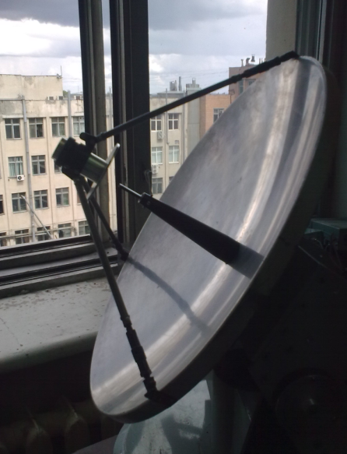
8 mm wavelength radiometer for atmospheric turbulence diagnostics
The radiometer was designed and manufactured in the Institute of Applied Physics as the high sensitive direct amplification modulating recei-ver of noise radiation

Slide 7
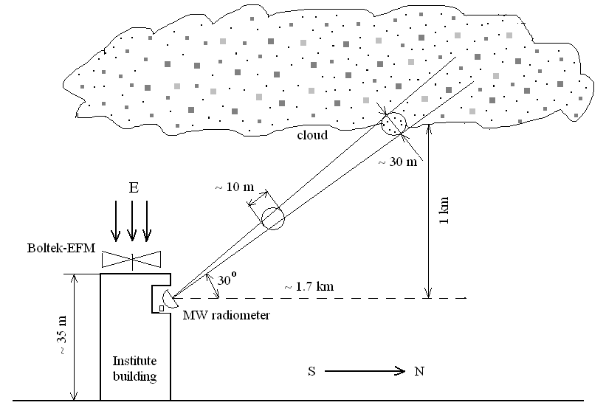
8 mm wavelength radiometer

Slide 8
General relations
Temporal structure function
B(τ) – correlation function
Integral transform for spectral density

Slide 9
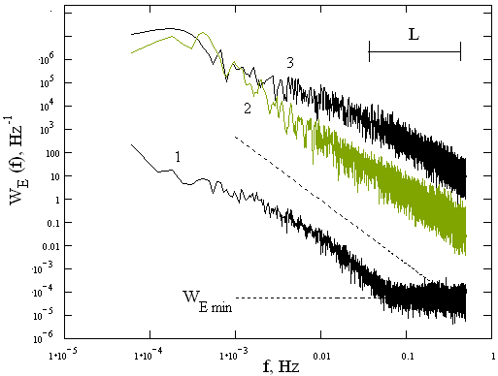
Spectral density of EF fluctuations
Various weather conditions in 2018: (a) cloudy and cloudless atmosphere, no big disturbances in the electric field (6 days); (b) - cloudy atmosphere, disturbances in the electric field are commensurate with thunderstorms, but no lightning strikes (7 days); (c) - thunderclouds with lightning (6 days)
.

Slide 10
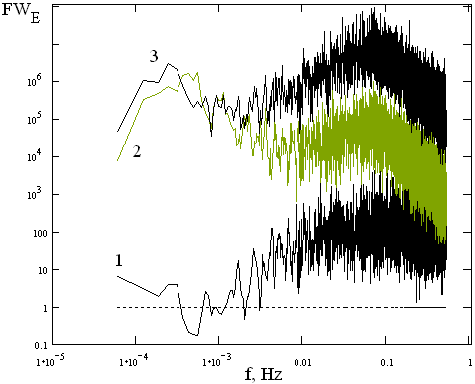
Spectral density of EF fluctuations
Various weather conditions in 2018. Right panel: Gain in the spectral density of E fluctuations with changing weather patterns: 1 - from (2) to (3), 2 - from (1) to (2), and 3 - from (1) to (3)

Slide 11
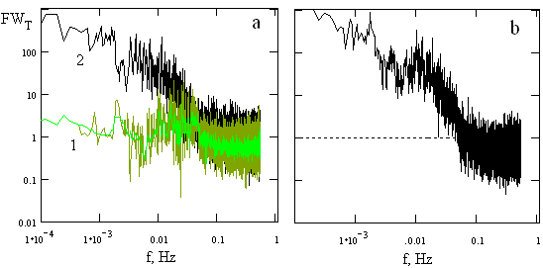
Enhancement factor for T fluctuations
Gain in the spectral density of fluctuations T with changing weather patterns: 1 - from (2) to (3), 2 - from (1) to (2), and 3 - from (1) to (3)

Slide 12
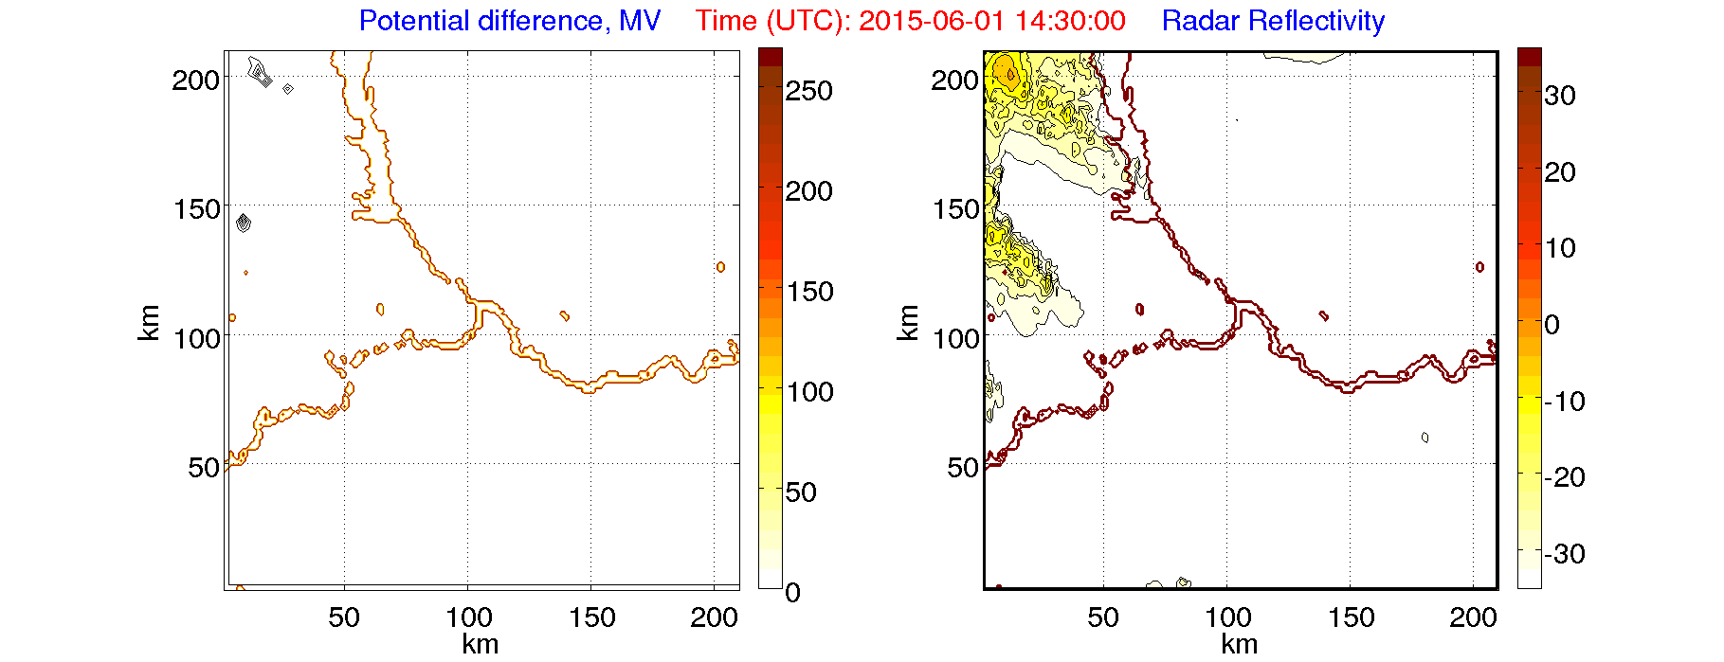
WRF simulations
Thunderstorm 1 June 2015 14:30 – 21:30 (UTC)
Initial conditions:
GFS 0.25º
Simulated time: 00:00-00:00(+1) UTC
Simulated area:
1200 x 1200 x 20 km
210 x 210 х 20 km
Grids:
3 x 3 х 0.5 km
1 x 1 х 0.5 km
60
40
20
0
-20

Slide 13
Modeling of thunderstorms taking into account turbulent effects
MV
z, km
Electric field
No turbulence
km
Electric potential
km
|E|, V/m
MV
dBz
Turbulence
Radar reflectivity
km
km
km
km

Slide 14
Simulations with WRF model in thunderstorm clouds with a high level of turbulence show
For weak thunderstorms and for the final stage of development of a powerful thunderstorm front, an increase in potentials was noted with a corresponding increase in areas with a high value of potentials.
For more intense thunderstorms and at the initial stage of the development of a powerful thunderstorm front, a decrease in the region of high potentials was observed as well as the separation of cells arising around the maximum of the potentials with the intensification of electric processes inside each formed cell.
For the most intensive stage of development of a powerful thunderstorm, one can note not only an increase in the potential difference and an increase in electrification processes, but also a tendency to unite two potential maximums into one cell.

Slide 15
Microwave emission observations show
Spectral characteristics of electric field and brightness fluctuations can be subdivided to three types related to weather conditions.
The spectra of fluctuations of the electric field caused by thunderclouds, as well as turbulence interior thundercloud, are significantly different from the spectra caused by ordinary Cumulus and layered clouds.
Compared with ordinary Cumulus and Stratus clouds, a limited band near frequency ~ 0.01 Hz with a higher level of fluctuations is distinguished in the spectral density of EF and T fluctuations in thunderclouds.
The work was supported by Russian Foundation for Basic Research (projects 19-05-00975 and 18-45-520010)

