Slide 1

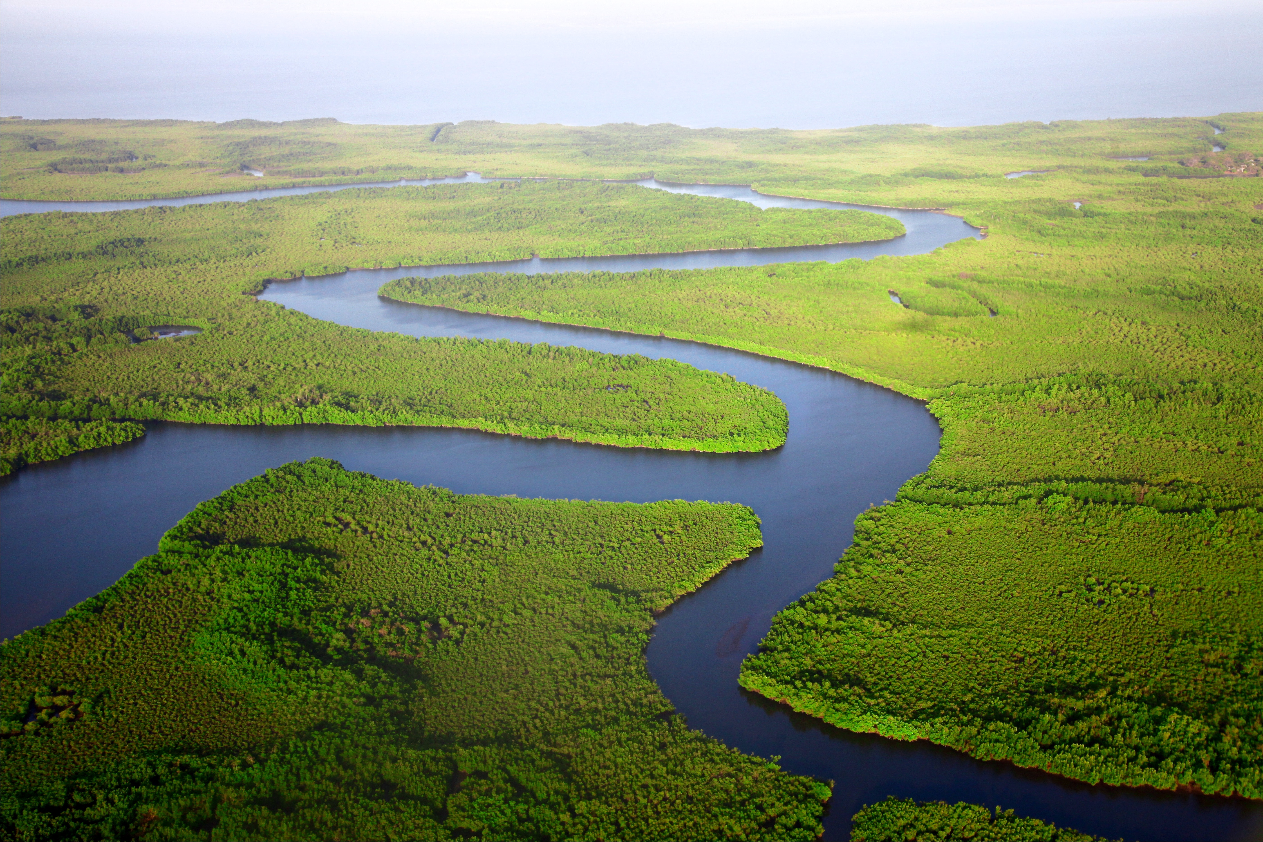

Unravelling the river morphological –
flood pattern linkages in Ayeyarwady River Basin, Myanmar
Leveraging free satellite data for informed decisions
Karthikeyan Matheswaran, , Dhyey Bhatpuria and Thanapon Piman
Stockholm Environment Institute, Asia Center, Bangkok
Karthi et al. All rights reserved
Notes:
Template note:
To create a new Section Divider slide, either a) copy this slide and edit the existing text; or b) copy the white brand shape (in place) to a newly added Section Divider slide from the template library.
Due to the way PowerPoint handles layers, the brand shape on the section divider slide cannot be locked in place. Ensure that this shape is not moved, resized or otherwise altered when using this template slide. The image can be changed.
Photo credit: Getty images / yimwow https://www.gettyimages.com/license/490316478

Slide 2
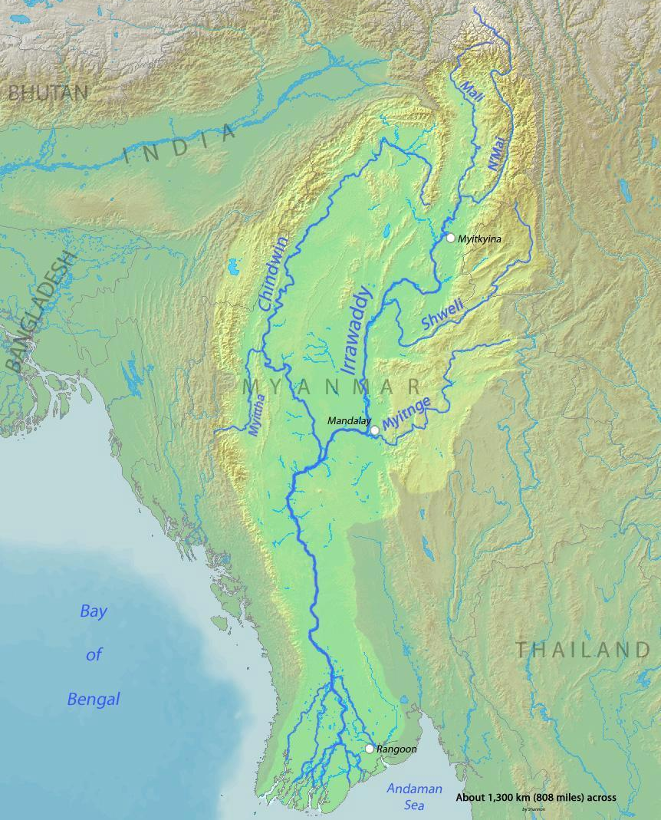
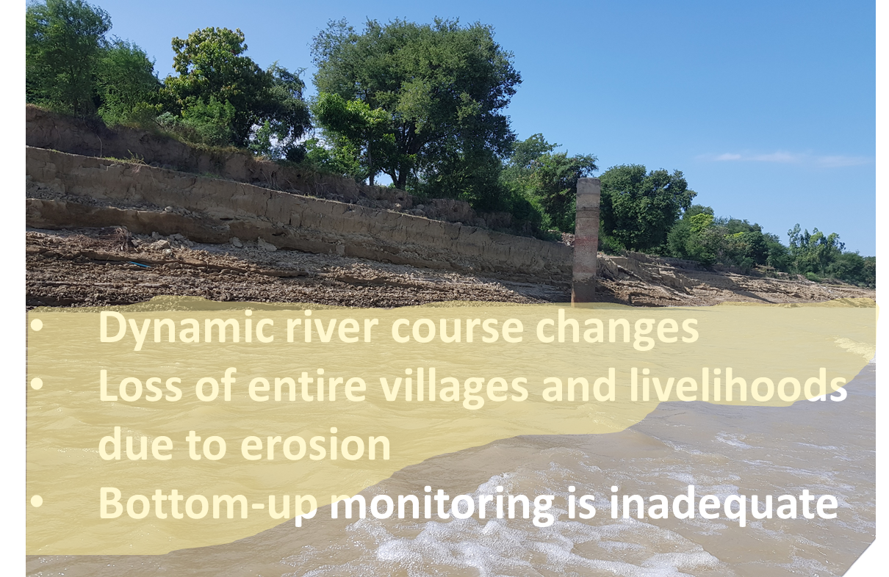
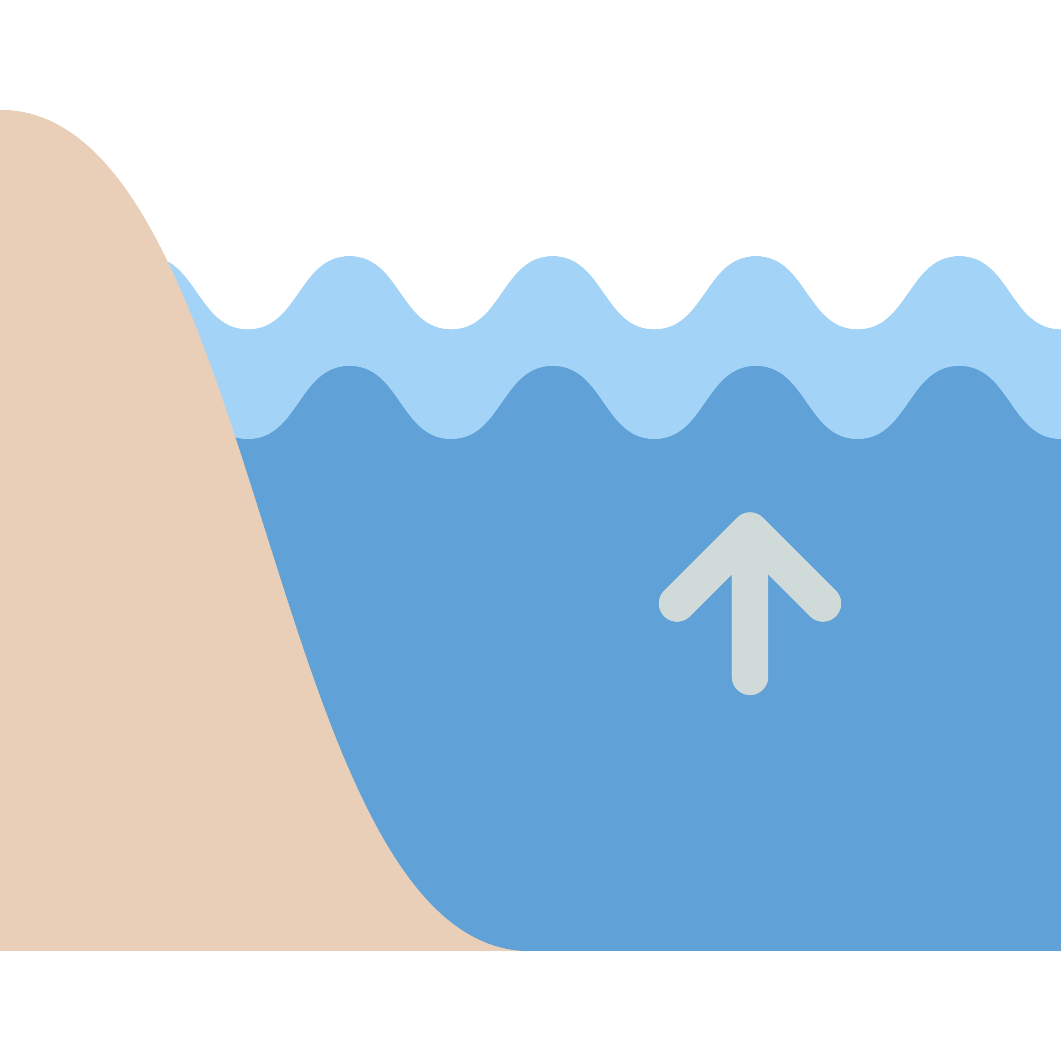
The Problem
Feedback between floods and river channel changes – a key knowledge gap

Slide 3
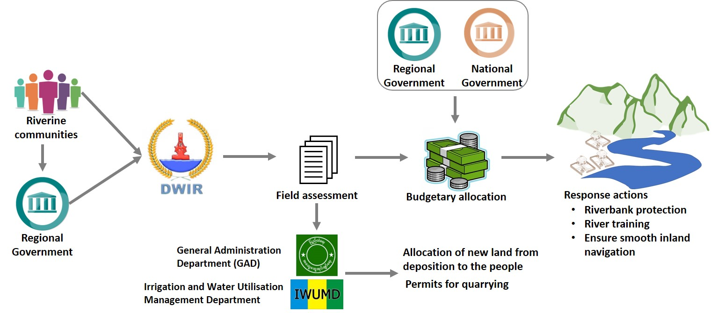
Stakeholders

Slide 4
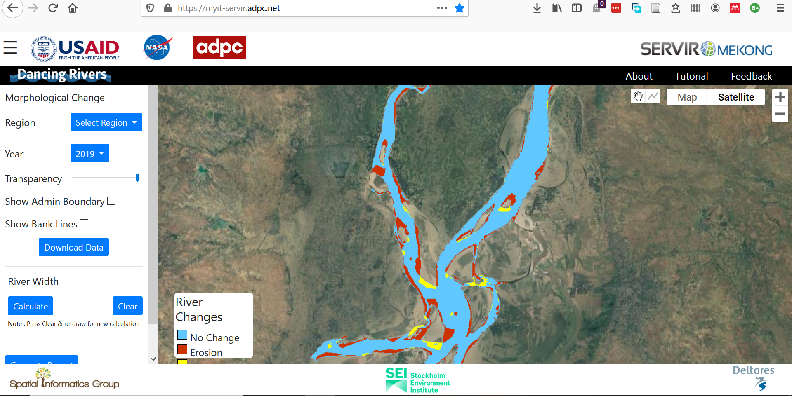
The goal
To develop a web-based seasonal monitoring system for Ayeyarwady River covering ~2500 km
to support informed riverbank management

Slide 5
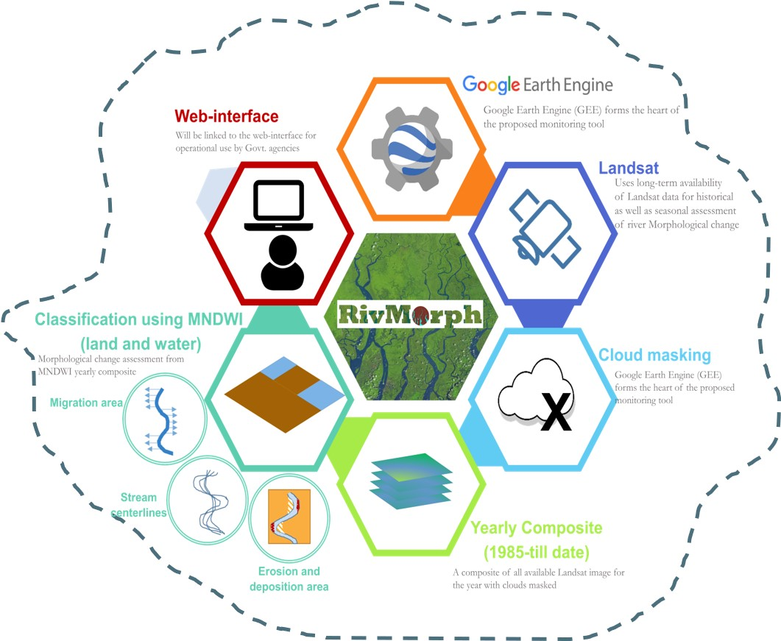
Approach
30-year Landsat dataset
Backend in GEE
Maps erosion and deposition areas at the end of every monsoon season.
Cover more than 2000 km length of the river

Slide 6
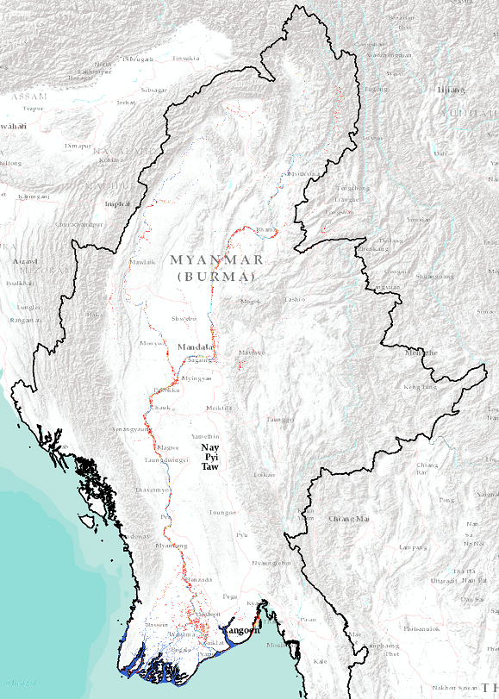
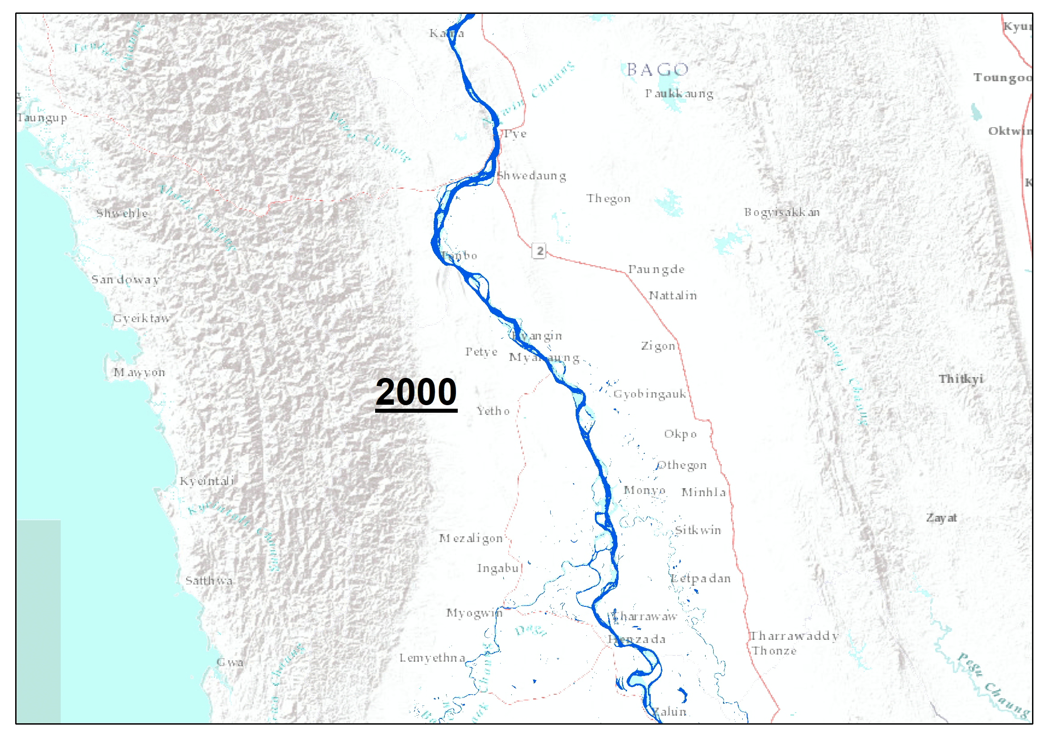
Results : River course change

Slide 7
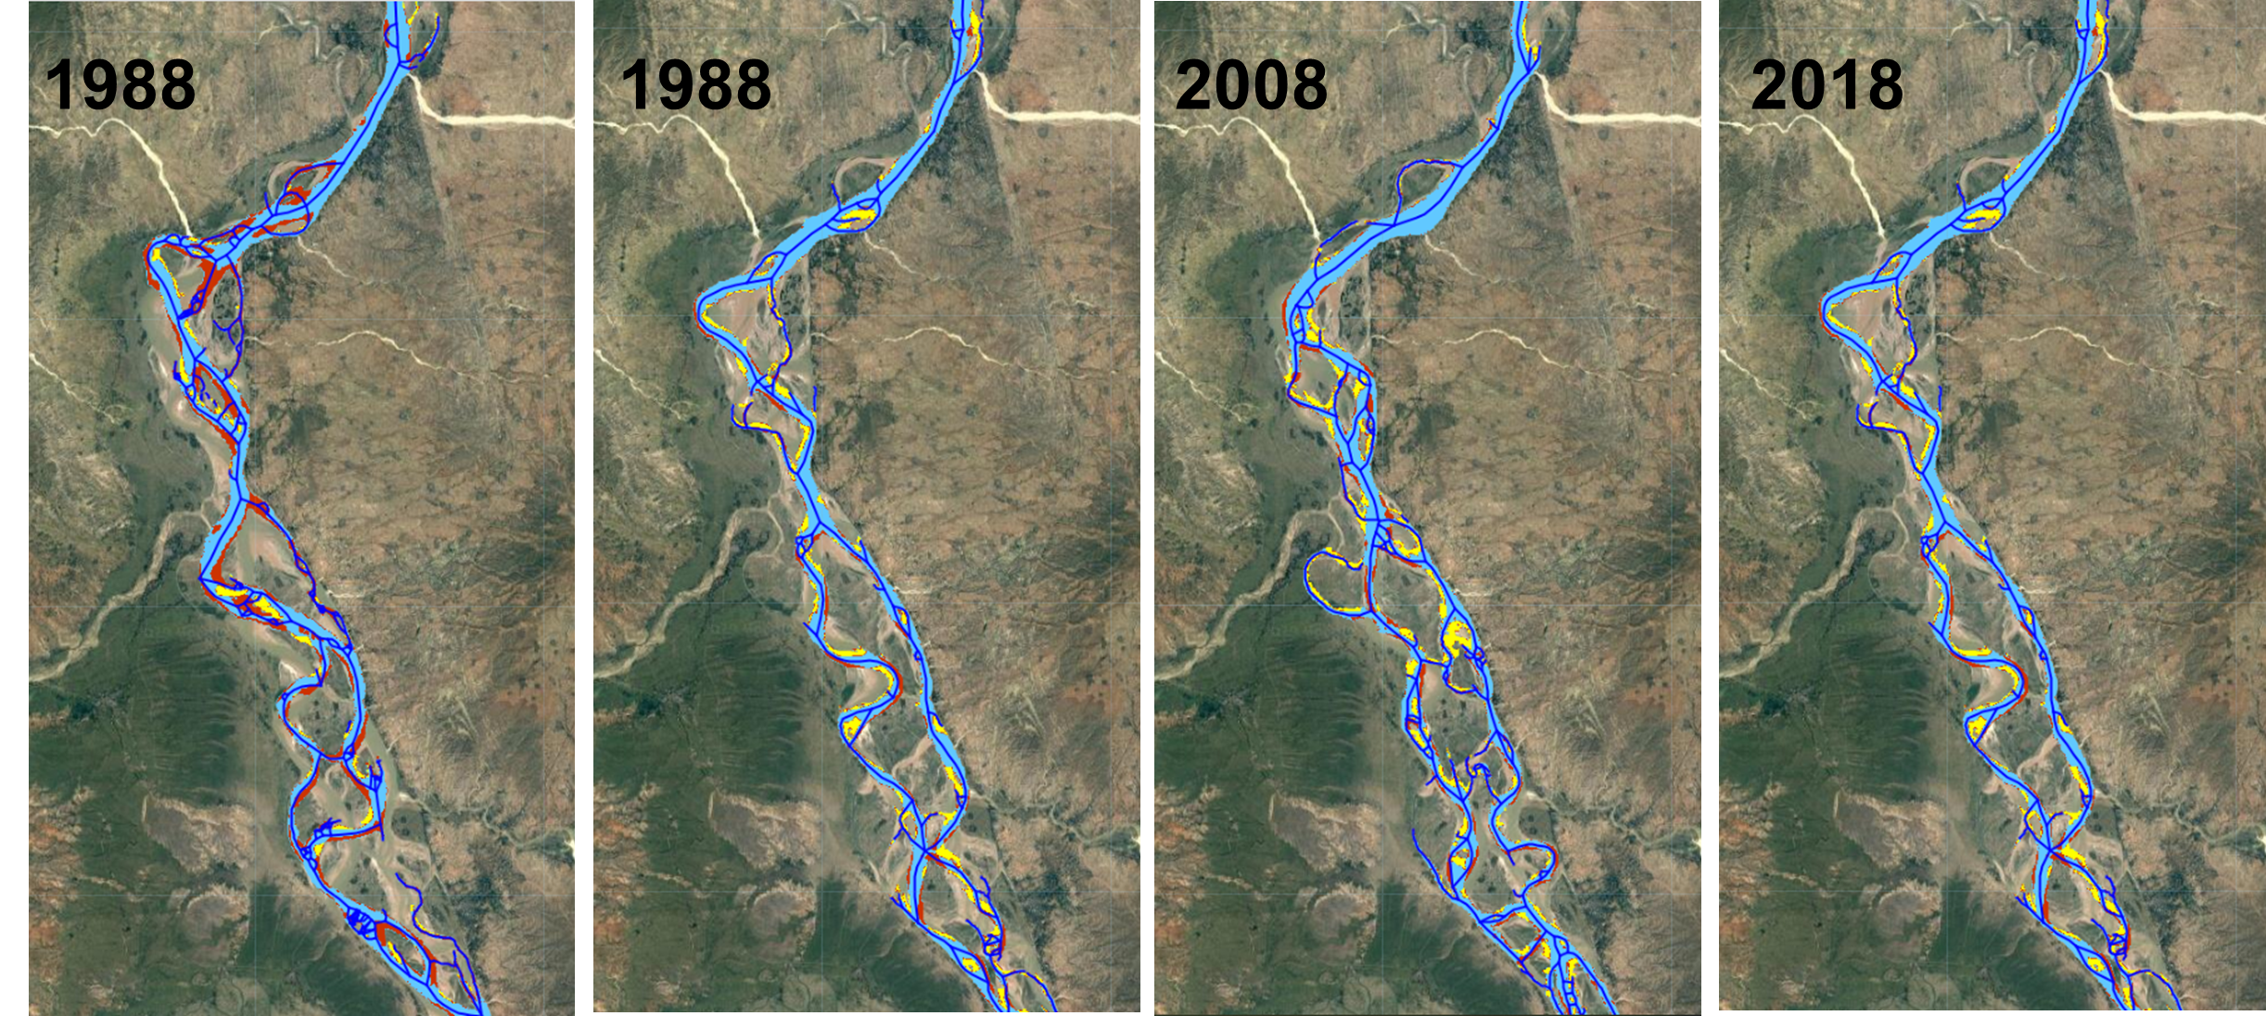
Results : Erosion and deposition areas

Slide 8
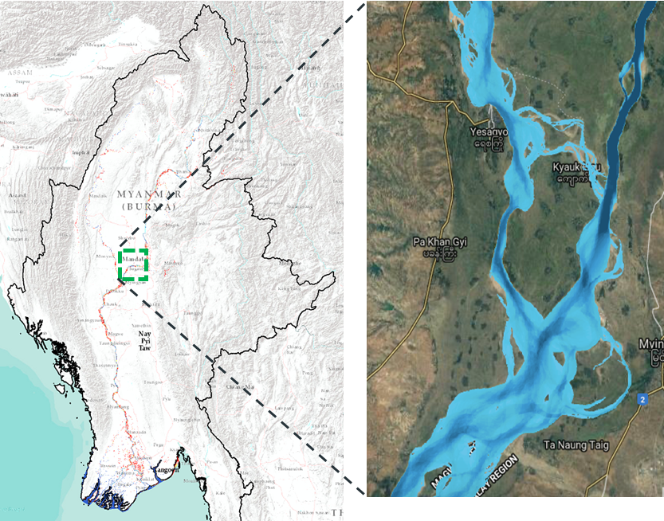
Results: Hotspots
Years
1
30

Slide 9
Hotspots : Floods and River morphology
Flood hazard (aggregated 2000-2019)
Morphological change (aggregated 2000-2019)

Slide 10
Floods and morphological change – Closer look
Flood hazard (aggregated 2000-2019)
Morphological change (aggregated 2000-2019)

Slide 11


Future work
Upstream land use change
Flow dynamics
Geology
Sedimentation patterns
Floods dynamics
River course change

Slide 12
Conclusion
A freely available seasonal river morphological change monitoring system
Provides spatial information in erosion location along ~2000 km river length.
Web-based interface eliminates the complexity for government stakeholders.
System is modular and easy to replicate for other rivers
Acknowledgement : This work is a part of SERVIR Mekong projects a joint initiative of the U.S. Agency for International Development (USAID) and the U.S. National Aeronautics and Space Administration (NASA), implemented by the Geospatial Information Department of Asian Disaster Preparedness Center (ADPC). It makes use of publicly available satellite imagery and technologies to address challenges related to water resources, disasters, climate resilience, agriculture and ecosystems in the Lower Mekong.
.

Slide 13
Links
Tool:
https://myit-servir.adpc.net/
Brochure:
https://servir.adpc.net/sites/default/files/public/tools/attachments/Dancing%20rivers%20user%20guide.pdf
Short film:
https://www.youtube.com/watch?v=XGlhvLTLvqE
Blogs:
https://servir.adpc.net/news/dancing-rivers-myanmar-mapping-moves-space
https://servir.adpc.net/news/training-myanmars-next-generation-river-engineers
https://www.myanmarwaterportal.com/news/1560-promoting-satellite-based-river-morphological-change-monitoring-system-in-myanmar.html

Slide 14
Thank you https://myit-servir.adpc.net/
For more information:
Karthi.Matheswaran@sei.org
Notes:
Template note:
To create a new Section Divider slide, either a) copy this slide and edit the existing text; or b) copy the white brand shape (in place) to a newly added Section Divider slide from the template library.
Due to the way PowerPoint handles layers, the brand shape on the section divider slide cannot be locked in place. Ensure that this shape is not moved, resized or otherwise altered when using this template slide. The image can be changed.
Photo credit: Getty images / yimwow https://www.gettyimages.com/license/490316478

