Slide 1
Productivity and carbon export potential in the Weddell Sea, with a focus on the waters near Larsen C Ice Shelf
Raquel Flynn^{*1,} Jessica Burger¹, Shantelle Smith¹, Kurt Spence¹, Thomas Bornman^{2,3}, Sarah Fawcett¹
*flyraq001@myuct.ac.za
¹Department of Oceanography, University of Cape Town, Cape Town
²Elwandle Node, South African Environmental Observation Network
³Institute for Coastal and Marine Research, Nelson Mandela University, Nelson Mandela Bay

Slide 2
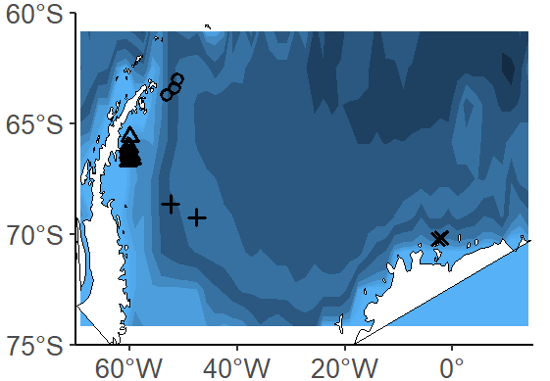
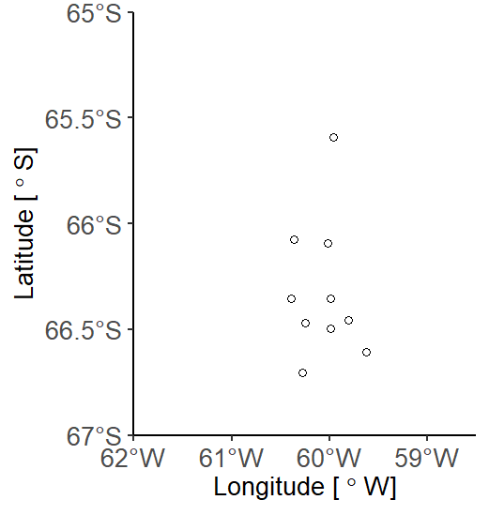
Study Area
AP1
AP2
Antarctic Peninsula
AP3
0
L10
Larsen C
L4
L9
WG1
WG2
Fimbul
Weddell Gyre
F1
F3
L3
L8
F2
F4
L6
L2
L7
L1
L5

Slide 3
New vs. Regenerated production
CO₂
New production refers to production fuelled by nitrate
Regenerated production is fuelled by ammonium and urea
Euphotic
POM
new
regenerated
NO₃⁻
NH₄⁺/Urea
shallow
remin.
Aphotic
NO₃⁻
nitrification
NH₄⁺
deep
remin.

Slide 4
New vs. Regenerated production
CO₂
Euphotic
In a steady state system
POM
=
new
regenerated
NO₃⁻
NH₄⁺/Urea
shallow
remin.
Aphotic
NO₃⁻
nitrification
NH₄⁺
deep
remin.

Slide 5
New vs. Regenerated production
CO₂
The f-ratio provides an estimate of carbon export:
f > 0.5 = predominantly new production
f < 0.5 = predominantly regenerated production
Euphotic
POM
new
regenerated
NO₃⁻
NH₄⁺/Urea
shallow
remin.
Aphotic
NO₃⁻
nitrification
NH₄⁺
deep
remin.

Slide 6
New vs. Regenerated production
CO₂
Euphotic
POM
Euphotic zone nitrification
=
overestimating new production
new
regenerated
NO₃⁻
nitrification
NH₄⁺/Urea
shallow
remin.
Aphotic
NO₃⁻
nitrification
NH₄⁺
deep
remin.

Slide 7
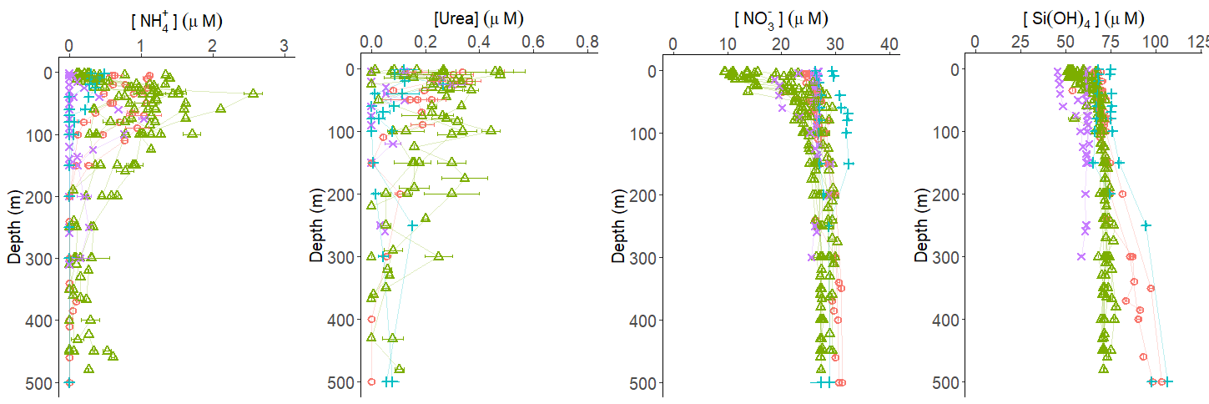
Nutrient concentrations
[NH₄⁺] (µM)
[Urea] (µM)
[NO₃⁻] (µM)
[Si(OH)₄] (µM)
125
Weddell Gyre
Fimbul
High concentrations of regenerated N sources were observed at Fimbul ice shelf (in late summer only), Larsen C ice shelf, and along the Antarctic Peninsula .
Lower than subsurface [NO₃⁻] and [Si(OH)₄] were observed in the surface waters at Fimbul ice shelf (in late summer only) and Larsen C ice shelf.

Slide 8
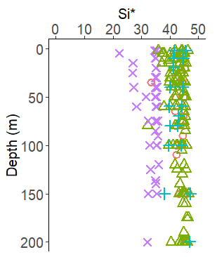
Nutrient concentrations
(µM)
Weddell Gyre
Fimbul
(µM)
Weddell Gyre
Fimbul
Under iron replete conditions, diatoms consume Si(OH)₄ and NO₃⁻ at a ratio of 1:1

Slide 9
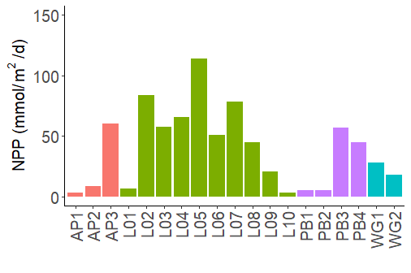
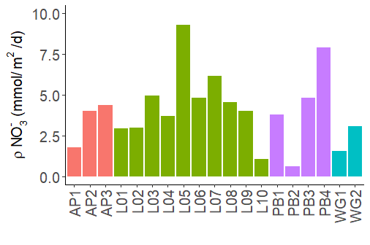
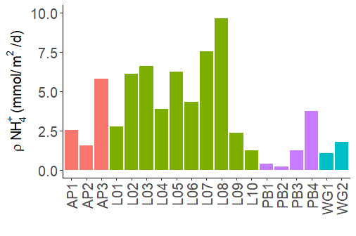
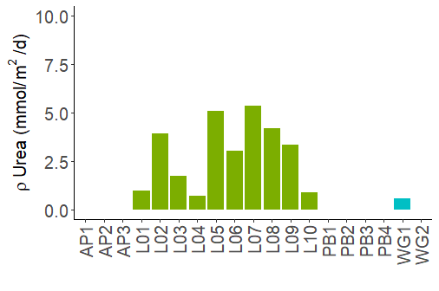
NPP and N uptake rates
Net primary production
Nitrate uptake
On average, the highest uptake rates were observed at Larsen C ice shelf and the lowest at the Weddell Gyre stations.
F4 appears different from all other Fimbul stations, and this is due to F4 being sampled in late summer while F1-F3 were sampled in early summer.
The experiments were size-fractionated and nanoplankton dominated (data not shown) .
NPP (mmol/m²/d)
NO₃⁻ uptake (mmol/m²/d)
F1
F2
F4
F3
F1
F2
F4
F3
Ammonium uptake
Urea uptake
NH₄⁺ uptake (mmol/m²/d)
Urea uptake (mmol/m²/d)
Weddell Gyre
Fimbul
F1
F2
F4
F3
F1
F2
F4
F3

Slide 10
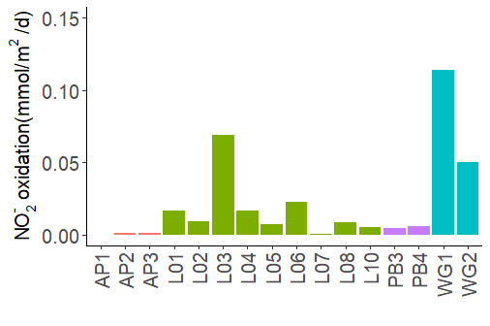
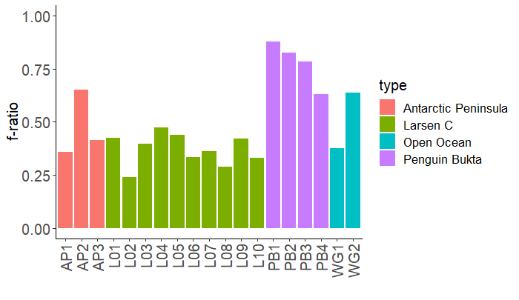
Carbon export potential
Net primary production
Nitrate uptake
Nitrification
NO₃⁻ uptake (mmol/m²/d)
NO₂⁻ oxidation (mmol/m²/d)
NPP (mmol/m²/d)
F1
F2
F4
F3
F1
F2
F4
F3
F4
F3
Ammonium uptake
Urea uptake
f-ratio
NH₄⁺ uptake (mmol/m²/d)
Urea uptake (mmol/m²/d)
Weddell Gyre
Fimbul
F1
F2
F4
F3
F1
F2
F4
F3
F1
F2
F4
F3

Slide 11
Phytoplankton community composition
Position | Dominant Phytoplankton spp. | Comment | Average f-ratio
Antarctic Peninsula | Corethron pennatum (Diatom) | High biomass of C. Pennatum and low diversity of other spp. | 0.47
Larsen C ice shelf | Phaeocystis Antarctica (Haptophyte) | All stations were dominated by P. Antarctica. Various chain-forming diatom spp. also present. | 0.38
Fimbul ice shelf | Chaetoceros spp. (Diatom) | High biomass and diversity of various diatom spp. | 0.78
Weddell Gyre | Corethron pennatum (Diatom) | Low biomass and diversity observed. C. Pennatum present were small and weakly silicified. | 0.50
Shifts in the phytoplankton community (Diatoms vs. P. Antarctica) can occur in response to changes in both physical (e.g., vertical stability) and biological (e.g., nutrient concentrations) conditions.

Slide 12
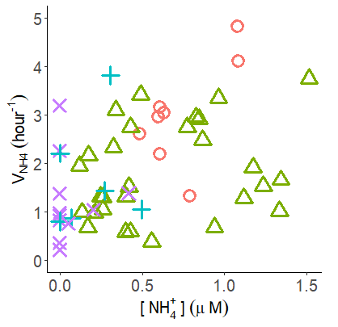
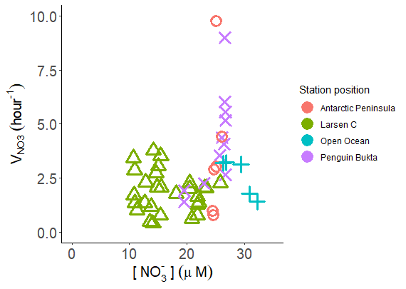
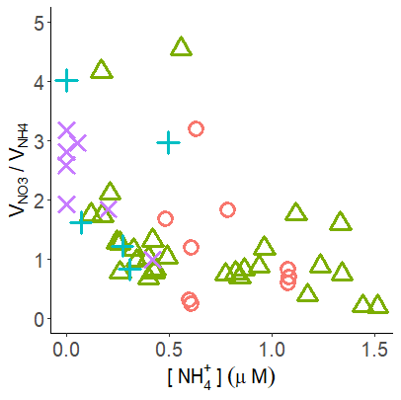
Potential NH₄⁺ inhibition at Larsen C
Weddell Gyre
Fimbul
[NH₄⁺] ≥0.5 µM inhibit nitrate uptake rates as phytoplankton preferentially consume NH₄⁺.
This has previously been observed in the Weddell Sea in late summer by Goeyens el at. (1995).

Slide 13
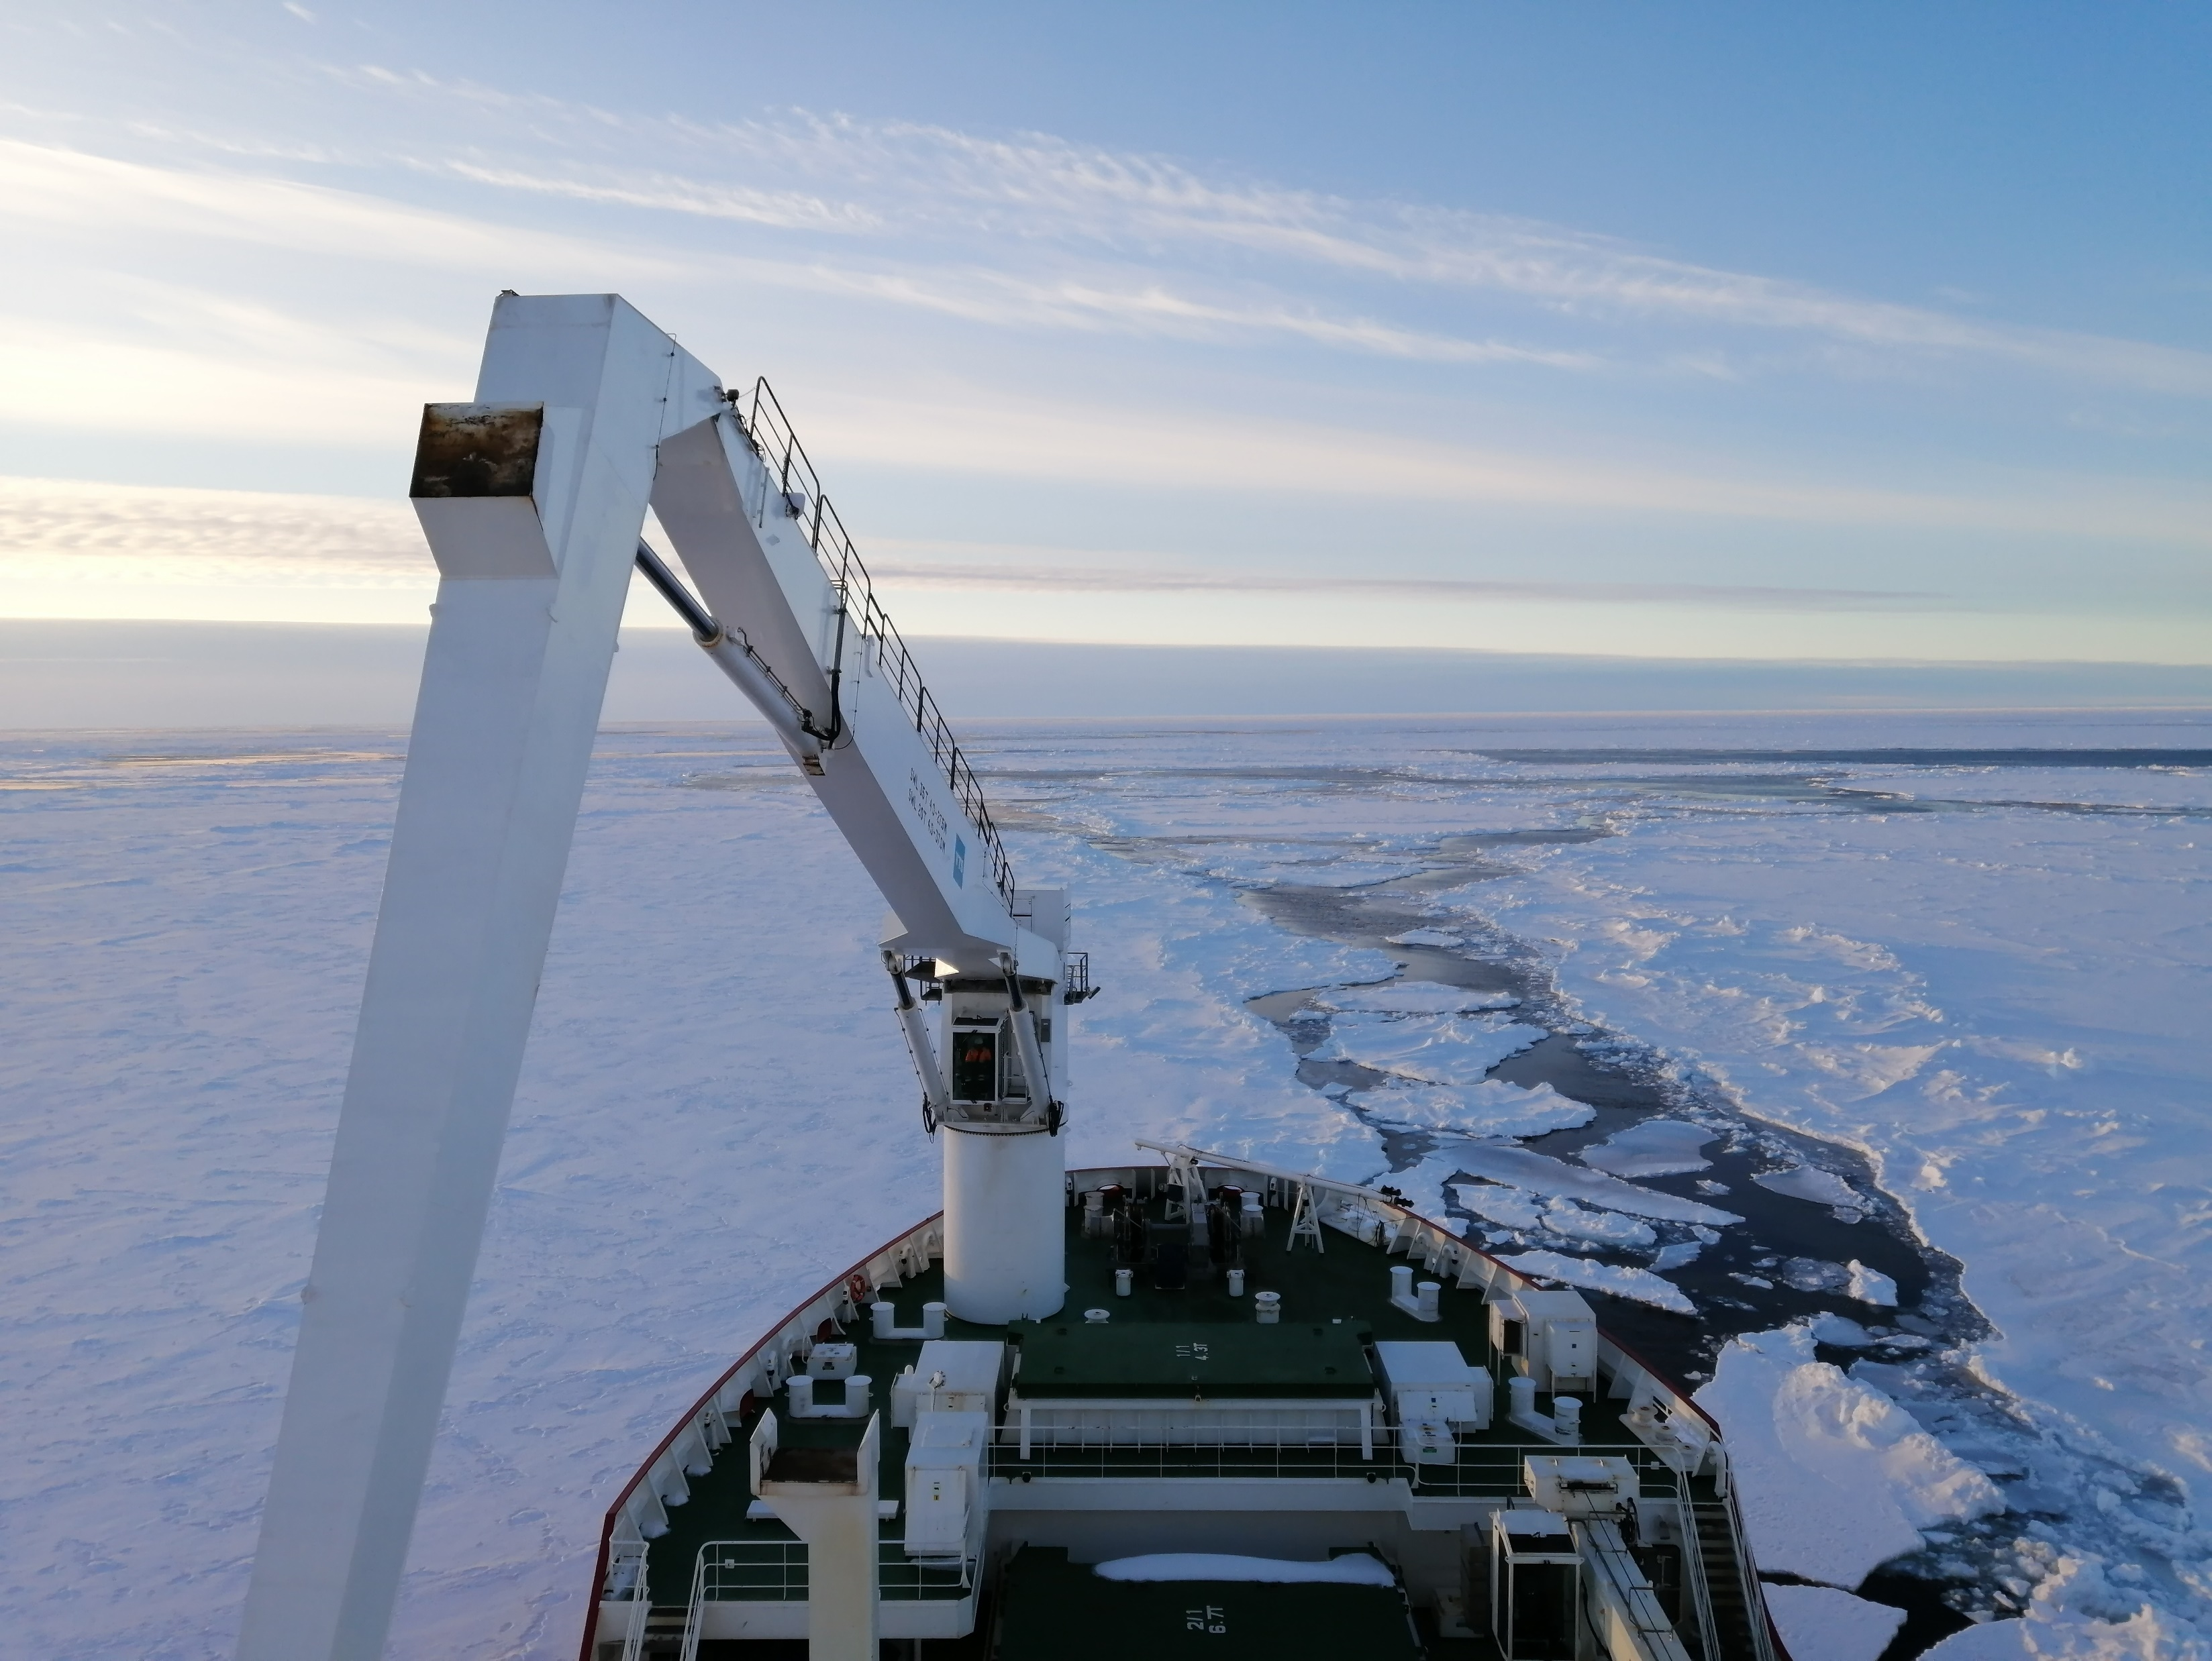
Summary
Uptake throughout the Weddell Sea is dominated by the nanoplankton (3-20 µm), mostly in the form of diatoms.
We hypothesize that iron replete conditions were observed throughout the Weddell Sea.
The highest relative carbon export potential was measured at Fimbul ice shelf, likely driven by phytoplankton community.
Larsen C is characterised by <50% carbon export potential due to potential NH₄⁺ inhibition.

Slide 14
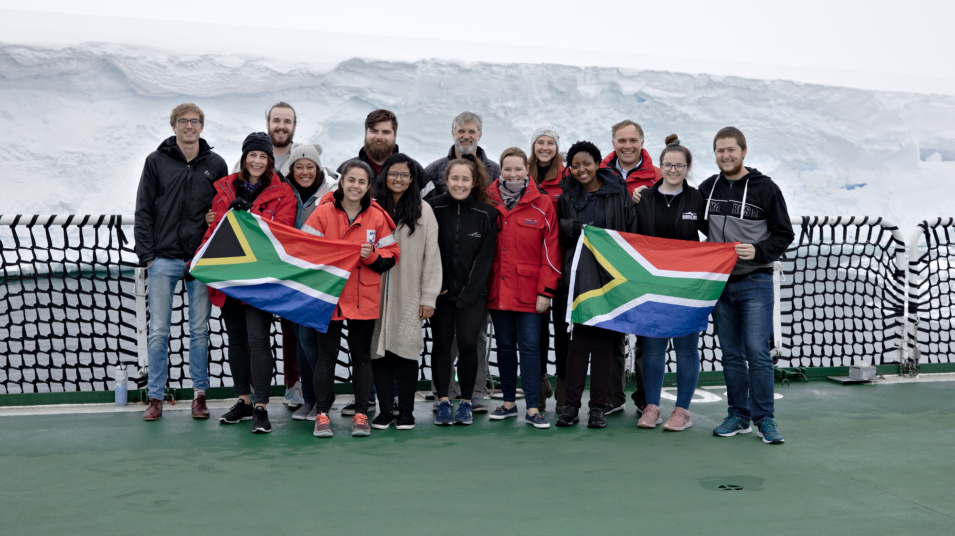
Acknowledgements:
Biogeochemistry team on SANAE 58 voyage
Fawcett-Altieri Lab
Captain and crew of the RV SA Agulhas II
University of Cape Town Stable Isotope Lab
Funding:
NRF-SANAP
University of Cape Town
Weddell Sea expedition 2019
Photo taken by Holly Ewart

