Slide 1
EGU General Assembly 2020
Combination of subsurface organic fertilization and film mulching could effectively optimize soil structure in saline alkali soil
Zhang Hongyuan, Pang Huancheng, Lu Chuang, Wang Jing, Wang Guoli, Chang Fangdi, Li Yuyi*
Institute of Agricultural Resources and Regional Planning, Chinese Academy of Agricultural Sciences, Beijing, P.R.China
May 8, 2020

Slide 2
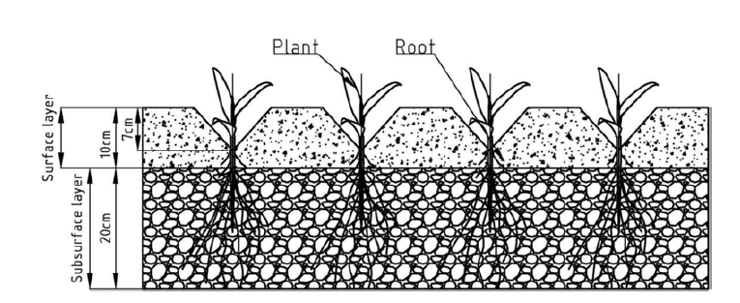
BACKGROUND
Saline soil has a serious negative effect on crop growth in the world, subsurface organic fertilization combined with plastic film mulching (OMP) is one of the effective measures to solve this issue.
Yield increase: increase crop yield by 18.2-29.4%;
Water retention: increase moisture content by 3-5%;
Fertilization: organic matter increased by 25.1-38.4%;
Salt suppression: the salt accumulation rate of the surface layer has been reduced by about one time.
Fig.1 A sketch of the subsurface layer.
Object: The impact on soil structure especially soil pore structure under OMP ?

Slide 3
Materials and Methods
A three-year continuous positioning test was performed in Wuyuan County, Inner Mongolia from 2015 to 2017.
The experiment included four treatments:
Plowing with no plastic mulching (CK);
Plowing plus plastic mulching (PM);
Organic manure amendment of the subsurface (10–30 cm) layer with no plastic mulching (OM);
OM plus plastic mulching (OMP).
Take out the soil layer by layer
Laying organic fertilizer
Field test arrangement

Slide 4
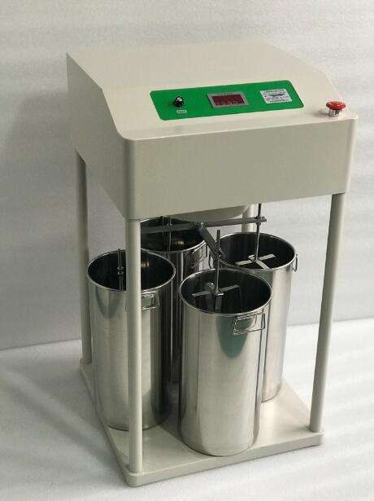
Materials and Methods
Soil samples of 0-10cm, 10-30cm and 30-40cm soil layers were collected in 2017.
The distribution and stability of aggregates were measured by wet sieve method.
Soil pore structure information was obtained by X-ray CT scanning and image processing.

Slide 5
Under the condition of subsurface organic fertilization (OM, OMP), which increased the content of large aggregate and water stability.
Table Water-stable aggregate size distribution under subsurface organic amendment after 3a
Soil Depth | Treatment | Macro-aggregate/(g·kg⁻¹) |  |  | Micro-aggregate/(g·kg⁻¹) |  | Mean weight diameter/(mm)
 |  | >2mm | 0.25-2mm |  | 0.053-0.25mm | < 0.053mm
0-10cm | CK | (0.144±0.007) ª | (0.288±0.013) ^{b} |  | (0.210±0.024) ª | (0.357±0.010) ª | (0.510±0.082)^{b}
 | PM | (0.086±0.018) ª | (0.300±0.010) ^{b} |  | (0.242±0.013) ª | (0.372±0.015) ª | (0.470±0.053)^{b}
 | OM | (0.102±0.013) ª | (0.321±0.018) ^{b} |  | (0.246±0.013) ª | (0.332±0.019) ª | (0.509±0.110)^{b}
 | OMP | (0.111±0.016) ª | (0.412±0.022) ª |  | (0.256±0.020) ª | (0.222±0.021) ^{b} | (0.619±0.232)ª
10-30cm | CK | (0.046±0.012) ª | (0.244±0.011) ^{c} |  | (0.256±0.012) ª | (0.455±0.011) ª | (0.371±0.054)^{c}
 | PM | (0.053±0.024) ª | (0.348±0.008) ^{b} |  | (0.228±0.010) ª | (0.371±0.013) ^{b} | (0.489±0.070)^{c}
 | OM | (0.064±0.019) ª | (0.349±0.007) ^{b} |  | (0.261±0.012) ª | (0.326±0.015) ^{b} | (0.505±0.114)^{b}
 | OMP | (0.086±0.025) ª | (0.397±0.005) ª |  | (0.248±0.011) ª | (0.268±0.004) ^{c} | (0.578±0.181)ª
30-40cm | CK | (0.205±0.023) ª | (0.398±0.023) ª |  | (0.188±0.010) ^{b} | (0.210±0.016) ª | (0.686±0.087)ª
 | PM | (0.209±0.011) ª | (0.414±0.019) ª |  | (0.165±0.015) ^{b} | (0.212±0.019) ª | (0.705±0.060)ª
 | OM | (0.271±0.013) ª | (0.361±0.018) ª |  | (0.134±0.003) ^{b} | (0.235±0.018) ª | (0.703±0.058)ª
 | OMP | (0.221±0.015) ª | (0.276±0.021) ª |  | (0.235±0.025) ª | (0.269±0.020) ª | (0.574±0.073)ª

Slide 6
Compared with OM, the content of organic carbon in each particle size aggregate in 0-10cm and 10-30cm soil of OMP decreased by 4.24-24.89% and 19.35-40.26% respectively.
Fig.2 Effect of subsurface organic amendment after 3a on SOC of different aggregate classes

Slide 7
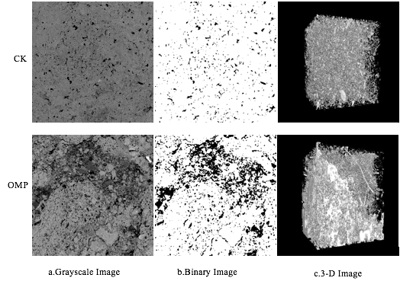
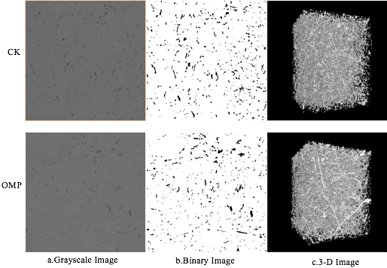
The large porosity (greater than 30 μm) of 10-30cm and 30-40cm soil layers of OMP increased by 10.52% and 0.71% than that of CK.
Fig.3 2-D and 3-D characteristics of soil pores in subsurface soils under subsurface organic amendment after 3a
Fig.4 2-D and 3-D characteristics of soil pores in deeper soils under subsurface organic amendment after 3a

Slide 8
The porosity of each equivalent pore size range under OMP increased significantly than that of CK.
Fig.5 Effect of subsurface organic amendment after 3a on soil pore size distribution at different depths
Note: CK-SS, subsurface soil under the treatment of plowing with no plastic mulching ; OMP-SS, subsurface soil under the treatment of organic manure amendment plus plastic mulching; CK-DS, deep layer soil under the treatment of plowing with no plastic mulching ; OMP-DS, deep layer soil under the treatment of organic manure amendment plus plastic mulching.

Slide 9
Summary
Under the condition of subsurface organic fertilization (OM, OMP), the dominant particle size of each soil layer changed from < 0.053 mm aggregate to 0.25-2 mm aggregate, which increased the content of large aggregate and water stability.
Combination of subsurface organic fertilization and film mulching (OMP) could maintain higher organic carbon content, enhancing soil respiration.
Combination of subsurface organic fertilization and film mulching (OMP) significantly increased soil macroporosity and improved soil pore structure.

Slide 10
Thanks for your time!
Email:lliyuyi@caas.cn

