Slide 1
Using GPS Derived Shear Strain Rates in Southern California to Constrain Fault Slip Rate, Locking Depth, and Residual Off-Fault Strain Rates
Lajhon Campbell, William Holt
Stony Brook University

Slide 3
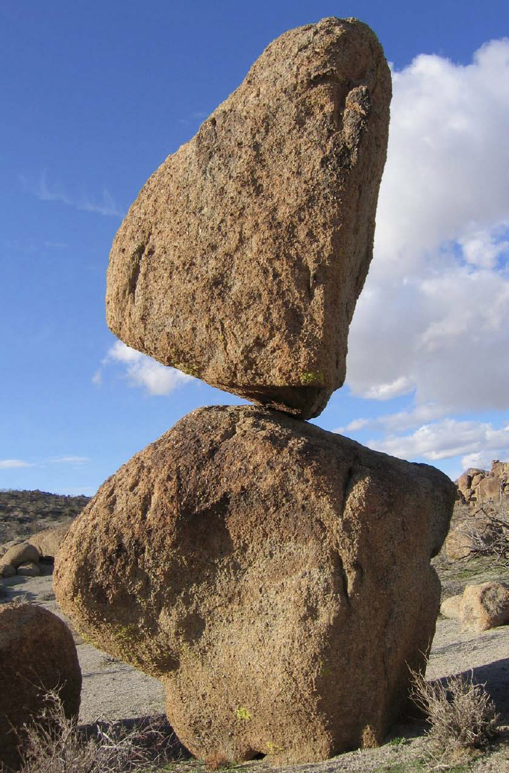
Atwater & Stock (1998)
Nick Hinze, Nevada Bureau of Mines and Geology

Slide 4
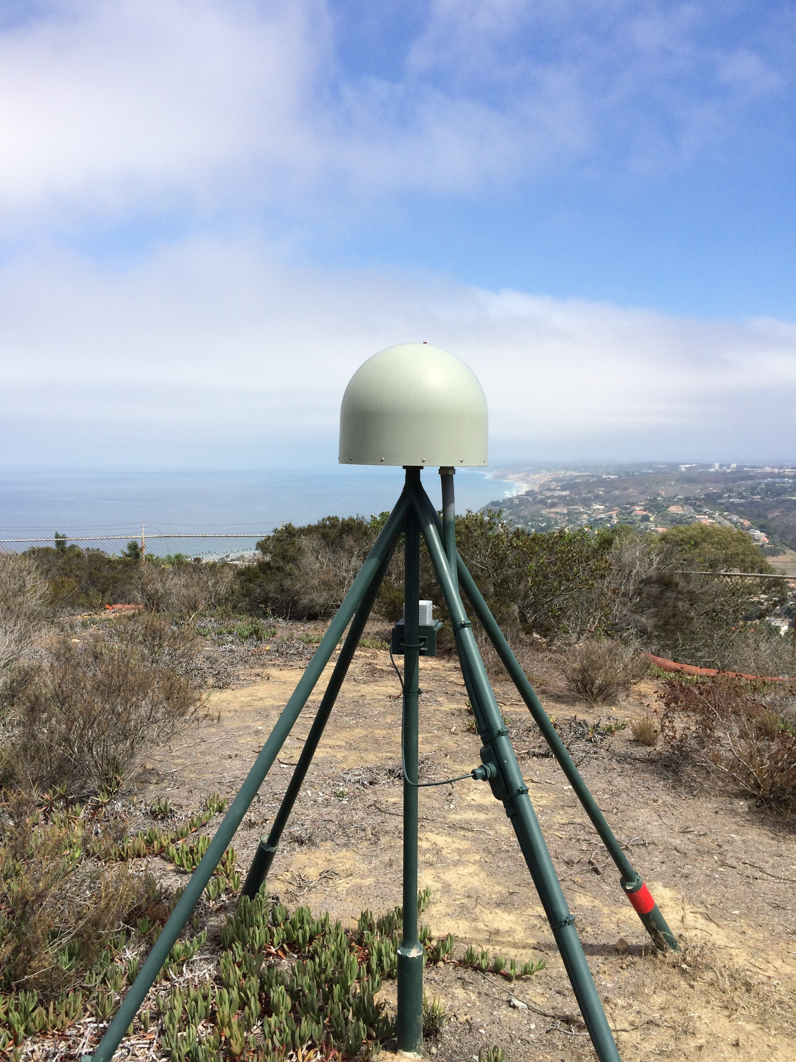

Slide 6
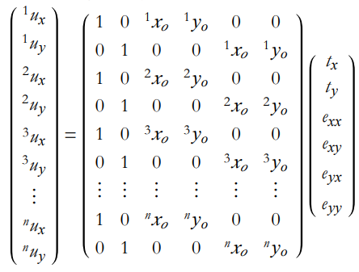

Slide 7
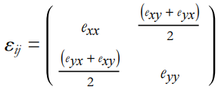
(Allmendinger, 2012)

Slide 8
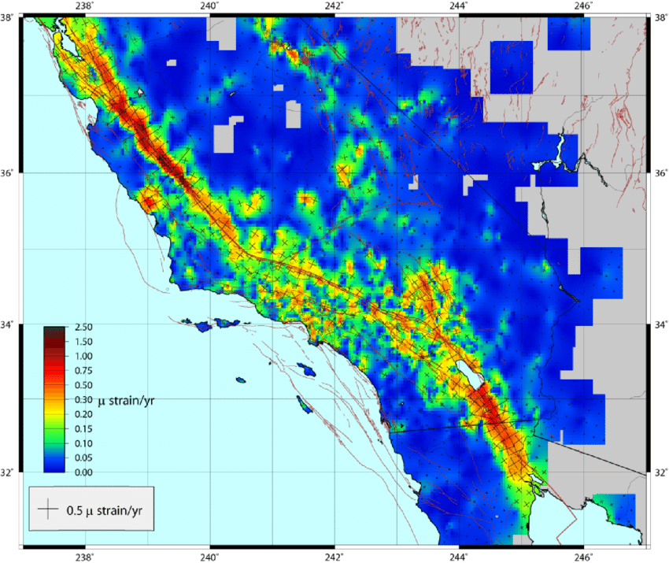
Hackl et al, 2009

Slide 9
Motivation & Methodology
Resolution of a continuous horizontal strain field to find slip-rates and locking depth of across faults:

Slide 10
Motivation & Methodology
Resolution of a continuous horizontal strain field to find slip-rates and locking depth of across faults:
Spherical Method (Beavan and Haines, 2001), (Haines & Holt, 1993)
Bi-Cubic Bessel Interpolation of GPS Velocities
A priori information on fault style

Slide 11
0.1° x 0.1° Finite Element Grid for Modeling Velocities
Holt et al. [2000]

Slide 12
Observed and Model Velocities

Slide 13
Residual Velocities (Observed – Predicted)

Slide 14
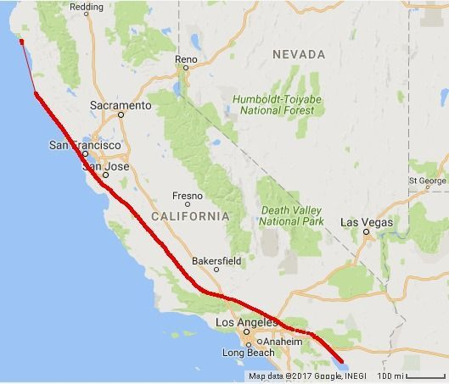
Motivation & Methodology
Resolution of a continuous horizontal strain field to find slip-rates and locking depth of across faults
Extraction of strike-slip component of the strain field
y-axis is now parallel to the fault
y
x-axis is now perpendicular to the fault
x
=
+
Pure Strike-Slip Component
Dilational Component

Slide 15
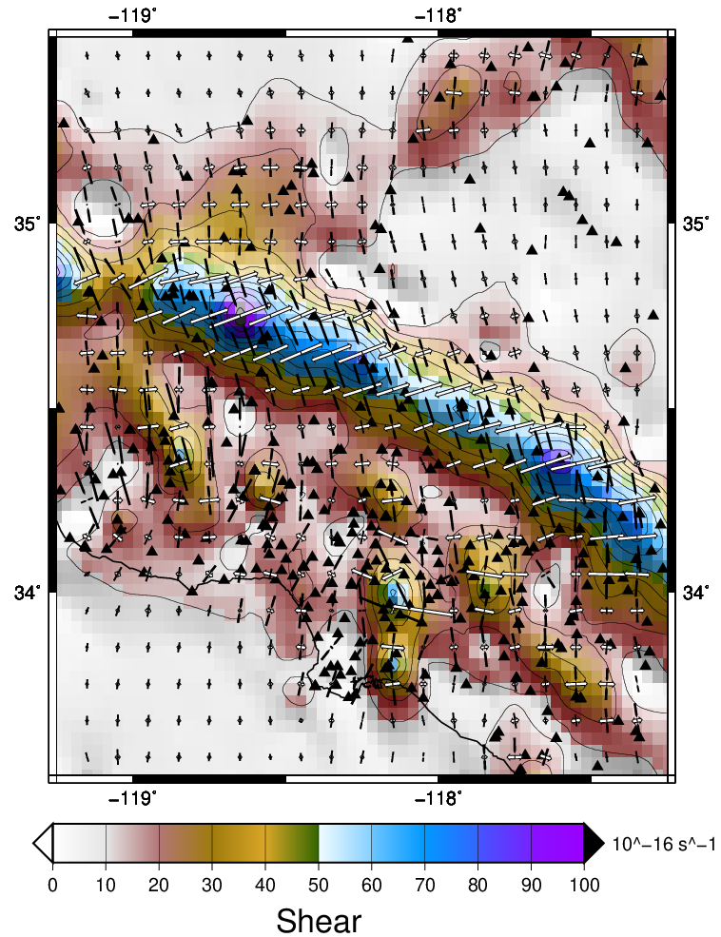
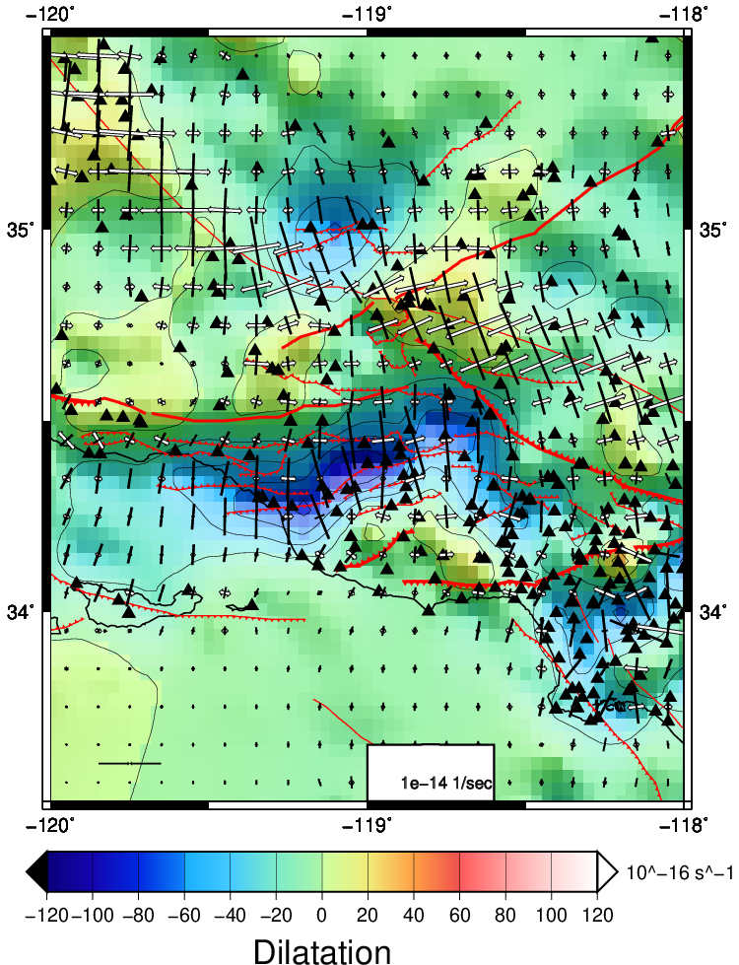

Slide 16
Model Shear Strain Rates (Pure SS) from Inversion of GPS

Slide 17
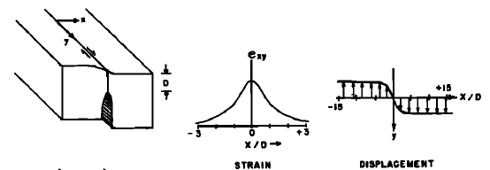
Screw Dislocation Model
Savage and Burford [1973]

Slide 18
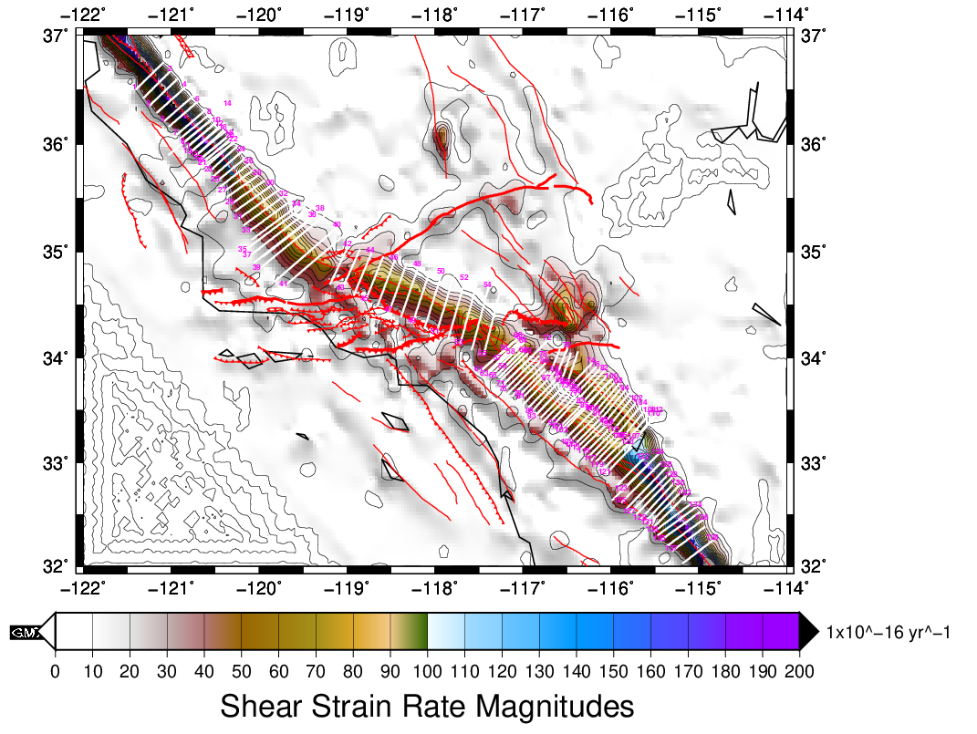

Slide 19
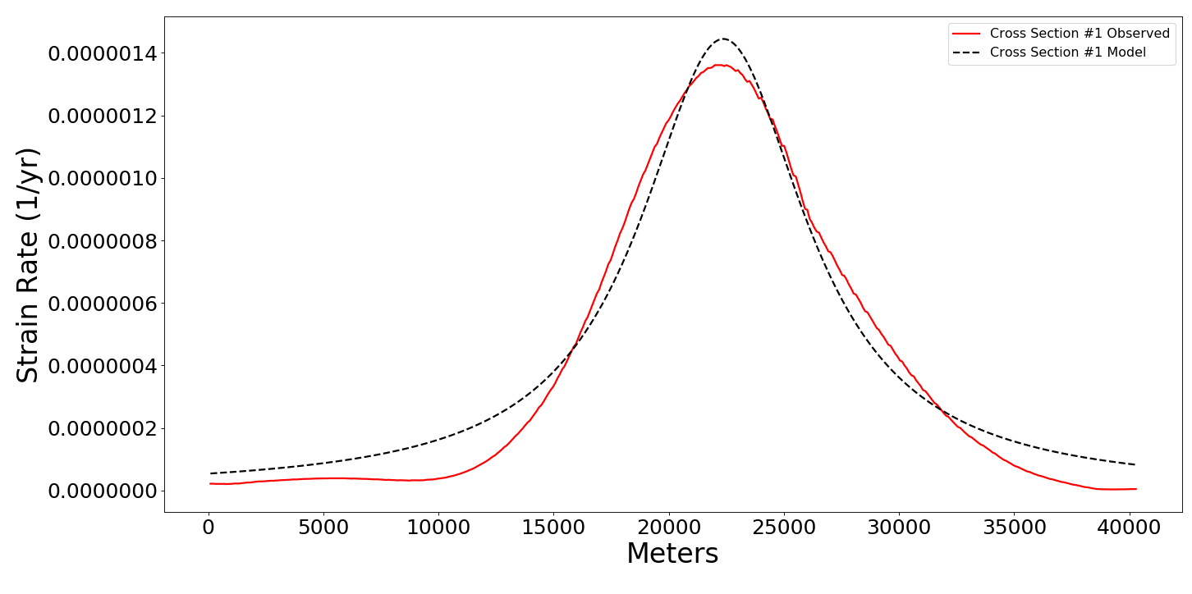
Slip Rate: 39.3 mm/yr
Locking Depth: 5.82km

Slide 20
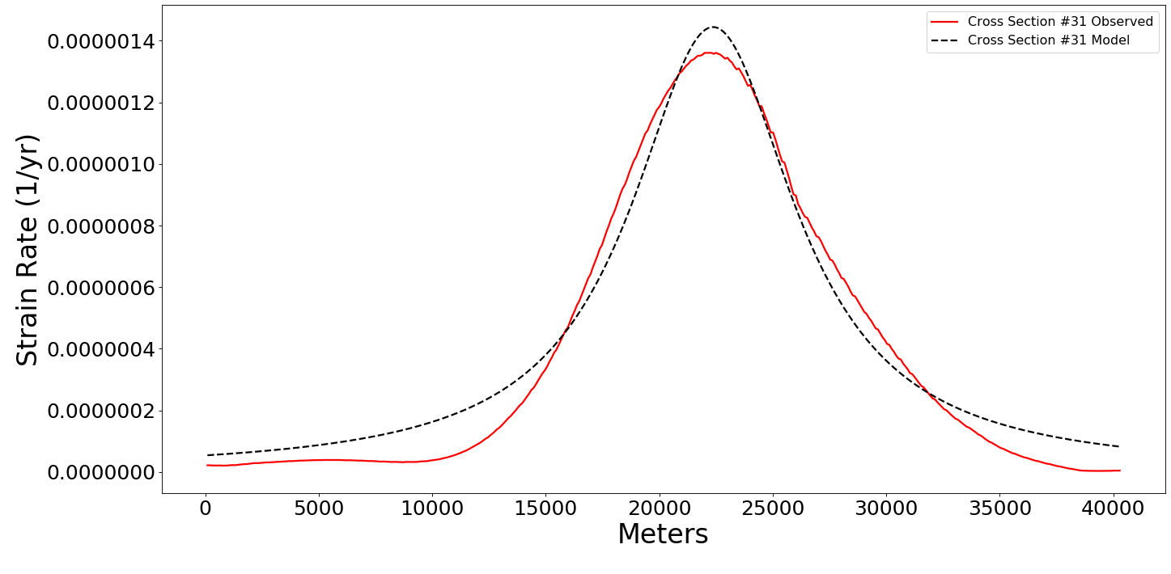
Slip Rate: 25.6 mm/yr
Locking Depth: 10.38km

Slide 21
Slip Rate: 16.1 mm/yr
Locking Depth: 10.64km

Slide 22
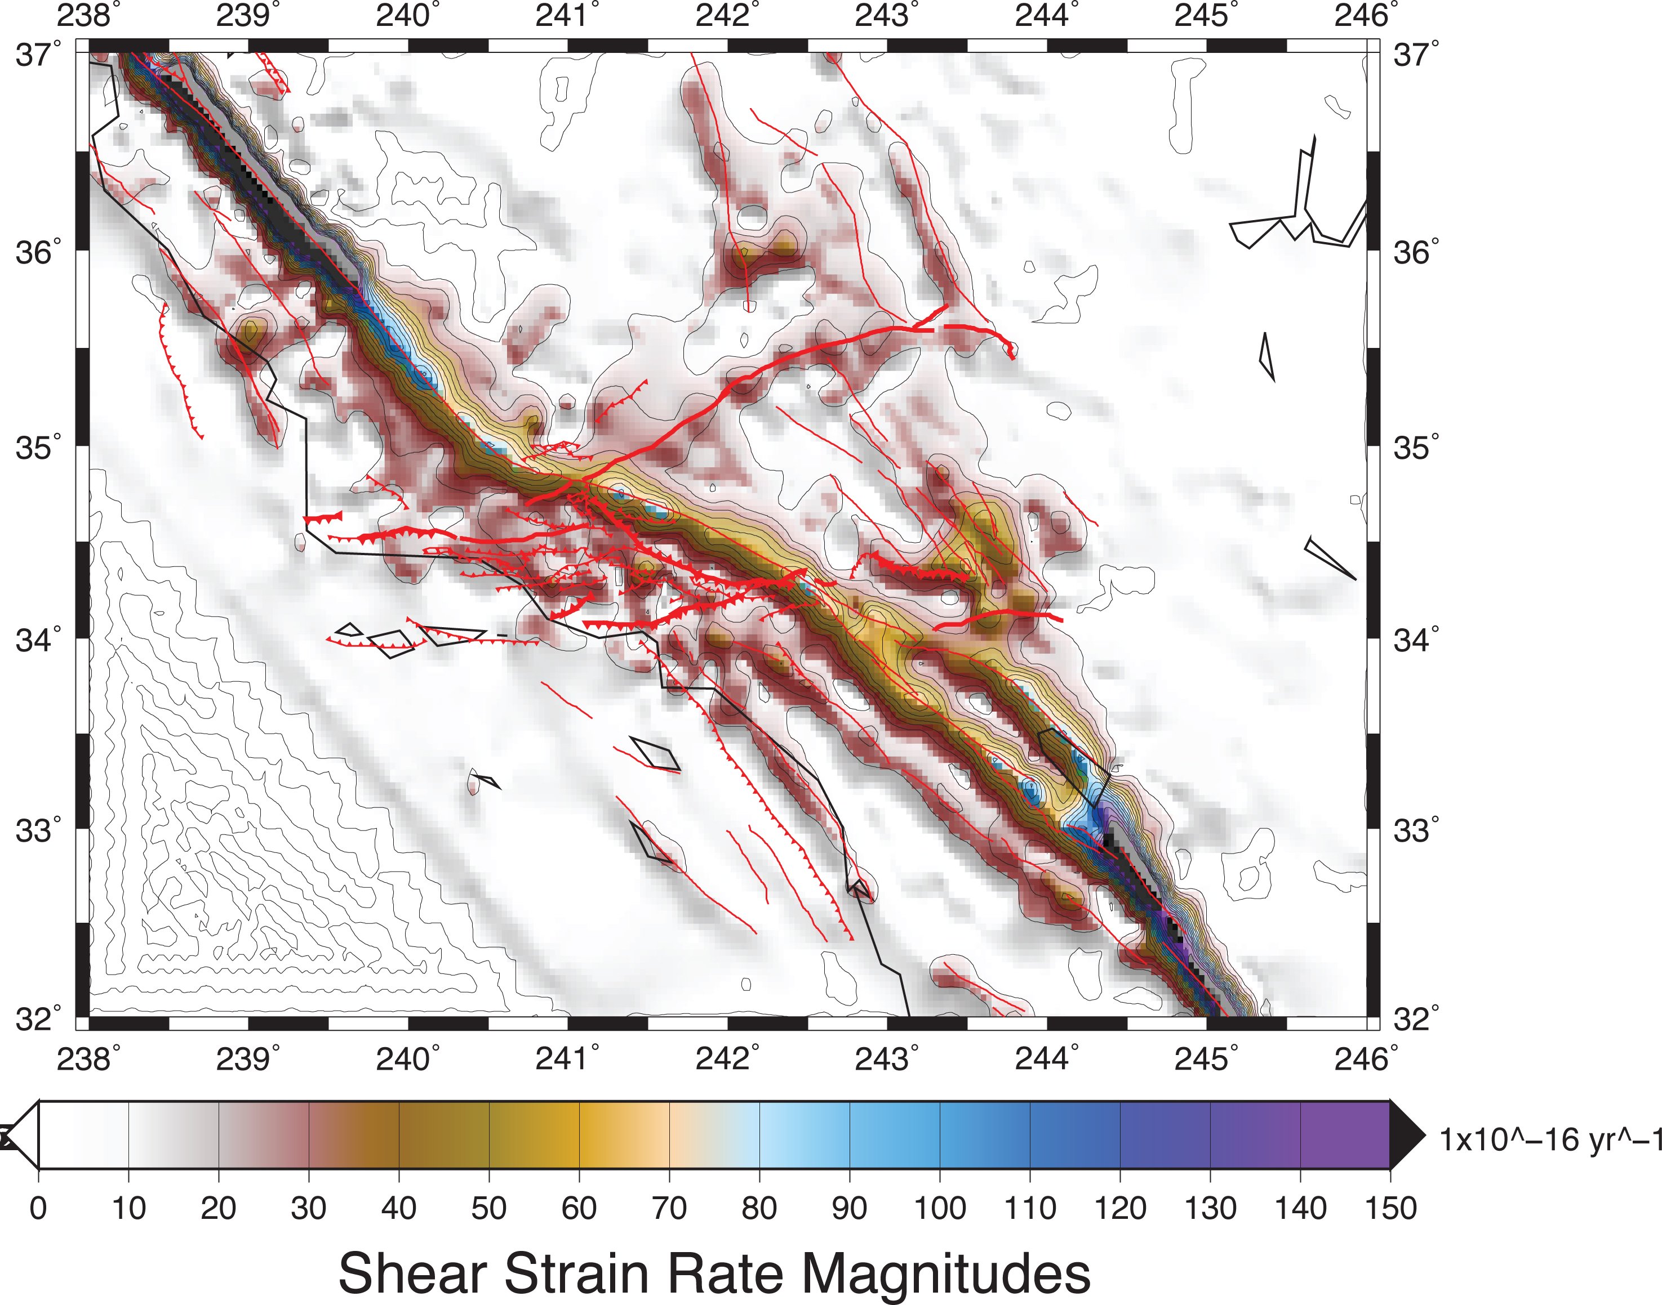
32 (5)
21 (10)
19 (10)
19 (9)
20 (9)
16 (10)
11 (7)
12 (10)
14 (8)
17 (7)
12 (9)
19 (8)
34 (7)

Slide 23
Conclusions
Using shear strain rates associated with pure strike-slip faulting filters out potential contamination from off-fault deformation. This data product may be better suited for resolving fault slip rate and effective locking depths along the major shear zones.
Effective fault locking depths inferred to date are shallower than most previous estimates.

Slide 24
References
Allmendinger, R.W., Cardozo, N, & Fisher, D.M. (2012). Structural Geology Algorithms, Vectors and Tensors : Cambridge University Press, 289 p., ISBN 978 - 1 - 107 - 40138 - 9..
Atwater, T., & Stock, J. (1998). Pacific-North America Plate Tectonics of the Neogene Southwestern United States: An Update. International Geology Review, 40(5), 375–402. doi: 10.1080/00206819809465216
Beavan, J., & Haines, J. (2001). Contemporary horizontal velocity and strain rate fields of the Pacific-Australian plate boundary zone through New Zealand. Journal of Geophysical Research: Solid Earth, 106(B1), 741–770. doi: 10.1029/2000jb900302
Hackl, M. & Malservisi, R. & Wdowinski, S. (2009). Strain patterns from dense GPS networks. Natural Hazards and Earth System Sciences. 9. 10.5194/nhess-9-1177-2009.
Haines, A. J., & Holt, W. E. (1993). A procedure for obtaining the complete horizontal motions within zones of distributed deformation from the inversion of strain rate data. Journal of Geophysical Research: Solid Earth, 98(B7), 12057–12082. doi: 10.1029/93jb00892
Holt, W. E., Chamot-Rooke, N., Pichon, X. L., Haines, A. J., Shen-Tu, B., & Ren, J. (2000). Velocity field in Asia inferred from Quaternary fault slip rates and Global Positioning System observations. Journal of Geophysical Research: Solid Earth, 105(B8), 19185–19209. doi: 10.1029/2000jb90004
Savage, J. C., & Burford, R. O. (1973). Geodetic determination of relative plate motion in central California. Journal of Geophysical Research, 78(5), 832–845. doi: 10.1029/jb078i005p00832

Slide 25
Future Work

