Slide 1

Deficit irrigation and the reuse of reclaimed water as strategies to cope with water scarcity in perennial crops.
A summary of long-term trials within the H2020 SHUI project
J.J. Alarcón, E. Nicolas, F. Pedrero, P.A. Nortes D.S. Intriglolo*
¹ CSIC - Centro de Edafología y Biología Aplicada del Segura, (Murcia), Spain
* e-mail address: dintri@cebas.csic.es

Slide 2
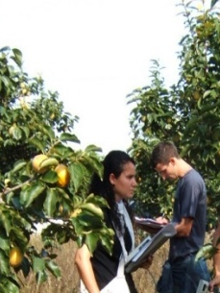
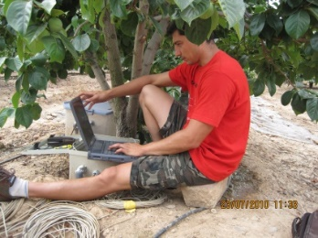




Acknowledgments
The team
CEBAS-CSIC: J.M. Bayona, C. Romero. E. Pérez, F. Sanz, A. Yeves, D. Guerra, D. Hortelano, A. Martínez, J.M. Ramírez, J.L. Ruiz,
IVIA: J.G. Pérez, L. Bonet J.M. de Paz, F. Visconti
Albacete (ITAP+UCLM): R. López, M.A. Moreno
Current grants related with the research
H2020: Shui
Agencia Estatal de Investigación:
  RTC-2016-4972-2 and RTC-2017-6365-2
Life: Climatree
Interreg: RiskAquaSoil and Triple-C, ClimAlert

Slide 3
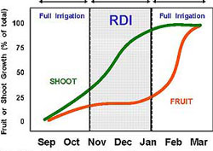
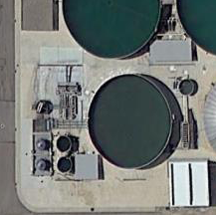
Background
In woody perennial crops, long-term responses to the watering regime (quantity and quality) are required
There is much of information on short-term responses to the irrigation (deficit and saline water application)
There is a need to conduct long-term studies to determine the effects on soil sustainability and plant performance
The H2020 project SHUI (Managing water scarcity in European and Chinese cropping systems) is an opportunity to continue with the research on regulated deficit irrigation and non-conventional water use

Slide 4
Research goals
To determine the long-term effects of different irrigation strategies in:
Citrus trees with different water quality and quantity regimes, including the use of non-conventional water resources
Grapevines for wine production with wither deficit irrigation or the use saline water
This study is on-going to determine the agronomic water use efficiency and economic sustainability of the different practices

Slide 5
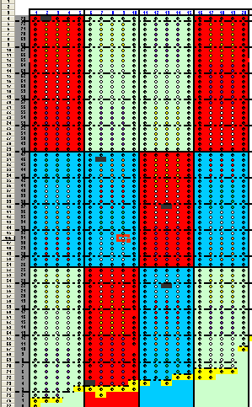
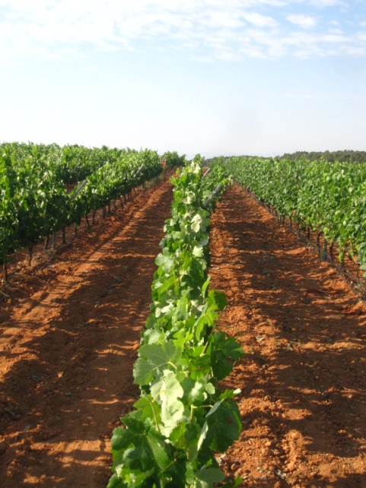
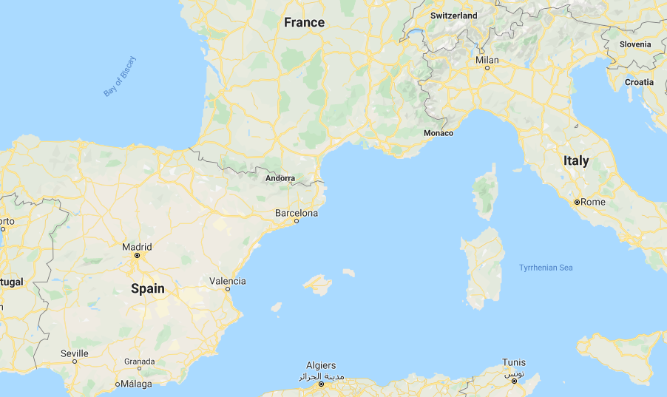
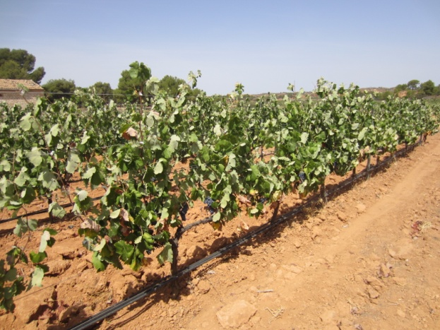
Grapevine research (Irrigation Regime)
Irrigation treatments
Full irrigation 100% ETc = 276 mm
Regulated déficit irrigation 35% ETc = 92 mm
Rainfed
Vineyard located in Requena (Valencia, eastern Spain)

Slide 6
Results
 | 2012 |  | 2013 | 2014 | 2015 | 2016 | 2017 | 2018 | 2019
Irrigation regimes | Irrigation applied (mm/year)
Full irrigation | 271 | 201 |  | 362 | Data were not taken | 309 | 123 | 69 | 56
Regulated deficit irrigation | 90 | 63 |  | 127 |  | 110 | 62 | 68 | 96
Rainfed | 0 | 0 |  | 0 |  | 0 | 0 | 0 | 0
 | Yield (t/ha)
Full irrigation | 8,6 | 12,2 |  | 13,1 | Data were not taken | 18,4 | 16,3 | 12,1 | 9,1
Regulated deficit irrigation | 4,6 | 5,3 |  | 7,5 |  | 11,1 | 8,9 | 6,9 | 9,9
Rainfed | 4,2 | 4,9 |  | 2,4 |  | 5,3 | 7,4 | 7,8 | 5,8
 | Total anthocyanin (mg/g)
Full irrigation | 0,52 | 0,45 |  | 0,39 | Data were not taken | 1,38 | O,65 | 0,81 | 0,94
Regulated deficit irrigation | 0,86 | 0,89 |  | 0,60 |  | 1,60 | 0,97 | 1,02 | 0,85
Rainfed | 1,03 | 0,66 |  | 1,04 |  | 1,92 | 0,98 | 1,21 | 1,49

Slide 7
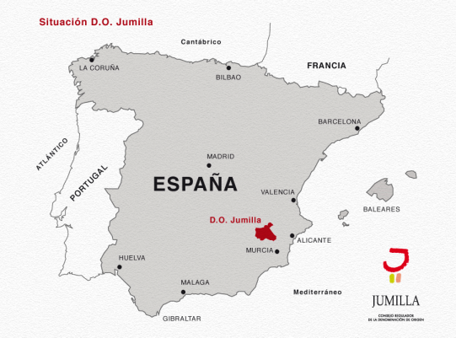
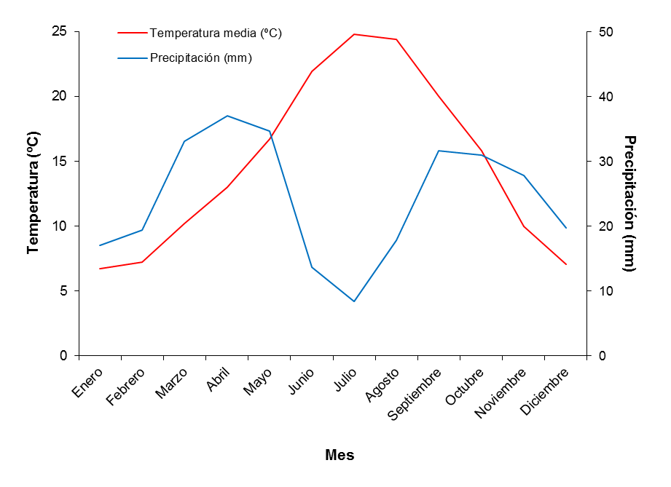
Grapevine research (Irrigation Quality)
The experiment was carried out in a commercial vineyard, locates in Fuente-Álamo (Albacete, Spain).
Climate is semiarid Mediterranean.
  Annual rainfall average 291 mm
  Annual average (ET0) is 1280 mm
Treatments | Salts used | CE(dS/m) | Irrigation (mm)
Rainfed | - | - | 0
Standard water | - | 1,5-2 | 104
Sulfate water | Na₂SO₄+ MgSO₄ | 4,5-5 | 106
Chloride water | NaCl | 4,5-5 | 102
Temperatura (º C)
Precipitación (mm)
mes

Slide 8
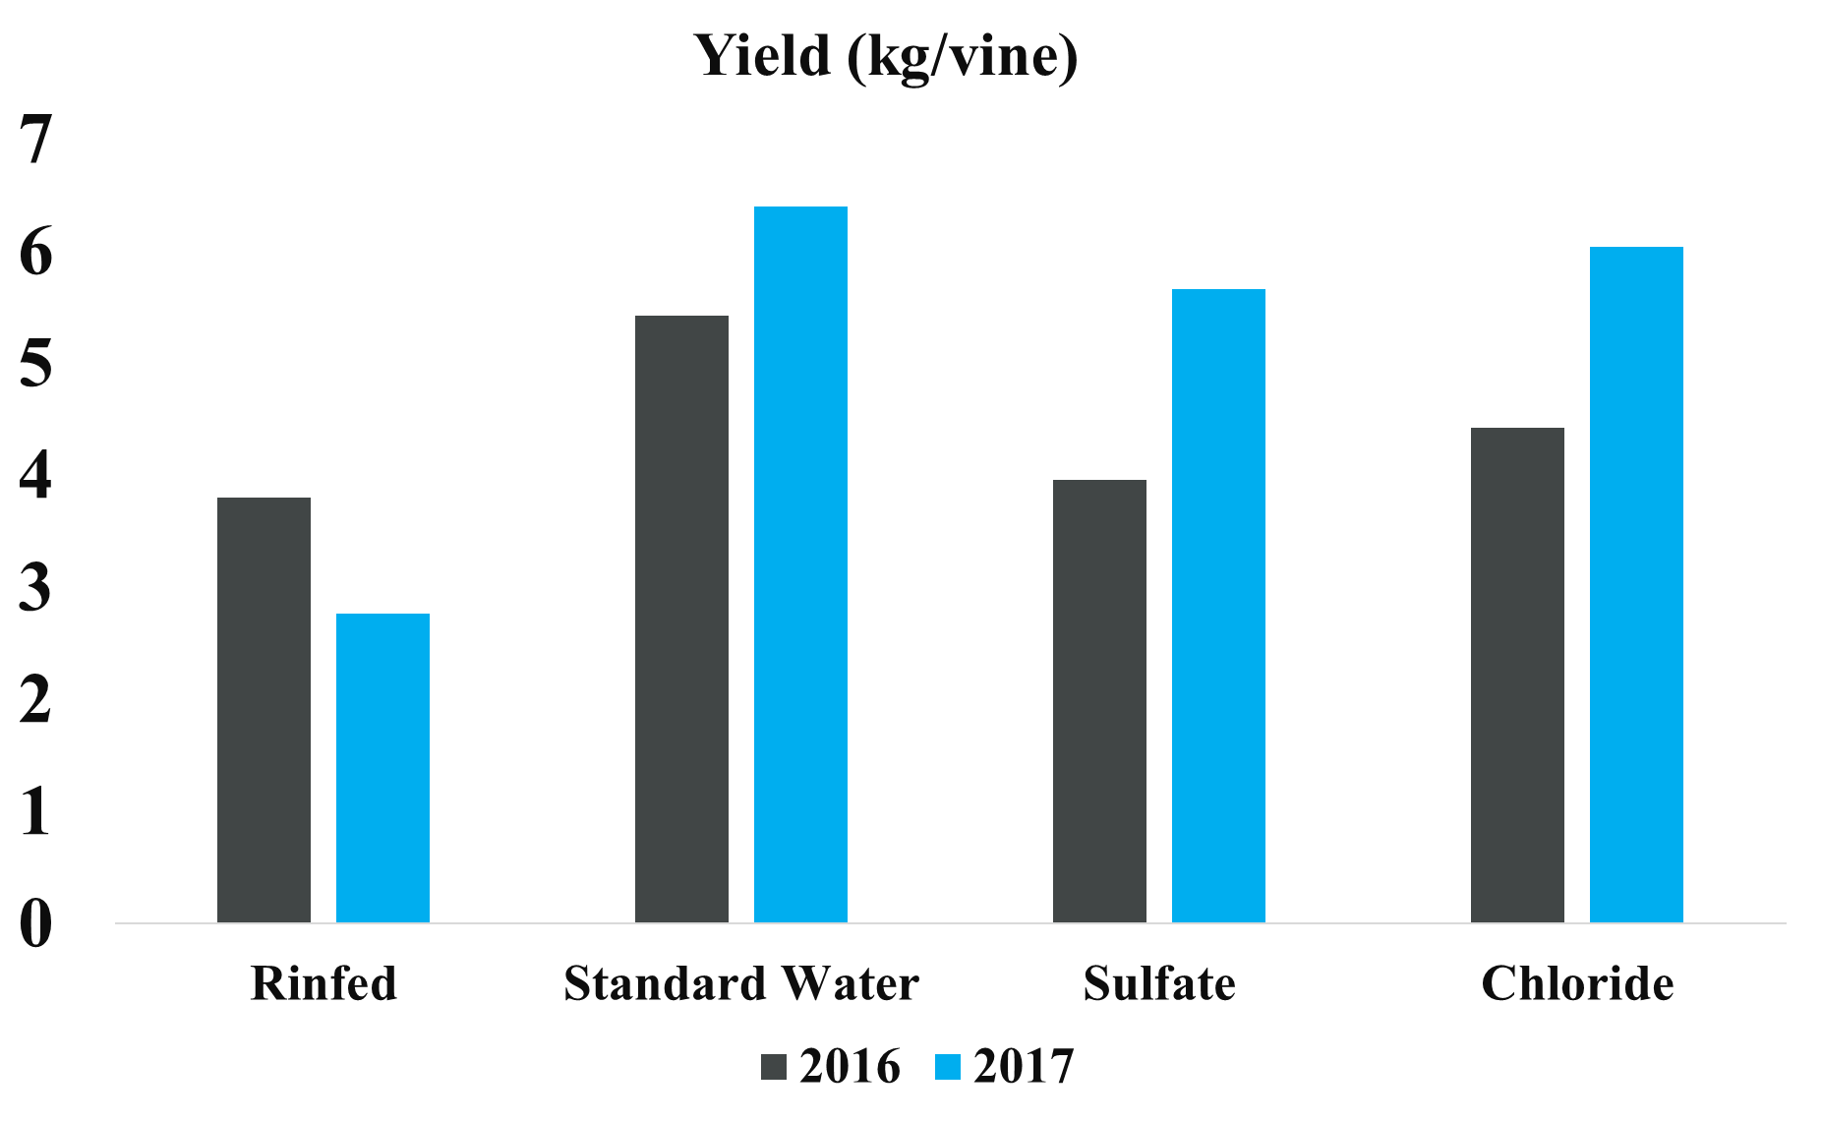
Results
 | STT(ºBrix) |  | Total acidity (mg/L) |  | Tartaric acid (mg/L) |  | Malic acid (mg/L)
 | 2016 | 2017 | 2016 | 2017 | 2016 | 2017 | 2016 | 2017
Rinfed | 25.6 a | 23.6a | 4.3 a | 5.1a | 4.4 | 5.0 b | 1.5 a | 2.7 a
Standard Water | 27.1 ab | 23.3ab | 6.6 b | 5.7b | 4.3 | 4.9 ab | 2.1 b | 3.8 c
Sulfate | 28.2 bc | 23.1ab | 5.6 ab | 5.6b | 4.3 | 4.7 a | 2.0 b | 3.5 bc
Chloride | 28.9 c | 22.4b | 6.7 b | 5.0b | 4.2 | 5.0 b | 2.3 b | 3.4 b

Slide 9
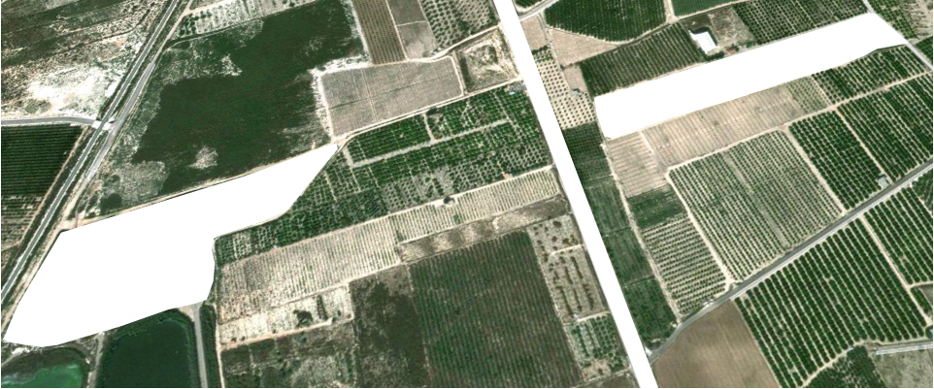
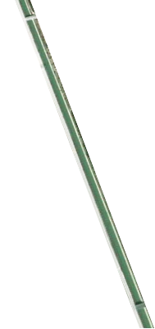
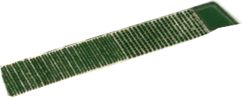
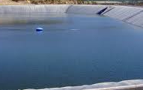
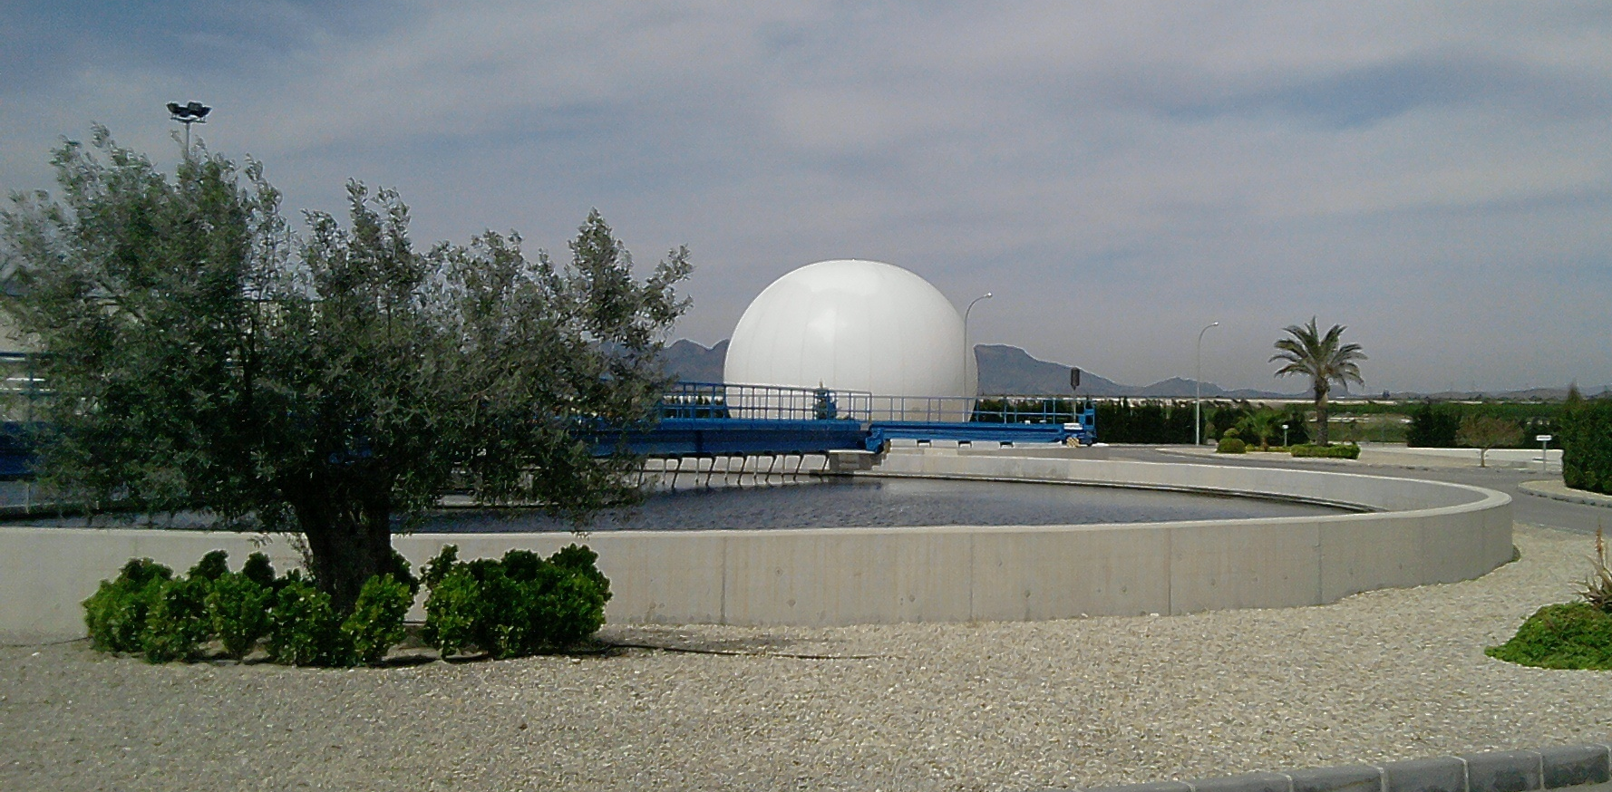
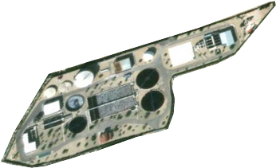
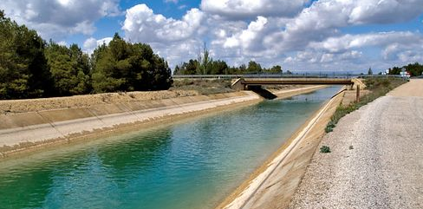
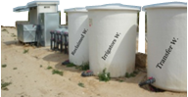

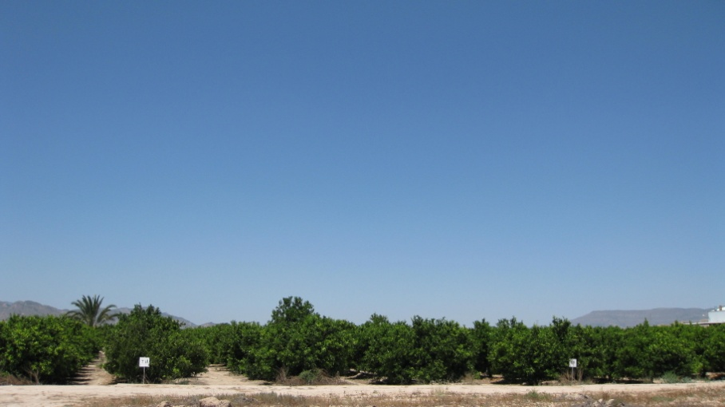

Citrus Research (Wastewater reuse)
Orchard : Lo Montero
Province : Campotejar-Murcia
Irrigators association
WWTP
3-4 dS.m⁻¹
1-4 dS/m⁻¹
Variety : “Orogrande”
Rootstock : Carrizo
Age : 8 year-old
Soil : Clay-Loam
Plant Spacing : 3.5 x 5 m
Irrigation system: 3 emitters.t⁻¹
x 4 l.h⁻¹
Tajo-Segura
1 dS/m⁻¹
Physico-chemical & Microbiological analysis
3 samples per source every month

Slide 10
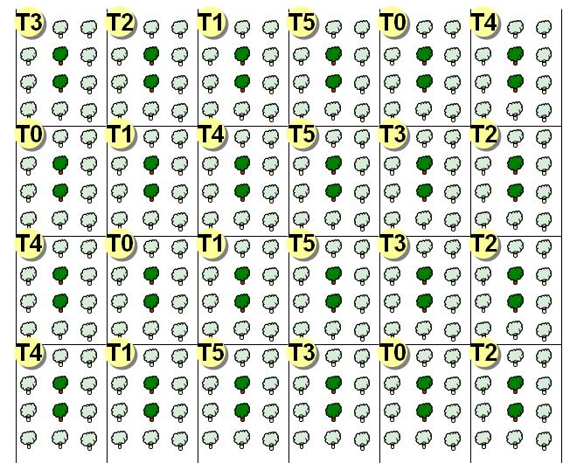
Material and Methods
Irrigation Treatments
Transfer water
TW-C
TW-RDI
Reclaimed water
RW-C
RW-RDI
Jan
Feb
Mar
Apr
May
Jun
Jul
Aug
Sep
Oct
Nov
Dec
Jan
Feb
Mar
Apr
May
Jun
Jul
Aug
Sep
Oct
Nov
Dec
CONTROL
CONTROL
100 % ETc
100 % ETc
RDI
RDI
100 %
50 % ETc
100 % ETc
100 %
50 % ETc
100 % ETc

Slide 11
Results. Citrus deficit irrigation with reclaimed water
Mandarine
Grapefruit

Slide 12
Results. Citrus deficit irrigation with reclaimed water
Treatment | Peel thickness (mm) |  | Juice volume (ml) |  | º Brix |  | pH |  | Total Acidity |  | Maturity Index |  | Vitamin C
TW-CTR | 2,52 | ± 0,75a | 53,00 | ± 13,05a | 11.6 | ±0.7a | 3.6 | ±0.1a | 0,9 | ±0.1a | 12,8 | ±1.5a | 8,5 | ±0.6a
TW-RDI | 2,20 | ± 0,44a | 53,80 | ± 14,81a | 12.0 | ±0.4a | 3.7 | ±0.0a | 0,9 | ±0.0a | 13,8 | ±0.6a | 11,0 | ±0.4b
RW-CTR | 2,43 | ± 0,43a | 61,33 | ± 14,32a | 12.2 | ±0.9a | 3.7 | ±0.1a | 1,0 | ±0.1a | 11,9 | ±0.8a | 13,8 | ±1.1ab
RW-RDI | 2,57 | ± 0,48a | 57,53 | ± 12,71a | 12.7 | ±1.0a | 3.6 | ±0.1a | 1,1 | ±0.1a | 11,8 | ±0.6a | 17,7 | ±0.6c

Slide 13
Take home messages
GRAPEVINE: Irrigation quantity experiment. No clear long-term detrimental responses to rainfed nor to deficit irrigation was reported. Regulated deficit irrigation is the best strategy to optimize the balance between yield and fruit composition
GRAPEVINE: Irrigation quality experiment. In the mid-term (two seasons) salinity was not harmful for grapevine performance. The experiment is on-going within the SHUI project to determine the mid-term effects.
CITRUS: A tendency to reduce the number of fruits was detected under RW treatments. This reduction was more pronounced under regulated deficit irrigation (RW-RDI treatment).
CITRUS: Irrigation with reclaimed water tends to accumulate salts within the plant root zone. Therefore, careful monitoring is needed to avoid possible reduction in the soil agronomic properties.
CITRUS: Combined effects of RDI strategies and reclaimed water increased some fruit quality parameters on mandarin trees. [Vit.C] RDI-RW > RDI > Control treatments.

Slide 14
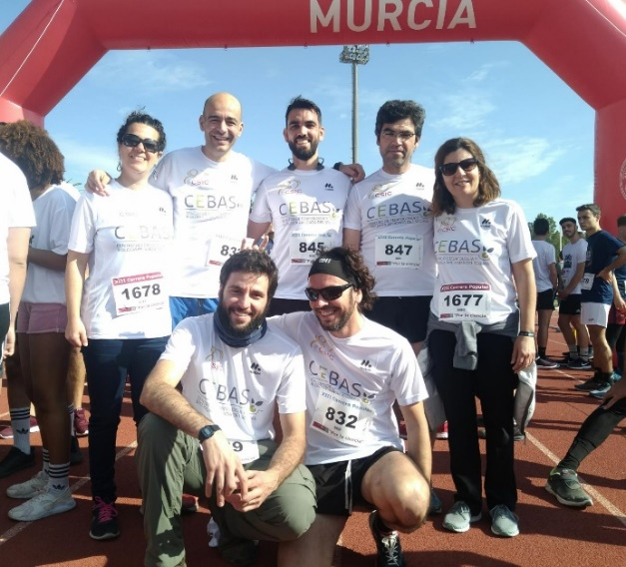
Finish line!
Deficit irrigation and the reuse of reclaimed water as strategies to cope with water scarcity in perennial crops.
A summary of long-term trials within the H2020 SHUI project
J.J. Alarcón, E. Nicolas, F. Pedrero, P.A. Nortes D.S. Intriglolo*
CSIC - Centro de Edafología y Biología Aplicada del Segura, (Murcia), Spain
* e-mail address: dintri@cebas.csic.es

