Slide 1
Energetic particles measurements on the lunar far-side by Lunar Lander Neutron and Dosimetry(LND) experiment
Zigong Xu¹, Robert F Wimmer-Schweingruber^{1,2}, Jingnan Guo^{1,3}, Jia Yu¹, Shenyi Zhang², T. Berger⁴, D. Matthiä⁴, S. Burmeister¹, S. I. Böttcher¹, B. Heber¹
[1].University of Kiel
[2]. NSSC, Peking, China
[3].University of Science and Technology of China
[4]. Institute of Aerospace Medicine, DLR, Cologne

Slide 2
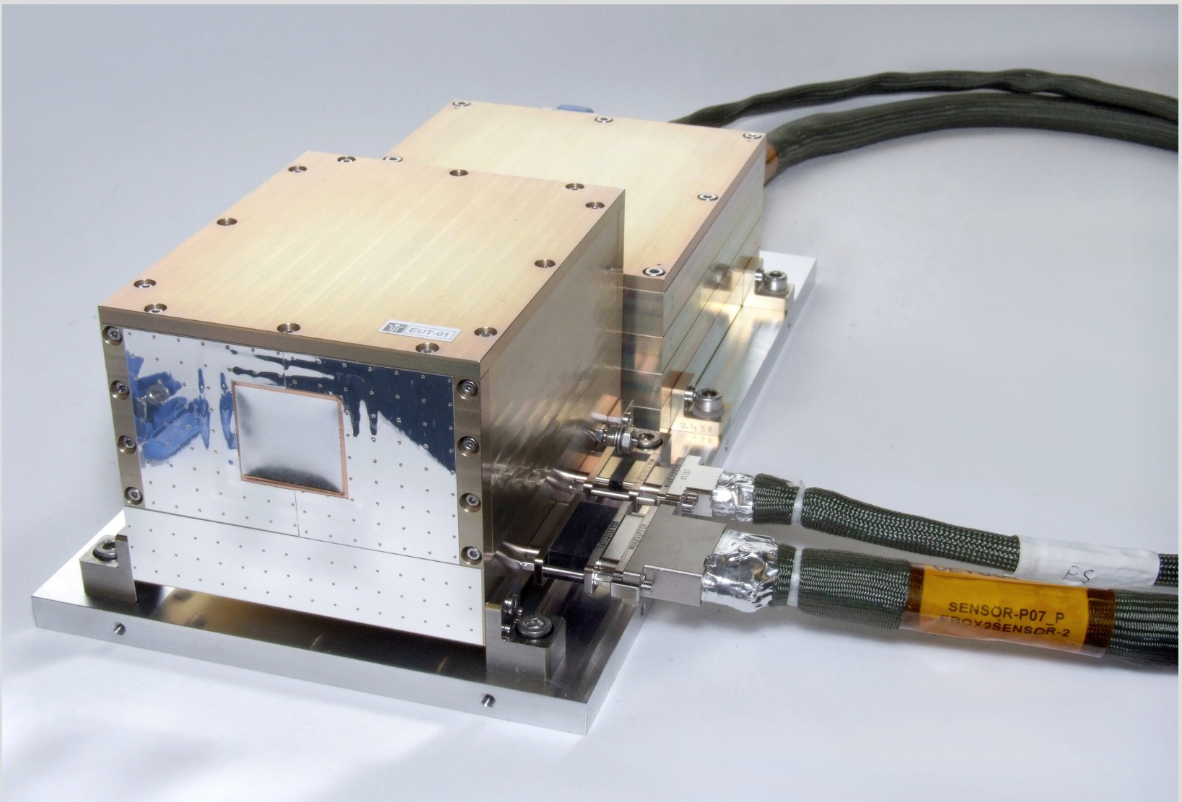
Outline
Part 1:
Overview of LND
GCR background
Part 2:
SEP event

Slide 3
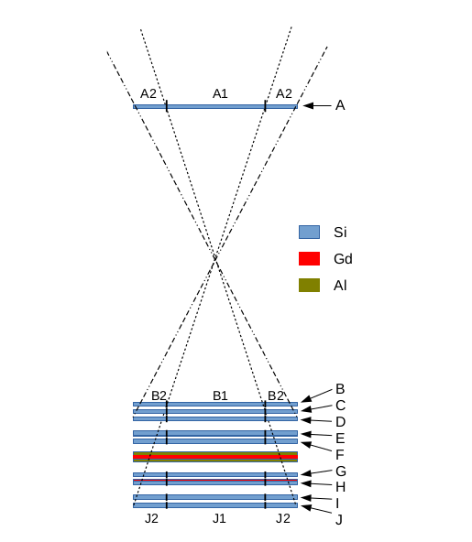
Overview of LND mission
Part1
Chang’e-4: launched- 7 December 2018; landed on the far side of Moon- 3 January 2019
LND – started working soon after landed.
Up to now: 17th lunar day data and more after.
Ten silicon detectors. A-J
Method: dE/dX. Tell apart the particle species.
Data products: total ionizing dose, LET spectra, charged particles
Instrument paper: arXiv:2001.11028

Slide 4
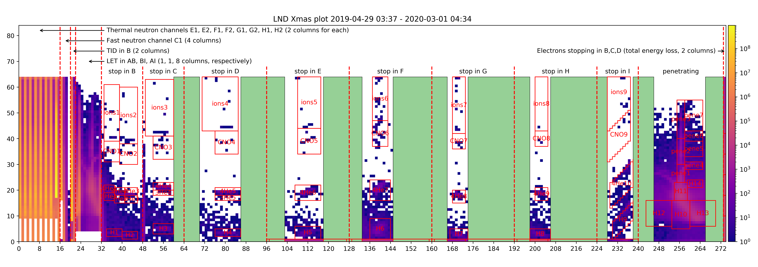
Overview of LND mission – X-mas plot
Part1

Slide 5
GCR background
Part1
before
Spectra over 2019, LND covers 8-35 MeV
K-S test ; LND Agrees well with SOHO/EPHIN.
Model and Observation, not fit well. The uncertainty of model need to be considered.
After
Notes:
High cadence data product

Slide 6
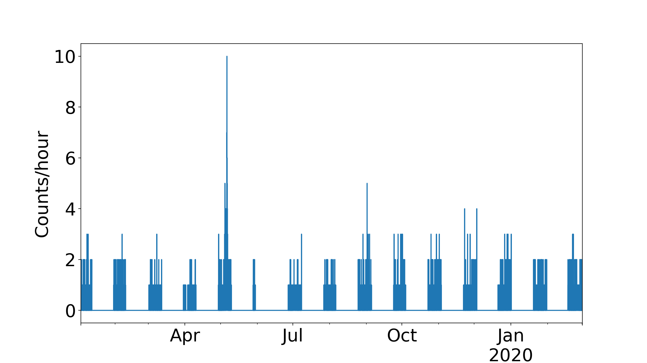
Introduction
Part 2 - SEP
LND protons
Quiet sun and only one SEPs detected by LND
E50, M1.0 class flare ,a narrow and slow CME
Notes:
Lunar lander Neutron and dosimetry Experiment on-board the Chang’E has been working for 16th months to now.
Though the primary object is to measure the radiation level on the lunar far-side preparing for astronaut, the charged particle telescope could also provide high quality data monitoring the solar activities. However, the last year(2019) is the valley between cycle 24 and 25 and the boring sun did present us many large eruption except a small SEPs event captured by LND in the May. That is the only SEPs we saw and that is why we are interested in.
This events was relative to a active region located at E50, where a M1.0 class flare erupted before the SEPs and is also accompanied with a narrow and slow CME. By a comprehensive analysis of the in-situ measurement and remote-sensing, the real source and the propagation of the energetic electrons and protons is puzzling us. We give our speculation and the possible explanation about this large distance SEP event.

Slide 7
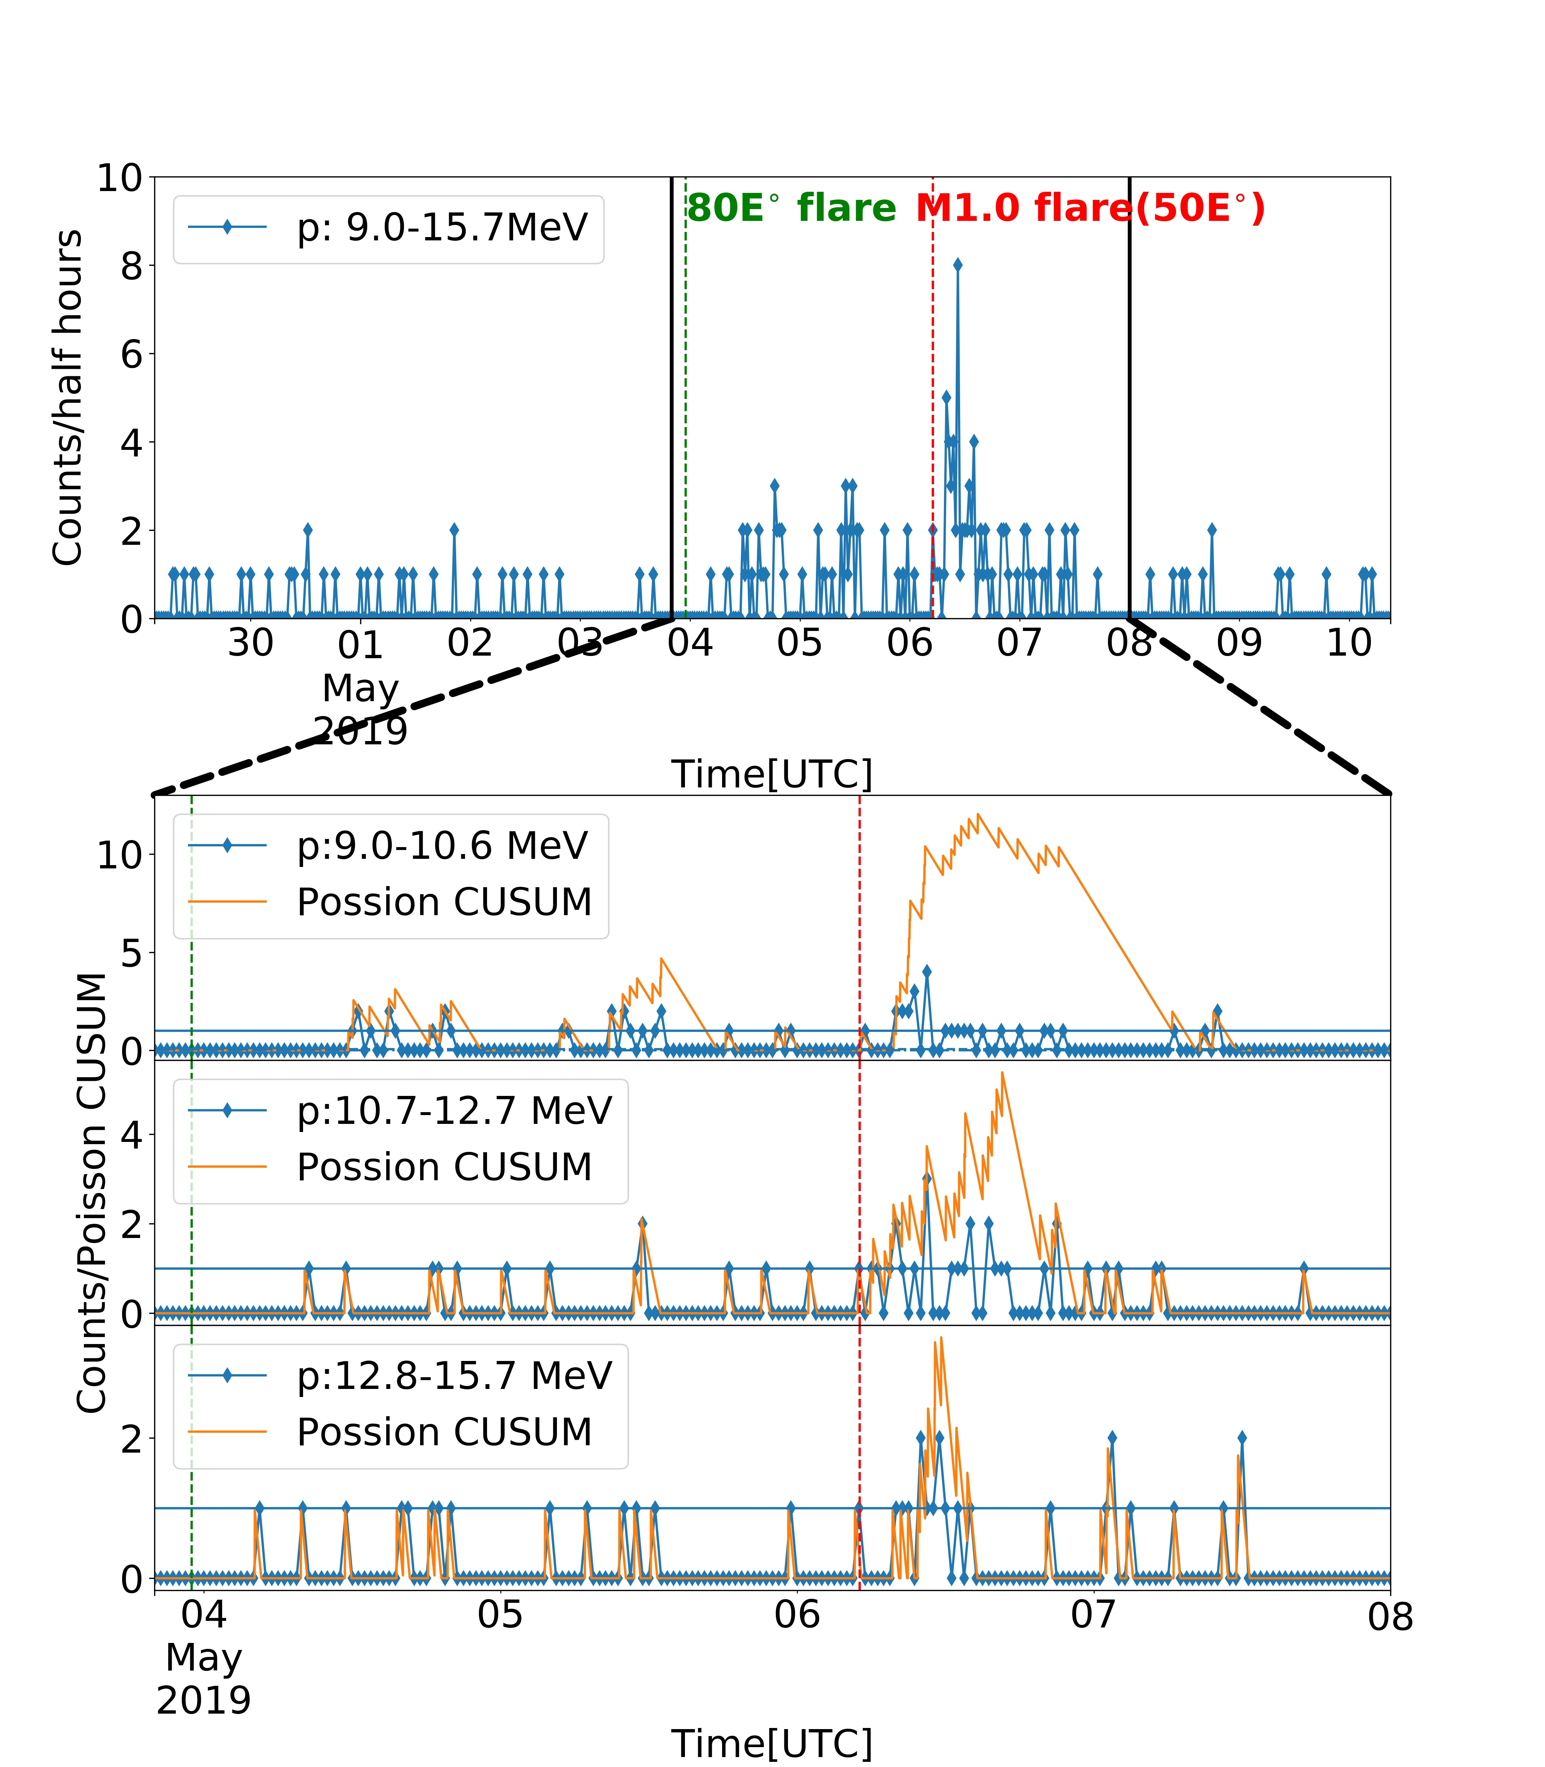
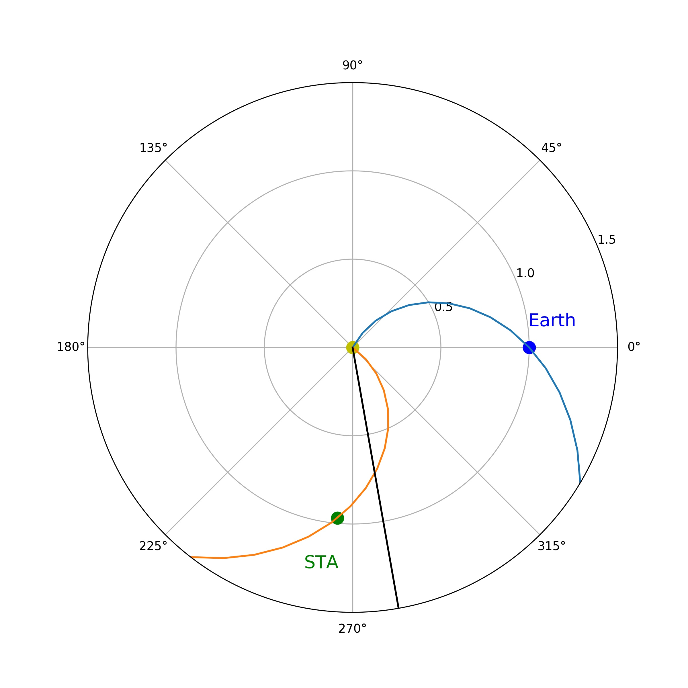
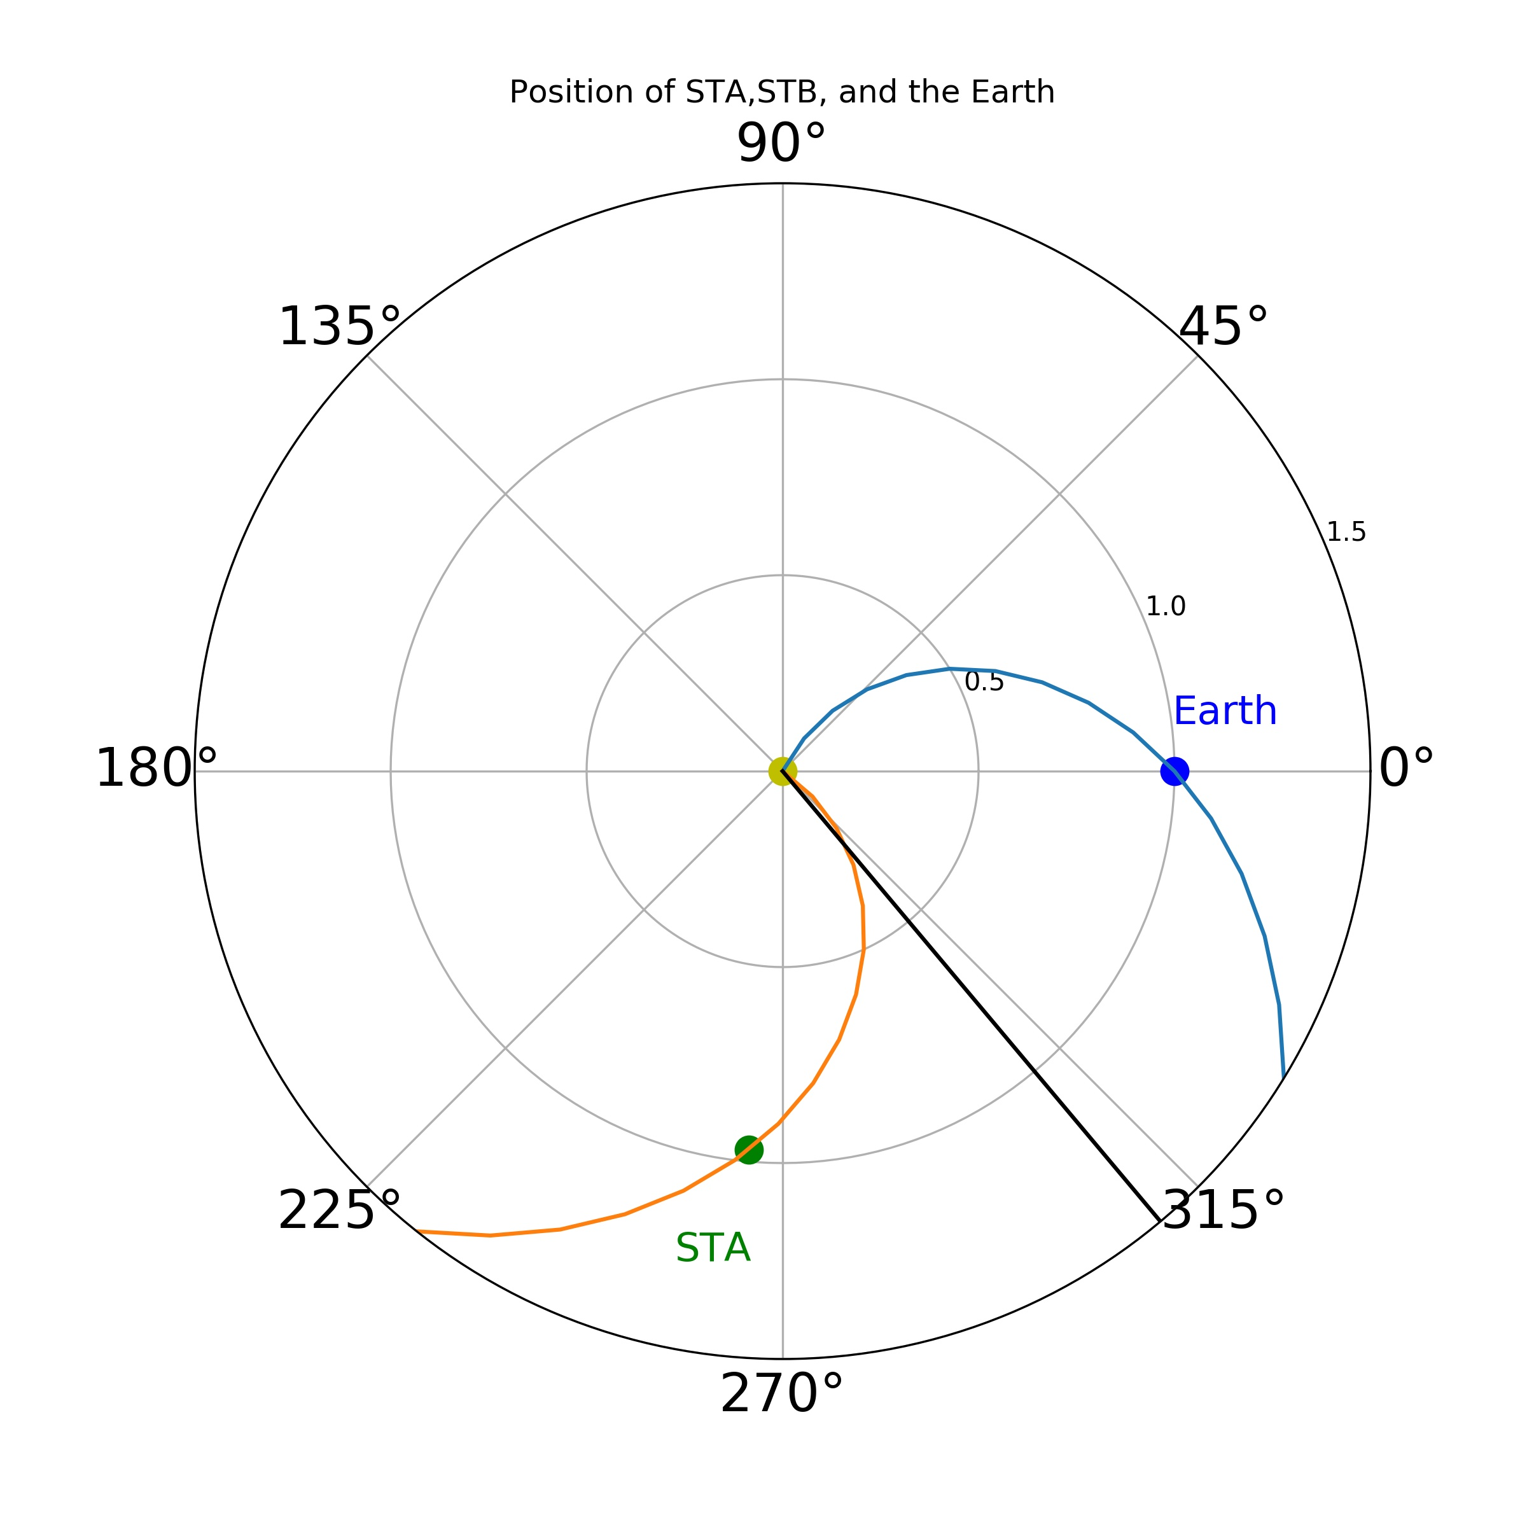
Part 2 – SEP – observation
LND measurement in 30 minutes cadence
07:32
Poisson - CUSUM method
(Huttunen-Heikinmaa 2004)
by LND
Notes:
LND measurement in 30 minute cadence.
Very poor statistic in separate channels.
Using Possion-CUSUM method to determined the onset time.
Large error bar even it is based on 1 minute data
-LND measurement in the energy range 9.0-15.7 MeV, the sum up of the lowest three energy channels, shown in Counts/half hours. The red line and the green line indicate that eruption time of the closest flare(AR 12470). One is located in 80E, the second one is 50E, as shown in two coordinate system plots, green point is STA, and blue point is Earth. Black line is the location of flare.
-Bottom three: counts every half hour in those three channels and their Poisson-CUSUM.
When the variable is a poisson distribution; Cumulative sum quality control schemes , to monitor the small change in industry.
- The onset time of 10.7-12.7MeV particle is 07:32 calculated from possion-cusum method based on 1 minute data. 08:00 for 9.0-10.6MeV. Obviously, due to the poor statistic, a large error bar is needed for the onset time

Slide 8
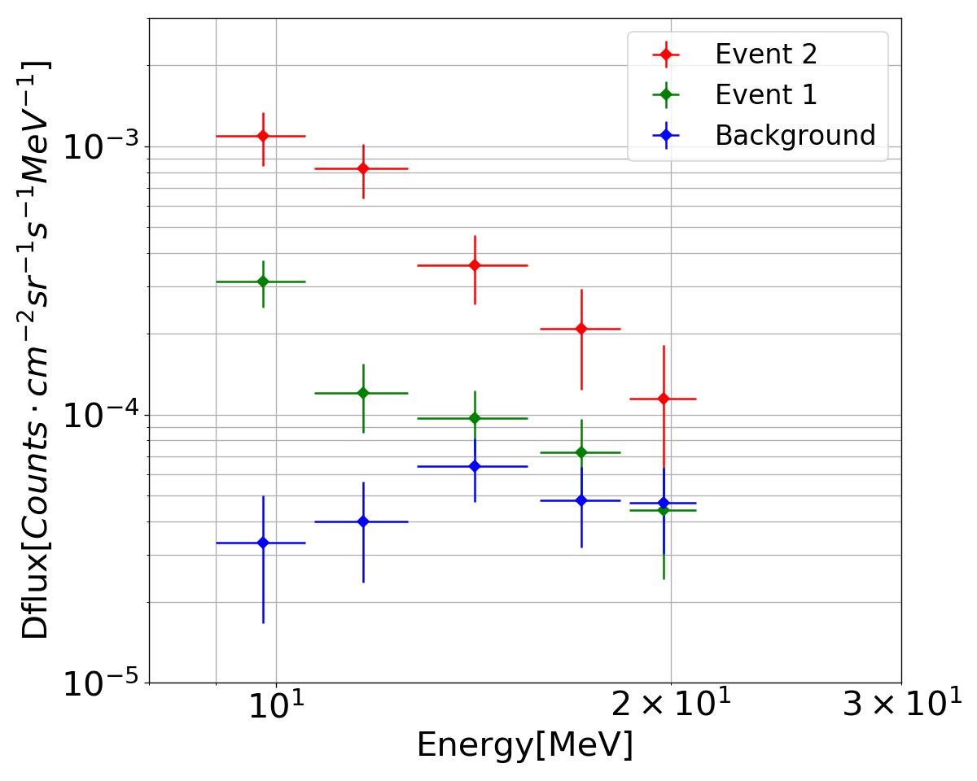
Part 2 – SEP – observation
Event 1: integrated spectra 0504-0505
Event 2: integrated spectra 0506 06:00-17:00
Background: 0502 - 0503

Slide 9
Summary
This new instrument has worked on the lunar-far side for 17 months so far and will continue to observe in the future.
Apart from the TID and LET measurement which is the main objective of LND, the charged particle telescope also function well. The quite time spectra agree well with the SOHO/EPHIN.
The SEPs on 6 May 2019 is the only clear one observed by LND during the last year, the spectra are well above the background.
There is a lot of space between the Sun and Earth/Moon in which ”such things can happen". Combining with Solar Orbiter and Parker solar Probe, LND would be very helpful to improve our understanding of heliosphere.

