Slide 1
Determination of thermal conductivities in the laboratory and the field: A comparison
Linda Schindler, Sascha Wilke, Simon Schüppler, Hanne Karrer, Roman Zorn, Hagen Steger, Philipp Blum

Slide 2
Agenda
Geographical and geological setting
Test site - Drilling profile
Lab characterization
  Petrophysical measurements
  Comparison of thermal conductivity and other rock parameters
Thermal Response Test
Comparison of the thermal conductivity measured in the lab and the field
Conclusion

Slide 3
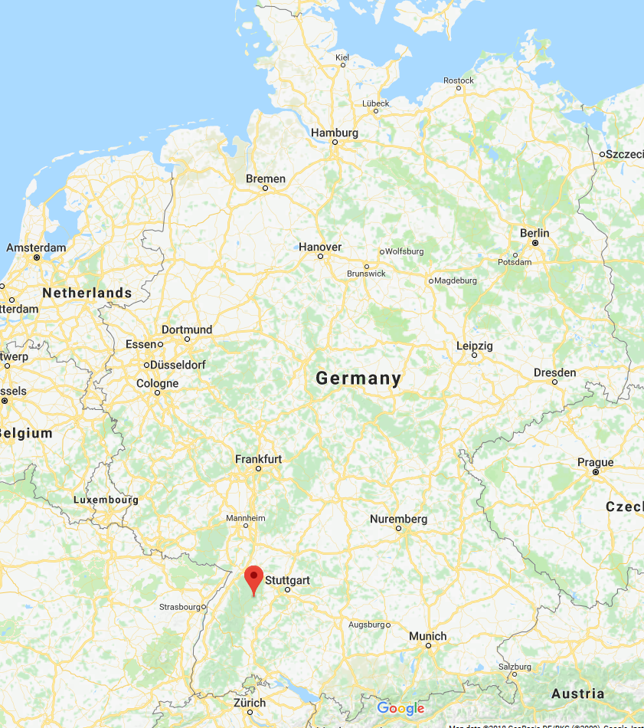
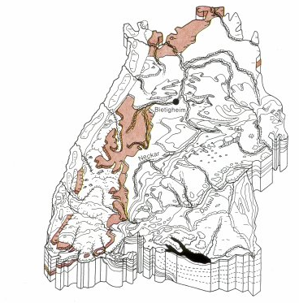

1. Geographical position and geology
Test site in the Northern Black Forrest in South West Germany (~ 45 km western of Stuttgart)
100 m deep drilling into the Upper and Middle Buntsandstein
Installation of borehole heat exchanger (double U-pipe)
Source: googlemaps.com

Slide 4
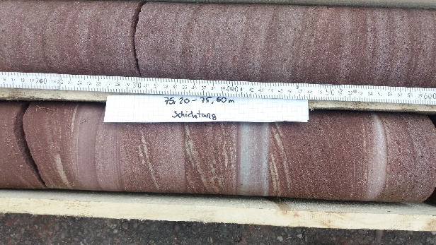
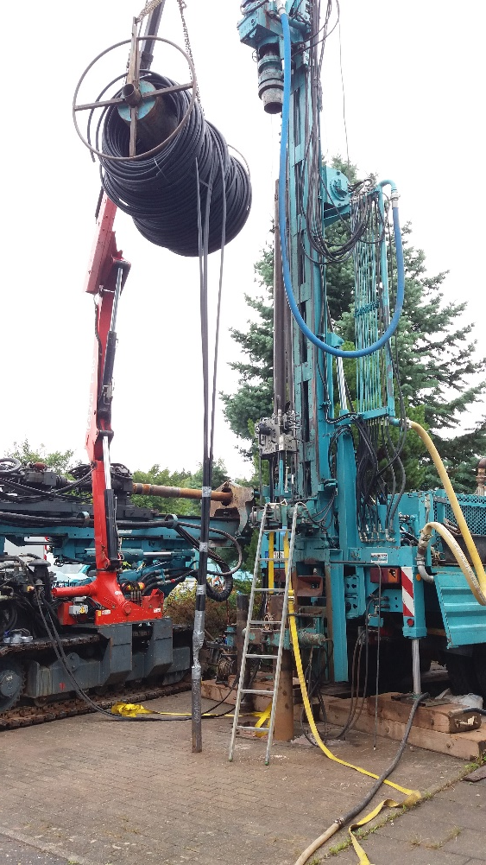
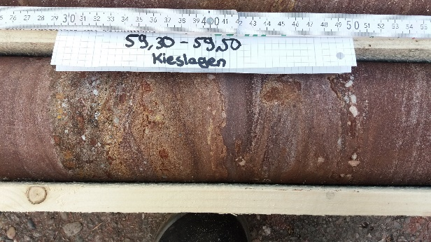
2. Test site – Drilling profile
Cross bedding
Heterogeneous layer
Installation of borehole heat exchanger

Slide 5
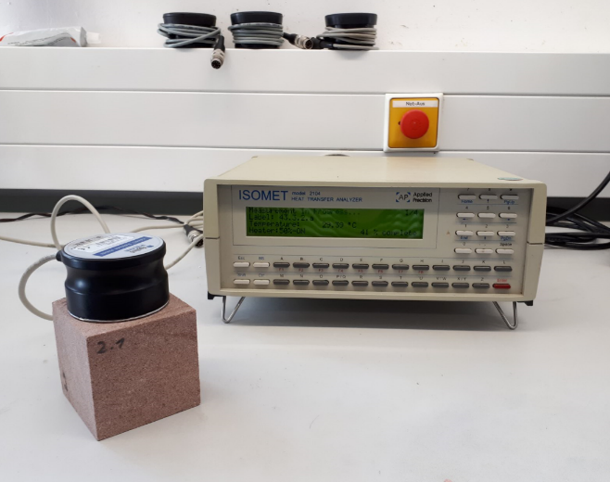
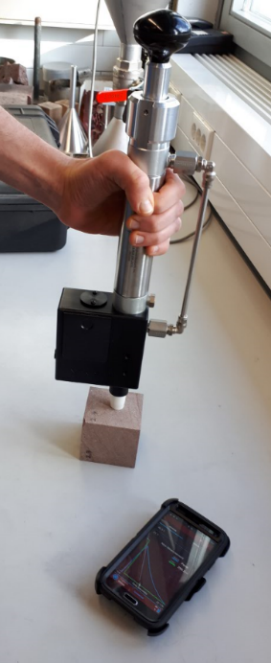
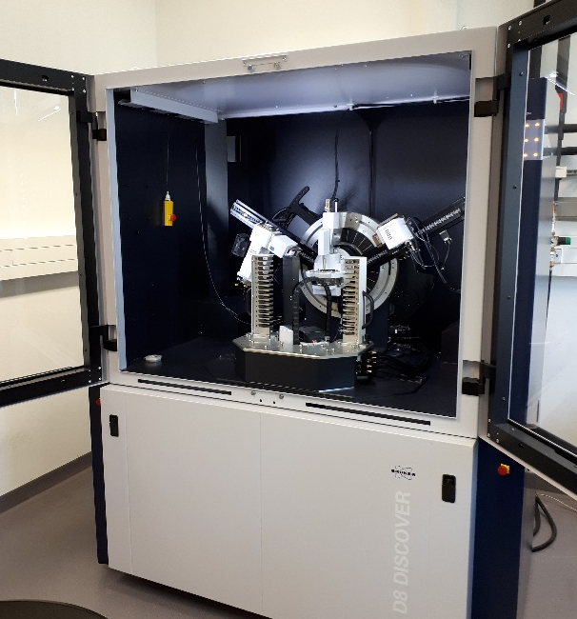
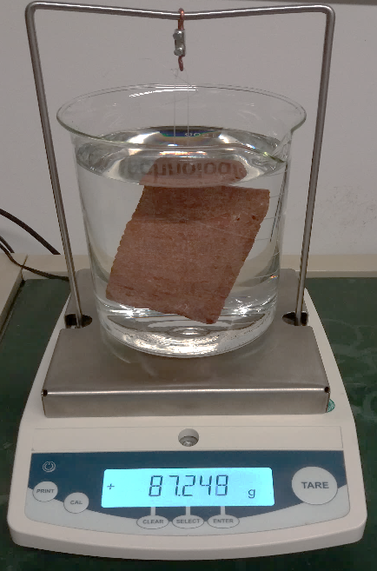
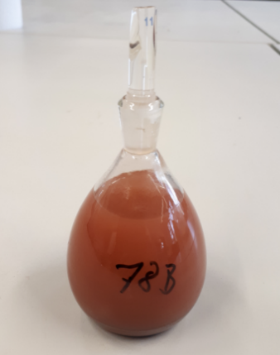
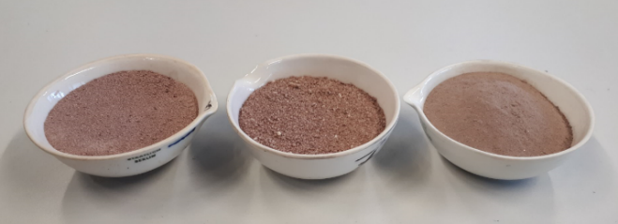
3. Lab characterization – Determination of petrophysical properties
Mineralogy
Porosity, density
Thermal conductivity
Grain size
Permeability
Grain density

Slide 6
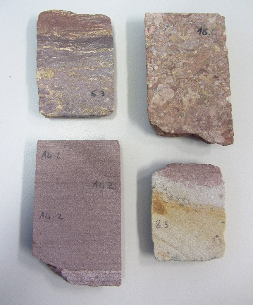

3. Lab characterization – Density
$$\overline{ρ}=2.68 g/cm³$$
Mineral | Density [g/cm³]
Quartz | 2.65
Feldspar | 2.56-2.76
Mica | 2.80-3.20
Hematite | 4.15
Ilmenite | 4.50-5.00
Calcite | 2.70
Mineralogy:
Quartz
Feldspar (Mikrokline)
Mica (Biotite & Muskovite)
Hematite
Rutile
Illite
Source: Matthes, S. (2001) Mineralogie, Springer Verlag, Berlin.

Slide 7



3. Lab characterization – Porosity & permeability
Fractures
Fractures
Fractures
$$k_{f, min}= 1.13 ∙{10}^{−8} m/s$$
Fractures
$$k_{f, max}= 3.56 ∙{10}^{−6} m/s$$
Low permeability
Fractures
$$\overline{k_{f}} = 2.69 ∙{10}^{−7} m/s$$

Slide 8
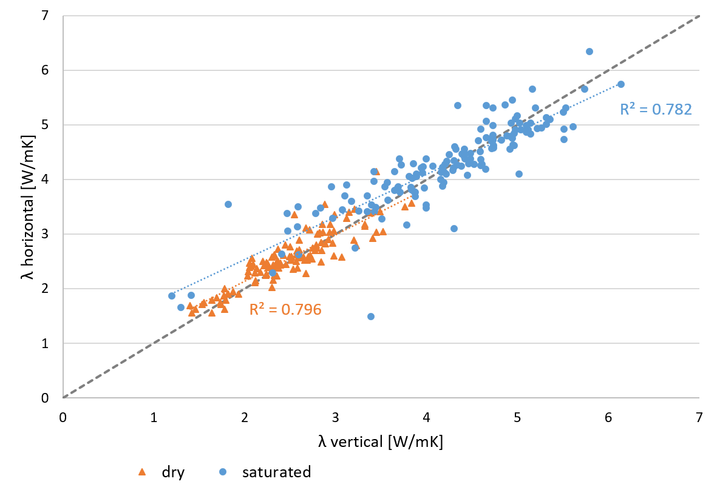
3. Lab characterization – Thermal conductivity
Slight anisotropy due to:
  Layering
  Clay lenses
λ_{Water}= 0.6 W/mK
λ_{Air} = 0.026 W/mK
Positive correlation of λ and saturation grade apparent

Slide 9
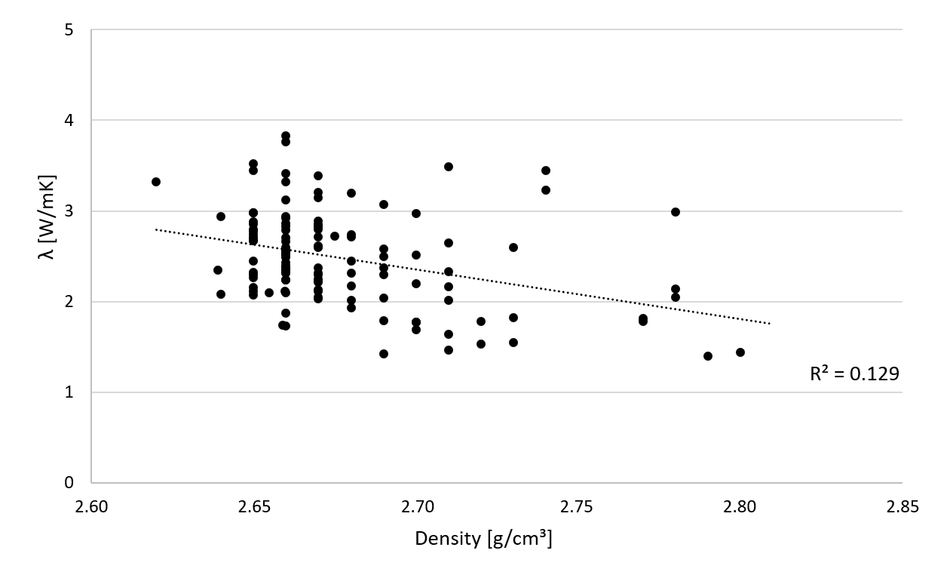
3. Lab characterization – Thermal conductivity vs. density
Mineral | λ [W/mK]
Quartz | 1.36-12.00
Feldspar | 2.11
Biotite | 1.70-2.30
Muskovite | 0.84-5.10
Hematite | 11.20
Clay minerals | 2.90
Calcite | 3.20-5.50
Rutile | 5.12
No correlation between λ and density apparent
Potential reason: Heterogeneity of the sandstone

Slide 10
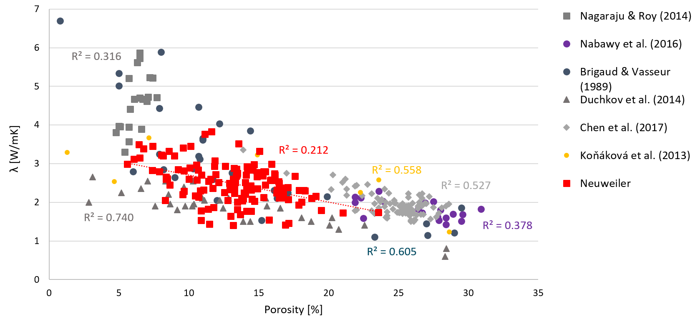
3. Lab characterization – Thermal conductivity vs. porosity
Negative correlation of λ and porosity apparent

Slide 11
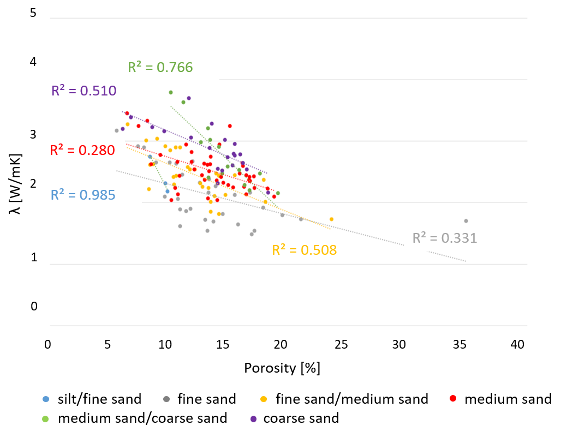
3. Lab characterization – Thermal conductivity vs. grain size and porosity
Classification of sandstone depending on grain size
Negative correlation of λ and grain size visible

Slide 12
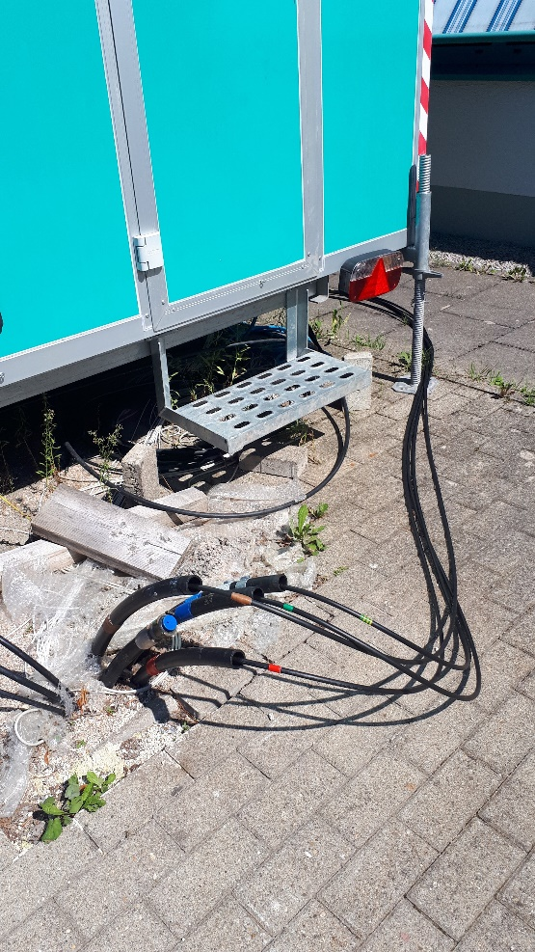



4. Field characterization – Classical TRT
TRT October 2017 → Convergence was not achieved
TRT November 2018
Analysis according to German Standard VDI 4640-Blatt 5 assuming an infinite line source:
T_{f}: Fluid temperature [°C]
q: Heat injection rate per unit length [W/m]
λ: Thermal conductivity [W/mK]
$$T_{f}\left(f\right)=k ∙\ln\left(t\right)+m$$
$$k=\frac{q}{4∙ π∙λ}$$
$$λ=\frac{q}{4∙ π∙k}$$
 | Duration [days] | q [W/m]
TRT 2017 | 6 | 50
TRT 2018 | 12 | 64.4

Slide 13
4. Field characterization – Thermal conductivity
Vertical ground water flow?
Fractures
Fractures
71 m
Fractures
Fractures
Fractures

Slide 14
5. Comparison of thermal conductivity determined in the lab and the field
At shallow depth: Poor match of λ determined in the lab and the field
  Potential reason: clay rich layers
λ_{dry} ≈ 2.46 W/mK
λ_{saturated} ≈ 4.22 W/mK
λ_{TRT 2018} ≈ 4.58 W/mK

Slide 15
6. Conclusion
Density
Porosity
Saturation grade
Grain size
Thermal conductivities of a sandstone are correlated with other petrophysical parameters;
Thermal conductivities are spatially resolved along a 100 m drill core.
Thermal conductivity is anisotropic.
In contrast to previous studies no clear correlation between thermal conductivity and porosity could be detected;
Determined thermal conductivities in the field are higher than in the laboratory.
Correlation degree to λ

Slide 16
Thank you for your attention!
Linda Schindler
Emmy-Noether-Str. 11
76131 Karlsruhe
+49(0)721 6105 1315
linda.schindler@eifer.org

