Slide 1
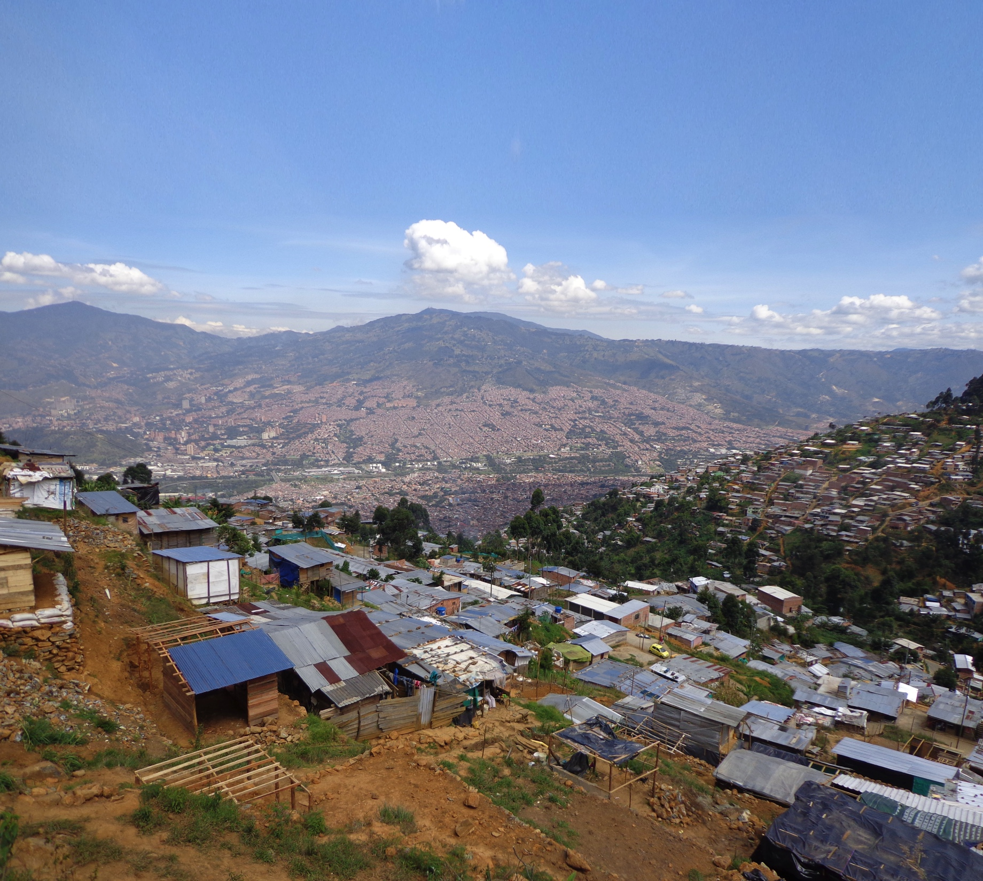

Design of a low-cost Early Warning System (EWS) in informal settlements in Medellín, Colombia (Project Inform@Risk)
Moritz Gamperl
Chair of Engineering Geology
Technical University of Munich
John Singer
AlpGeorisk, Unterschleißheim
Kurosch Thuro
Chair of Engineering Geology
Technical University of Munich
EGU General Assembly^{May 5, 2020}
NH3.11
Towards reliable Landslide Early Warning Systems
Funding code: 03G0883A-F

Slide 2

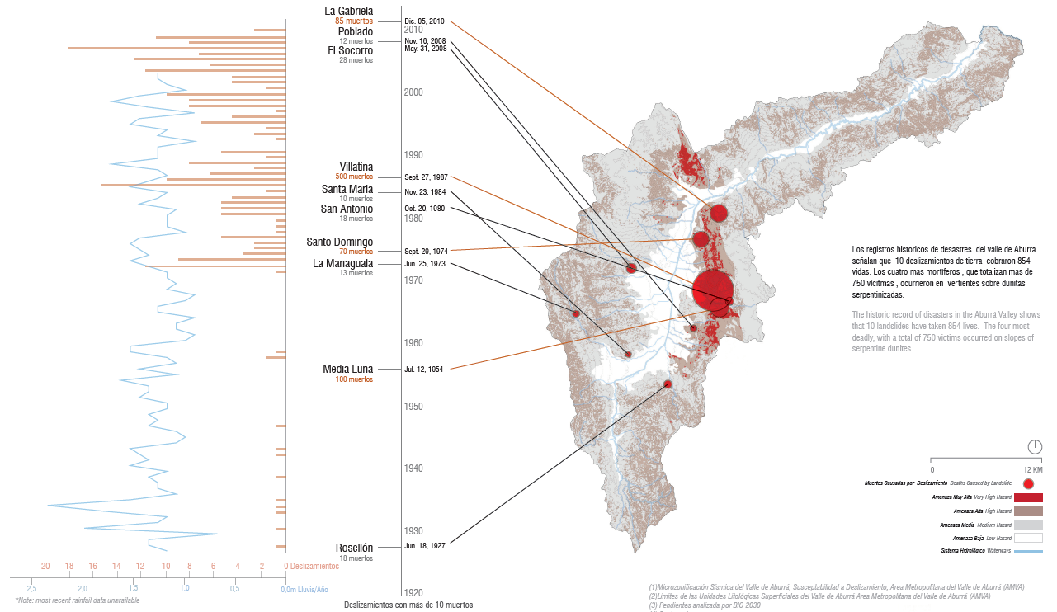
Motivation
Fatalities due to slope movements in the Aburrá Valley
Very high risk
Slopes > 27° in weathered dunites
> 2000 Landslides
in 30 years
The deadliest occurred in the western slopes
Deeply weathered and serpentinized Dunite crops out
20 Events / Year
10 Events / Year
2 m Prec. / Year
URBAM Report: Rehabitar la ladera 2012

Slide 3
Goals
Integrated Early Warning System
Social integration in informal neighborhood
Spatial integration in public spaces
Multi-scalar application
Multi-sectoral participation of actors
Accurate and site-specific data basis
Low-cost technical equipment and maintenance
Multi-scalar application and transferability
Replicable technology and adaptable guidelines

Slide 4
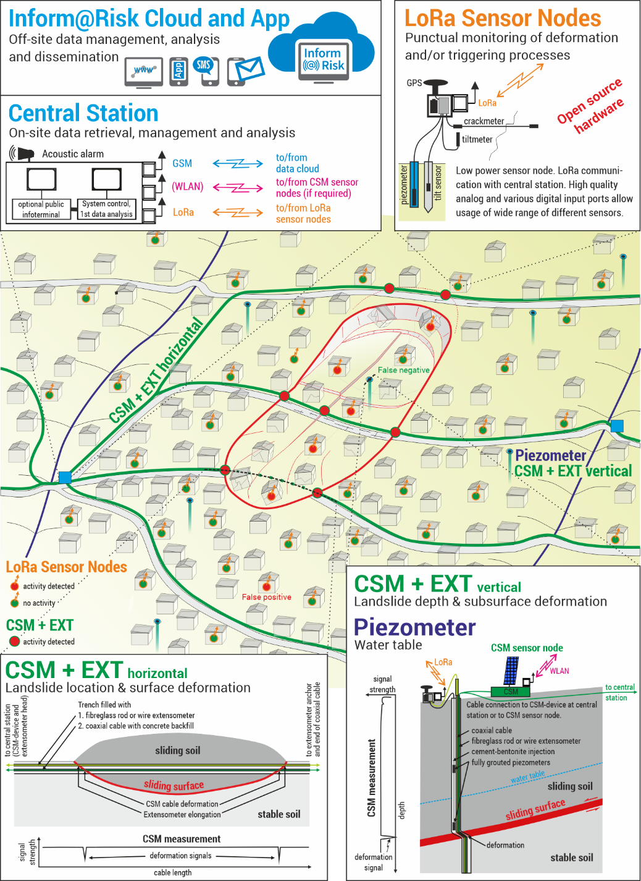
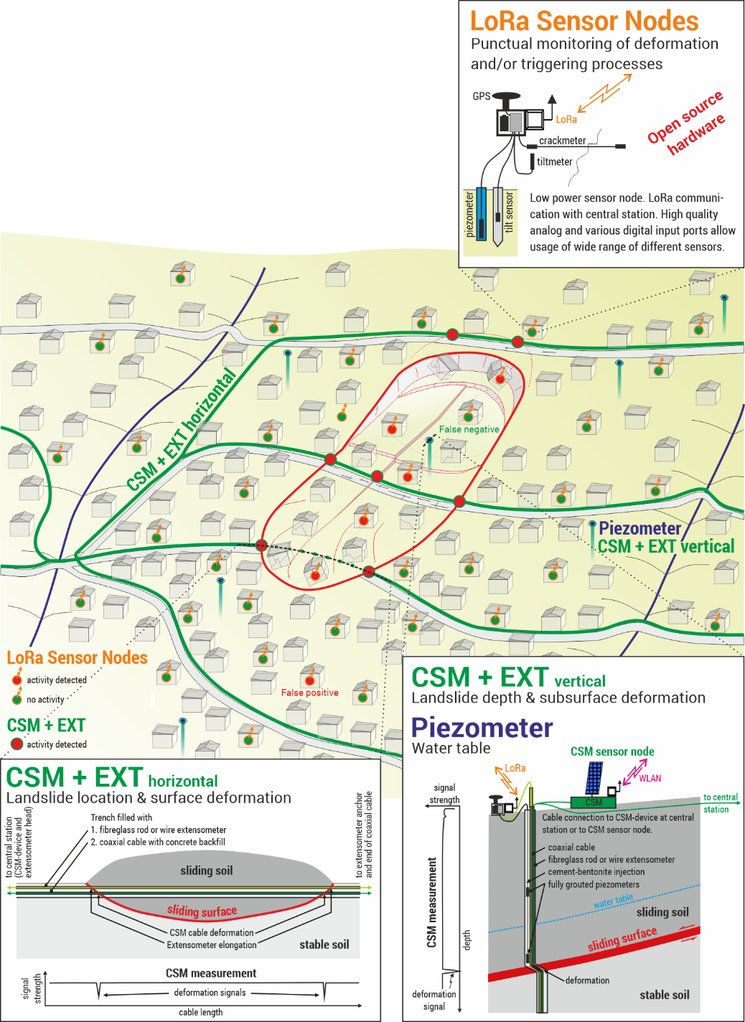
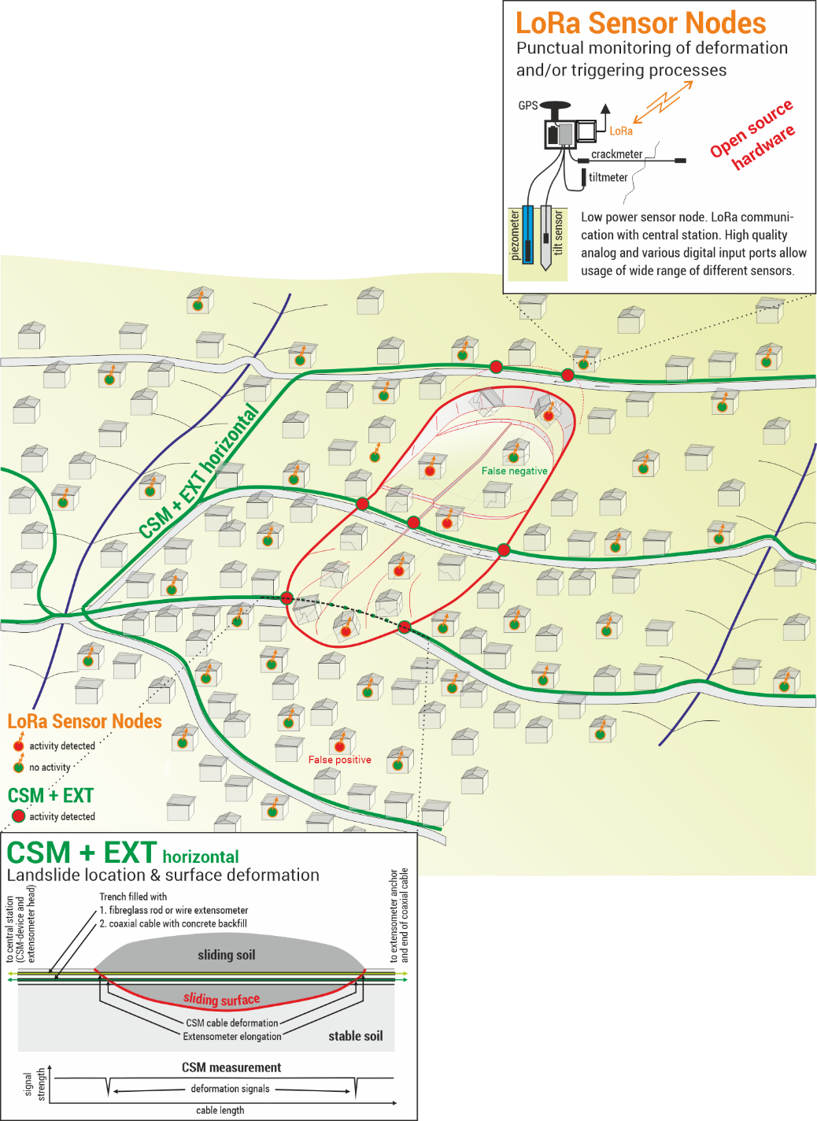
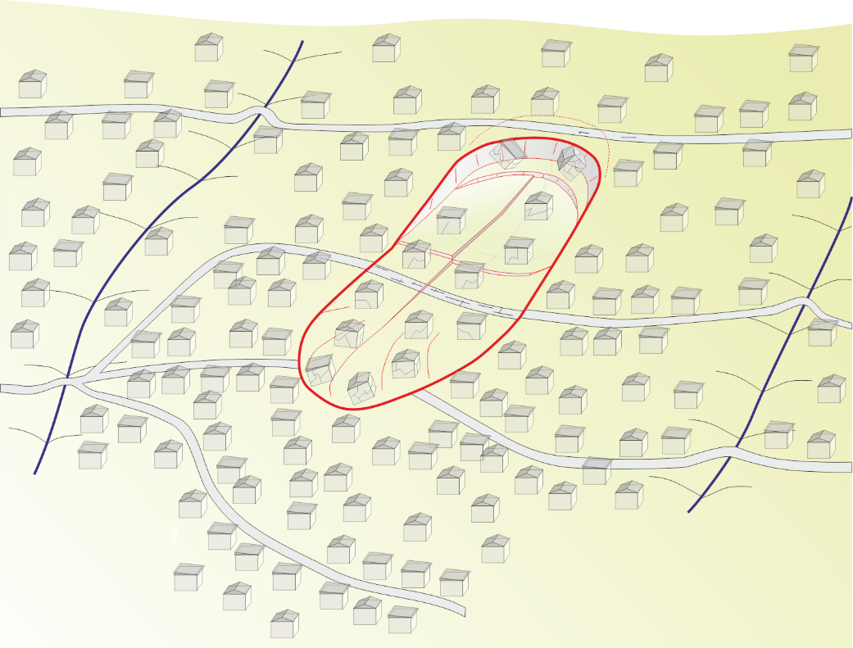
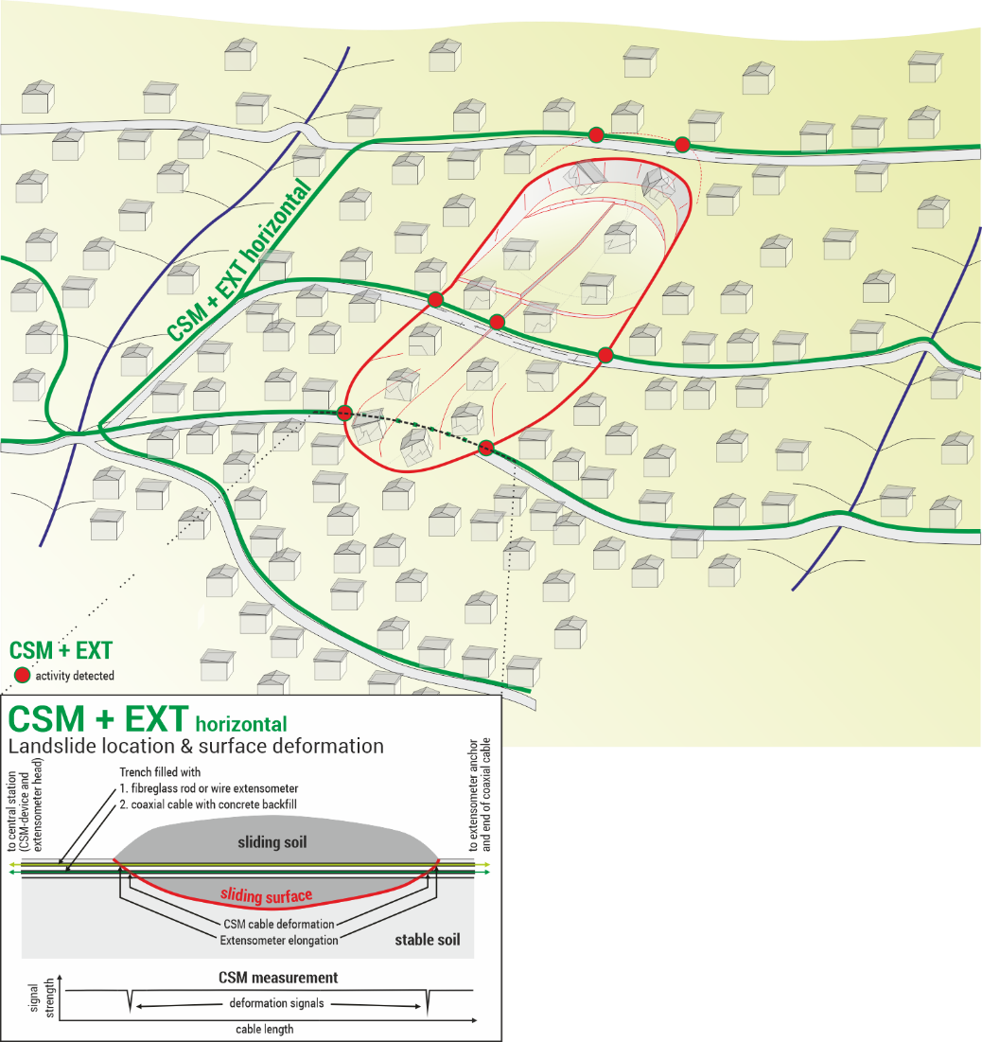
Technical concept of the LEWS
Continuous Shear Monitor &
Extensometer (horizontal)
  CSM: Localization and quantification
  EXT: For high deformation
LoRa wireless geosensor network
  Wireless communication via LoRa
  Extremely low power consumption, long running time, low costs
  Connection of almost any geotech. sensors possible
Instrumented boreholes
  Piezometer, CSM, EXT
  Selective in high risk areas
Weather Station
Existing Data (SIATA)
  Rain radar, weather stations, seismometer

Slide 5
Outlook
Drillings, test installation of system in Medellín planned for May 2020
  → Delayed due to travel restrictions
Backup plan: installation of sensors on a similar landslide area in Bavaria (test of hardware + software, social aspects can not be simulated
Complete installation in Colombia until March 2021 (hopefully..)
Read more at:
  https://www.bmbf-client.de/projekte/informrisk
  Thuro K, Singer J, Menschik B, Breuninger T, Gamperl M (2020) Development of an early warning system for shallow landslides in the tropical Andes (Medellín; Colombia). Geomechanics and Tunnelling.

