Slide 1
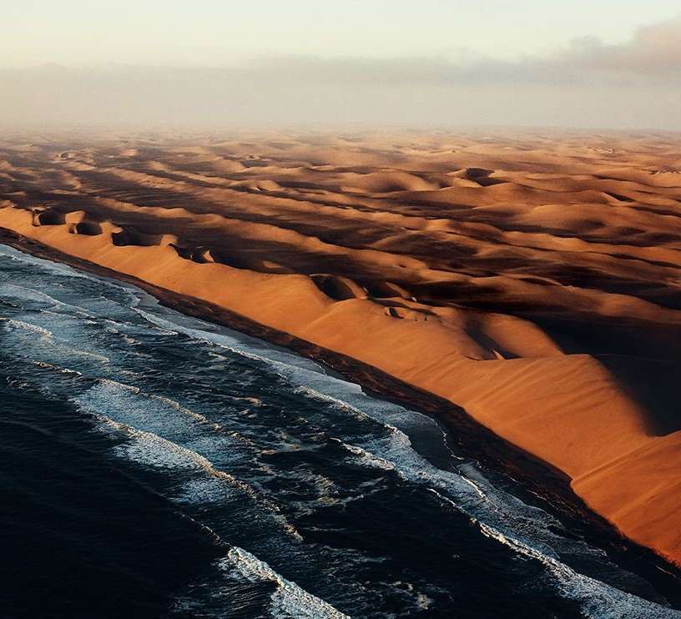
Temporal and spatial Sea Surface Temperature (SST) variability off the Southwest African coast
Dr. Fernanda Nascimento,
Martin Schmidt, Volker Mohrholz
Leibniz-Institut für Ostseeforschung Warnemünde (IOW)
Notes:
Image source: https://oms.entegral.net/uploads/o393/Namibia%20Skeleton%20Coast.jpg

Slide 2
Benguela NiÑos/Niñas
Similar events to El Niño (La Niña), but in the Atlantic Ocean
Warmer (cooler) water than climatologic average in Benguela Upwelling region
Changes in local economy, ecosystem and ocean dynamics.

Slide 3
Objetives
1
2
How can models reproduce Benguela Niños/Niñas events?
How can we identify Benguela Niños/Niñas events in satellite observations?

Slide 4
Methodology
1º Width Coastal Strip
Longitudinal average of Sea Surface Temperature
Data interpolated to same latitude (Reynold’s) and time (exp 19)
Climatology (Greene et al., 2019)
Power Spectrum
EOFs
Coherence Squared

Slide 5
Methodology
1º Width Coastal Strip SST
Daily satellite observations (Reynolds et al., 2007) were compared to 4 numerical models
Configuration/Models | Era-interim forcing | CCMP2 wind data | Bodin short wave radiation | Bunker long wave radiation | Open boundary Conditions | Dimensions | Ecological model
BANINO Exp 4 | X | X | X | X | ECCO kf080i | 60°W - 20°E, 35°S - 12°N
BANINO Exp 5 | X | X | X | X | cube92 cube92 | 60°W - 20°E, 35°S - 12°N
BANINO Exp 15 | X | X | X | X | cube92cube92 | 60°W - 20°E, 35°S - 12°N | X
GENUS Exp 19 | X | X | X | X | ECCO | 10°W - 20°E, 35°S - 12°N

Slide 6
Results

Slide 7
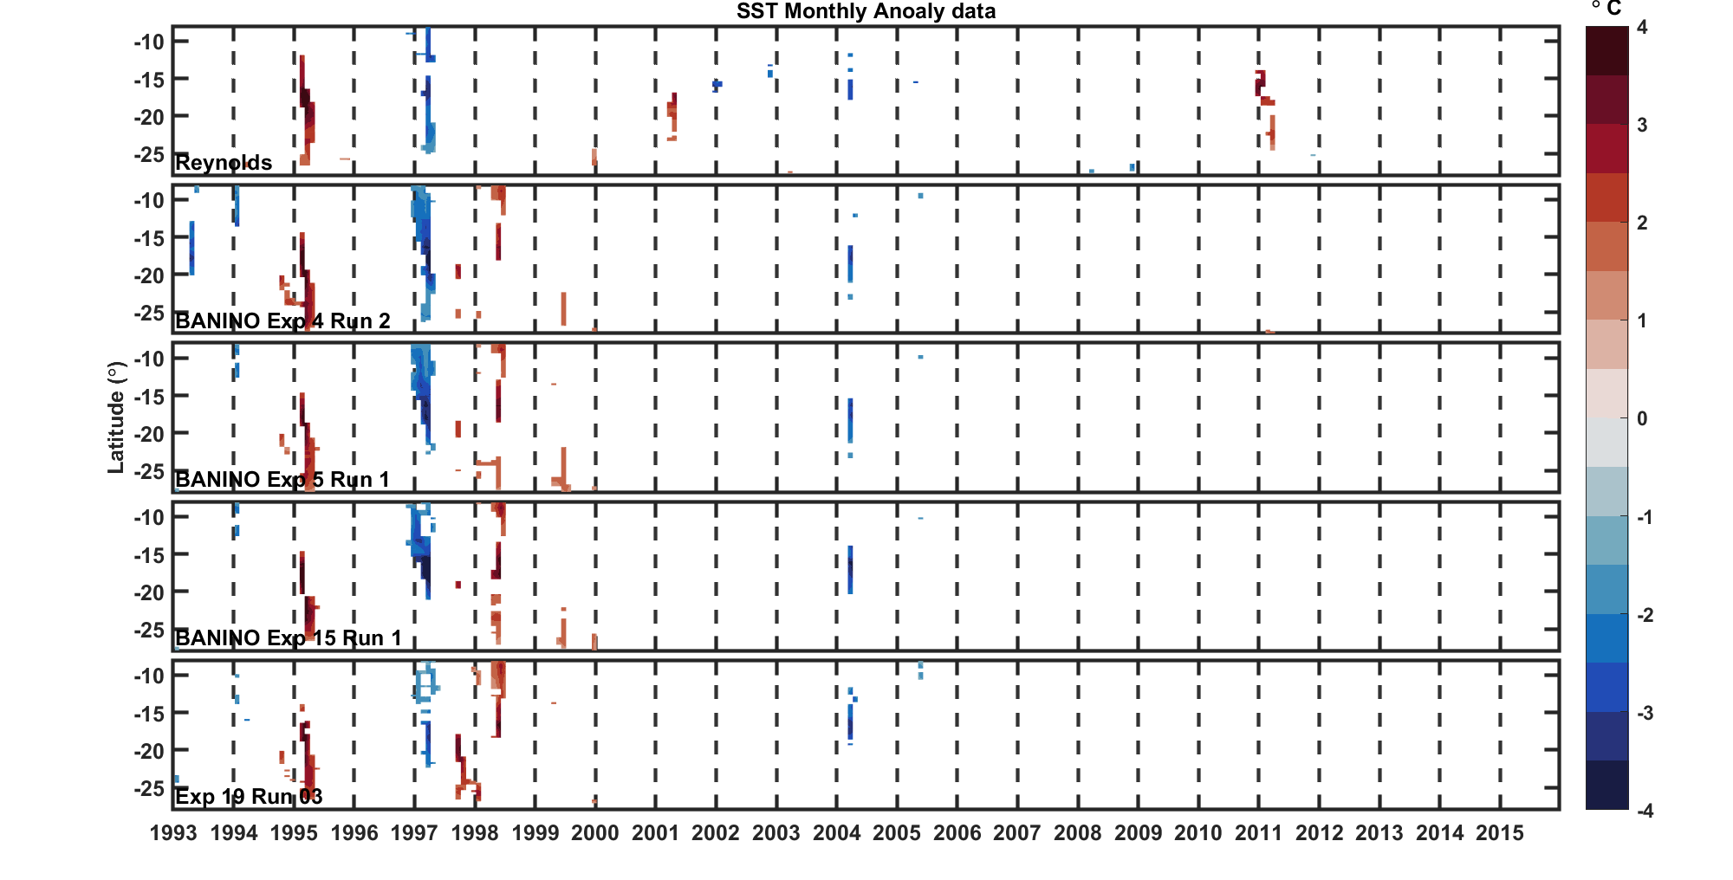
Monthly average SST minus monthly climatology
Notes:
Here, we see monthly sst anomaly minus 2 times the latitudinal standard deviation. We can see higher warming and cooling anomalies, all in years known to be niño years: 95, 99, 2011. However, the 2011 Niño event is only visibla no observations, not being reproduce in the models (with 2 standard deviations, when using just one it can be seen).
We also see the niña year, 97. As mentioned by Junker et al. (2017), 2004 alo present a cooling year.
98 has a higher warming than even the niño of 99, but this may be a reaction of the models to the previous year unusually colder (the coldest niña in the past 60 years). We can see that in the obsrvation ths wwarming up does not how.

Slide 8
Power Spectrum
Notes:
For the power spectrum we have always two peaks, one at around 0.35 cpy and another at around 0.7 cpy. A weaker peak also appears on 1 cpy and a few longer, but in general the models are able to reproduce the same variability as seen in theobservations.

Slide 9
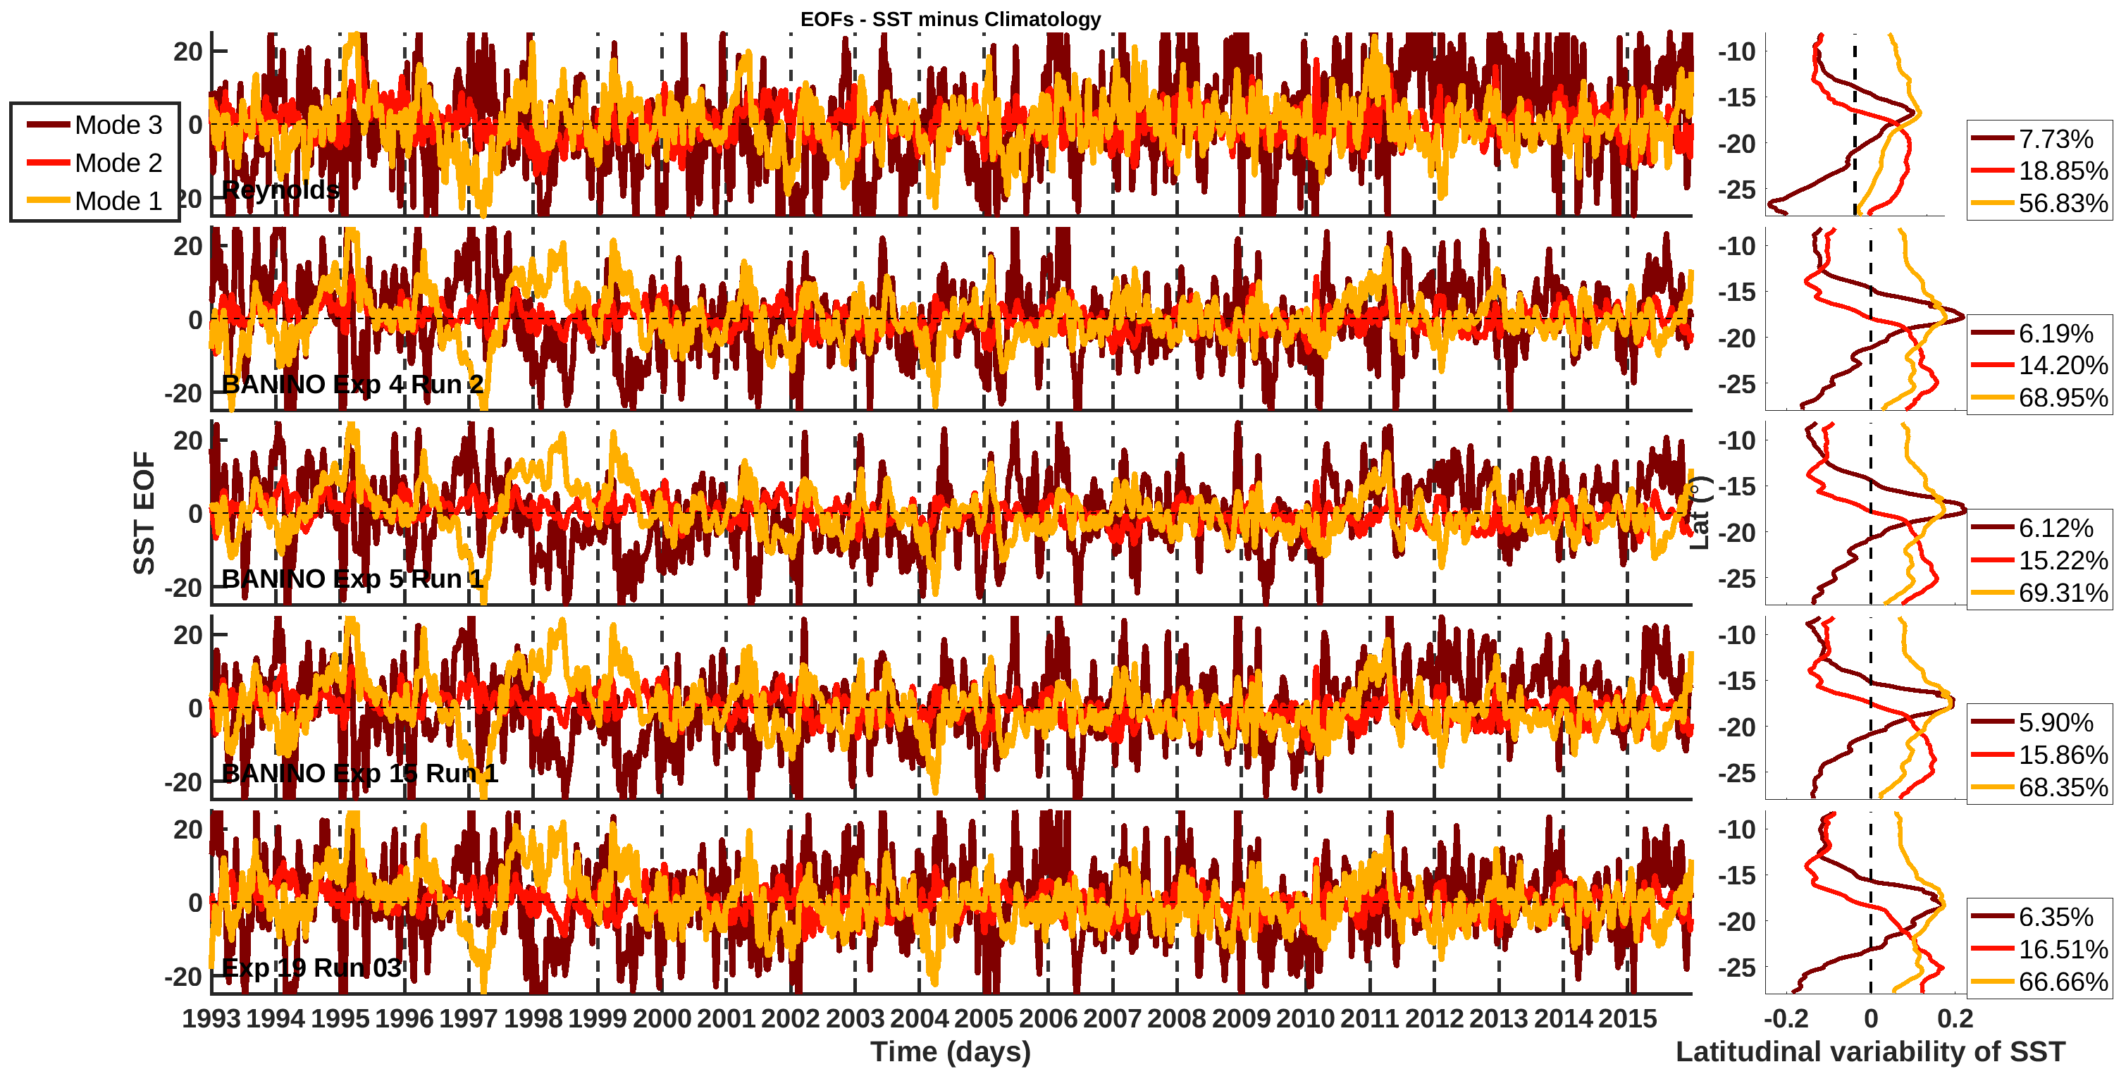
EOFs
Notes:
Analysing the EOFs, mainly the primary componente, we can see that, as expected, when we have a positive anomoly on it we have the years of Niño and a negativa anomaly imply years of Niña.
I also calculate the values that are higher than 2 standard deviation for the primary component. This will be shown in the next graphic.

Slide 10
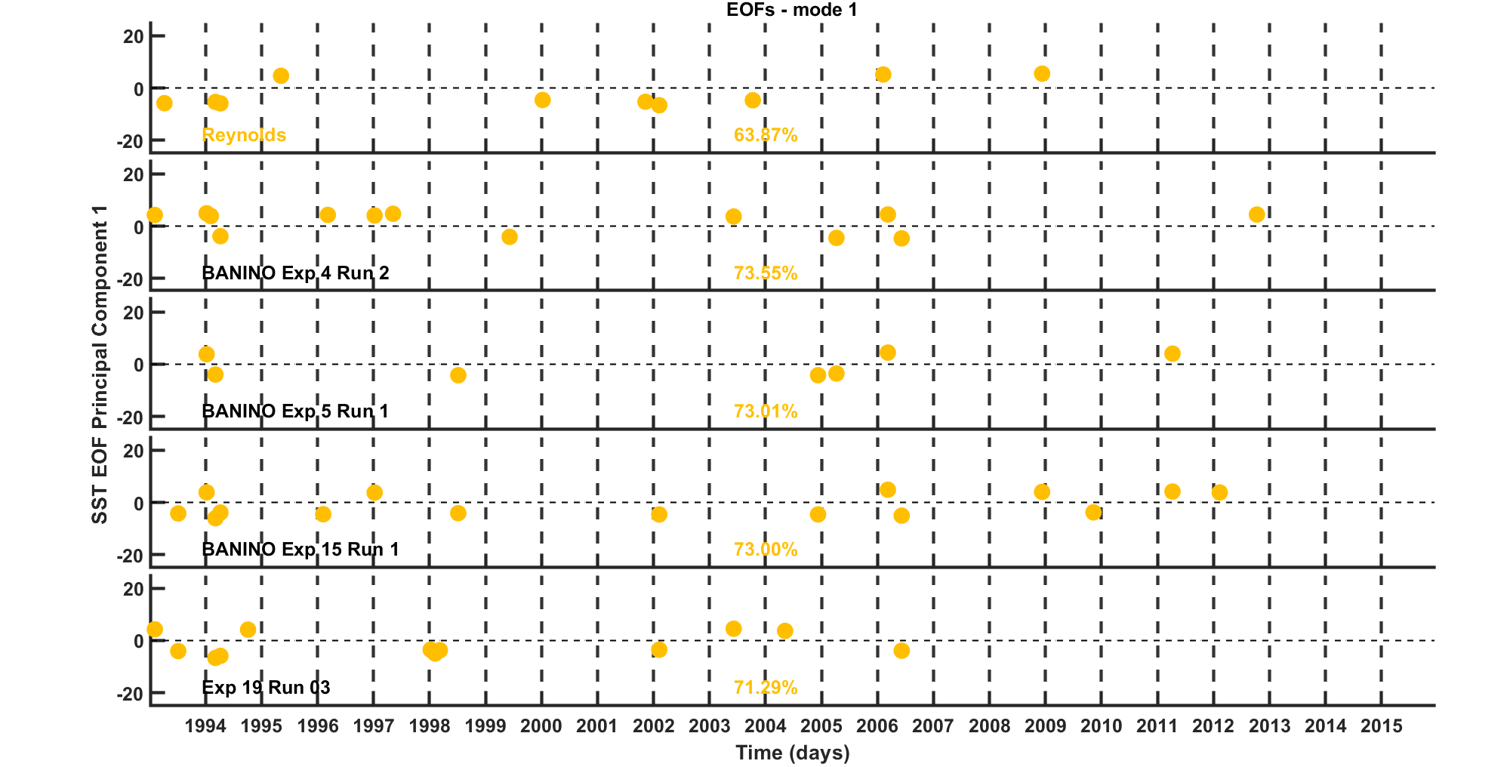
EOFs

Slide 11
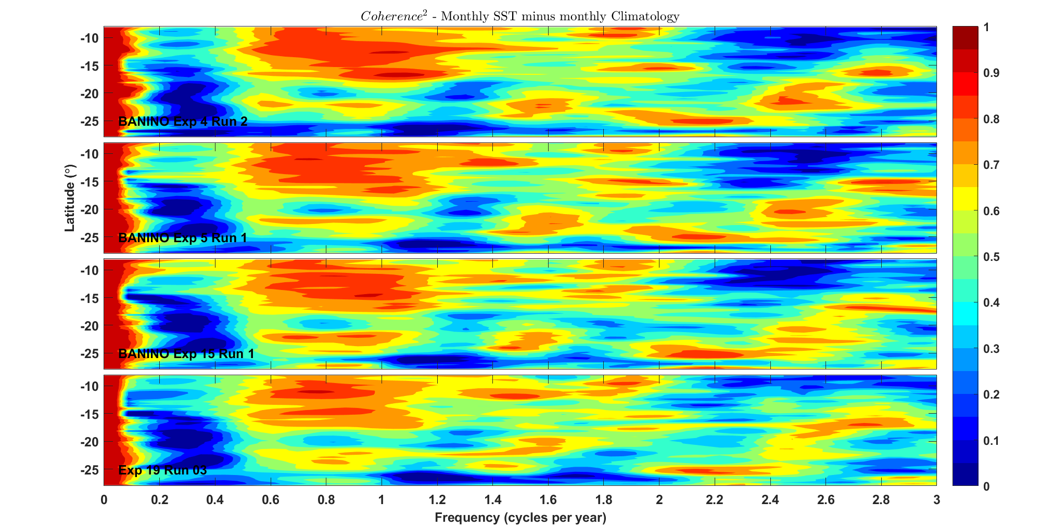
Coherence²

Slide 12
Summary
Benguela Niños and a Niña were identified in the observations when climatology was extracted:
1995, 1999 and 2011 warmer (> SST anomaly) signals;
1988 presented a warmer signal in models that did not showed in obsrevations;
1997 cooler signal;
2004 also presented a cooler signal (in both data), however no recorded Niña in this year.
The models reproduce SST variability, however there are over and under estimations;
Models underestimates lower temperatures, reaching a minimum of ~13 º C, while the observations reach ~11º C.
Frequencies variabilities were reproduced by the models
Only the latitudinal (seasonal) variability was highly coherent with observations
Climatology variability presented a lower coherence then latitudinal variability;
Even so, the variability has been reproduced within the same order of magnitude as in the observations.

Slide 13
Next steps
Apply same methodology to Sea Surface Height (SSH) and Sea Surface Salinity (SSS)
Publish the paper.

Slide 14
Thank you!

Slide 15
References
Reynolds, R. W., Smith, T. M., Liu, C., Chelton, D. B., Casey, K. S., & Schlax, M. G. (2007). Daily high-resolution-blended analyses for sea surface temperature. Journal of Climate, 20(22), 5473-5496.
Greene, C. A., Thirumalai, K., Kearney, K. A., Delgado, J. M., Schwanghart, W., Wolfenbarger, N. S., ... & Blankenship, D. D. (2019). The climate data toolbox for MATLAB. Geochemistry, Geophysics, Geosystems, 20(7), 3774-3781.
Imbol Koungue, R. A., Rouault, M., Illig, S., Brandt, P., & Jouanno, J. (2019). Benguela Niños and Benguela Niñas in forced ocean simulation from 1958 to 2015. Journal of Geophysical Research: Oceans, 124(8), 5923-5951.
Junker, T., Mohrholz, V., Siegfried, L., & van der Plas, A. (2017). Seasonal to interannual variability of water mass characteristics and currents on the Namibian shelf. Journal of Marine Systems, 165, 36-46.

