Slide 1
Interplanetary shocks as a source of sustained gamma-ray emission from the Sun
Nat Gopalswamy & Pertti Mäkelä
NASA/GSFC
EGU online conference May 20120

Slide 2
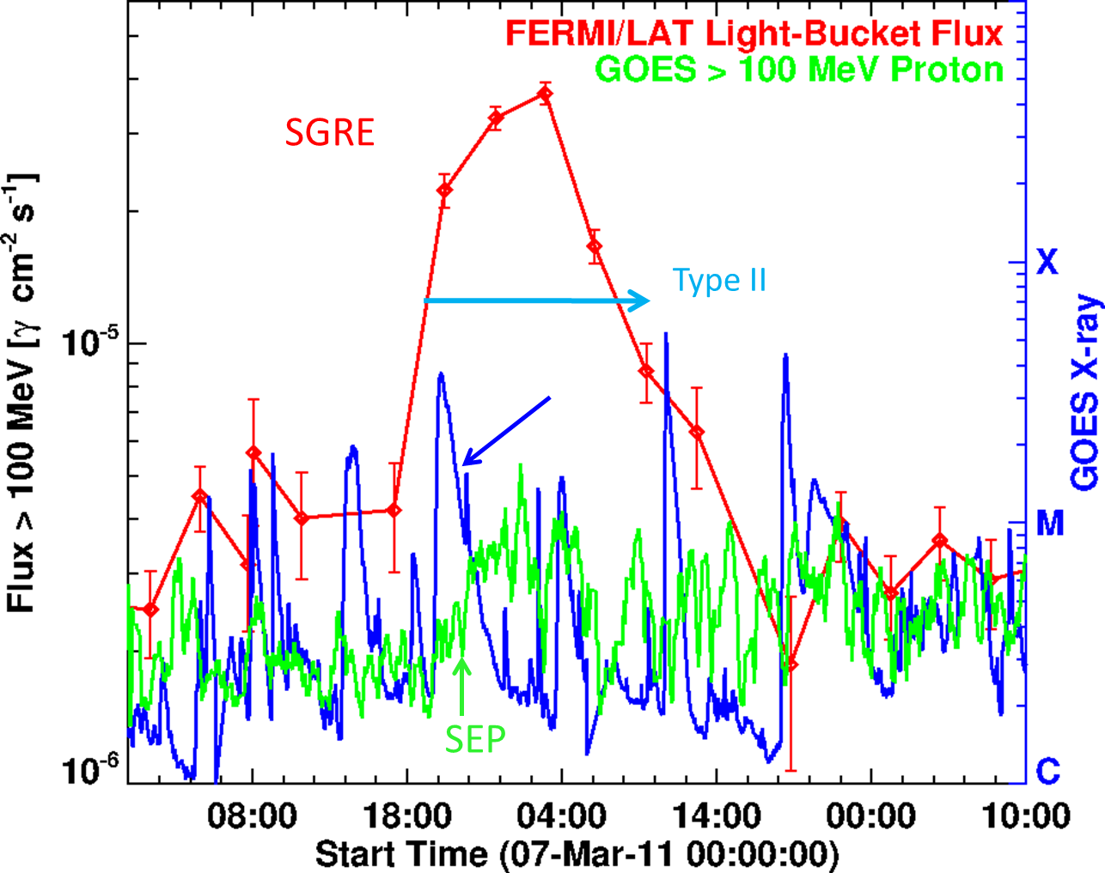
Sustained Gamma-ray Emission (SGRE) from the Sun
>100 MeV Gamma rays
Duration up to a day
Pion decay continuum
>300 MeV particles needed
Stochastic spectrum (flare)
Shock spectrum (CME-driven)
Associated with IP type II bursts
GLE-like CMEs (~2000 km/s)
16 hrs
1 hr

Slide 3
Scenarios: Flare particles and shock particles
Flare process stops accelerating after the impulsive phase. Shock continues to accelerate for hours to days
Over the SGRE duration the shock accelerates ~10 KeV electrons, it also accelerates >300 MeV protons
Energetic protons and electrons travel away and toward the Sun from the flare site and shock; protons traveling toward the Sun cause the gamma-ray emission
Shock-nose has the highest-energy particles, so the precipitation is still in the vicinity of the CME flux rope feet (spatially extended compared to the flare arcade)
To get long-duration via flare particles, they need to be trapped, but in flare loops
Gopalswamy et al. 2019

Slide 4
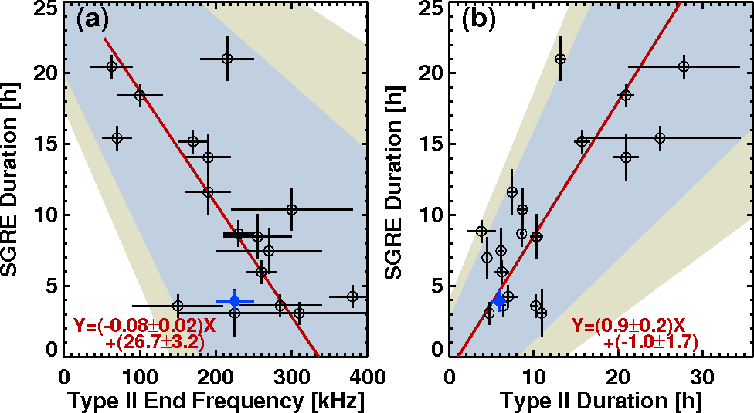
Evidence for Shock Source
(c)
300 MeV protons
SGRE duration is directly proportional to the Type II duration
SGRE duration is inversely proportional to the ending frequency of type II bursts (directly proportional to the distance over which the shock is viable)
Shock electrons propagating toward the Sun may contribute to bremsstrahlung gamma-rays

Slide 5
Spatially-extended Gamma-rays: 2014/09/01
Flares: compact source; shock: extended source
Most of the gamma-ray photons must be occulted
Gopalswamy 2020

Slide 6
Spatial-extended emission expected from the shock scenario
CME Flux rope spatially more extended than the flare structure (post-eruption arcade)
Hard X-rays and impulsive-phase are confined to post eruption arcade
2015 June 21 CME speed: 1366 km/s, M2.6 flare; SGRE 14 h; type II 21 h

Slide 7
Lack of Correlation between # protons in SEP events and inferred from SGRE (de Nolfo + 2019)
X –axis: # protons inferred from SEP events at PAMELA
Y –axis: # protons inferred from Fermi gamma-ray events
Since SEPs are from shock, lack of correlation suggests shock may not be the source
De Nolfo + 2019

Slide 8
Why the lack of correlation?
Explore the reasons for the lack of correlation based on:
the spatially extended nature of gamma-ray source: In events ~30⁰ from the limb, the gamma-ray flux is underestimated
For events poorly connected to the observer (PAMELA), the number of protons in the SEP event is underestimated
Apply these to the scatter plot (de Nolfo + 2019)

Slide 9
Lack of Correlation between # protons in SEP events and inferred from SGRE (de Nolfo + 2019)
Low SEP proton # (2)

Slide 10
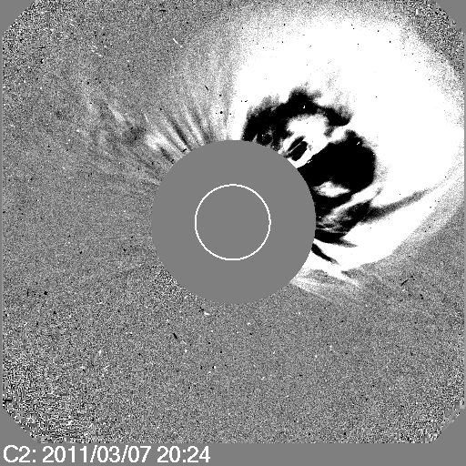
High-latitude Event
Highest energy particles are accelerated close to the nose
The CME nose at 43 deg from the equator.
B0 angle was at its maximum: -7.25 deg → effective ecliptic distance as 38.25 deg
For GLEs, the ecliptic distance of the CME/shock nose is ~13 degrees.
For >300 MeV particles, the nose area is certainly larger than that for GeV particles, but not as far as 38 degrees.
Poor latitudinal connectivity is responsible for not observing the >300 MeV particles at Earth.
PA = 313
Source N31W53; B0 = -7.25 deg

Slide 11
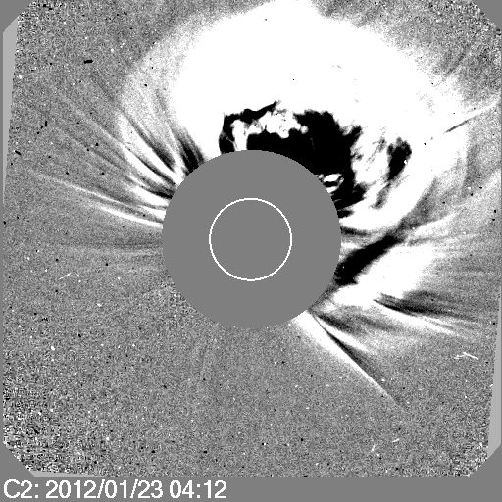
Another Example: Barely 300 MeV particles
PA = 340
MPA 326

Slide 12
Lack of correlation between # protons in SEP events and inferred from SGRE (de Nolfo + 2019)
Well/marginally connected events (7)

Slide 13
Lack of Correlation between # protons in SEP events and inferred from SGRE (de Nolfo + 2019)
Low γ proton # (5)
Outlier: May not be SGRE.
decay of the impulsive-phase emission? (Share +2018)

Slide 14
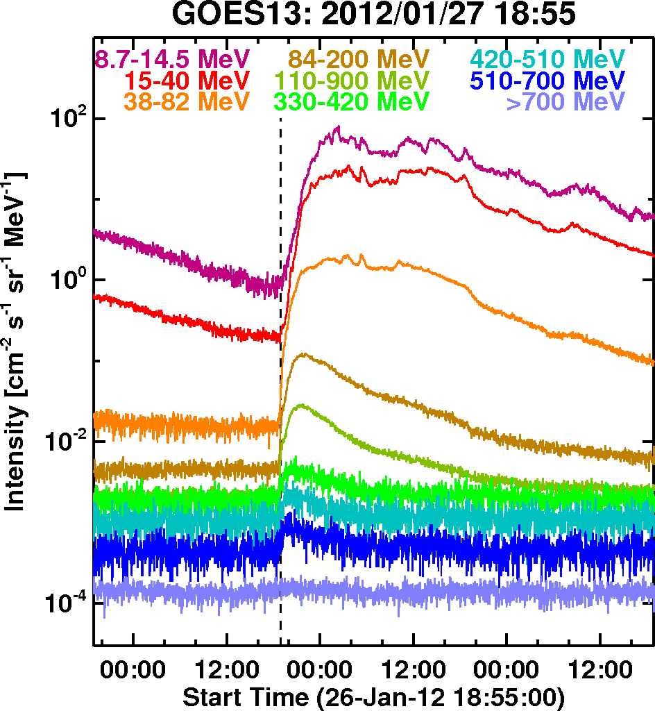
Limb Event; High-latitude event?
PA is at much lower latitude than the 2012 Jan 23 event (same active region)
Flat nose region -
Nose is better connected
Almost a GLE!
N27W51; B0 = -5.6, nose PA 296⁰

Slide 15
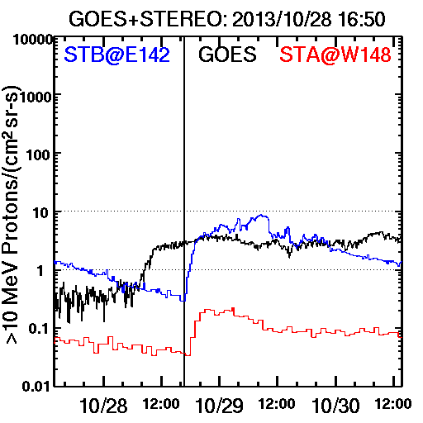
Outlier Event: 2013 Oct 28, S14E28; B0=+6
May not be an SGRE event –
Decay phase of the impulsive event
(Share + 2018)
Weak SEP event at well-connected STEREO-B
Shock weakens quickly

Slide 16
Lack of Correlation between # protons in SEP events and inferred from SGRE (de Nolfo + 2019)
Low γ proton # (5)
Latitudinal connectivity problem
Nsep underestimated
Reasonable
correlation
Limb events: Underestimate
of γ flux & Nγ
Outlier: May not be SGRE.
decay of the impulsive-phase emission? (Share +2018)

Slide 17
Conclusions
The lack of correlation between SEP protons and those inferred from SGRE is explained.
High-energy particles from CME nose at large ecliptic distances is not well observed at Earth → underestimate of high-energy proton number
Since SGRE sources are spatially extended, gamma-ray flux is underestimated, so are the inferred proton number
Well connected events are reasonably correlated; accounting for the above effects move the data points close to the well-connected group
Shock source is consistent with the SGRE properties

