Slide 1
“Soil Education Manual
- Toolbox for DIY program at your classroom”
by International Union of Soil Sciences (IUSS)
Takashi Kosaki, Rattan Lal and
Laura Bertha Reyes Sánchez
International Union of Soil Sciences, Vienna, Austria
(kosakit8@vega.aichi-u.ac.jp)

Slide 2
Apology:
The title and publication schedule of the book by IUSS to be discussed in this paper was changed due to the COVID-19 pandemic and other reasons. Sorry for inconvenience.
New title and schedule:
“Soil Sciences Education: Global Concepts and Teaching”
to be published in summer 2020.
Objective
To provide readers, e.g. who are mainly engaged in teaching soils, geosciences, environment, ecosystems, art, etc., in schools, working at museums, serving at educational or extension organizations such as NPOs, NGOs, etc., with basic framework of soil and soil science education and a collection of good practices currently employed, so that the readers could learn and share with whatever suited to their own condition efficiently.

Slide 3
2. Contents of the book
Part 1 “Framework of Soil Science Education”
Chap. 1: Framing Soil Science Education (D. Field)
Chap. 2: Tenets in Soil Science Education: Using Soil Science Education as an
Integrator for Environmental Education for K-12 Curricula (R. Ral)
Chap. 3: Guidelines for introducing essence of soil science in pre and primary school
children (K. Mori and H. Hirai)
Chap. 4: Guidelines for under- and post-graduate students (E. Brevik et al.)
Chap. 5: Educating to build a citizen preservation culture (L.B.R. Sánchez)
Part 2 “Good Practice in Soil Science Education”
Chap. 6.1: Interactive approach as a tool of capacity building in soil resources
knowledge and fertility management: case study of cotton farmers’
trainers in Burkina Faso (M. Toraore et al.)
Chap. 6.2: Challenges in soil science education in India and way forward
(J. Prasad et al.)
Chap. 6.3: Good practices in Japan (H. Hirai and K. Mori)
Chap. 6.4: Good practices in Taiwan (W. Huan and Z. Hseu)
Chap. 7.1: Good practices in DIY soil activities in Austria (T. Sanden et al.)
Chap. 7.2: Ecological education at the Dokuchaev Central Soil Museum -Russia
(B. Aparin and E. Suchacheva)

Slide 4
Chap. 7.3: Soil education activities of the Spanish Society of Soil Science:
towards the dissemination of the importance of soils for sustainability
(J. Mataix et al.)
Chap. 8.1: Project-Based Learning, a novel tool for soil science teaching – Argentina
(F.G. Fritz)
Chap. 8.2: Soil education in Brazil (C. Muggler et al.)
Chap. 8.3:Engaging Young Learners Through Online, Classroom, and Community Soil
Science Education Initiatives in Canada (M. Krzic et al.)
Chap. 8.4: Soil science: education and research with children from rural schools in
Caldas, Colombia (C. Londoño and M.M. Bolanos-Benavides)
Chap. 8.5: Educational experiences for children in Mexico (L.B.R. Sánchez)
Chap. 8.6: Importance of soil texture for lettuce cultivation in the school bio-garden
- Peru (S.D. Agüero-Aguilar)
Chap. 8.7: Venezuela: Kids and the Soil (J.C. Rey et al.)
Chap. 9.1: Soil Science Education in Australia (D. Field et al.)
Chap. 9.2: Learning by doing is more memorable: the practice of pedagogically
aligned learning in university level soil science in New Zealand
(C.M.S. Smith et al.)
Part 3 “Future of Soil Science Education”
Chap. 10: Guiding the Future of Soil Science Education: informed by global
experiences (D. Field et al.)

Slide 5
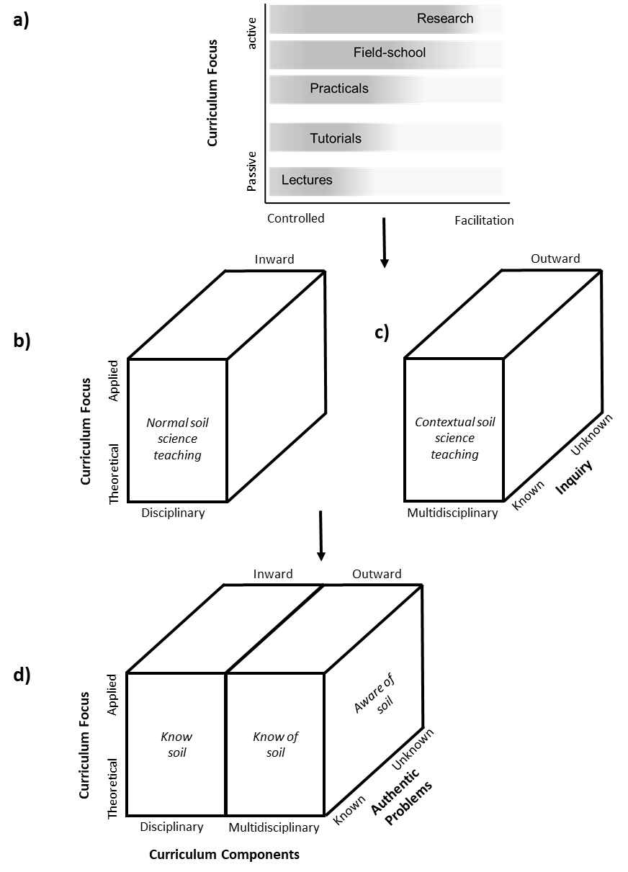
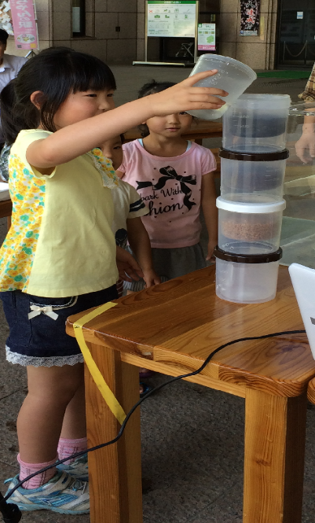
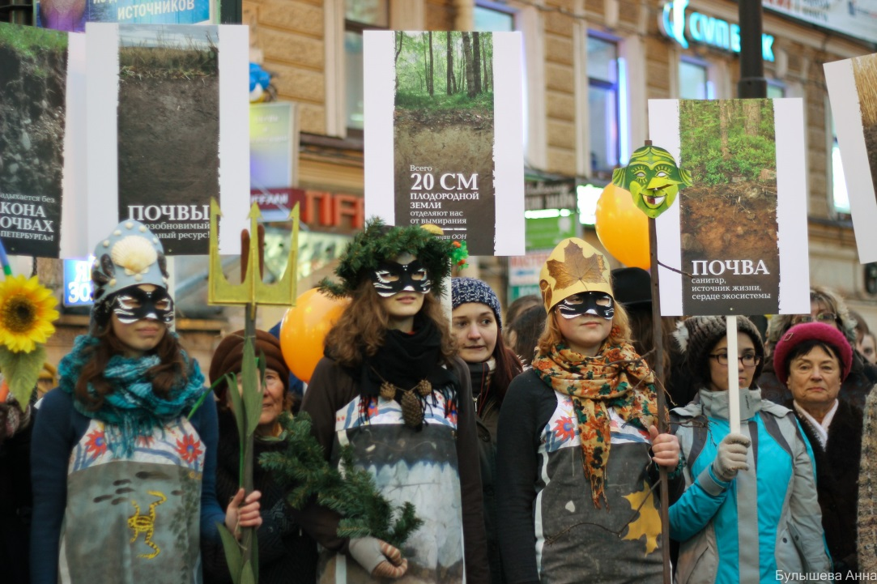
3. What to do with this book
The IUSS is planning to distribute the above publication to a variety of societies so that the current contents and methods and the systems of soil and soil science education be criticized for further improvement towards promoting and enhancing research, education and public awareness of soils as one of the disciplines of geo- and bio-sciences in the future.
(Field)
(Aparin and Suchacheva)
(Hirai and Mori)

