Slide 1
UAV Radar imaging for cultural heritage:
a first prototype
Esposito G.¹, Noviello C.¹, Ludeno G.¹, Gennarelli G.¹, Fasano G.², Renga A.², Soldovieri F.¹, Catapano I.¹
¹Institute for Electromagnetic Sensing of the Environment, National Research Council (IREA-CNR),
²Department of Industrial Engineering (DII) University of Naples “Federico II”
Contact person: esposito.g@irea.cnr.it

Slide 2
Outline
Why UAV radar imaging
UAV radar prototype
Imaging approach
Experimental test
Conclusions and future works
Reference: Catapano, I.; Gennarelli, G.; Ludeno, G.; Noviello, C.; Esposito, G.; Renga, A.; Fasano, G.; Soldovieri, F. Small Multicopter-UAV-Based Radar Imaging: Performance Assessment for a Single Flight Track. Remote Sens. 2020, 12.

Slide 3
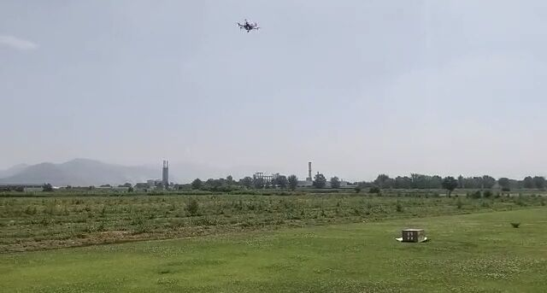
Why UAV radar imaging
Advantages
Vertical take-off and landing from very small areas
Possibility to investigate inaccessible areas
High operative flexibility
Possibility to move in all directions
→ new radar measurement configurations
Cost-effectiveness

Slide 4
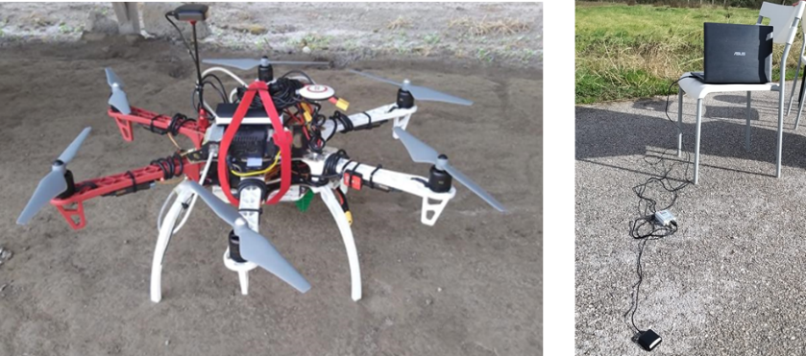
Why UAV radar imaging
Disadvantages
Data collection is not performed
along a straight line direction
at constant velocity
Need of accurate knowledge of UAV position and velocity, otherwise distortions appear in the radar image
Solution:
Carrier-based Differential GPS (CDGPS)
single-frequency Ublox LEA-6T systems connected to active patch antennas are used as on board and ground based station

Slide 5
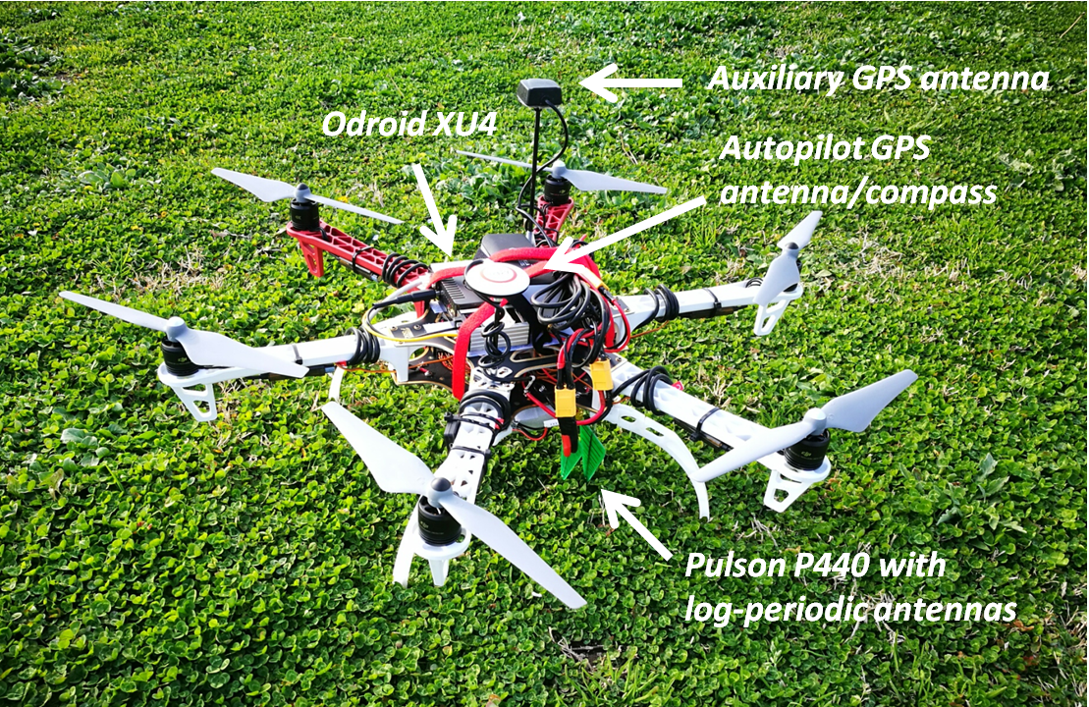
UAV radar prototype
Components
Commercial hexacopter: self-assembled DJI F550
Naza M-Lite autopilot with remote GPS/compass
Onboard systems: radar, Odroid XU4, auxiliary GPS receiver (Ublox LEA-6T) and antenna, DC-DC converter

Slide 6
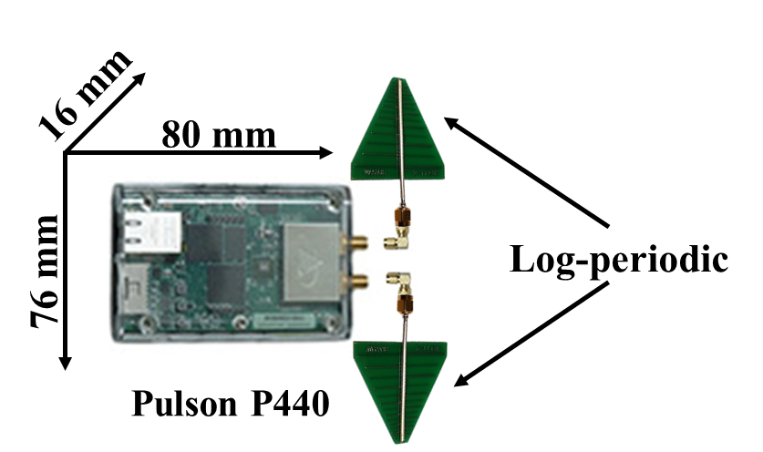
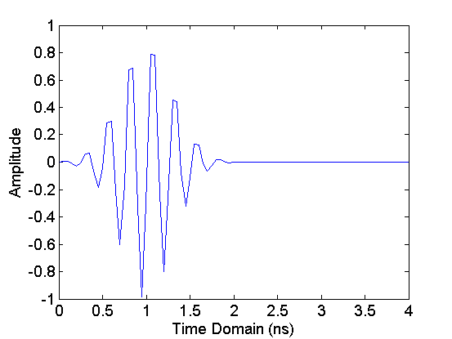
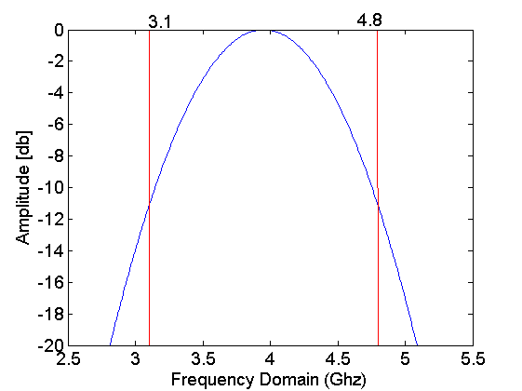
UAV radar prototype
Radar
Time domain ultra-wide-band system
76 mm X 80 mm X 16 mm, about 100 g
Log periodic antennas with a 6 dB gain over the frequency range from 2 GHz to 11 GHz.
Antennas mounted in down looking configuration
Parameters | Values
Low Frequency(f_{L}) | 3.1 Ghz
High Frequency (f_{H}) | 4.8 Ghz
Band center frequency (fc) | 3.95 Ghz
Bandwidth (BW) | 1.7 Ghz
UWB pulse in time domain
UWB pulse in frequency domain

Slide 7
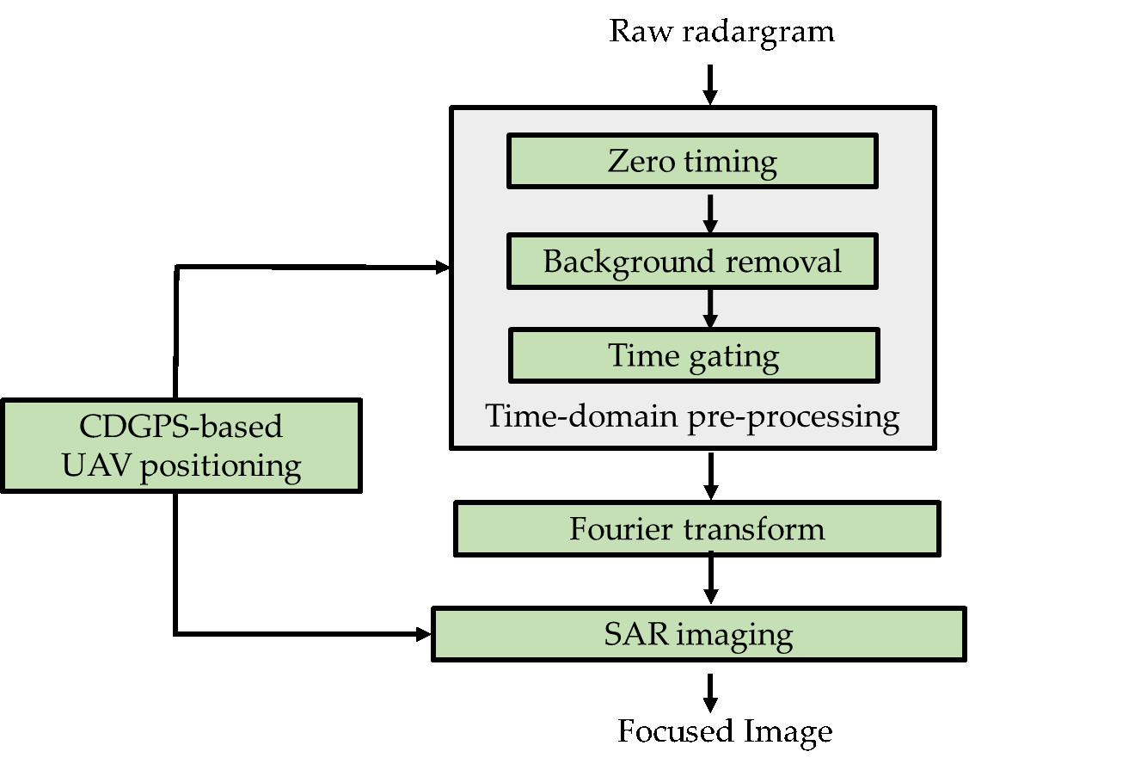
Imaging Approach
The strategy takes as input the raw radargram, i.e. the radar signals collected at each measurement position (along the flight path) versus the fast-time. The final output is a focused and more easy interpretable image, referred as tomographic image, which depicts the investigated area

Slide 8
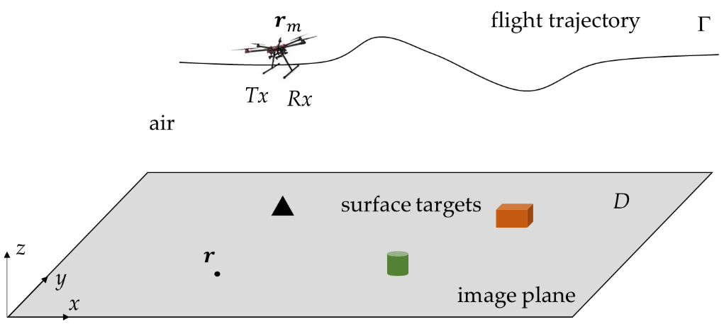
Imaging Approach
SAR Imaging formulation
$$E_{s}\left(r_{m},ω\right)=\iint_{D}{\frac{e^{−j2k_{0}|r_{m}−r| }}{{|r_{m}−r|}^{2}}σ\left(r\right)dr}=ℒσ$$
Unknown reflectivity function at a point $r∈D$
Scattered signal at each measurement point $r_{m}∈ Γ$

Slide 9
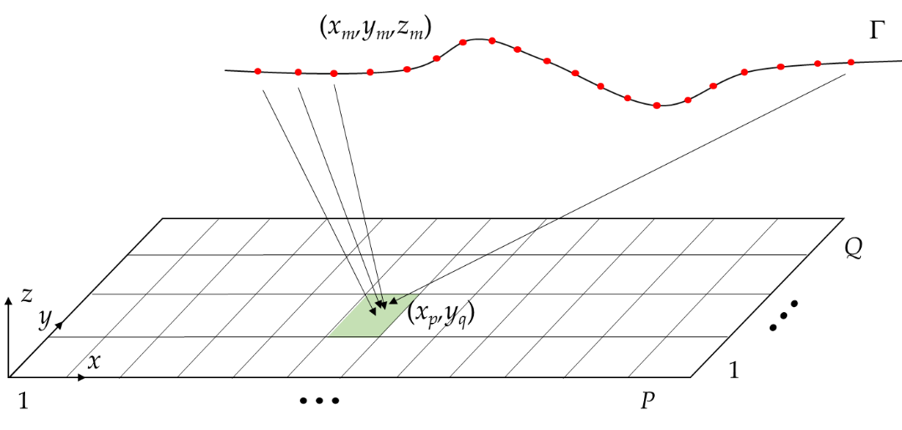
Imaging Approach
Discretized solution
$$\tilde{σ}\left(x_{p},y_{q}\right)=\sum_{m=1}^{M}{\sum_{n=1}^{N}{E_{s}\left(x_{m},y_{m},z_{m},ω_{n}\right)\frac{e^{\frac{j2ω_{n}}{c_{0}}\sqrt{{\left(x_{p}−x_{m}\right)}^{2}+{\left(y_{q}−y_{m}\right)}^{2}+z_{m}^{2}} }}{{\left(x_{p}−x_{m}\right)}^{2}+{\left(y_{q}−y_{m}\right)}^{2}+z_{m}^{2}}}}\begin{aligned}& \\ & p=1…P, \\ & q=1…Q\end{aligned}$$

Slide 10
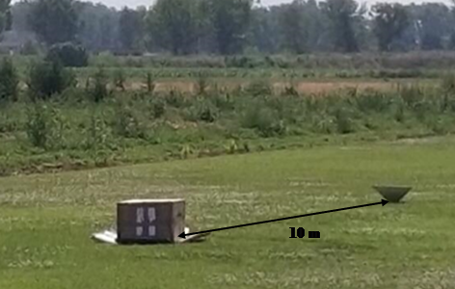
Experimental test
Objective: testing the ability of CDGPS technique to estimate the UAV position with the accuracy required for target imaging and verifying the imaging capability of the overall radar system
The experimental tests were carried out at an authorized site for amateur UAV flights in Acerra, Naples, Italy.
Target 1
Target 2
 | Average altitude [m] | Duration [s] | Covered path [m] | Gathered data [points]
Flight 1 | 4 | $$17.5$$ | $31.4$ | $251$
Flight 2 | $$10$$ | $21.7$ | $$33$$ | $$331$$

Slide 11
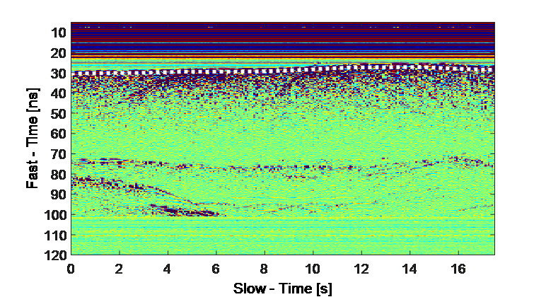
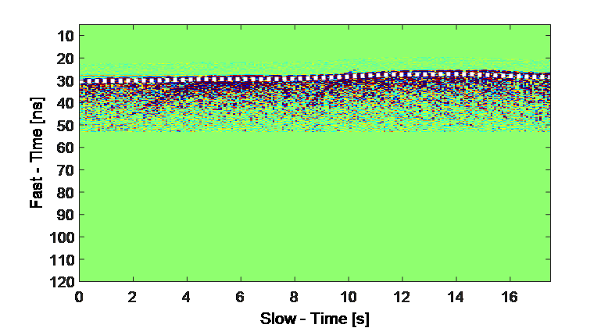
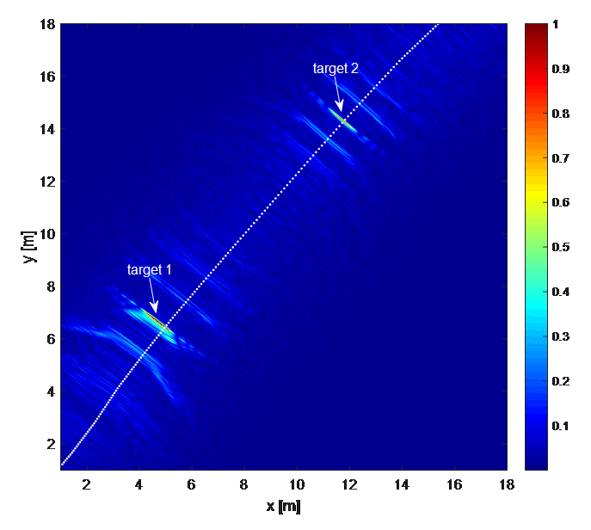
Experimental test
Flight 1
Raw Radargram
Filtered Radargram
Tomographic image
No ambiguities occur because the targets are located at the radar nadir directions

Slide 12
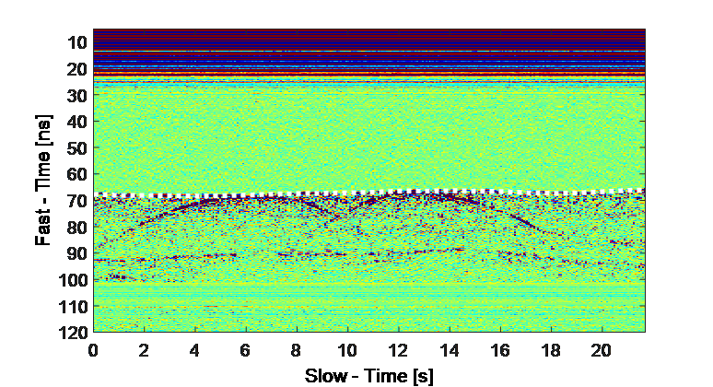
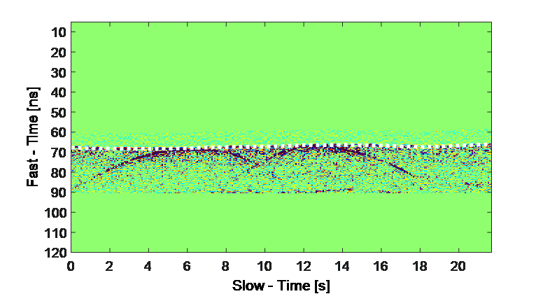
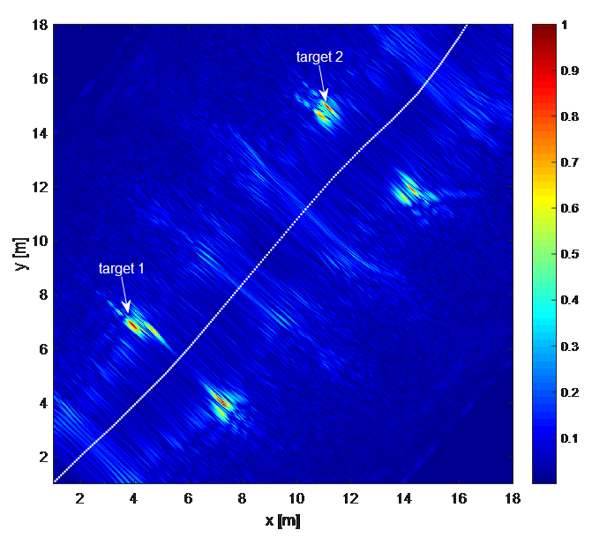
Experimental test
Flight 2
Raw Radargram
Filtered Radargram
Tomographic image
Left-right ambiguities occur because the targets are far from the radar nadir direction

Slide 13
Conclusions and future works
Conclusions
A Multicopter-UAV radar imaging system has been proposed
CDGPS technique allowed us to estimate the 3D M-UAV flight path with centimeter accuracy
An advanced imaging approach, based on the adjoint inverse scattering problem, has been adopted to obtain focused images of on surface targets in the case of a single flight track
Future works
Further flight tests to assess the subsurface imaging system capability
Non-rectilinear trajectory (such as circular or slanting flights) to overcome the ambiguity effects
Waypoint following and grid surveys to regularly sample the area of interest

Slide 14
Acknowledgments
Thanks to the VESTA project
“Valorizzazione E Salvaguardia del paTrimonio culturAle
attraverso l’utilizzo di tecnologie innovative”
(Enhancement and Preservation of the Cultural Heritage through the use of
innovative technologies)
by which the present work
has been financed

