Slide 1
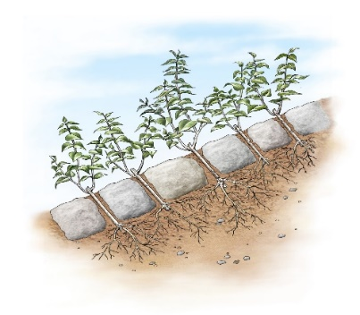
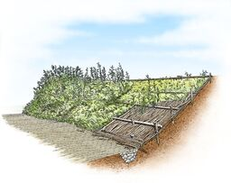
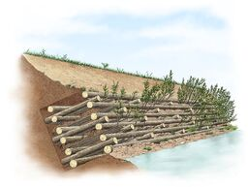
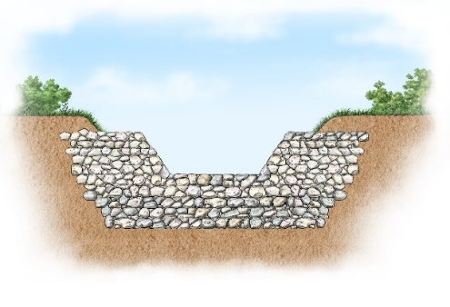
Abstract
Landslide risk mitigation that takes into account the safeguarding of environmental landscape involves several technical difficulties. However, at present, it is fundamental to identify sustainable technical and ￼economic solutions in order to preserve the Italian areas characterized by an undoubted landscape and environmental heritage.
In most cases, landscape is deeply and destructively hit both when a landslide occurs, both when countermeasures for its mitigation are taken. Indeed, traditional technical solutions to increase slope safety are often costly and very impacting on natural environment and landscape. A possible alternative for improving slope stability is based on the use of non-invasive naturalistic engineering techniques [1]. Such solutions have a low impact on landscape and natural environment, conserving landscape identity and characteristics. Unfortunately, nowadays the use of these solutions is limited, since they suffer of a lack of rational approaches that quantify their stabilizing action. To overcome such constraint, we carried out a numerical study to evaluate the efficiency of remedial works based on naturalistic engineering to improve slope stability, considering a wide range of ideal slopes and different combinations of pre- and post- conditions (geometry, materials, types of soil protection solutions, etc.). As shown by the results of the stability analyses, in all the cases considered, the adopted naturalistic engineering techniques are able to increase the level of safety of the slopes with a very limited impact on the natural environment and landscape, due to the use of natural materials for the construction.
In this work we present a summary of the main techniques adopted in the field of naturalistic engineering. After introducing the methods generally used in evaluating the slope stability, the role played by vegetation in the mitigation of hydrogeological instability will be presented, with particular reference to the mechanical effect exerted by the plant roots which typically increases the soil shear strength. Then, the numerical study carried out to quantify the stabilizing effects deriving from the presence of vegetation will be shown, together with the main results obtained. Finally design indications for the application of non-invasive reinforcement techniques are presented.
Technical solutions for landslide risk mitigation with low impact on landscape
Diana Salciarini¹, Evelina Volpe², Elisabetta Cattoni³
1-Department of civil and environmental engineering, University of Perugia, Italy
2-National Research Council of Italy, Research Institute for Geo-Hydrological Protection, Perugia, Italy
3- eCampus University, Novedrate (CO), Italy
EGU-General Assembly, 4-8 May 2020
Correspondence: diana.salciarini@unipg.it

Slide 2
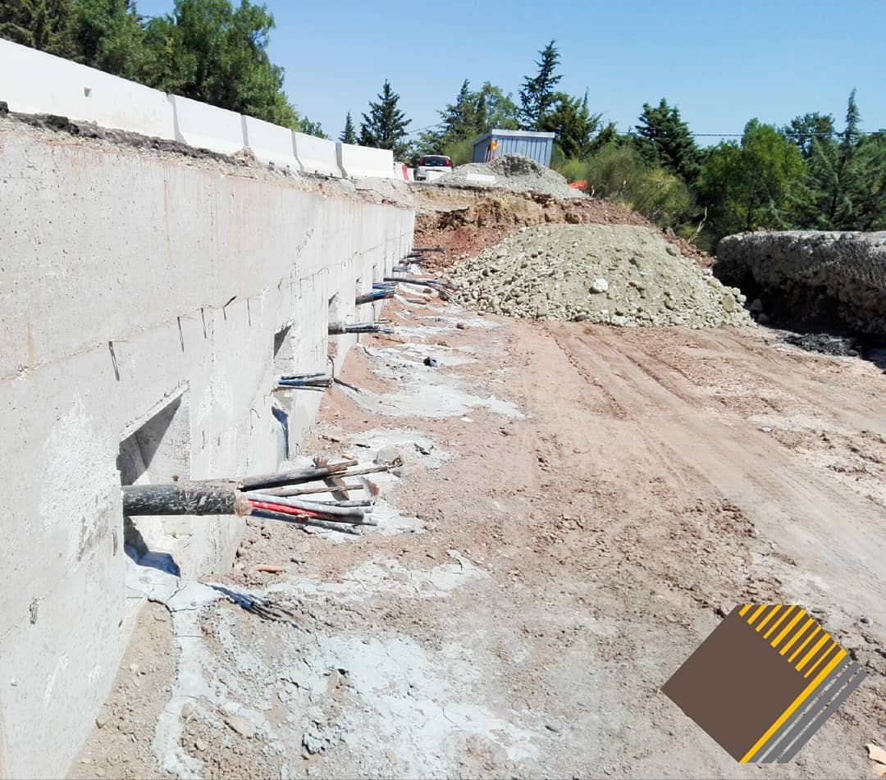
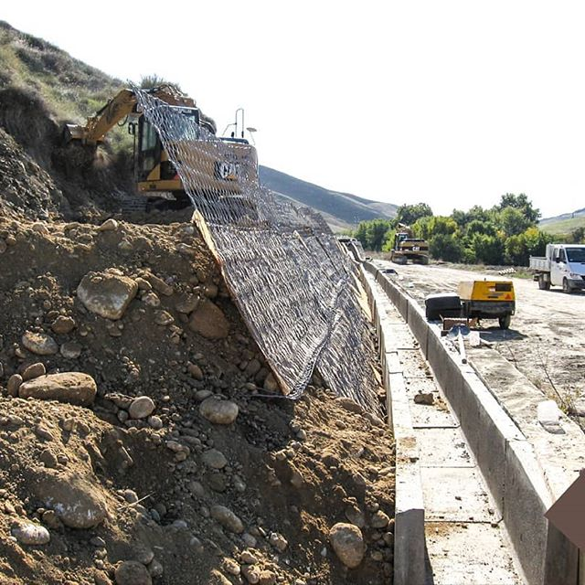
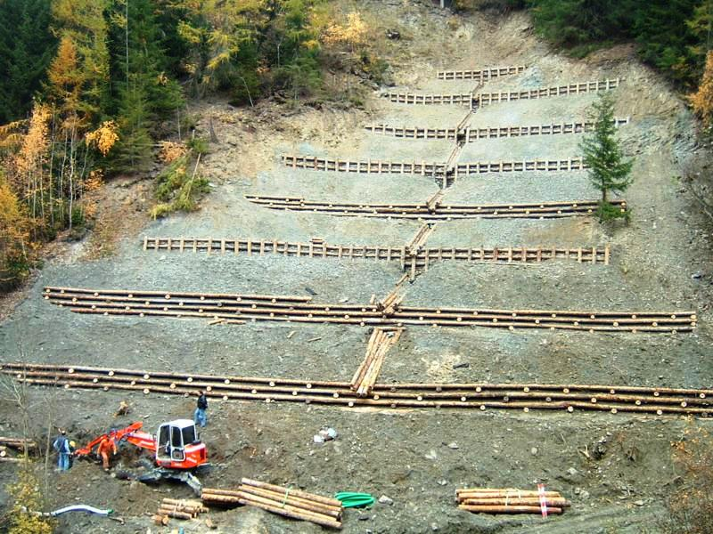
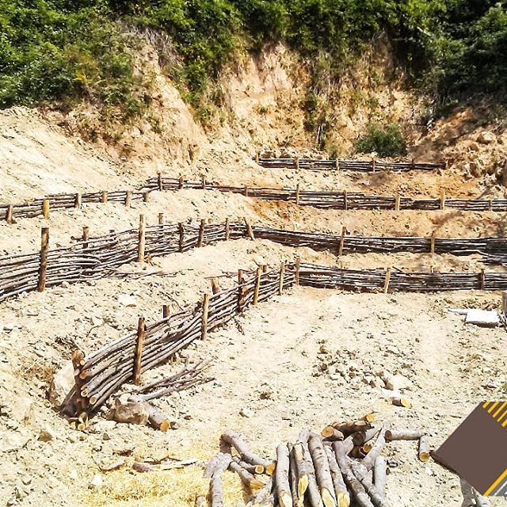
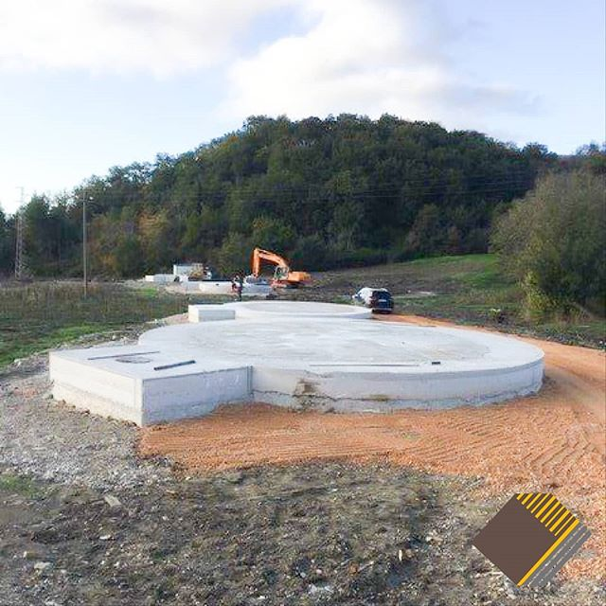
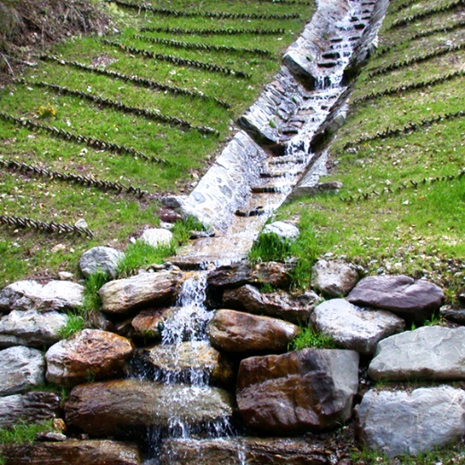
How to reduce the landslide risk of natural slopes?
Traditional engineering infrastructures
Naturalistic engineering solutions
IMPROVE THE SLOPES STABILITY CONDITIONS PRESERVING THE LANDSCAPE IDENTITY
High cost
High impact
Ecological collapse
Low impact
Low cost
Conservation of biodiversity
Computational methods design well-known
Non-standardized design methodologies

Slide 3
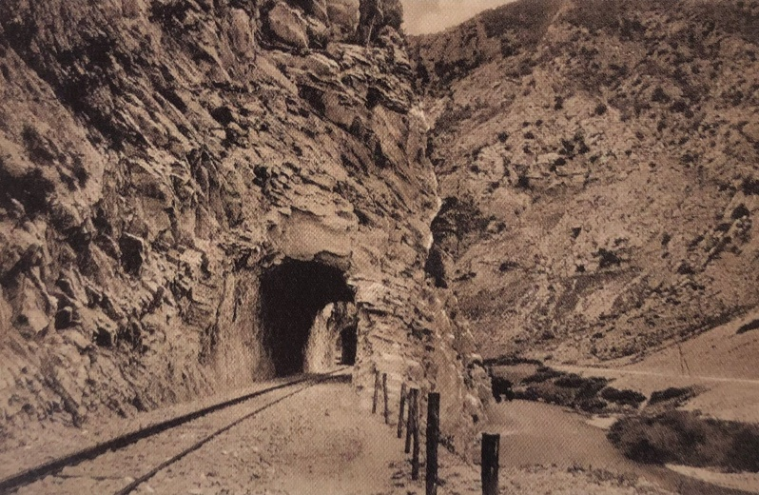
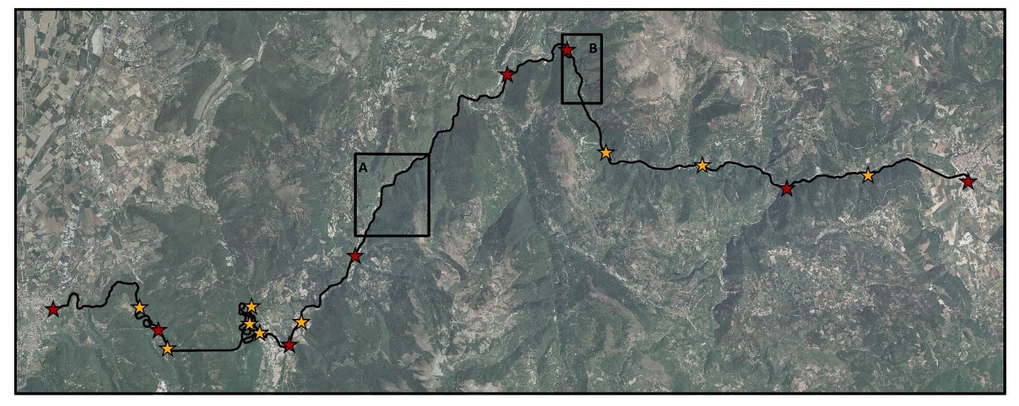
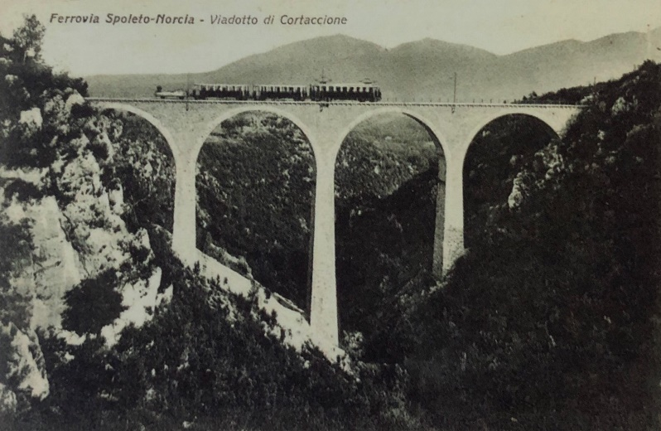
The case study
The naturalistic measures are indicated to reduce landslide risk mitigation in the areas characterized by particular natural environment.
An exemplary case study is represented by the GREENWAY SPOLETO-NORCIA.
The greenway is located in the Valnerina district (Umbria region), includes the track of Spoleto Norcia railway, realized in 1926 and abandoned in the 1960.
At the beginning of new millennium, the railway was converted in a beautiful and attractive greenway, but after central Italy earthquake, the greenway was closed due to high landslide risk detected in different sectors of the track.

Slide 4
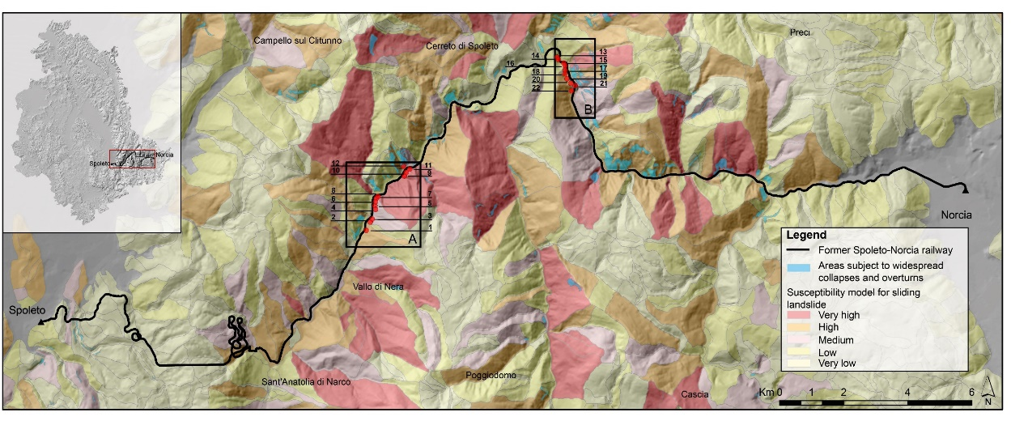
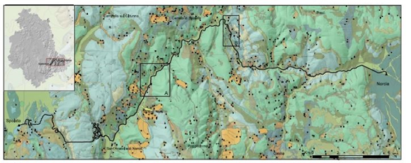
Characteristics of the study area
The greenway results in high landslide susceptibility areas.
Many landslides occurred along the track (see black dots).
The study area is characterized by the presence of rock soils covered by landslide deposits (soil cover thicknesses about 3 m).
After intense and prolonged rainfall, the soil covers are subject to shallow landslide reactivations.
To reduce the landslide risk and to protect the landscape, the naturalistic countermeasures realization were designed.
22 potentially unstable slopes have been examined. In this study the results related to 2 standard type of slopes are shown.
Methodology
The stability analyses, carried out with classical limit equilibrium methods, have been performed using:
Classical deterministic approach
The stability conditions are quantified by Fs.
Fs represents the ratio between the available shear strength and the mobilized shear stress along a potential failure surface.
Fs values, close to 1, indicate limit equilibrium conditions.
Probabilistic approach
The stability conditions are quantified by probability of failure PoF
Pof represents the probability that Fs<1
The strength soil characteristics are described by specific probability density functions (pdf).

Slide 5
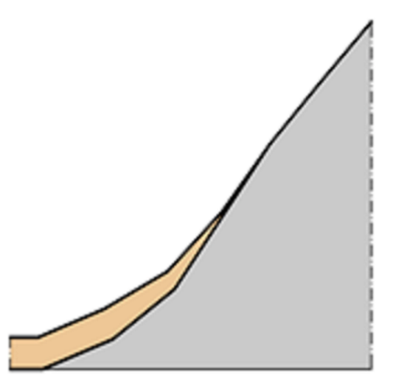
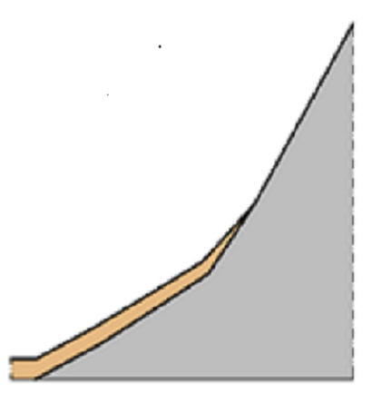
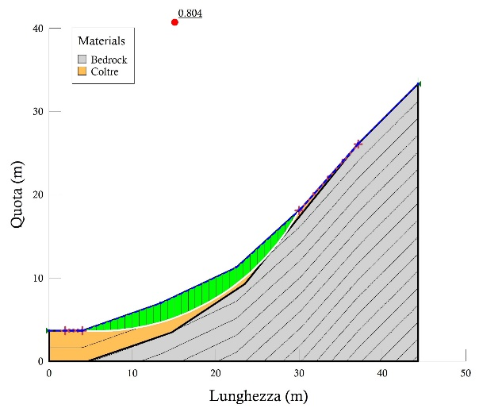
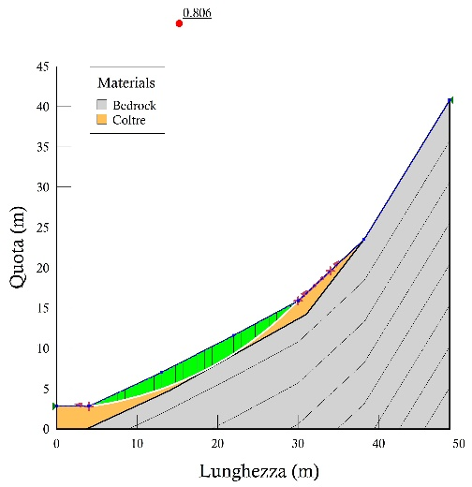
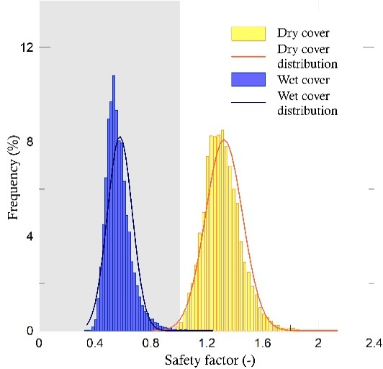
Slopes stability before countermeasures
Deterministic properties considered for soil cover T1 [1]
 | γ [kN/m³] | c’ [kPa] | φ [°]
T1 | 18 | 5 | 28
Bedrock | -- | -- | --
Stochastic properties for in situ soil cover [2]
 | pdf | Valore medio | COV
c | Lognormale | 5 [kPa] | 0.23 [-]
φ | normale | 28 [°] | 0.07 [-]
S1
S2
Calculation profile considered in the stability analysis
S1
S2
S1
S2
Fs values obtained from deterministic analysis
PoF distribution obtained from probabilistic approach
(*) the stability analysis results are obtained considering the piezometric line at the ground surface
[1] Salciarini, D.; Fanelli, G.; Tamagnini, C. A probabilistic model for rainfall—induced shallow landslide prediction at the regional scale. Landslides 2017, 14, 1731–1746.
[2] Fanelli, G.; Salciarini, D.; Tamagnini, C. Reliable Soil Property Maps over Large Areas: A Case Study in Central Italy. Environmental and Engineering Geoscience 2016, 22, 37–52.

Slide 6
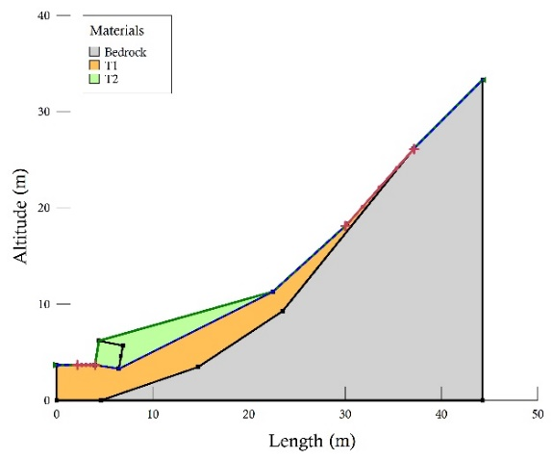
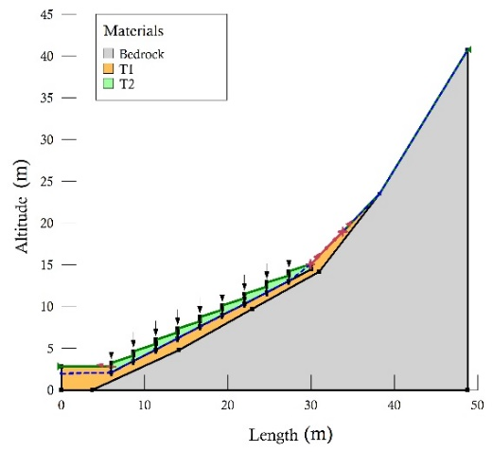
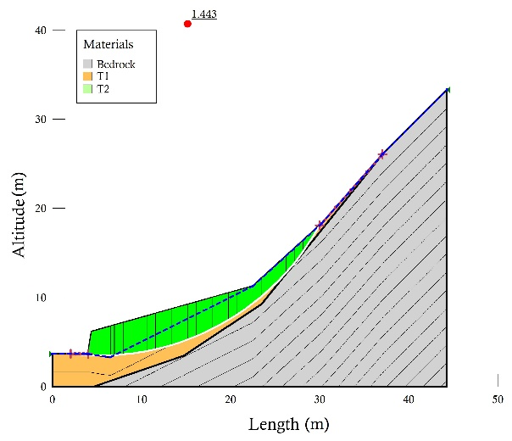
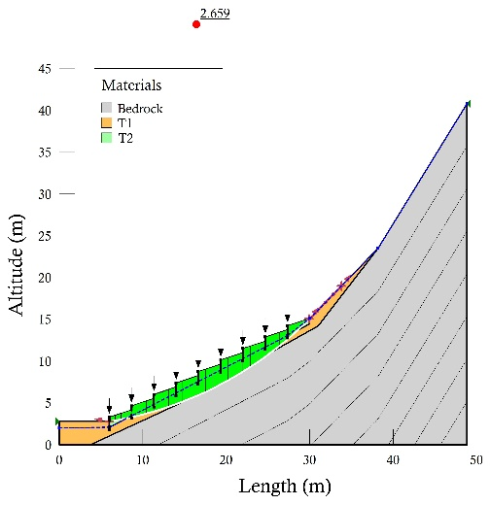
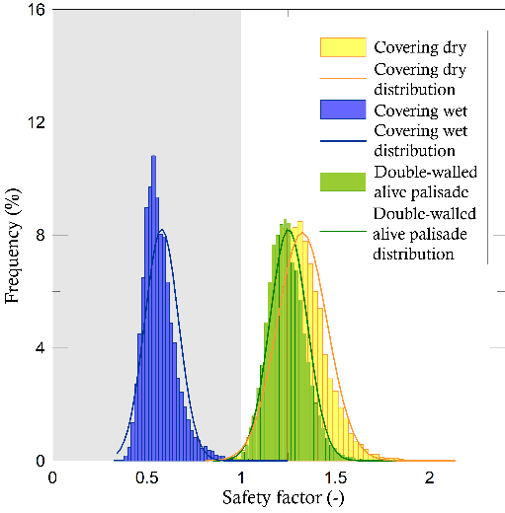
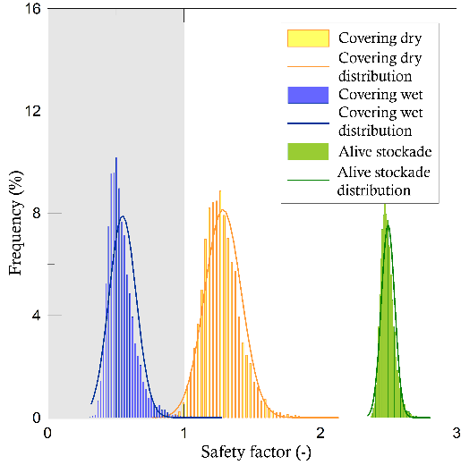
Slopes stability after countermeasures
Deterministic properties considered for soil cover
 | γ [kN/m³] | c [kPa] | φ [°]
T1 | 18 | 5 | 28
T2 (*) | 20 | 10 | 35
(*) T2 is the «reinforced» cover after stabilization works
Stochastic properties for in situ soil cover
S1
S2
 | pdf | mean value | COV
c | lognormale | 10 [kPa] | 0.2 [-]
φ | normale | 35 [°] | 0.06 [-]
Proposed countermeasures: S1-double walled wooden piling, S2-stockade [3]
S1
S2
Fs values obtained from deterministic analysis
PoF distribution obtained from probabilistic approach
(*) the stability analysis results are obtained considering the piezometric line at the ground surface
[3] Salciarini, D.; Volpe, E.; Di Pietro, L.; Cattoni, E. A case study of sustainable countermeasures against shallow landslides in central Italy. Geosciences, 6 April 2020.

Slide 7
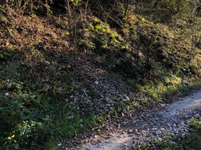
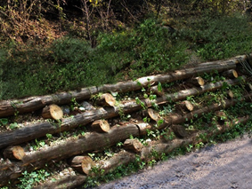
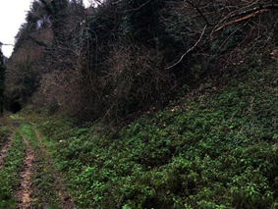
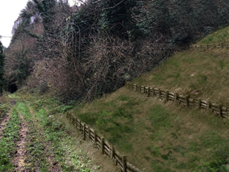
Conclusions
The realization of naturalistic engineering works improves drastically the slopes stability conditions.
For the 2 slopes considered, the implementation of the simulated countermeasures produces a relevant increase of Fs and PoF.
The double-walled wooden piling and the stockade reduce the reactivation risk of shallow landslides, protecting the environment and landscape features.
S | Fs | E_{Fs} | PoF | Δ_{Pof}
S1 | 1.44 | 79% | 0.2 [-] | 0.79
S2 | 2.66 | 229% | 0.0 [-] | 0.99
E_{fs}(%) represents the efficency of the engineering work. It is defines as:
E_{Fs}(%)=(F_{s,post}-F_{s,pre})/(F_{s,pre}), where F_{s,post} represents the safety factor after countermeasure installation, F_{s,pre} represents the safety factor in the slope initial condition, and Δ_{Pof} is the variation of PoF before and after the works.
Simulated naturalistic work for S1 through photographic rendering, a) Initial condition, b) condition after naturalistic work realization.
Simulated naturalistic work for S2 through photographic rendering, a) Initial condition, b) condition after naturalistic work realization.
a
b
a
b

