Slide 1



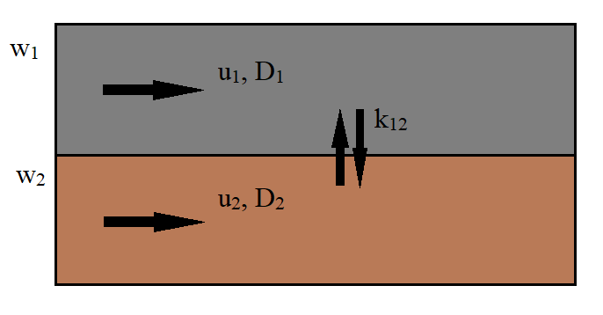
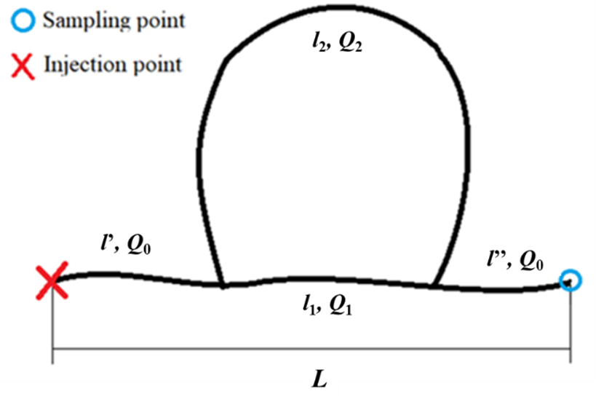
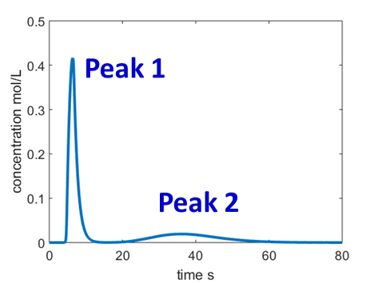
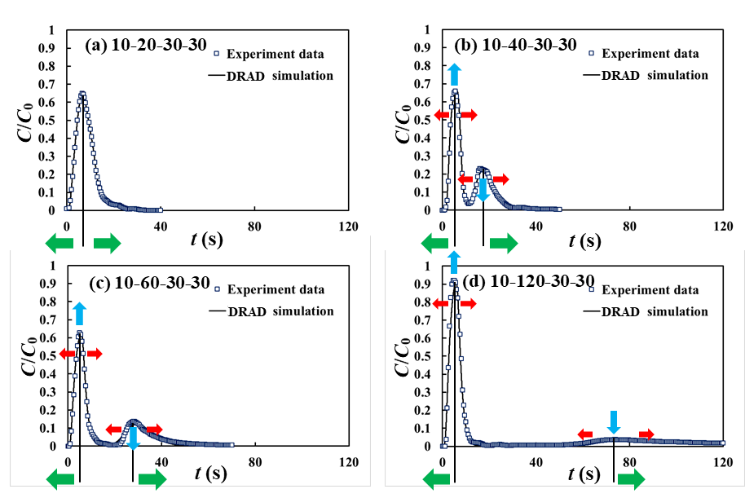
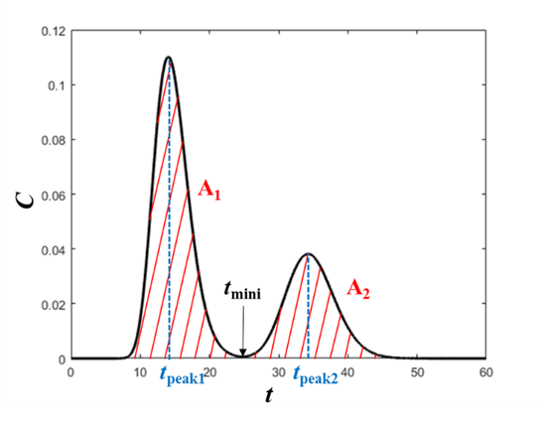
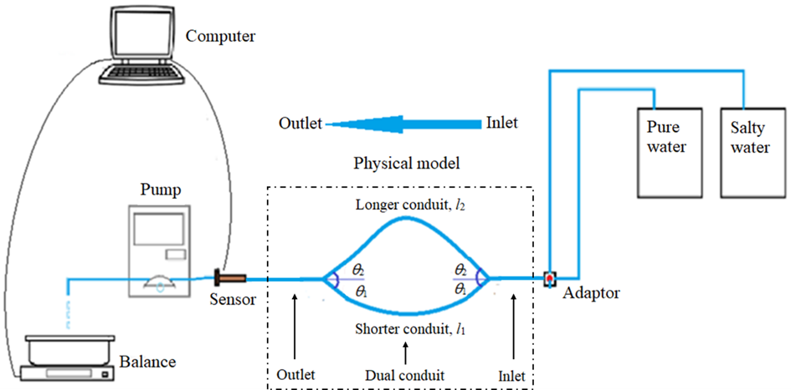
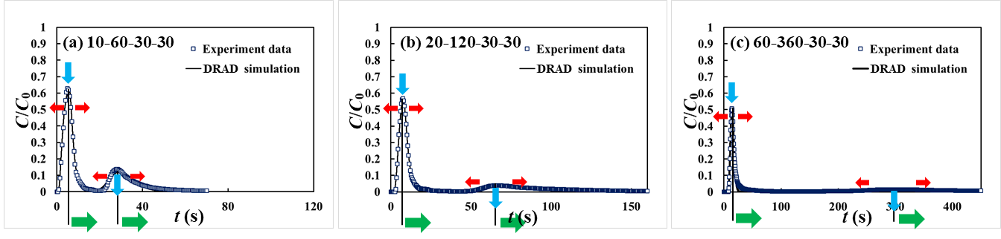
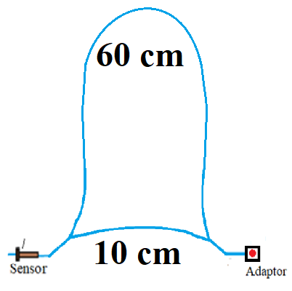
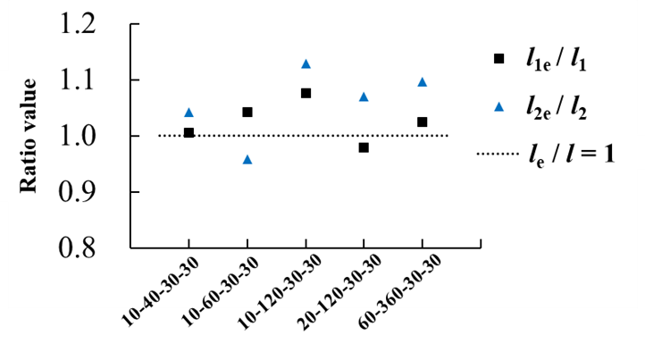
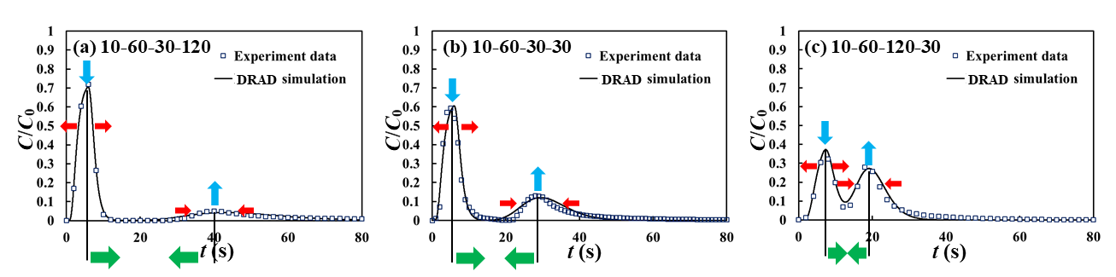
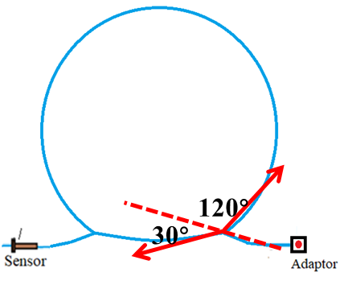
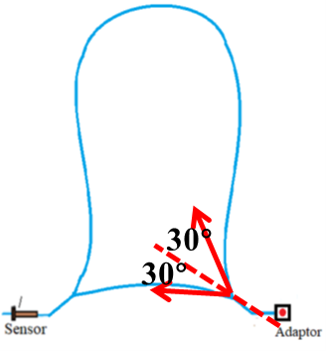
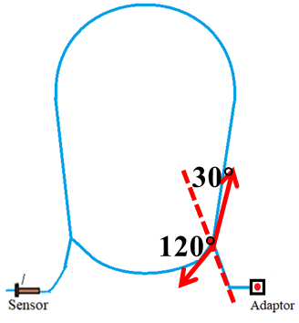

Solute transport in dual conduit structure: experiment and modelling
Chaoqi Wang¹, Xiaoguang Wang¹, Samer Majdalani¹, Vincent Guinot¹, Herve Jourde¹
¹Hydrosciences Montpellier, UMR 5569, France
Introduction
Methods
A method for inferring underground conduit lengths from the dual-peaked BTCs
During tracer experiment, widely used for the study of karst aquifers, dual-peaked breakthrough curves (BTCs) are sometimes observed.
Such phenomenon is generally attributed to the dual-conduit structure.
However, how the geometry of dual conduit structure influences the BTCs is poorly understood. So, physical experiments were carried out to study this effect.
In order to analyze the experiment results more quantitatively, the BTCs were fitted with Dual Region Advection Dispersion (DRAD) model. It assumes two regions flowing in parallel, exchanging mass due to concentration difference, and ADE is assumed valid in both regions.
We propose to use the dual-peaked BTCs to infer the length of conduits when we obtain fully separated dual-peaked BTCs and the transport process is advection-dominant. The method has 3 steps.
The governing equations:
Step 1. Data collection
The method requires 3 information about the conduit structure:
1) The flow rate at the sampling point, Q₀.
2) The average diameter of the conduits, R.
3) The conduit length between the injection and the sampling point, L×S_{f}. With L the distance between injection and the sampling point, S_{f} is sinuosity factor).
k₁₂=k₂₁
w₁+w₂=1
Figure 4. Schematic diagram of the DRAD model
Experiment results
Step 2. BTC analysis
We extract the time corresponding to both peaks (t_{peak1}, t_{peak2}), calculate the area under the two part of the BTC (A₁, A₂). When the Péclet number is sufficiently high (in our experiments, Pe≥ 7.77), we have:
Q₁/Q₂ ≈ A₁/A₂
And according to mass balance:.
Q₀=Q₁+Q₂.
With these two equations, we can calculate Q₁ and Q₂.
Group 1:
Figure 1. Dual conduit structure
Figure 2. Dual-peaked BTCs
Experimental Setup
NaCl
Figure 8. A fully separated BTC
Step 3. Conduit length calculation
Pulse injection
Figure 5. Experiment and fitting results of Group l
With the following two equations, we can estimate the lengths of the two conduits, l_{1e} and l_{2e} :
Figure 3. Experiment flow chart
As the length ratio increases, the arrival of the first peak (t_{peak1}) appears slightly earlier while theone of the second peak (t_{peak2}) is delayed.
As the length ratio increases, the concentration value of the first peak (C_{peak1}) increases, while the concentration value of the second peak (C_{peak2}) decreases.
Experiments are designed by varying the shorter conduit length l₁, longer conduit length l₂ and connection angles θ₁, θ₂ (Table 1).
Table 1. Experiment setup
Group 2:
Verification
Group | Experiment label | Conduit length (cm) |  | Connection angles (deg)
 |  | l₁ | l₂ | θ₁ | θ₂
1 | 10-20-30-30 | 10 | 20 | 30 | 30
 | 10-40-30-30 | 10 | 40 | 30 | 30
 | 10-60-30-30 | 10 | 60 | 30 | 30
 | 10-120-30-30 | 10 | 120 | 30 | 30
2 | 10-60-30-30 | 10 | 60 | 30 | 30
 | 20-120-30-30 | 20 | 120 | 30 | 30
 | 60-360-30-30 | 60 | 360 | 30 | 30
3 | 10-60-30-30 | 10 | 60 | 30 | 120
 | 10-60-30-120 | 10 | 60 | 30 | 30
 | 10-60-120-30 | 10 | 60 | 120 | 30
We verify the effectiveness of the method with experimental data of Groups 1 and 2. The ratios between estimated and true lengths is shown on Figure 9.
Figure 6. Experiment and fitting results of Group 2
As the length increases, the two peaks become increasingly separated.
As the length increases, both concentration values C_{peak1} and C_{peak2} show a decreasing trend, with C_{peak2} decreasing faster than C_{peak1}.
Figure 9. Ratios between estimated and true lengths
Group 3:
It can be seen that the length ratios for various experiments scatter around 1.0, which indicates a correct estimation of conduits lengths by the proposed method.
Conclusions
How the dual-conduit structure (length ratio, total length, connection angle) may influence the BTCs shape is studied.
DRAD model is valid in reproducing the dual-peaked BTCs.
A method to estimate the underground conduit length from recorded dual-peaked BTCs is proposed. The method showed a good performance in estimating the conduit length from our experimental BTCs and might thus be applied to the interpretation of field tracer tests in karst system.
Group 1 is designed to study the effect of the length ratio between both conduits on transport processes.
Group 2 is designed to study the effect of the total conduit length variation on the transport process, keeping the length ratio between both pipes as 1:6.
Group 3 is designed to study the effect of the connection angle between both conduits on transport processes.
Figure 7. Experiment and fitting results of Group 3
As the connection angle between both conduits (θ₁-θ₂) increases, the two peaks become closer to each other, namely t_{peak1} increases and t_{peak2} decreases and C_{peak1} decreases, while C_{peak2} increases.
Note: The paper that presents detailed derivation process of the method has just been submitted. If you feel interested, please contact: chaoqi.wang@etu.umontpellier.fr

