Slide 1
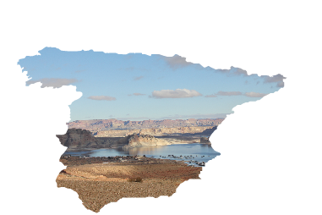
Drought Management Plans in Spain: Are we improving the way we manage drought?
Dr Julia Urquijo (UPM)
Dr Lucia De Stefano (UCM, F. Botín)
Dr Teresa Gómez Villarino
EGU 2020 – 8th May 2020

Slide 2
Background
Drought Management Plans (DMP) are a key tool for managing droughts from a risk-management perspective.
Water Framework Directive (WFD) encourage its development to complement RBMP in the European Union.
In 2007 Spain approved DMPs by River Basin District (RBDs) that enforced the development of DMP in 2007. In 2018 a second generation of DMP were approved for all the inter-regional RBD.
There is little research on the effectiveness of such plans based on in-depth and ex post analysis (Kallis 2008). The evaluation of DMP is incipient and little references can be found, mainly in the US (ex. Fu & Tang, 2013; Fu, Svoboda et al., 2013;, Fu & Tang et al., 2013; and Fontaine, Steineman & Hayes, 2012).
Evidences to show whether they work or not as a tool for a proactive and effective drought management are needed. Spain is presented as a relevant case study to advance in DMP development and results.

Slide 3
Objectives & Research questions
The main objective is to evaluate the adequacy, pertinence and utility of the DMP as policy instrument to deal with drought. We considered both the 2007 and the 2018 DMPs.
The specific objectives are:
To analyse how DMPs have evolved from 2007 to 2018
To determine to what extent and how they have improved
To identify gaps and challenges for the future
Additionally, we address the following questions of:
Are there significant differences between plans?
Are there territorial differences? About which topics?

Slide 4
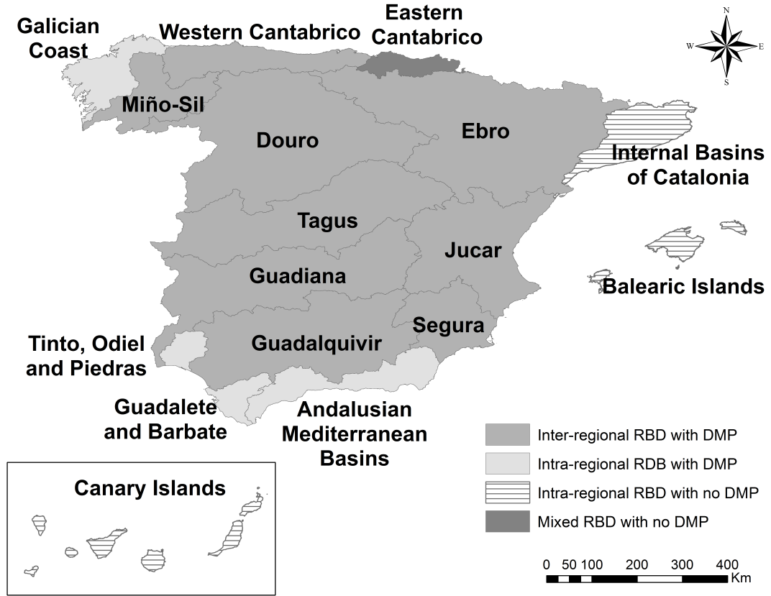
Materials
8 DMP from Inter-regional RBD
DMP 2007 - DMP 2018
DOU | Douro
EBR | Ebro
GDQ | Guadalquivir
GUA | Guadiana
JUC | Jucar
MIN | Miño-Sil
SEG | Segura
TAG | Tagus

Slide 5
Methodology
Literature review
Conceptual model
International references, principles & guidelines
Spanish Guidelines for DMP development
Academic literature on the topic
3 components
12 criteria
43 indicators
Research protocol & indicators definition
Content analysis
Check list
Coding process
Scale 0 -3
DMP analysis
Analysis of results
2007 – 2018 Comparison

Slide 6
Preliminary findings
The scope and content of the DMPs are more homogeneous and consistent in 2018 than in 2007.
They all show clear improvements on its quality.
In 2018 all DMP obtained an overall score above the mean score, and for 75% of the criteria
Relative position changes between 2007 and 2018.
JUC: best performance
DUE: great improvement between 2007 and 2018
Drought vulnerability component is addressed better than Drought measures and management component, and Drought description component.

Slide 7
Preliminary findings
IMPROVEMENTS:
Formal definition of prolonged droughts
Analysis of non-conventional resources
Analysis of water demands from tourism sector
Identification of measures or actions to reduce vulnerability and vulnerability areas
Process of drought declarations
Identification of means, staff and budget needed
Establishment of different means and mechanisms for participation and communication
REMAINING CHALLENGES:
Identifications and quantification of drought impacts
Assessment of vulnerability factors
Estimation of cost and effectiveness of drought measures
Ex-post evaluation of DPM performance

Slide 8
Final remarks
The analysis of DMPs shows clear improvements in all the DMPs between 2007 and 2018.
Experienced gained in previous drought episodes management may have been incorporated in the revision of the plans and new plans can be used as a good example to develop other DMPs.
The methodology enables the assessment of the quality of the DMPs and it can be easily replicated by using the research protocol.
The identifications of gaps and potential issues (related to lower performance of the criteria or lower rates of improvement) could be taken into account in subsequent plans revision.

Slide 9
Thanks!!
Lucia De Stefano, PhD
Universidad Complutense de Madrid
luciads@geo.ucm.es
Julia Urquijo Reguera, PhD
Universidad Politécnica de Madrid
julia.urquijo@upm.es
Maria Teresa Gómez Villarino, PhD
Universidad Politécnica de Madrid
teresa.gomez.villarino@upm.es

