Slide 1
Landslide Susceptibility Zonation Mapping in and Around Dharamshala, Himachal Pradesh Using Bivariate Statistical Techniques – A Comparative Study
By
Kumari Sweta
Under the Supervision of:
Dr. Ajanta Goswami
Department of Earth Sciences
IIT Roorkee

Slide 3
INTRODUCTION
Landslide is defined as the downward and outward movement of rock, soil and any slope forming material under the influence of gravity.
When the failure or rupture surface is prominent and identifiable then only it is called landslide otherwise the movement is termed mass wasting
Landslides are one of the major natural hazards recognized in the whole Himalayan arc
High to very high fatality rate (~1person/100 sq. km per year)
Societal and economic losses more than 550 crores/year (SOURCE: Himachal Pradesh State Disaster Management Authority, 2011)
Figure Source: AGU Blog

Slide 4
contd..
Landslides are mainly associated with hilly reasons.
As per the landslide hazard zonation map prepared by GSI shows that along with Himalayas the coastal region is also affected.
Landslides occur where the shear stress of slope material exceeds its shear strength either due to heavy precipitation, seismicity or anthropogenic activity
Since Himalayan belt is the fragile & youngest mountain range of world it is tectonically & seismically very active as well heavy rainfall occur especially during summer monsoon make it most hazardous
Fig. Landslide Hazard Zonation Map by GSI

Slide 5
Major Landslides of India
Table: Some Major historical landslides of Indian Continent
Event | Occurrence | Estimated Loss
July, 1991 | Assam | 300 people killed
July, 1993 | Itanagar | 25 people buried alive
14 August, 1998 | Okhimath, Uttarakhand | 69 people killed
August, 1998 | Malpa, Maharashtra | 400 casualties
24 September, 2012 | Northern Sikkim | 27 people died
16 June, 2013 | Kedarnath, Uttarakhand | More than 5700 casualties
30 July, 2014 | Malin, Maharashtra | 157 people killed
1 July, 2015 | Darjeeling, WB | 40+ people died
13 August, 2017 | NH-154, Mandi, HP | 40+ death along with heavy economic loss
10 March, 2018 | Bageshwar, Uttarakhand | Approx. 400 people affected
These are some important landslides which caused heavy loss to life and property, except these many more landslides occur nearly daily especially in Himalayan belt.

Slide 6
Classification of Landslides
VARNES´ CLASSIFICATION OF SLOPE MOVEMENTS
The landslide classification based on Varnes' (1978) system has two terms:
- the first term describes the material type,
- the second term describes the type of movement.

Slide 7
contd..
The material types used by the various schemes are Rock, Earth, Soil, Mud and Debris, being classified as follows:
Rock: is “a hard or firm mass that was intact and in its natural place before the initiation of movement”.
Soil: is “an aggregate of solid particles, generally of minerals and rocks, that either was transported or was formed by the weathering of rock in place. Gases or liquids filling the pores of the soil form part of the soil”.
Earth: “describes material in which 80% or more of the particles are smaller than 2mm, the upper limit of sand sized particles”.
Mud: “describes material in which 80% or more of the particles are smaller than 0.06mm, the upper limit of silt sized particles”.
Debris: “contains a significant proportion of coarse material; 20% to 80% of the particles are larger than 2mm, and the remainder are less than 2mm”.

Slide 8
contd..
The five kinematically distinct types of movement are described in the sequence:
Fall: Falls are abrupt movements of masses of geologic materials, such as rocks and boulders, that become detached from steep slopes or cliffs (fig. 3D). Separation occurs along discontinuities such as fractures, joints, and bedding planes, and movement occurs by free-fall, bouncing, and rolling. Falls are strongly influenced by gravity, mechanical weathering, and the presence of interstitial water.
Topple: Toppling failures are distinguished by the forward rotation of a unit or units about some pivotal point
Slide: Although many types of mass movements are included in the general term “landslide,” the more restrictive use of the term refers only to mass movements, where there is a distinct zone of weakness that separates the slide material from more stable underlying material. The two major types of slides are rotational slides and translational slides.
Spread: Lateral spreads are distinctive because they usually occur on very gentle slopes or flat terrain. The failure is caused by liquefaction, the process whereby saturated, loose, cohesionless sediments (usually sands and silts) are transformed from a solid into a liquefied state.
Flow:

Slide 9
contd..
Varnes, D. J. 1978. Slope movement types and processes. In: Special Report 176: Landslides: Analysis and Control (Eds: Schuster, R. L. & Krizek, R. J.). Transportation and Road Research Board, National Academy of Science, Washington D. C., 11-33.

Slide 10
contd..
Major Causes of Landslide
Factors Causing of Landslides
Inherent Factors
Triggering Factors
Geological Parameters
Geotechnical Parameters
Rainfall
Earthquakes
Anthropogenic

Slide 11
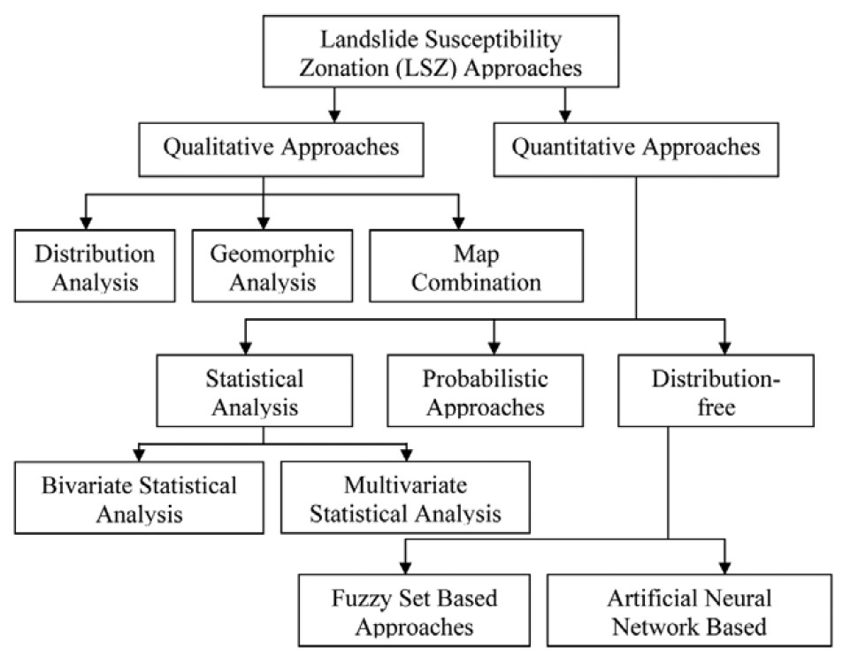
Landslide susceptibility mapping (LSM)
Landslide susceptibility mapping is the process of classifying the land surface into different categories of stability relatively, based on an estimated significance of landslide causative factors.
Reference: Kanungo, D.P., Arora, M.K., Sarkar, S. and Gupta, R.P., 2012. Landslide Susceptibility Zonation (LSZ) Mapping–A Review.

Slide 12
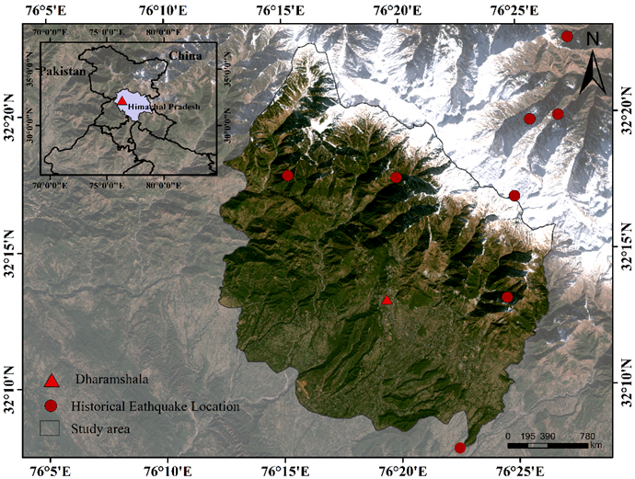
STUDY AREA
Dharamshala and surrounding covers an area of 356sq.Km with an elevation between 4584m to 616m above mean sea level
Tectonically it is traversed by longitudinal Main Boundary Thrust from SE to NW direction.
As per IS 1893:2016 (Part I) the study area lies in Zone V of Seismic Zonation Map of India (PGA= 0.36g for 2% exceedance probability in 50 years)
IMD data estimates the mean annual precipitation as 2900 ± 639mm
2011 census data showed the total population of approx. 50,000
Boundary
Latitude: 32⁰5’ to 32⁰25’N
Longitude: 76⁰10’ to 76⁰30’E

Slide 13
Geology of the Area
Geological unit | Stratigraphic Age | Rock Type
Salkhala Formation | Archaean - Proterozoic (undifferentiated) | Carbonates and metamorphic rocks like slate, phyllite & schist
Kullu Formation | Mesoproterozoic - Neoproterozoic (undifferentiated) | Plutonic and metamorphic
Sundernagar Formation | Mesoproterozoic | Sands and sandstones
Malani Volcanic Suite | Neoproterozoic | Basalts and Rhyolites
Upper Murree Group | Eocene - Miocene | Sands and sandstones
Undiff. Murree Group, Dharamshala Group, Dagshai, and Kasauli Formations | Eocene - Miocene | Sands and sandstones
Lower Siwalik Group | Miocene | Sandstone and Shales
Middle Siwalik Group | Miocene - Pliocene | Sandstone and Shales
Upper Siwalik Group | Pliocene - Pleistocene | Boulder conglomerates with clays and grit
Fig. Geological Map
Source: Bhukosh (GSI Portal)

Slide 14
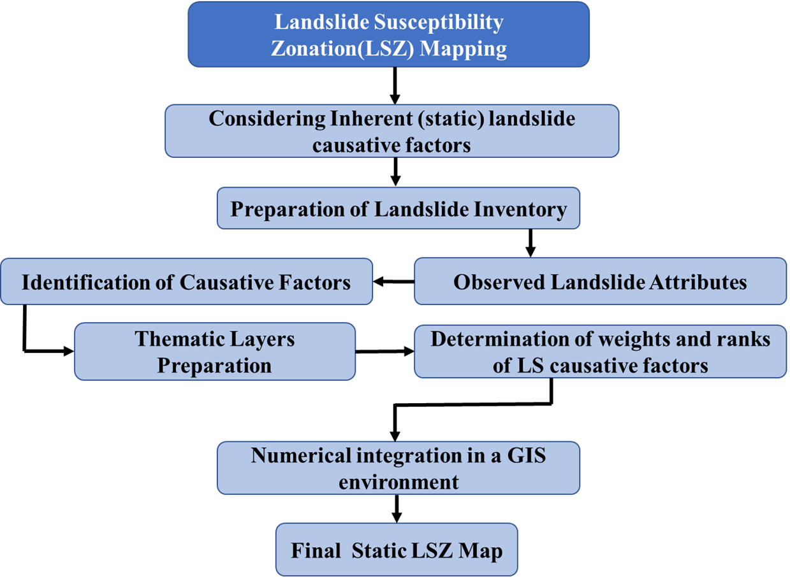
OVERALL METHODOLOGY

Slide 15
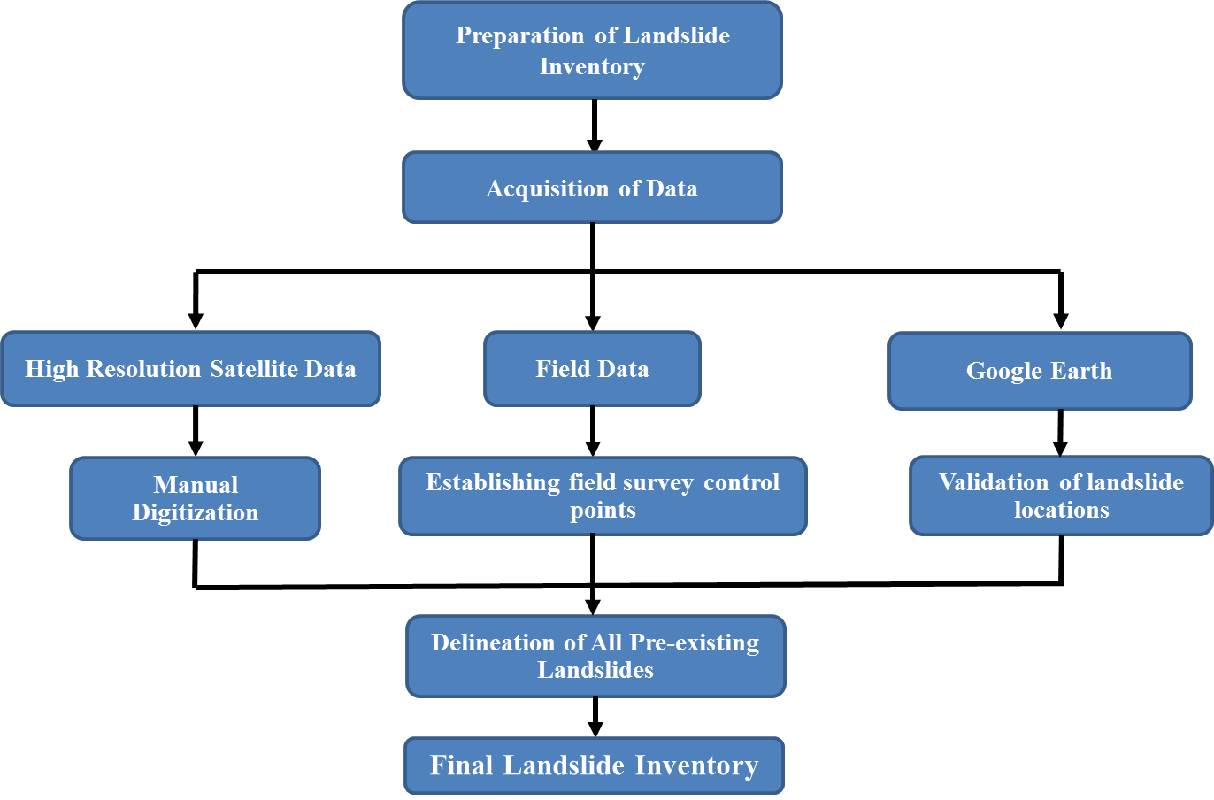
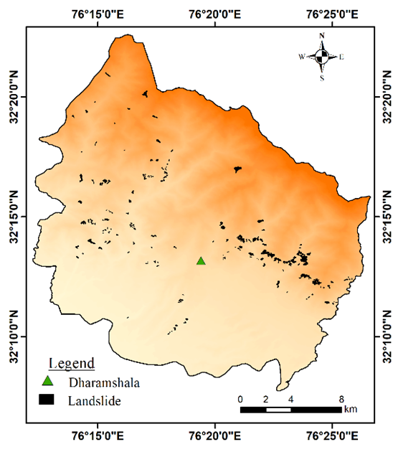
contd..
Fig. Landslide Inventory Map of the study area
Fig. Flow chart showing steps for Inventory Preparation

Slide 16
Generation of Thematic Layers
Thematic Layers
DEM
High Resolution Satellite Images
Regional Geological Map and Field Survey
Slope
Aspect
Curvature
Elevation
Land Use Land Cover
Structural Map
Lithology Map
Topographic Wetness Index
Rasterization of Thematic Layers of Causative Factors in a GIS Environment

Slide 17
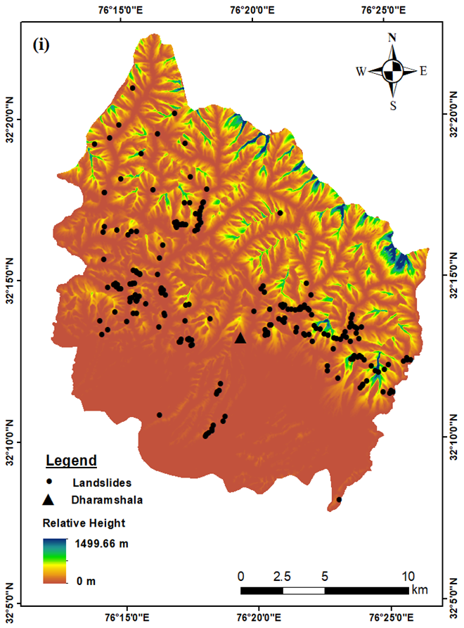
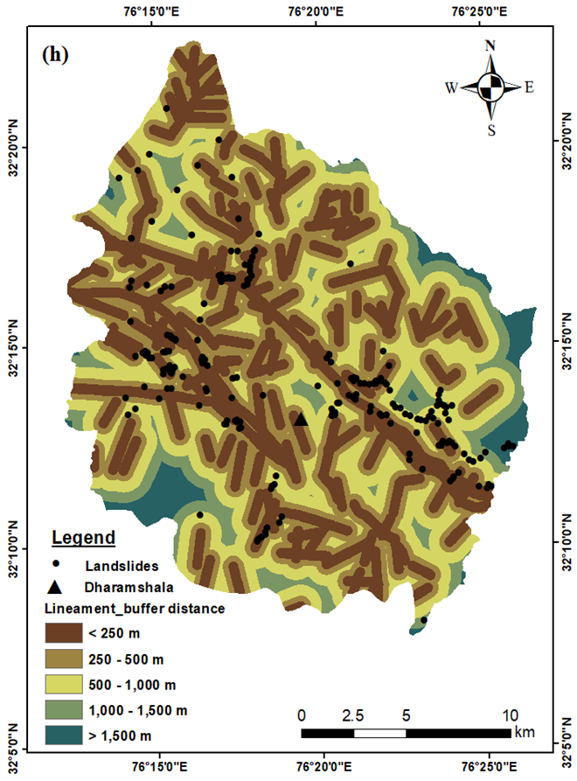
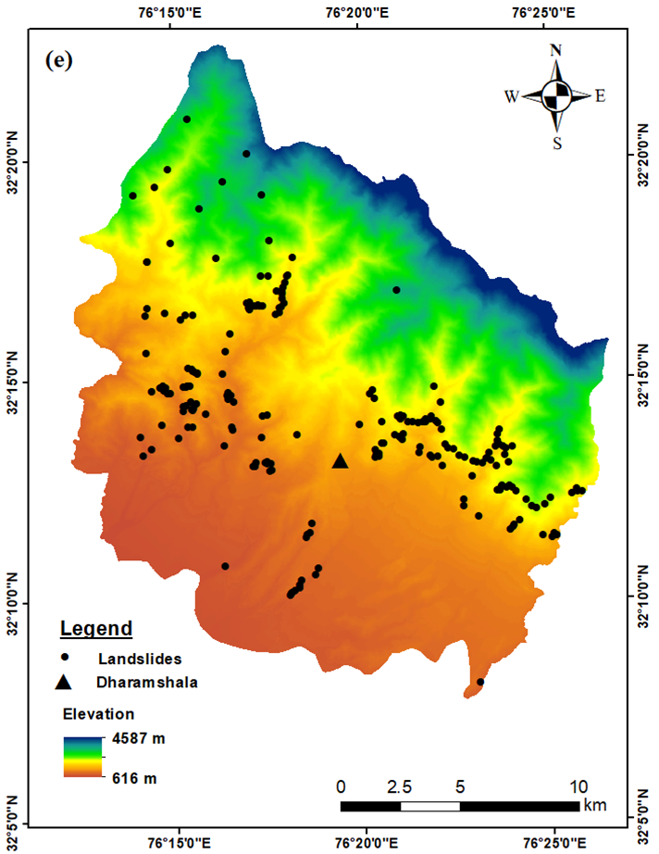
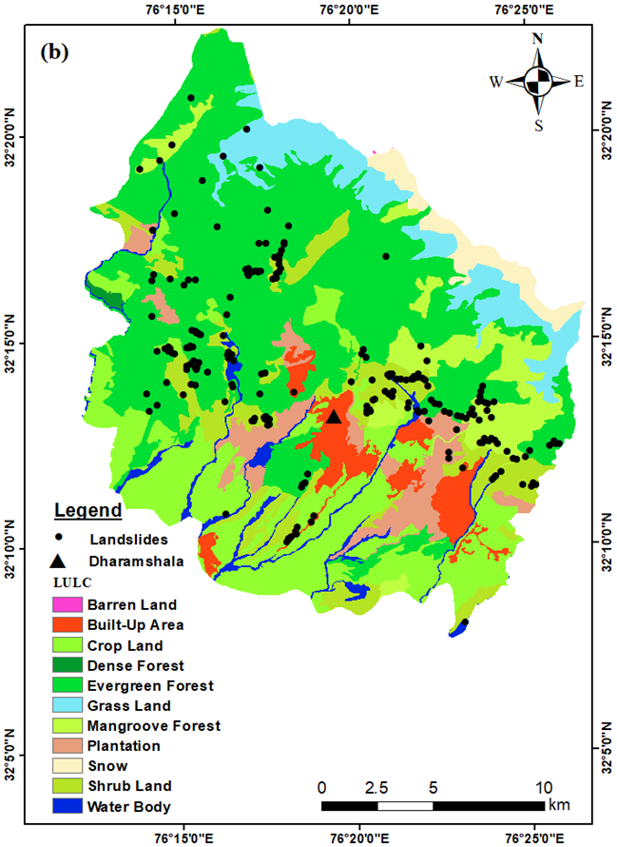
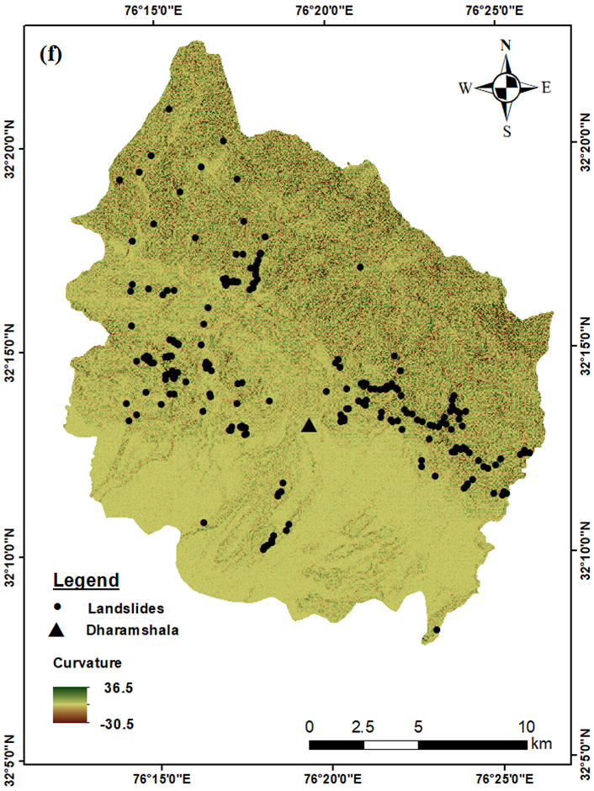
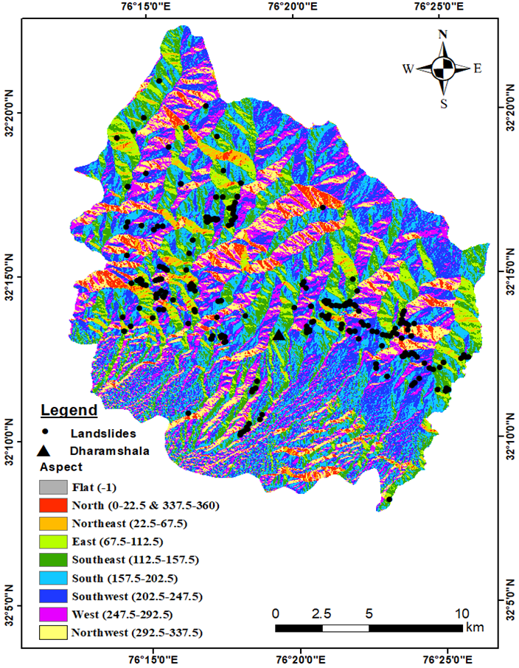
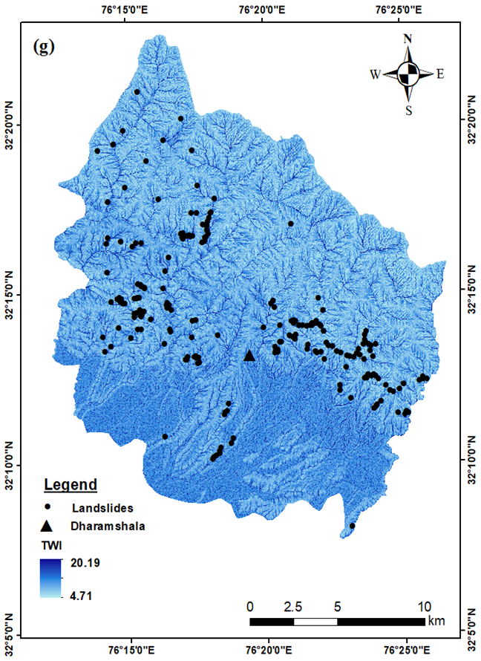
Causative Factor’s Thematic Maps

Slide 18
Methods for Weight Calculation
Landslide
Inventory
Information Value Method
$$w_{i }=ln\frac{Densclass}{Densmap}$$
$$=ln\frac{Npix\left(S_{i}\right)/Npix(N_{i})}{\sum_{i=1}^{n}{Npix\left(S_{i}\right)}/Npix(N_{i})}$$
Lithology
LULC
Slope
gradient
Frequency Ratio Method
Frequency Ratio= Slide Ratio/Class Ratio
Slide Ratio = Number of Landslide pixel in class/ Total number of Landslide pixels
Class Ratio =Number of pixels in individual class/Total number of pixels in whole class
Slope
aspect
Lineament
Buffer
Relative Relief
Altitude
Cosine Amplitude Method
$$rij= \frac{[\sum_{k=1}^{p}{x_{ik}∗x_{jk}}]}{\sqrt{(\sum_{k=1}^{p}{x_{ik}^{2})(\sum_{k=1}^{p}{x_{jk}^{2})}}}}$$
Slope
curvature
TWI

Slide 19
Weights of Causative Factors Using Different Methods
Relative Relief | Very Low(0-70.57) | 560067 | 3465 | -0.017 | 0.962 | 0.059
 | Low(70.57-188.19) | 238769 | 1811 | 0.071 | 1.179 | 0.047
 | Moderate(188.19-370.50) | 105225 | 573 | -0.072 | 0.846 | 0.023
 | High(370.50-670.44) | 37463 | 236 | -0.009 | 0.979 | 0.016
 | Very High(670.44-1499.66) | 8619 | 28 | -0.297 | 0.505 | 0.004
TWI | Very Low(4.71-7.32) | 222972 | 1477 | 0.013 | 1.030 | 0.040
 | Low(7.32-8.60) | 301256 | 1719 | -0.052 | 0.887 | 0.040
 | Moderate(8.60-9.99) | 263573 | 737 | -0.362 | 0.435 | 0.018
 | High(9.99-11.99)) | 123074 | 1993 | 0.401 | 2.517 | 0.073
 | Very High(11.99-20.20) | 39268 | 187 | -0.131 | 0.740 | 0.012
Lineament Buffer | Buffer Zone(20-280) | 368350 | 2410 | 0.193 | 1.559 | 0.052
 | Buffer Zone (300-620) | 307441 | 1747 | -0.054 | 0.883 | 0.040
 | Buffer Zone (640-1040) | 174560 | 1751 | 0.007 | 1.017 | 0.051
 | Buffer Zone (1060-1660) | 75203 | 161 | -0.478 | 0.333 | 0.008
 | Buffer Zone (1680-3220) | 24589 | 44 | -0.556 | 0.278 | 0.004
Slope | Very gentle (0-11.22) | 245836 | 134 | -1.072 | 0.085 | 0.003
 | Gentle (11.22-23.05) | 190454 | 899 | -0.135 | 0.734 | 0.026
 | Moderate (23.05-33.36) | 204841 | 2069 | 0.196 | 1.570 | 0.058
 | Steep (33.36-43.97) | 209951 | 2323 | 0.235 | 1.720 | 0.065
 | Very Steep (43.97-77.34) | 99061 | 688 | 0.033 | 1.079 | 0.028
Aspect | Flat(-1) | 2354 | 2 | -0.879 | 0.132 | 0.001
 | North (0-22.5) and (337.5-360) | 39057 | 251 | 0.000 | 0.999 | 0.016
 | Northeast (22.5-67.5) | 26680 | 65 | -0.422 | 0.379 | 0.005
 | East (67.5-112.5) | 65847 | 646 | 0.183 | 1.525 | 0.032
 | Southeast (112.5-157.5) | 142702 | 1353 | 0.168 | 1.474 | 0.046
 | South (157.5-202.5) | 205973 | 1749 | 0.121 | 1.320 | 0.049
 | Southwest (202.5-247.5) | 224560 | 1265 | -0.058 | 0.876 | 0.034
 | West (247.5-292.5) | 150360 | 523 | -0.267 | 0.541 | 0.017
 | Northwest (292.5-337.5) | 92610 | 259 | -0.362 | 0.435 | 0.011
Elevation | Very Low(616-1266) | 364668 | 822 | -0.455 | 0.350 | 0.017
 | Low(1266-1913) | 196460 | 3292 | 0.416 | 2.604 | 0.095
 | Moderate(1913-2577) | 171361 | 1424 | 0.111 | 1.292 | 0.044
 | High(2577-3350) | 147488 | 413 | -0.361 | 0.435 | 0.014
 | Very High(3350-4587) | 70166 | 162 | -0.445 | 0.359 | 0.008
Curvature | Strongly Concave(-30.5--3.66) | 42780 | 408 | 0.171 | 1.482 | 0.025
 | Concave(-3.66--1.07) | 186950 | 1788 | 0.172 | 1.487 | 0.053
 | Planar(-1.07-1.03) | 491151 | 2125 | -0.172 | 0.672 | 0.039
 | Convex(1.03-3.66) | 185995 | 1524 | 0.105 | 1.274 | 0.045
 | Strongly Convex(3.66-36.5) | 43267 | 268 | -0.016 | 0.963 | 0.016
Factors | Classes | Class Pixel | LS Pixel | Info Val | Frequency Ratio | r_{ij}
LULC | EF | 393392 | 2543 | 0.002 | 1.005 | 0.052
 | SL | 89731 | 1068 | 0.267 | 1.850 | 0.046
 | MF | 64554 | 1704 | 0.613 | 4.103 | 0.086
 | BL | 36 | 0 | 0.000 | 0.000 | 0.000
 | GL | 71926 | 233 | -0.298 | 0.504 | 0.011
 | SI | 25417 | 0 | 0.000 | 0.000 | 0.000
 | WB | 25004 | 114 | -0.150 | 0.709 | 0.009
 | CL | 179818 | 235 | -0.692 | 0.203 | 0.007
 | PL | 52337 | 189 | -0.251 | 0.561 | 0.011
 | DF | 2079 | 0 | 0.000 | 0.000 | 0.000
 | BU | 45849 | 27 | -1.038 | 0.092 | 0.002
Lithology | Salkhala Fm. | 63811 | 176 | -0.368 | 0.429 | 0.009
 | Upper Murree Grp | 197496 | 508 | -0.398 | 0.400 | 0.015
 | Undiff. Murree Grp, Dharmasala Grp, Dagshai and Kasauli Fm. | 2251 | 0 | 0.000 | 0.000 | 0.000
 | Upper Siwalik Grp | 235568 | 622 | -0.387 | 0.410 | 0.016
 | Lower Siwalik Grp | 26486 | 8 | -1.328 | 0.047 | 0.001
 | Sundernagar Fm. | 79976 | 2950 | 0.758 | 5.733 | 0.133
 | Malani Volcanic Suite | 209669 | 533 | -0.403 | 0.395 | 0.015
 | Kullu Fm. | 102775 | 841 | 0.104 | 1.272 | 0.034
 | Middle Siwalik Grp | 32111 | 475 | 0.362 | 2.299 | 0.034

Slide 20
Results
Info Val
Frequency Ratio

Slide 21
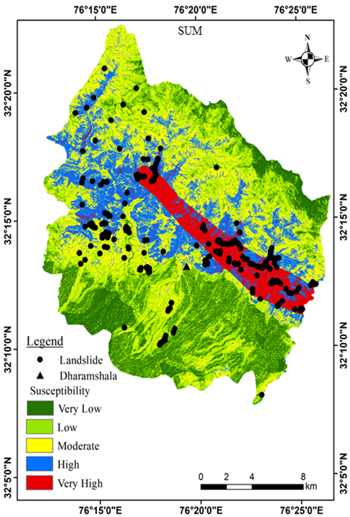
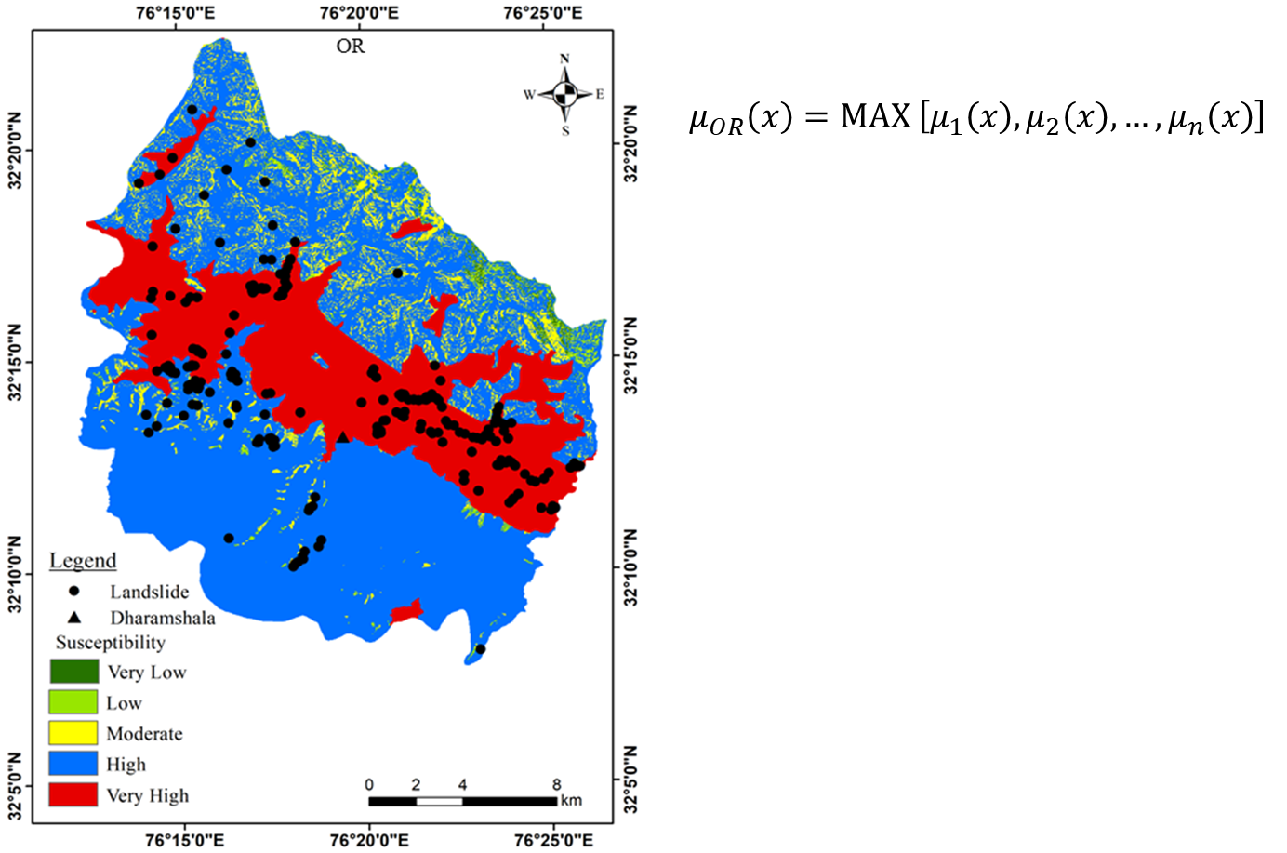
cont.………
$$\left.μ_{AND}\left(x\right)=MIN [μ_{1}\left(x\right), μ_{2}\left(x\right),…,μ_{n}\left(x\right)\right]$$
$$μ_{SUM}\left(x\right)=1−\prod_{i=1}^{n}{\left(1−μ_{i}\left(x\right)\right)}$$
$$μ_{PRODUCT}\left(x\right)=\prod_{i=1}^{n}{1μ_{i}\left(x\right)}$$
$$μ_{γ}\left(x\right)={\left[μ_{SUM}\left(x\right)\right]}^{γ}×{\left[μ_{PRODUCT}\left(x\right)\right]}^{1−γ}$$

Slide 22
Validation of Models Using ROC Curve
LSZ Map | Approximate Accuracy (%)
INFO VAL | 83.45
FREQUENCY RATIO | 83.43
Table showing accuracy of two models. Both Info Val and frequency ratio have nearly equal accuracy in terms of AUC.
Fig. ROC assessment of LSZ MAPS generated using Info Val and FR method

Slide 23
cont.………
LSZ Map using Fuzzy Operator | Approximate Accuracy (%)
AND | 77.6
OR | 77.0
SUM | 83.8
PRODUCT | 84.0
GAMMA 0.1 | 84.0
GAMMA 0.3 | 84.0
GAMMA 0.5 | 84.1
GAMMA 0.7 | 84.2
GAMMA 0.9 | 84.3
On the basis of ROC curve Gamma 0.9 gives the maximum value of AUC indicating the best suitable map.
Fig. ROC assessment of LSZ MAPS generated using fuzzy operators

Slide 24
Spatial Validation of LSZ maps: Frequency Ratio assessment
FR assessment of LSZ maps generated from Info Val and Frequency ratio method
FR assessment of LSZ maps generated from different fuzzy operators
All maps are showing increasing value from very low to very high susceptibility class

Slide 25
Conclusions
Many methods have been proposed for spatial prediction of landslides, e.g., bivariate and multivariate statistical, probabilistic, etc. but the accuracy of these models varies from one area to another
This study compared three models Info Val, FR method (traditional bivariate statistical) and Fuzzy Set Procedure (distribution free statistical bivariate) for landslide susceptibility mapping
All three models shows acceptable accuracy in terms of AUC and FR assessment but FSP shows the best result
Out of all five fuzzy operators Gamma operator with higher γ value gives best result
For the present study area map generated with Fuzzy Gamma 0.9 is best LSZ map
This map can be helpful for decision makers and future development planners to avoid the zones with high susceptibility during implementing a project

Slide 26
THANK YOU ☺

