Slide 1
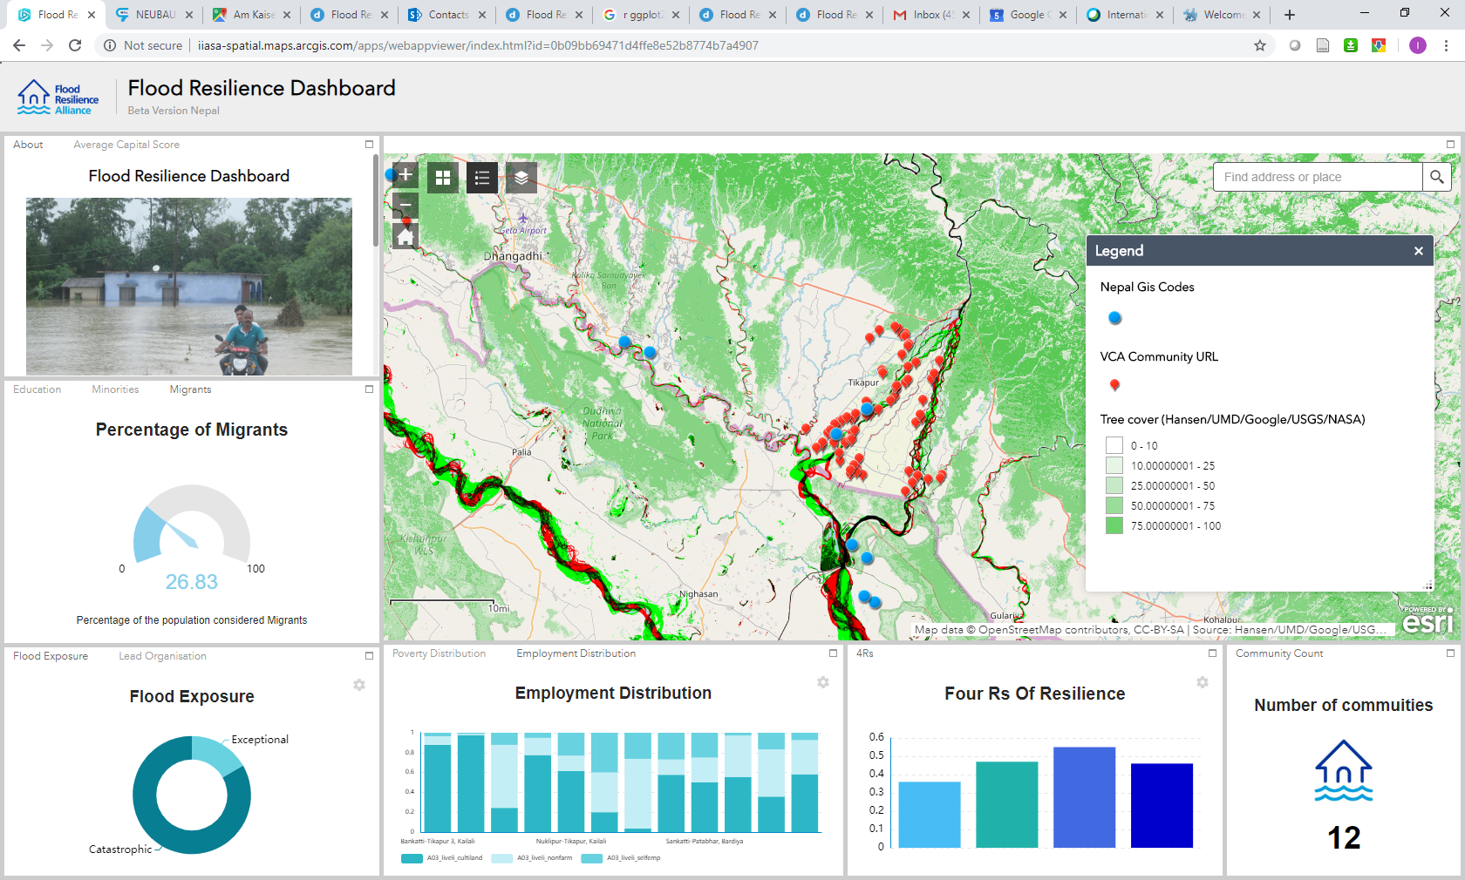
The Flood Resilience Dashboard
Ian McCallum¹ Stefan Velev¹ Finn Laurien¹ Reinhard Mechler¹ Adriana Keating¹ Stefan Hochrainer-Stigler¹ and Michael Szoenyi² ¹IIASA, Laxenburg, Austria, ²Zurich Insurance Company, Zurich, Switzerland
Purpose
Crowdsourcing: Picture-Pile
Lowering the entry barrier
The purpose of the “Flood Resilience Dashboard” is to put geo-spatial flood resilience data into the hands of practitioners. The idea is to provide an intuitive platform that combines as much open, peer-reviewed flood resilience related spatial data as possible with available related spatial data from the Flood Resilience Alliance, which in turn can be used to inform decisions.
This data will include among others the Zurich Flood Resilience Measurement for Communities (FRMC) data, Vulnerability Capacity Assessment (VCA) maps, remote sensing derived information on flooding and other biophysical datasets (e.g. forest cover, water extent), modelled risk information, satellite imagery (e.g. night-time lights), crowdsourced data and more.
The Dashboard will, as much as possible, lower the entry barrier for non-technical users, providing a simple login experience for the users. Users should be able to explore the Dashboard using standard web map navigation tools. The various charts and tables on the Dashboard dynamically refresh as features on the map are selected or the map extent is changed. No previous experience or understanding of geo-spatial data is required, beyond basic web-map navigation.
Understanding what builds resilience is fundamental to informing action, yet few systematic and large-scale efforts have systematically measured resilience
Flood Resilience Measurement Framework for Communities (FRMC)
Flood Resilience Dashboard (Beta-version)
The Alliance developed the FRMC to benchmark and track the underlying sources of resilience.
The FRMC involves measuring a community’s sources of resilience pre- and post-disaster, operationalised around 5 types of assets (human, natural, social, physical and financial) and their interactions.
Resilience sources are qualitatively graded based on household surveys, community focus groups, expert informants, and other third-party sources. Sources are assessed by specially trained NGO experts embedded in communities, while data is collected globally via an integrated mobile and web-based system.
The FRMC, rolled out globally in Latin America, Asia, Europe and the US to more than 100 communities, is helping communities and development partners make improved decisions on how to build resilience.
References:
Danylo, O., Moorthy, I., Sturn, T., See, L., Laso Bayas, J.-C., Domian, D., Fraisl, D., Giovando, C., Girardot, B., Kapur, R., Matthieu, P.-P., and Fritz, S.(2018) The picture pile tool for rapid image assessment: a demonstration using hurricane matthew, ISPRS Ann. Photogramm. Remote Sens. Spatial Inf. Sci., IV 4, 27-32, https://www.isprs-ann-photogramm-remote-sens-spatial-inf-sci.net/IV-4/27/2018/.
Liu W, Dugar S, McCallum I, Thapa G, See L, Khadka P, Budhathoki N, Brown S, et al. (2018). Integrated Participatory andCollaborative Risk Mapping for Enhancing Disaster Resilience. ISPRS International Journal of Geo-Information 7 (2): p. 68. DOI:10.3390/ijgi7020068.
McCallum, I., Liu, W., See, L., Mechler, R., Keating, A., Hochrainer-Stigler, S., Mochizuki, J., Fritz, S.,Dugar, S., Arestegui, M., Szoenyi, M., Laso Bayas, J.C., Burek, P., French, A. and Moorthy, I. (2016). Technologies to Support Community Flood Disaster Risk Reduction. International Journal of Disaster Risk Science 7, 2: 198-204.
The Alliance partners are: Concern Worldwide, the International Federation of the Red Cross (IFRC), the International Institute for Applied Systems Analysis (IIASA) the Institute for Social and Environmental Transition-International (ISET-International), the London School of Economics, MercyCorps, Plan International, Practical Action, Zurich Insurance.
The Zurich Flood Resilience Alliance, initiated and funded by Zurich Insurance, brings together NGO partners, academia and the private sector to help build flood resilience in communities across the globe.

